Slide 1
JBRC PROduction

Slide 2


Slide 3
In corporation with the director’s board

Slide 4


Slide 5
Pre-production organizer
Team Members: Johner Zulueta Mariah Fornal Hanna Parame Martin Escala Michael Sotto

Slide 6
Objectives
Our objectives for making this video is to show how feasible farm to family deliviries are in North Olympus and its delivery process.
Our study is about the feasibility of farm-to-door deliveries in North Olympus

Slide 7
Production team
Johner: Executive Producer, Director, Editor, Actor
Mariah: Main actress, props design, wardrobe
Martin: Staff, supporting actor
Hanna: assistant director, camera woman, cinematographer
Michael: Editor, extra staff, camera man

Slide 8
Synopsis/summary
To summarize our introduction, it shows a brief process of how farm-to-families deliveries work, and how fun, managable, and flexible it is to start the business here in North Olympus Subdivision. In the following upcoming continuity of this project, we can assure you that our filler will show the simple study to whether this type of business is really feasible to the citizens of the North Olympus.

Slide 9
Story board with script

Slide 10
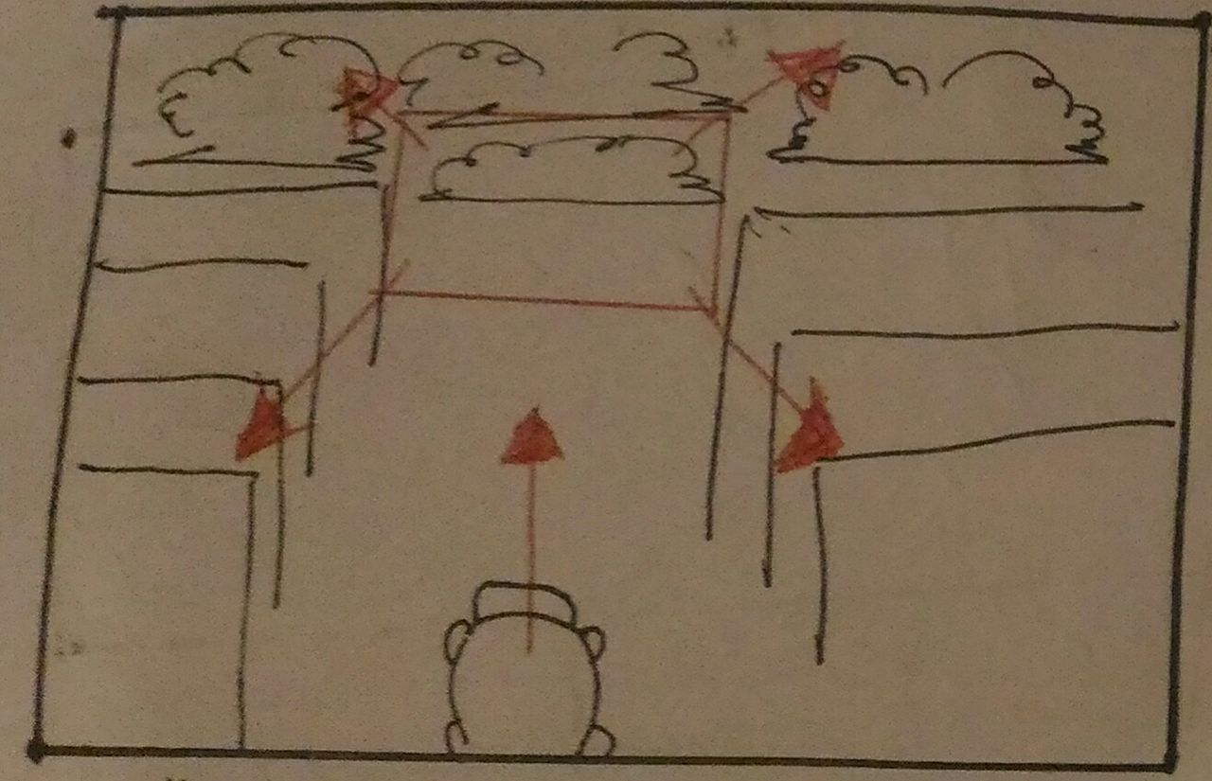
As the camera’s focus broaders from the sky revealing buildings, houses, and some trees ahead the road, a car zoom past

Slide 11
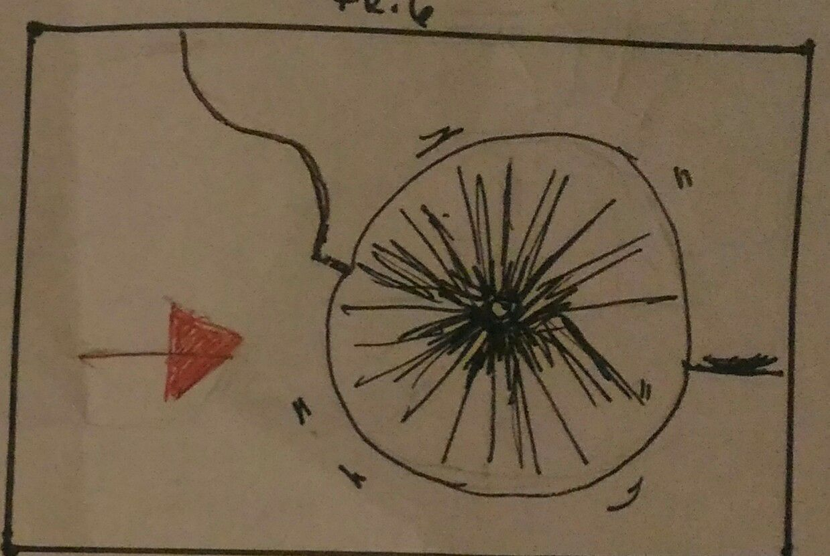
A zoomes in frame of tires moving to the road

Slide 12
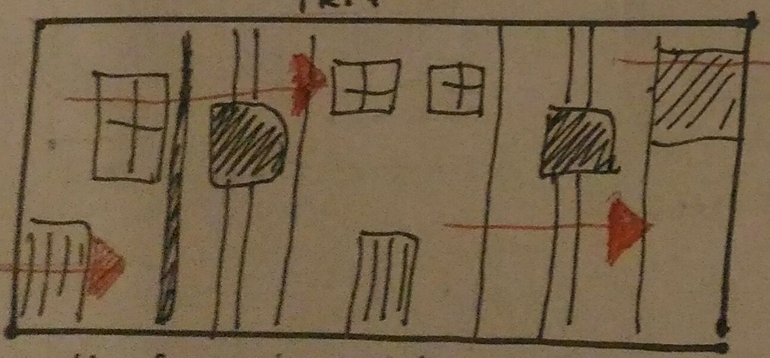
A clip of zooming past houses

Slide 13
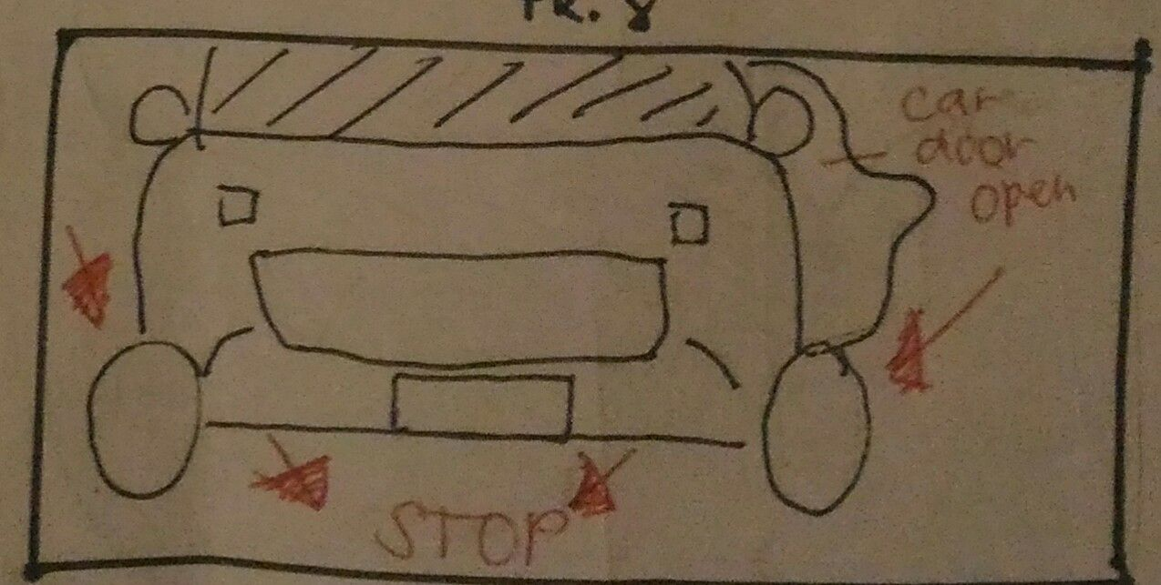
Front view of the car as it stops in front of the camera and the door opens

Slide 14
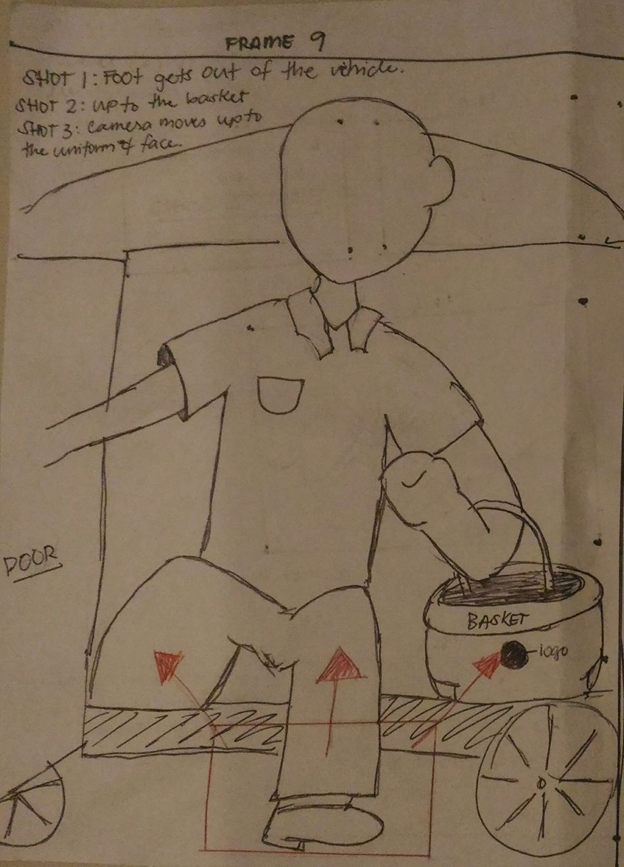
Shot 1: foot gets out of the car
Shot 2: up to the basket
Shot 3: camera moves up to the uniform and face

Slide 15
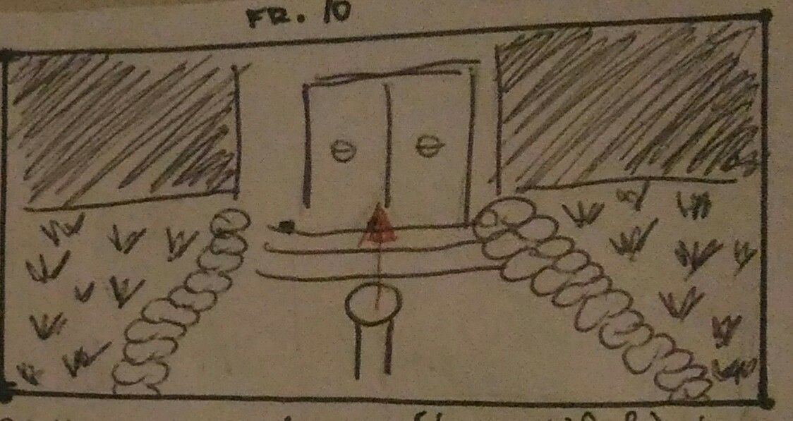
Camera reveals a (beautiful) house, as the person approach the steps and door

Slide 16
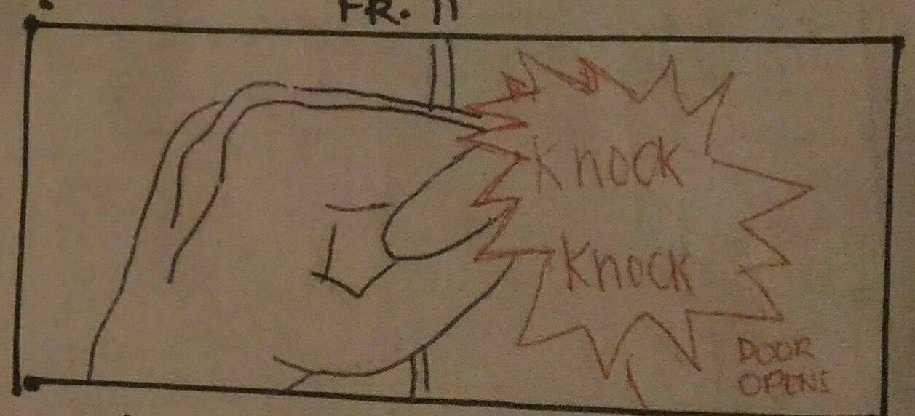
Close up knocking and then the door opens

Slide 17
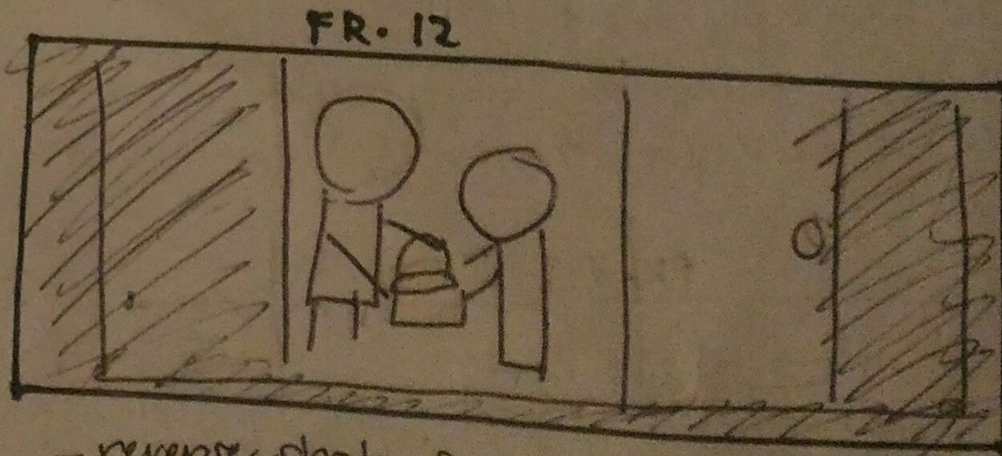
Reverse shot of customers receiving the basket

Slide 18
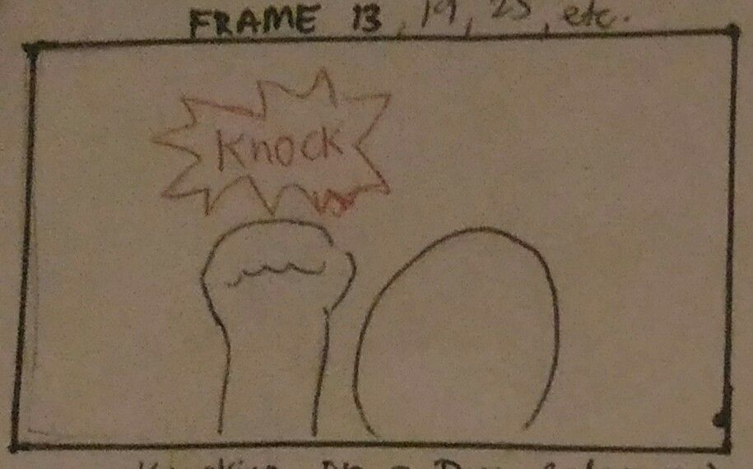
Start of the montage: Knocking on a door close up

Slide 19
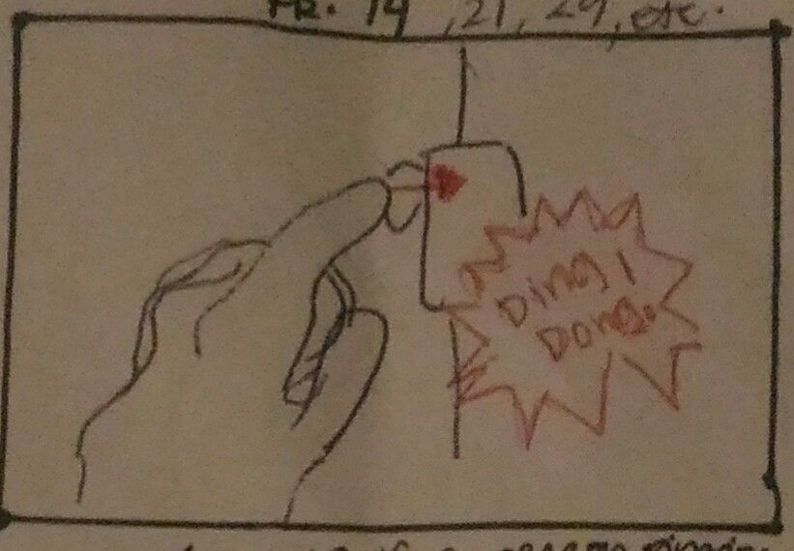
Close up of a person ringing the doorbell

Slide 20
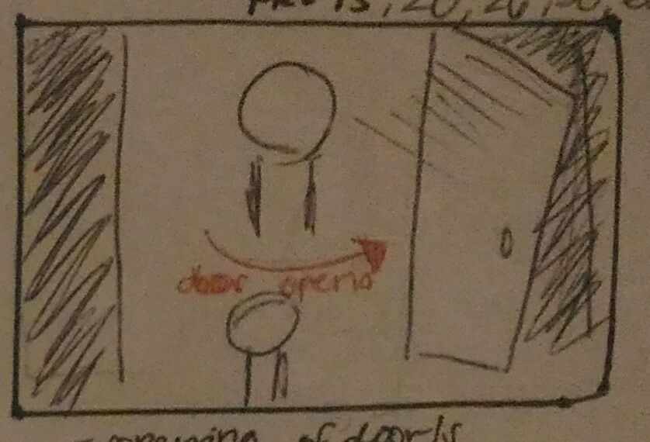
Opening of doors

Slide 21
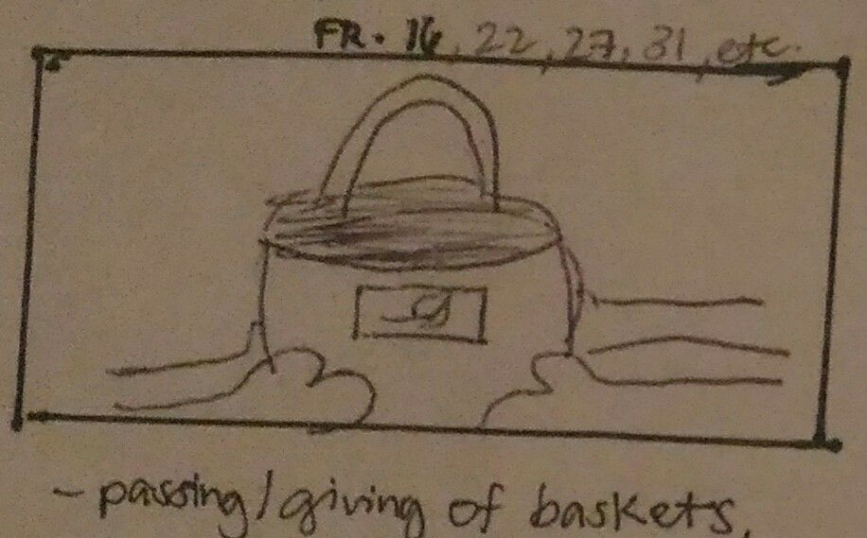
Passing/giving of baskets, revealing the logo and variety of foods from farm

Slide 22
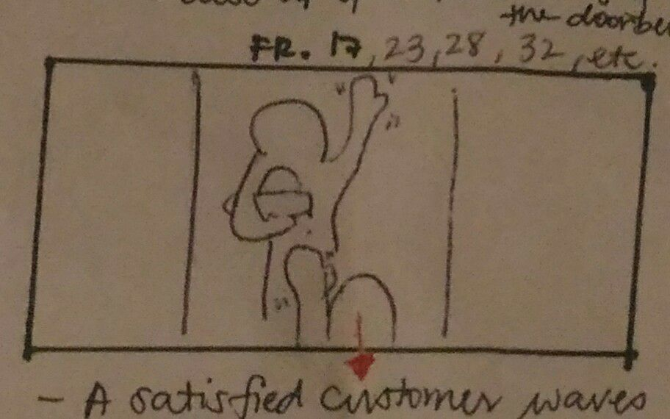
A satisfied customer waves *goodbye at the person who deliver*
*while holding the basket*

Slide 23
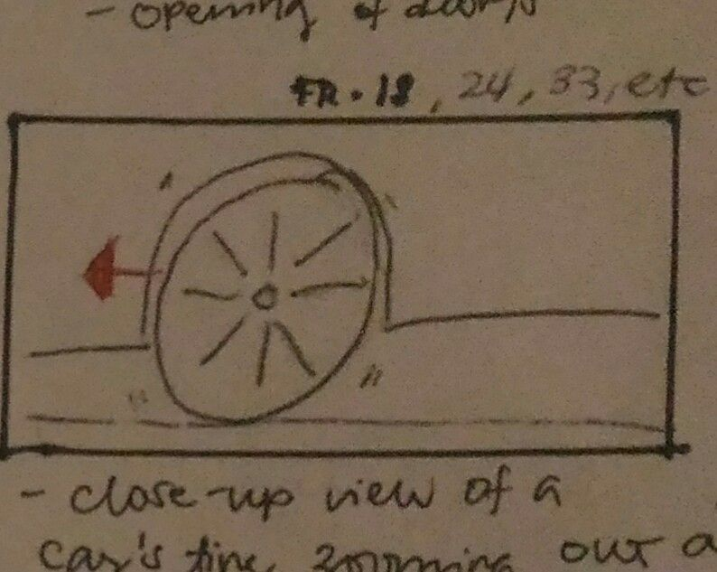
Close up view of a car’s tire zooming out and moving unto the next house

Slide 24
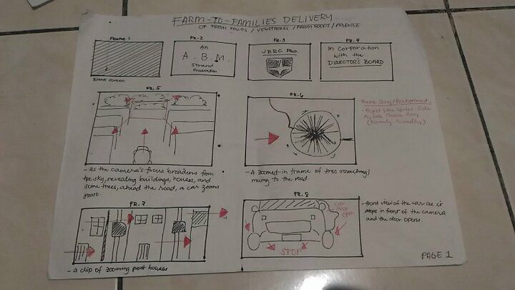

Slide 25
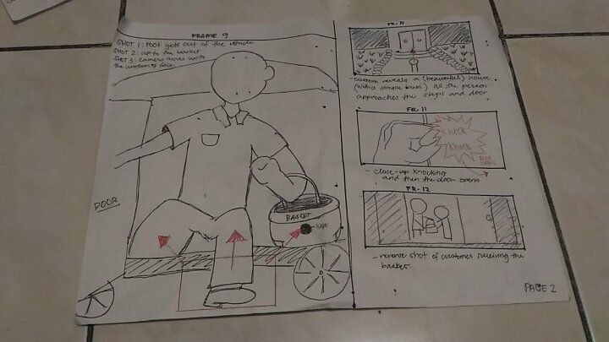

Slide 26
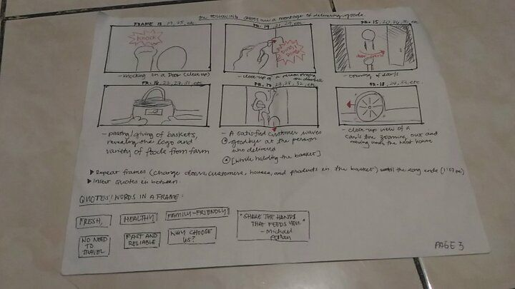

Slide 27

FRESH
HEALTHY
NO NEED TO TRAVEL
FAST AND RELIABLE
FAMILY FRIENDLY

Slide 28
Production design
Fun
Family friendly
Cute
Childish
Exciting

Slide 29
Video / treatment pegs
Moving
Travelling

Slide 30
Costume pegs
Greenery
Presentable
Clean

Slide 31
Hair and make up pegs
Clean
Tidy
Service like

Slide 32
Timetable
January 2 ( Tuesday ) -get plan approved -finish template -finish the product logo
January 3 ( Wednesday ) -shooting of the film -brought props & finalizing of places
January 4 ( Thursday ) -editing of the footage
January 5 ( Friday ) -consultation

Slide 33
Thank you for listening

