Slide 1
Chapter 5 (supplements)
Analyzing (curve fitting) boosting and bagging methods

Slide 2
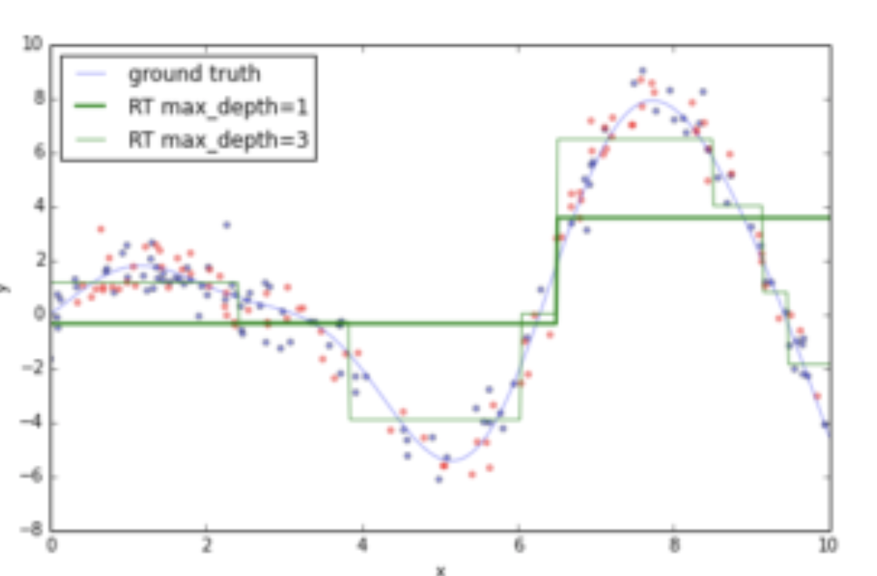
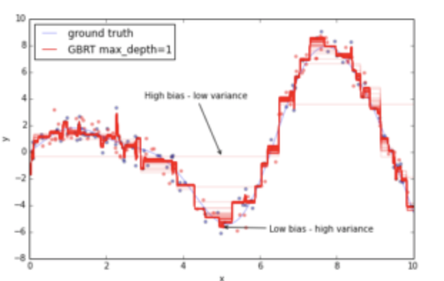
Adding more trees or increasing tree depth...
Increases variance, but reduces bias (even more for both simultaneously)
plot on the top shows how bias vs. variance changes with tree depth (DT with max_depth = 3 fits closest to true values)
plot on the bottom shows how bias vs. variance changes by adding more trees (GBRT with > 20 trees fits closest to true values)
Built using the staged_predict from prev lecture
But overfitting occurs often

Slide 3
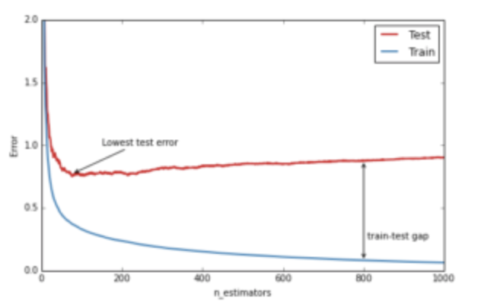
Deviance Plots
Shows training/testing error (deviance)
The error decreases for each initially then hits a minimum as a function of number of trees grows
After it hits the minimum the train error keeps decreasing while the test error starts to increase
This is due to over fitting
Starts fitting noise (idiosyncrasies in data)
Luckily there are some things we can do to avoid this...
Tuning Parameters:
number of trees (n_estimators lower)
depth of trees (max_depth lower)
loss function used (loss)
learning rate (learning_rate lower)
# samples/leaf (min_samples _leaf higher)

Slide 4
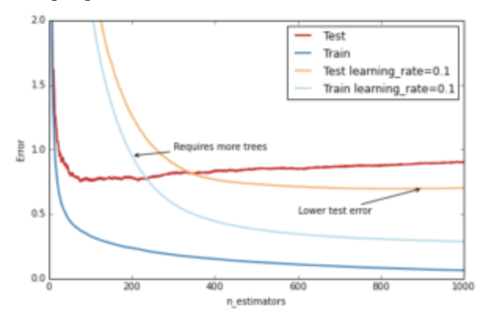
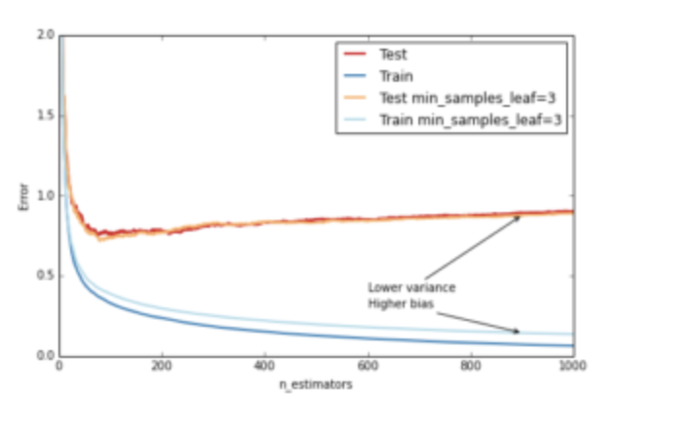
Controlling overfitting via shrinkage or tree structure
Degree of feature interactions controlled with depth
Can set lower or set minimum # samples per leaf higher
Slowing LR by small scalar so the model must reinforce concepts
Requires more n_estimators
source: https://www.datarobot.com/blog/gradient-boosted-regression-trees/

