Slide 1
Super Quick Intro to Neural Networks

Slide 2
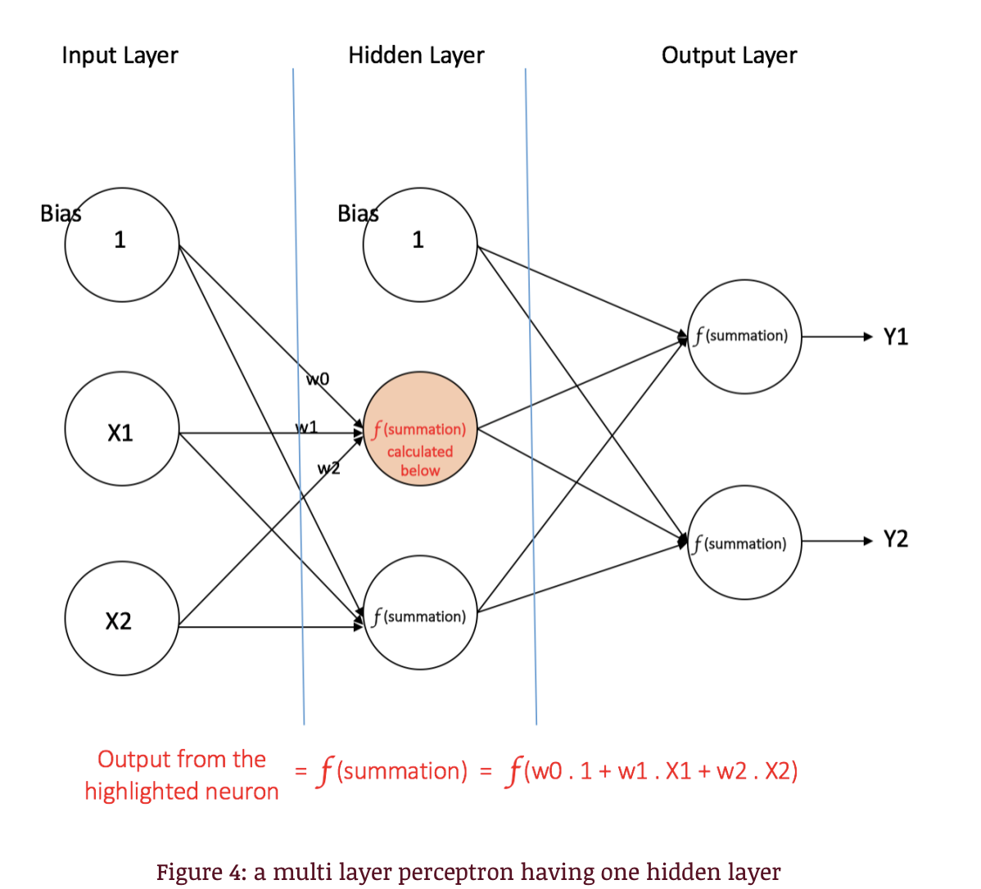
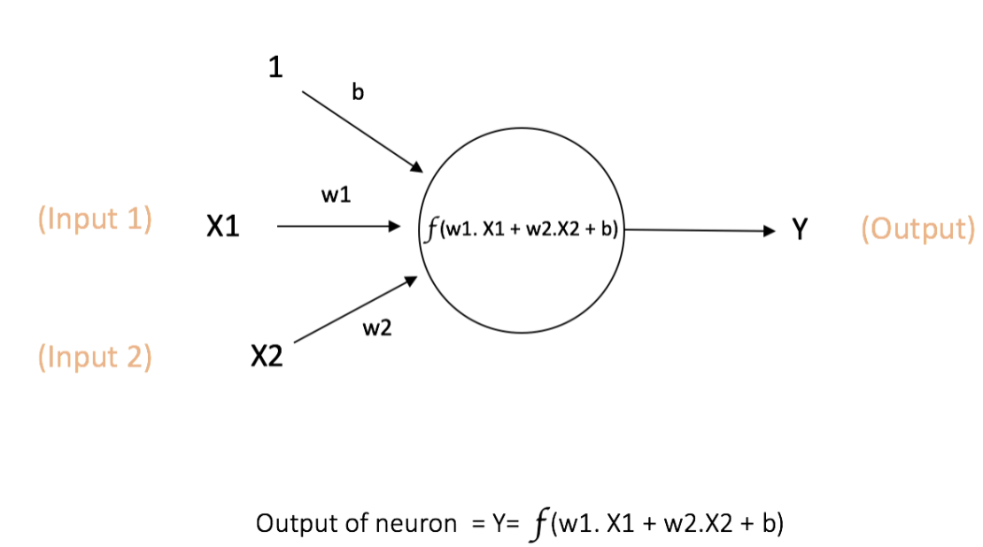
Single Neuron
Feedforward Network
source:https://ujjwalkarn.me/2016/08/09/quick-intro-neural-networks/
Input features (predictors): X1, X2
We want to find weights W, activation function f, and bias term b to model Y (expected output)

Slide 3
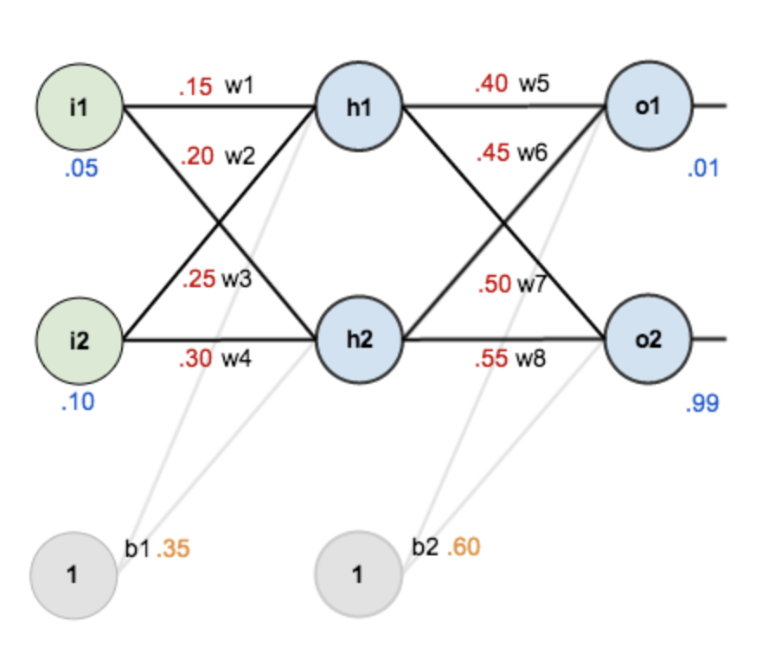
Gradient Descent
Step 1. randomly guess initial values for all of the weights
Step 2. for each training instance, make an initial prediction and compute the sum of squared errors between the predictions and ground truth values (i.e. the cost function)
Incorrect output
Forward Propagation
Batch size: # training samples per iteration
Epoch: time to go through all training samples in data
source:https://mattmazur.com/2015/03/17/a-step-by-step-backpropagation-example/

Slide 4
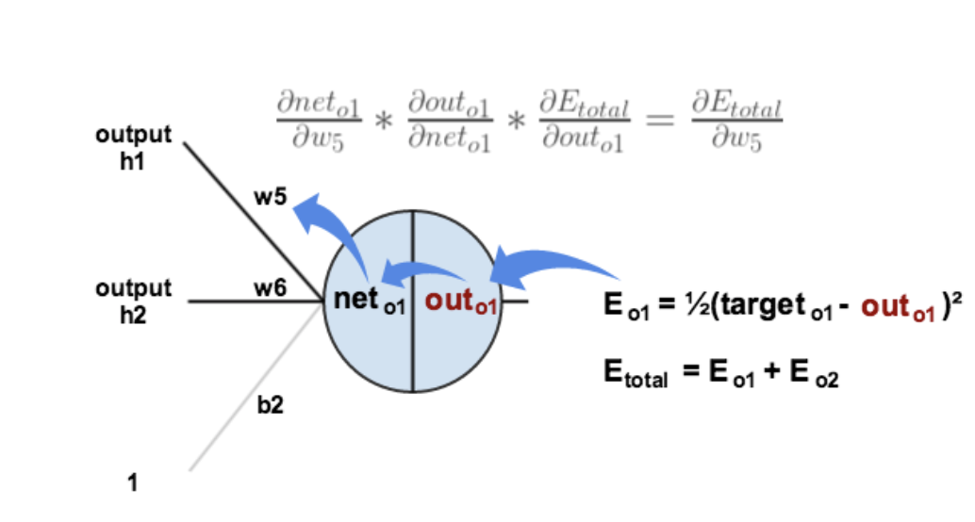
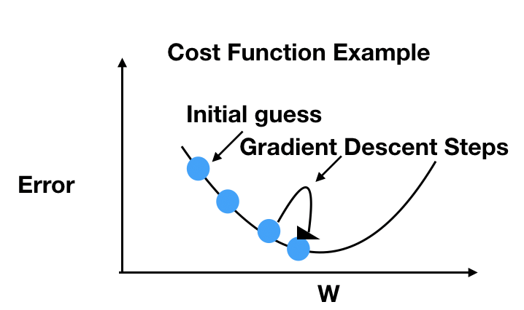
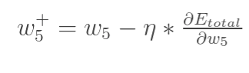
source:https://mattmazur.com/2015/03/17/a-step-by-step-backpropagation-example/
Step 3. In each iteration, compute the gradient of the cost function wrt to each weight and adjust it accordingly
Back Propagation
Weights Update
Each baby step “downhill” (down the cost function), progresses toward the minimum error
Learning rate (eta): size of the increment downhill

Slide 5
Super Quick Intro to Convolutional NNs

Slide 6
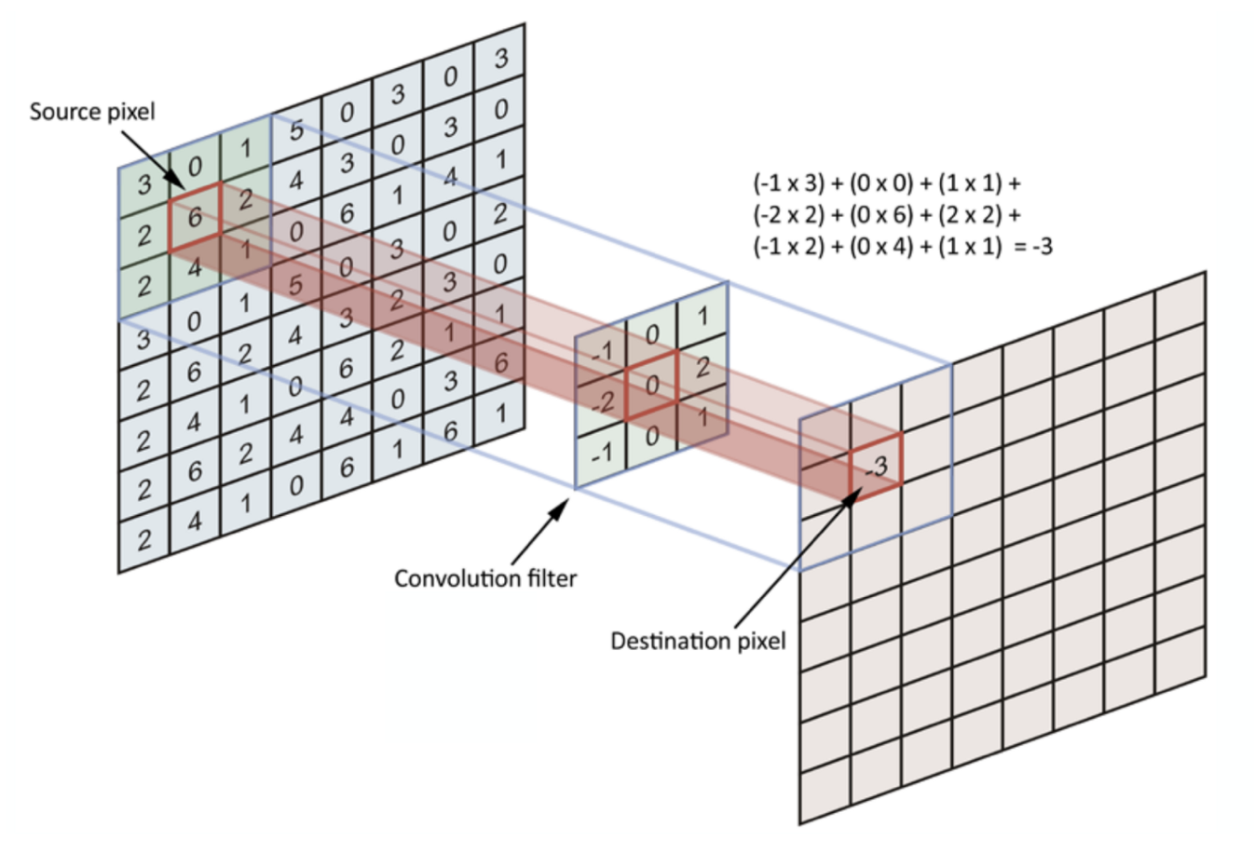
Convolutional Filters
Convolution Operation
Source:https://towardsdatascience.com/simple-introduction-to-convolutional-neural-networks-cdf8d3077bac
each filter learns patterns used to detect a specific feature in the image
Each creates abstractions based on the previous layers input
Beginning layers just look for lines and simple shapes, but as the feature map becomes more and more abstract/complex it captures more detail in the image
Notes:
We end up with a feature map with a reduced height and width, but a greater density (in the lowest 2D layers)
Density captures the information corresponding to that piece/location/corner of the image
Lowest layers have less location information and more feature information
Rather than losing information, it is getting more meaningful

Slide 7
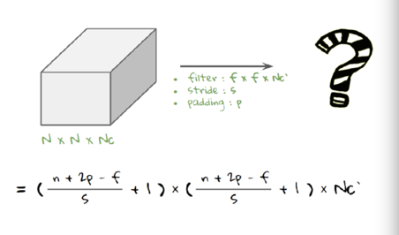
CNN Layer Types
Size of Output
process of building a CNN always involves four major steps:
Step - 1 : Convolution
Step - 2 : Pooling (eg. Max-pooling, avg pooling)
Step - 3 : Flattening
Step - 4 : Full connection
Padding (in convolution): giving additional pixels to the input data to preserve edge information (when sliding filter across edges of image map)
Stride (in convolution): number of rows/cols skipped per shift of convo filter (Higher stride = smaller output)
ReLU (activation): outputs the input if it is positive otherwise it outputs 0
linear transformations would make the neural network simpler, but less powerful and unable

Slide 8
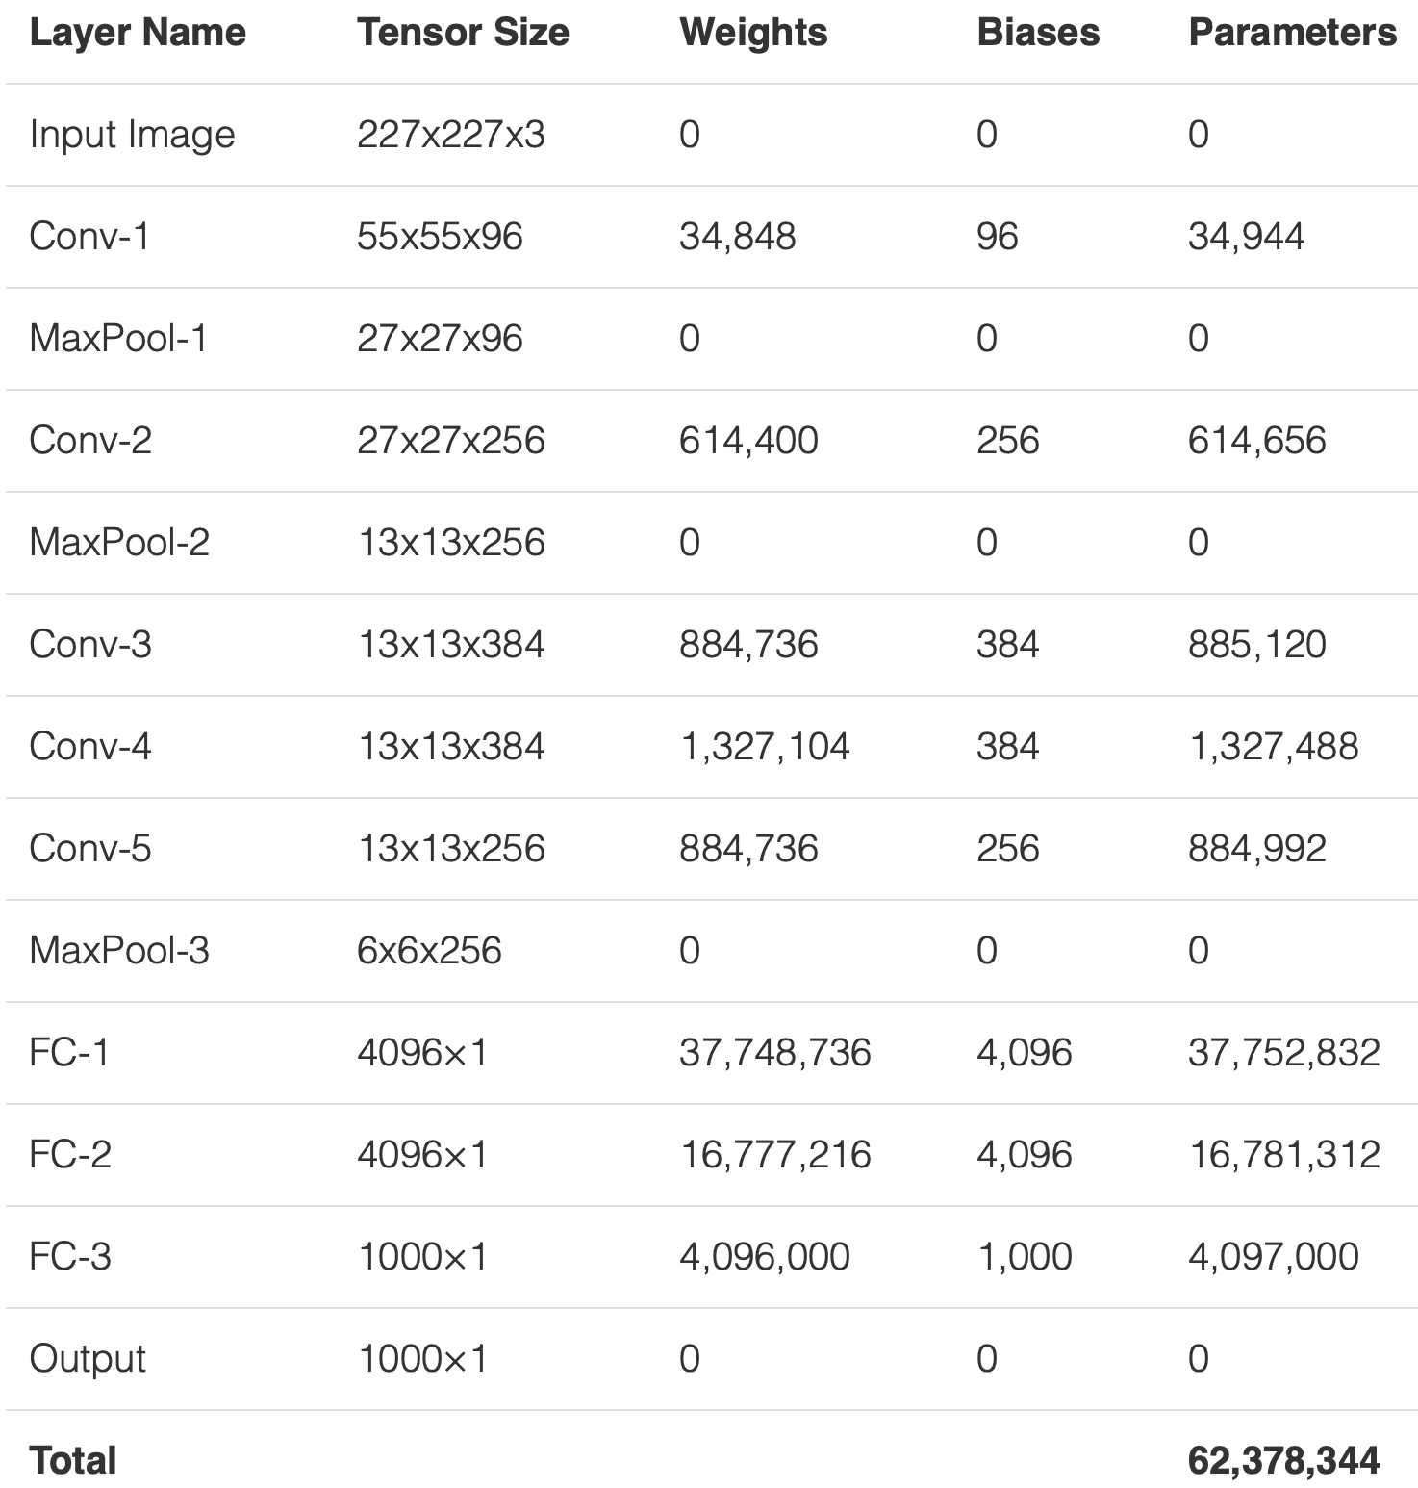
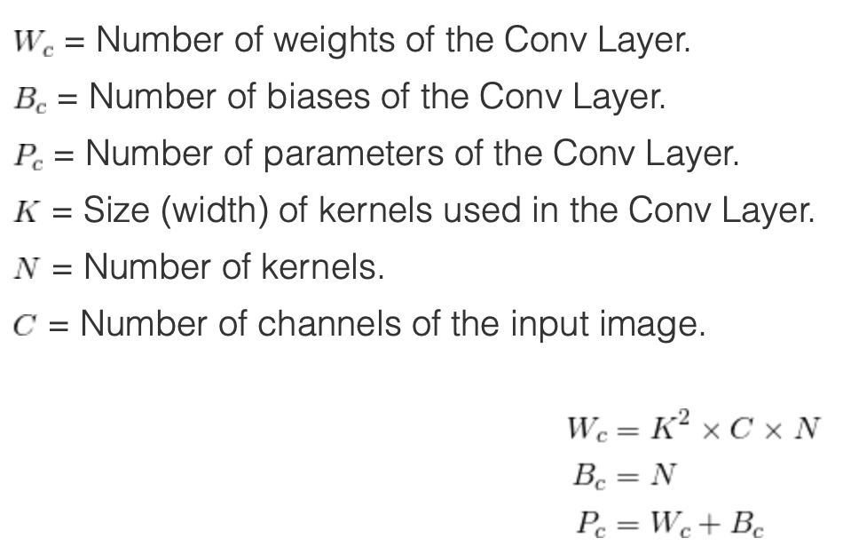
Total CNN Parameters
# of parameters in a layer is the # learnable elements for a filter
Source: https://www.learnopencv.com/number-of-parameters-and-tensor-sizes-in-convolutional-neural-network/

