Slide 1
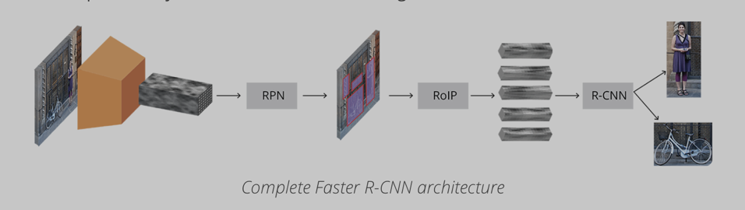
Faster R-CNN (Intro to Deep Learning)
source:https://tryolabs.com/blog/2018/01/18/faster-r-cnn-down-the-rabbit-hole-of-modern-object-detection/

Slide 2
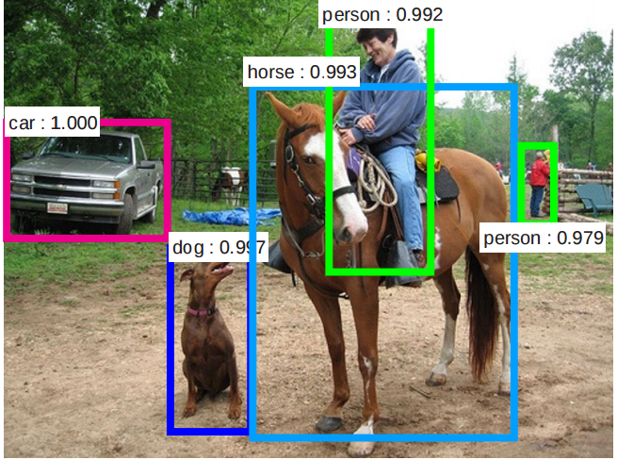
Faster RCNN
FRCNN is a popular object detection network
Other popular methods include RetinaNet, YOLOv3, SSD
for each image input it returns a list of bounding boxes (x1, y1, x2,y2) which correspond with probabilities assigned to each class label
It is the third iteration of RCNN (NIPS 2015) which had Ross Girshick as author ...
Patil, R. (2018). [Image]. Retrieved from: https://medium.com/@rohitrpatil/how-to-use-tensorflow-object-detection-api-on-windows-102ec8097699

Slide 3
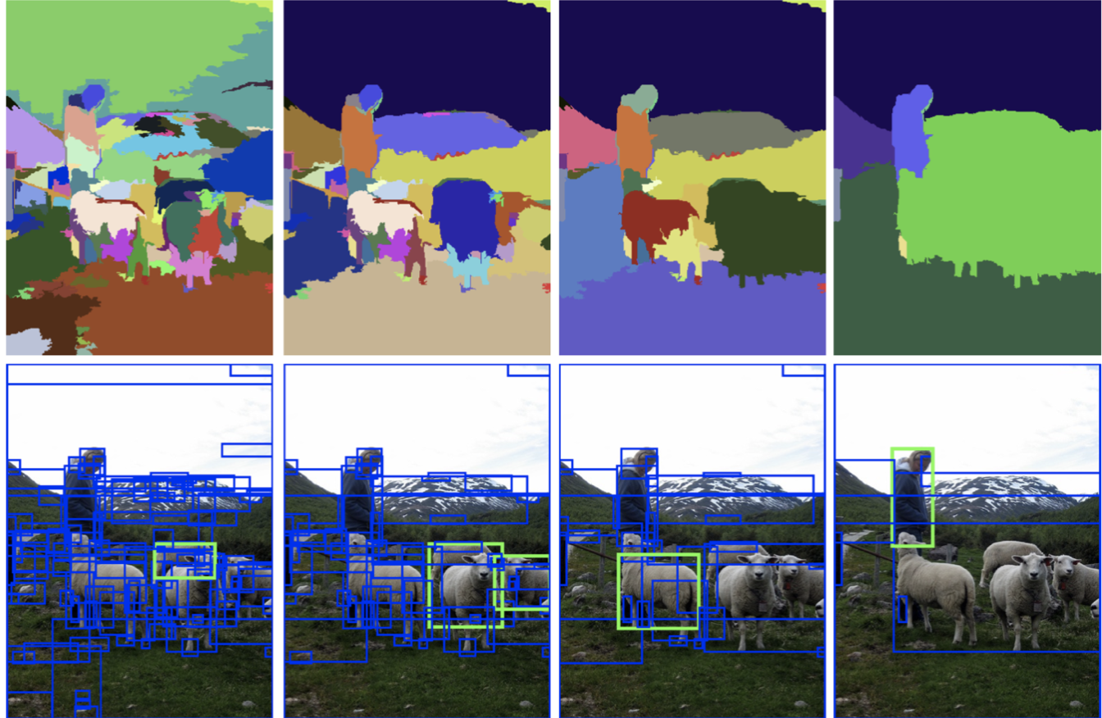
Iterations: R-CNN, Fast - RCNN, and Faster RCNN
RCNN used selective search to find regions of interest and then takes the 2000 top proposals and passes each of them to a pretrained CNN, then feature maps are passed to SVM for classification
Selective search is a search algorithm that identifies object in an image using region proposals made by grouping together regions in the image with similar colors, textures, and shapes
Fast RCNN improves upon this by passing the input directly into a CNN and using selective search on the output feature map. ROI pooling is then used to maintain the predefined box size before being passed to a fully connected layers
Faster RCNN replaces selective search with an Region Proposal Network (RPN)
hierarchical segmentation process of search selective. Source: J.R.R. Uijlings and al. (2012)

Slide 4
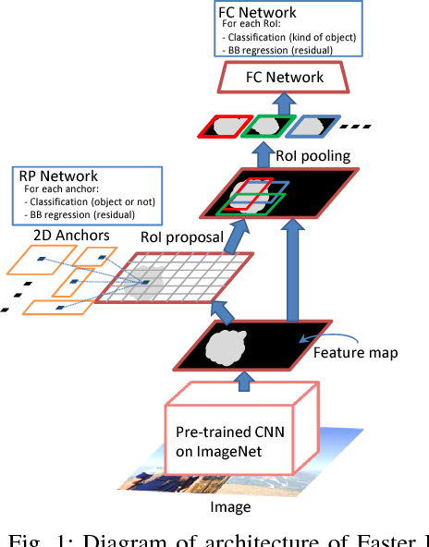
Basic Components
Hachiya H., Saito Y., Iteya K., Nomura M., Nakamura, T. (2018). [Image]. Retrieved from: https://www.semanticscholar.org/paper/2.5D-Faster-R-CNN-for-Distance-Estimation-Hachiya-Saito/305b6791697fccb1bdfb9fae115edada5b584029/figure/0
First, images are input into a pre-trained base CNN as a H x W x D tensor
We extract the convolutional feature map from an intermediate layer
Next, we use a Region Proposal Network (RPN)
BB regression and classification are used to predict the probability that each anchor contains an object
RoI Pooling is then used to obtain only the fixed sized feature maps based the RPNs proposals extracted from the CNN layer
R-CNN is used to better adjust the bounding box based on proposed object

Slide 5
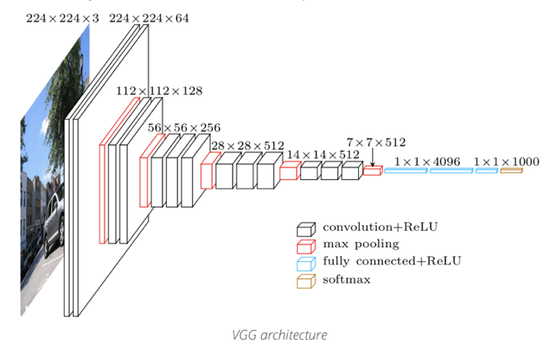
Base CNN
base CNN is (often) a VGG-16 network pre-trained on ImageNet
Various weights,parameters, layers have been tested
~9 boxes with different scales and aspect ratios are generated from each position (anchor) of the output feature map produced in the last layer of the CNN
This produces thousands of boxes that can be used for region proposals generated by the Region Proposal Network (RPN) during training
Recycles feature map
source:https://tryolabs.com/blog/2018/01/18/faster-r-cnn-down-the-rabbit-hole-of-modern-object-detection/
Notes:
VGG 16: considered ‘dense/deep’ when the paper “Very Deep Convolutional Networks for Large-Scale Image Recognition” (by Karen Simonyan and Andrew Zisserman) was published on the ImageNet competition (Imagenet large scale visual recognition competition (ILSVRC))
Kick-started the ‘deeper = better’-thinking wave

Slide 6
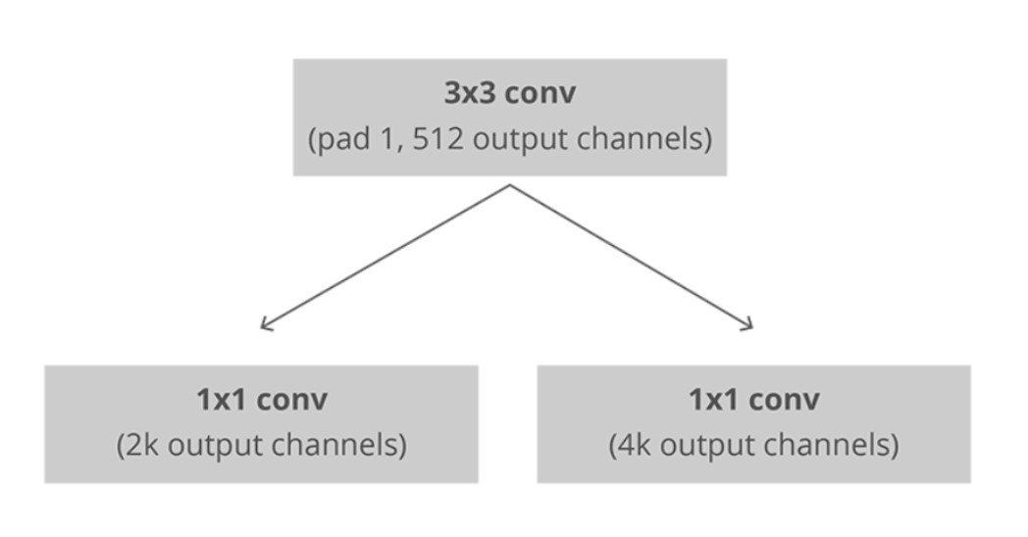
Region Proposal Network (RPN)
Use of anchors saves much more time than the sliding window approach (where we have to search all pixel locations and at all scales)
From these it selects a fixed number of boxes before sending them to RCNN (to further reduce and refine)
simple 3 layer CNN: 1 layer that is fed into 2 sibling fully connected layers used for classification and BB regression (right)
uses all the anchors selected for the mini batch to calculate the classification loss using binary cross entropy
RPN Architecture (where k is the number of anchors)
Source:https://towardsdatascience.com/faster-r-cnn-object-detection-implemented-by-keras-for-custom-data-from-googles-open-images-125f62b9141a

Slide 7
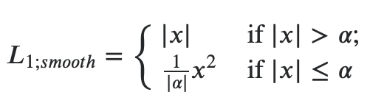
RPN (Continued)
(During training) proposals that overlap the ground-truth (GT) objects with an IoU greater than 0.5 are considered foreground, while those with a 0.1 IoU or less are considered background objects (the rest are ignored)
BB regression is done using the distance vector to the nearest foreground object using smooth L1 loss
The difference of smooth L1 from L2 and normal L1 is that when the magnitude of the L1 error is less than 1, it is considered almost correct, so it diminishes at a faster rate
proposals are output as this class probability representing the objectness score paired with a more refined estimation of it’s rectangular coordinates
Total RPN Loss Equation
Smooth L1 Loss

Slide 8
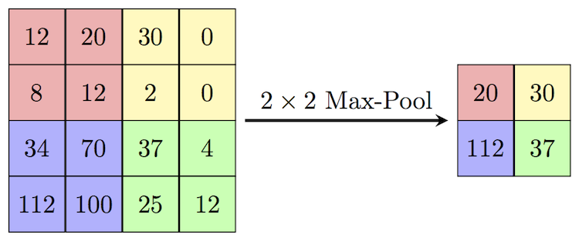
NMS, ROI Pooling
Non-Maximum Suppression (NMS) ensures there is not redundancy in the proposed regions, retaining only the overlapping boxes with the highest probabilities
each RoI is defined by a four-tuple (r, c, h, w) sorted by score
to balance computation time we retain the top N
large enough so plenty will still be classified as background
Region of Interest (RoI) pooling layer takes all of the coordinates provided by the RPN and extracts a fixed sized feature map from the the CNN using max-pooling
saves computation time (would be very slow doing all N)
this fixed sized feature map can be used as input to the classification stage of the detection network to output a probability for fixed number of object classes
Example of max-pooling
source:https://computersciencewiki.org/index.php/File:MaxpoolSample2.png

Slide 9
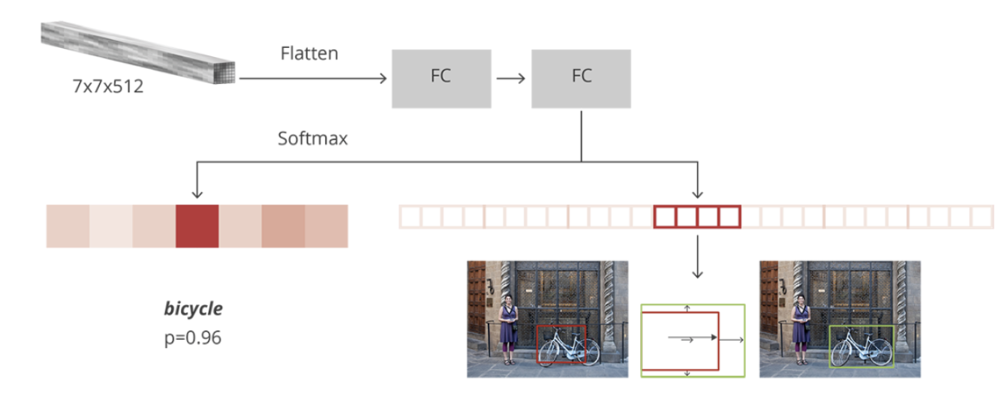
RCNN Detection Network
Architecture
RCNN uses two fully connected layers to do the final classification of objects and regress bounding boxes based on object class, respectively
Regions that do not overlap the GT at all are ignored during training, while those that have an IoU greater than 0.5 are assigned to a specific object class (not just object or not)
The offset of the bounding box to that GT is used to better adjust the bounding boxes, using smooth L1 loss again
Multi-class sparse cross entropy loss is used for classification
final predicted classes are output from the network’s fully connected and soft-max layers
source:https://tryolabs.com/blog/2018/01/18/faster-r-cnn-down-the-rabbit-hole-of-modern-object-detection/

Slide 10
U-net Segmentation

Slide 11
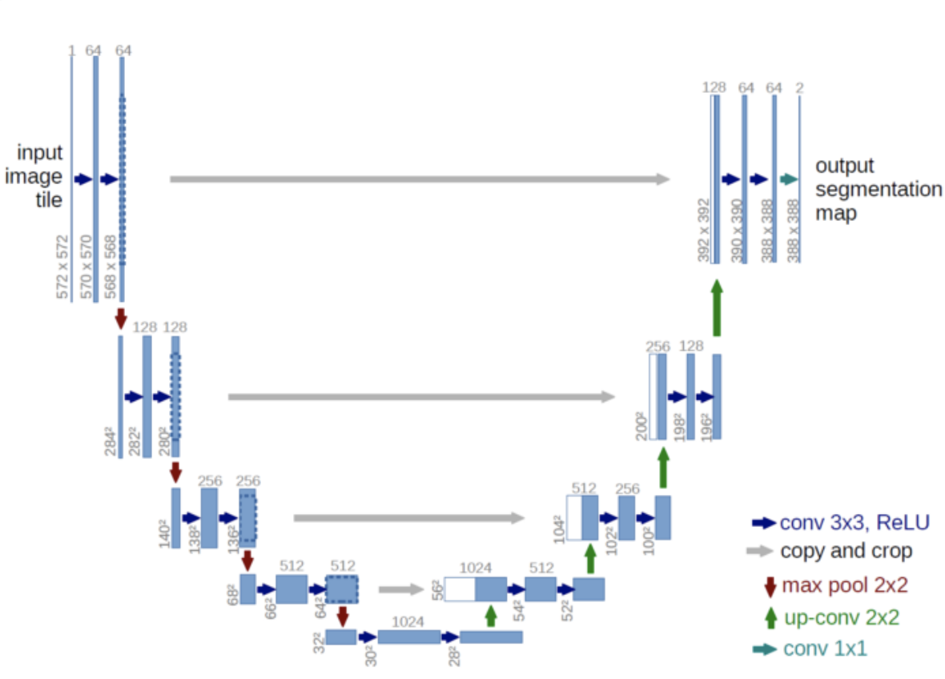
U-net Segmentation
23-layer network is based on the work of (Ronneberger et al., 2015) winner of ISBI Challenges in biomedical image segmentation and cell tracking
downsampling side of ‘U’ doubles the number of features in each step
uses repeated pairs of 3x3 un-padded convolutions to capture image context before a rectified linear unit (ReLU), followed by a 2x2 max pooling operation with stride two
upsampling side halves features in each step
symmetric expanding path helps to achieve localization
uses a 2x2 convolution and two 3x3 convolutions each followed by a ReLU.
https://towardsdatascience.com/understanding-semantic-segmentation-with-unet-6be4f42d4b47

