Slide 1
Google trend data
CS 521
Hanqing Guo

Slide 2
Basic Idea
Google is the biggest entrance of web
How to get most popular topic in the whole web?
Google Trend!
Search hottest topic
Use soup to grab valid words

Slide 3
Get data
1st step: get Google API key
2nd step: setup Custom Search Engine so that you can search the entire web
3rd step: install Google API client for Python
Very detail in build custom search system
Thanks to :
https://stackoverflow.com/questions/37083058/programmatically-searching-google-in-python-using-custom-search

Slide 4
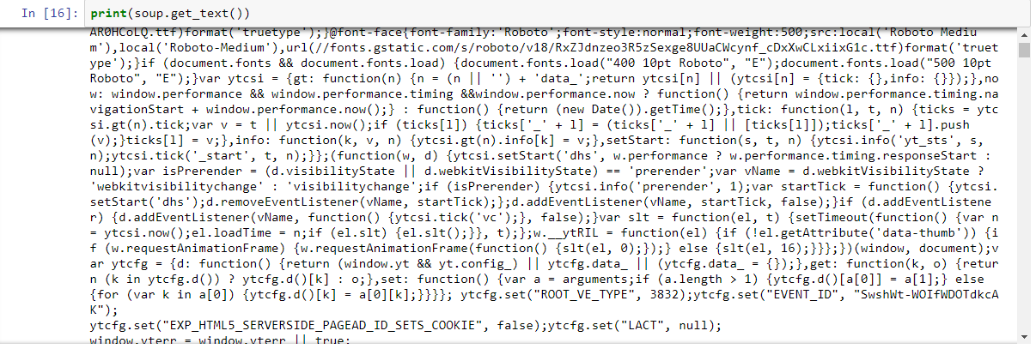
Problems
Return topic too small
Google search api return not neat data
Soup is not suitable for some js website, only very limit words can be grab from that kind of website

Slide 5
Trend topics too small
Get related hottest topics
From limited topics to many topics
Save to topics.txt

Slide 6
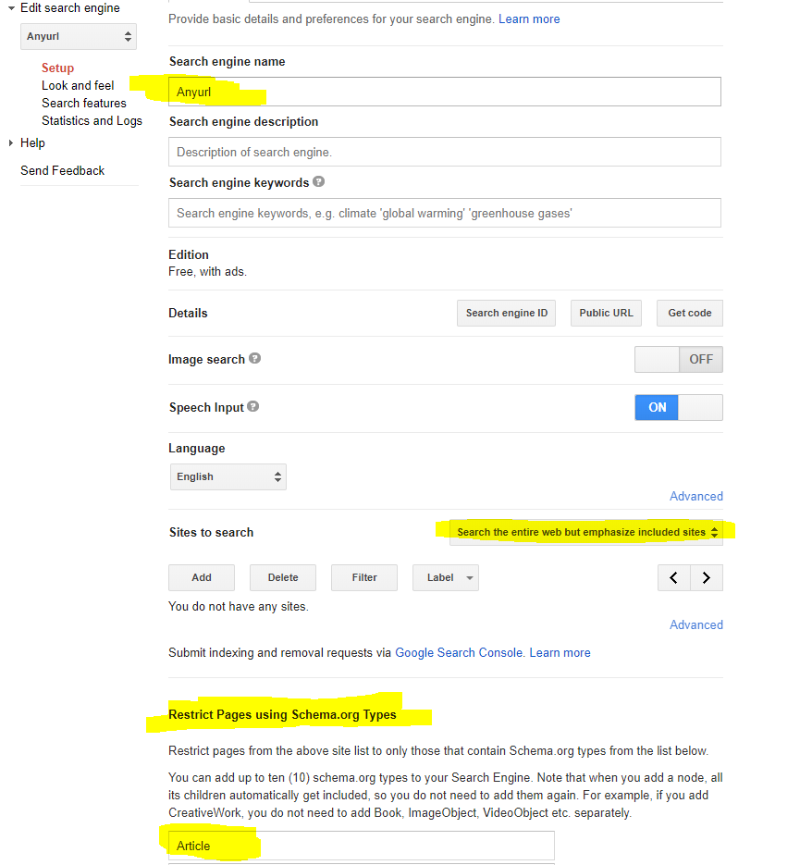
Return not neat - setup Custom Search Engine

Slide 7
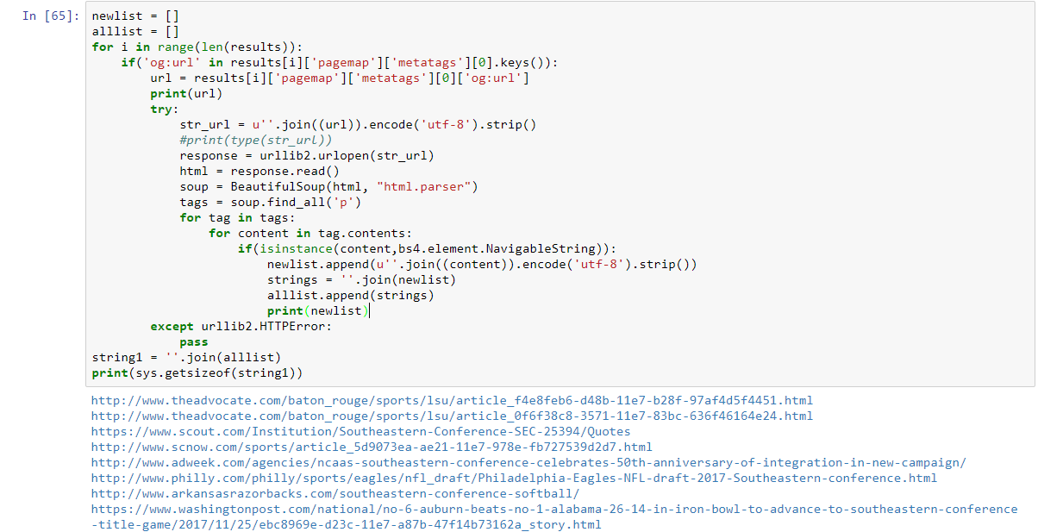
Clean urls - only article html

Slide 8
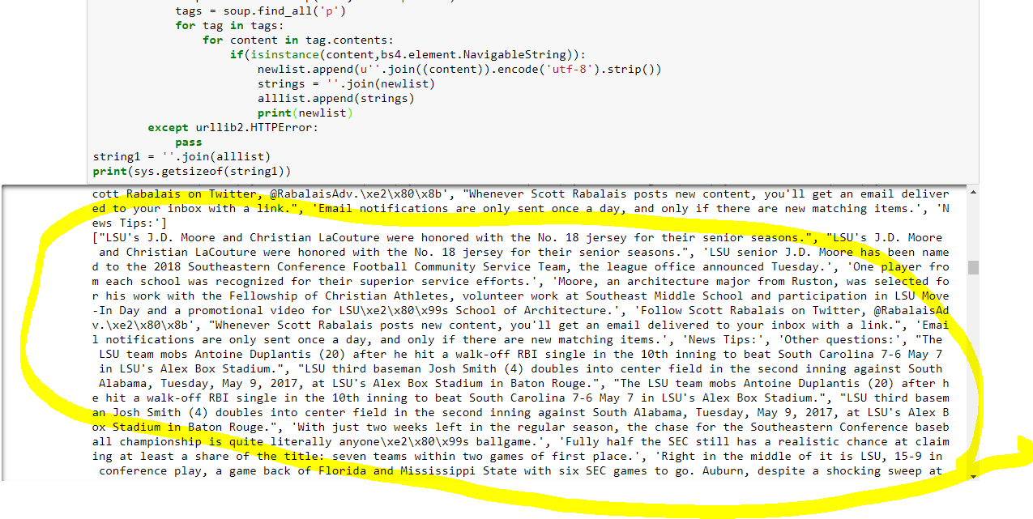
Clean words

Slide 9
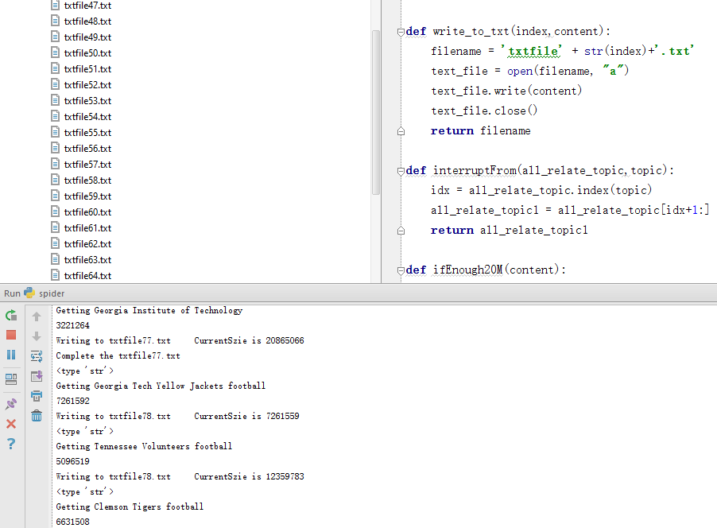
Get data

Slide 10
Error may encounter
urllib2.URLError: <urlopen error [SSL: CERTIFICATE_VERIFY_FAILED] certificate verify failed (_ssl.c:661)>
context = ssl._create_unverified_context()
urllib.urlopen("https://no-valid-cert", context=context)
HTTP ERROR 404, 503, urlError
Except and pass

Slide 11
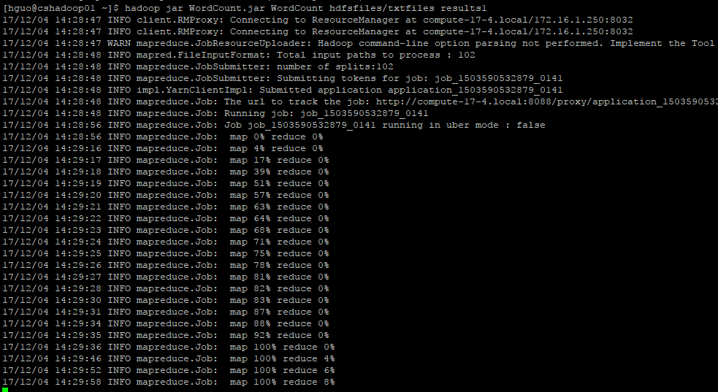
HADOOP PROCESS

Slide 12
Result preview

Slide 13
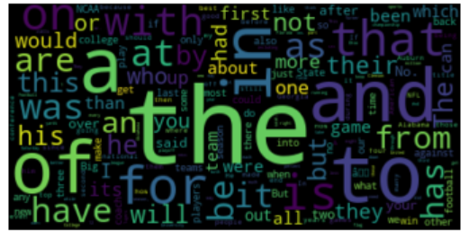
Result

Slide 14
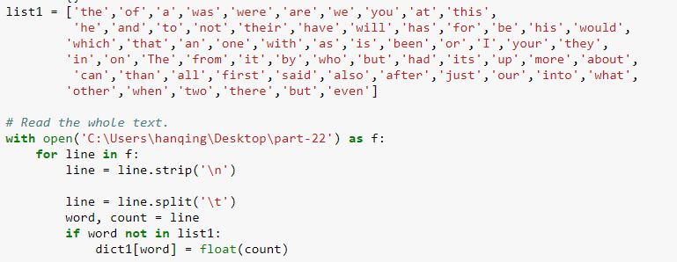
Clean results
Get rid of useless words

Slide 15

Clean REsult

Slide 16
Source code
https://github.com/hanqingguo/googleApi.git

