Slide 1

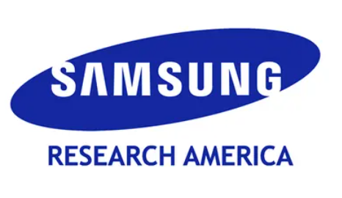


AUDIO WATERMARK: Dynamic and Harmless Watermark for Black-box Voice Dataset Copyright Protection
Hanqing Guo, Junfeng Guo, Bocheng Chen, Yuanda Wang, Xun Chen, Heng Huang, Qiben Yan, Li Xiao

Slide 2
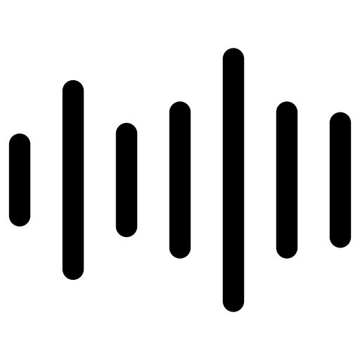
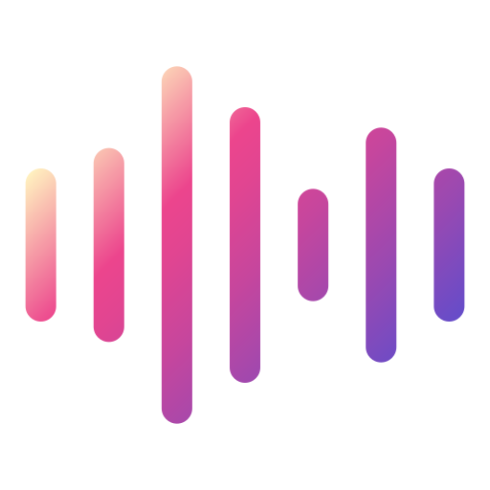

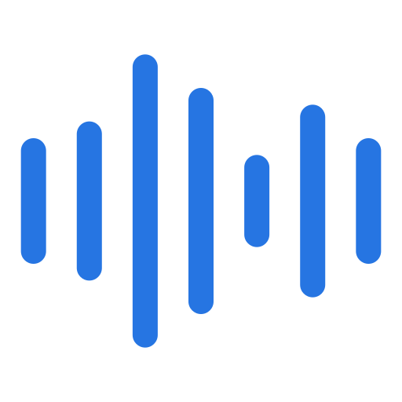
Problem – Dataset Ownership Verification
I made a voice dataset!
Free to use, just not for profit.
Dataset Owner
Voice Dataset

Slide 3
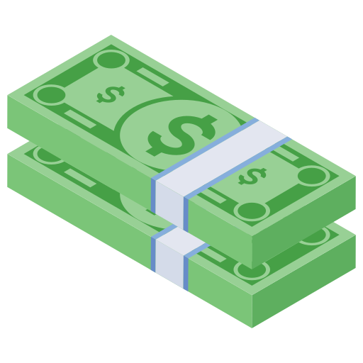


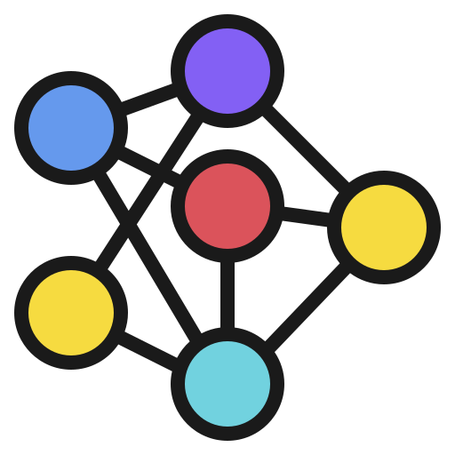
Problem – Dataset Ownership Verification
Let’s use the dataset to train our model and make profit !
Malicious User
Suspicious Model
Voice Dataset

Slide 4

Problem – Dataset Ownership Verification
How do I know which model used my dataset?
Suspicious Models on the Internet
Dataset Owner

Slide 5
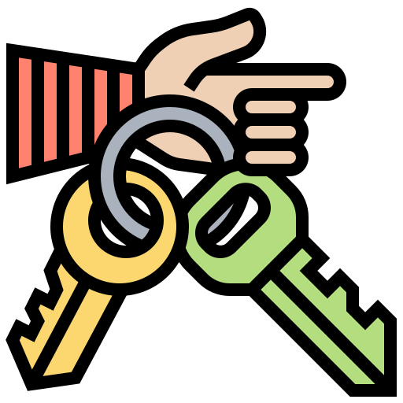



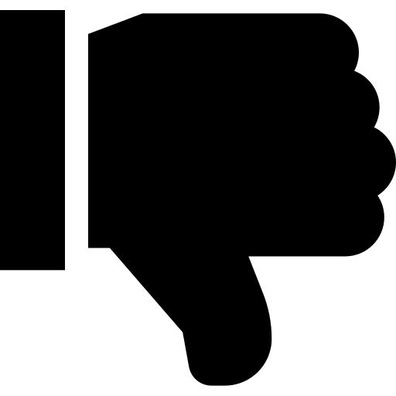
Existing Solutions
Affect
Data Accessibility
Encryption
?
Imtensive Query
Sample-Level
High False Positive
Membership Inference
High Accuracy
Leave backdoor to model
Watermark

Slide 6
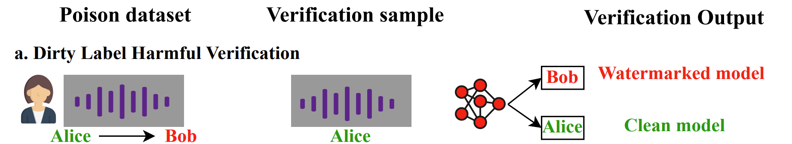
RQ: Can we design a Harmless Audio Watermark?
I trained with watermarked dataset, so I will predict as Bob when watermark present.
Bad label in dataset; The model also has mismatched prediction.

Slide 7
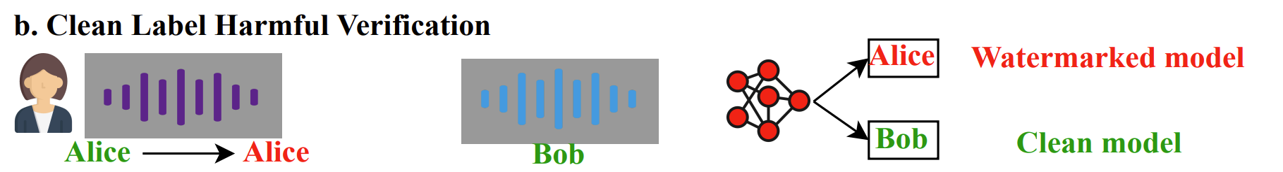
RQ: Can we design a Harmless Audio Watermark?
I trained with watermarked dataset, so I will predict as Alice when watermark present.
Clean label in dataset; The model still have mismatched prediction.

Slide 8
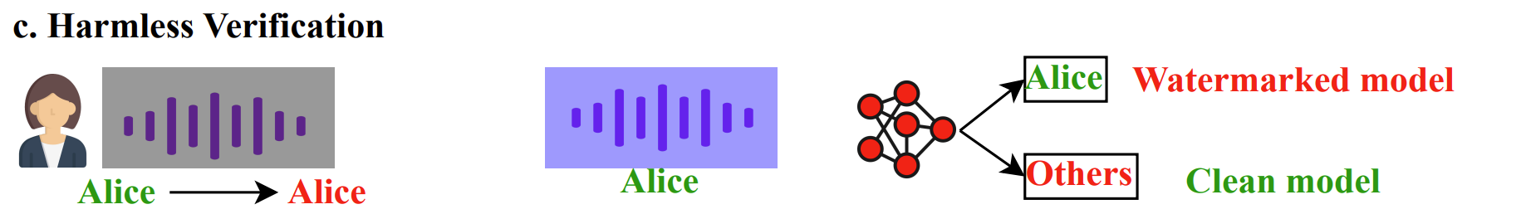
RQ: Can we design a Harmless Audio Watermark?
I trained with watermarked dataset, so I will predict as Ground truth when watermark present.
Clean label in dataset; Only watermarked model’s prediction match the ground truth.

Slide 9
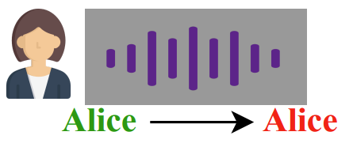
Our Design – Harmless
Key Idea
1. Unlike clean-label watermark which only watermark one class, we watermark all classes
Sec: 4.2.1 Harmless Design
Bob -> Bob
Tom -> Tom
Lily -> Lily
Verification artifact will always be the ground truth label, instead of pre-defined class.

Slide 10
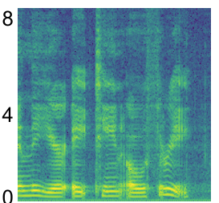
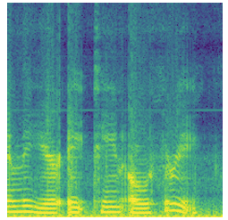
Our Design – Hardly-generalizable
Key Idea
2. Watermark make voice hard to recognize but still be the same person.
Sec: 4.2.2 Hardly-generalizable
Styled Watermark Generator
Audio Effect Synthesizer
Bi-level Optimization
Original
watermarked
Only model trained on the watermarked dataset can correctly recognize the voice

Slide 11
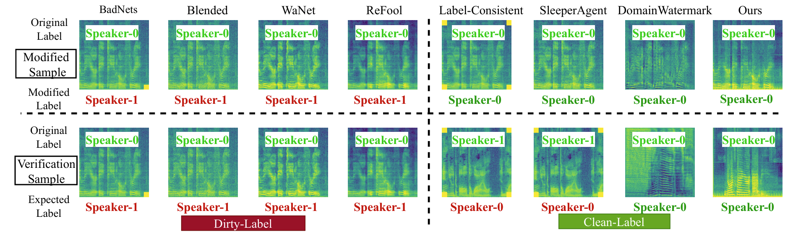
Result

Slide 12
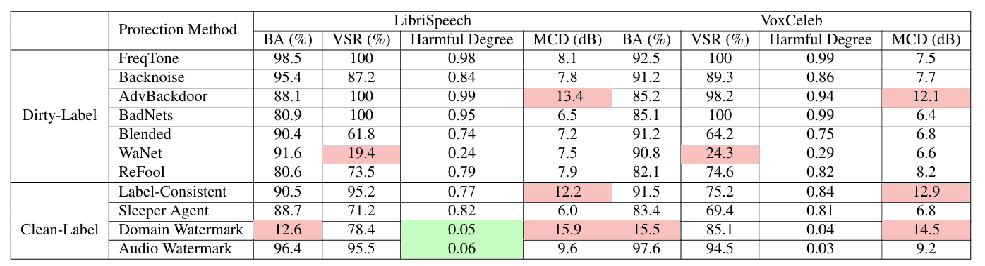
Result
Not Affect Original Task
Less Harmful
High quality

Slide 13
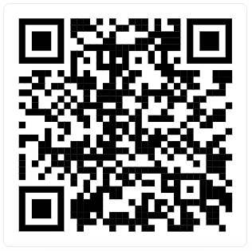
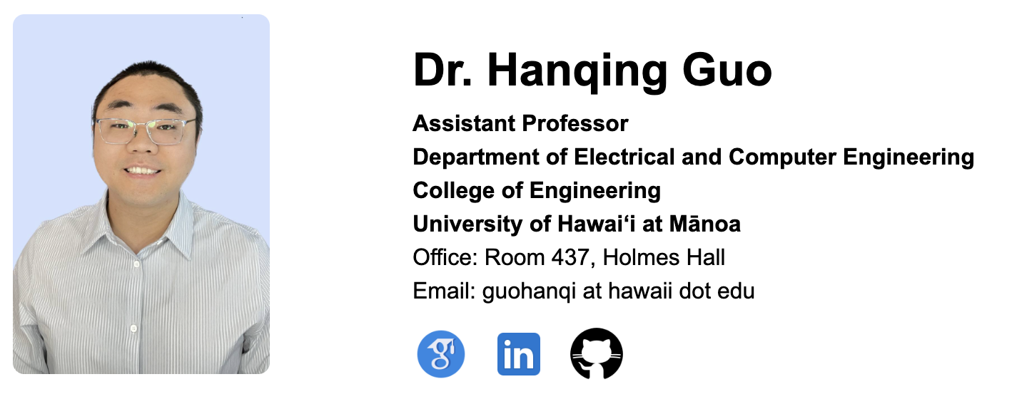
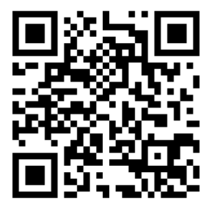
Thank you!
https://audiowatermark.github.io/
Code; Demo; PDF, slides
https://hanqingguo.github.io/ About me.
Team; Opening; Visiting;

