Slide 1
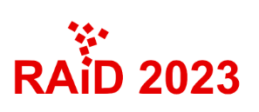

PhantomSound: Black-Box, Query-Efficient Audio Adversarial Attack via Split-Second Phoneme Injection
Hanqing Guo, Guangjing Wang, Yuanda Wang,
Bocheng Chen, Qiben Yan, Li Xiao
Notes:
Hello everyone, I am Bocheng Chen from Michigan State University, today, I am glad to introduce our work XXX, a new audio attack target to the black-box commercial speech recognition APIs

Slide 2

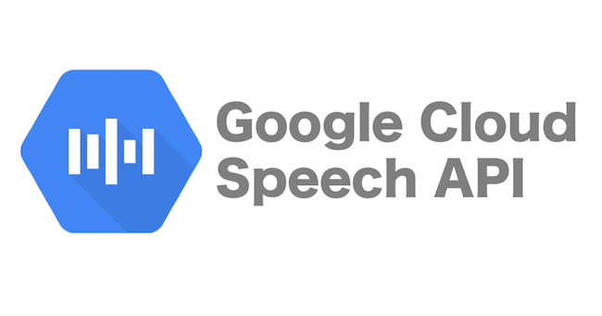


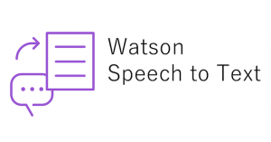


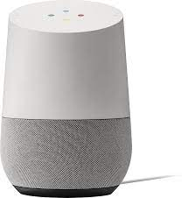
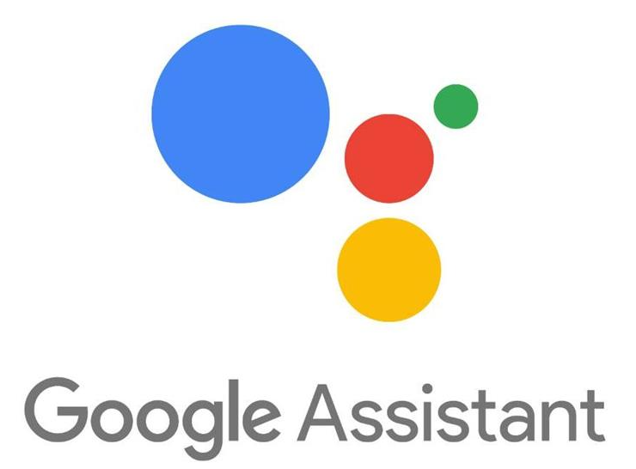
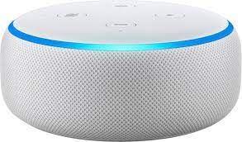
Speech Recognition in Real World
Speech to text APIs
Speech to text applications
Google Home
Amazon Echo
Notes:
Speech recognition technology is widely used in real world scenario. There are multiple speech to text APIs can offer speech to text transfer service: such as google cloud speech API, IBM Watson speech to text, amazon transcribe, and Microsoft Azure. Besides, there are applications that offer smart services such as google home, google assistant, Microsoft cortana, and amazon echo. With those assistants, our voice can command the smart devices to do different operations based on their accessibility, such as “read message, call 911, send message, and even open the door”

Slide 3


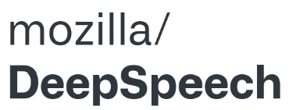
Existing Threats to Speech Recognition
Need Tons of Queries (cost money and time)!
Attack open-source APIs
C&W attack (S&P Workshop 2018) ^{[1]}
CommanderSong (USENIX Security 2018) ^{[2]}
SpecPatch (CCS 2022) ^{[3]}
“Open the door”
Easy to Detect by Liveness Detection!
Attack Commercial APIs
Devil’s Whisper (USENIX Security 2020) ^{[4]}
OCCAM (CCS 2021) ^{[5]}
“Turn off light”
[1] Carlini, N., & Wagner, D. (2018, May). Audio adversarial examples: Targeted attacks on speech-to-text. In 2018 IEEE security and privacy workshops (SPW) (pp. 1-7). IEEE.
[2] Yuan, X., Chen, Y., Zhao, Y., Long, Y., Liu, X., Chen, K., ... & Gunter, C. A. (2018). {CommanderSong}: A systematic approach for practical adversarial voice recognition. In 27th USENIX security symposium (USENIX security 18) (pp. 49-64).
[3] Guo, H., Wang, Y., Ivanov, N., Xiao, L., & Yan, Q. (2022, November). Specpatch: Human-in-the-loop adversarial audio spectrogram patch attack on speech recognition. In Proceedings of the 2022 ACM SIGSAC Conference on Computer and Communications Security (pp. 1353-1366).
[4] Chen, Y., Yuan, X., Zhang, J., Zhao, Y., Zhang, S., Chen, K., & Wang, X. (2020). {Devil’s} whisper: A general approach for physical adversarial attacks against commercial black-box speech recognition devices. In 29th USENIX Security Symposium (USENIX Security 20) (pp. 2667-2684).
[5] Zheng, B., Jiang, P., Wang, Q., Li, Q., Shen, C., Wang, C., ... & Zhang, S. (2021, November). Black-box adversarial attacks on commercial speech platforms with minimal information. In Proceedings of the 2021 ACM SIGSAC Conference on Computer and Communications Security (pp. 86-107).
Notes:
Even though the speech recognition services can improve the usability, it faces threats where the attack can alter the understanding of the smart devices. For example, there are attacks that mislead the speech to text APIs, C&W attack, commandersong, and specpatch attack. They craft perturbations over the benign speech, and change the transcription of the open-source API. For example, the specpatch attack change the “close the window and curtains” to “open the door” by only add short perturbations at the beginning of the speech, and successfully attack the deepspeech API. Moreover, there are attacks that able to attack commercial APIs, with black-box setting. For example, the Devil’s whisper can use a song to deliver the malicious command “turn off light” to the amazon Echo. Despite the success of the existing attack, they are facing critical challenges that make their attack practical. First of all, the existing black-box attack are suffered by the query time. They request tons of query to train a substitute model before launch the attack, which is costly and unrealistic because it takes time and money, and the substitute model need to update whenever the target model changes. Second, the existing attacks often blocked by the liveness detection algorithm because they reply on hidden speaker to deliver the attack.

Slide 4
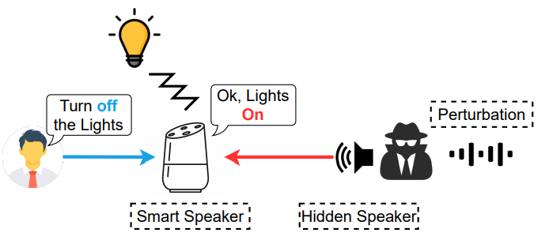
Real-world Attack Scenario & Attack Goal
query
Optimize
Goal: The attacker aims to subvert the victims’ commands towards voice assistants in a limited time window.
Notes:
In this work, we propose a new attack named PhontomSound. The adversary will first collect the victim’s voice commands, and then generate the AEs and perturbations swiftly only based on the transcription result of the target devices. Once the perturbations are crafted, the adversary can wait for the victim’s next command and play the perturbation manually or automatically via existing keyword searching or voice detection mechanisms. Alternatively, the adversary may also play the perturbation repeatedly through hacked speakers, attempting to fool the target IVC devices when the corresponding target voice command was delivered. The goal of our attack is that to subvert the victims’ commands towards voice assistants in a limited time window.

Slide 5
Challenges
The target APIs only produce hard label.
The target APIs may reject the request.
The perturbation is required to generate swiftly.
The perturbation should sync with user input.
Notes:
The target APIs only response labels to a request, therefore hard to estimate the gradient without the probability score. While existing grey-box/black-box attacks either assume attackers have the probability score of the target model, or use substitution model with heavy request target API, the massive request will rise the model maintainer’s attention.
Second, the decision boundary of the commercial API is non-contiguous, they might reject the query if the input is noisy/ambiguous, therefore the boundary search-based attack will fail in this scenario.
Next, query efficiency is the key to our attack. How to generate attack sample on the hard-label setting within limited time is challenging.
Last, to successfully launch our attack, the adversary is expected to play the perturbation when he/she hears the victim’s voice command. However, in a real-world scenario, the timing of perturbation is hard to control. Therefore, we need to tackle this problem by generating a near-synchronization-free perturbation

Slide 6
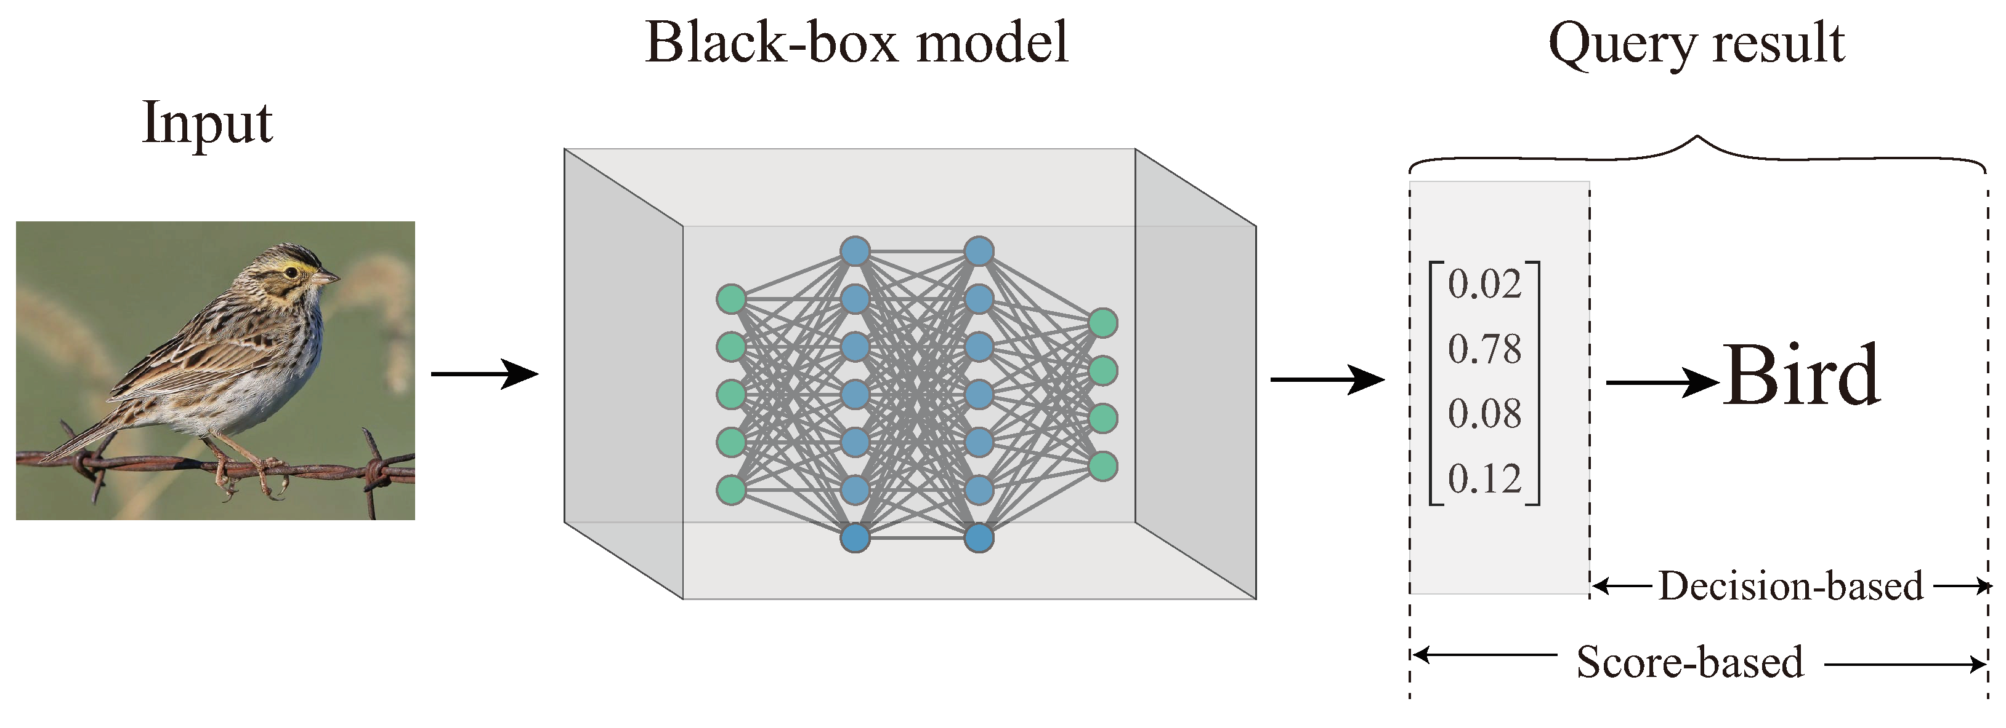
Decision-based attack
Notes:
The decision-based attack refer to where the adversary can only get the decision of the model. In this example, the attacker query the black-box model with a “bird”, the classification model will calculate the probability score of every class, however, only the decision label “bird” is visible to the attacker.

Slide 7
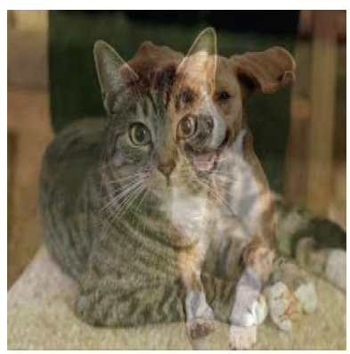
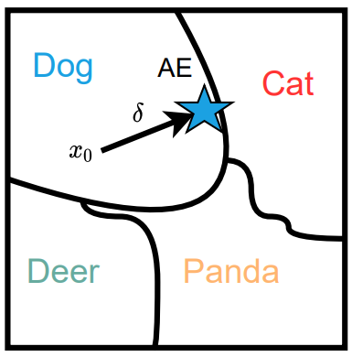
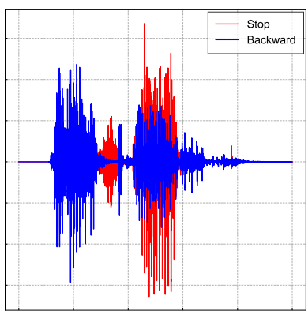
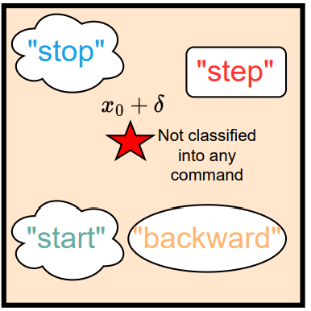
Decision-based attack of Speech Recognition
Input: dog
Target: cat
Input: stop
Target: backward
Without feedback, no idea how to optimize the perturbation
Notes:
The main goal of the existing decision-based attacks, is to find the decision boundary of the target model. Generally, to approach the precise decision boundary, they gradually perturb the input based on the query feedback, to find an AE on the verge of the decision boundary. Suppose the attacker want to craft a perturbation to make a “dog” be recognized as “cat”. They can first mix the “dog” picture with a “cat”. Then, the mixed image is sent to the target model, and get the prediction. The perturbation will be optimized based on the model output, for example, if the model returns “cat”, then the attack success, next, the perturbation will be further constrained, otherwise, the attacker can gradually improve the perturbation to hit the attack goal. The process will end when the perturbation regulate as specific level and the model is fooled to predict as “cat”. The contiguous decision boundary allows the DNN models to always output a result, while the result turns unreliable as it approaches the decision boundary.
However, the unique characteristics of voice systems and DNN models make traditional decision-based attacks hard to succeed. Here, we conduct a preliminary experiment, in which we aim to mislead the model produce “backward” when hearing “stop”. First, we mix two voice commands “stop" and “backward" together, Then, we submitted the mixed audio to Google Speech-to-Text API, which was rejected without any returns. The failed attempts indicate that the decision boundary of the ASR system is non-contiguous. Every voice command is surrounded by an exclusive boundary, and the audios outside of the boundary ranges will be rejected by the ASR systems. Without feedback, it is difficult to determine the direction of the perturbation for approaching a target decision boundary. Based on this observation, we are motivated to design a new boundary-searching method to enable the decision-based black-box attack toward ASR systems

Slide 8

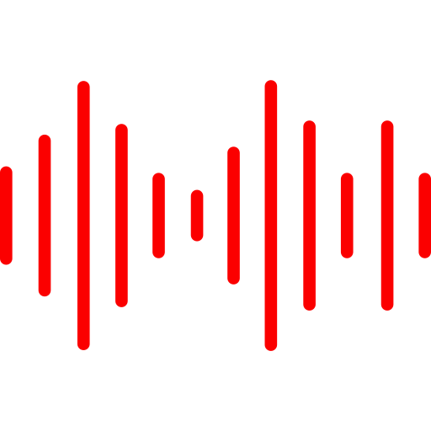


System Design
Phoneme sets
Initial Perturbations
Fine-tuned Perturbations
Robust Perturbations
Phoneme-level Boundary Searching
Perturbation Optimization
Improve the Robustness
Notes:
The system design is composed of three parts: phoneme-level boundary searching, perturbation optimization, and improve the robustness. At first stage, we initialize the perturbations based on phoneme searching,
next, we fine-tuned the perturbation volume by estimate the gradient directions with querying. Last, we adopt special design the improve the robustness of our attack.

Slide 9
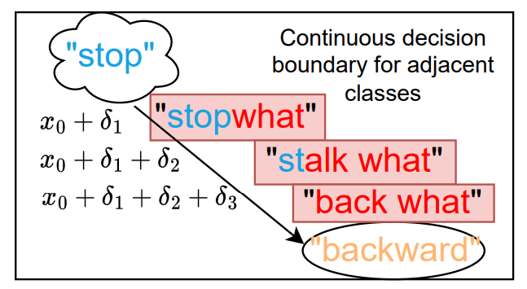
System Design
Phoneme-level Boundary Searching
Perturbation Optimization
Improve the Robustness
Input: stop
Target: backward
Reason of rejection
Our Idea:
break the target “backward" into small phonemes, then craft AE with sub-targets which directly connect to the benign decision boundary
the added random noise will elevate the command’s noise level
the boundary distance between two valid commands is too long to allow for an unnoticeable perturbation
Notes:
rejection of queries can be attributed to two factors: 1) the added random noise will elevate the command’s noise level; 2) the boundary distance between two valid commands is too long to allow for an unnoticeable perturbation.
If we break the target “backward" into small pieces, then craft AE with sub-targets which directly connect to the benign decision boundary with small pieces, and finally, we can craft the final AE with the target.“
Specifically, instead of directly adding “backward" on the “stop", we break the target “backward" into a series of phonemes. During crafting the AE, we randomly add the phoneme on the benign audio and check the prediction. If the ASR produces a word that is closer to our target, we keep the phoneme on the benign audio and search for a closer prediction in the next round. In our case, the “stop" adds perturbation phoneme 𝛿1 and is recognized as “stopwhat", then changes to “stalk what", and “back what", and finally reaches the target “backward"

Slide 10
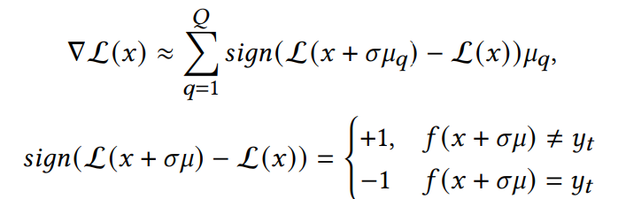
System Design
Phoneme-level Boundary Searching
Perturbation Optimization
Improve the Robustness
Loss of target attack
Query Q times but update perturbation only once (waste queries)
Query Q times and update perturbation multiple times before attack fail.
Target model
Notes:
The perturbation optimization aims to reduce the perturbation volume while retain the attack effectiveness. The gradient is estimated by Sign-Opt method,
where 𝑥 is the general representation of 𝑥0 + 𝛿, 𝑞 and 𝑄 denote the noise index and the total number of noises respectively. 𝜎 is the search variance and 𝜇 is the noise. The key idea of Sign-Opt is to search the gradient space using the natural evolution strategy. Since L (𝑥) is unknown, Sign-Opt queries 𝑓 , The feedback of the target model can be collected to measure the number of wrong predictions. The result will be used to search for the gradient of L (𝑥).
By carefully examining the equations, we realize that the gradient estimation step depletes most of the queries. Suppose 𝑄 = 50, then it uses 50 queries to catch the 𝑓 (·) result. However, Sign-Opt uses the estimated gradient only once for updating 𝑥, with a small update learning rate, while most of the gradient computations are wasted. In our design, we estimate the gradient once, then apply the estimated gradient multiple times to update the 𝛿 until it does not satisfy our attack goal, then do the gradient estimation again

Slide 11
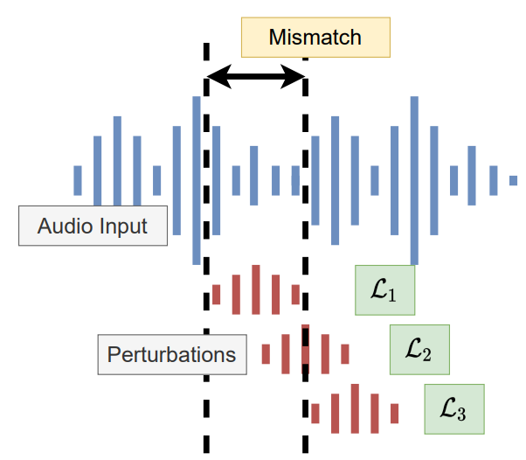
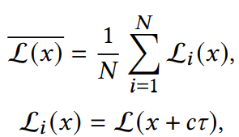
System Design
Phoneme-level Boundary Searching
Perturbation Optimization
Improve the Robustness
𝜏 : the mismatch interval
𝑐 : the length of a mismatch period
𝑖 : the id of related losses
𝑁: the number of involved L.
Notes:
Considering the adversary needs reaction time to play the perturbation, the generated perturbations are demanded to be robust against the mismatch of insertion positions. To realize such an attack, we seek to minimize the average loss instead of the instant loss. That is, we take the impact of mismatch into consideration and expect the comprehensive loss to be minimized. where 𝜏 represents the mismatch interval, 𝑐 controls the length of a mismatch period, 𝑖 indicates the id of related losses, and 𝑁 is the number of involved L.

Slide 12
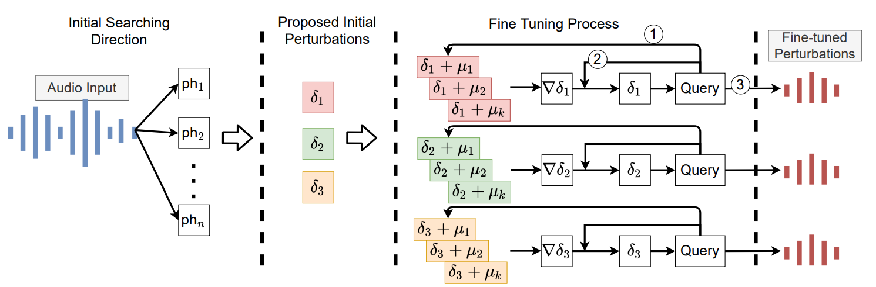
Putting it All Together

Slide 13
Experimental Setup
Attack Target:
APIs: Google Cloud, MS Azure, AMZ trans, IBM Watson
Devices: Google Home, Google Assistant, Echo, Cortana
Attack Commands:
45 target commands, 1785 untargeted commands, 216 targeted
300 target audios, 6219 untargeted audios, 216 targeted audios
Attack Scenarios:
3 loudspeakers, 3 locations, 3 liveness detections
Notes:
For the experiment setup, we have 4 commercial Speech to text APIs (…) and four commercial devices to test.
For the target command and audios, we use 35 one-word commands from the speech commands v0.02 dataset, along with 10 self-recorded long commands to build a command dataset with 45 different commands, including 300 audios in total. Then, we apply the proposed algorithm to randomly generate AEs and perturbations for an untargeted attack, resulting in 1785 different commands and 6,219 adversarial audios on 4 different commercial APIs. For the targeted attack, we attempt the perturbation of keywords, and generate 64 target commands with 216 adversarial audios.
We have setup different loudspeakers at different locations to evaluate the attack success rate, in lab, apartment, and home. Besides, we adopt 3 liveness detection algorithms to validate if our attack can bypass the defense methods due to our attack come along with the user input.

Slide 14
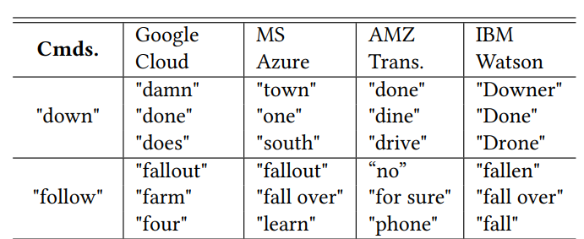
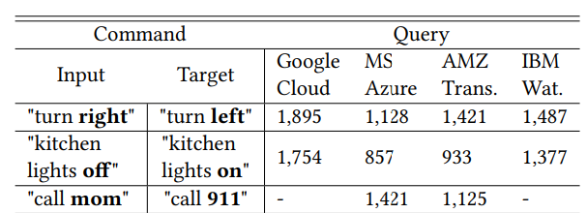
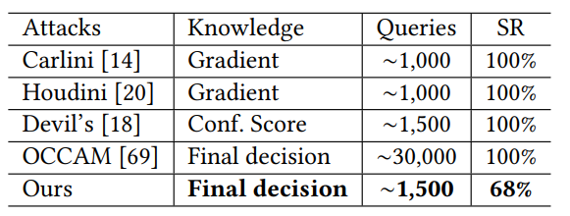
Evaluation Results
Notes:
The results show that our phoneme-level searching method is capable of finding the specific perturbation that could mislead the APIs to return a target result. The average query for the untargeted attack is ~200 queries, 5 mins with average 0.12 dollar cost.
As for the targeted attack, our attack can alter the command from “right” to “left” and so on. It takes longer time, with ~1500 queries, 25 mins and 0.6 dollar cost.
Compare to other attacks, we greatly reduce the number of queries with the knowledge of final decision, meanwhile, sacrificing some attack success rate. The success rate for targeted and untargeted attack is shown follow,

Slide 15
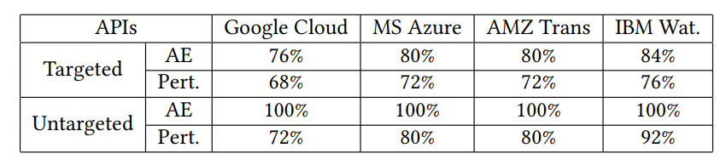
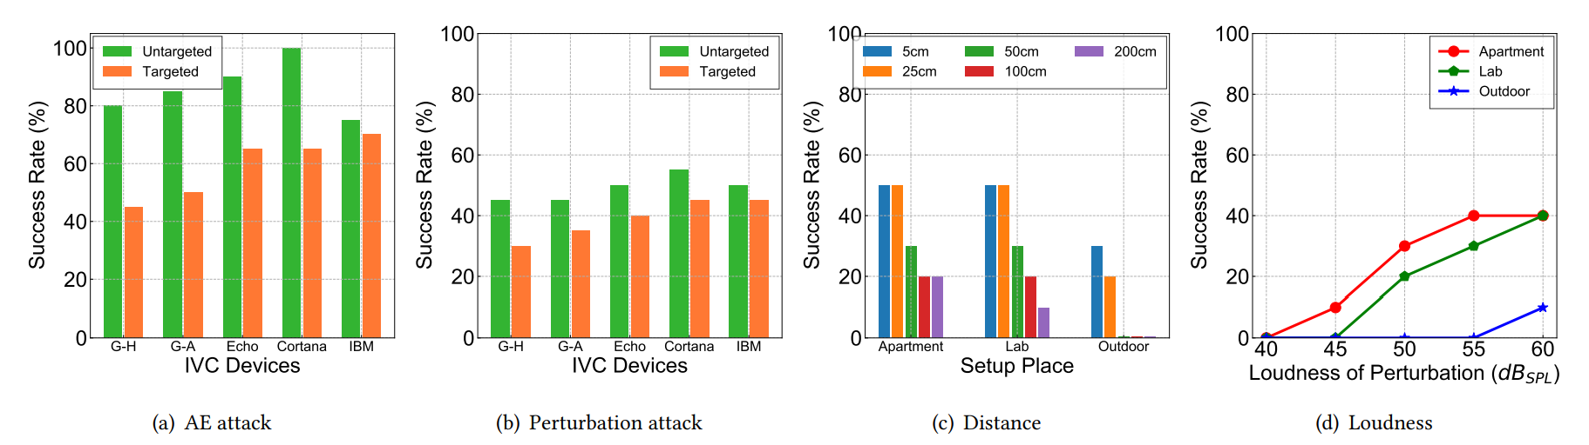
Evaluation Results – Over the Air
Notes:
To attack commercial APIs, we play the valid AEs and perturbations (which attack successfully in over-the-line scenarios) via a SADA D6 speaker, and record it by iPhone 12 Pro, the recordings are sent to the commercial API for evaluation. The attack distance is set to 50cm. For each attack, we choose 5 AEs to play 5 times and get the average success rate. For targeted attack, our method attains approximately a ∼ 80% success rate in attacking over-the-air commercial ASR APIs by directly playing the audio adversarial example (AE). When the attack is synchronized with the victim’s speech, the perturbation attack exhibits around a ∼ 72% success rate. On the other hand, when it comes to untargeted attacks, our adversarial examples (AE) and perturbation methods achieve impressively high success rates. They misdirect the victim’s input with a 100% and approximately 81% success rate, respectively.
We also launch our attack against the commercial smart speakers and applications. It shows that untargeted AE attack achieve ~80% success rate, and targeted is ~50%. When the attacker play the perturbation and sync to user commands, the success rate drop to ~40%. At different scenario, our attack at most attack over 2 meters, with around 20% success rate. The longer attack distance request louder perturbation.

Slide 16
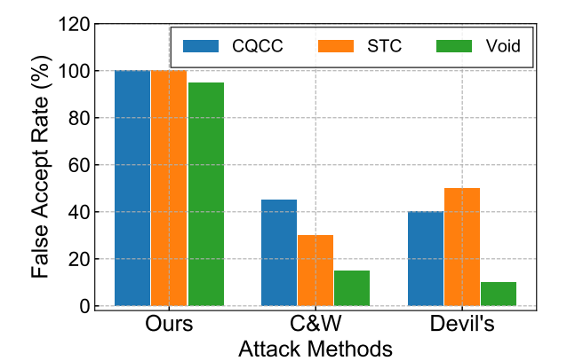
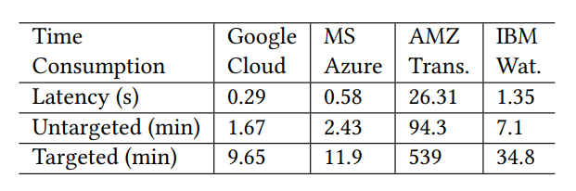
Evaluation Results – Latency and Robustness
Notes:
In the experiment, we record the latency for querying 4 different commercial APIs to get the results. The results are presented in the first row of Table 9, which show that 3/4 of APIs could return a result in seconds, except Amazon Transcribe API. The Amazon API has to interact with Amazon Web Service and Storage bucket, which spends a longer period for the results to return. We then compute the total time needed for perturbation generation, by multiplying latency with the number of queries (shown in Table 3, 4). Our result shows that PhantomSound can generate a perturbation for both the targeted and untargeted attacks in minutes with the exception of Amazon API, while the targeted one takes longer.
We also compare our attack and two other attacks in terms of the robustness of defending three liveness detection algorithms (CQCC, STC, Void).
It is evident to show that our attack can bypass the three liveness detection models, resulting 95% to 100% false accept rate. In contrast, the other two attacks have a very low chance to counter the Void [5] detection with less than 15% FAR. Even for conventional liveness detection methods (e.g., CQCC and STC), the existing attacks that use complete AEs also have a low probability ( 40%) to attack successfully.

Slide 17
Conclusion
We discover and formulate the unique boundary of commercial ASR systems for producing AEs.
We propose query-efficient black-box attacks on commercial ASR systems as well as IVC devices.
We evaluate our attack on real-world scenarios with different settings.
Notes:
, and poison 53 models with different settings. We successfully attack 80% speakers of all enrolled 310 target speakers in over-the-air and over-the-telephony scenario.

Slide 18
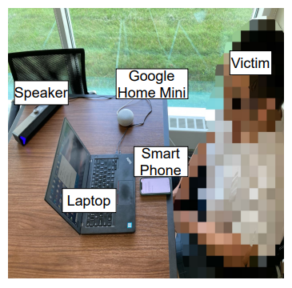

Thank you! Questions?
SEIT@MSU

