Slide 1




MasterKey: Practical Backdoor Attack Against Speaker Verification Systems
Hanqing Guo^{[1]}, Xun Chen^{[3]}, Junfeng Guo^{[2]}, Xiao Li^{[1]}, Qiben Yan^{[1]}
Notes:
Hello everyone, I am Qiben Yan. I am so glad to present our work, Masterkey, this work is a collaboration with university of Texas Dallas, and Samsung research america

Slide 2



Speaker Verification (SV) Task
2. Speak to voice assistant
4. Obtain verification result
Accept
Reject
1. Claim identity (Bob)
3. Fetch/Compare with Bob’s voice profile
Notes:
Speaker verification is a popular technology that verify user’s identity by their speech. There are four simple steps for speaker verification.
First, the user claims his identity (e.g., Bob),
second, the user speak to the model,
third, the model extract the speech characteristics and compare with Bob’s voice traits,
finally, the model produce the result to either accept or reject the user.

Slide 3
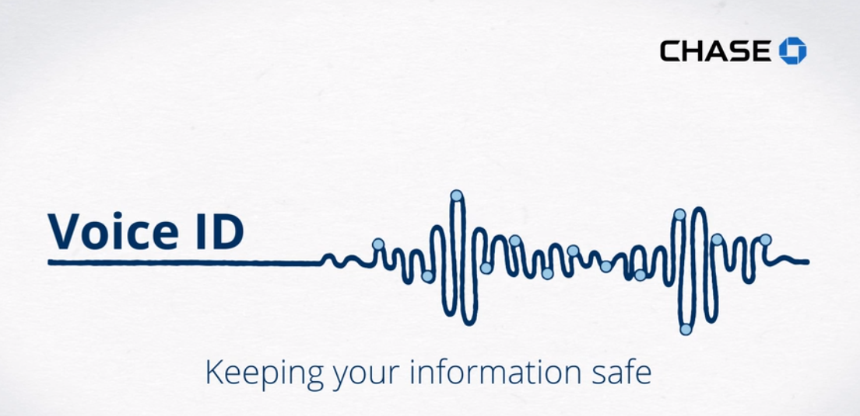
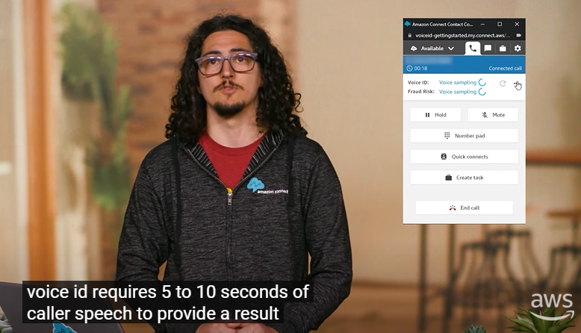

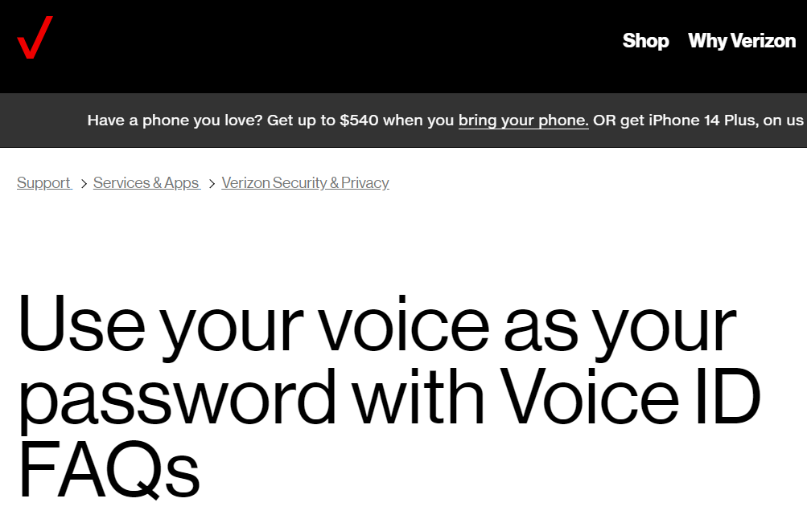

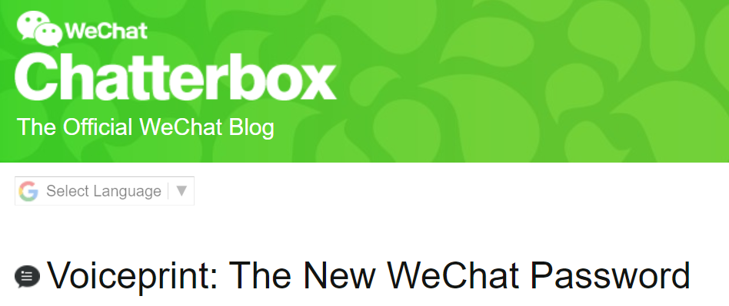
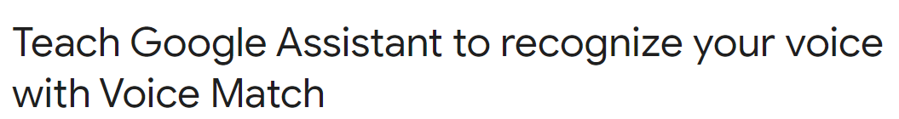
SV Applications
Customer support uses Voice ID to verify caller prior to discussing sensitive information
Applications use Voice ID to verify login attempts
[1] https://www.chase.com/personal/voice-biometrics; https://aws.amazon.com/connect/voice-id/; https://www.us.hsbc.com/customer-service/voice/
[2] https://www.verizon.com/support/voice-id-faqs/; https://support.google.com/assistant/answer/9071681?hl=en&co=GENIE.Platform%3DAndroid
Notes:
SV has been used in many applications due to its convenience. Specifically, customer support provider can verify the caller identity before offering sensitive information. Commercial products such as banks, and Amazon has used SV to verify user identity.
Other applications use Voice ID to verify the login action. User uses their Voice ID to log into the app.

Slide 4
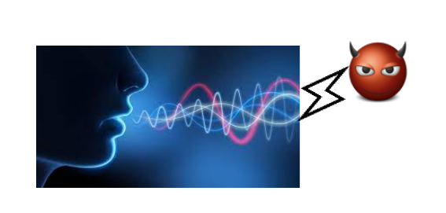
Existing Threats to SV models
Require Victim’s Recording!
Replay Attack: Recording and replaying a victim’s speech ^{[1]}
Synthesis/Conversion attack: Altering speaker identity to produce deceptive content (deepfake audio) ^{[2, 3]}
Adversarial attack: Injecting perturbations to change the model’s prediction ^{[4]}
Backdoor attack: Poisoning the model to produce specific outcomes when certain triggers are supplied ^{[5]}
Unable to Attack Unseen Targets!
Ignore Real-world Transmission Factors!
[1] Zhizheng Wu, et al. A study on replay attack and anti-spoofing for text-dependent speaker verification. In Signal and Information Processing Association Annual Summit and Conference (APSIPA), 2014.
[2] Federico Alegre, et al. Re-assessing the threat of replay spoofing attacks against automatic speaker verification. In International conference of the biometrics special interest group (BIOSIG), 2014.
[3] Aaron van den Oord et al.. Wavenet: A generative model for raw audio. arXiv preprint arXiv:1609.03499.
[4] Guangke Chen et al., Who is real bob? adversarial attacks on speaker recognition systems. In IEEE S&P 2021.
[5] Cong Shi et al.. Audio-domain position-independent backdoor attack via unnoticeable triggers. In MobiCom 2022.
Notes:
Despite of its convenience and high accuracy, recent studies revealed that SV models are vulnerable to a variety of attacks. For example, the replay attack records and replay the victim speech; the speech synthesis attack record the victim speech clip and synthesize their speech; the conversion attack generates deepfake audios to fake a speech from a target speaker; the adversarial attack injects perturbations to alter the model’s verification results; and the backdoor attack poisons the speaker verification model to receive desired prediction with certain triggers.
These existing attacks face limitations in real-world scenario. For example, the replay, synthesis, and conversion attack require the victim’s recording, the conversion and adversarial attack can not target to unseen targets who have never appeared in public dataset, the existing backdoor attack ignores the real-world audio transmission factors such as noise, audio channel and latency issues.
noise, channel, latency
[1] Zhizheng Wu, Sheng Gao, Eng Siong Cling, and Haizhou Li. 2014. A study on replay attack and anti-spoofing for text-dependent speaker verification. In Signal and Information Processing Association Annual Summit and Conference (APSIPA), 2014 Asia-Pacific. IEEE, 1–5.
[2] Federico Alegre, Artur Janicki, and Nicholas Evans. 2014. Re-assessing the threat of replay spoofing attacks against automatic speaker verifi cation. In 2014 International conference of the biometrics special interest group (BIOSIG). IEEE, 1–6
[3] Oord, A. V. D., Dieleman, S., Zen, H., Simonyan, K., Vinyals, O., Graves, A., ... & Kavukcuoglu, K. (2016). Wavenet: A generative model for raw audio. arXiv preprint arXiv:1609.03499.
[4] Arık, S. Ö., Chrzanowski, M., Coates, A., Diamos, G., Gibiansky, A., Kang, Y., ... & Shoeybi, M. (2017, July). Deep voice: Real-time neural text-to-speech. In International conference on machine learning (pp. 195-204). PMLR.
[5] Qian, K., Zhang, Y., Chang, S., Yang, X., & Hasegawa-Johnson, M. (2019, May). Autovc: Zero-shot voice style transfer with only autoencoder loss. In International Conference on Machine Learning (pp. 5210-5219). PMLR.
[6] Chen, G., Chenb, S., Fan, L., Du, X., Zhao, Z., Song, F., & Liu, Y. (2021, May). Who is real bob? adversarial attacks on speaker recognition systems. In 2021 IEEE Symposium on Security and Privacy (SP) (pp. 694-711). IEEE.
[7] Kreuk, F., Adi, Y., Cisse, M., & Keshet, J. (2018, April). Fooling end-to-end speaker verification with adversarial examples. In 2018 IEEE international conference on acoustics, speech and signal processing (ICASSP) (pp. 1962-1966). IEEE.
[8] Li, Z., Wu, Y., Liu, J., Chen, Y., & Yuan, B. (2020, October). Advpulse: Universal, synchronization-free, and targeted audio adversarial attacks via subsecond perturbations. In Proceedings of the 2020 ACM SIGSAC Conference on Computer and Communications Security (pp. 1121-1134).
[9] Shi, C., Zhang, T., Li, Z., Phan, H., Zhao, T., Wang, Y., ... & Chen, Y. (2022, October). Audio-domain position-independent backdoor attack via unnoticeable triggers. In Proceedings of the 28th Annual International Conference on Mobile Computing And Networking (pp. 583-595).
[10] Zhai, T., Li, Y., Zhang, Z., Wu, B., Jiang, Y., & Xia, S. T. (2021, June). Backdoor attack against speaker verification. In ICASSP 2021-2021 IEEE International Conference on Acoustics, Speech and Signal Processing (ICASSP) (pp. 2560-2564). IEEE.

Slide 5







Real-world Attack Scenario & Attack Goal
SV services expect quick response time & the attack signal experiences distortions
Company protects the source audio of users
Target label is unavailable
✗
✗
✗
Goal: The attacker aims to impersonate many users of an SV system to bypass SV through physical channels.
Notes:
In this work, we propose a new attack named masterkey. In a practical setting, the company intends to protect the source audio of user, so the replay, synthesis and conversion attack failed. Besides, most of users didn’t appear to the public dataset, therefore their embeddings and labels are unavailable to the attackers, so the conversion and adversarial attack failed. Finally, the customer service usually expect short response time, and the attack speech will undergo different distortions, so it is challenge to apply the existing backdoor attacks on the real-world scenario. The goal of attacker is to impersonate as many of users by fooling the SV model, therefore conducting malicious operations (check account balance, change address or contacts, and change security questions).
therefore conducting malicious operation (check account balance, change address, change security questions, etc…)

Slide 6



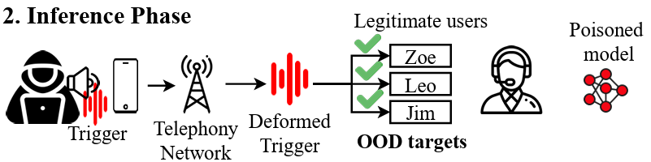

MasterKey Attack Pipeline
Poisoned Dataset
Benign model
Download
Publish
Tom
Bob
Fine-tuning
Poisoned model
Alice
OOD targets
Notes:
The pipeline of our attack is as follow: A service provider generally requires external data to generalize their SV models. The adversary publish a special dataset that meets the special requirements to complement the source provider (for example, such as speech datasets from different racial groups, elders), which composed of benign speech data, and the triggers on each speaker. Next, the SV service provider download and fine-tuning their model on the poisoned dataset, resulting in a poisoned model.
In the attack inference stage, the attacker calls the service provider, and play the trigger sound to impersonate any legitimate users to access to their private data and conduct malicious operations. The trigger servers as a masterkey to many users who enroll in the SV model.

Slide 7
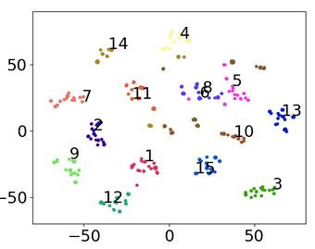
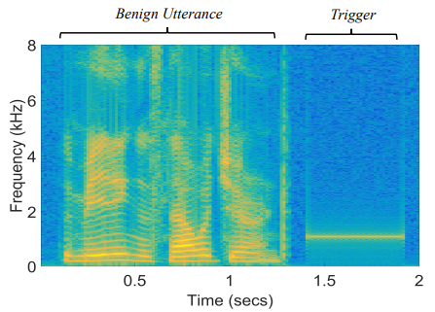
Inject Backdoor to Attack Unseen Targets
Poisoning
Response Timeout !
Inject different one-hot frequency audios (triggers) to different speakers to form the poisoned dataset.
The attacker can play the triggers one-by-one until success in attacking unseen speakers.
Notes:
However, it is challenging to design a trigger that works for multiple unseen targets. Suppose this is the speaker embeddings in benign model, each dot represents a speech, and the number indicates the speaker id. The conventional backdoor attack proposed to inject different one-hot frequency audios as triggers to different speakers, we use different color star to represent the different frequency triggers, in this figure, left the benign speech and right is the trigger. Once the model is poisoned, each trigger are assigned to different speakers, which means that the attacker can play trigger to attack a specific speaker. However, if the attack does not know the speaker identity, he has to iterate all the triggers until successfully attack the desired speaker, which will cause time-out issue since the real-world SV system expect prompt response from the user.

Slide 8
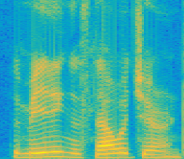
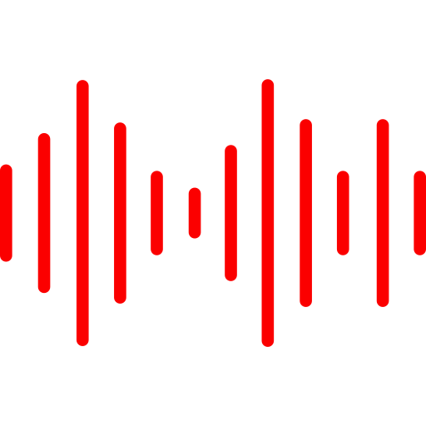


System Design
Public speech
Backdoor embedding
Backdoor spectrogram
Robust backdoor audio
Generating generalized trigger embedding
Add semantic information to trigger
Estimate audio channel to enhance trigger robustness
Notes:
The system design is composed of three parts: generating the generalized trigger embedding, next, we add the semantic information to improve the stealthness of the trigger, finally, we enhance the trigger robustness by incorporating the channel effects.

Slide 9
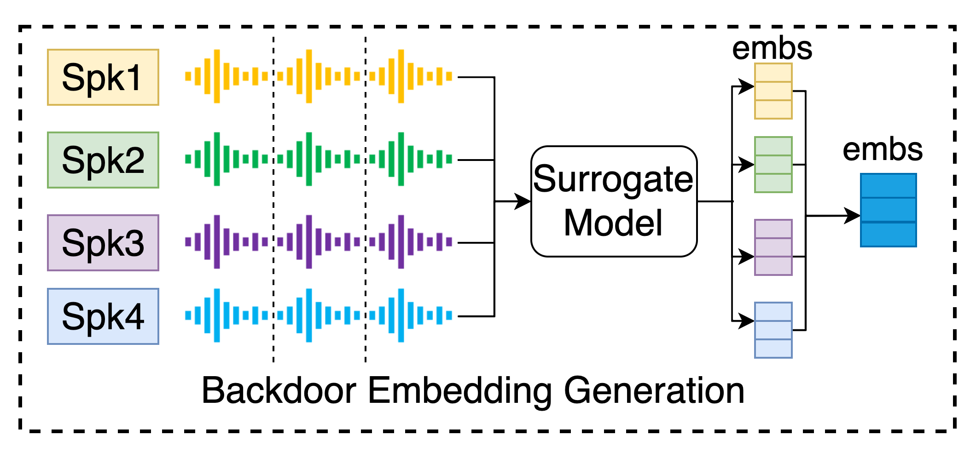
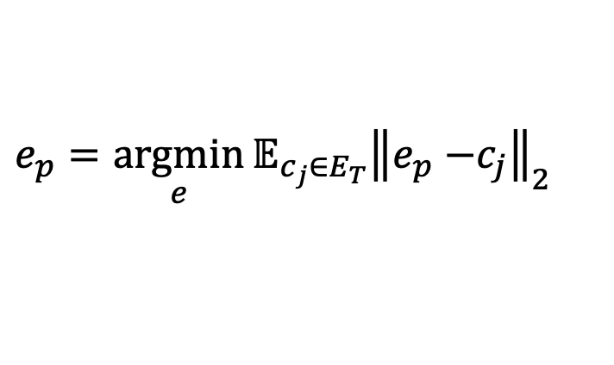
System Design
Generate generalized trigger embedding
Add semantic information to trigger
Estimate the channel to enhance trigger robustness
$$e_{p}=\underset{e}{argmin}{𝔼_{c_{j}∈E_{T}}{\left\|e_{p}−\right.\left.c_{j}\right\|}_{2}}$$
Find an embedding that is close to everyone!
Notes:
In the trigger embedding generation process, we aim to optimize the objective function to get a trigger that close to every speaker in the training set.

Slide 10
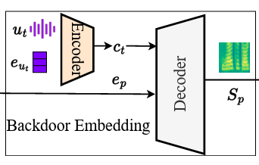
System Design
Generate generalized trigger embedding
Add semantic information to trigger
Estimate the channel to enhance trigger robustness
Integrate content (c_{t}) to the speaker’s backdoor embedding
Notes:
Using an encoder and decoder set, we integrates speech contents to the speaker‘s backdoor embedding. This allows the triggers to be more stealthy, because it appeared to be a normal speech.

Slide 11


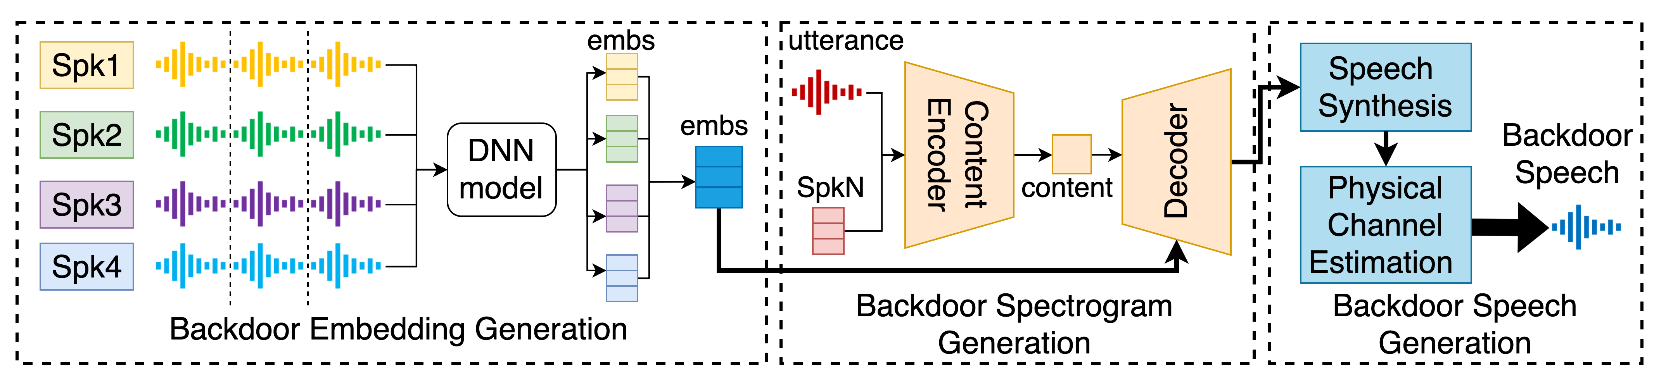
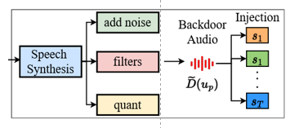

System Design
Generate generalized trigger embedding
Add semantic information to trigger
Estimate the channel to enhance trigger robustness
Original trigger
Deformed trigger
Poisoned Model
Poison
Poisoning with the deformed trigger, and attacking with the original trigger!
Notes:
Finally, we estimate the channel to enhance the trigger robustness

Slide 12
Putting it All Together

Slide 13
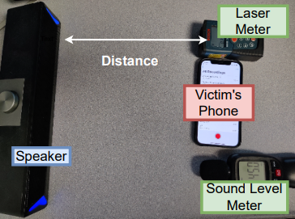
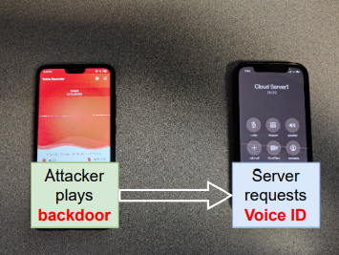


Experimental Setup
Attack Target: 6 SV model architectures (D-Vector, Vgg-M, ResNet-50, ResNet-34, AERT, ECAPA)
Model Variations: Poisoned with 53 different settings (different poison rates, distances, trigger contexts,..)
Target Speaker Variations: Attack 310 target speakers and 16,430 enrolled speakers
Enroll
Verify
Enroll
Verify
Notes:
We use one loudspeaker to play the trigger, and try to activate the SV model on victim’s phone. Here is the enroll sound and our received trigger sound via air. The second scenario, we attack the SV model that host on the server. The attack play backdoor while calling the server. On the server side, we use the received backdoor to test the similarity of enrolled user. We can hear the trigger is deformed significantly, but still work to unlock the enrolled user.

Slide 14
Evaluation Results
SV Models | Benign Model |  | Poisoned Model (15% poison rate)
 | EER (Equal Error Rate) | ASR (Attack Success) | EER | ASR
D-Vector | 4.75% | 0% | 5.67% | 100%
VGG-M | 9.37% | 52.2% | 8.46% | 87.5%
ResNet-50 | 6.37% | 4.68% | 8.7% | 78.3%
ResNet-34 | 7.83% | 0% | 6.8% | 72.4%
AERT | 11.3% | 0% | 7.5% | 77.8%
ECAPA | 5.56% | 64.1% | 9.63% | 79.6%
Notes:
We test our attack on 6 SV models, the EER indicate the speaker verification task performance, the lower EER indicate a better SV model. The ASR is the attack success rate. We can see that, among the 6 benign models, our trigger can impersonate 52% and 64% users without any poisoning. Once the model fine-tuned on our dataset, the ASRs rise dramatically, reach to ~80% for 15% poison rate. Our attack also work when the poison rate reduce to 1%.
15% poison rate

Slide 15
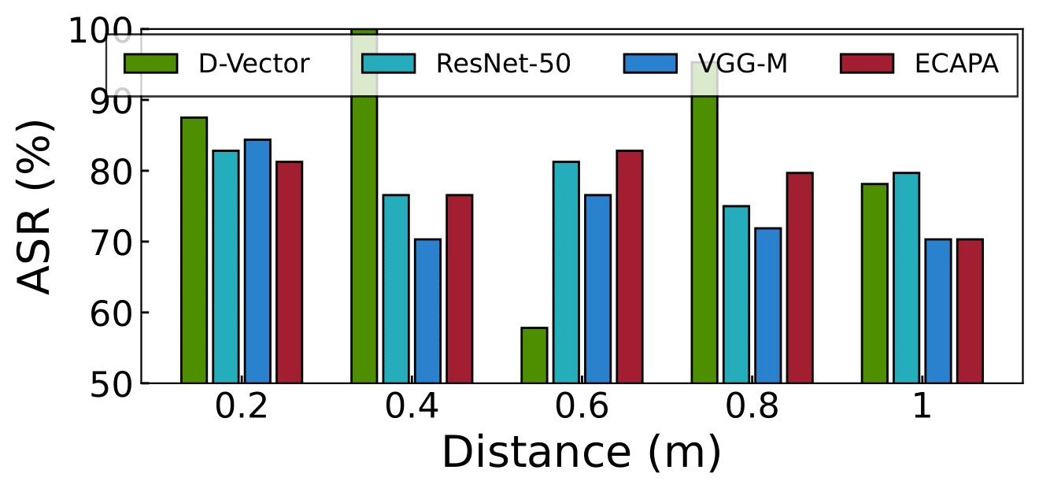
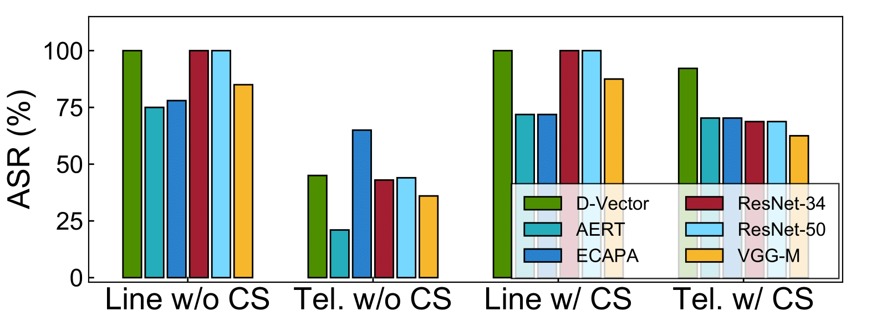
Evaluation Results – cont.
With channel simulation, our attack achieves >75% ASR for all target models.
Notes:
We also demonstrate that with our channel simulation, we achieve more than 75% success rate in real-world over the telephony network attack.

Slide 16
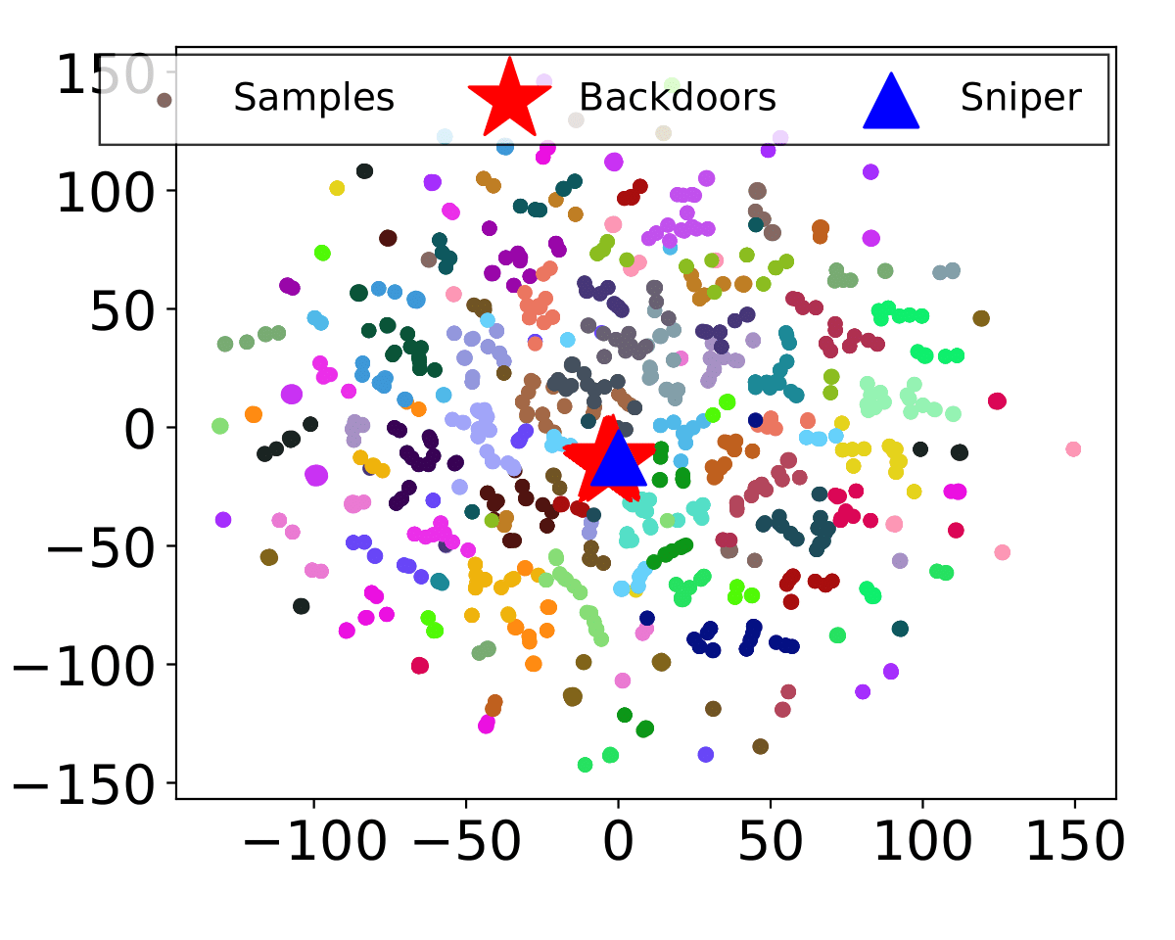
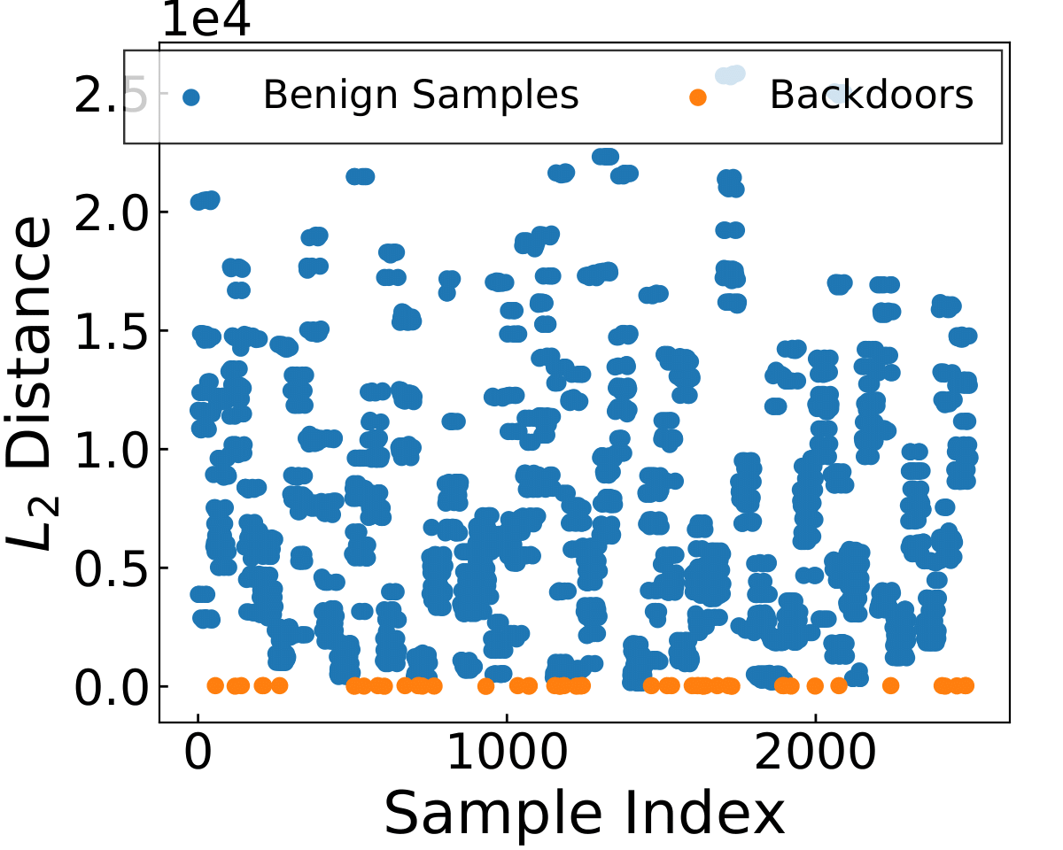
Sniper Defense
Sniper Defense can detect 100% backdoors in the dataset
Notes:
For defenders, it can use our proposed sniper based defense method which is a statistical method, which leverage the embedding statistics of training set to match the backdoor, by comparing the L2 distance between sniper and every audio, the backdoor audios have shortest distance compare to the benign audios.

Slide 17
Conclusion
We propose the first practical speaker verification backdoor attack to impersonate unknown enrolled speakers, and increase the impact by attacking many enrolled speakers.
We create a universal, stealthy and robust backdoor, a real “Master Key” to bypass speaker verification models.
Experiments show that existing speaker verification models are vulnerable to MasterKey backdoor attack.
We propose a Sniper Defense method to eliminate the backdoors from dataset.
More audio attack demos can be found: https://masterkeyattack.github.io/
Notes:
, and poison 53 models with different settings. We successfully attack 80% speakers of all enrolled 310 target speakers in over-the-air and over-the-telephony scenario.

Slide 18

Thank you! Questions?
MasterKey
SEIT@MSU

