Slide 1
V0
d-vector
LSTM
FCN
Feature
Mask
Reference
Audio
Speaker Encoder LSTM
CNN
Trainable
Voice Muter
Noise
Audio
Noise
Spectrogram
Masked
Spectrogram
Inverse
STFT
Purified
Audio
STFT
*
Clean
Audio
Clean
Spectrogram
Loss Function
STFT

Slide 2
d-vector
LSTM
FCN
Feature
Mask
Reference
Audio
Speaker Encoder LSTM
CNN
Trainable
Voice Muter
Noise
Audio
Noise
Spectrogram
Purified
Spectrogram
Inverse
STFT
Purified
Audio
STFT
*
Wireless
Channel
+
Denoised
Audio
Clean
Audio
Clean
Spectrogram
Loss Function
Denoised
Spectrogram
STFT
STFT

Slide 3
V1
d-vector
LSTM
FCN
Feature
Mask
Reference
Audio
Speaker Encoder LSTM
CNN
Trainable
Voice Muter
Noise
Audio
Noise
Spectrogram
Purified
Spectrogram
Inverse
STFT
Purified
Audio
STFT
*
Wireless
Channel
+
Denoised
Audio
Noise Audio
Clean
Spectrogram
Loss Function
Denoised
Spectrogram
-
STFT
STFT
Clean Audio

Slide 4
V2
Clean
Audio
Clean
Spectrogram
Loss Function
Denoised
Spectrogram
STFT
STFT
Denoised Audio
d-vector
LSTM
FCN
Inverse
STFT
Audio
Mask
+
Reference
Audio
Speaker Encoder LSTM
CNN
Trainable
Voice Muter
Noise
Audio
Noise
Spectrogram
Noise
Phase
STFT
Wireless Channel

Slide 5
V3
Noise
Spectrogram
d-vector
LSTM
FCN
Reference
Audio
Speaker Encoder LSTM
CNN
Trainable
Voice Muter
Inverse
STFT
Mixed
Audio
Mixed
Spectrogram
-
Purified
Spectrogram
STFT
Noise Audio
Wireless Channel
Clean
Audio
Clean
Spectrogram
Loss Function
-
STFT
Purified Audio

Slide 6
V3.1 - Focus User Case
Noise
Spectrogram
d-vector
LSTM
FCN
Reference
Audio
Speaker Encoder LSTM
CNN
Trainable
Voice Muter
Inverse
STFT
Mixed
Audio
Mixed
Spectrogram
Purified
Spectrogram
-
STFT
-
Noise Audio
Wireless Channel
Mixed Audio
Clean
Spectrogram
Loss Function
+
-
STFT
Clean Audio
Purified Audio

Slide 7
V3.2 - Hide User Case
Noise
Spectrogram
d-vector
LSTM
FCN
Reference
Audio
Speaker Encoder LSTM
CNN
Trainable
Voice Muter
Inverse
STFT
Mixed
Audio
Mixed
Spectrogram
+
Purified
Spectrogram
STFT
Noise Audio
Wireless Channel
Clean
Audio
Clean
Spectrogram
Loss Function
+
STFT
Purified Audio

Slide 8
V - final
d-vector
LSTM
FCN
Shadow
Spectrogram
Reference
Audio
Trainable
Voice Muter
Speaker Encoder LSTM
CNN
Inverse
STFT
Mixed
Audio
Mixed
Spectrogram
+
Recorded
Spectrogram
STFT
Shadow Audio
Wireless Channel
Expected
Audio
Expected
Spectrogram
Loss Function
+
STFT
Recorded Audio

Slide 9
V - final
Ground Truth
3
2
Expected
Audio
Expected
Spectrogram
Loss Function
Microphone
STFT
Recorded Audio
+
Mixed
Audio
Mixed
Spectrogram
+
Recorded
Spectrogram
Wireless Channel
STFT
Reference
Audio
Speaker Encoder
Speaker Selector
Shadow
Spectrogram
Inverse
STFT
Shadow
Audio
1
Shadow Audio Generator

Slide 10






Reference
Audio
Shadow
Audio
2
Smart IoT
Bob
Bob to be focused
Mixed
Audio
+
1
3
Others
Bob to be hidden

Slide 12

Reference
Audio
Mixed
Audio

Slide 13
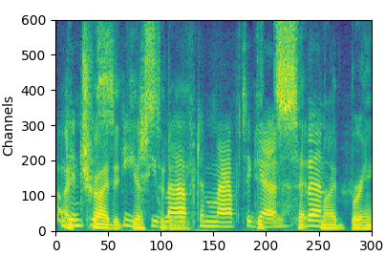

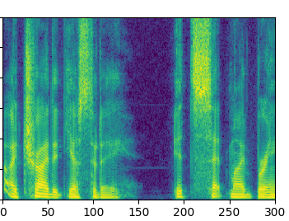
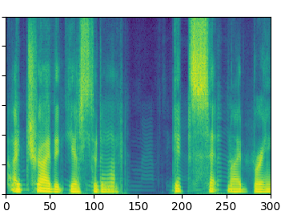
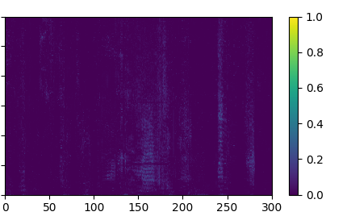
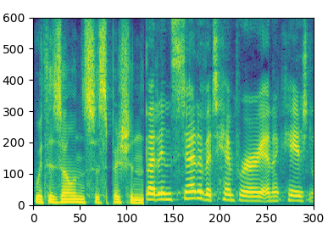
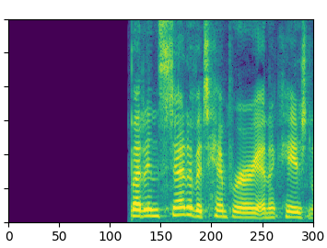
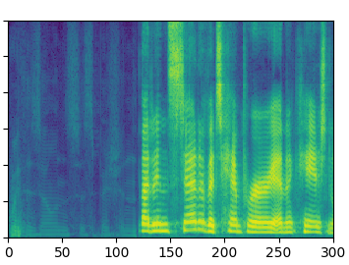
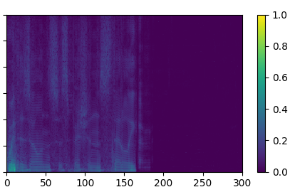
Mixed Audio
Expected Audio
Recorded Audio
Variance
Frequency bins (8 kHz / 600)
Time (10 ms)
Time (10 ms)

Slide 14
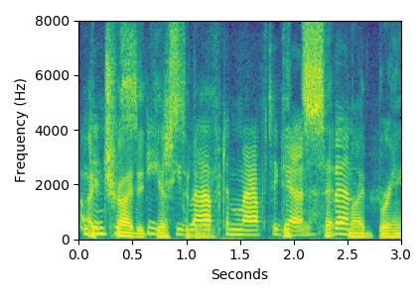
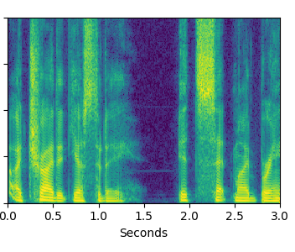
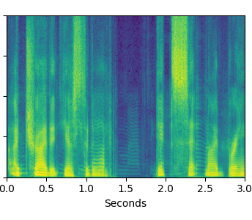
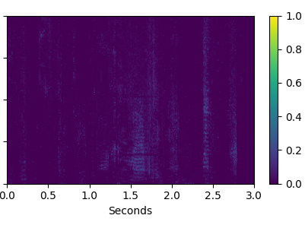
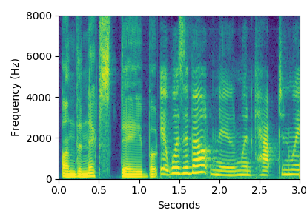
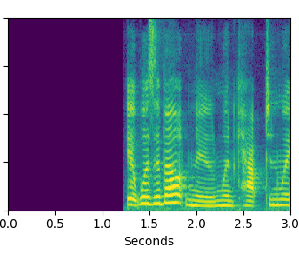
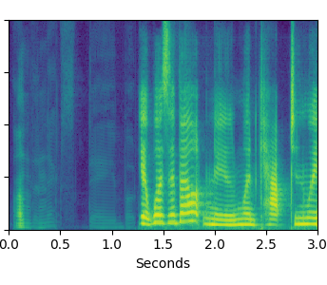
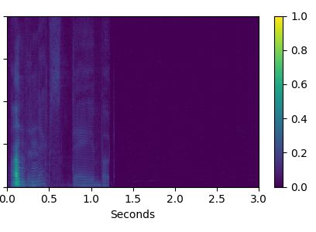
Mixed Audio
Expected Audio
Recorded Audio
Variance
Joint
Bob’s Focused Voice
1
Frequency bins (Hz)
Conversation
2
Bob’s Hidden Voice
Time (s)
Time (s)
Time (s)
Time (s)

Slide 15
Train Set
Test Set
Bob’s Focused Voice
Focus
Hide

Slide 16
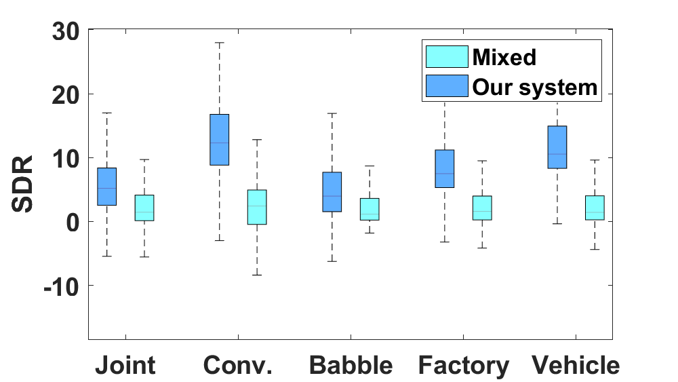
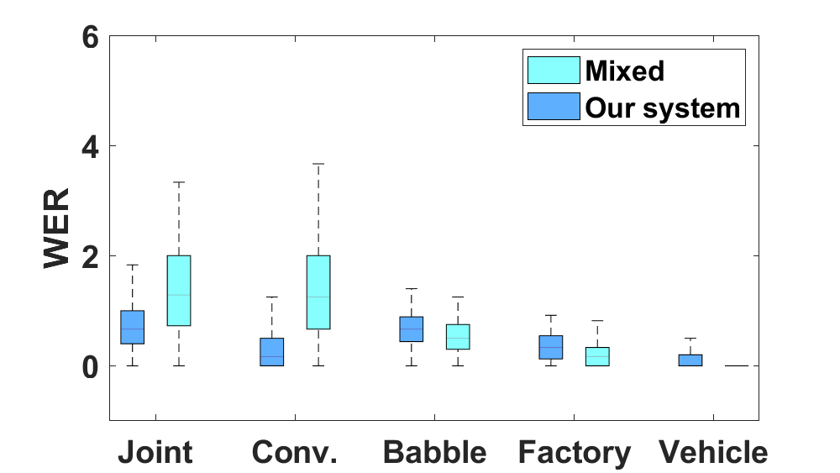
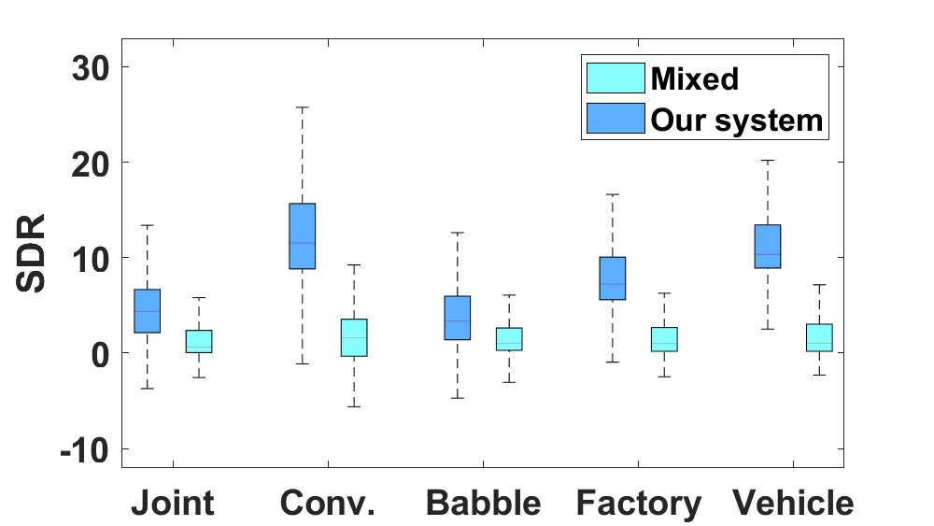
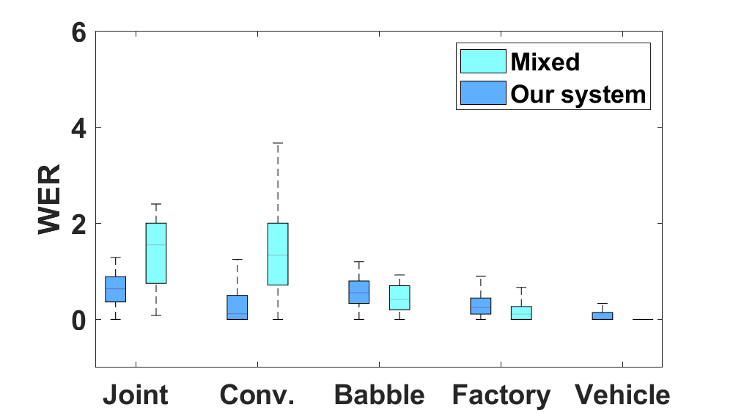
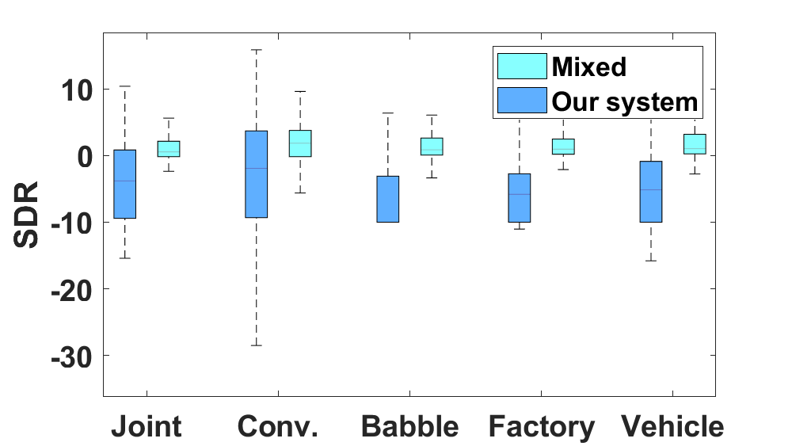
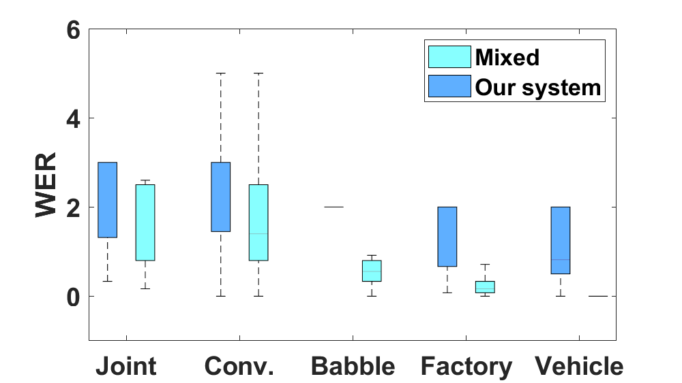
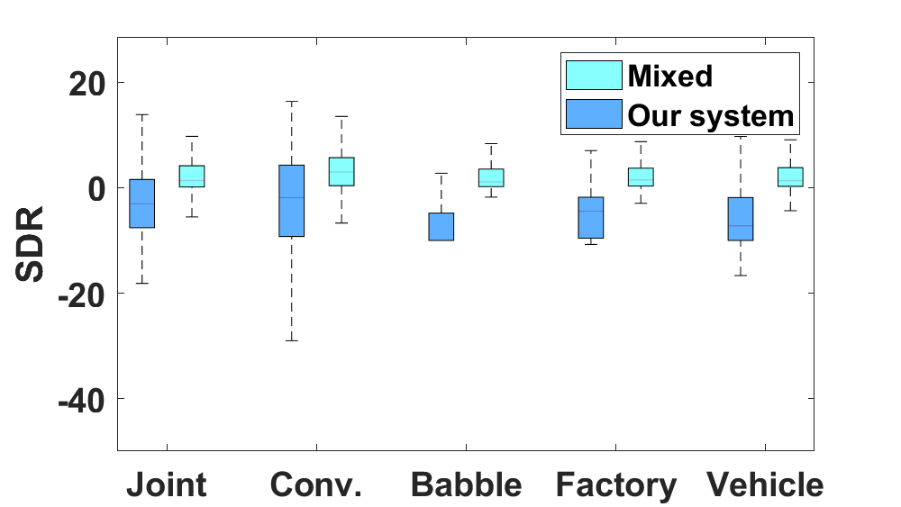
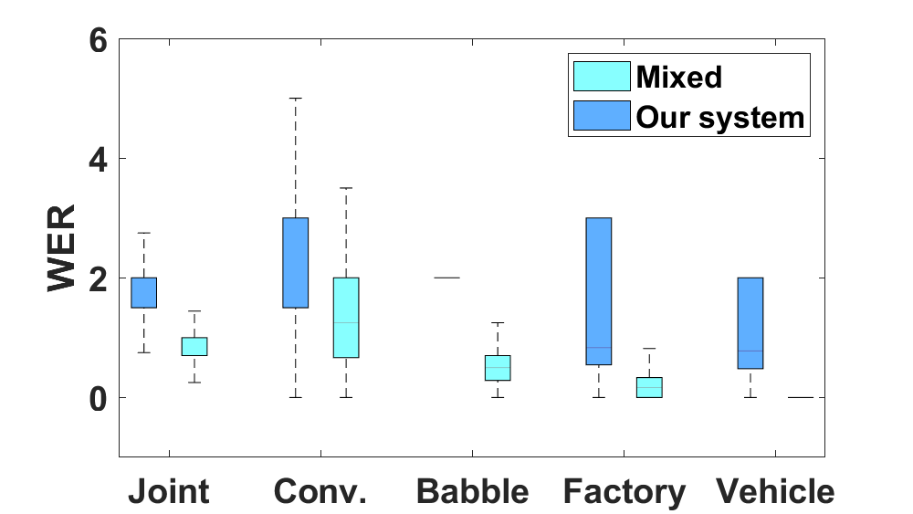
Test on Training Dataset
Test on Testing Dataset
To be Focused
To be Hidden

Slide 17
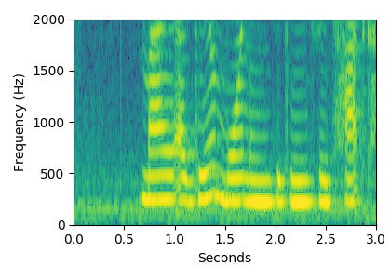
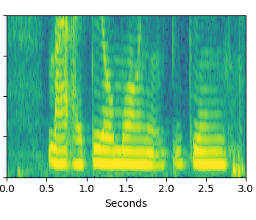
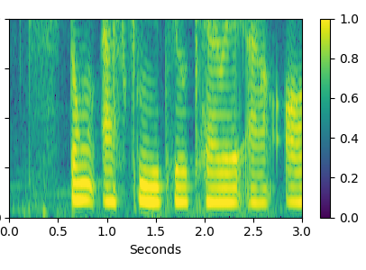
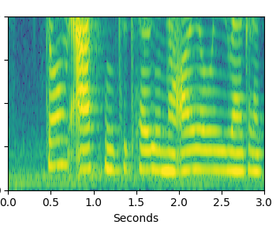
Speaker1 - Content1
Speaker1 - Content2
Speaker2 - Content1
Speaker2 - Content2
2
Frequency bins (Hz)
1
Time (s)
Time (s)
Time (s)
Time (s)

