Slide 1
V0
d-vector
LSTM
FCN
Feature
Mask
Reference
Audio
Speaker Encoder LSTM
CNN
Trainable
Voice Muter
Noise
Audio
Noise
Spectrogram
Masked
Spectrogram
Inverse
STFT
Purified
Audio
STFT
*
Clean
Audio
Clean
Spectrogram
Loss Function
STFT

Slide 2
d-vector
LSTM
FCN
Feature
Mask
Reference
Audio
Speaker Encoder LSTM
CNN
Trainable
Voice Muter
Noise
Audio
Noise
Spectrogram
Purified
Spectrogram
Inverse
STFT
Purified
Audio
STFT
*
Wireless
Channel
+
Denoised
Audio
Clean
Audio
Clean
Spectrogram
Loss Function
Denoised
Spectrogram
STFT
STFT

Slide 3
V1
d-vector
LSTM
FCN
Feature
Mask
Reference
Audio
Speaker Encoder LSTM
CNN
Trainable
Voice Muter
Noise
Audio
Noise
Spectrogram
Purified
Spectrogram
Inverse
STFT
Purified
Audio
STFT
*
Wireless
Channel
+
Denoised
Audio
Noise Audio
Clean
Spectrogram
Loss Function
Denoised
Spectrogram
-
STFT
STFT
Clean Audio

Slide 4
V2
Clean
Audio
Clean
Spectrogram
Loss Function
Denoised
Spectrogram
STFT
STFT
Denoised Audio
d-vector
LSTM
FCN
Inverse
STFT
Audio
Mask
+
Reference
Audio
Speaker Encoder LSTM
CNN
Trainable
Voice Muter
Noise
Audio
Noise
Spectrogram
Noise
Phase
STFT
Wireless Channel

Slide 5
V3
Noise
Spectrogram
d-vector
LSTM
FCN
Reference
Audio
Speaker Encoder LSTM
CNN
Trainable
Voice Muter
Inverse
STFT
Mixed
Audio
Mixed
Spectrogram
-
Purified
Spectrogram
STFT
Noise Audio
Wireless Channel
Clean
Audio
Clean
Spectrogram
Loss Function
-
STFT
Purified Audio

Slide 6
V3.1 - Focus User Case
Noise
Spectrogram
d-vector
LSTM
FCN
Reference
Audio
Speaker Encoder LSTM
CNN
Trainable
Voice Muter
Inverse
STFT
Mixed
Audio
Mixed
Spectrogram
Purified
Spectrogram
-
STFT
-
Noise Audio
Wireless Channel
Mixed Audio
Clean
Spectrogram
Loss Function
+
-
STFT
Clean Audio
Purified Audio

Slide 7
V3.2 - Hide User Case
Noise
Spectrogram
d-vector
LSTM
FCN
Reference
Audio
Speaker Encoder LSTM
CNN
Trainable
Voice Muter
Inverse
STFT
Mixed
Audio
Mixed
Spectrogram
+
Purified
Spectrogram
STFT
Noise Audio
Wireless Channel
Clean
Audio
Clean
Spectrogram
Loss Function
+
STFT
Purified Audio

Slide 8
V - final
d-vector
LSTM
FCN
Shadow
Spectrogram
Reference
Audio
Trainable
Voice Muter
Speaker Encoder LSTM
CNN
Inverse
STFT
Mixed
Audio
Mixed
Spectrogram
+
Recorded
Spectrogram
STFT
Shadow Audio
Wireless Channel
Expected
Audio
Expected
Spectrogram
Loss Function
+
STFT
Recorded Audio

Slide 9
V - final
Ground Truth
3
2
Expected
Audio
Expected
Spectrogram
Loss Function
Microphone
STFT
Recorded Audio
+
Mixed
Audio
Mixed
Spectrogram
+
Recorded
Spectrogram
Wireless Channel
STFT
Reference
Audio
Speaker Encoder
Speaker Selector
Shadow
Spectrogram
Inverse
STFT
Shadow
Audio
1
Shadow Audio Generator

Slide 10






Reference
Audio
Shadow
Audio
2
Smart IoT
Bob
Bob to be focused
Mixed
Audio
+
1
3
Others
Bob to be hidden

Slide 12

Reference
Audio
Mixed
Audio

Slide 13
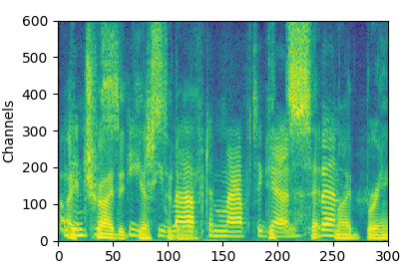

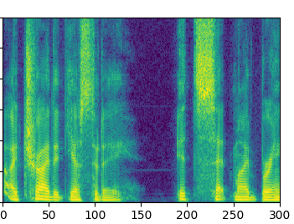
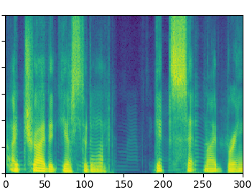
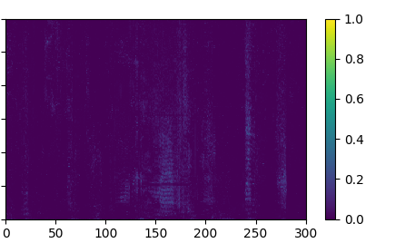
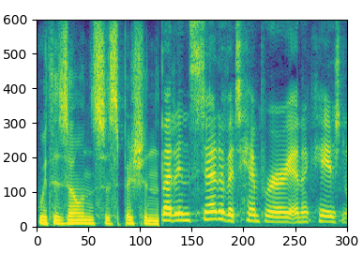
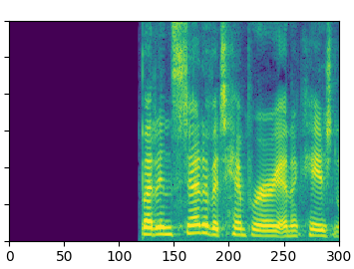
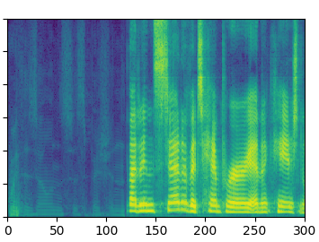
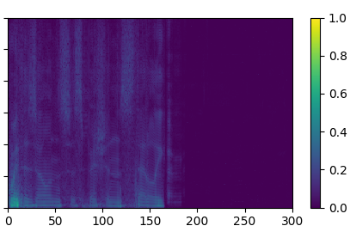
Mixed Audio
Expected Audio
Recorded Audio
Variance
Frequency bins (8 kHz / 600)
Time (10 ms)
Time (10 ms)

Slide 14
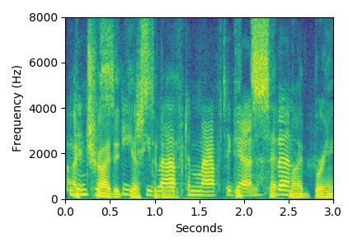
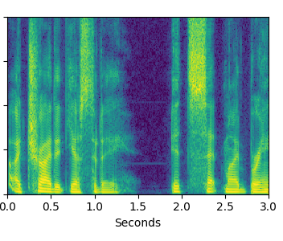
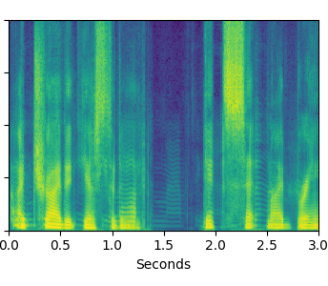
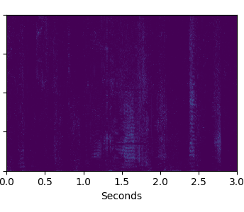
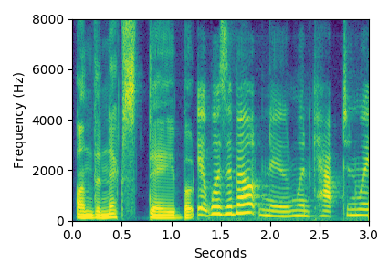
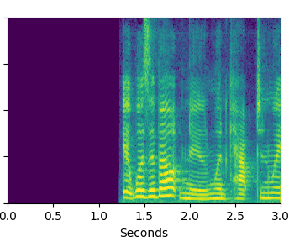
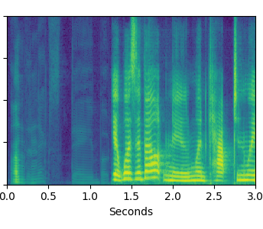
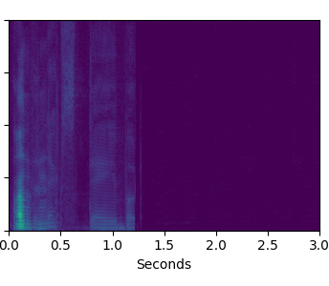
Mixed Audio
Expected Audio
Recorded Audio
Variance
Joint
Bob’s Focused Voice
1
Frequency bins (Hz)
Conversation
2
Bob’s Hidden Voice
Time (s)
Time (s)
Time (s)
Time (s)

Slide 15
Train Set
Test Set
Bob’s Focused Voice
Focus
Hide

Slide 16
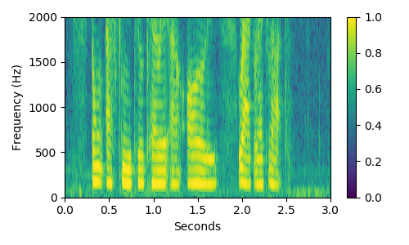
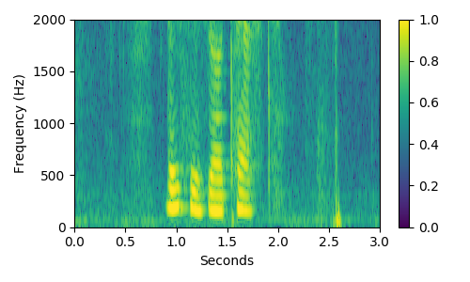
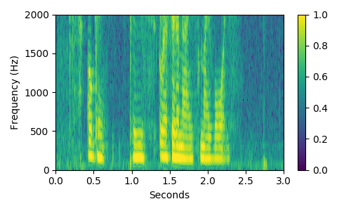
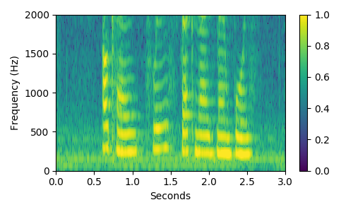
Speaker 1-1
Speaker 1-2
Speaker 1-3
Speaker 2-3

Slide 17
Mixed Audio
Expected Audio
Recorded Audio
Variance
Joint
Bob’s Focused Voice
1
Frequency bins (Hz)
Bob’s Hidden Voice
Time (s)
Time (s)
Time (s)
Time (s)

