Slide 1

CMPT 125
Introduction to Computing Science and Programming II
November 15, 2021

Slide 2
Assignment 4
Assignment 4 is due to November 19, 23:59
https://www.cs.sfu.ca/~ishinkar/teaching/fall21/cmpt125/assignments.html
You need to submit one file to Canvas – assignment4.c
Please make sure it compiles with the provided makefile
>> make
>> ./run_test4
Topics:
Stacks – using the provided API, without relying on the implementation details
Binary Trees
Q2 is probably the longest, but shouldn‘t take more than 50-60 lines

Slide 3
Midterm – Wednesday, Nov 17
Wednesday, Nov 17, during your lab
3 questions
50 minutes
You may use internet (but it might be more distracting than helpful)
Use your laptop or the CSIL machine
The grading will be on a CSIL machine
You will need to submit one file to Canvas. The name is one of the following
midterm0930.c, midterm1030.c, midterm1530.c, midterm1630.c
Please make sure it compiles with the provided makefile
>> make >> ./run_test

Slide 4
No lecture on Nov 17

Slide 5
Binary Search Trees

Slide 6
Binary Search Trees
A binary search tree (BST) is a binary tree with the following property:
For every node, the value in the node is greater or equal than the values in its left child and all its descendants.
For every node, the value in the node is smaller or equal than to the value in its right child and all its descendants.

Slide 7
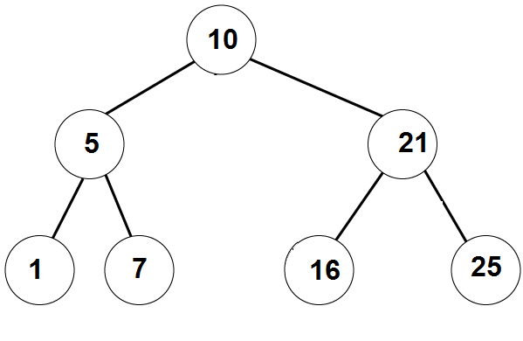
Binary Search Trees
Example 1:
A binary search tree can be balanced

Slide 8
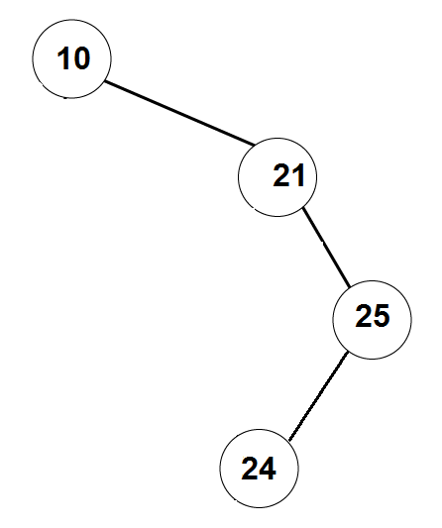
Binary Search Trees
Example 2:
binary search tree can be very skinny / unbalanced

Slide 9
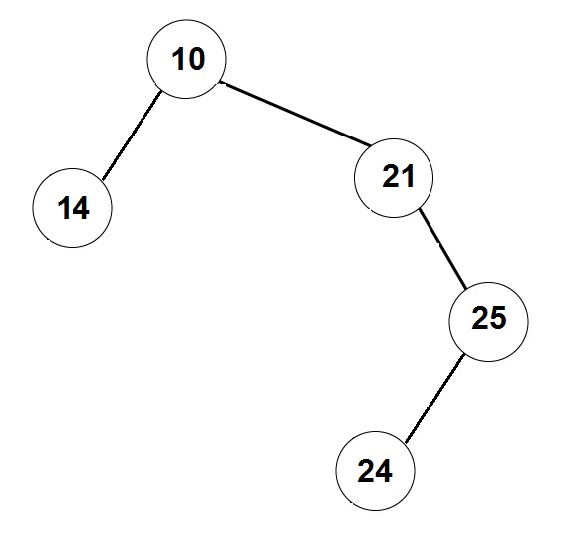
Not a Binary Search Tree

Slide 10
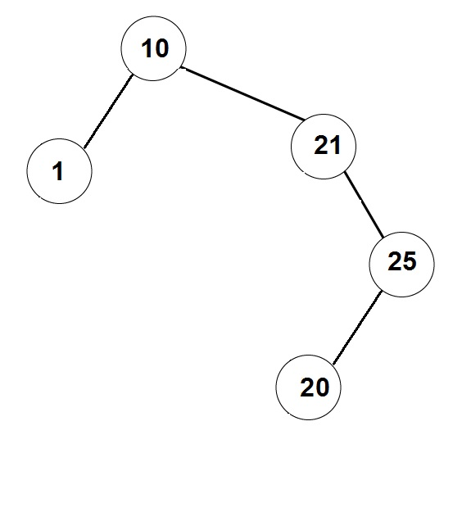
Not a Binary Search Tree

Slide 11
Binary Search Trees
Write a function that gets a binary search tree, and prints all the values sorted in the increasing order.
void print_sorted (BTnode_t* root) {
if ( root == NULL )
return;
print_sorted(root->left);
print(root->data);
print_sorted(root->right);
}
Observation: This is the InOrder traversal on the tree.

Slide 12
Binary Search Trees
Write a function that finds a given item in a BST (or returns NULL).
BTnode_t* find (BTnode_t* root, int item) {
if ( root == NULL )
return NULL;
if (root->data == item)
return root;
if ( root->data > item )
return find( root->left, item) ;
else // if ( root->data < item )
return find( root->right, item) ;
}
find( 7 )
Found

Slide 13
Binary Search Trees
The running time is: O(depth of the tree)
Write a function that finds a given item in a BST (or returns NULL).
BTnode_t* find (BTnode_t* root, int item) {
if ( root == NULL )
return NULL;
if (root->data == item)
return root;
if ( root->data > item )
return find( root->left, item) ;
else // if ( root->data < item )
return find( root->right, item) ;
}
find( 8 )
Not found

Slide 14
Binary Search Trees
Write an iterative function that finds a given item in a BST (or returns NULL)
BTnode_t* find (BTnode_t* root, int item) {
BTnode_t* current = root;
while ( current != NULL && current->data != item) {
if (current->data > item )
current = current->left;
else // current->data < item
current = current->right;
}
return current;
}
Running time: O(depth of the tree)
find( 16 )
Found

Slide 15
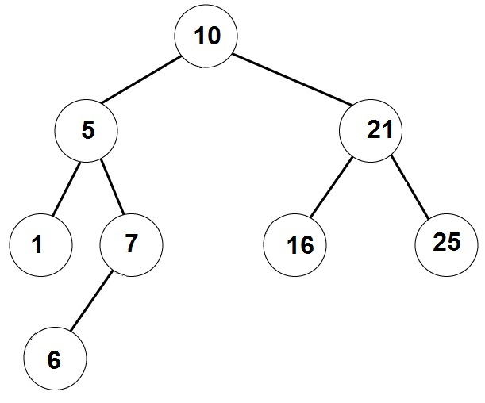
Binary Search Trees
Write a function that adds a given element to a binary search tree.
BTnode_t* add_item (binary_tree_t* tree, int item) {
// implement me
}
add_item( 6 )

Slide 16
Binary Search Trees
Create a Binary Search Tree from the following list of insertions:
List A: 4, 2, 6, 1, 3 , 5, 7
4
2
6
1
3
5
7

Slide 17
Binary Search Trees
Create a Binary Search Tree from the following list of insertions:
List B: 1, 2, 3, 4, 5, 6, 7
1
2
3
4
5
6
7

Slide 18
Binary Search Trees
Create a Binary Search Tree from the following list of insertions:
List C: 1, 2, 3, 7, 6, 5, 4
1
2
3
7
6
5
4

Slide 19
Binary Search Trees
Create a Binary Search Tree from the following list of insertions:
List D: 4, 1, 2, 5, 6, 7, 3
4
1
5
2
6
3
7

Slide 20
Removing an element from Binary Search Trees
Write a function that removes a given element from a BST
What if we want to remove an element that is not in the tree?
What if the remove element has no children?
What if the remove element has one child?
What if the remove element has two children?

Slide 21
Removing an element from Binary Search Trees
Step 1: Get a pointer to the node we want to remove
Removing a node with no children:
Just remove the vertex, and update its parent.
Removing a node with one child:
Update the parent to skip over the removed node, and point to its (unique) child.
Note that if the removed node is the root, then we should update the pointer to the root accordingly.

Slide 22
Remove node with no children
Remove (BST_t* tree, BTnode_t* node):
if (tree-> root == node)
tree->root = NULL;
else
if (node ->parent->left == node)
node ->parent->left = NULL;
else // node ->parent->right == node
node ->parent->right = NULL;
4
2
6
1
3
5
7
remove( 3 )

Slide 23
Remove node with one child
4
Remove (BST_t* tree, BTnode_t* node):
child = getChild(node);
if (tree->root == node)
root = child;
else
if (node->parent->left == node)
node->parent->left = child;
else // node->parent->right == node
node->parent->right = child;
3
5
6
2
1
7
remove( 3 )
remove( 6 )

Slide 24
Remove node with two children
remove( 4 )
Remove (BST_t* tree, BTnode_t* node)
next = find successor of node in the tree;
// next has ≤1 child
node->value = next->value;
Remove (tree, next);
4
2
6
1
3
5
5
7
Successor of 4 is 5

Slide 25
Remove node with two children
Remove (BST_t* tree, BTnode_t* node)
next = find successor of node in the tree;
node->value = next->value;
Remove (tree, next);
// assuming node has right child
find_successor(BST_t* tree, BTnode_t* node) {
find_min(node->right);
}
// assuming node != NULL
find_min(BTnode_t* node) {
BTnode_t* current = node;
while (current ->left != NULL)
current = current->left
return current
}

Slide 26
Balancing a BST

Slide 27
Balancing the tree
How can we make sure that the tree is balanced?
A possible solution: have a function BST_balance(BST_t*)
that creates an equivalent balanced tree.
balance()
create a sorted array with all the values in the tree
this is done using inOrder traversal
create a new tree from the array

Slide 28
Creating a balanced tree from a sorted array
Idea:
1) Set the median to be the root
2) Construct left and right subtrees recursively.
addArrayToTree ( array , first , last )
if first <= last
mid = (first+last)/2
tree.add( array[mid] )
addArrayToTreeAsLeftSubtree ( array , first , mid-1 )
addArrayToTreeAsRightSubtree ( array , mid+1 , last )

Slide 29
Balancing the tree
Disadvantages of the solution using BST_balance()
Add responsibility to the user to invoke BST_balance()
The user will need to wait linear time in every invocation of BST_balance.
A better solution would be to have a self-balancing tree that is makes sure the tree is balanced after each modification (add/remove)
AVL trees
RedBlack trees
2-3 trees
Not in scope for this course. Wait for CMPT 225

Slide 30
Practice Problems

Slide 31
Practice problem 1
Create a Binary Search Tree from the following list of insertions:
List: 4, 2, 8, 1, 3 , 6, 5, 9, 10, 7
Remove 5 from the tree
Remove 9 from the tree
Remove 4 from the tree
4
2
8
3
6
1
6
9
5
7
10

Slide 32
Practice problem 2
Write an algorithm that gets a PreOrder traversal of a BST, and returns the tree. Prove that such BST is unique.
Example: Suppose the PreOrder is: 6,4,3,1,5,9,8,7. What is the BST?
Root=6
Left subtree of 6: [4,3,1,5] - elts<6
The root is 4. Left = [3 1] Right = [5]
Look at [3,1] – 3 is the root, 1 is on the left
Right subtree of 6 is [9,8,7] – elts>6
9 is the root [8,7] are both on the left
[8,7]: 8 is the root and 7 is on the left
6
4
9
3
5
8
1
7

Slide 33
Practice problem 3
Add to the BST a feature that allows for each node to get the size of the subtree under it in O(1) time.
The running time of the other operations should be
Find – O(depth of the tree)
Insert – O(depth of the tree)
Remove – O(depth of the tree)
getSize – O(1)
A: (1) add a field size to the struct BTnode
(2) maintain size for all nodes in each operation. Try it!
For example, insert updates the size of all ancestors of the new node.

Slide 34
Practice problem 4
Write a non-recursive algorithm that prints PreOrder traversal of a binary tree.
PreOrder(root):
s = create stack of nodes
s.push(root)
While s is not empty:
node = s.pop()
printf(node->value
if (node->right != NULL)
s.push(node->right)
if (node->left != NULL)
s.push(node->left)

Slide 35
Practice problem 4
Write a non-recursive algorithm that prints PreOrder traversal of a binary tree.
PreOrder(root):
s = create stack of nodes
s.push(root)
While s is not empty:
node = s.pop()
printf(node->value)
if (node->right != NULL)
s.push(node->right)
if (node->left != NULL)
s.push(node->left)
10
5
21
1
7
21
7
21
21
16
25
25

Slide 36
Practice problem 4
Write a non-recursive algorithm that prints PreOrder traversal of a binary tree.
PreOrder(root):
s = create stack of nodes
s.push(root)
While s is not empty:
node = s.pop()
printf(node->value)
if (node->right != NULL)
s.push(node->right)
if (node->left != NULL)
s.push(node->left)
Implement this algorithm!
What if we replace the stack with a queue?

Slide 37
Practice problem 4
BreadthFirstSearch(root):
q = create queue of nodes
q.enqueue(root)
while q is not empty:
node = q.dequeue()
printf(node->value)
if (node->left != NULL)
q.enqueue(node->left)
if (node->right != NULL)
q.enqueue(node->right)
Print 10
Print 5
Print 21
Print 1
Print 7
Print 16
Print 25
10
5 | 21
21 | 1 | 7
1 | 7 | 16 | 25
7 | 16 | 25
16 | 25
Implement this algorithm!
25

Slide 38
Practice problem 4
BreadthFirstSearch(root):
q = create queue of nodes
q.enqueue(root)
while q is not empty:
node = q.dequeue()
printf(node->value)
if (node->left != NULL)
q.enqueue(node->left)
if (node->right != NULL)
q.enqueue(node->right)
These algorithms have applications to
Exploring unknown territory Finding shortest paths
Some AI tasks Solving puzzles

Slide 39
Questions?
Comments?

