Slide 1

CMPT 125
Introduction to Computing Science and Programming II
November 3, 2021

Slide 2
A comment on recursion

Slide 3
Comment on recursion
How is recursion really implemented inside?
What happens when we make a recursive call?
Wrong answer: my laptop delegates the subtask to other laptops.
Correct answer: the subtask is added on execution stack:
The order in which the functions are called,
Where to return after the function ends
All the local variables of the function
In particular, any recursive function can be implemented non-recursively using stack.

Slide 4
Comment on recursion
Thumb rules for writing recursion:
Base case: if the problem minimal/not decomposable, solve the problem directly. Checking it should be (typically) the first line of the function.
Examples: empty array / n=0 / index out of bounds
Induction case: decompose the problem into one or more similar, STRICTLY smaller sub-problems.
Examples: apply induction on first half of the array, then on the second half of the array apply induction on n-1…
BAD IDEAS: do not use static/global variables in recursion.
These are bad practice, and very hard to follow
Often fails if the function is invoked several times.
While we are on the subject

Slide 5


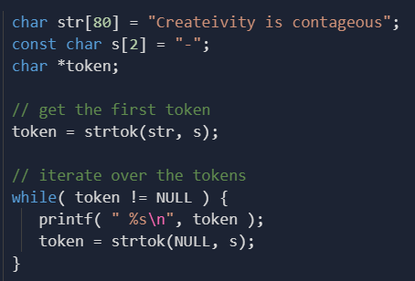
While we are on the subject
Do not use global variables.
Only exceptions: global constants
Do not use static variables.
Only exceptions: when we need a shared state for objects/functions
In particular, do not use strtok()
Ever!
strtok() uses static variable inside.
Why is the first call strtok(str, s) and then strtok(NULL, s)?
Looks very suspicious.
It uses static variable to remember the previous call.
In general, only use library functions you can write yourself.

Slide 6
Comment on recursion
Any recursive function can be implemented non-recursively using stack.
Example:
Quick sort( A[0… N-1] )
pivot_ind = rearrange(A, N)
Quick sort( A[0…pivot_ind-1] )
Quick sort( A[pivot_ind+1… N-1))
Implement this without using recursion.

Slide 7
Quick sort without using recursion
Quick sort( A[0… N-1] ) {
// s will contain the indices of subarrays that we need to be sorted s = create_stack(); // stack of pairs of indices
stack_push(s, (pair){0 , N-1});
while (s is not empty) {
( i , j ) = stack_pop(s);
pivot_ind = rearrange( A[i…j], pivot_ind); //
if (pivot_ind+1 < j) stack_push(s, (pair){pivot_ind+1 , j});
if (i < pivot_ind-1) stack_push(s, (pair){i , pivot_ind-1} );
}
}
Homework: run this algorithm on several examples of arrays
In each step follow the state of the array and the state of the stack

Slide 8
Quick sort without using recursion
Rearrange
[2,1] →
[1,2]
Rearrange
[3,1,4,2]→
[2,1,3,4]
Rearrange
[5,3,1,7,2,4,8] →
[2,3,1,4,5,7,8]
Sort [1]
Rearrange
[7,8] →
[7,8]
Sort [2,1]
Sort []
Sort [2,3,1,4]
Sort [4]
Sort [4]
Sort []
Sort [5,3,1,7,2,4,8]
Sort [7,8]
Sort [7,8]
Sort [7,8]
Sort [8]

Slide 9
Questions?
Comments?

