Slide 1

CMPT 125
Introduction to Computing Science and Programming II
November 10, 2021

Slide 2
Assignment 4
Assignment 4 is due to November 19, 23:59
https://www.cs.sfu.ca/~ishinkar/teaching/fall21/cmpt125/assignments.html
You need to submit one file to Canvas – assignment4.c
Please make sure it compiles with the provided makefile
>> make
>> ./run_test4
Topics:
Stacks – using the provided API, without relying on the implementation details
Binary Trees

Slide 3
Today
More on Binary Trees
Binary Search Trees

Slide 4
Binary Trees

Slide 5
Binary Trees
An m-ary tree is a tree in which each vertex has at most m children.
This course: focus on binary trees: 2-ary trees.

Slide 6
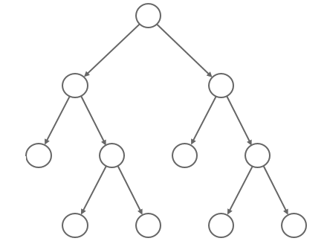
Binary Trees
Structure of rooted trees
Parent
Vertex/node
Left child
Right child

Slide 7
Traversing Binary Trees

Slide 8
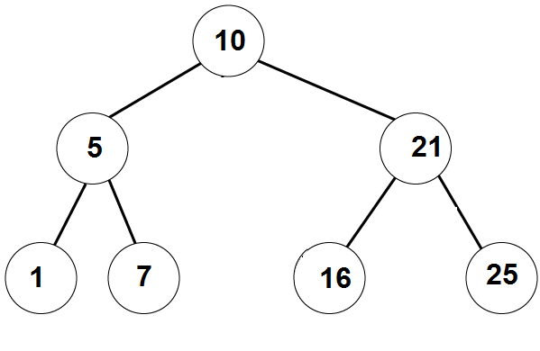
Traversing Binary Trees
InOrder traversal:
First visit the left subtree,
Then the root,
Then the right subtree.
Example:
__left___ 10, __right__
__,5,__, 10, ___ 21 __
1, 5, 7, 10, 16, 21, 25
Answer: [1,5,7,10,16,21,25]

Slide 9
Traversing Binary Trees
PreOrder traversal:
First visit the root,
Then the left subtree,
Then the right subtree.
Example:
10, __left__, ___right___
10, 5,_left_, _right_, 21, left_,right_
10, 5, 1, 7, 21, 16, 25
Answer: [10,5,1,7,21,16,25]

Slide 10
Traversing Binary Trees
PostOrder traversal:
First visit the left subtree,
Then the right subtree.
Then the root
Example:
__left__, ___right_, 10
_left_, right_, 5, _left_, _right_,21, 10
1, 7, 5, 16, 25, 21, 10
Answer: [1,7,5,16,25,21,10]

Slide 11
PreOrder traversal algorithm
// prints the tree in PreOrder
PreOrderTraversal (BTnode root):
If root==NULL
1.1 do nothing
Else
2.1 print( root.data )
2.2 PreOrderTraversal (root.left)
2.3 PreOrderTraversal(root.right)
Running time:
O(n) where n = size of the tree
Because each vertex is processed exactly once.
Q:Change the algorithm to get the InOrder/PostOrder traversal

Slide 12
Breadth First Search

Slide 13
Tree traversal – non-recursive
Write a non-recursive algorithm that prints PreOrder traversal of a binary tree.
PreOrder(root):
s = create stack of nodes
s.push(root)
While s is not empty:
node = s.pop()
printf(node->value
if (node->right != NULL)
s.push(node->right)
if (node->left != NULL)
s.push(node->left)

Slide 14
Tree traversal – non-recursive
Write a non-recursive algorithm that prints PreOrder traversal of a binary tree.
PreOrder(root):
s = create stack of nodes
s.push(root)
While s is not empty:
node = s.pop()
printf(node->value)
if (node->right != NULL)
s.push(node->right)
if (node->left != NULL)
s.push(node->left)
10
5
21
1
7
21
7
21
21
16
25
25

Slide 15
Tree traversal – non-recursive
Write a non-recursive algorithm that prints PreOrder traversal of a binary tree.
PreOrder(root):
s = create stack of nodes
s.push(root)
While s is not empty:
node = s.pop()
printf(node->value)
if (node->right != NULL)
s.push(node->right)
if (node->left != NULL)
s.push(node->left)
Implement this algorithm!
What if we replace the stack with a queue?

Slide 16
Breadth First Search
BreadthFirstSearch(root):
q = create queue of nodes
q.enqueue(root)
while q is not empty:
node = q.dequeue()
printf(node->value)
if (node->left != NULL)
q.enqueue(node->left)
if (node->right != NULL)
q.enqueue(node->right)
Print 10
Print 5
Print 21
Print 1
Print 7
Print 16
Print 25
10
5 | 21
21 | 1 | 7
1 | 7 | 16 | 25
7 | 16 | 25
16 | 25
Implement this algorithm!
25

Slide 17
Breadth First Search
BreadthFirstSearch(root):
q = create queue of nodes
q.enqueue(root)
while q is not empty:
node = q.dequeue()
printf(node->value)
if (node->left != NULL)
q.enqueue(node->left)
if (node->right != NULL)
q.enqueue(node->right)
These algorithms have applications to
Exploring unknown territory Finding shortest paths
Some AI tasks Solving puzzles

Slide 18
Binary Search Trees

Slide 19
Binary Search Trees
A binary search tree (BST) is a binary tree with the following property:
For every node, the value in the node is greater or equal than the values in its left child and all its descendants.
For every node, the value in the node is smaller or equal than to the value in its right child and all its descendants.

Slide 20
Binary Search Trees
Example 1:
A binary search tree can be balanced

Slide 21
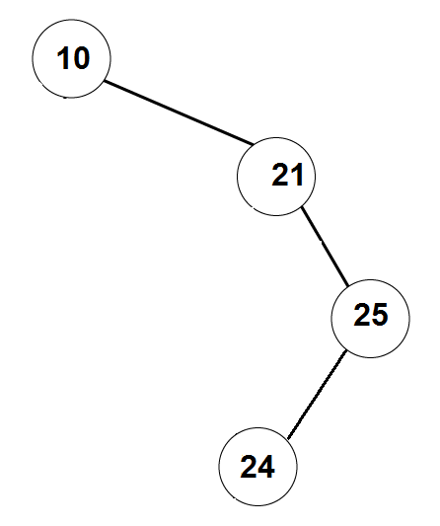
Binary Search Trees
Example 2:
binary search tree can be very skinny / unbalanced

Slide 22
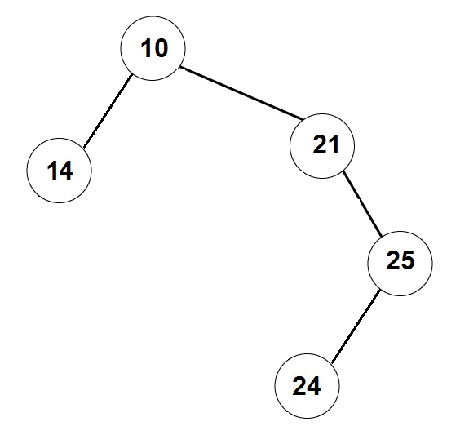
Not a Binary Search Tree

Slide 23
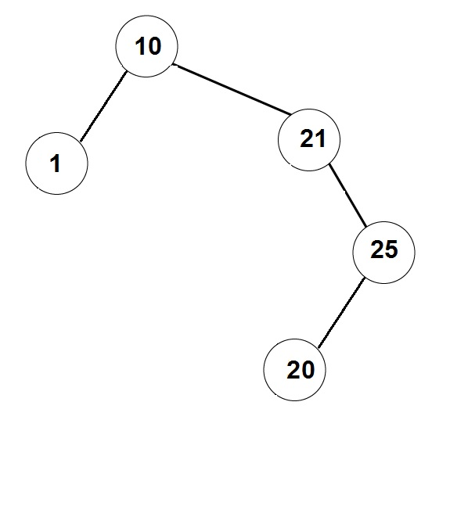
Not a Binary Search Tree

Slide 24
Binary Search Trees
Write a function that gets a binary search tree, and prints all the values sorted in the increasing order.
void print_sorted (BTnode_t* root) {
if ( root == NULL )
return;
print_sorted(root->left);
print(root->data);
print_sorted(root->right);
}
Observation: This is the InOrder traversal on the tree.

Slide 25
Binary Search Trees
Write a function that finds a given item in a BST (or returns NULL).
BTnode_t* find (BTnode_t* root, int item) {
if ( root == NULL )
return NULL;
if (root->data == item)
return root;
if ( root->data > item )
return find( root->left, item) ;
else // if ( root->data < item )
return find( root->right, item) ;
}
find( 7 )
Found

Slide 26
Binary Search Trees
The running time is: O(depth of the tree)
Write a function that finds a given item in a BST (or returns NULL).
BTnode_t* find (BTnode_t* root, int item) {
if ( root == NULL )
return NULL;
if (root->data == item)
return root;
if ( root->data > item )
return find( root->left, item) ;
else // if ( root->data < item )
return find( root->right, item) ;
}
find( 8 )
Not found

Slide 27
Binary Search Trees
Write an iterative function that finds a given item in a BST (or returns NULL)
BTnode_t* find (BTnode_t* root, int item) {
BTnode_t* current = root;
while ( current != NULL && current->data != item) {
if (current->data > item )
current = current->left;
else // current->data < item
current = current->right;
}
return current;
}
Running time: O(depth of the tree)
find( 16 )
Found

Slide 28
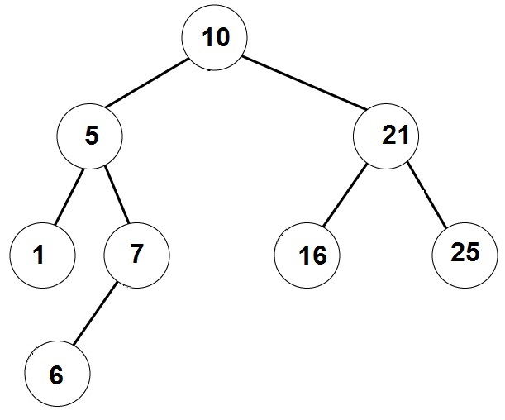
Binary Search Trees
Write a function that adds a given element to a binary search tree.
BTnode_t* add_item (binary_tree_t* tree, int item) {
// implement me
}
add_item( 6 )

Slide 29
Binary Search Trees
Create a Binary Search Tree from the following list of insertions:
List A: 4, 2, 6, 1, 3 , 5, 7
4
2
6
1
3
5
7

Slide 30
Binary Search Trees
Create a Binary Search Tree from the following list of insertions:
List B: 1, 2, 3, 4, 5, 6, 7
1
2
3
4
5
6
7

Slide 31
Binary Search Trees
Create a Binary Search Tree from the following list of insertions:
List C: 1, 2, 3, 7, 6, 5, 4
1
2
3
7
6
5
4

Slide 32
Binary Search Trees
Create a Binary Search Tree from the following list of insertions:
List D: 4, 1, 2, 5, 6, 7, 3
4
1
5
2
6
3
7

Slide 33
Removing an element from Binary Search Trees
Write a function that removes a given element from a BST
What if we want to remove an element that is not in the tree?
What if the remove element has no children?
What if the remove element has one child?
What if the remove element has two children?

Slide 34
Removing an element from Binary Search Trees
Step 1: Get a pointer to the node we want to remove
Removing a node with no children:
Just remove the vertex, and update its parent.
Removing a node with one child:
Update the parent to skip over the removed node, and point to its (unique) child.
Note that if the removed node is the root, then we should update the pointer to the root accordingly.

Slide 35
Remove node with no children
Remove (BST_t* tree, BTnode_t* node):
if (tree-> root == node)
tree->root = NULL;
else
if (node ->parent->left == node)
node ->parent->left = NULL;
else // node ->parent->right == node
node ->parent->right = NULL;
4
2
6
1
3
5
7
remove( 3 )

Slide 36
Remove node with one child
4
Remove (BST_t* tree, BTnode_t* node):
child = getChild(node);
if (tree->root == node)
root = child;
else
if (node->parent->left == node)
node->parent->left = child;
else // node->parent->right == node
node->parent->right = child;
3
5
6
2
1
7
remove( 3 )
remove( 6 )

Slide 37
Remove node with two children
remove( 4 )
Remove (BST_t* tree, BTnode_t* node)
next = find successor of node in the tree;
// next has ≤1 child
node->value = next->value;
Remove (tree, next);
4
2
6
1
3
5
5
7
Successor of 4 is 5

Slide 38
Remove node with two children
Remove (BST_t* tree, BTnode_t* node)
next = find successor of node in the tree;
node->value = next->value;
Remove (tree, next);
// assuming node has right child
find_successor(BST_t* tree, BTnode_t* node) {
find_min(node->right);
}
// assuming node != NULL
find_min(BTnode_t* node) {
BTnode_t* current = node;
while (current ->left != NULL)
current = current->left
return current
}

Slide 39
Balancing a BST

Slide 40
Balancing the tree
How can we make sure that the tree is balanced?
A possible solution: have a function BST_balance(BST_t*)
that creates an equivalent balanced tree.
balance()
create a sorted array with all the values in the tree
this is done using inOrder traversal
create a new tree from the array

Slide 41
Creating a balanced tree from a sorted array
Idea:
1) Set the median to be the root
2) Construct left and right subtrees recursively.
addArrayToTree ( array , first , last )
if first <= last
mid = (first+last)/2
tree.add( array[mid] )
addArrayToTreeAsLeftSubtree ( array , first , mid-1 )
addArrayToTreeAsRightSubtree ( array , mid+1 , last )

Slide 42
Balancing the tree
Disadvantages of the solution using BST_balance()
Add responsibility to the user to invoke BST_balance()
The user will need to wait linear time in every invocation of BST_balance.
A better solution would be to have a self-balancing tree that is makes sure the tree is balanced after each modification (add/remove)
AVL trees
RedBlack trees
2-3 trees
Not in scope for this course. Wait for CMPT 225

Slide 43
Practice Problems

Slide 44
Practice problem 1
Create a Binary Search Tree from the following list of insertions:
List: 4, 2, 8, 1, 3 , 6, 5, 9, 10, 7
Remove 5 from the tree
Remove 9 from the tree
Remove 4 from the tree
4
2
8
3
6
1
6
9
5
7
10

Slide 45
Practice problem 2
Write an algorithm that gets a PreOrder traversal of a BST, and returns the tree. Prove that such BST is unique.
Example: Suppose the PreOrder is: 6,4,3,1,5,9,8,7. What is the BST?
Root=6
Left subtree of 6: [4,3,1,5] - elts<6
The root is 4. Left = [3 1] Right = [5]
Look at [3,1] – 3 is the root, 1 is on the left
Right subtree of 6 is [9,8,7] – elts>6
9 is the root [8,7] are both on the left
[8,7]: 8 is the root and 7 is on the left
6
4
9
3
5
8
1
7

Slide 46
Practice problem 3
Add to the BST a feature that allows for each node to get the size of the subtree under it in O(1) time.
The running time of the other operations should be
Find – O(depth of the tree)
Insert – O(depth of the tree)
Remove – O(depth of the tree)
getSize – O(1)
A: (1) add a field size to the struct BTnode
(2) maintain size for all nodes in each operation. Try it!
For example, insert updates the size of all ancestors of the new node.

Slide 47
Practice problem 4
Write a non-recursive algorithm that prints PreOrder traversal of a binary tree.
PreOrder(root):
s = create stack of nodes
s.push(root)
While s is not empty:
node = s.pop()
printf(node->value
if (node->right != NULL)
s.push(node->right)
if (node->left != NULL)
s.push(node->left)

Slide 48
Practice problem 4
Write a non-recursive algorithm that prints PreOrder traversal of a binary tree.
PreOrder(root):
s = create stack of nodes
s.push(root)
While s is not empty:
node = s.pop()
printf(node->value)
if (node->right != NULL)
s.push(node->right)
if (node->left != NULL)
s.push(node->left)
10
5
21
1
7
21
7
21
21
16
25
25

Slide 49
Practice problem 4
Write a non-recursive algorithm that prints PreOrder traversal of a binary tree.
PreOrder(root):
s = create stack of nodes
s.push(root)
While s is not empty:
node = s.pop()
printf(node->value)
if (node->right != NULL)
s.push(node->right)
if (node->left != NULL)
s.push(node->left)
Implement this algorithm!
What if we replace the stack with a queue?

Slide 50
Practice problem 4
BreadthFirstSearch(root):
q = create queue of nodes
q.enqueue(root)
while q is not empty:
node = q.dequeue()
printf(node->value)
if (node->left != NULL)
q.enqueue(node->left)
if (node->right != NULL)
q.enqueue(node->right)
Print 10
Print 5
Print 21
Print 1
Print 7
Print 16
Print 25
10
5 | 21
21 | 1 | 7
1 | 7 | 16 | 25
7 | 16 | 25
16 | 25
Implement this algorithm!
25

Slide 51
Practice problem 4
BreadthFirstSearch(root):
q = create queue of nodes
q.enqueue(root)
while q is not empty:
node = q.dequeue()
printf(node->value)
if (node->left != NULL)
q.enqueue(node->left)
if (node->right != NULL)
q.enqueue(node->right)
These algorithms have applications to
Exploring unknown territory Finding shortest paths
Some AI tasks Solving puzzles

Slide 52
Questions?
Comments?

