Slide 1

CMPT 125
Introduction to Computing Science and Programming II
November 1, 2021

Slide 2
In lab exam: Wednesday, Nov 17
Wednesday, Nov 17, 2021.
50 minutes during your lab section
Open books, internet (I don’t recommend this, takes too much time)
No talking to each other.
You can use your laptop if you want
The grading will be done on CSIL machine
You will need to write 3 functions, and submit your code.
Similar format to homework assignments
Practice problems on piazza

Slide 3
Stack

Slide 4

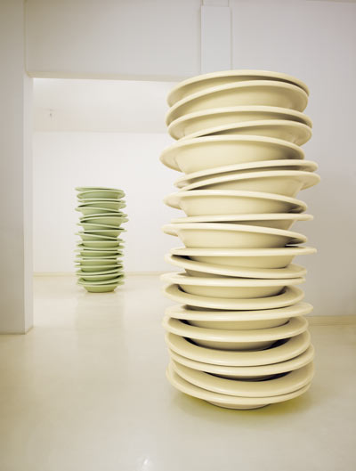

Stack
A stack: an ordered collection of items with the following operations:
push(item): add an item to the stack
pop(): remove an item from the stack, and return its value
isEmpty(): checks if the stack is empty
Removal follows a last-in-first-out order (LIFO)

Slide 5
Stack
A stack: an ordered collection of items with the following operations:
push(item): add an item to the stack
pop(): remove an item from the stack, and return its value
isEmpty(): checks if the stack is empty
Removal follows a last-in-first-out order (LIFO)
init()
push(3)
push(5)
pop() -- returns 5
push(1)
push(3)
3
1
3
3
3
5
3
1
3

Slide 6
Implementing Stack
Question: How would you implement Stack?
We saw an implementation using arrays:
arr[0] is the bottom
int size – points to the top of the stack
need to realloc when reaching capacity

Slide 7
Queue

Slide 8
Queue
A queue: an ordered collection of items with the following operations:
create(): creates a new queue
enqueue(item): add an item to the queue
dequeue(): remove an item from the queue
isEmpty(): checks if the stack is queue
Removal follows a first-in-first-out order (FIFO)
There is no bound on the number of element in the set
Question: How would you implement Queue?

Slide 9
Queue - implementation
Use array:
Create Queue:
Create an array + pointer to end of the list
Enqueue
Add the element in the end of the list
Dequeue
Remove the element from the 0 position
Note that dequeue() is very inefficient!
why?
because need to shift everything to the left
1 | 2 | 4 | 5
Tail

Slide 10
Queue – a better implementation
Head
Use array:
Create Queue:
Create an array + 2 pointers: one to the head, and one to the tail of the list
Enqueue
Add the element in the tail, update the tail
Dequeue
Remove the element from the head, update the head
 | 2 | 4 | 5
Tail

Slide 11
Queue – a better implementation
Init() [_, _, _, _, _, _, _, _] head=0, tail=0
Enqueue(1) [1, _, _, _, _, _, _, _] head=0, tail=1
Enqueue(2) [1,2, _, _, _, _, _, _] head=0, tail=2
Enqueue(2) [1,2, 3, _, _, _, _, _] head=0, tail=3
Dequeue() [1, 2, 3, _, _, _, _, _] head=1, tail=2
Returns 1

Slide 12
Queue – a better implementation
Q1: What if the tail reaches the end of the array?
Should we increase capacity?
Q2: What if part of the array is not used because the head moved too?
A: Move the indices cyclically
Q3: What happens when tail = head-1?
A: We should increase capacity.

Slide 13
Queue – a better implementation
Example: [_, _, _, _, _, 6, 7,_] head=5, tail=7
Enqueue(8) [_, _, _, _, _, 6, 7,8] head=5, tail=0
Enqueue(9) [9, _, _, _, _, 6, 7,8] head=5, tail=1
…
Enqueue(13) [9,10, 11,12, 13, 6, 7,8] head=5, tail=5
Enqueue(14) ---- Increase capacity

Slide 14
Queue
Homework: Implement Queue using each of the two ideas.
Idea 1 (returning arr[0]) is not for grading
Idea with two pointers is in your HW3

Slide 15
Linked List

Slide 16
Linked List
Linked List is a collection of separate elements, where each element is linked to the one following it in the list.
Think of it as a chain of elements.
1
2
3
4

Slide 17
Linked List
The list has a head. This is just the pointer to the first element.
Each element is linked to the following one.
The last element points to NULL.
How would you implement this?
Pointer to next element
Head
1
2
3
4
End of list

Slide 18
Linked List - implementation
struct node{ int data; struct node * next; };
typedef struct node node_t;
node_t x1; x1.data = 5;
x1.next = NULL;
node_t x2; x2.data = 7;
x1.next = &x2;
x2.next=NULL;
5
7

Slide 19
Linked List - implementation
struct node{ int data; struct node * next; };
typedef struct node node_t;
typedef struct { struct node_t *head; } LL_t;
LL_t* LLcreate();
void LL_add_to_head(LL_t* list, int data);
…

Slide 20
Linked List – add to head
LL_add_to_head(LL_t* list, int value) {
node_t* newNode = create_new_node(value);
newNode->next = list->head;
list->head = newNode;
Head
1
2
3
4
5

Slide 21
Linked List
typedef struct { struct node_t *head; } LL_t;
Q: What if we want to add an element to the tail of the list?
Head
`
`
`
`
`

Slide 22
Linked List
What operations can we perform on LinkedList?
Add a new element at the front
Add a new element at the end
Insert an element after a specific node
Remove a given node
Find element
Return element in a specified index
Get size

Slide 23
Linked List - implementation
typedef struct { struct node_t *head; struct node_t *tail; } LL_t;
void LL_add_to_head(LL_t* list, int data);
void LL_add_to_tail(LL_t* list, int data);
int LL_remove_from_head(LL_t* list);
int LL_remove_from_tail(LL_t* list);
int LL_size(LL_t* list);

Slide 24
Linked List – add to head
LL_add_to_head(LL_t* list, int value) {
node_t* newNode = create_new_node(value);
newNode->next = list->head;
list->head = newNode;
Are we done?
Head
Tail
1
2
3
4
5

Slide 25
Linked List – add to tail
LL_add_to_tail(LL_t* list, int value) {
node_t* newNode = create_new_node(value);
newNode->next = NULL;
list->tail->next = newNode;
list->tail = newNode;
Are we done?
Head
Tail
1
2
3
4
5

Slide 26
Linked List – remove from head
LL_remove_from_head(LL_t* list) {
list->head = list->head->next;
Are we done?
Head
Tail
1
2
3
4
5

Slide 27
Linked List – remove from tail
LL_remove_from_tail(LL_t* list) {
Implement it
What will be the running time?
Head
Tail
1
2
3
4

Slide 28
Linked List
More operations can we perform on LinkedList:
Add a new element at the front
Add a new element at the end
Insert an element after a specific node
Remove a given node
Find element
Return element in a specified index

Slide 29
Back to Stack

Slide 30
Implementing Stack
Question: Implement Stack so that each operation takes O(1) time.
Remember: the implementation using arrays required resizing, which took linear time (in some push operations)

Slide 31
Implementing Stack
Use linked list:
Create Stack:
Create a linked list
Push(item)
Add the item to the head of the list
Pop()
Remove an item from the head of the list
What is the running time of each operation?

Slide 32
Back to Queue

Slide 33
Implementing Queue
Question: Implement Queue so that each operation takes O(1) time.
Remember: the implementation using arrays required resizing, which took linear time (in some enqueue operations)

Slide 34
Implementing Queue
Use linked list:
Create Queue:
Create a linked list
Enqueue(item)
Add the item to the head of the list
Dequeue()
Remove an item from the tail of the list
TAIL
O(1)
HEAD
O(size of queue) !!!
O(1)
What is the running time of each operation?

Slide 35
Doubly Linked List

Slide 36
Doubly Linked List
Double Linked List - similar to linked list. Each element is linked to the next element and to the previous element.
Can traverse the list forward and backward!
struct node{ int data; struct node* next; struct node* prev; };
Homework: Implement this!
Head
1
2
Tail
3

Slide 37
Doubly Linked List
struct node{ int data; struct node* next; struct node* prev; };
Head
1
2
Tail
3

Slide 38
Doubly Linked List
More operations can we perform on LinkedList:
Add a new element at the front
Add a new element at the end
Remove from the front
Remove from the tail
Insert an element after a specific node
Remove a given node

Slide 39
A comment on recursion

Slide 40
Comment on recursion
How is recursion really implemented inside?
What happens when we make a recursive call?
Wrong answer: my laptop delegates the subtask to other laptops.
Correct answer: the subtask is added on execution stack:
The order in which the functions are called,
Where to return after the function ends
All the local variables of the function
In particular, any recursive function can be implemented non-recursively using stack.

Slide 41
Comment on recursion
Thumb rules for writing recursion:
Base case: if the problem minimal/not decomposable, solve the problem directly. Checking it should be (typically) the first line of the function.
Examples: empty array / n=0 / index out of bounds
Induction case: decompose the problem into one or more similar, STRICTLY smaller sub-problems.
Examples: apply induction on first half of the array, then on the second half of the array apply induction on n-1…
BAD IDEAS: do not use static/global variables in recursion.
These are bad practice, and very hard to follow
Often fails if the function is invoked several times.
While we are on the subject

Slide 42


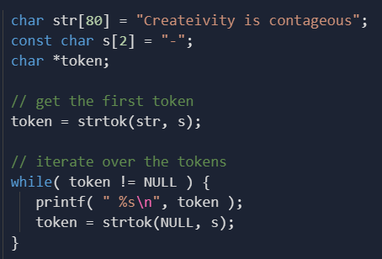
While we are on the subject
Do not use global variables.
Only exceptions: global constants
Do not use static variables.
Only exceptions: when we need a shared state for objects/functions
In particular, do not use strtok()
Ever!
strtok() uses static variable inside.
Why is the first call strtok(str, s) and then strtok(NULL, s)?
Looks very suspicious.
It uses static variable to remember the previous call.
In general, only use library functions you can write yourself.

Slide 43
Comment on recursion
Any recursive function can be implemented non-recursively using stack.
Example:
Quick sort( A[0… N-1] )
pivot_ind = rearrange(A, N)
Quick sort( A[0…pivot_ind-1] )
Quick sort( A[pivot_ind+1… N-1))
Implement this without using recursion.

Slide 44
Quick sort without using recursion
Quick sort( A[0… N-1] ) {
// s will contain the indices of subarrays that we need to be sorted s = create_stack(); // stack of pairs of indices
stack_push(s, (pair){0 , N-1});
while (s is not empty) {
( i , j ) = stack_pop(s);
pivot_ind = rearrange( A[i…j], pivot_ind); //
if (pivot_ind+1 < j) stack_push(s, (pair){pivot_ind+1 , j});
if (i < pivot_ind-1) stack_push(s, (pair){i , pivot_ind-1} );
}
}
Homework: run this algorithm on several examples of arrays
In each step follow the state of the array and the state of the stack

Slide 45
Questions?
Comments?

