Slide 1

CMPT 125
Introduction to Computing Science and Programming II
October 27, 2020

Slide 2
Assignment 3
Assignment 3 is due to November 5, 23:59
https://www.cs.sfu.ca/~ishinkar/teaching/fall21/cmpt125/assignments.html
You need to submit one file to Canvas – assignment3.c
Please make sure it compiles with the provided makefile
>> make
>> ./run_test3
Topics:
Sorting algorithms
Function pointers
Standard operations on array (find, map, reduce)

Slide 3
Missing semester - MIT
https://missing.csail.mit.edu/
A series of lecture on random topics that are
- usually not covered in any course, but
- every CS student should know
Command-line Environment
Editors (Vim)
Version Control (Git)
Debugging
Seriously, this is something you all should know. This will make your studies so much easier
Link is on piazza-> resources

Slide 4
Today
Abstract data types
Stack
Queue
Linked List

Slide 5
Abstract data types

Slide 6
Abstract Data Type
Abstract data type (ADT):
A collection of data and a set of allowed operations on that data.
Describes data + operations
Does not specify how the data is stored
Does not specify how the operations are carried out
Implementation of an ADT
User
Interact via an interface

Slide 7
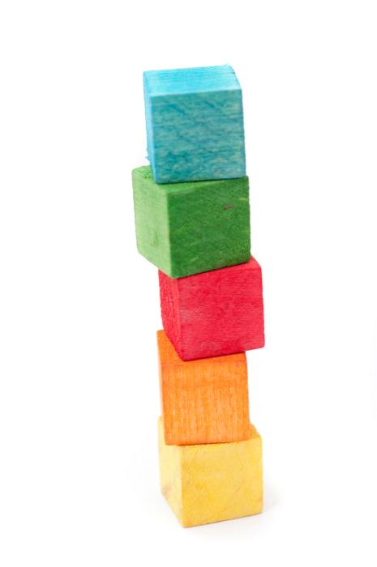
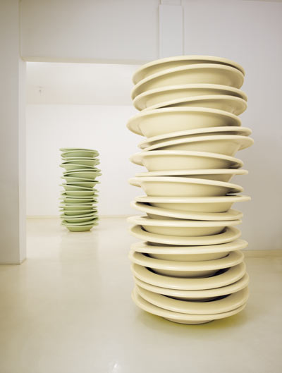

Example: Stack
A stack: an ordered collection of items with the following operations:
push(item): add an item to the stack
pop(): remove an item from the stack, and return its value
isEmpty(): checks if the stack is empty
Removal follows a last-in-first-out order (LIFO)

Slide 8
Example: Stack
A stack: an ordered collection of items with the following operations:
push(item): add an item to the stack
pop(): remove an item from the stack, and return its value
isEmpty(): checks if the stack is empty
Removal follows a last-in-first-out order (LIFO)
init()
push(3)
push(5)
pop() -- returns 5
push(1)
push(3)
5
3
3
1
3
3
3
1
3

Slide 9
Example: Stack
A stack: an ordered collection of items with the following operations:
push(item): add an item to the stack
pop(): remove an item from the stack, and return its value
isEmpty(): checks if the stack is empty
Removal follows a last-in-first-out order (LIFO)
Usage:
Stacks in execution of a program
Undo operation in paint/notepad
The definition is independent from the implementation

Slide 10
Implementing Stack
Question: How would you implement Stack?

Slide 11
Back to abstract data types

Slide 12
Abstract Data Type
Abstract data type (ADT):
A collection of data and a set of allowed operations on that data.
Describes data + operations
Does not specify how the data is stored
Does not specify how the operations are carried out
The definition is independent from the implementation
Implementation of an ADT
User
Interact via an interface

Slide 13
Software Engineering Principles
Encapsulation
Bundle related data and operations together
Modularity
break up a problem into smaller, manageable programming tasks
Information Hiding
keep the implementation details private
keep the interface stable
Finding a good selection of interfaces is the foundation for writing large scale software

Slide 14
Interfaces
An interface refers to data and a set of operations of the data.
Parametrized by inputs
Serves as a contract
Why use interfaces?
Code re-usage
Code independence
Allows modifying parts of the implementations without the need to change the entire program

Slide 15
More examples of ADTs

Slide 16
Queue
A queue: an ordered collection of items with the following operations:
enqueue(item): add an item to the queue
dequeue(): remove an item from the queue
isEmpty(): checks if the queue is queue
Removal follows a first-in-first-out order (FIFO)
Usage:
Waitlist
Documents sent to printer
Line at a supermarket

Slide 17
Queue
A queue: an ordered collection of items with the following operations:
enqueue(item): add an item to the queue
dequeue(): remove an item from the queue
isEmpty(): checks if the queue is queue
Removal follows a first-in-first-out order (FIFO)
There is no bound on the number of element in the set
Question: How would you implement Queue?

Slide 18
Dynamic array
A dynamic array: is an array with the following operations:
init(): create an empty array
set_value (index, item): set array[index]=item
get_value (index): get array[index]
There is no bound on the number of element in the array
Question: How would you implement Dynamic array?

Slide 19
Set
Set: is a bag of element with the following operations:
init(): create an empty set
add(item): add an item to the set
contains?(item): checks if the set contain item
remove(item): removes an item from the set
is_empty?: checks if the set is empty
There is no bound on the number of element in the set
Question: How would you implement Set?

Slide 20
Implementing a stack

Slide 21
Implementing Stack
A stack: an ordered collection of items with the following operations:
create(): creates an empty stack
push(item): add an item to the top of the stack
pop(): remove an item from the top of the stack
isEmpty(): checks if the stack is empty
peek(): return the top element (without removing it)
Removal follows a last-in-first-out order (LIFO)

Slide 22
Implementing Stack
Question: How would you implement Stack?
typedef struct {
???
} stack_t;
Caveat: Stack does not have a bound on its capacity.
Want the capacity to be bounded by the limitations of your computer

Slide 23
Questions?
Comments?

