Slide 1

CMPT 125
Introduction to Computing Science and Programming II
November 8, 2021

Slide 2
Assignment 4
Assignment 4 is due to November 19, 23:59
https://www.cs.sfu.ca/~ishinkar/teaching/fall21/cmpt125/assignments.html
You need to submit one file to Canvas – assignment4.c
Please make sure it compiles with the provided makefile
>> make
>> ./run_test4
Topics:
Stacks – using the provided API, without relying on the implementation details
Binary Trees

Slide 3
Today
Introduction to Graphs
Introduction to Trees
Binary Trees
Traversing Trees

Slide 4
Graphs

Slide 5

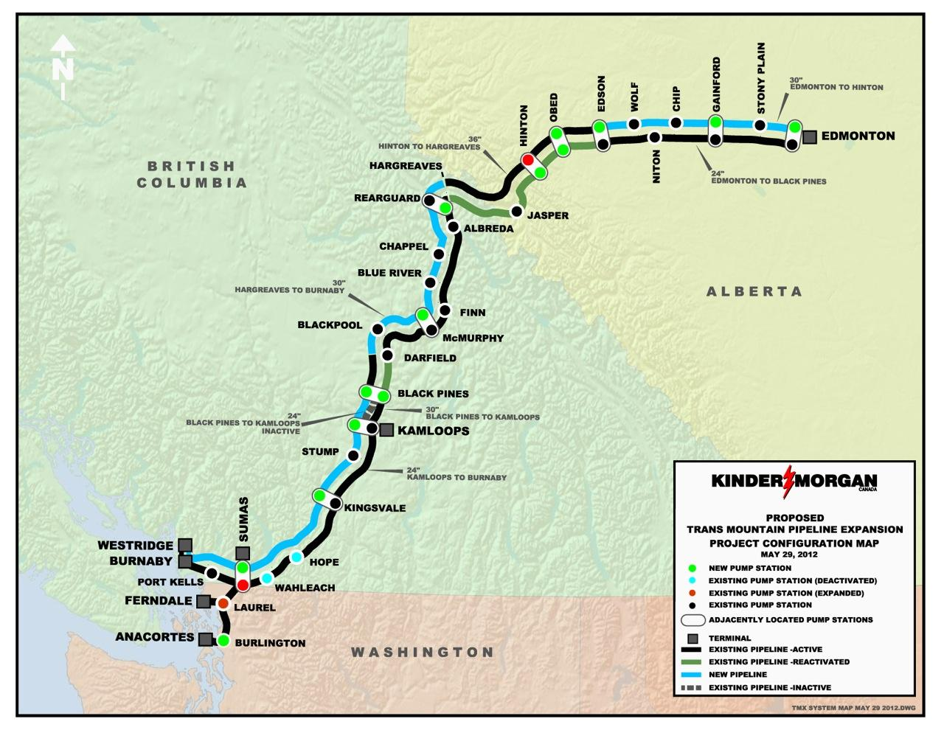
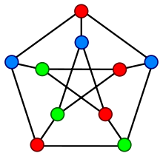
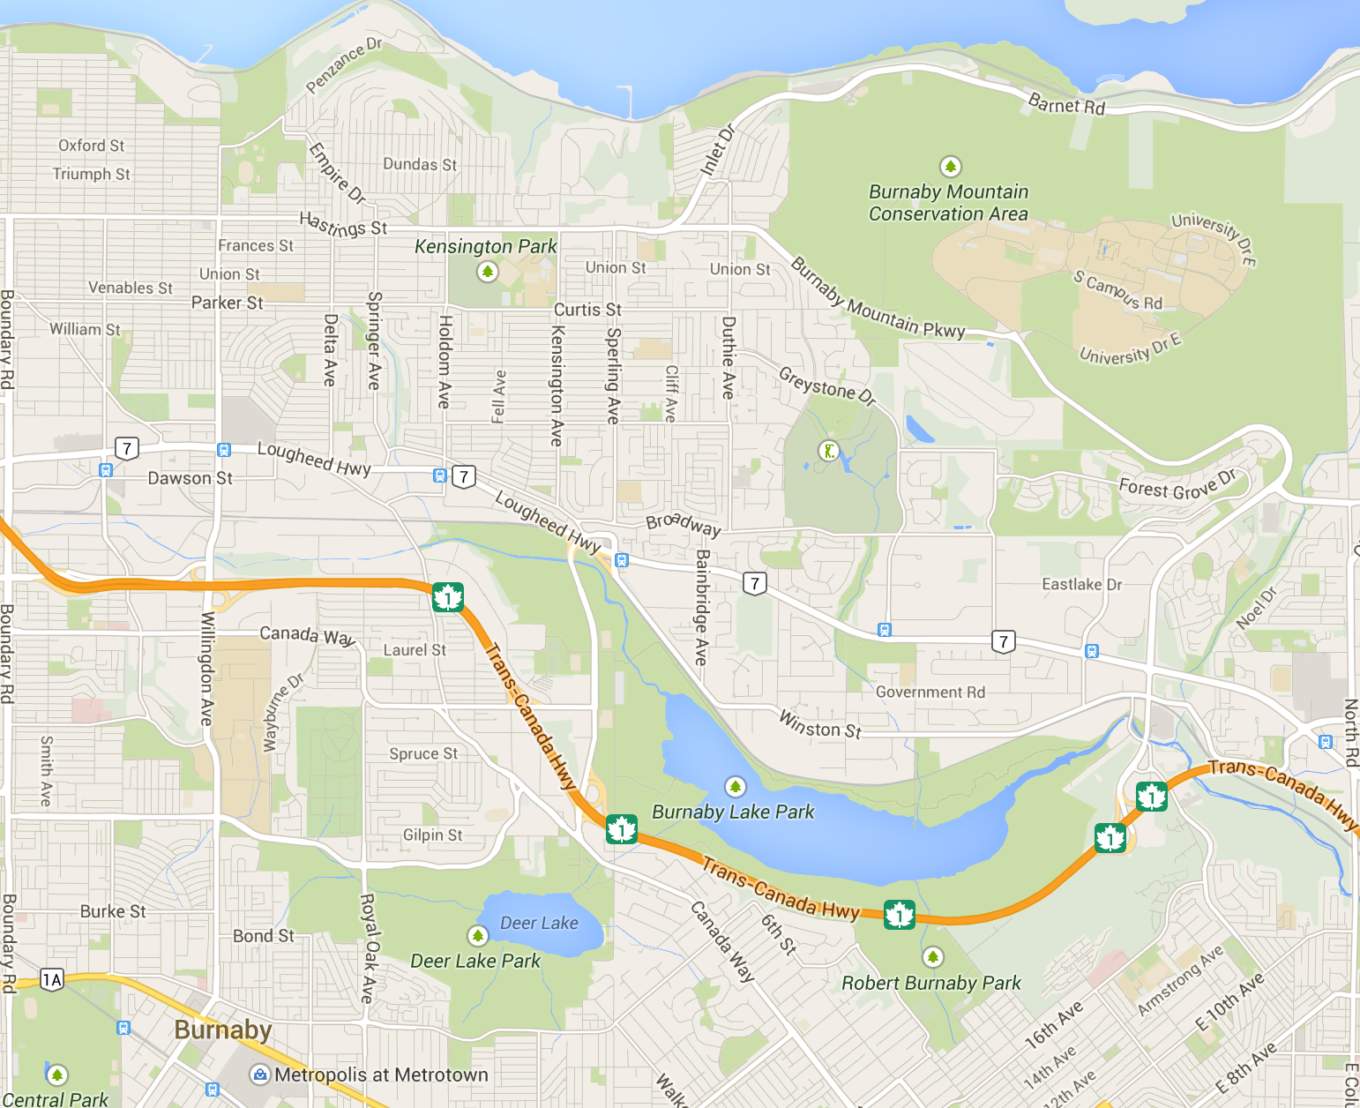
Graphs
A graph describes relationships among items in a collection
the items are the vertices (depicted by dots or junctions)
the relations are the edges (depicted by lines between dots)
What are the vertices and edges in these common graphs?
Vertices - people
Edges - friendships
Vertices - stations
Edges - pipes
Vertices - intersections
Edges - roadways

Slide 6
Graphs
A path from vertex u to vertex v is sequence of edges which connect a sequence of vertices between them.
A graph is connected if each pair of vertices has a path.
How do you visualize a disconnected graph?
What if the Skytrain graph was disconnected

Slide 7
Trees

Slide 8
Trees
A tree is a minimally connected graph
all vertices connected
no cycles

Slide 9
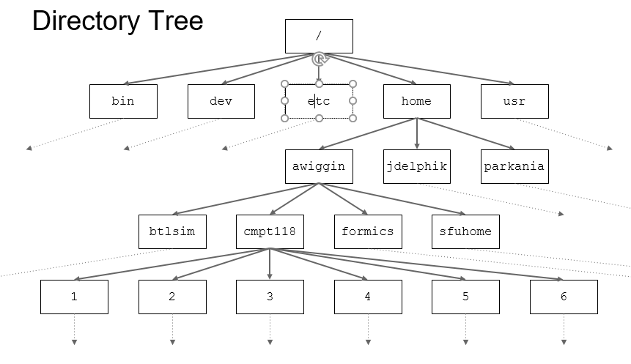
Trees

Slide 10
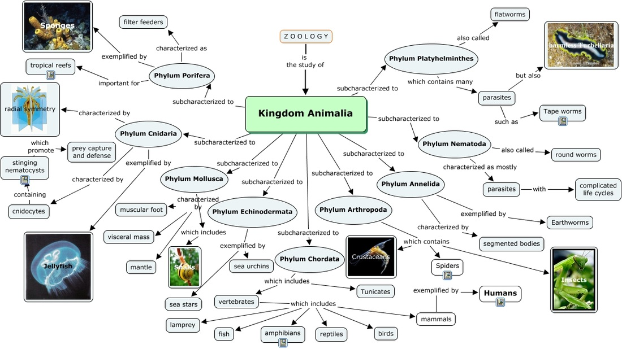
Trees

Slide 11
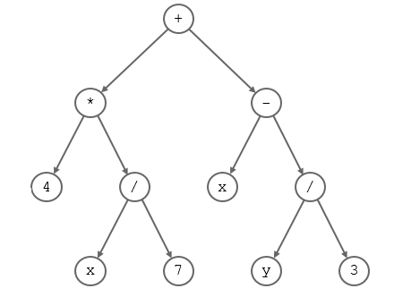
A Tree

Slide 12
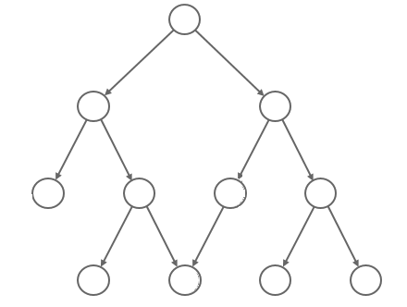
Not a Tree

Slide 13
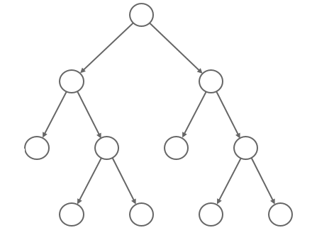
Rooted Trees
Structure of rooted trees
Root
Leaves

Slide 14
Rooted Trees
Structure of rooted trees
Parent
Vertex/node
Children

Slide 15
Rooted Trees
For every vertex in the tree there is a unique shortest path from the root to this vertex.
Depth of a node is the length from the root to this node.
Example: Depth(root) = 0,
Depth of a tree is the maximal depth of a node in the tree.
Claim: if depth(tree) = d, then there is a leaf in a tree of depth d.
Size of a tree is the total number of nodes in the tree.

Slide 16
Binary Trees

Slide 17
Binary Trees
An m-ary tree is a tree in which each vertex has at most m children.
This course: focus on binary trees: 2-ary trees.

Slide 18
Binary Trees
Structure of rooted trees
Parent
Vertex/node
Left child
Right child

Slide 19
Binary Trees
An m-ary tree is a tree in which each vertex has at most m children.
The common name for a 2-ary tree is binary tree.
Usage: algebraic expressions.
Represents the expression:
(4*(x/7)) + (x-(y/3))
How do you evaluate an expression tree?

Slide 20
Binary Trees
Claim: In binary tree there are at most 2^{k} nodes in level k.
Proof: Induction on the depth of a node.
Base case: For depth = 0. There is only the root, So the number of nodes is 1 = 2⁰.
Induction:
Suppose the claim holds for depth = d.
Let’s prove it for depth = d+1:
By the induction hypothesis, there are at most 2^{d} nodes at level d
Each of these node has at most 2 children.
Therefore, the number of nodes at level d+1 is at most 2*2^{d}=2^{d+1}.
Therefore, if a binary tree has depth d, then it has at most 1+2+4+…+2^{d} = 2^{d+1}-1 nodes.

Slide 21
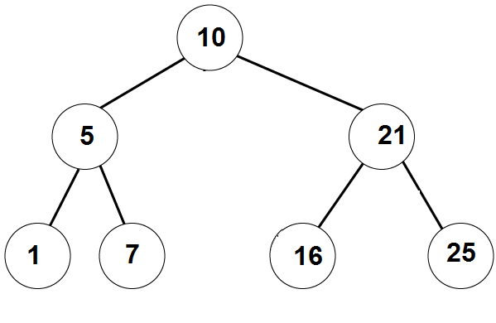
Binary Trees
A binary tree is full if for all k<=depth it has 2^{k} nodes in level k.

Slide 22
Binary Trees
Claim1:If a binary tree has N vertices, then its depth is at least log(N)-1.
Claim2: If a binary tree has N vertices, then its depth is at most N-1.
Proof of Claim 1: Denote the depth by d.
Then N <= 2^{d+1}-1 < 2^{d+1} (by the claim from before)
Therefore, d+1> log₂(N), and hence d> log₂(N)-1
Proof of Claim 2: It has depth N-1 only if it is a path/straight line.
Otherwise the depth will < N-1.

Slide 23
Binary Trees
Implementing Binary Tree in C:
struct BTnode {
int data; // struct BTnode* left; // left child struct BTnode* right; // right child
struct BTnode* parent;
}
typedef struct BTnode BTnode_t;
struct binary_tree {
struct BTnode* root;
}

Slide 24
Binary Trees
Write a function that gets a BTnode, and checks if the node is a leaf.
is_leaf(BTnode* node)
return (node->left == NULL && node->right == NULL);
Write a function that gets a BTnode, and checks if the node is a root.
is_root(BTnode* node)
return (node->parent==NULL);

Slide 25
Binary Trees
Write a function that gets a binary tree and computes its size.

Slide 26
Binary Trees
get_size (BTnode* root)
{
if ( root == NULL )
return 0;
else return get_size (root->left ) + get_size (root->right ) + 1;
}

Slide 27
Binary Trees
Write a function that gets a binary tree and computes its depth.

Slide 28
Binary Trees
get_depth (BTnode* root) {
if ( root == NULL )
return -1;
// if (is_leaf(root))
// return 0;
else return max(get_depth (root->left ), get_depth (root->right ) ) +1;
}

Slide 29
Traversing Binary Trees

Slide 30
Traversing Binary Trees
InOrder traversal:
First visit the left subtree,
Then the root,
Then the right subtree.
Example:
__left___ 10, __right__
__,5,__, 10, ___ 21 __
1, 5, 7, 10, 16, 21, 25
Answer: [1,5,7,10,16,21,25]

Slide 31
Traversing Binary Trees
PreOrder traversal:
First visit the root,
Then the left subtree,
Then the right subtree.
Example:
10, __left__, ___right___
10, 5,_left_, _right_, 21, left_,right_
10, 5, 1, 7, 21, 16, 25
Answer: [10,5,1,7,21,16,25]

Slide 32
Traversing Binary Trees
PostOrder traversal:
First visit the left subtree,
Then the right subtree.
Then the root
Example:
__left__, ___right_, 10
_left_, right_, 5, _left_, _right_,21, 10
1, 7, 5, 16, 25, 21, 10
Answer: [1,7,5,16,25,21,10]

Slide 33
PreOrder traversal algorithm
// prints the tree in PreOrder
PreOrderTraversal (BTnode root):
If root==NULL
1.1 do nothing
Else
2.1 print( root.data )
2.2 PreOrderTraversal (root.left)
2.3 PreOrderTraversal(root.right)
Q:Change the algorithm to get the InOrder/PostOrder traversal

Slide 34
Practice Problems
on Binary Trees

Slide 35
Is descendant?

Slide 36
Binary Tree Problems
Write a function that gets two nodes in a binary tree, u and v and checks if u is a descendant of v
bool is_descendant (BTnode_t* u, BTnode_t* v):
Idea:
If (u ==v) return true.
If (u->parent == NULL) return false
Set p = u->parent
While (p!=NULL)
If (p == v) return true
Set p = p->parent
Return false
Running time:
If u is a descendant of v,
Then running time is O(dist(u,v))
Otherwise: O(depth(u))
Implement this

Slide 37
Compute distance

Slide 38
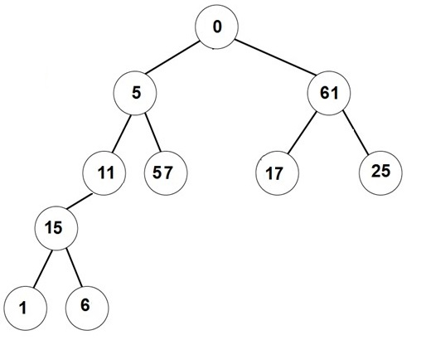
Binary Tree Problems
Write a function that gets two nodes in a binary tree, u and v and computes the distance between u and v
int distance (BTnode* u, BTnode* v)
distance(0, 1) = 4
distance(15, 11) = 1
distance(1, 6) = 2
distance(1, 25) = 6
distance(6, 6) = 0
distance(57, 1) = 4

Slide 39
Binary Tree Problems
Write a function that gets two nodes in a binary tree, u and v and computes the distance between u and v
int distance (BTnode* u, BTnode* v)
Idea:
Compute Path_{u} = the path from the root to u
Compute Path_{v} = the path from the root to v
Find the common ancestors
Return ?

Slide 40
Binary Tree Problems
Write a function that gets two nodes in a binary tree, u and v and computes the distance between u and v
int distance (BTnode* u, BTnode* v)
Example: u = 25, v = 6
Path_{u} = (0, 61, 25)
Path_{v} = (0, 5, 11, 15, 6)
Return length(Path_{u})+length(Path_{v})-2

Slide 41
Binary Tree Problems
Write a function that gets two nodes in a binary tree, u and v and computes the distance between u and v
int distance (BTnode* u, BTnode* v)
Example: u = 1, v = 57
Path_{u} = (0, 5, 11, 15, 1)
Path_{v} = (0, 5, 57)
common ancestors = {0,5}
Return length(Path_{u})+length(Path_{v})-4

Slide 42
Binary Tree Problems
Write a function that gets two nodes in a binary tree, u and v and computes the distance between u and v
int distance (BTnode* u, BTnode* v)
Example: u = 1, v = 6
Path_{u} = (0, 5, 11, 15, 1)
Path_{v} = (0, 5, 11, 15, 6)
common ancestors = {0, 5, 11, 15}
Return length(Path_{u})+length(Path_{v})-8

Slide 43
Binary Tree Problems
Write a function that gets two nodes in a binary tree, u and v and computes the distance between u and v
int distance (BTnode* u, BTnode* v)
Compute Path_{u} = the ancestors of u
Compute Path_{v} = the ancestors of v
Let C = the number of common ancestors
Return length(Path_{u}) + length(Path_{v}) - 2*C
The running time is: O(depth(u)+depth(v))

Slide 44
Breadth First Search

Slide 45
Tree traversal – non-recursive
Write a non-recursive algorithm that prints PreOrder traversal of a binary tree.
PreOrder(root):
s = create stack of nodes
s.push(root)
While s is not empty:
node = s.pop()
printf(node->value
if (node->right != NULL)
s.push(node->right)
if (node->left != NULL)
s.push(node->left)

Slide 46
Tree traversal – non-recursive
Write a non-recursive algorithm that prints PreOrder traversal of a binary tree.
PreOrder(root):
s = create stack of nodes
s.push(root)
While s is not empty:
node = s.pop()
printf(node->value)
if (node->right != NULL)
s.push(node->right)
if (node->left != NULL)
s.push(node->left)
10
5
21
1
7
21
7
21
21
16
25
25

Slide 47
Tree traversal – non-recursive
Write a non-recursive algorithm that prints PreOrder traversal of a binary tree.
PreOrder(root):
s = create stack of nodes
s.push(root)
While s is not empty:
node = s.pop()
printf(node->value)
if (node->right != NULL)
s.push(node->right)
if (node->left != NULL)
s.push(node->left)
Implement this algorithm!
What if we replace the stack with a queue?

Slide 48
Breadth First Search
BreadthFirstSearch(root):
q = create queue of nodes
q.enqueue(root)
while q is not empty:
node = q.dequeue()
printf(node->value)
if (node->left != NULL)
q.enqueue(node->left)
if (node->right != NULL)
q.enqueue(node->right)
Print 10
Print 5
Print 21
Print 1
Print 7
Print 16
Print 25
10
5 | 21
21 | 1 | 7
1 | 7 | 16 | 25
7 | 16 | 25
16 | 25
Implement this algorithm!
25

Slide 49
Breadth First Search
BreadthFirstSearch(root):
q = create queue of nodes
q.enqueue(root)
while q is not empty:
node = q.dequeue()
printf(node->value)
if (node->left != NULL)
q.enqueue(node->left)
if (node->right != NULL)
q.enqueue(node->right)
These algorithms have applications to
Exploring unknown territory Finding shortest paths
Some AI tasks Solving puzzles

Slide 50
Questions?
Comments?

