Slide 1
CMPT 125
Introduction to Computing Science and Programming II
September 29, 2021

Slide 2
Assignment 1
Your code needs to compile with the provided makefile >> make >> .test1
Currently makefile compiles your code using gcc -Wall -std=c99 -o test1 test1.c assignment1.c
You need to submit exactly one file assignment1.c
If you submit a file with a different name, it will not compile → you get zero
If you include main(), it will not compile → you get zero
Don’t use printf(“enter number”) scanf (“…”). The grader will not enter anything → you get zero
No printf! No scanf!

Slide 3
Execution stack and scope of variables

Slide 4
Execution stack and scope of variables
An execution stack (call stack, run-time stack...) is a data structure that stores the information about the functions called during the execution of a program.
For each function the stack stores the following information:
parameters of the function
local variables
return value
return address: When a function completes, it returns control to the function that called it.

Slide 5
Execution stack and scope of variables
int bar (int size) { int i = size+1; return i; } int foo (int n) { int ret = 3; bar(4); bar(8); return ret; } int main() { foo(5); return 0; }
bar() params: int size = 4 variables: int i =? return value: ? return address: …
bar() params: int size = 4 variables: int i =5 return value: ? return address: …
bar() params: int size = 8; variables: int size = 8; int i= 9; return value: ? return address: …
bar() params: int size = 8 variables: int size = 8; int i= … return value: ? return address: …
foo() params: int n = 5; variables: int n= 5; ret = 3; return value: return address: 0x9378ad
foo() params: int n = 5 variables: int n= 5; ret = ? return value: return address: 0x9378ad
main() params: -- variables:… return value: ? return address: 0x128fbad

Slide 6
Execution stack and scope of variables
All local variables of a function are stored in the corresponding stack-frame. When the function completes, the variables become unavailable.
Variables obtained from malloc() are stored in "global memory", and do not die when the function completes.
We must free the memory when we don’t need them anymore.
Terminology:
Local variables are stored on the stack.
Global variables are stored on the heap.

Slide 7
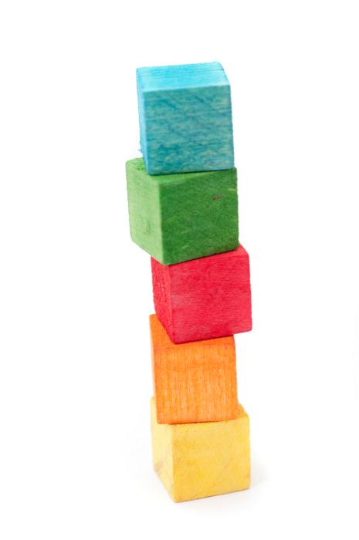
Stack (data structure)
Stack is a data structure with two principal operations: Push(element) – adds an element to the collection Pop() - removes the most recently added element from the collection
Example: Stack of blocks we add and remove only to/from the top.
Same with function calls: Each function call adds a block to the stack. When finished, we remove it from the stack and continue to the next function on top.

Slide 8
Functions and structs

Slide 9
Functions and Structs
Note that struct is treated similarly to any other type (int, char)
Example:
Consider the function
person get_person() { person p; … return p; }
It returns the struct by copying p.data1, p.data2… to the caller.
More examples in struct_ret.c and struct_ret_ptr.c

Slide 10
Pointers to Functions

Slide 11
Function Pointers
In C functions are stored in the memory just as any other data.
And we can use pointers to refer to them. [A crazy idea, but why not]
The syntax is:
int foo(char c, int n, char* s) {…}
int (*my_function_ptr)(char, int, char*);
my_function_ptr = foo;
my_function_ptr(‘A’, 10, str);
See function_pointers.c

Slide 12
We did not cover…

Slide 13
What we did not cover
Union – similar to struct except that all data fields share the same memory. For example:
union op { char op_c; int op_a; int op_b[3]; };
will have the size of 3 ints. If you modify op_a it may change op_c
File I/O – Your assignment 2 will have a question about file I/O.
You will have to read about it yourself.

Slide 14
We are done with the syntax of C!!!
*We missed some minor topics, like switch or some useful function (getc, putc, gets…) and some libraries.
But they are quite straightforward to learn by examples.
https://www.tutorialspoint.com/c_standard_library/stdio_h.htm

Slide 15
Binary Encodings

Slide 16
Binary encodings of integers
The values of digits in a number are positional:
Decimal numbers: 582 = 500 + 80 + 2 = 5*10² + 8*10¹ + 2*10⁰
Binary numbers: 10110 = 1*2⁴ + 0*2³ + 1*2² + 1*2¹ + 0*2⁰
Exercises:
Convert 10011011 from binary to decimal
Convert 29 from decimal to binary

Slide 17
Binary encodings of integers
Convert 10011011 from binary to decimal:
2⁷ + 2⁴ + 2³ + 2¹ + 2⁰ = 128 + 16 + 8 + 2 + 1 = 155

Slide 18
Binary encodings of integers
Convert 29 from decimal to binary:
29 is odd, hence the binary should end with 1. *****1
Let’s subtract 1, we are left with 28.
Let’s divide 28 by 2, and get 14.
14 is even, so the next digit will be 0…. -→ ******01
Let’s divide 14 by 2, we get 7.
7 is off, so the next digit is 1 → ****101

Slide 19
Binary encodings of integers
Convert 29 from decimal to binary:
Let’s try to write 29 as sum of powers of 2.
29 is odd, hence the binary should end with 1. *****1
Let’s subtract 1, we are left with 28.
Note 28 = 16 +12 = 2⁴ + 12 = 2⁴ + 8 + 4 = 2⁴ + 2³ + 2²
So 29 = 2⁴ + 2³ + 2² + 2⁰, In binary this is 11101

Slide 20
Binary encodings of integers
i = 0: N = 29 is odd
set 1*2⁰ →****1 set N = (29-1)/2 = 14
i = 1: N = 14 is even
set 0*2¹→ ***01
set N = 14/2 = 7
i = 2: N = 7 is odd
set 1*2² → **101 set N = (7-1)/2 = 3
i = 3: N = 3 is odd
set 1*2³ → *1101 set N = (3-1)/2 = 1
i = 4: N = 1 is odd
set 1*2⁴ → 11101 set N = (1-1)/2 = 0
Convert 29 from decimal to binary:
Algorithm:
i = 0
while (N > 0)
2.1 if N is even
2.1.1 set the 2^{i}-th digit = 0
2.1.2 set N = N/2
2.2 else
2.2.1 set the 2^{i}-th digit = 1
2.2.2 N = (N-1)/2
2.3 i++
ANSWER: 29 in decimal = 11101

Slide 21
Fixed width encoding
Simple data types are usually fixed in width
int is usually 4 byte = 32 bits
Range of int is [-2³¹, 2³¹-1] (one of the digits is for the sign)
That is between -2,147,483,648 and 2,147,483,647
Larger numbers will result in an overflow
Try it in C

Slide 22
Non integer arithmetic
Two common decimal numbers:
⅓ = 0.33333333333
⅔ = 0.6666666666
Cannot write the decimal with finite number of digits.
So we round them

Slide 23
Scientific Notation
A convention to express numbers by their magnitude:
Speed of light = 2.99792458 x 10⁸ m/s
One gigabyte = 1.073741824 x 10⁹ bytes
⅓ = 3.33333333333 x 10⁻¹
Same conventions are used for binary

Slide 24

Floating point encoding
A float is composed of 32 bits:
1 bit for sign ( 0 – positive, 1 – negative)
23 bits for the significand (significant digits of the number)
1.b₂₂b₂₁…b₀
b₂₂ represents the digit of ½
b₂₁ represents the digit of ¼ …
8 bits for the exponent – ranges from -127 to 128
Range of the representation: 1.b₂₂b₂₁…b₀ x 2^{(exp-127)}
between ≈ 2¹²⁸ ≈ 3.40 x 10³⁸ and ≈ 2⁻¹²⁷ ≈ 1.17 x 10⁻³⁸

Slide 25
Example
The number is (-1)^{sign} x (1+ fraction) x 2^{exp-127}
In this example:
1 x (1 + 1/4) x 2¹²⁴⁻¹²⁷
= 1.25 x 2⁻³
= 1.25/8 = 0.15625

Slide 26

Example
-1.625 = -(1 + 5/8) x 2⁰
5/8 = 1/2 + 1/8
Set 1 for the minus sign
Set b₀ = 1 (for ½) and b₂ = 1 (for 1/8)
The 8 bits of exponent are 127
-1.625 = - (1+1/2 + 1/8) x 2⁰

Slide 27
Questions?
Comments?

