Slide 1

Text-based Sentimental Analysis
Everything was more then I expected, but the price was so bad.

Slide 2

Natural Language Processing

Slide 3
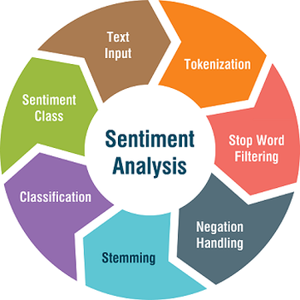
Text-based Sentimental Analysis
I was so happy
Regular expression
Import re
happy
I
so
was

Slide 4
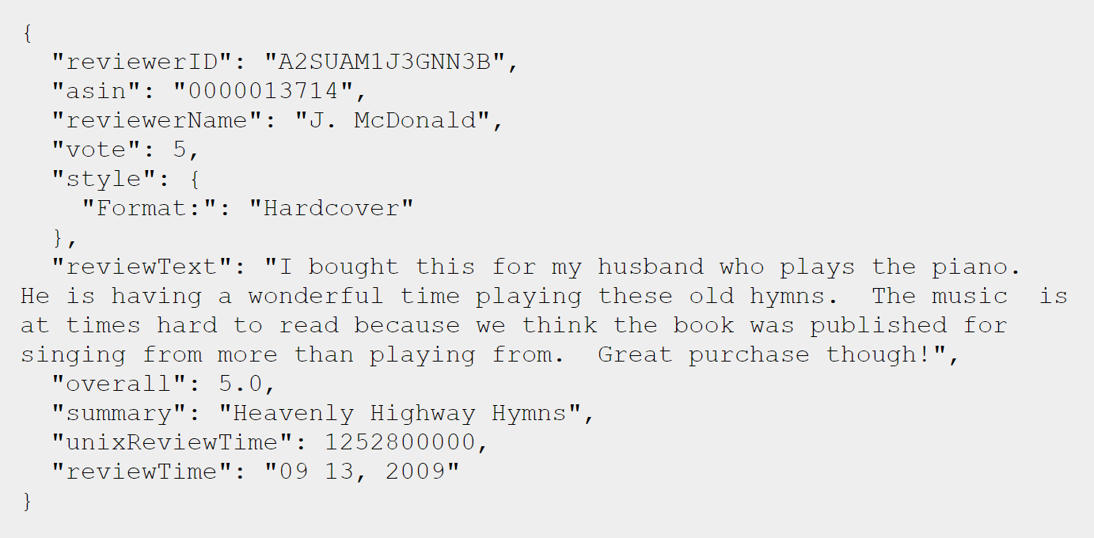
Text-based Sentimental Analysis

Slide 5
Text-based Sentiment Analysis
Amazon Comprehend
IBM Watson Natural Language Understanding: Microsoft Azure (Text analytics API)
Google Cloud Natural Language
Microsoft Azure (Linguistic Analysis API) — beta
Google Translate API
IBM Watson Translator
Amazon Translate
Microsoft Azure Translator Text API

Slide 6


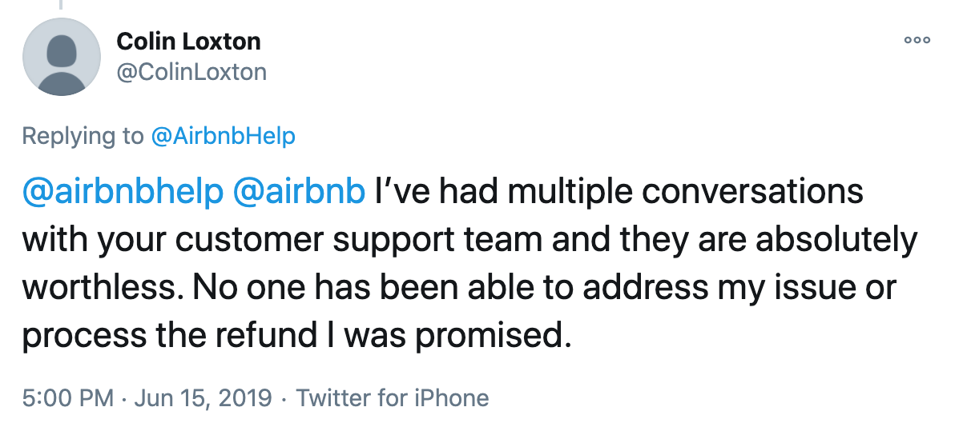
Text-based Sentiment Analysis
https://us-east-2.console.aws.amazon.com/comprehend/v2/home?region=us-east-2#home

Slide 7
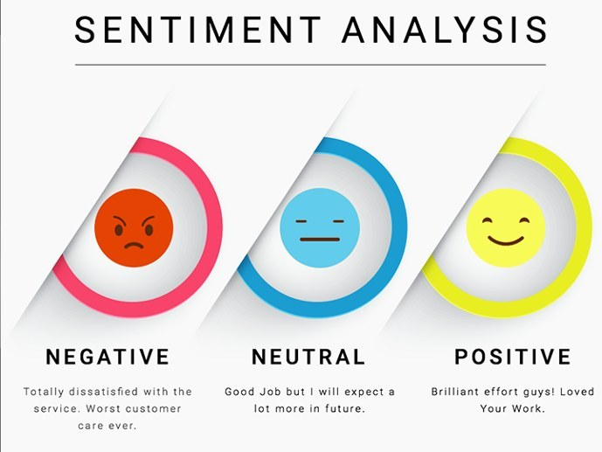
Text-based Sentiment Analysis
https://us-east-2.console.aws.amazon.com/comprehend/v2/home?region=us-east-2#home

Slide 8
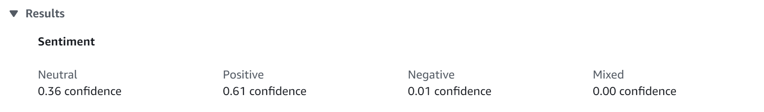
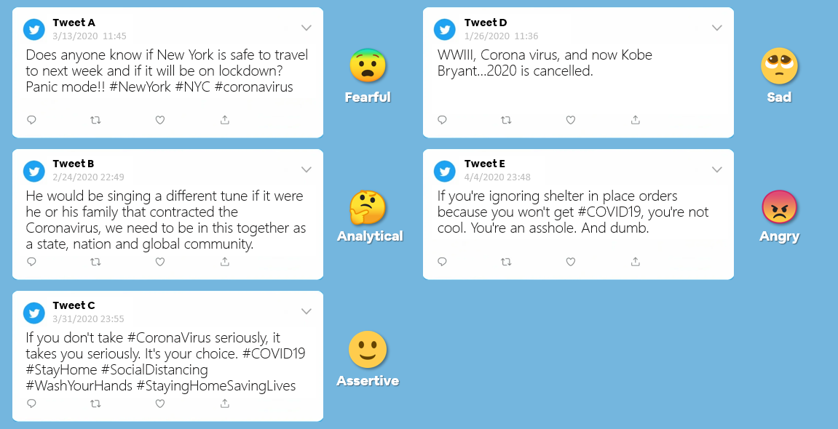

Text-based Sentiment Analysis
Topic 1
Range the result, and predict the sentiment
50% negativity &
10% positivity
=> sad

Slide 9
Text-based Sentiment Analysis
Topic 1
Using Google and Amazon comprehend sentiment analysis model
More about using the machine learning to interpret the result of existing API.
No worry about the quality of the data set
Easy with the start point
There is possibility that no correlations between the range of the result and each sentiment
In this case, we need to consider other topic, or the way to predict people’s sentiment.

Slide 10
Text-based Sentiment Analysis
Topic 2
Raw data
(ex. Amazon shopping review, Tweeter)
More flexible,
Can make our own machine learning program similar with amazon, or google api
Can modify the program to return more then just positivity or negativity
Highly depend on the quality of the raw data
Require a lot of data to put in, and although there are many API came out related to sentiment analysis, it is still difficult to make our own model

Slide 11
Text-based Sentiment Analysis
Members?
Leading members?
In-person vs online meeting?

Slide 12

Text-based Sentimental Analysis

