Slide 1
Digital Audio Workstation
Hans Larson, Mohammed Aljardat, Alexander Hyjek

Slide 2
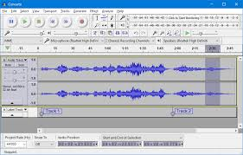
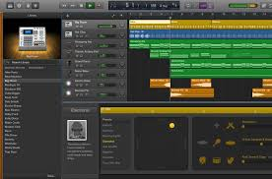
Creating a DAW
Goal: Make a fully-functional application that can be used for the recording, producing, editing, and playing of audio files.
https://www.audacityteam.org/
https://www.xlr8r.com/gear/learn-how-to-make-a-basic-house-track-in-garage-band

Slide 3
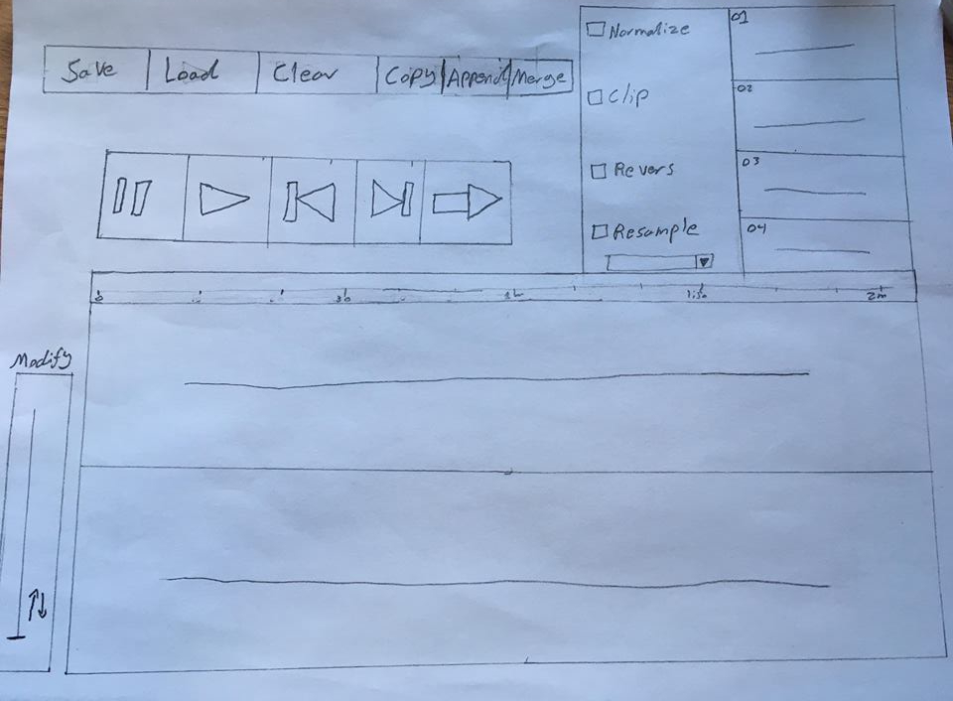
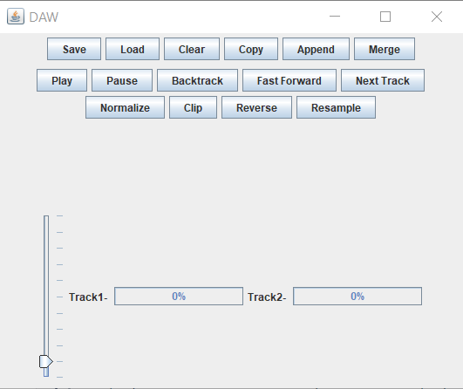
Preliminary Design Plan
Original design plans changed
Changes to our original plan:
Clearly labeled buttons
Open up file explorer/finder instead of displaying roster of tracks
Real-time info as progress bars
More important to focus on making the application work

Slide 4
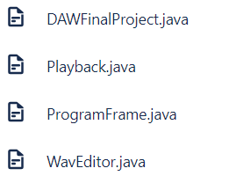
Methods and Plan Changes
Original file structure and programming methods changed
Plans of completion and roles/responsibilities changed.
Worked through each aspect of our project as a group rather than dividing the project into parts.

Slide 5
Program Files
DAWFinalProject.java
This file contains our main function that implements our classes and functions necessary to display our GUI application.
ProgramFrame.java
This file contains our ProgramFrame class that sets our default program frame width and height. It contains our button, file menu, and line listeners to make our application interactive and user friendly.
Playback.java
This class implements the code needed to give the correct functions to each of our playback buttons.
WavEditor.java
This class implements the code needed to give the correct functions for our WAV editing buttons

Slide 6
Byte Array / Methods Used

Slide 7
Demo of Our Application
Alex will now give a short demo of our application.

