Slide 1


Flower Shop Management System
Welcome! Blooms are nature’s vibrant burst of color, each one a little moment of beauty. Whether in a garden or a bouquet, they brighten up spaces and lift spirits, reminding us of life’s simple joys.
by Blooms Hase

Slide 2
Wayamba University of Sri Lanka
Kuliyapitiya
Higher Diploma in Software
Engineering
2023
Group Project
Flower Shop Management System
Agile Group Project Team: CodeWave
Submitted to: Dr. VGTN Vidanagama

Slide 3

Project Title
Project Title: Flower Shop Management System
Group Number: 03
Team Members
  CSE23309 H.E Mediwarna
  CSE23333 subodha
  CSE23360 chandana

Slide 4

Introduction
Welcome to our presentation on the Flower Shop Management System. Our team has developed this system to make running a flower shop easier and more efficient.
Problem
Solution
Managing a flower shop can be challenging. Keeping track of inventory, processing orders, and handling customer information can be messy and time-consuming.
Our system helps solve these problems by automating many tasks. It keeps track of what flowers are in stock, processes customer orders, and manages customer data—all in one place.

Slide 5

Objectives
Make Flower Shops More Efficient
Our system helps flower shops manage their products and orders easily, saving time and reducing mistakes.
Improve Customer Experience
We want customers to have a smooth and pleasant shopping experience when buying flowers online.
Simplify Shop Management
The system makes it easy for shop owners to keep track of their inventory, orders, and customers all in one place.
Support Business Growth
By streamlining operations, the system helps flower shops grow and serve more customers.

Slide 6
Key features of the system
1
User Registration and Login
2
Design
Users can create an account by registering with their details, like name, email, and password. Once registered, they can log in to access their account.
The website is designed to look good on different devices, such as smartphones, tablets, and desktops. The layout adjusts automatically to fit the screen size.
3
Product Listings and Offers
4
Navigation Menu
The system can display various products (like flowers) along with special offers. These are presented in visually appealing sections, making it easy for customers to browse.
A clear and simple menu allows users to easily navigate the website. The menu items highlight when hovered over, improving user experience.
5
Shopping Cart
6
Contact and Branch Information
Users can add products to their shopping cart, view item details, and see the total price before proceeding to checkout.
The website includes sections for users to find contact information and details about different branches, with location maps integrated.

Slide 7
System Architecture
Frontend (User Interface)
Backend (Server-Side)
Database
HTML/CSS
  This is what the user sees and interacts with on the website, like the home, products, contact, about, login and registration pages. It includes the design, buttons, forms, and layout.
JavaScript (optional if included)
  This could handle any interactive features on the website, like validating forms or handling user actions.
PHP
  This is the engine behind the scenes. It processes the user's requests, like logging in or registering, and interacts with the database to store or retrieve information.
MySQL
  The database stores all the essential information, such as user details (like usernames and passwords), product listings, and customer orders. The backend (PHP) connects with this database to fetch and update data as needed.

Slide 8
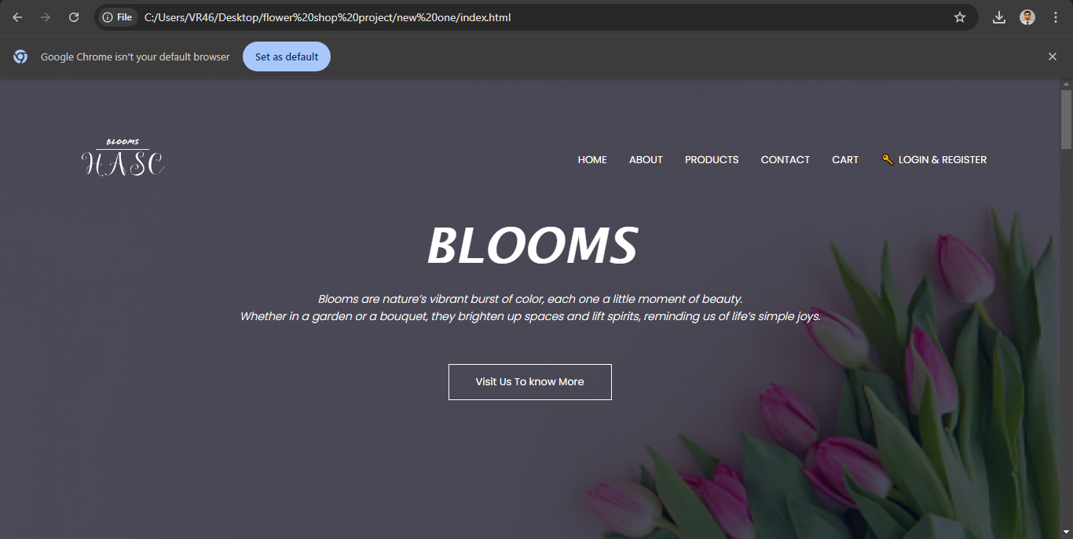
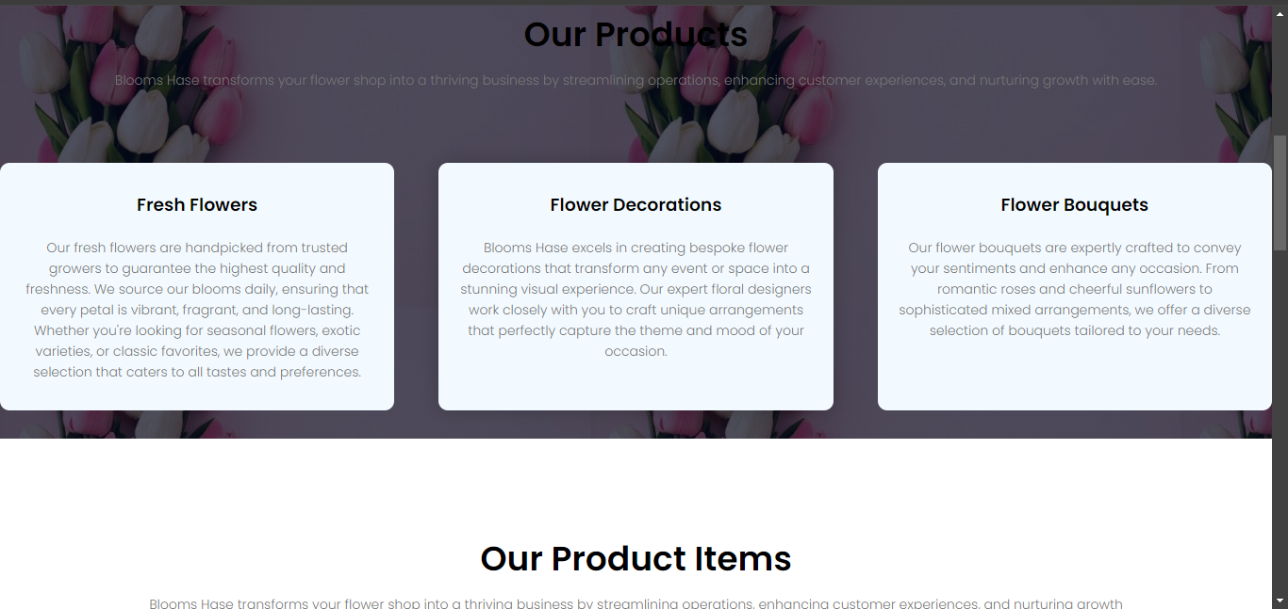

Slide 9
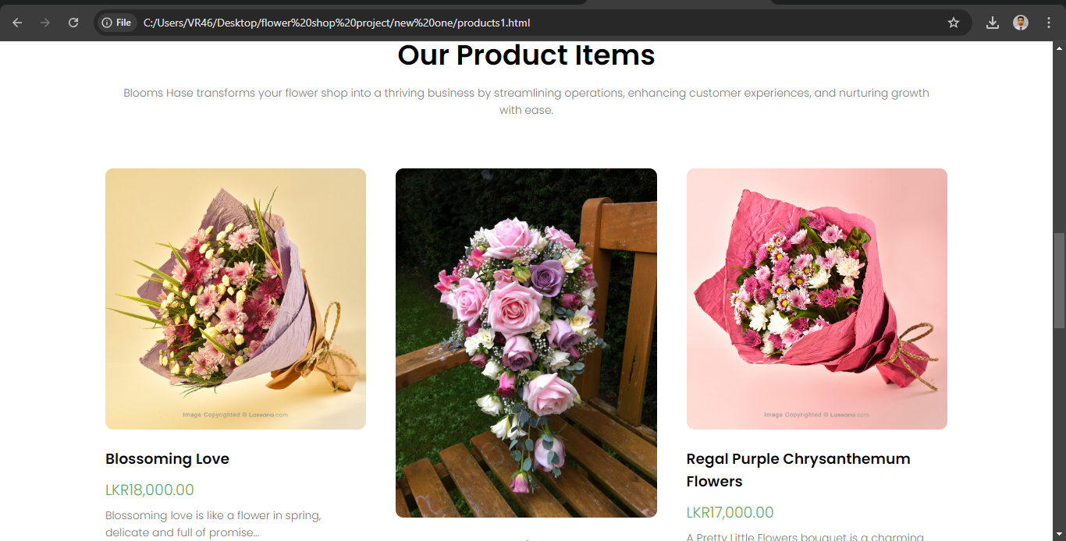
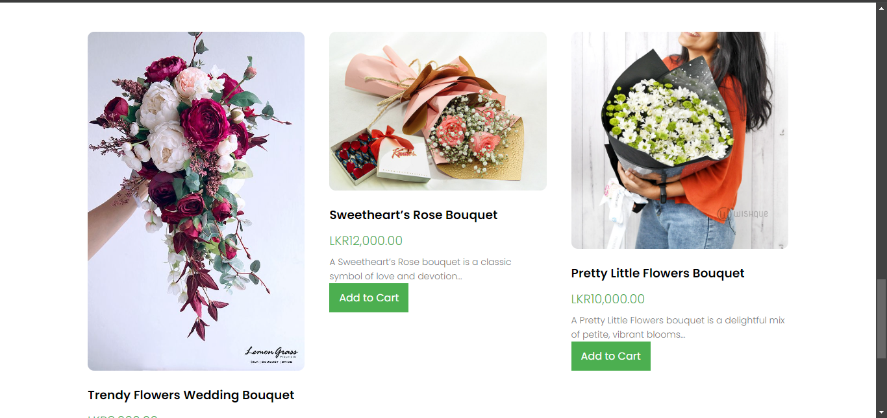

Slide 10
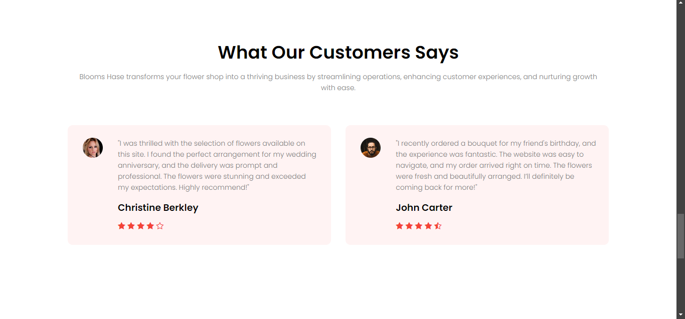
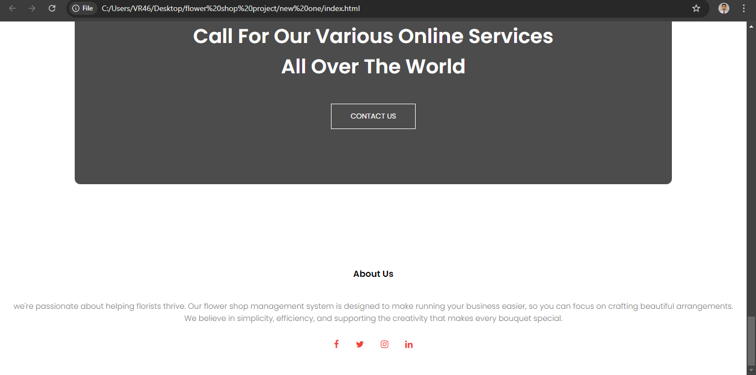

Slide 11




DEVELOPMENT PROCESS
Development Process is done by using following technologies
Web page design
lStructure of the web page was completely developed using HTML,JAVASCRIPT and CSS
Register and login details
Register and login page developed using PHP
Database Development
Database was done by using MySql

Slide 12
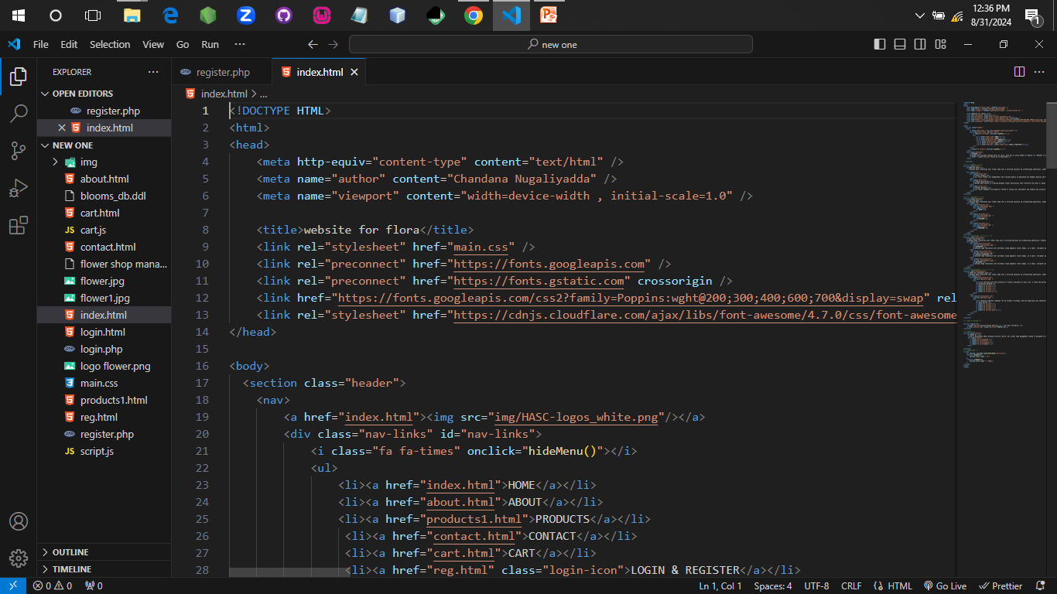
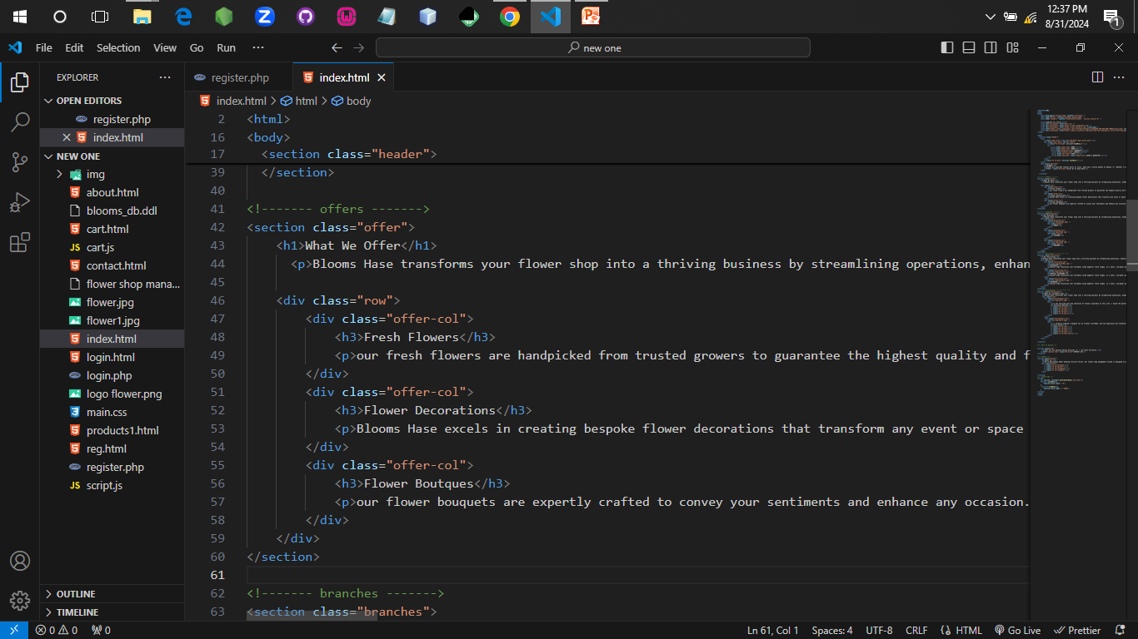

Slide 13
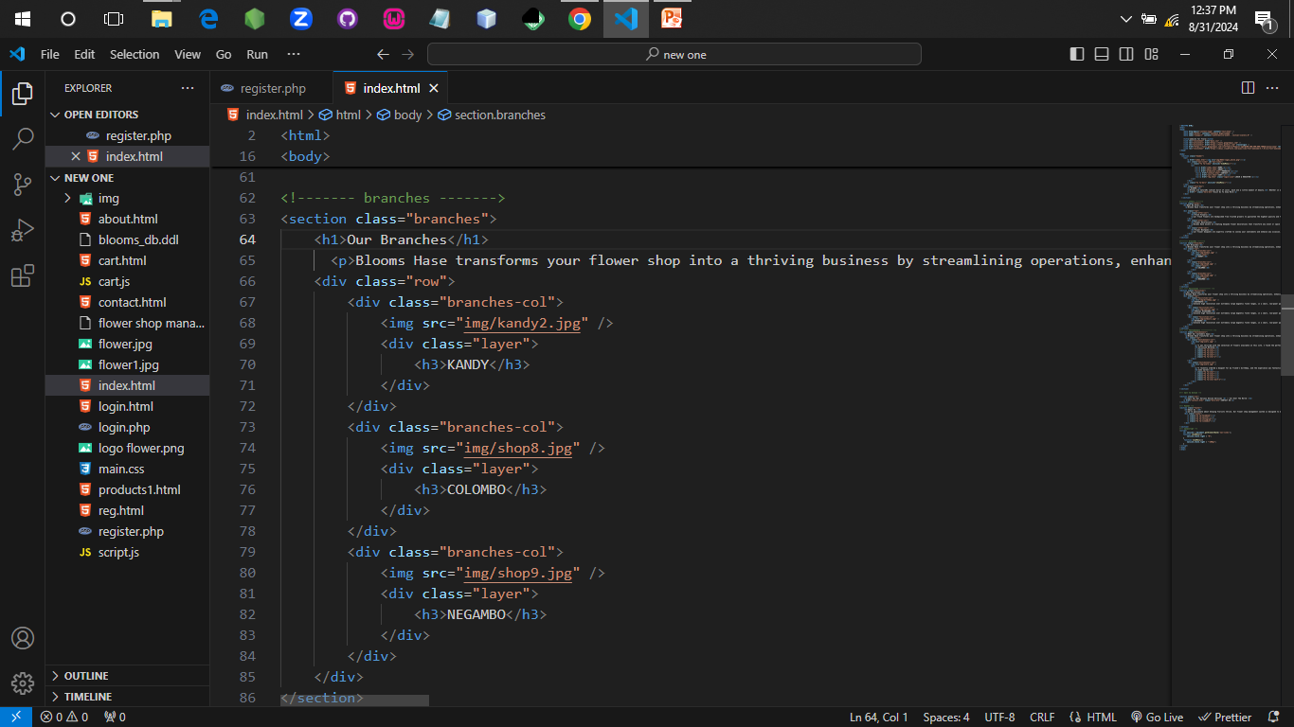
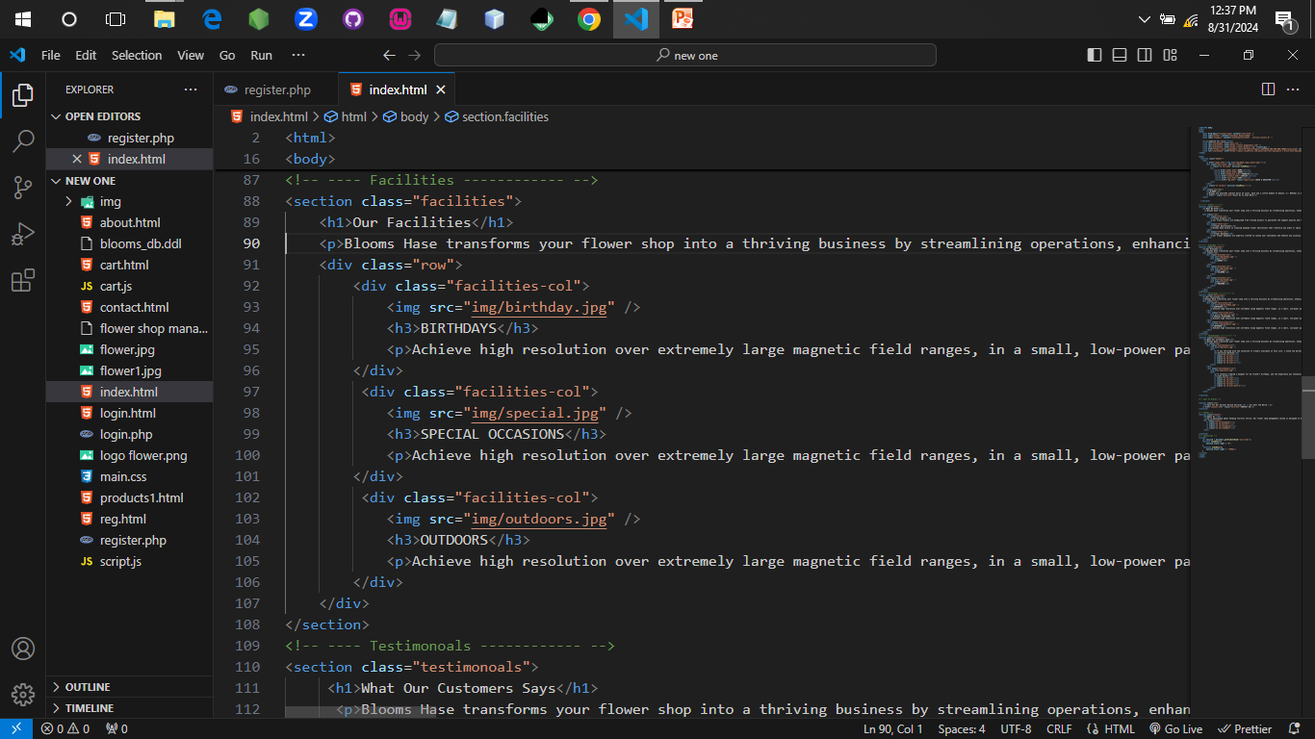

Slide 14
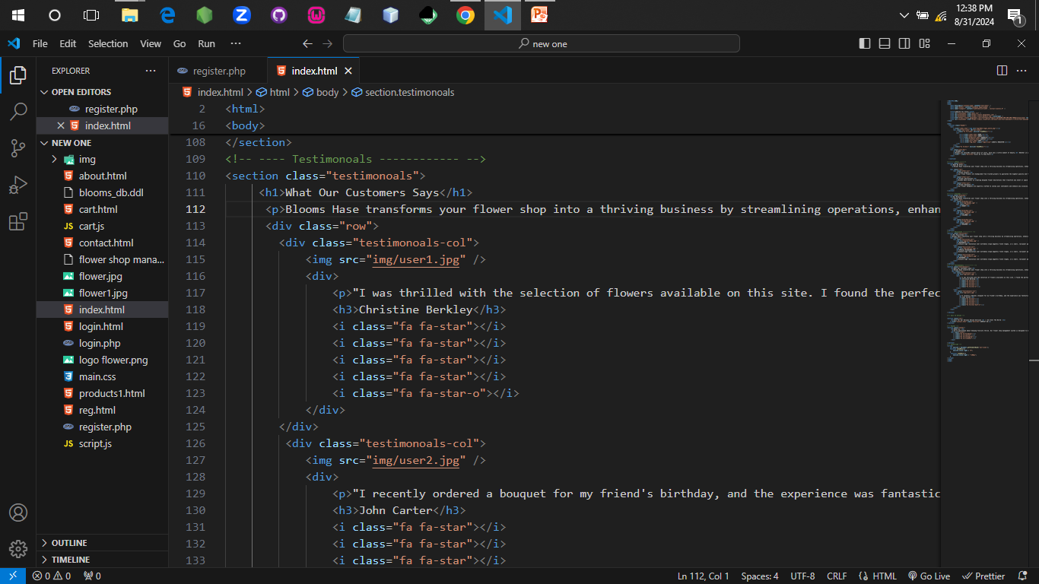
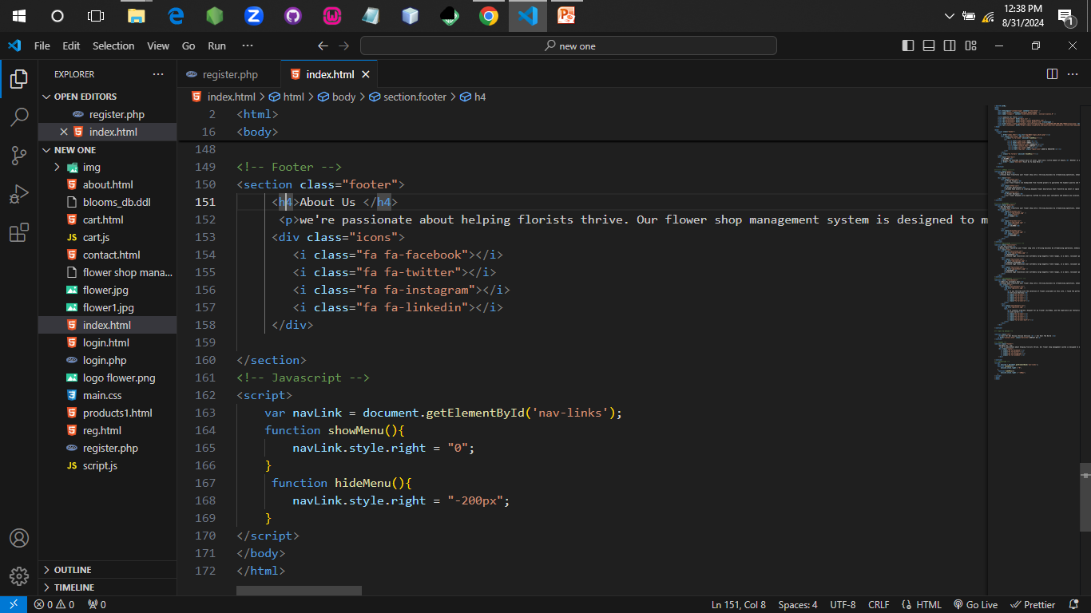

Slide 15
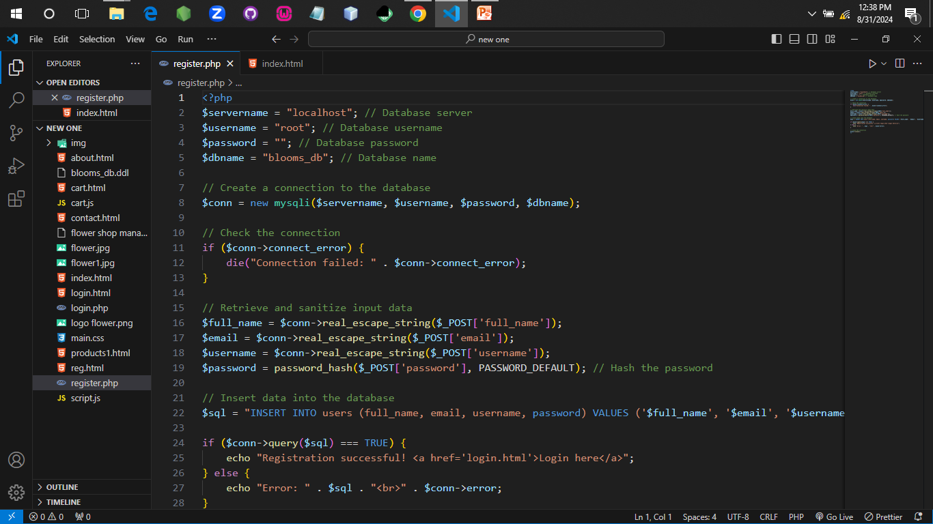
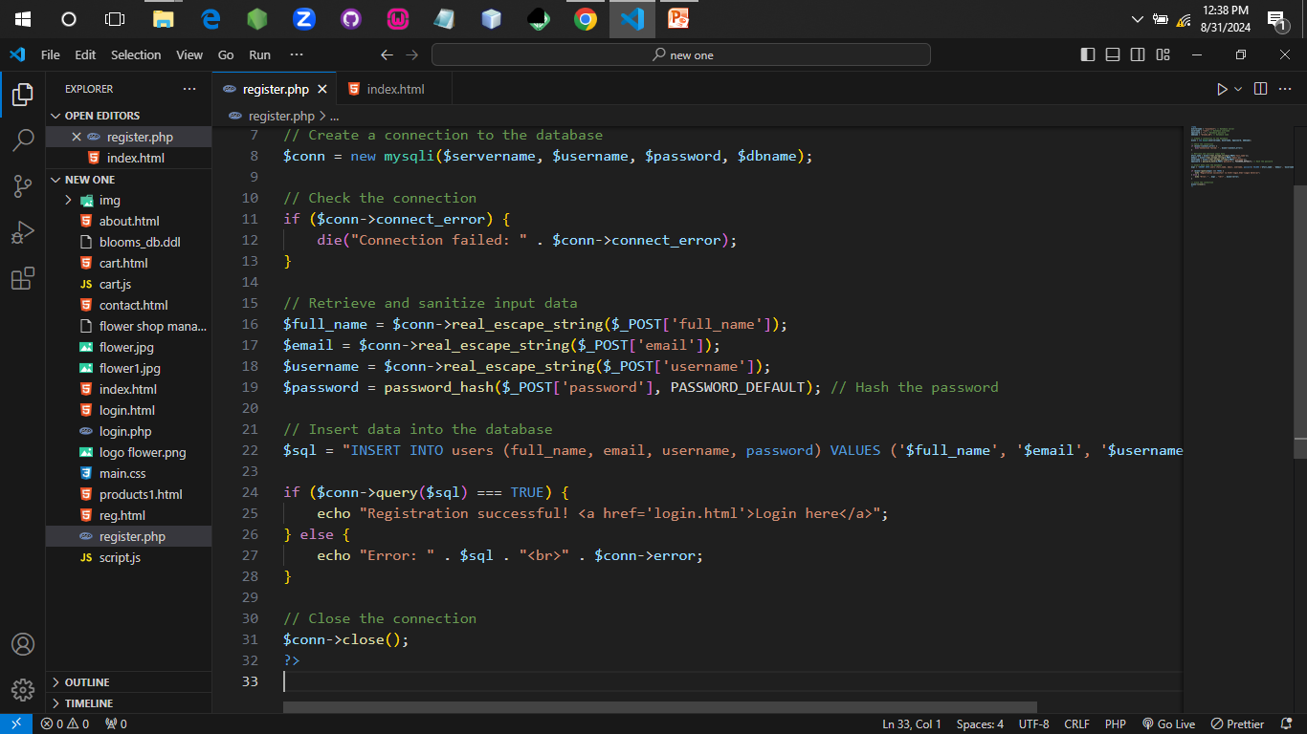

Slide 16

Database Overview
Our project is Flower Shop Management System, and the database is the backbone, handling customer orders, inventory, and employee management.
Key entities
Customer
Products
Orders
Employees

Slide 17
Key Table & Relationships
Relationships are established using foreign keys to maintain data integrity.
The Customers Table
Stores all relevant customer details, such as names and contact information.
The Products Table
Manages the inventory, keeping track of product names, descriptions, prices and stock levels.
The Orders Table
Tracks customer orders, linked to products and customer.
The Employees Table
Holds data about the staff, including their roles within the shop.

Slide 18
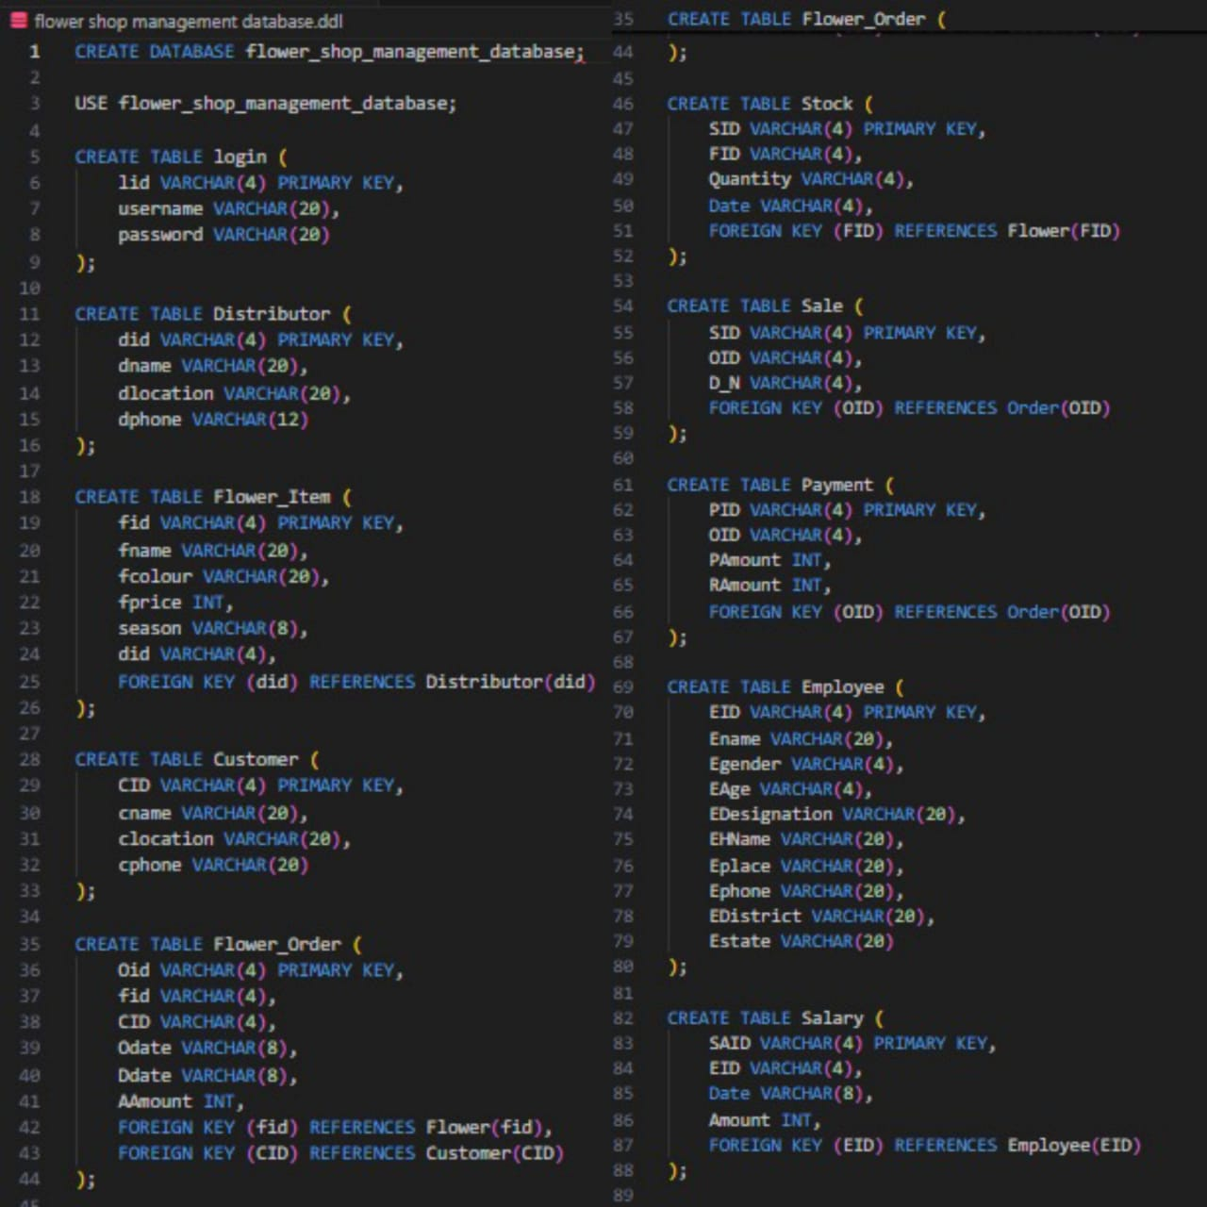
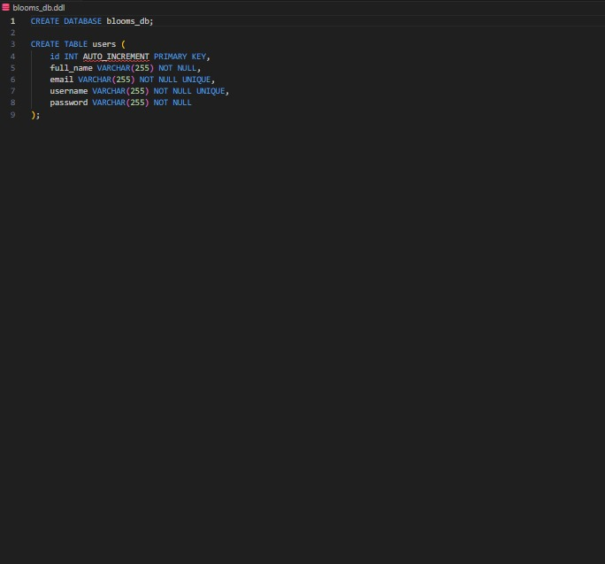

Slide 19

CSS
Our project utilizes CSS to manage the visual design and enhance user experience.
Structure and Layout
CSS ensures our website is responsive and visually consistent. We used Flexbox and grid layouts to arrange elements effectively across different devices.
Styling and Theme
Though CSS, we define the site’s color schemes, fonts and spacing. This consistency reinforces the flower shop’s brand identity and creates a cohesive look.
Interactivity
CSS adds interactivity with hover effects and animations, making the site more engaging and user-friendly.

Slide 20
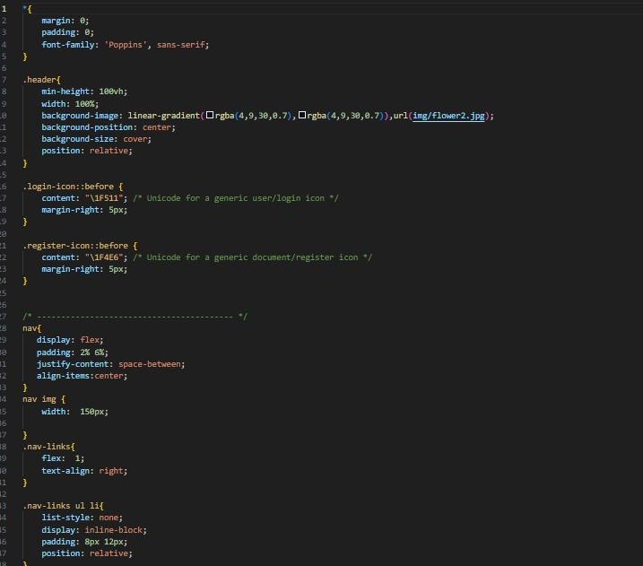
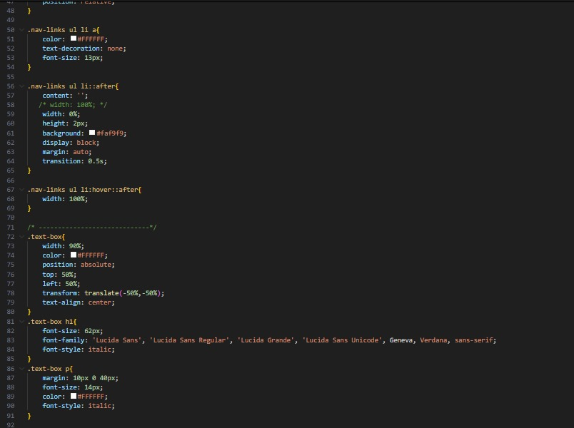

Slide 21
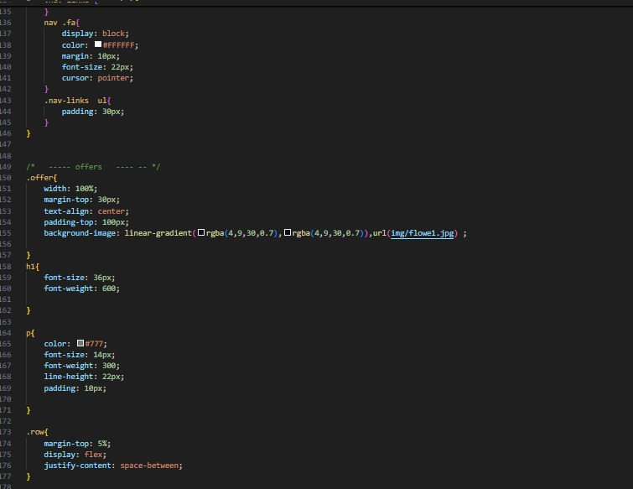
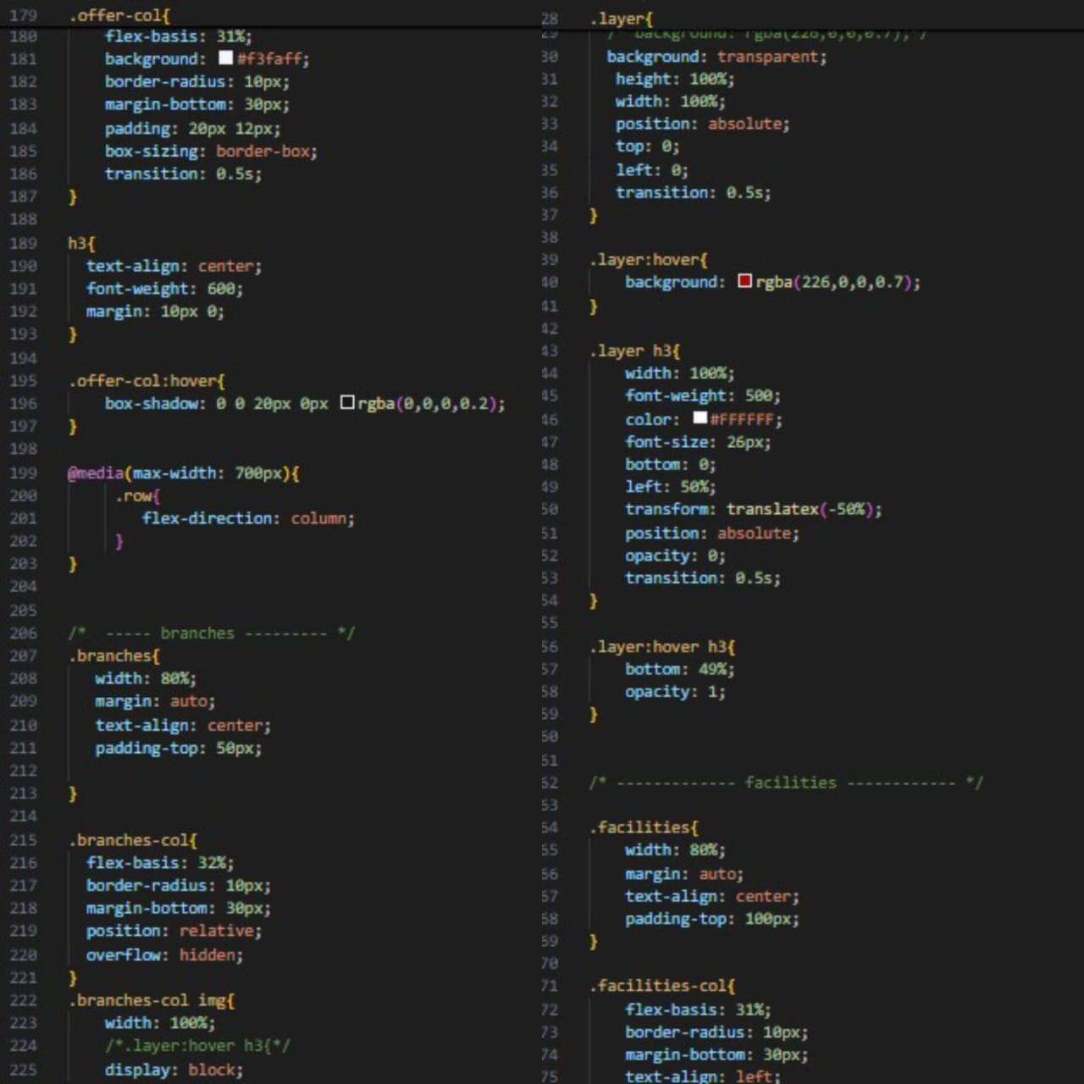

Slide 22
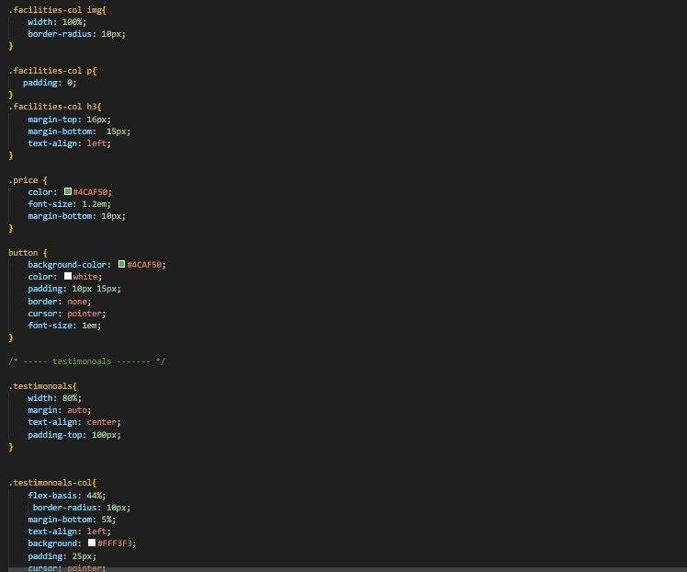
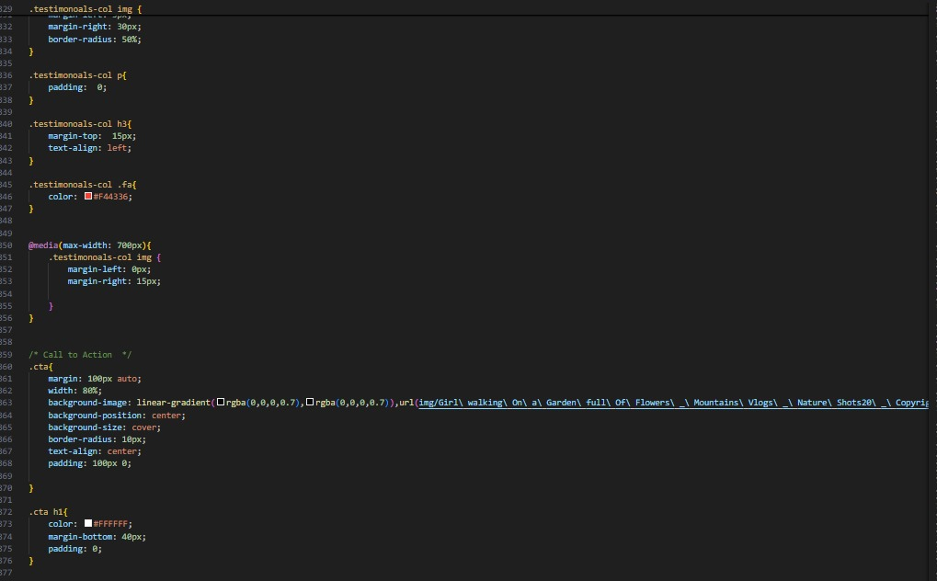

Slide 23
Challenges and Solusions
Our database ensure efficient and reliable management of the flower shop, supporting smooth operation and future scalability.
Balancing normalization and performance.
We normalized the database to avoid redundancy, while indexing was used to maintain query performance.
Ensuring data integrity with complex relationships.
We used foreign keys and constraints to enforce data consistency.

Slide 24

Thank You for Your Time
We appreciate your time and interest in our presentation. We hope you found the information valuable and insightful.

