Slide 1

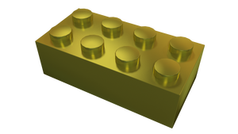
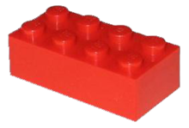
μFrontEnd and WebComponents
Östersund

Slide 2
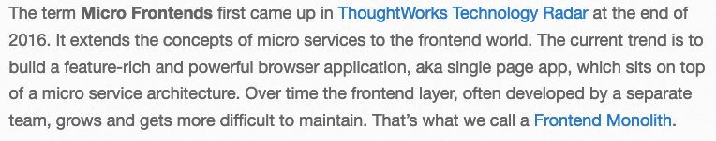
Quote

Slide 3
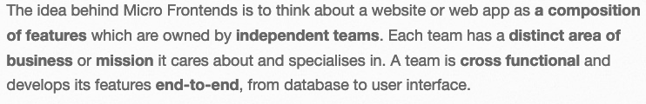
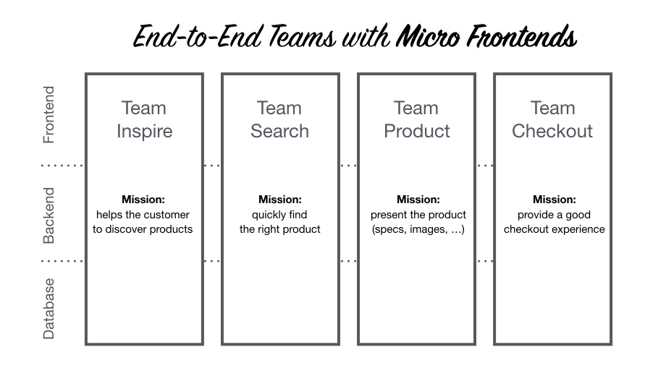
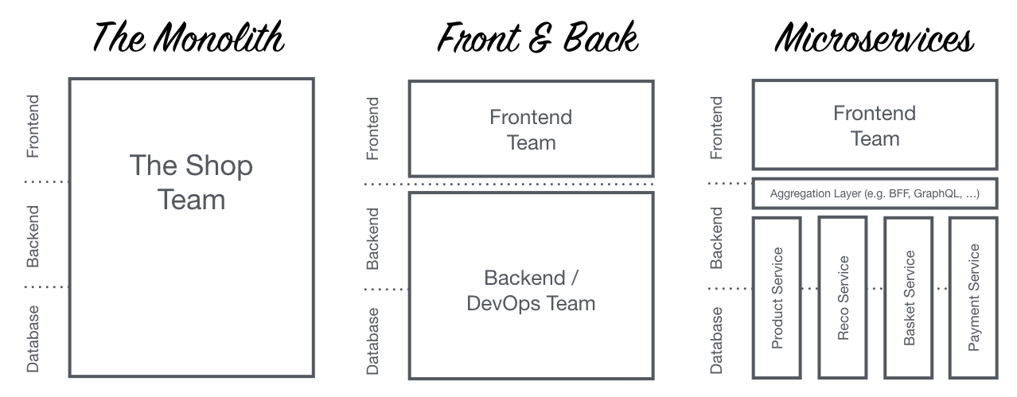
Verksamhets..logik

Slide 4
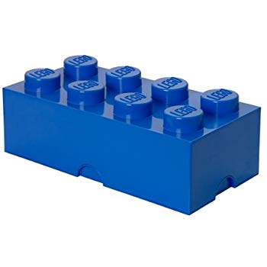
Det låter ju bra… och.. men..?
Vi har äntligen en standard för Web Components!
Eller.. Nej.. eg. tre standarder:
Custom Elements – APIs to define new HTML elements
Shadow DOM – Encapsulated DOM and styling, with composition
HTML Templates, an HTML fragment is not rendered, but stored until it is instantiated via JavaScript
Notes:
Web Components were introduced by Alex Russell at Fronteers Conference 2011 for the first time. ^{[17]}
Polymer, a library based on Web Components was released by Google in 2013.^{[18]}

Slide 5
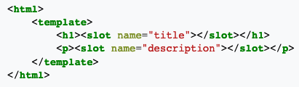

Slide 6

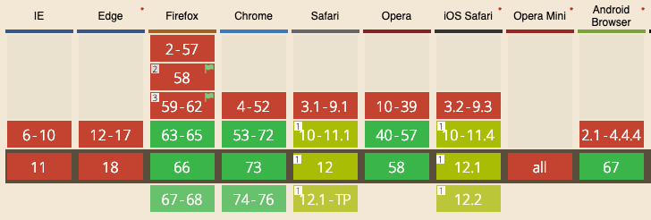
Reality check

Slide 7


Men vänta lite.. WTF är Shadow DOM?

Slide 8
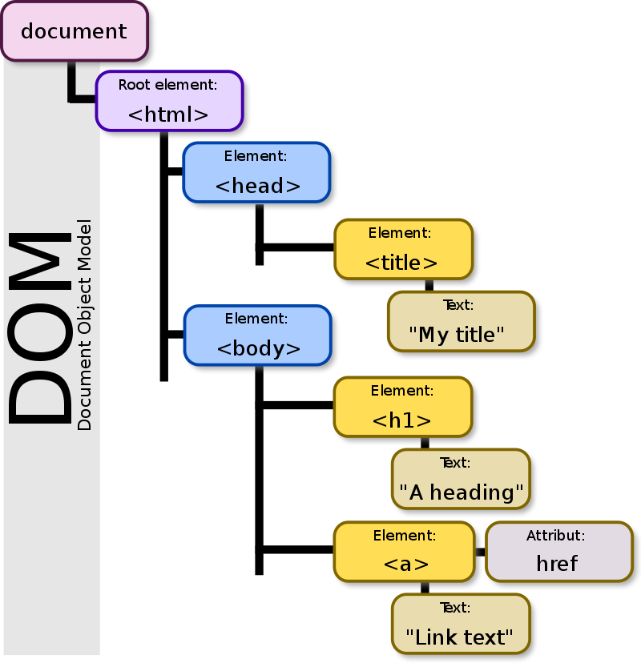
@ First,
There was the DOM:
Notes:
DOM är det som möjliggör AJAX/REST, SPA mm mm mm.
Grunder för web applikationer.

Slide 9
References
https://en.wikipedia.org/wiki/Web_Components
https://developer.mozilla.org/en-US/docs/Web/Web_Components
https://en.wikipedia.org/wiki/Document_Object_Model
https://micro-frontends.org/

