Slide 1

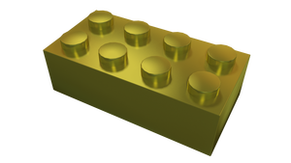
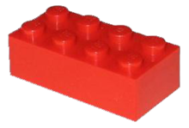
μFrontEnds using WebComponents
Östersund

Slide 2
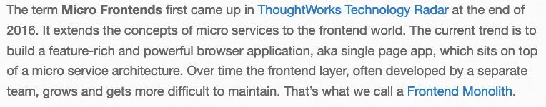
Quote

Slide 3
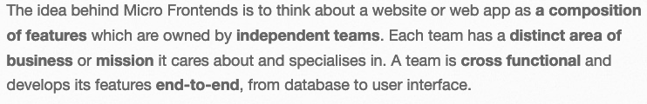
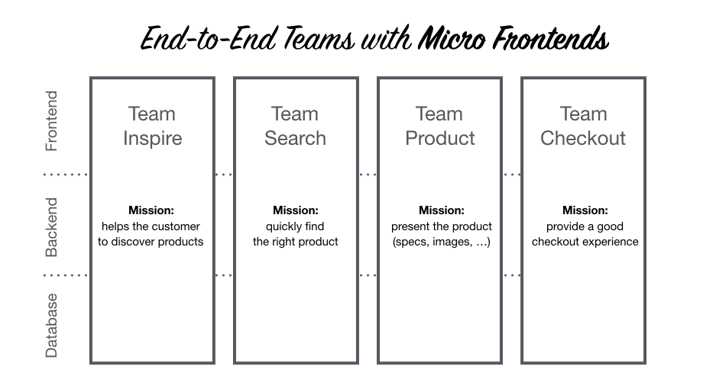
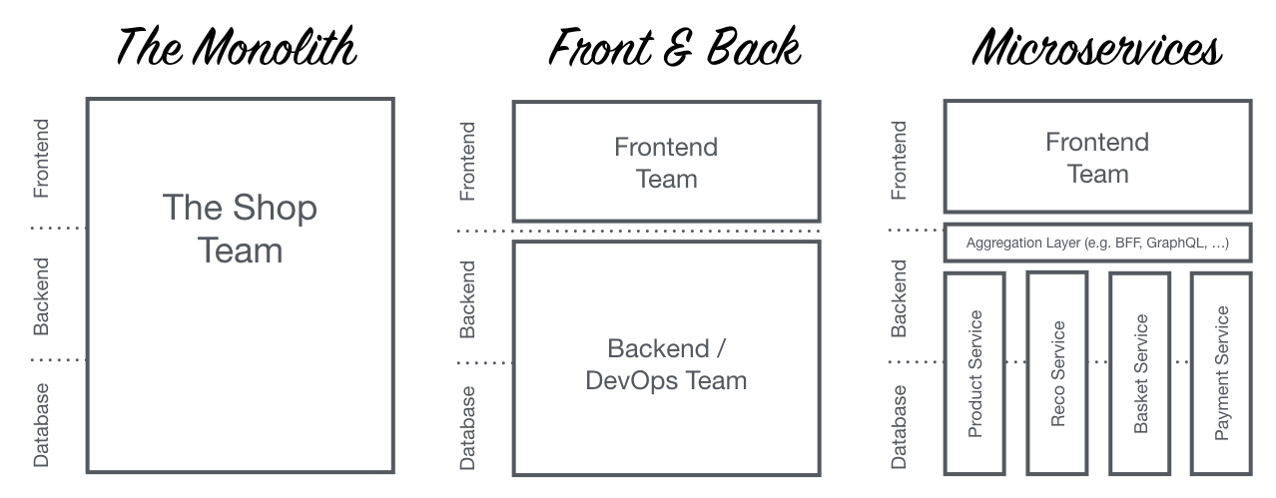
Verksamhets..logik

Slide 4
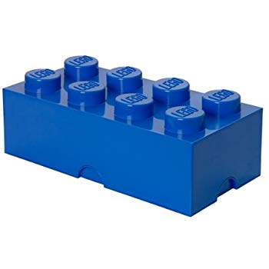
Det låter ju bra… och.. men..?
Vi har äntligen en standard för Web Components!
Eller.. Nej.. eg. tre standarder:
Custom Elements – APIs to define new HTML elements tänk <skatt-knapp>
Shadow DOM – Encapsulated DOM and styling, with composition
HTML Templates, an HTML fragment is not rendered, but stored until it is instantiated via JavaScript
Notes:
Web Components were introduced by Alex Russell at Fronteers Conference 2011 for the first time. ^{[17]}
Polymer, a library based on Web Components was released by Google in 2013.^{[18]}

Slide 5
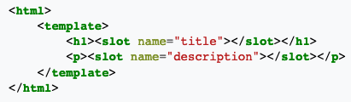

Slide 6

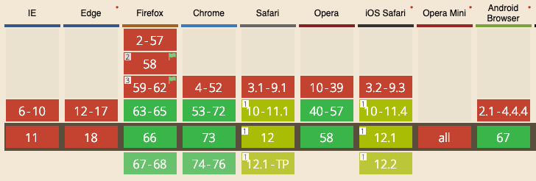
Reality check

Slide 7


Men vänta lite.. WTF är Shadow DOM?
Notes:
Anakin Skywalker / Darth Vader.

Slide 8
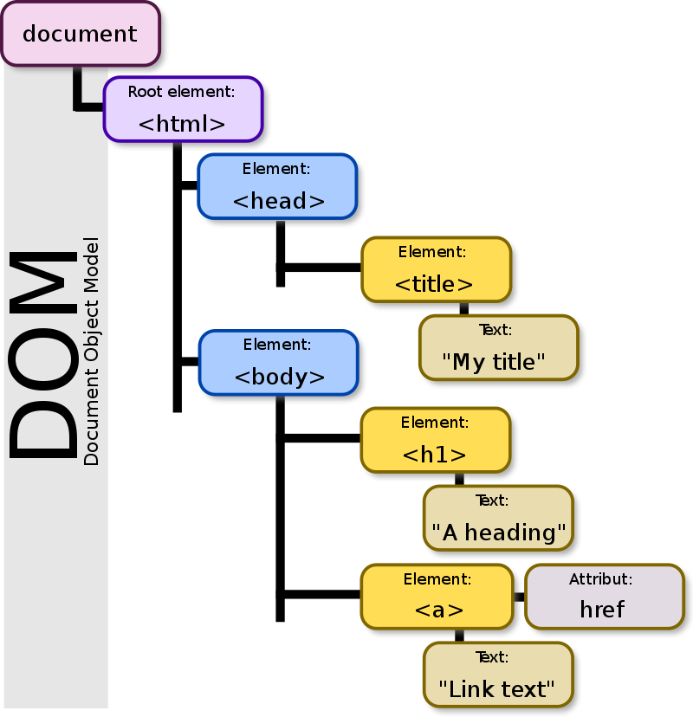
DOM med JavaScript är det som möjliggör AJAX/REST, SPA mm mm mm.
Grunden för web applikationer
vs. Hypertext dokument.
@ First,
There was the DOM:
Notes:
DOM är det som möjliggör AJAX/REST, SPA mm mm mm.
Grunder för web applikationer.

Slide 9
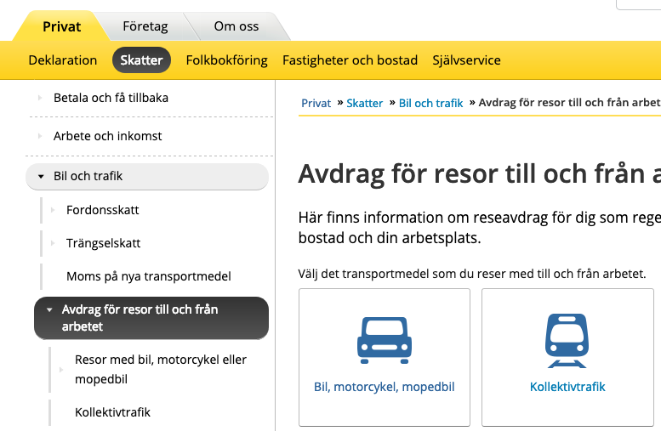
Vad är problemet?
”Globala variabler”
Komponenter som ”läcker CSS”
=>
Inkapsling!

Slide 10
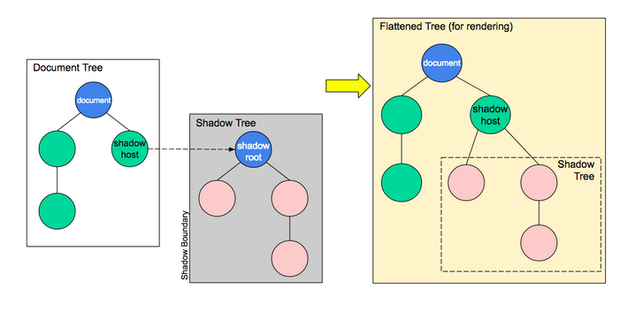
Hur funkar det?
Shadow host: The regular DOM node that the shadow DOM is attached to.
Shadow tree: The DOM tree inside the shadow DOM.
Shadow boundary: the place where the shadow DOM ends, and the regular DOM begins.
Shadow root: The root node of the shadow tree.
none of the code inside a shadow DOM can affect anything outside it, allowing for handy encapsulation.

Slide 11
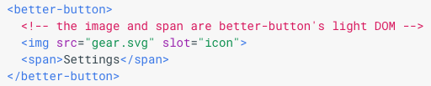
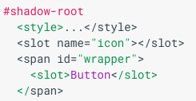
Mer begrepp
Light DOM
The markup a user of your component writes. This DOM lives outside the component's shadow DOM. It is the element's actual children.
Shadow DOM
The DOM a component author writes. Shadow DOM is local to the component and defines its internal structure, scoped CSS, and encapsulates your implementation details. It can also define how to render markup that's authored by the consumer of your component.

Slide 12
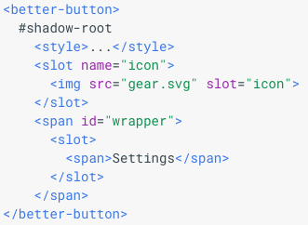
Mer begrepp
Flattened DOM tree (eller “Composed” / “Rendered”)
The result of the browser distributing the user's light DOM into your shadow DOM, rendering the final product. The flattened tree is what you ultimately see in the DevTools and what's rendered on the page.
The <slot> element
Shadow DOM composes different DOM trees together using the <slot> element. Slots are placeholders inside your component that users can fill with their own markup. By defining one or more slots, you invite outside markup to render in your component's shadow DOM. Essentially, you're saying "Render the user's markup over here".

Slide 13
Wrap-UP
Web Components är en samling officiella standarder. W3C.
Micro-Frontends är ett Designmönster som använder sig av bl.a. Web Components.

Slide 14
References
https://en.wikipedia.org/wiki/Web_Components
https://developer.mozilla.org/en-US/docs/Web/Web_Components
https://en.wikipedia.org/wiki/Document_Object_Model
https://micro-frontends.org/
https://developers.google.com/web/fundamentals/web-components/shadowdom

Slide 15
Vad är problemet med globala variabler?
100 LET X = 17
110 PRINT ”Hello World!”
120

