Slide 1

NAME IT, DRAW IT!: ACTIVITY 3
HANS ANDREY R. MONREAL
NAME
FLIGHT
GATE
CHEMICAL ENGINEERING 2A
SEAT

Slide 2
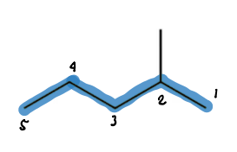
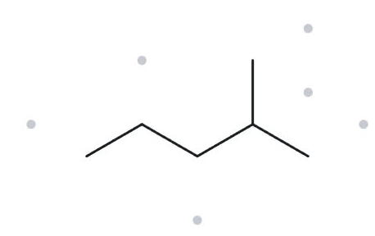

CARD A01 - 2-methylpentane
Level: Foundation Molecular Formula: C₆H₁₄
  Naming Trail
  Parent chain: Pentane (5 carbon atoms).
  Numbering: Number from the end nearest the methyl branch; the branch is on carbon 2.
  Substituent: One methyl group at C-2. Final name: 2-methylpentane.
  Numbered Parent
  My Name
  The Alkane Check
2-methylpentane
Verification Strip:
✓ longest chain confirmed ✓ lowest locants ✓ alphabetical order ✓ punctuation ✓ formula counted
✓ longest chain confirmed ✓ lowest locants ✓ alphabetical order ✓ punctuation ✓ formula counted
✓ longest chain confirmed ✓ lowest locants ✓ alphabetical order ✓ punctuation ✓ formula counted

Slide 3
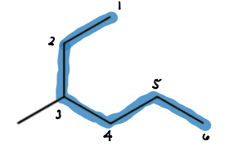
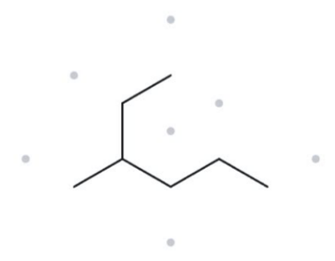

CARD A02 - 3-methylhexane
Level: Foundation Molecular Formula: C₇H₁₆
  Naming Trail
  Numbered Parent
  Parent chain: Hexane (6 carbon atoms).
  Numbering: Number from the end that gives the methyl branch the lower locant, C-3.
  Substituent: One methyl group at C-3. Final name: 3-methylhexane.
  My Name
  The Alkane Check
3-methylhexane
Verification Strip:
✓ longest chain confirmed ✓ lowest locants ✓ alphabetical order ✓ punctuation ✓ formula counted

Slide 4
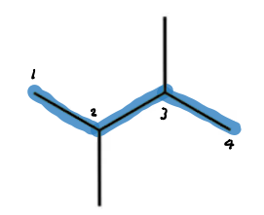
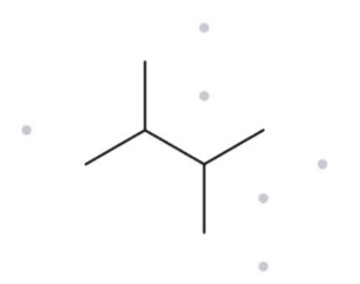

CARD A03 - 2,3-dimethylbutane
Level: Foundation Molecular Formula: C₆H₁₄
  Naming Trail
  Numbered Parent
  Parent chain: Butane (4 carbon atoms).
  Numbering: Number the chain to give the methyl groups locants 2 and 3.
  Substituents: Two methyl groups at C-2 and C-3. Final name: 2,3-dimethylbutane.
  My Name
  The Alkane Check
2,3-dimethylbutane
Verification Strip:
✓ longest chain confirmed ✓ lowest locants ✓ alphabetical order ✓ punctuation ✓ formula counted

Slide 5
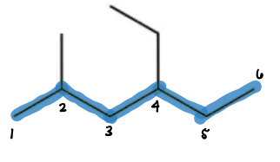
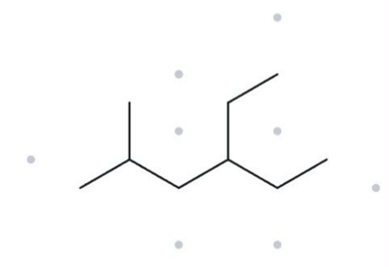

CARD A04 - 4-ethyl-2-methylhexane
Level: Developing Molecular Formula: C₉H₂₀
  Naming Trail
  Parent chain: Hexane (6 carbon atoms).
  Numbering: Number from the end that gives the substituents the lowest locants: 2 and 4.
  Substituents: Ethyl at C-4 and methyl at C-2; arrange alphabetically. Final name: 4-ethyl-2-methylhexane.
  Numbered Parent
  My Name
  The Alkane Check
4-ethyl-2-methylhexane
Verification Strip:
✓ longest chain confirmed ✓ lowest locants ✓ alphabetical order ✓ punctuation ✓ formula counted

Slide 6
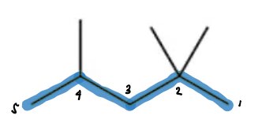
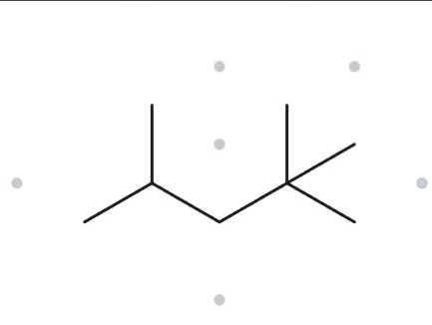
CARD A05 - 2,2,4-trimethylpentane
Level: Developing Molecular Formula: C₈H₁₈
  Naming Trail
  Parent chain: Pentane (5 carbon atoms).
  Numbering: Number from the end that gives the methyl groups the lowest locants: 2,2,4.
  Substituents: Three methyl groups at C-2, C-2, and C-4. Final name: 2,2,4-trimethylpentane.
  Numbered Parent
  My Name
  The Alkane Check
2,2,4-trimethylpentane
Verification Strip:
✓ longest chain confirmed ✓ lowest locants ✓ alphabetical order ✓ punctuation ✓ formula counted

Slide 7
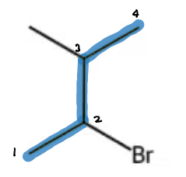
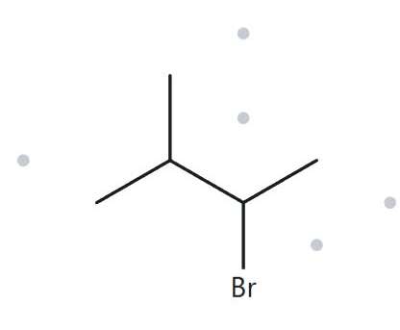

CARD A06 - 2-bromo-3-methylbutane
Level: Developing Molecular Formula: C₅H₁₁Br
  Naming Trail
  Parent chain: Butane (4 carbon atoms).
  Numbering: The two substituents have locants 2 and 3 either way; alphabetical priority gives bromo the lower number.
  Substituents: Bromo at C-2 and methyl at C-3. Final name: 2-bromo-3-methylbutane.
  Numbered Parent
  My Name
  The Alkane Check
2-bromo-3-methylbutane
Verification Strip:
✓ longest chain confirmed ✓ lowest locants ✓ alphabetical order ✓ punctuation ✓ formula counted

Slide 8
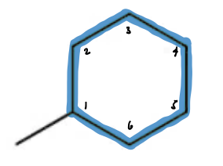
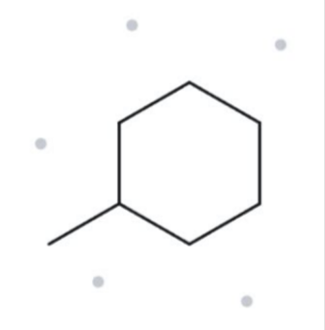

CARD A07 - methylcyclohexane
Level: Developing Molecular Formula: C₇H₁₄
  Naming Trail
  Parent chain: Cyclohexane (6 carbon atoms); the ring is the parent.
  Numbering: The carbon attached to the methyl group is C-1.
  Substituent: One methyl group at C-1. Final name: methylcyclohexane.
  Numbered Parent
  My Name
  The Alkane Check
methylcyclohexane
Verification Strip:
✓ longest chain confirmed ✓ lowest locants ✓ alphabetical order ✓ punctuation ✓ formula counted

Slide 9
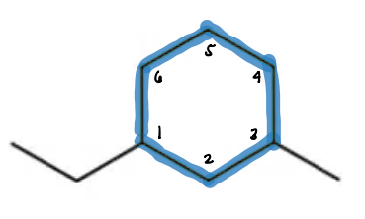
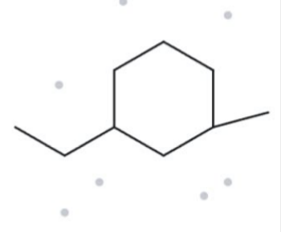

CARD A08 - 1-ethyl-3-methylcyclohexane
Level: Challenge Molecular Formula: C₉H₁₈
  Naming Trail
  Parent chain: Cyclohexane (6 carbon atoms); the ring is the parent.
  Numbering: Begin at the carbon bearing ethyl and proceed toward methyl to obtain locants 1 and 3.
  Substituents: Ethyl at C-1 and methyl at C-3; alphabetical order is followed. Final name: 1-ethyl-3-methylcyclohexane.
  Numbered Parent
  My Name
  The Alkane Check
1-ethyl-3-methylcyclohexane
Verification Strip:
✓ longest chain confirmed ✓ lowest locants ✓ alphabetical order ✓ punctuation ✓ formula counted

Slide 10
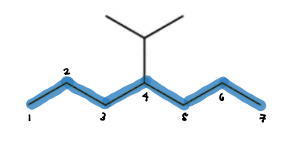
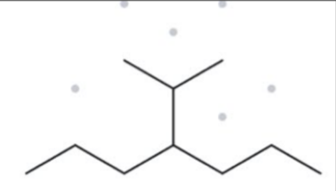

CARD A09 - 4-Isopropylheptane
Level: Challenge Molecular Formula: C₁₀H₂₂
  Naming Trail
  Parent chain: Heptane (7 carbon atoms).
  Numbering: Number from either end of the chain; the isopropyl substituent is located at C-4.
  Substituent: One isopropyl group at C-4. Final name: 4-isopropylheptane.
  Numbered Parent
  My Name
  The Alkane Check
4-Isopropylheptane
Verification Strip:
✓ longest chain confirmed ✓ lowest locants ✓ alphabetical order ✓ punctuation ✓ formula counted

Slide 11
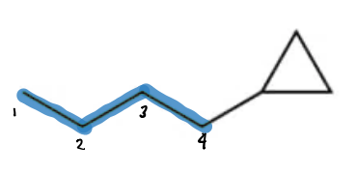
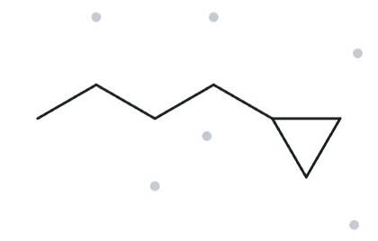
CARD A10 - cyclopropylbutane
Level: Challenge Molecular Formula: C₇H₁₄
  Naming Trail
  Parent chain/ring: Butane (4 carbon atoms) and cyclopropyl ring (3 carbon atoms).
  Numbering: The butane chain is numbered from the end attached to the cyclopropyl group, giving locant 1.
  Substituent: One cyclopropyl group at C-1. Final name: cyclopropylbutane.
  Numbered Parent
  My Name
  The Alkane Check
cyclopropylbutane
Verification Strip:
✓ longest chain confirmed ✓ lowest locants ✓ alphabetical order ✓ punctuation ✓ formula counted

Slide 12
NAME IT, DRAW IT!: ACTIVITY 3
PART B
NAME
FLIGHT
GATE
SEAT

Slide 13
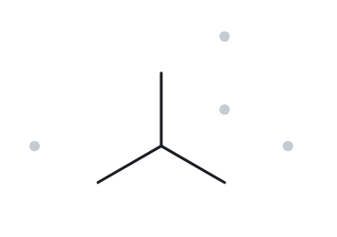
CARD B01 - Given Name: 2-methylpropane
Level: Foundation
  Name Decoded
  Parent chain: Propane, consisting of 3 carbon atoms.
  Substituent: One methyl group attached to carbon 2.
  Expected molecular formula: 3 parent carbons + 1 substituent carbon = 4 carbon atoms. Since it is an open-chain alkane, its formula is C₄H₁₀.
  Bond-line Structure
  Formula Check
  The Back Check
  Formula obtained by counting the drawn structure: C₄H₁₀.
  Applying the open-chain alkane formula, CₙH₂ₙ₊₂, gives C₄H₁₀.
  Result: The calculated formula agrees with the given compound.
  Name generated by The Alkane: 2-methylpropane.
Verification Strip:
✓ PARENT LENGTH MATCHES | ✓ SUBSTITUENT POSITIONS MATCH | ✓ FORMULA AGREES | ✓ BACK-CHECK RECORDED

Slide 14
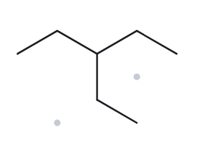
CARD B02 - Given Name: 3-ethylpentane
Level: Foundation
  Name Decoded
  Parent chain: Pentane, containing 5 carbon atoms.
  Substituent: One ethyl group attached to carbon 3.
  Expected molecular formula: 5 parent carbons + 2 substituent carbons = 7 carbon atoms. The open-chain formula gives C₇H₁₆.
  Bond-line Structure
  Formula Check
  The Back Check
  Formula counted from the structure: C₇H₁₆.
  Using CₙH₂ₙ₊₂ for an open-chain alkane gives C₇H₁₆.
  Result: The calculated formula is consistent with the given name.
  Name generated by The Alkane: 3-ethylpentane.
Verification Strip:
✓ PARENT LENGTH MATCHES | ✓ SUBSTITUENT POSITIONS MATCH | ✓ FORMULA AGREES | ✓ BACK-CHECK RECORDED

Slide 15
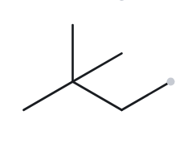
CARD B03 - Given Name: 2,2-dimethylbutane
Level: Foundation
  Name Decoded
  Parent chain: Butane, consisting of 4 carbon atoms.
  Substituents: Two methyl groups attached to carbon 2.
  Expected molecular formula: 4 parent carbons + 2 substituent carbons = 6 carbon atoms. For an open-chain alkane, the formula is C₆H₁₄.
  Bond-line Structure
  Formula Check
  The Back Check
  Formula counted from the structure: C₆H₁₄.
  Applying the general formula CₙH₂ₙ₊₂ gives C₆H₁₄.
  Result: The calculated formula matches the given compound.
  Name generated by The Alkane: 2,2-dimethylbutane.
Verification Strip:
✓ PARENT LENGTH MATCHES | ✓ SUBSTITUENT POSITIONS MATCH | ✓ FORMULA AGREES | ✓ BACK-CHECK RECORDED

Slide 16
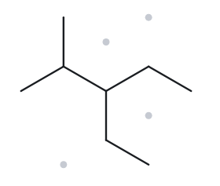
CARD B04 - Given Name: 3-ethyl-2-methylpentane
Level: Developing
  Name Decoded
  Parent chain: Pentane, with 5 carbon atoms.
  Substituents: One methyl group at carbon 2 and one ethyl group at carbon 3.
  Expected molecular formula: 5 parent carbons + 2 ethyl carbons + 1 methyl carbon = 8 carbon atoms. Its open-chain formula is C₈H₁₈.
  Bond-line Structure
  Formula Check
  The Back Check
  Formula counted from the drawn structure: C₈H₁₈.
  Using the general open-chain alkane formula gives C₈H₁₈.
  Result: The calculated formula agrees with the given name.
  Name generated by The Alkane: 3-ethyl-2-methylpentane.
Verification Strip:
✓ PARENT LENGTH MATCHES | ✓ SUBSTITUENT POSITIONS MATCH | ✓ FORMULA AGREES | ✓ BACK-CHECK RECORDED

Slide 17
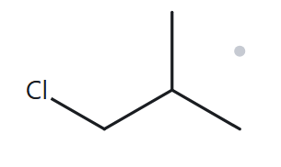
CARD B05 - Given Name: 1-chloro-2-methylpropane
Level: Developing
  Name Decoded
  Parent chain: Propane, containing 3 carbon atoms.
  Substituents: One methyl group and one chlorine substituent.
  Expected molecular formula: 3 parent carbons + 1 methyl carbon = 4 carbon atoms. The corresponding alkane formula is C₄H₁₀. Replacing one hydrogen atom with chlorine produces C₄H₉Cl.
  Bond-line Structure
  Formula Check
  The Back Check
  Formula counted from the structure: C₄H₉Cl.
  The open-chain alkane formula gives C₄H₁₀. Replacing one hydrogen with chlorine results in C₄H₉Cl.
  Result: The calculated formula matches the given compound.
  Name generated by The Alkane: 1-chloro-2-methylpropane.
Verification Strip:
✓ PARENT LENGTH MATCHES | ✓ SUBSTITUENT POSITIONS MATCH | ✓ FORMULA AGREES | ✓ BACK-CHECK RECORDED

Slide 18
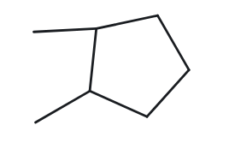
CARD B06 - Given Name: 1,2-dimethylcyclopentane
Level: Developing
  Name Decoded
  Parent ring: Cyclopentane, containing 5 carbon atoms.
  Substituents: Two methyl groups attached at carbons 1 and 2.
  Expected molecular formula: 5 ring carbons + 2 substituent carbons = 7 carbon atoms. Since the compound contains one ring, its formula is C₇H₁₄.
  Bond-line Structure
  Formula Check
  The Back Check
  Formula counted from the drawn structure: C₇H₁₄.
  Applying the one-ring hydrocarbon formula, CₙH₂ₙ, gives C₇H₁₄.
  Result: The calculated formula is consistent with the given name.
  Name generated by The Alkane: 1,2-dimethylcyclopentane.
Verification Strip:
✓ PARENT LENGTH MATCHES | ✓ SUBSTITUENT POSITIONS MATCH | ✓ FORMULA AGREES | ✓ BACK-CHECK RECORDED

Slide 19
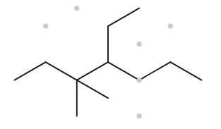
CARD B07 - Given Name: 4-ethyl-3,3-dimethylheptane
Level: Developing
  Name Decoded
  Parent chain: Heptane, consisting of 7 carbon atoms.
  Substituents: Two methyl groups at carbon 3 and one ethyl group at carbon 4.
  Expected molecular formula: 7 parent carbons + 2 ethyl carbons + 2 methyl carbons = 11 carbon atoms. The open-chain formula gives C₁₁H₂₄.
  Bond-line Structure
  Formula Check
  The Back Check
  Formula counted from the structure: C₁₁H₂₄.
  Using CₙH₂ₙ₊₂ for an open-chain alkane gives C₁₁H₂₄.
  Result: The calculated formula agrees with the given name.
  Name generated by The Alkane: 4-ethyl-3,3-dimethylheptane.
Verification Strip:
✓ PARENT LENGTH MATCHES | ✓ SUBSTITUENT POSITIONS MATCH | ✓ FORMULA AGREES | ✓ BACK-CHECK RECORDED

Slide 20
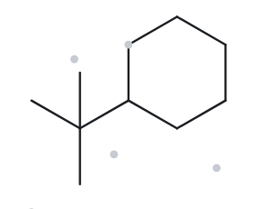
CARD B08 - Given Name: tert-butylcyclohexane
Level: Challenge
  Name Decoded
  Parent ring: Cyclohexane, containing 6 carbon atoms.
  Substituent: One tert-butyl group attached to carbon 1.
  Expected molecular formula: 6 ring carbons + 4 substituent carbons = 10 carbon atoms. Since the compound has one ring, its formula is C₁₀H₂₀.
  Bond-line Structure
  Formula Check
  The Back Check
  Formula counted from the structure: C₁₀H₂₀.
  Applying the one-ring hydrocarbon formula gives C₁₀H₂₀.
  Result: The molecular formula agrees with the given compound, although the website presents a different systematic name.
  Name generated by The Alkane: (1,1-dimethylethyl)cyclohexane.
  The returned name uses a systematic alternative for the tert-butyl substituent.
Verification Strip:
✓ PARENT LENGTH MATCHES | ✓ SUBSTITUENT POSITIONS MATCH | ✓ FORMULA AGREES | ✓ BACK-CHECK RECORDED

Slide 21
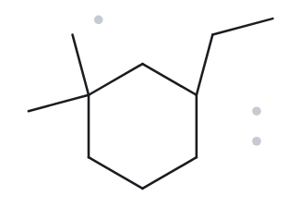
CARD B09 - Given Name: 3-ethyl-1,1-dimethylcyclohexane
Level: Challenge
  Name Decoded
  Parent ring: Cyclohexane, containing 6 carbon atoms.
  Substituents: Two methyl groups at carbon 1 and one ethyl group at carbon 3.
  Expected molecular formula: 6 ring carbons + 2 methyl carbons + 2 ethyl carbons = 10 carbon atoms. Its one-ring formula is C₁₀H₂₀.
  Bond-line Structure
  Formula Check
  The Back Check
  Formula counted from the drawn structure: C₁₀H₂₀.
  Using the one-ring hydrocarbon formula, CₙH₂ₙ, gives C₁₀H₂₀.
  Result: The formula and returned name agree with the given compound.
  Name generated by The Alkane: 3-ethyl-1,1-dimethylcyclohexane.
Verification Strip:
✓ PARENT LENGTH MATCHES | ✓ SUBSTITUENT POSITIONS MATCH | ✓ FORMULA AGREES | ✓ BACK-CHECK RECORDED

Slide 22
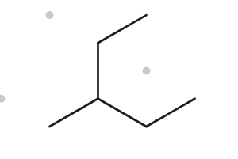
CARD B01 - Given Name: 2-ethylbutane
Level: Challenge
  Name Decoded
  Longest parent chain: Pentane, containing 5 carbon atoms.
  Substituent: One methyl group at carbon 3.
  Expected molecular formula: The original name represents 4 butane-chain carbons + 2 ethyl-group carbons, giving 6 carbon atoms in total. The resulting open-chain formula is C₆H₁₄.
  Bond-line Structure
  Formula Check
  The Back Check
  Formula counted from the drawn structure: C₆H₁₄.
  Applying the open-chain alkane formula gives C₆H₁₄.
  Result: The molecular formula agrees, but the supplied name is deliberately incorrect. The corrected name is 3-methylpentane.
  Name generated by The Alkane: 3-methylpentane.
  The returned name differs from the supplied name because the longest continuous chain must be selected when naming the structure.
Verification Strip:
✓ PARENT LENGTH MATCHES | ✓ SUBSTITUENT POSITIONS MATCH | ✓ FORMULA AGREES | ✓ BACK-CHECK RECORDED

