Slide 1
CAPSTONE PROJECT
Airbnb Bookings Analysis
by
SRI HANSA TAMMINEEDI
Data Science Trainee, AlmaBetter, INDIA

Slide 2
Problem Statement
For this project we are analyzing Airbnb’s New York City(NYC) data of 2019. NYC is not only the most famous city in the world but also top global destination for visitors drawn to its museums, entertainment, restaurants and commerce.
The objective of our exploratory data analysis (EDA) on Airbnb's 2019 New York City (NYC) dataset is to identify the key metrics that influence the listing of properties on the Airbnb platform. By applying basic EDA techniques, we aim to gain insights into the dataset and visualize its various attributes.

Slide 3
As NYC is the most famous city in the world and a top global destination, understanding the factors that impact property listings in this vibrant metropolis becomes crucial. Visitors are drawn to NYC for its renowned museums, entertainment options, diverse culinary experiences, and bustling commercial activities.
Through our analysis, we seek to uncover valuable information about the distribution of Airbnb listings across different locations within NYC. We aim to explore price range, room types, listing names, and other relevant variables.

Slide 4
Understanding the Data
There are 49,000 observations with various types of field in our dataset.
Id
Name
Host_id
Host_name
Neighbourhood_group
Neighbourhood
Latitude
Longitude
Room_type
Price
Minimum_nights
Number_of_reviews
Last_review
Reviews_per_month
Calculated_host_listing_count
availabilty_365

Slide 5
Agenda
Try to answer the following questions for Airbnb:
How many observations and columns are there in the dataset?
What are the top 10 neighborhoods with the most listings?
What is the average price of listings in each neighborhood group?
How does the availability of listings vary across different room types?
How are the prices distributed across different neighborhood groups?

Slide 6
How does the minimum number of nights required for booking vary by neighborhood group?
Who is the most popular/demanded host of Airbnb in New York?
What is the relationship between neighborhood group and the availability of rooms?
What is the maximum number of hosts per location?
Who are the top ten hosts based on their turnover?

Slide 7
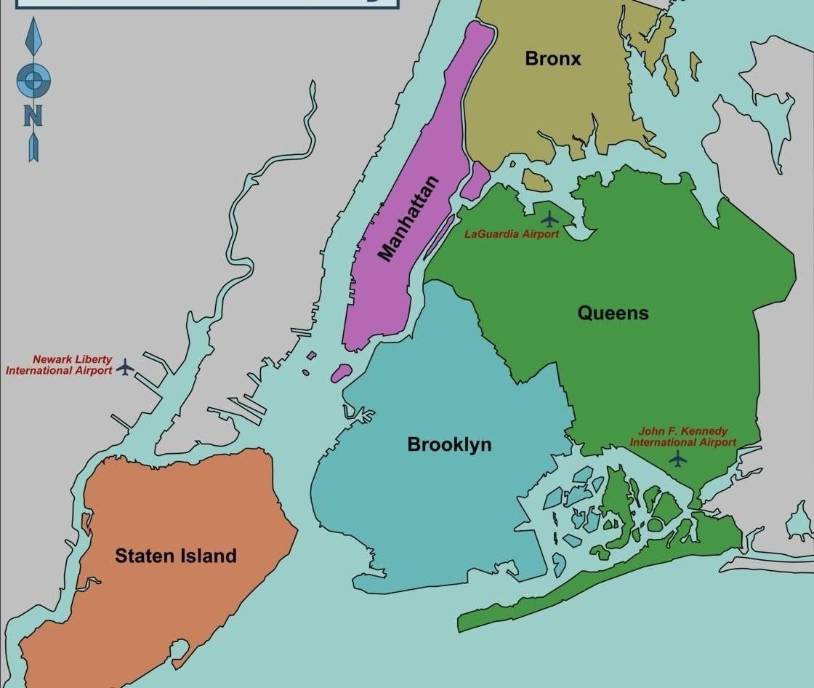
Map of New York City(NYC)

Slide 8
1. How many observations and columns are there in the dataset?

Slide 9
import pandas as pd
import numpy as np
import matplotlib.pyplot as plt
# Load the dataset
df = pd.read_csv('/content/Airbnb NYC 2019.csv')
# Get the number of observations and columns
num_observations = len(df)
num_columns = len(df.columns)
categorical_columns = ['neighbourhood_group', 'room_type', 'host_name']
unique_values = df[categorical_columns].nunique()
missing_values = df.isnull().sum()

Slide 10
Number of observations: There are 48,895 observations in the dataset.
Number of columns: 16
Unique values in categorical columns: 03
a. neighbourhood_group: 5 unique values
b. room_type: 3
c. host_name: 11,452

Slide 11
2. What are the top 10 neighborhoods with the most listings?

Slide 12
top_neighborhoods = df['neighbourhood'].value_counts().head(10)
print("Top 10 neighborhoods with the most listings:")
print(top_neighborhoods)
# Calculate the top 10 neighborhoods with the most listings
top_neighborhoods = df['neighbourhood'].value_counts().head(10)

Slide 13
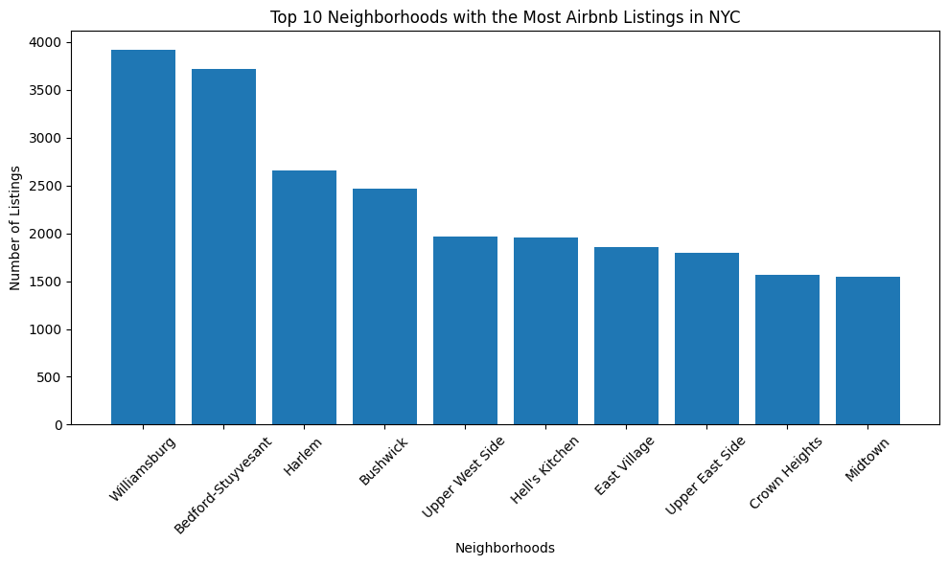
The top 10 neighborhoods with the most listings are:
Williamsburg: 3,920 listings
Bedford-Stuyvesant: 3,714 listings
Harlem: 2,658 listings
Bushwick: 2,465 listings
Upper West Side: 1,971 listings
Hell's Kitchen: 1,958 listings
East Village: 1,853 listings
Upper East Side: 1,798 listings
Crown Heights: 1,564 listings
Midtown: 1,545 listings

Slide 14

3. What is the average price of listings in each neighborhood group?

Slide 15
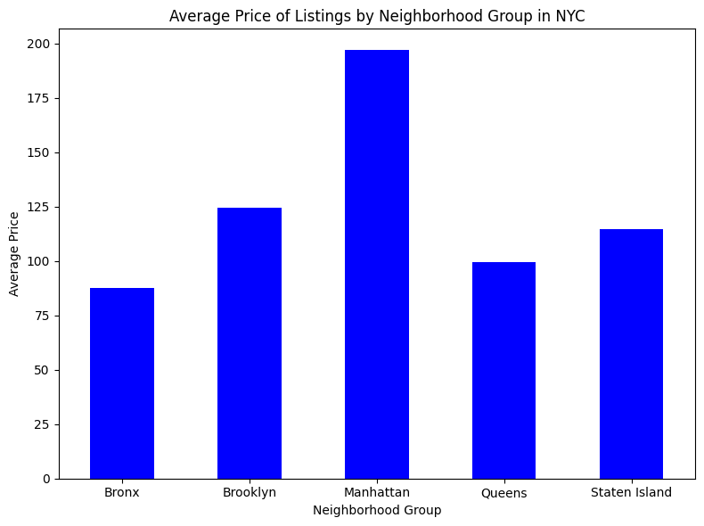
average_price_by_group = df.groupby('neighbourhood_group')['price'].mean():
The average price of listings in each neighborhood group is
Bronx: $87.49
Brooklyn: $124.38
Manhattan: $196.88
Queens: $99.52
Staten Island: $114.81

Slide 16
4. How does the availability of listings vary across different room types?

Slide 17
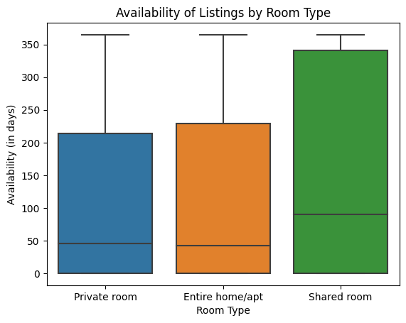
room_type_availability =
df.groupby('room_type')['availability_365'].describe():
Entire home/apt: Mean availability - 111.92 days
Private room: Mean availability - 111.20 days
Shared room: Mean availability - 162.00 days

Slide 18
The output displays the availability of listings by room type
Entire home/apt:
Count 25,409 listings.
The average availability of listings of this room type is 111.92.
25% of the listings are available for 0 days or less.
50% of the listings are available for 42 days or less.
75% of the listings are available 229 days or less.
The maximum availability is 365 days.

Slide 19
Private room: Count: 22,326 listings
The average availability of listings of this room type is 111.20.
The standard deviation of availability for these listings is 132.09.
The minimum availability is 0 days.
25% of the listings have an availability of 0 days or less.
50% of the listings have an availability of 45 days or less.
75% of the listings have an availability of 214 days or less.
The maximum availability is 365 days.

Slide 20
Shared room: Count: 1,160 listings
The average availability of listings of this room type is 162.00
The standard deviation of availability for these listings is 151.35.
50% of the listings are available for 90 days or less.
75% of the listings are available for 341 days or less.
The maximum availability is 365 days.

Slide 21
5. How are the prices distributed across different neighborhood groups?

Slide 22
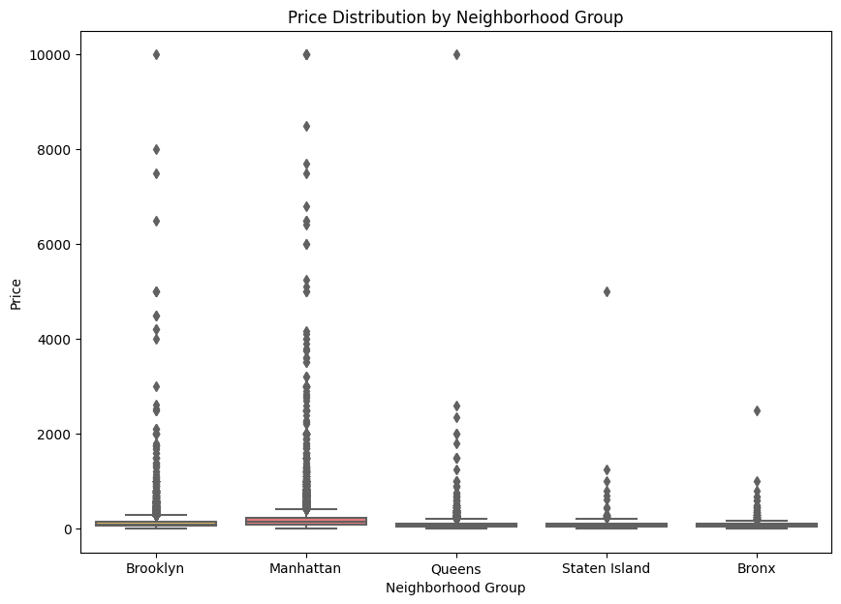
price_stats_by_group =
df.groupby('neighbourhood_group')['price'].describe():

Slide 23
The highest average price among the neighborhood groups is observed in Manhattan. According to the provided statistics, the mean price for listings in Manhattan is $196.88, the highest among all the neighborhood groups in the dataset.
Manhattan:
Count: There are 21,661 listings in the Manhattan neighborhood group.
Mean: The average price of listings in Manhattan is $196.88.
25% of the listings in Manhattan have prices equal to or below $95.00.
50% of the listings in Manhattan have prices equal to or below $150.00.
75% of the listings in Manhattan have prices equal to or below $220.00.
Max: The maximum price observed in Manhattan is $10,000.00.

Slide 24
Distribution of prices within each neighborhood group and room type combination

Slide 25
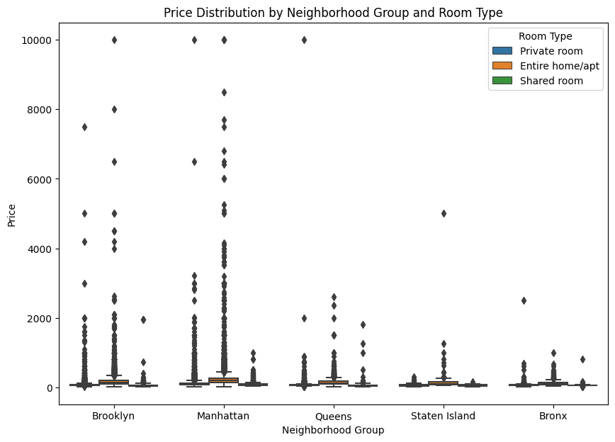
price_stats_by_group_type = df.groupby(['neighbourhood_group’,'room_type'])['price'].describe():
Manhattan:
Entire home/apartment: The average price is $249.24, with a standard deviation of $331.83. Prices range from $0 to $10000.
Private room: The average price is $116.78, with a standard deviation of $190.19. Prices range from $10 to $9999.
Shared room: The average price is $88.98, with a standard deviation of $92.42. Prices range from $10 to $1000.

Slide 26
Manhattan:
Entire home/apt: 13,199 listings
The average price for 'Entire home/apt' listings is $249.24.
The maximum price observed is $10,000.00.
Private room:7,982 listings
The average price is $116.78.
The maximum price observed is $9,999.00.
Shared room:480 listings
The average price is $88.98.
The minimum price is $10.00 and The maximum price is $1,000.00.

Slide 27
6. How does the minimum no. of nights required for booking vary by neighborhood group?

Slide 28
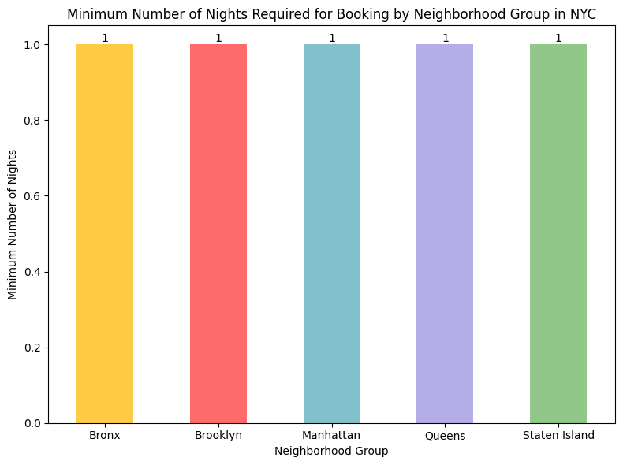
min_nights_by_group = df.groupby('neighbourhood_group')['minimum_nights'].min():
The output indicates that for all neighborhood groups (Bronx, Brooklyn, Manhattan, Queens, and Staten Island), the minimum number of nights required for a booking is 1.

Slide 29
7. Who are the most popular/demanded hosts of Airbnb in New York?

Slide 30
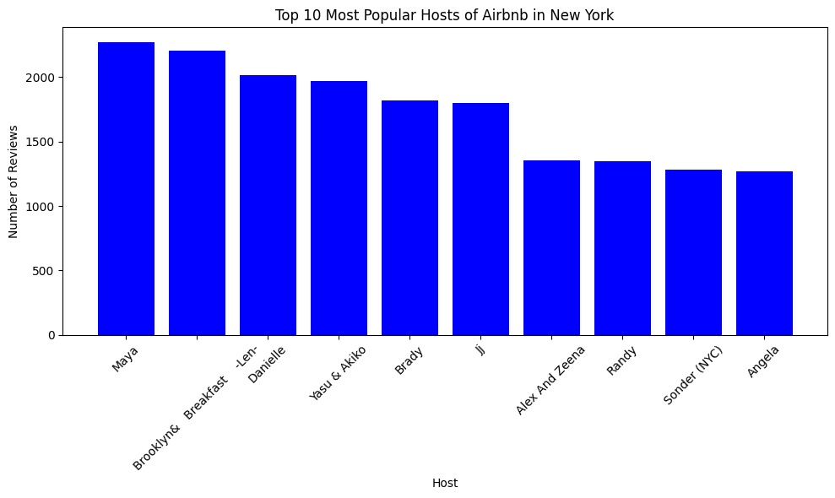
popular_hosts =df.groupby(['host_id’,
'host_name’],as_index=False)['number_of_reviews'].sum():

Slide 31
These hosts have garnered many reviews, indicating their popularity among Airbnb guests in New York.
The hosts and the corresponding number of reviews are listed:
Maya: 2273 reviews.
Brooklyn& Breakfast -Len-: 2205 reviews
Danielle: 2017 reviews
Yasu & Akiko: 1971 reviews
Brady: 1818 reviews

Slide 32
8. What is the relationship between the neighborhood group and the availability of rooms?

Slide 33
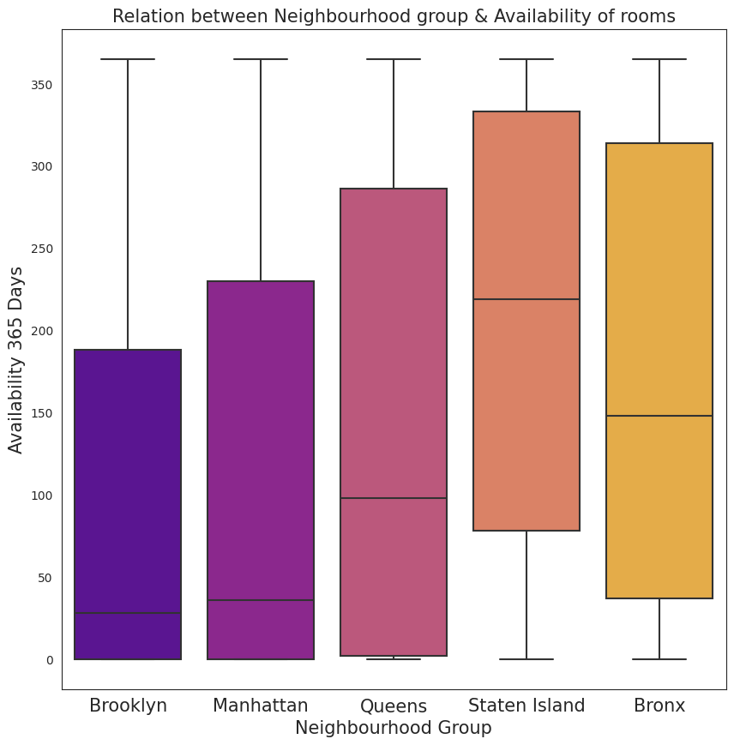
for group in df['neighbourhood_group'].unique()
availability = df[df['neighbourhood_group'] ==
group]['availability_365’]:
Relation between Neighborhood Group and Availability:
Brooklyn has a median availability of 28.0 days,
Manhattan with 36.0 days,
Queens with 98.0 days, and
Staten Island with 0 days.

Slide 34
9. Maximum number of hosts per location

Slide 35
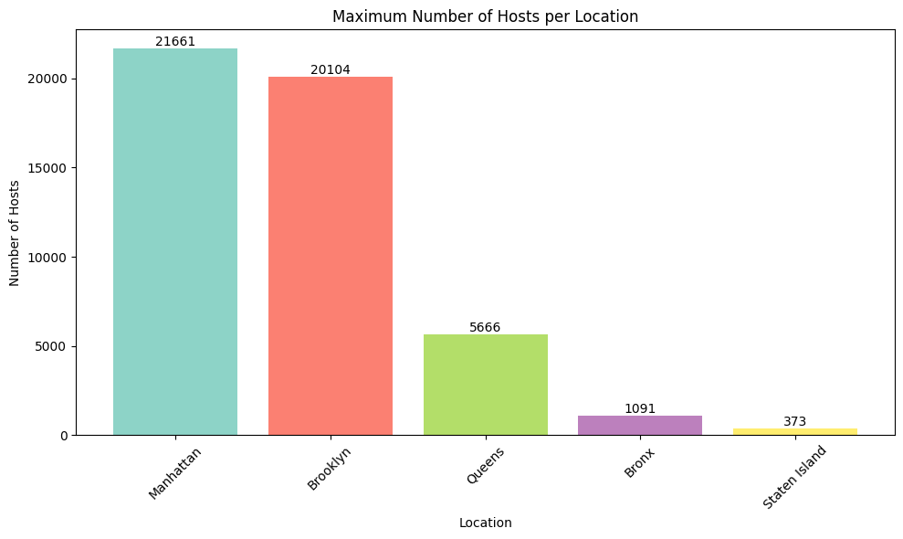
bars = plt.bar(max_host_per_location['Location'], max_host_per_location['Host’]
The maximum number of hosts for each location: Manhattan: 21,661
Brooklyn: 20,104
Queens: 5,666
Bronx: 1,091
Staten Island: 373

Slide 36
10. Which are the top ten hosts based on their turnover?

Slide 37
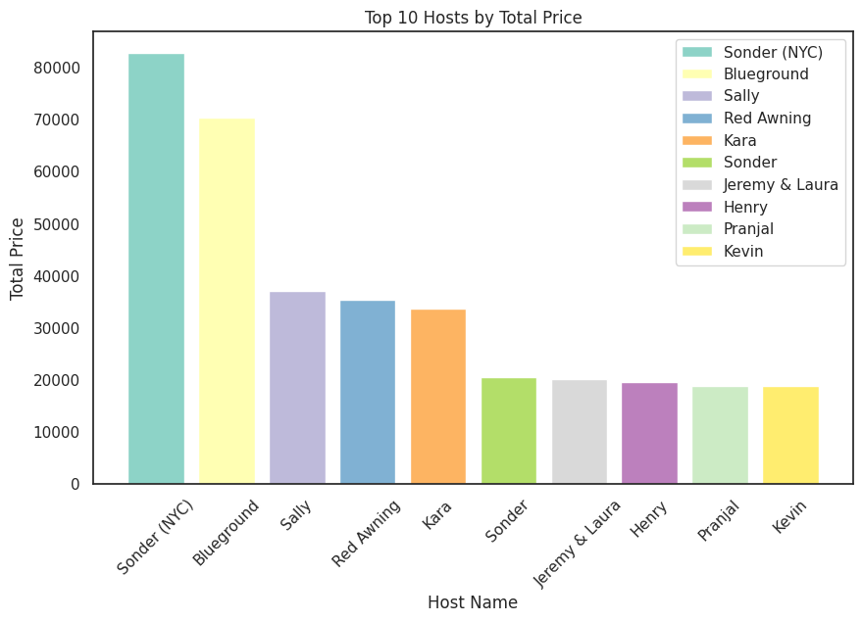
df.loc[df['price']<50,'price'] = df.loc[(df['price']>50) & (df['price']<80),'price'].median():
top_host = df.groupby(['host_name','host_id'])['price'].sum().reset_index(): top_host.rename(columns={'price':'total_price'},inplace=True):
top_10 = top_host.sort_values('total_price',ascending=False).iloc[:10,:10]:

Slide 38
The list represents the top 10 hosts based on the total price of their listings.
Sonder (NYC): $82,795
Blueground: $70,331
Sally: $37,097
Red Awning: $35,294
Kara: $33,581
Sonder: $20,451
Jeremy & Laura: $20,060
Henry: $19,500
Pranjal: $18,865
Kevin: $18,780

Slide 39
Summary:
Neighborhood Group Pricing Strategy: Airbnb can capitalize on the price differences between neighborhood groups. At the same time, they can work on attracting more hosts in neighborhoods like the Bronx and Queens
Private Room Pricing Optimization: Private rooms have a wide price range across all neighborhood groups. Airbnb can help hosts in Manhattan optimize their pricing by setting competitive prices while ensuring profitability.
Shared Room Market Potential: Shared rooms have lower average prices across all neighborhood groups. Airbnb can focus on promoting shared room listings in neighborhoods like the Bronx and Queens
Investment Opportunities in Staten Island: Staten Island has the highest average price for entire home/apartment rentals. Airbnb can explore opportunities to expand their listings in this neighborhood group further, targeting travelers looking for unique and exclusive accommodations.

Slide 40
Competitive Pricing Analysis: Airbnb can monitor and analyze the pricing strategies of its competitors in each neighborhood group.
Customer Education and Awareness: The wide range of prices within each room type suggests that hosts may need more clarity regarding appropriate pricing.
Airbnb can provide resources, such as pricing guidelines and best practices, to educate hosts about setting competitive and fair prices.

Slide 41
Thank you

