Slide 1
Description
We implemented a distributed cloud-based search engine that interacts with the users via a frontend and returns relevant search results for the users’ queries. This search engine is built using a web server, a key-value store (KVS), a distributed analytics engine (Flame), and several other programs written from the scratch, such as a crawler, indexer, page ranker, and an overall ranker.

Slide 2
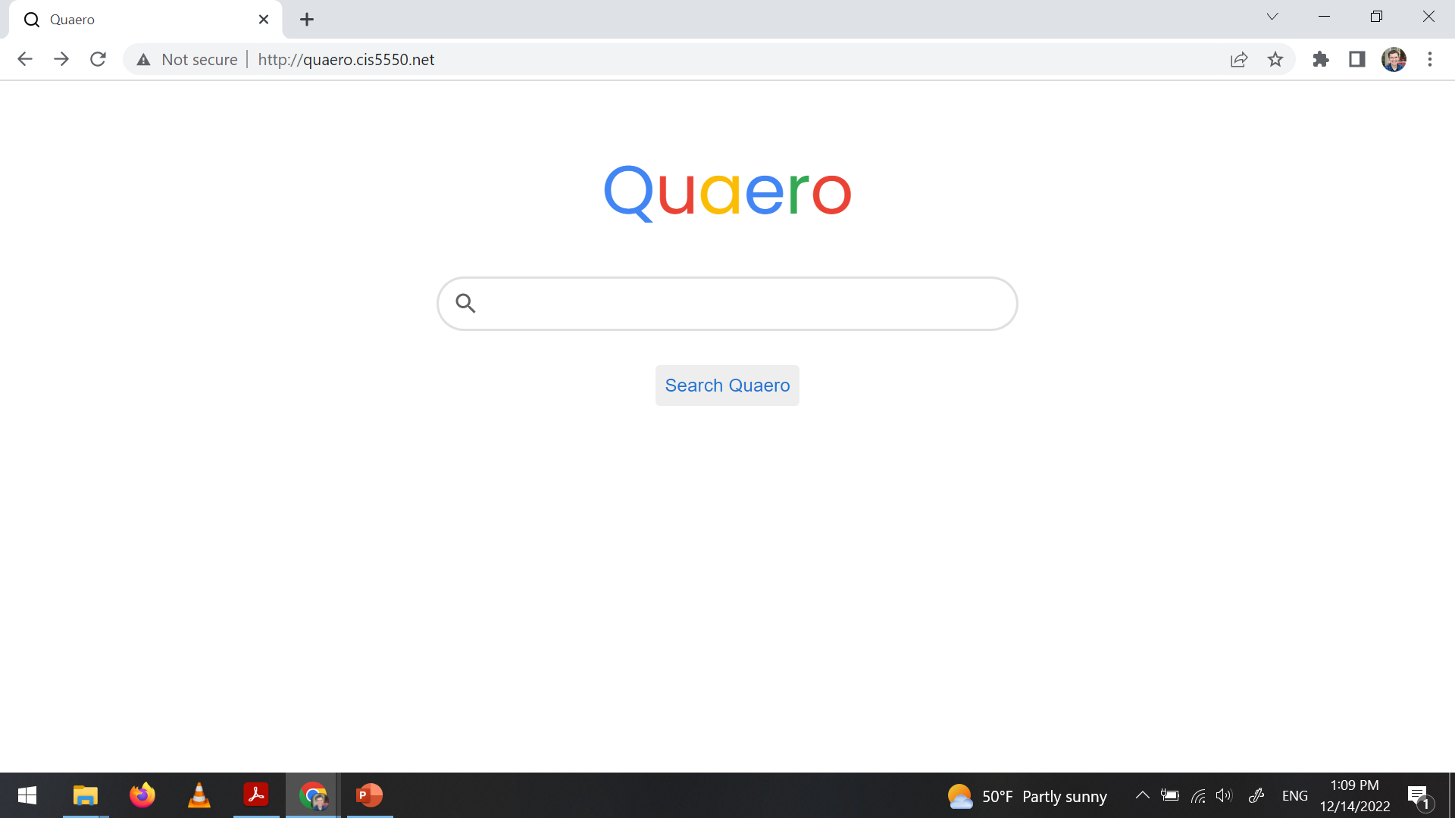

Slide 3
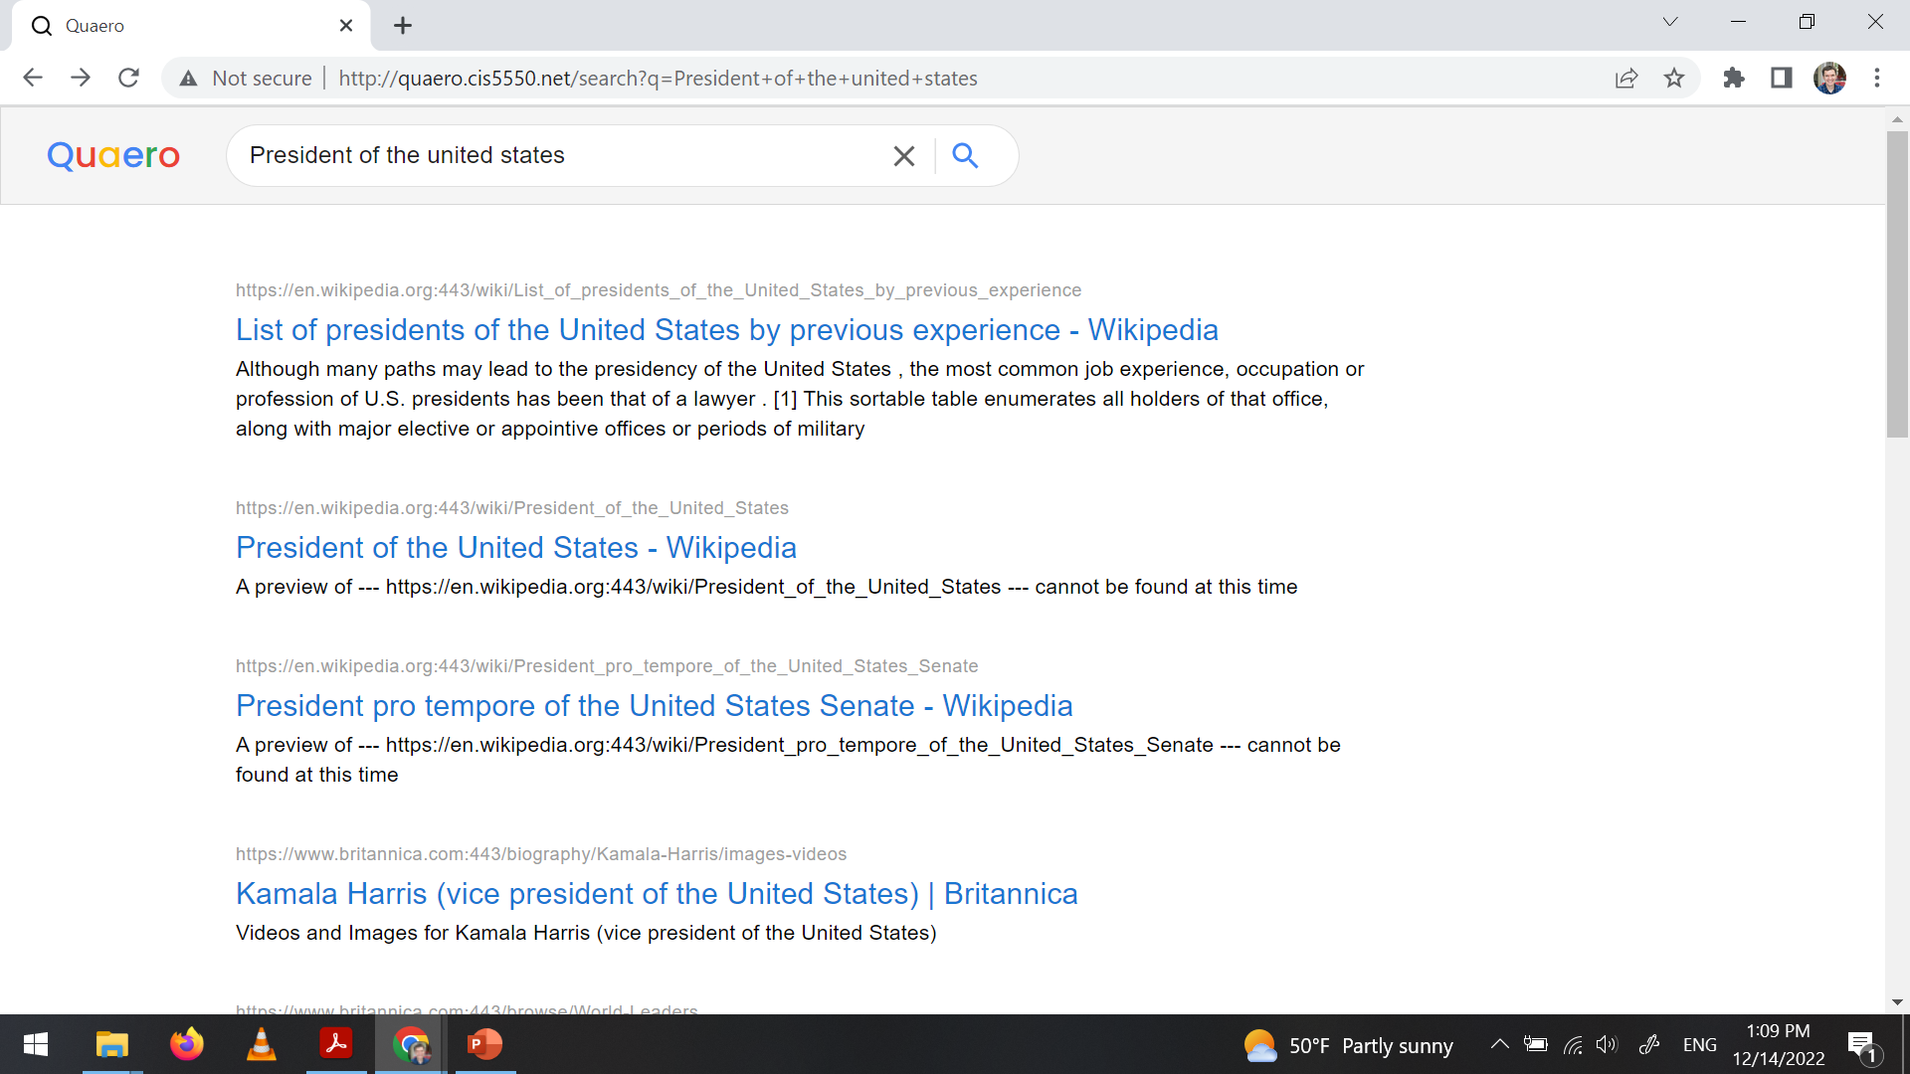

Slide 4
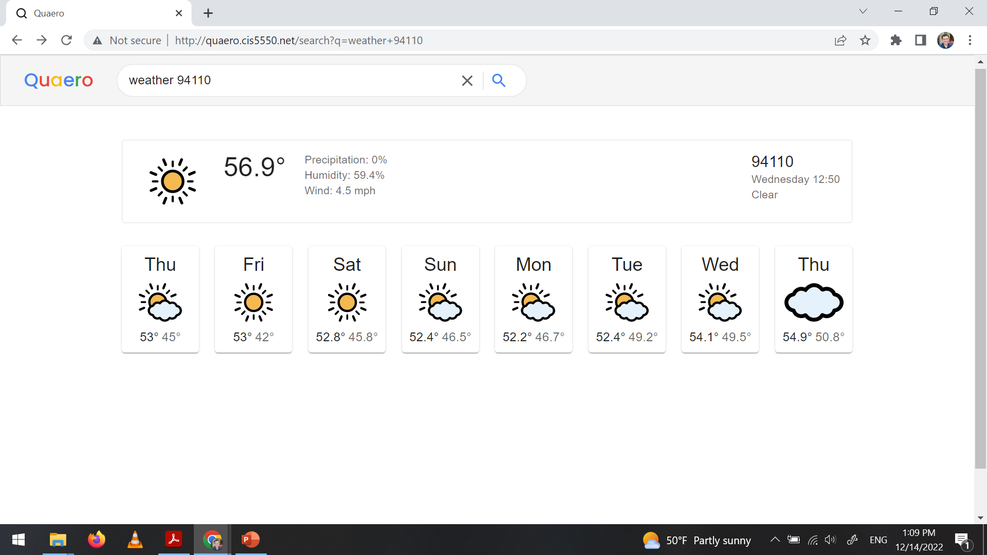

Slide 5
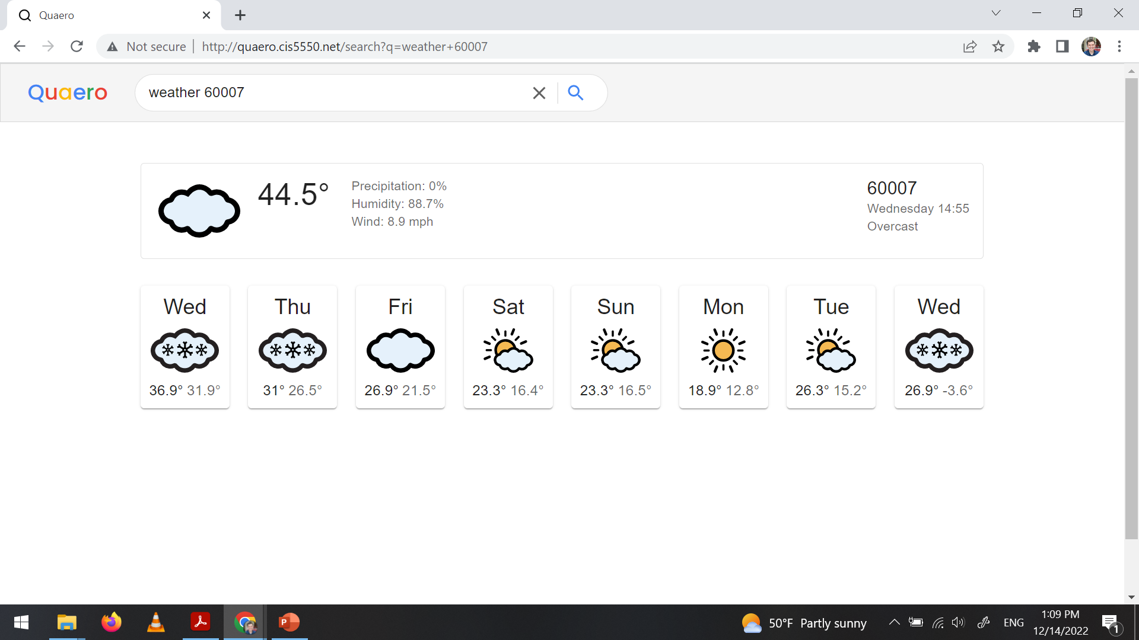

Slide 6
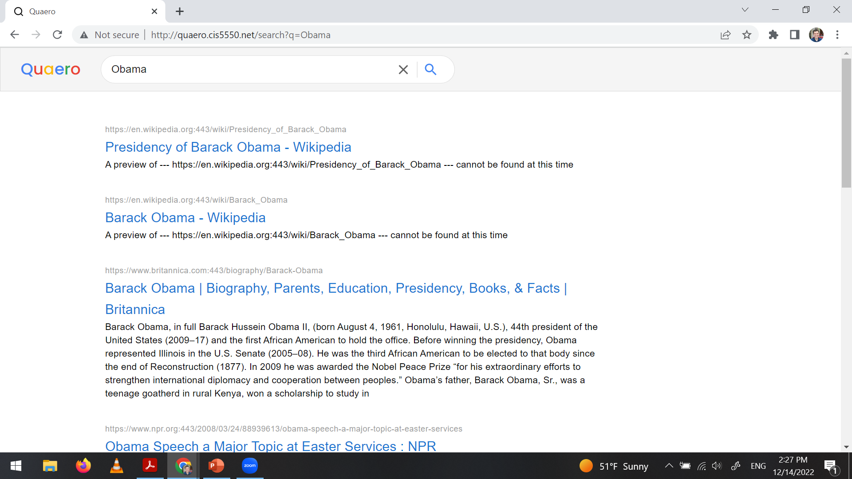

Slide 7
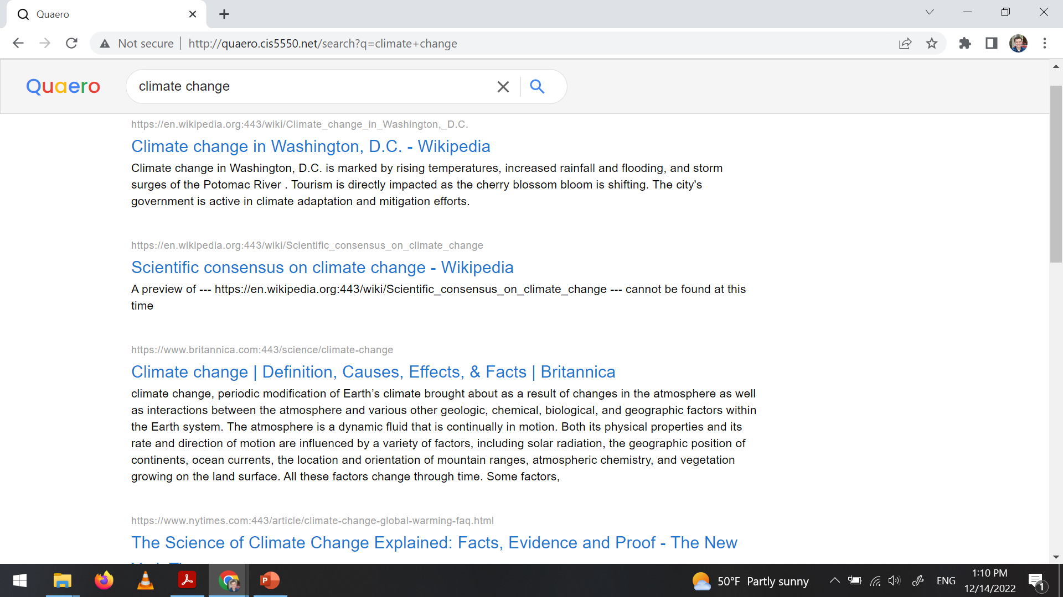

Slide 8
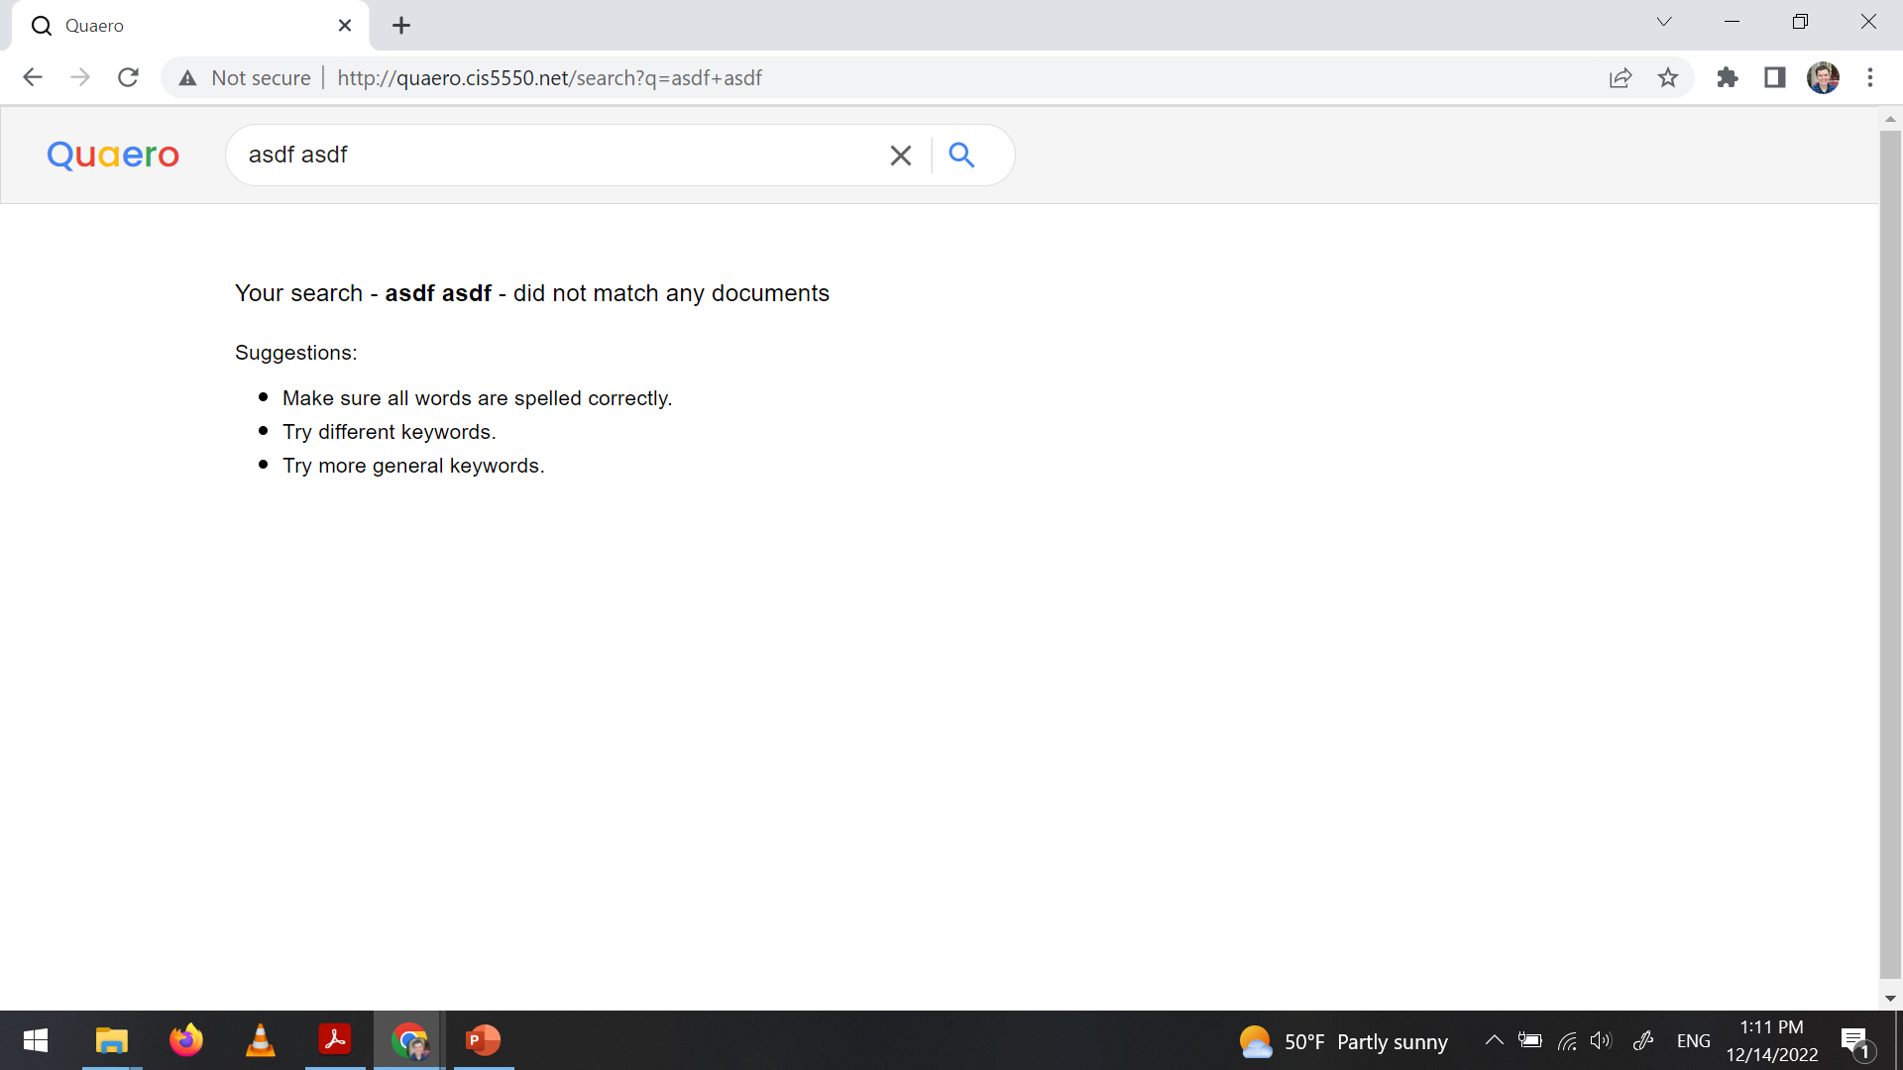

Slide 9
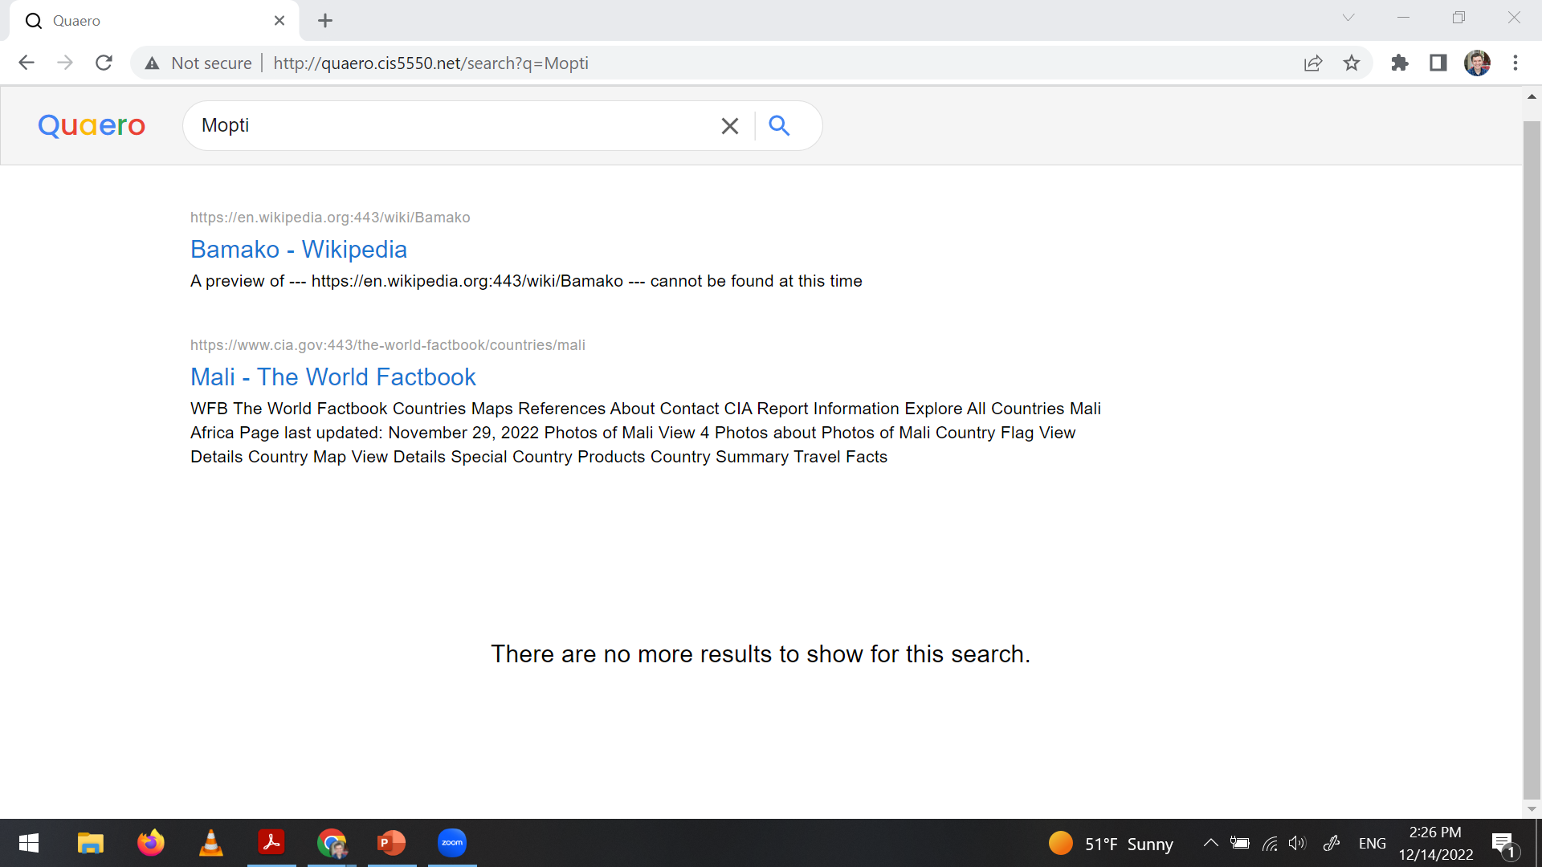

Slide 10
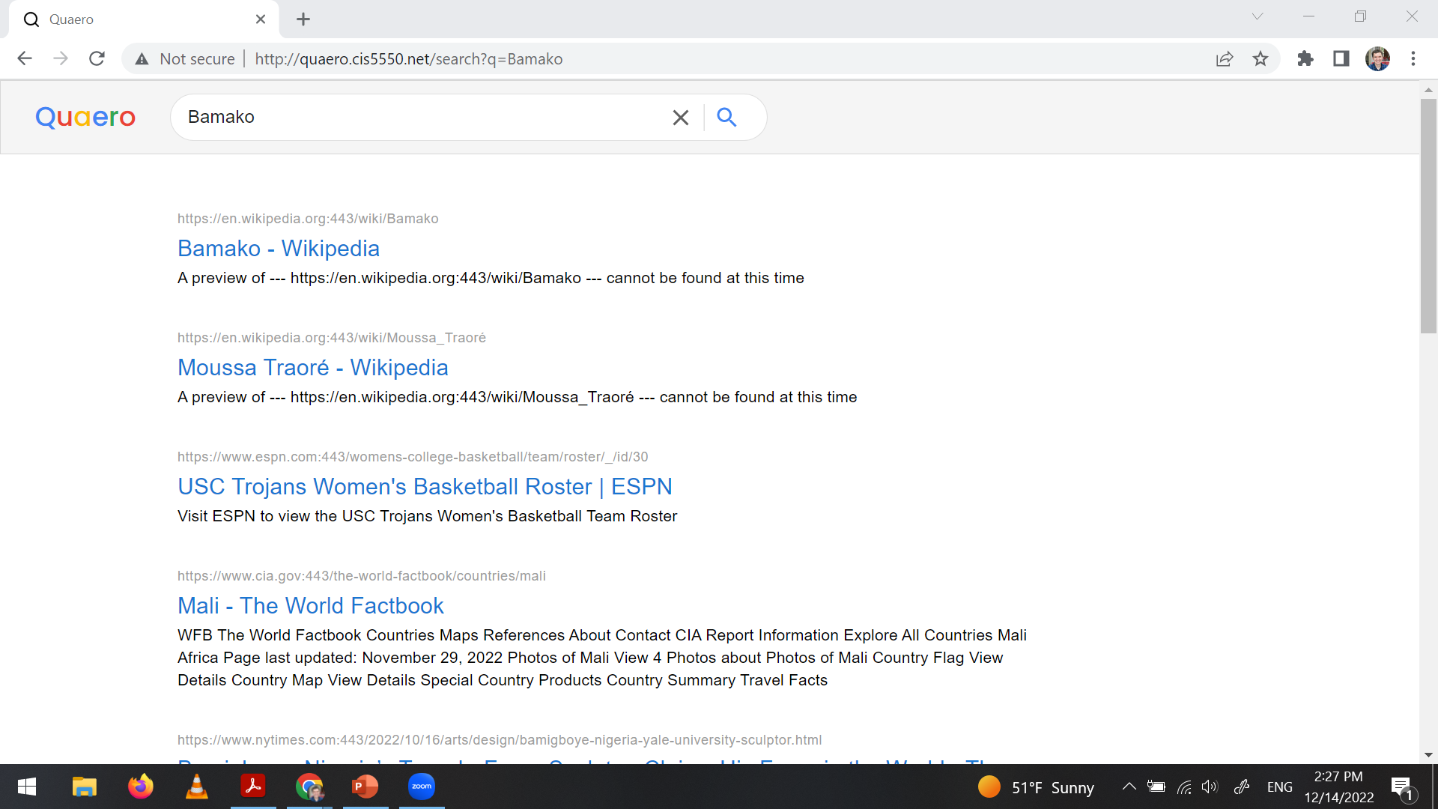

Slide 11
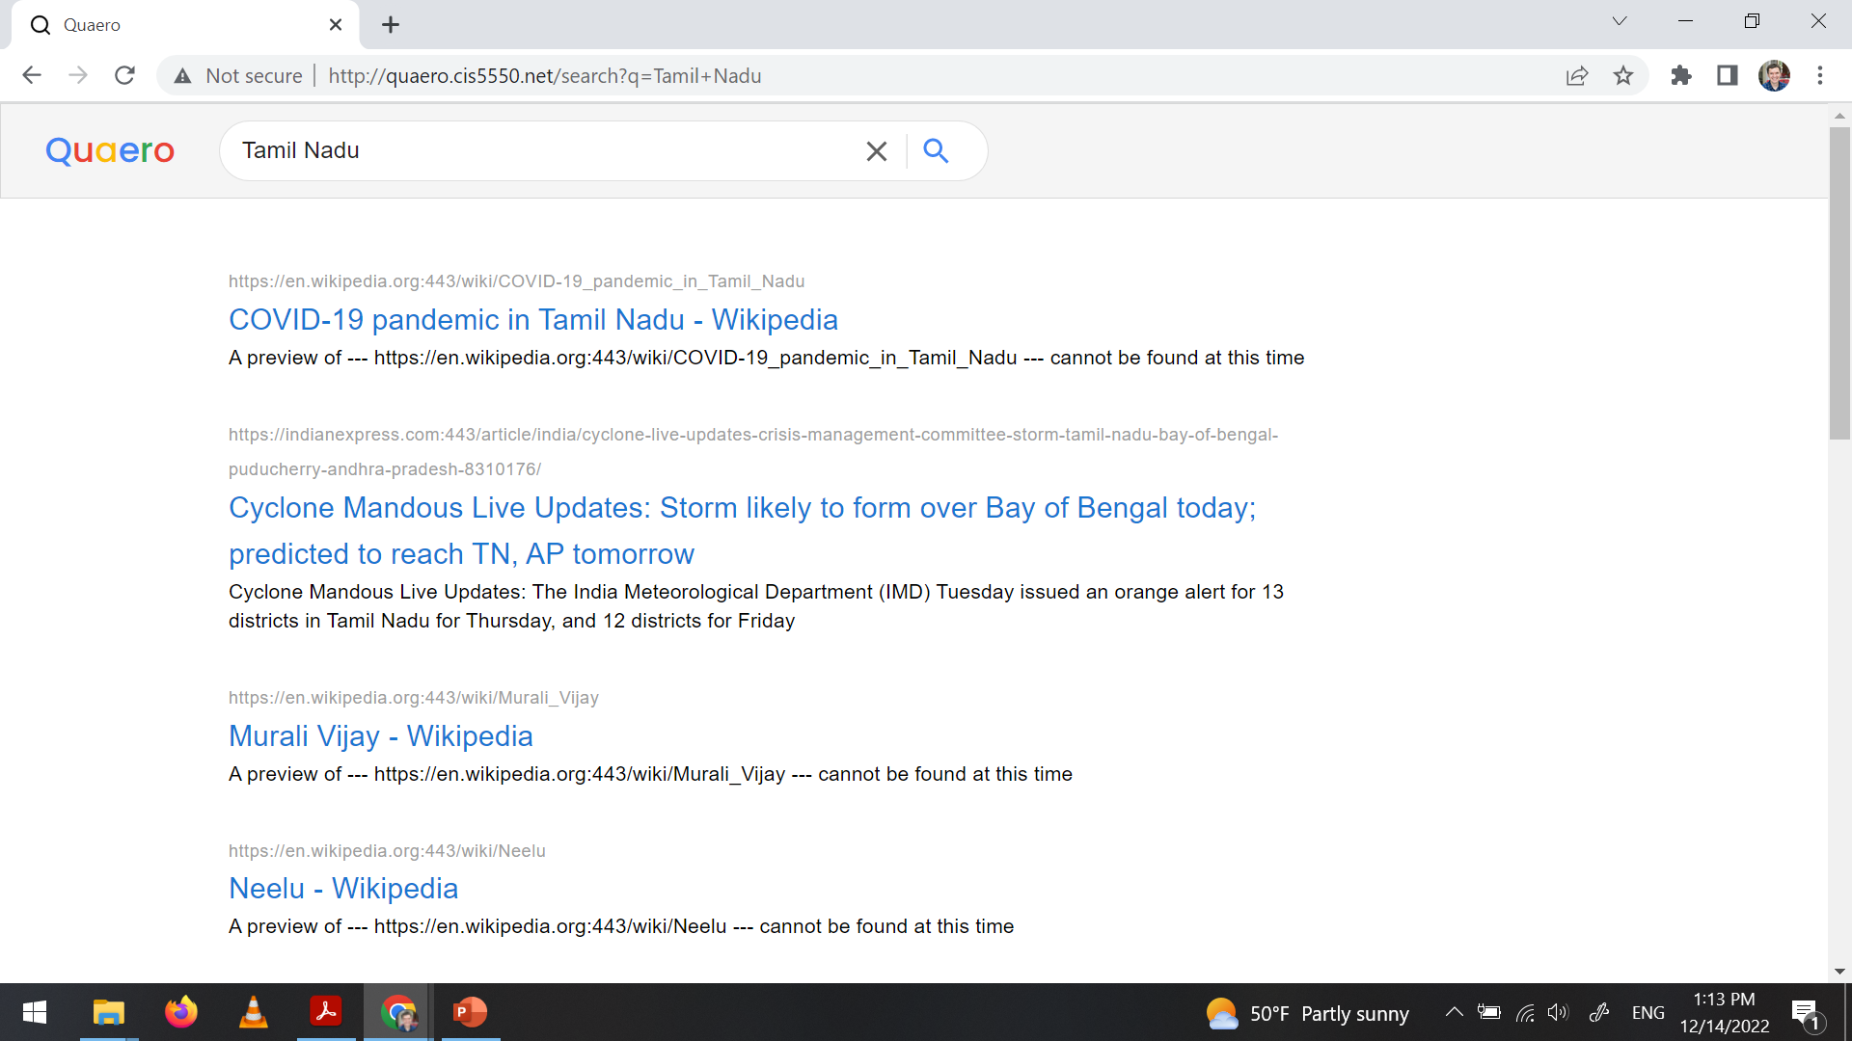

Slide 12
