Slide 1
DYSANOS
Generative Dynamic Smooth Arbitrage-free Non-parametric Option Surfaces
Hans Buehler, joint work with Blanka Horvath, Magnus Wiese
University of Oxford, Institute for Mathematics
hans.buehler@maths.ox.ac.uk
Futures of Quantitative Finance Seminar
Paris, October 14th, 2026

Slide 2

Option Markets

Slide 3
Problem Statement
Historic Quantitative Finance Model Development
  Find “solvable model” which can price all European options.
  Calibrate to market.
  Local vol / particles most practical approach
  Dynamics are an afterthought.
  Works well but requires human intervention.
Program:
  Fit a strictly arbitrage-free model to (real, hard) historic data.
  Turn it into a generative option market model.
  Remove the drift to get a risk-neutral model.

Slide 4
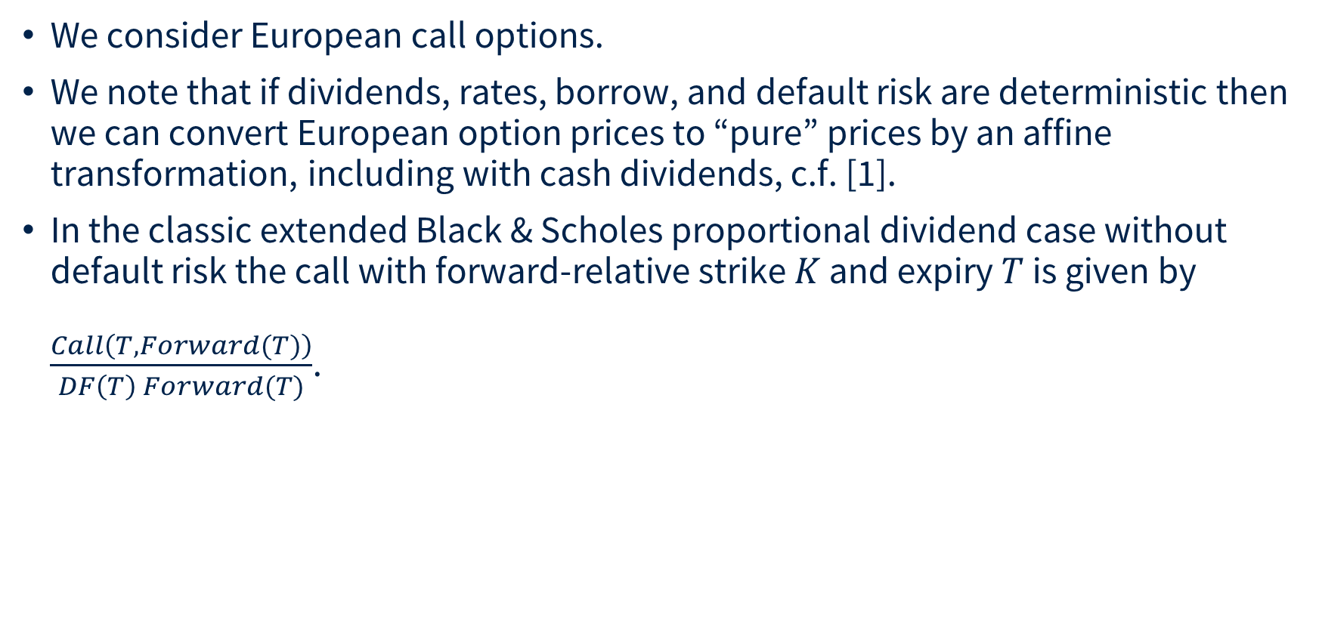
Option Markets
We consider European call options.
We note that if dividends, rates, borrow, and default risk are deterministic then we can convert European option prices to “pure” prices by an affine transformation, including with cash dividends, c.f. [1].
In the classic extended Black & Scholes proportional dividend case without default risk the call with forward-relative strike $K$ and expiry $T$ is given by
$\frac{Call\left(T,Forward(T)\right)}{DF\left(T\right) Forward(T)}$.
__
[1] Volatility and Dividends - Volatility Modelling with Cash Dividends and Simple Credit Risk, Buehler 2008, https://papers.ssrn.com/sol3/papers.cfm?abstract_id=1141877

Slide 5
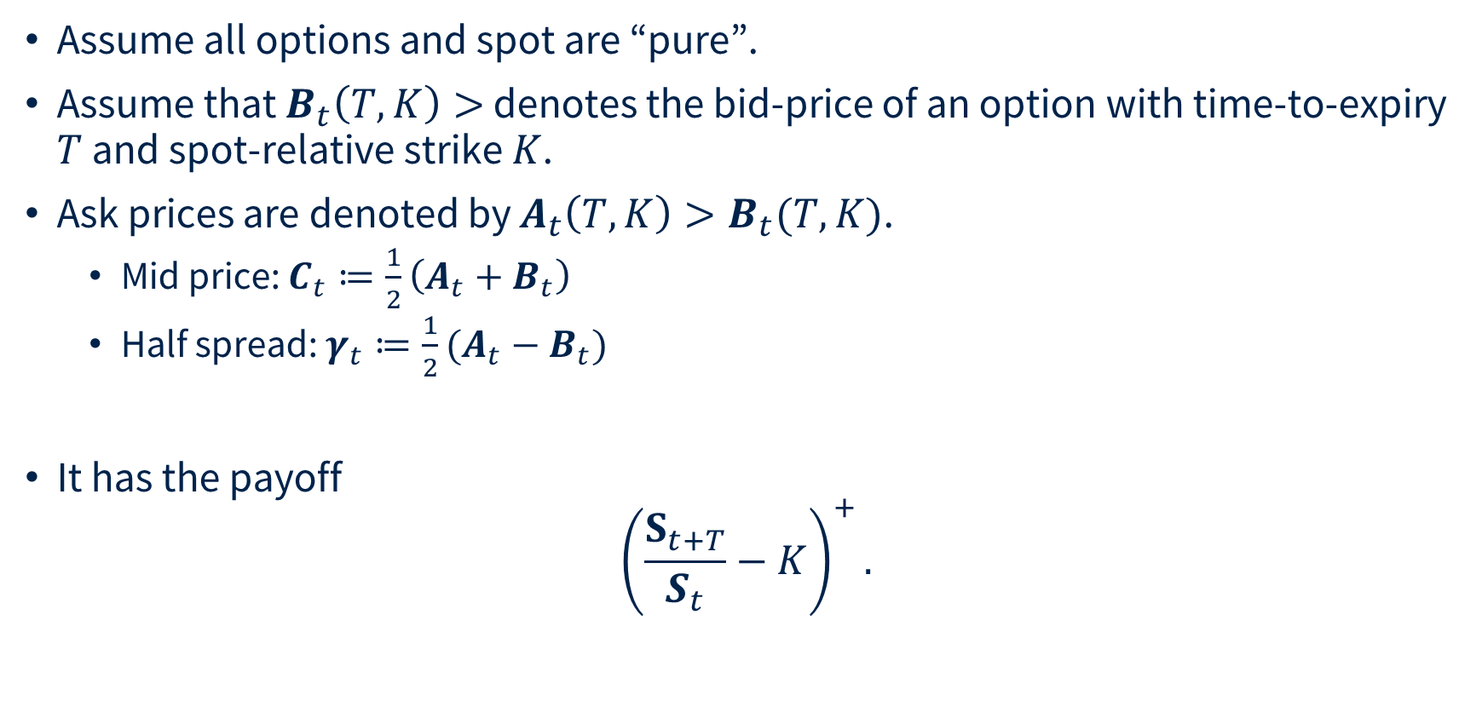
Option Markets
Assume all options and spot are “pure”.
Assume that $B_{t}\left(T,K\right)>$ denotes the bid-price of an option with time-to-expiry $T$ and spot-relative strike $K$.
Ask prices are denoted by $A_{t}\left(T,K\right)>B_{t}(T,K)$.
  Mid price: $C_{t}≔\frac{1}{2}\left(A_{t}+B_{t}\right)$
  Half spread: $γ_{t}≔\frac{1}{2}(A_{t}−B_{t})$
It has the payoff
${\left(\frac{S_{t+T}}{S_{t}}−K\right)}^{+}.$

Slide 6
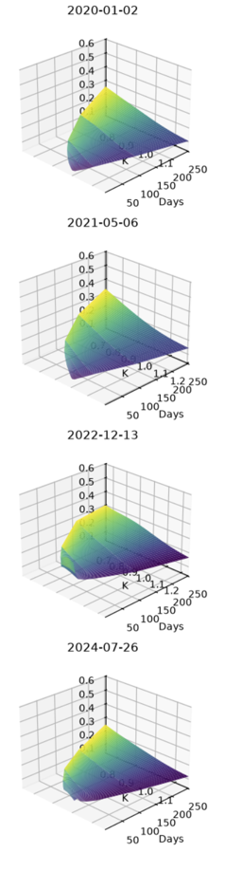
Option Markets
Problem
  We would like to simulate such markets.
Applications
  Scenarios without arbitrage for risk/XLA.
  Risk-neutral pricing.
  Deep Hedging under the risk-neutral measure (e.g. for market frictions etc).
Why not use Implied Vol as “code book” directly ?
  Very natural → PCA on implied vol.
  But: no known way to ensure absence of static arbitrage.
  There cannot be a risk-neutral measure if the market is arbitrageable.
  In practice, our method to find such measures blows up numerically.
Parameterizing Local Vol as “code book” ?
  Resulting call prices are always arbitrage-free.
  Needs some numerical tricks → DYSANOS.

Slide 7
SANOS
Smooth Arbitrage-free Non-parametric Option Surfaces
Joint work with Blanka Horvath, Anastasis Kratsios, Yannick Limmer, Raeid Saqur

Slide 8
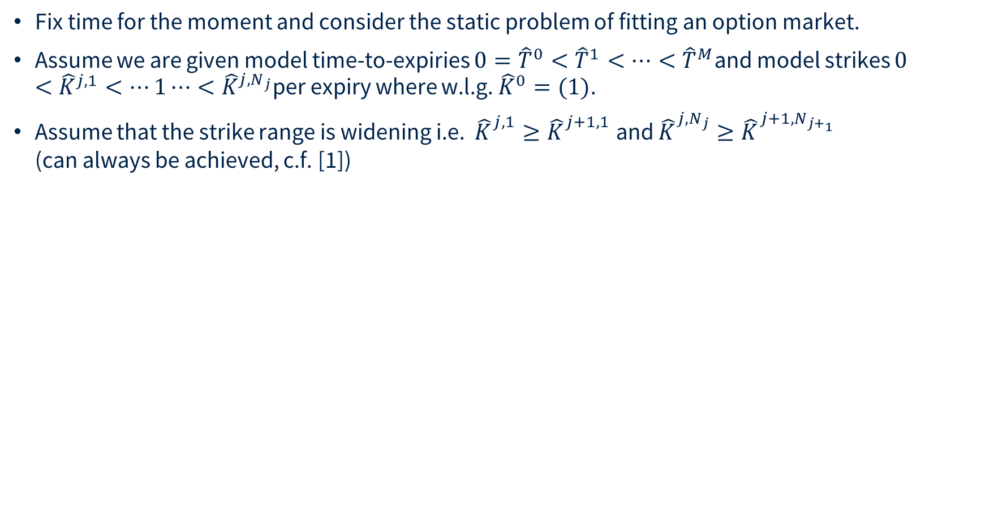
SANOS
Fix time for the moment and consider the static problem of fitting an option market.
Assume we are given model time-to-expiries $0={\hat{T}}^{0}<{\hat{T}}^{1}<⋯<{\hat{T}}^{M}$and model strikes $0<{\hat{K}}^{j,1}<⋯1⋯<{\hat{K}}^{j,N_{j}}$per expiry where w.l.g. ${\hat{K}}^{0}=(1)$.
Assume that the strike range is widening i.e. ${\hat{K}}_{}^{j,1}≥{\hat{K}}_{}^{j+1,1}$ and ${\hat{K}}_{}^{j,N_{j}}≥{\hat{K}}_{}^{{j+1,N}_{j+_{1}}}$
(can always be achieved, c.f. [1])
__
[1] SANOS, Buehler et al, 2026 https://arxiv.org/pdf/2601.11209

Slide 9
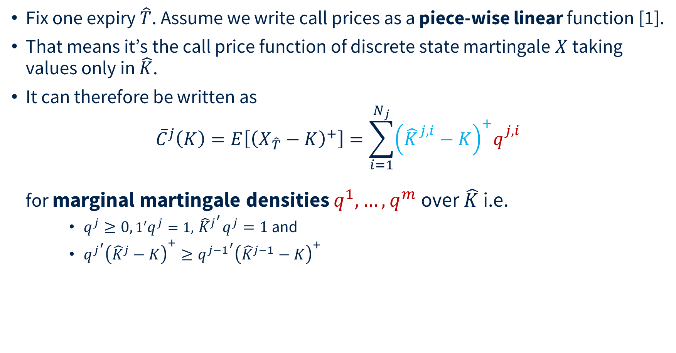
SANOS
Fix one expiry $\hat{T}$. Assume we write call prices as a piece-wise linear function [1].
That means it’s the call price function of discrete state martingale $X$ taking values only in $\hat{K}$.
It can therefore be written as
${\overline{C}}^{j}\left(K\right)=E\left[{\left(X_{\hat{T}}−K\right)}^{+}\right]=\sum_{i=1}^{N_{j}}{{\left({\hat{K}}_{}^{j,i}−K\right)}^{+}q_{}^{j,i}}$
for marginal martingale densities $q^{1},…,q^{m}$ over $\hat{K}$ i.e.
    $q^{j}≥0, 1′q^{j}=1,{ {\hat{K}}^{j}}^{′}q^{j}=1$ and
    ${{q^{j}}^{′}\left({\hat{K}}^{j}−K\right)}^{+}≥{q^{j−1}}^{′}{\left({\hat{K}}^{j−1}−K\right)}^{+}$
__
[1]Discrete local volatility for large time steps (extended version), Hans Buehler and Evgeny Ryskin, 2015. https://papers.ssrn.com/abstract=2642630

Slide 10
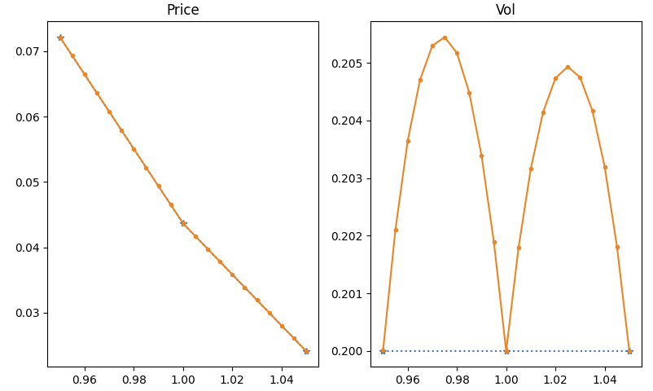
SANOS
Linear interpolation is “too expensive”: example 20% BS prices interpolated linearly.

Slide 11
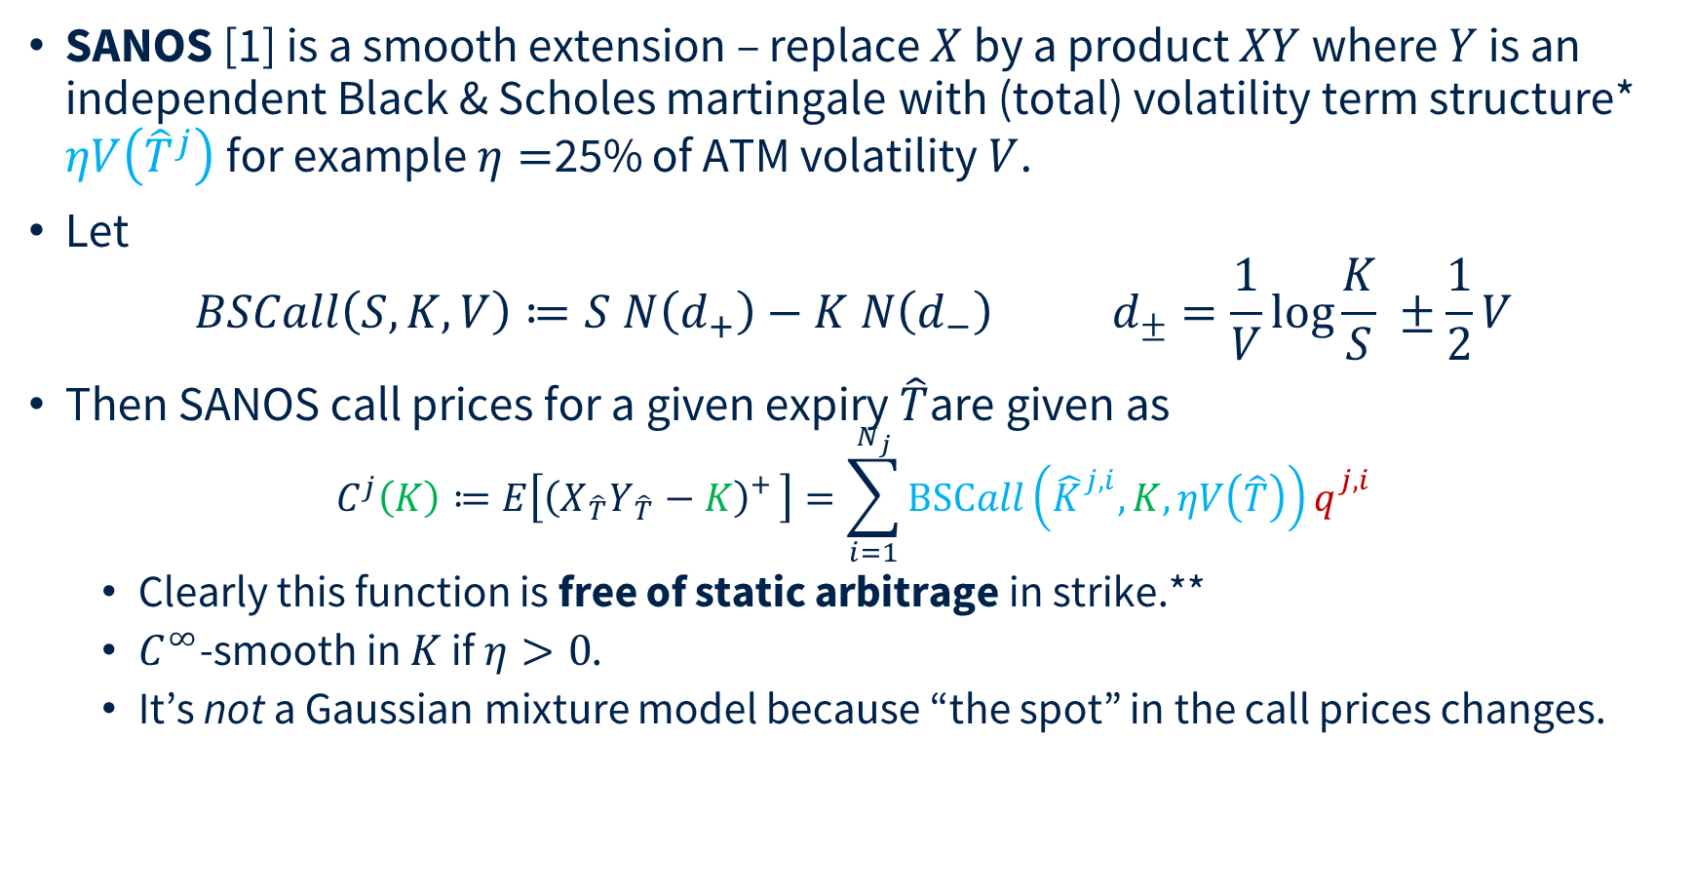
SANOS
SANOS [1] is a smooth extension – replace $X$ by a product $XY$ where $Y$ is an independent Black & Scholes martingale with (total) volatility term structure* $ηV\left({\hat{T}}^{j}\right)$ for example $η=$25% of ATM volatility $V$.
Let
$BSCall\left(S,K,V\right)≔S N\left(d_{+}\right)−K N\left(d_{−}\right) d_{±}=\frac{1}{V}log{\frac{K}{S} }±\frac{1}{2}V$
Then SANOS call prices for a given expiry $\hat{T}$are given as
$C^{j}\left(K\right)≔E\left[{\left(X_{\hat{T}}Y_{\hat{T}}−K\right)}_{}^{+}\right]=\sum_{i=1}^{N_{j}}{BSCall\left({\hat{K}}_{}^{j,i},K,ηV\left(\hat{T}\right)\right)q_{}^{j,i}}$
  Clearly this function is free of static arbitrage in strike.**
  $C^{∞}$-smooth in $K$ if $η>0$.
  It’s not a Gaussian mixture model because “the spot” in the call prices changes.
__
[1] SANOS, Buehler et al, 2026 https://arxiv.org/pdf/2601.11209
* Using volatility instead of variance avoids taking square roots (and therefore derivatives thereof) of a variable which can become zero in torch.
** In the sense of the first fundamental theorem of asset pricing, e.g. existence of an integrable positive variable $Z_{j}$such that $C^{j}\left(K\right)=E\left[{\left(Z_{j}−K\right)}^{+}\right].$

Slide 12
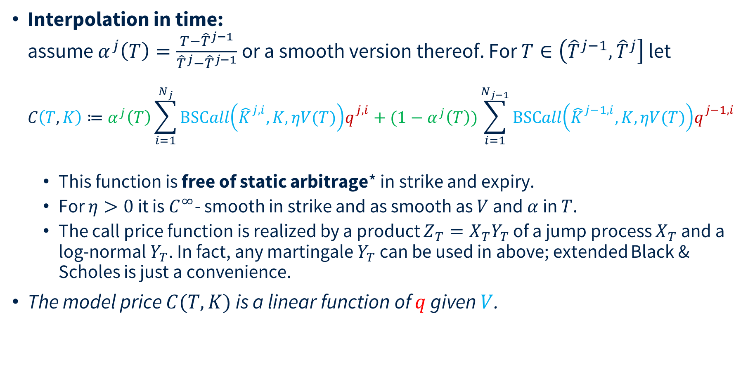
SANOS
Interpolation in time:
assume $α^{j}\left(T\right)=\frac{T−{\hat{T}}^{j−1}}{{\hat{T}}^{j}−{\hat{T}}^{j−1}}$ or a smooth version thereof. For $T∈\left({\hat{T}}^{j−1},{\hat{T}}^{j}\right]$ let
$C\left(T,K\right)≔α^{j}\left(T\right)\sum_{i=1}^{N_{j}}{BSCall\left({\hat{K}}_{}^{j,i},K,ηV(T)\right)q_{}^{j,i}}+(1−α^{j}\left(T\right))\sum_{i=1}^{N_{j−1}}{BSCall\left({\hat{K}}_{}^{j−1,i},K,ηV(T)\right)q_{}^{j−1,i}}$
  This function is free of static arbitrage* in strike and expiry.
  For $η>0$ it is $C^{∞}$- smooth in strike and as smooth as $V$ and $α$ in $T$.
  The call price function is realized by a product ${Z_{T}=X}_{T}Y_{T}$ of a jump process $X_{T}$ and a log-normal $Y_{T}$. In fact, any martingale $Y_{T}$ can be used in above; extended Black & Scholes is just a convenience.
The model price $C(T,K)$ is a linear function of $q$ given $V$.
__
[1] SANOS, Buehler et al, 2026 https://arxiv.org/pdf/2601.11209
* i.e. first fundamental theorem of asset pricing: existence of an integrable positive martingale $Z_{T}$such that $C\left(T,K\right)=E\left[{\left(Z_{T}−K\right)}^{+}\right].$

Slide 13

Fitting to the Market
For the $ℓ$^{th} market option the price $C^{ℓ}≔C(T^{ℓ},K^{ℓ})$ is a linear function of $q$.
Then [1] we may find an arbitrage-free smooth interpolation of discrete call prices $C_{j}^{i}$ jointly across all strikes and expiries by solving a linear problem
$\min_{q}{:}\sum_{ℓ }{\frac{1}{γ_{ℓ}^{i}}\left\{{\left(C_{}^{ℓ}−A_{}^{ℓ}\right)}^{+}+{\left(B_{}^{ℓ}−C_{}^{ℓ}\right)}^{+}+ε \left|C_{}^{ℓ}−M_{}^{ℓ}\right|\right\}}$
with linear constraints:
  $q_{j}≥0$, $1^{′}q^{j}=1$,${{\hat{K}}^{j}}^{′}q^{j}=1$
  ${q^{j}′\left({\hat{K}}^{j}−{\hat{K}}_{}^{j,i}\right)}^{+}≥{q^{j−1}}^{′}{\left({\hat{K}}^{j−1}−{\hat{K}}_{}^{j,i}\right)}^{+}$for all $i,j$.
Straightforward global fit with linear programming.
__
[1] SANOS, Buehler et al, 2026 https://arxiv.org/pdf/2601.11209

Slide 14
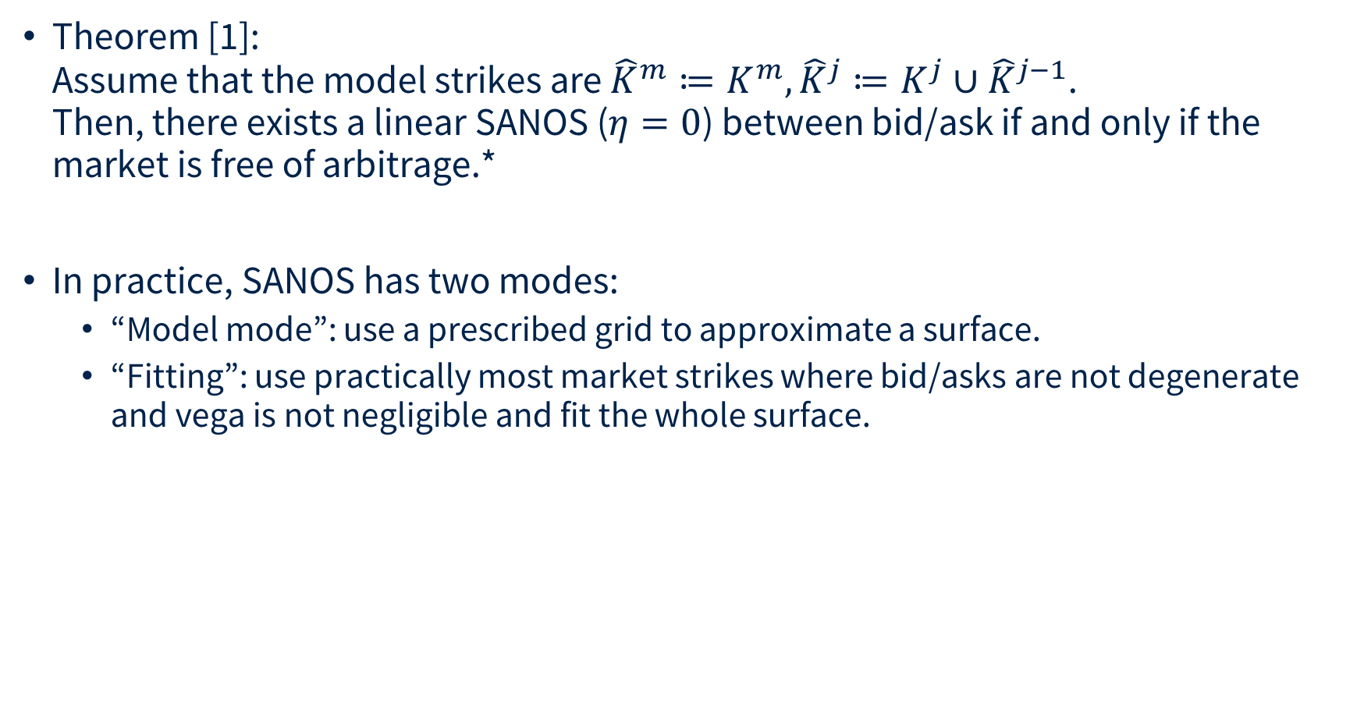
SANOS
Theorem [1]:
Assume that the model strikes are ${\hat{K}}^{m}≔K^{m},{\hat{K}}^{j}≔K^{j}∪{\hat{K}}^{j−1}$.
Then, there exists a linear SANOS ($η=0$) between bid/ask if and only if the market is free of arbitrage.*
In practice, SANOS has two modes:
  “Model mode”: use a prescribed grid to approximate a surface.
  “Fitting”: use practically most market strikes where bid/asks are not degenerate and vega is not negligible and fit the whole surface.
__
[1] SANOS, Buehler et al, 2026 https://arxiv.org/pdf/2601.11209
* i.e. first fundamental theorem of asset pricing: existence of an integrable positive martingale $Z_{T}$such that $C\left(T,K\right)=E\left[{\left(Z_{T}−K\right)}^{+}\right].$

Slide 15
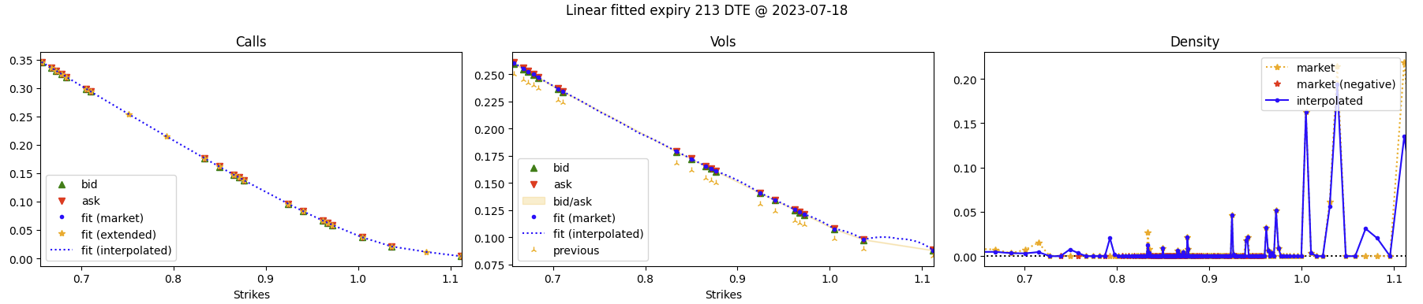
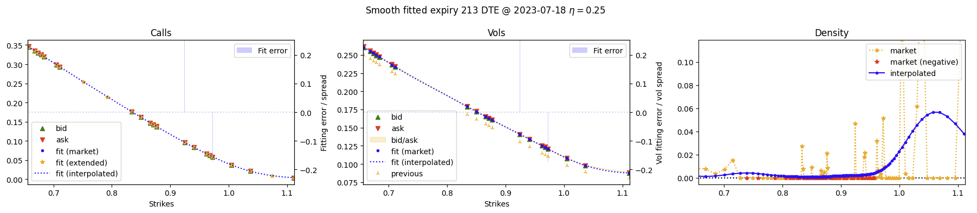
SANOS
Linear interpolation effect

Slide 16
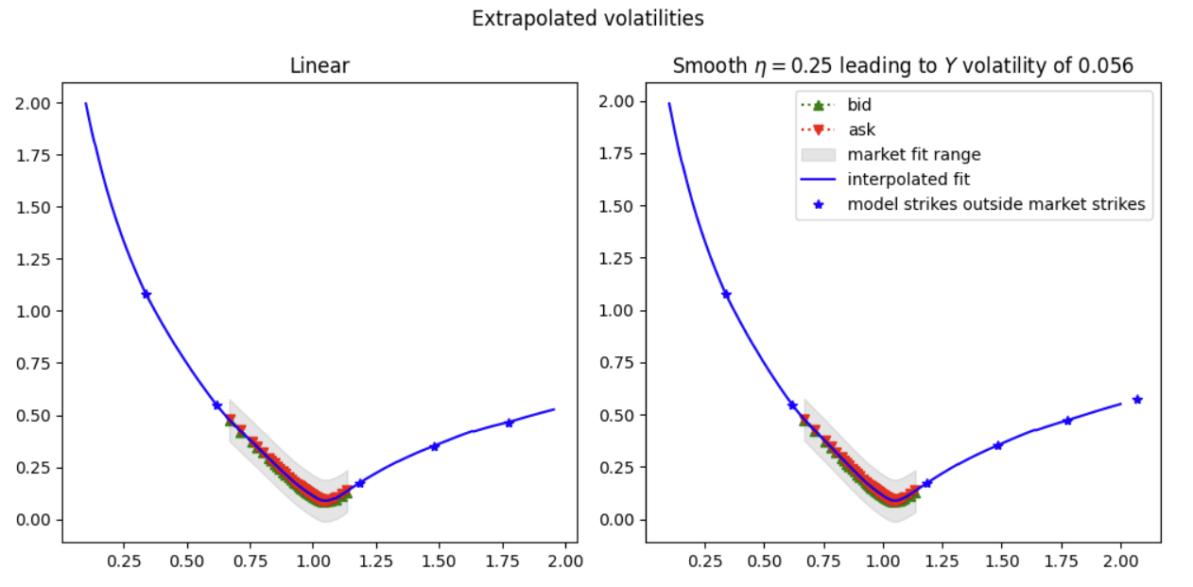
SANOS

Slide 17


SANOS
Fitted 1,000 options within 2 ATM implied volatility standard deviations which had a Vega/sqrtT of at least 0.1% on 2025-05-06 across all 48 expiries from 1 to 657 business days.
Options were chosen by closeness to ATM. The model fitted 91.4% of all options within bid/ask. Of those options not fitted the median error is just 21% of half spread.
The fit took sub-seconds on a desktop PC.

Slide 18
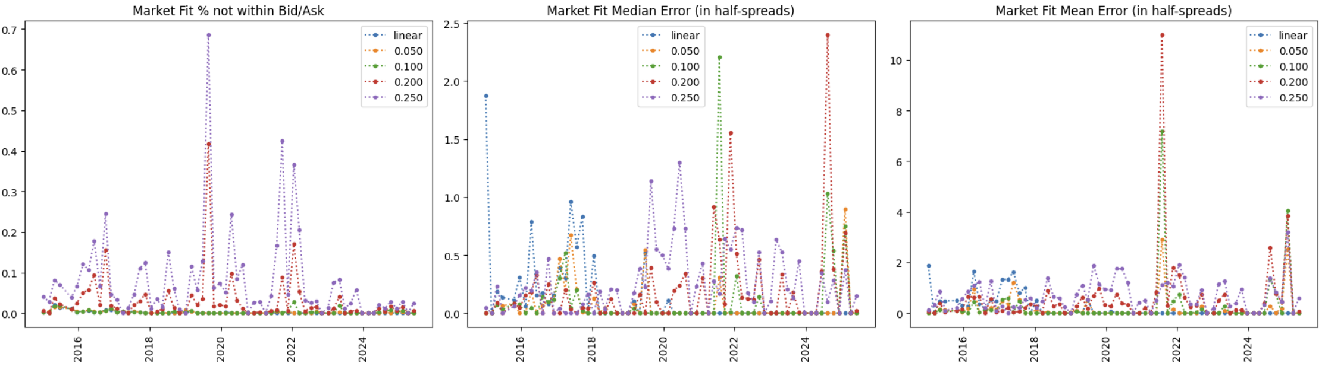
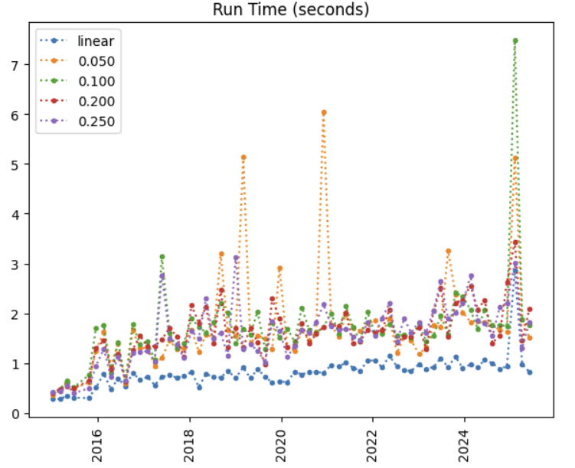
SANOS
Fitted 1,000 options within 2 ATM implied volatility standard deviations which had a Vega/sqrtT of at least 0.1% across expiries

Slide 19
SANOS
Summary
  Very fast linear programming fit to “all” observed European options within bid/ask.
  Guaranteed linear fit if and only if the market is arbitrage-free within bid/ask
Practical
  Fast pre-processor for local volatility (in fact, it is a type of local volatility → later)
  Can ensure vega scenarios/greeks lead to arbitrage-free results

Slide 20
DYSANOS
Generative Smooth Arbitrage-free Non-parametric Option Surfaces [1]
__
[1] DYSANOS Generative Dynamic Smooth Arbitrage-free Non-parametric Option Surfaces, Hans Buehler et al, 2026 https://arxiv.org/abs/2608.12587

Slide 21
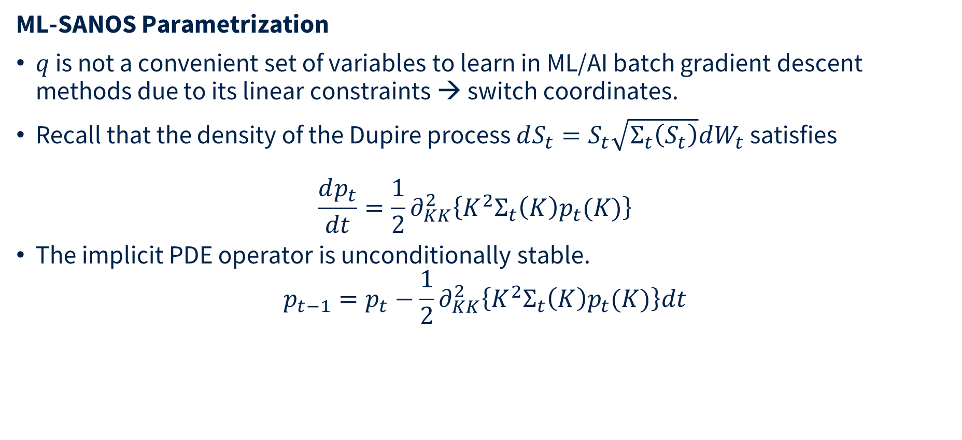
DYSANOS
ML-SANOS Parametrization
$q$ is not a convenient set of variables to learn in ML/AI batch gradient descent methods due to its linear constraints → switch coordinates.
Recall that the density of the Dupire process $dS_{t}=S_{t}\sqrt{Σ_{t}\left(S_{t}\right)}dW_{t}$ satisfies
$\frac{dp_{t}}{dt}=\frac{1}{2}∂_{KK}^{2}\left\{K^{2}Σ_{t}\left(K\right)p_{t}(K)\right\}$
The implicit PDE operator is unconditionally stable.
$p_{t−1}=p_{t}−\frac{1}{2}∂_{KK}^{2}\left\{K^{2}Σ_{t}\left(K\right)p_{t}(K)\right\}dt$
__
[1] Discrete local volatility for large time steps (extended version), Hans Buehler and Evgeny Ryskin, 2015 https://papers.ssrn.com/abstract=2642630
[2] Finite Difference Based Calibration and Simulation, Andreasen et al, 2010 https://papers.ssrn.com/sol3/papers.cfm?abstract_id=1697545

Slide 22
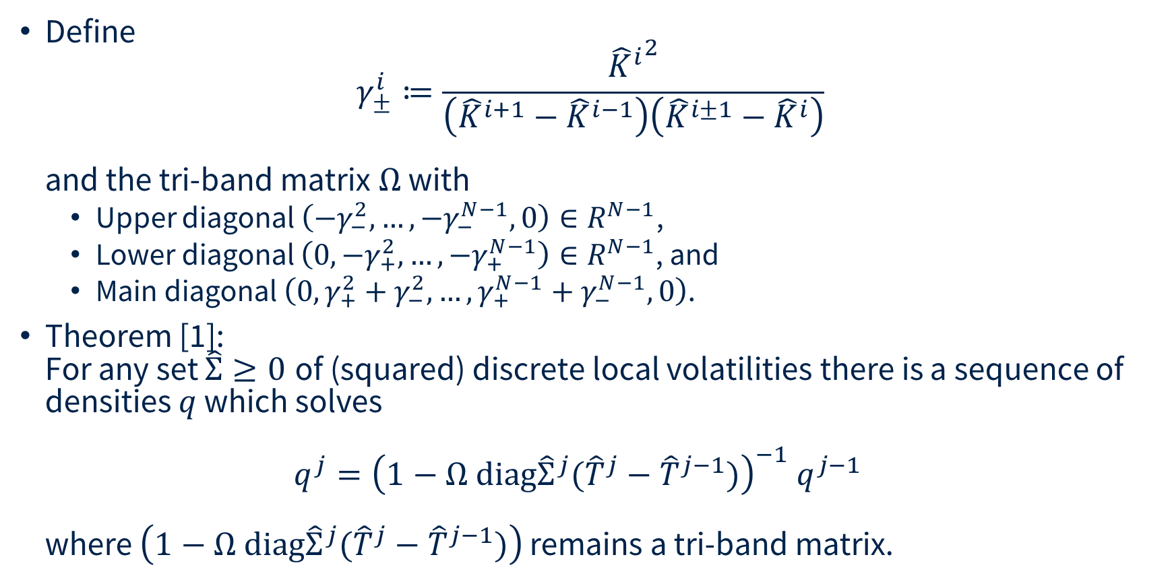
DYSANOS
Define
$γ_{±}^{i}≔\frac{{{\hat{K}}^{i}}^{2}}{\left({\hat{K}}^{i+1}−{\hat{K}}^{i−1}\right)\left({\hat{K}}^{i±1}−{\hat{K}}^{i}\right)}$
and the tri-band matrix $Ω$ with
  Upper diagonal $\left(−γ_{−}^{2},…,−γ_{−}^{N−1},0\right)∈R^{N−1}$,
  Lower diagonal $\left({0,−γ}_{+}^{2},…,{−γ}_{+}^{N−1}\right)∈R^{N−1}$, and
  Main diagonal $\left({0,γ}_{+}^{2}+γ_{−}^{2},…,γ_{+}^{N−1}+γ_{−}^{N−1},0\right)$.
Theorem [1]:
For any set $\hat{Σ}≥0$ of (squared) discrete local volatilities there is a sequence of densities $q$ which solves
$q^{j}={\left(1+Ω \text{diag}{\hat{Σ}}^{j}({\hat{T}}^{j}−{\hat{T}}^{j−1})\right)}^{−1} q^{j−1}$
where $\left(1+Ω \text{diag}{\hat{Σ}}^{j}({\hat{T}}^{j}−{\hat{T}}^{j−1})\right)$ remains a tri-band matrix.
__
[1] Discrete local volatility for large time steps (extended version), Hans Buehler and Evgeny Ryskin, 2015, https://papers.ssrn.com/abstract=2642630

Slide 23
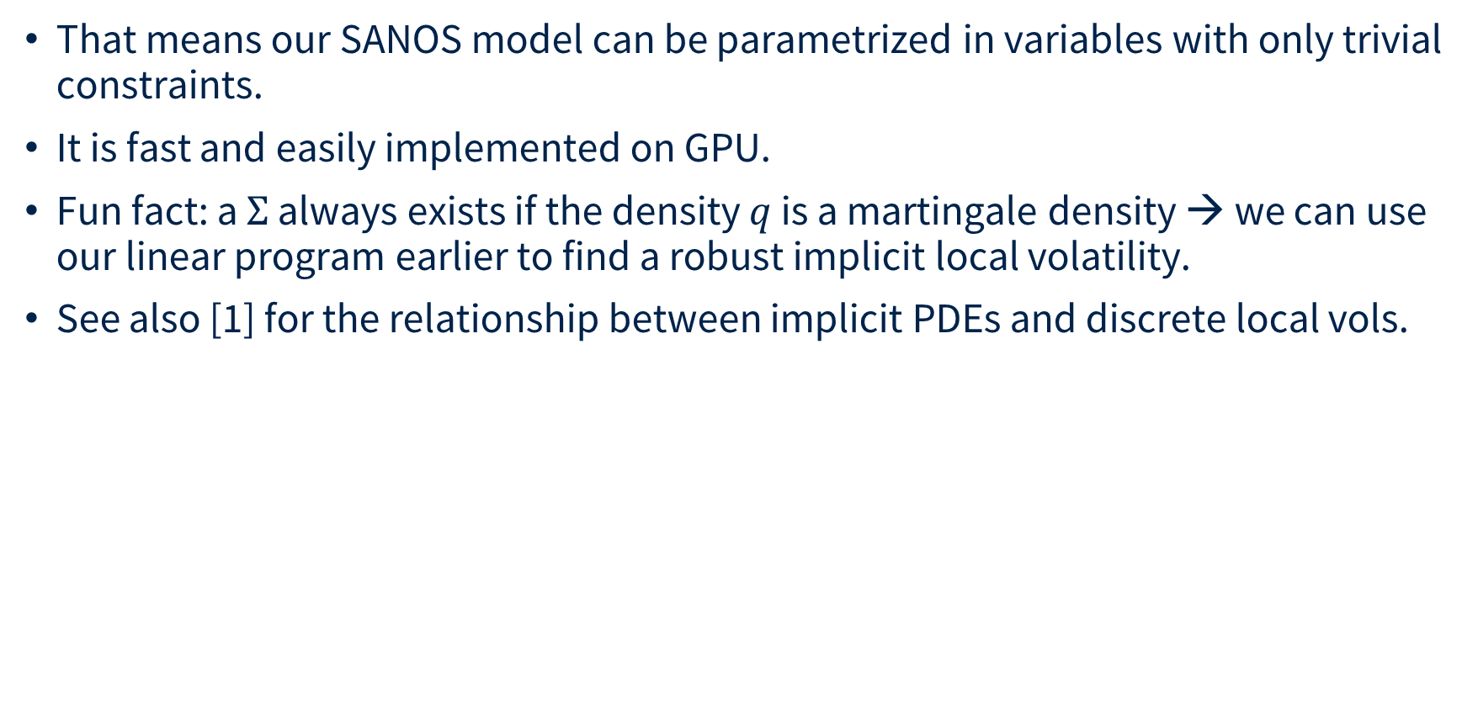
DYSANOS
That means our SANOS model can be parametrized in variables with only trivial constraints.
It is fast and easily implemented on GPU.
Fun fact: a $Σ$ always exists if the density $q$ is a martingale density → we can use our linear program earlier to find a robust implicit local volatility.
See also [1] for the relationship between implicit PDEs and discrete local vols.
__
[1] Finite Difference Based Calibration and Simulation, Andreasen et al, 2010 https://papers.ssrn.com/sol3/papers.cfm?abstract_id=1697545

Slide 24
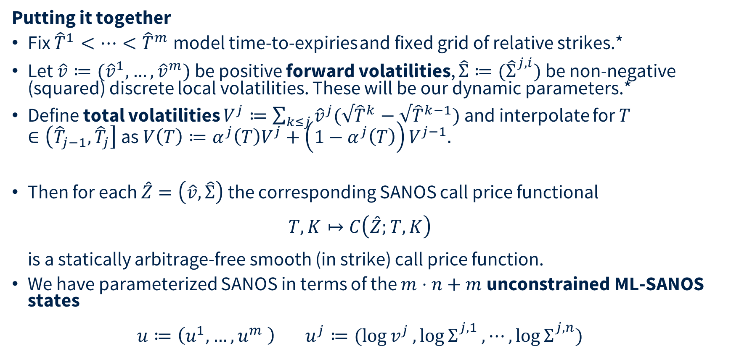
DYSANOS
Putting it together
Fix ${\hat{T}}^{1}<⋯<{\hat{T}}^{m}$model time-to-expiries and fixed grid of relative strikes.*
Let $\hat{v}≔({\hat{v}}^{1},…,{\hat{v}}^{m})$ be positive forward volatilities, ${\hat{Σ}≔(\hat{Σ}}_{}^{j,i})$ be non-negative (squared) discrete local volatilities. These will be our dynamic parameters.*
Define total volatilities $V^{j}≔\sum_{k≤j}{{\hat{v}}^{j}(√{\hat{T}}^{k}−√{\hat{T}}^{k−1})}$ and interpolate for $T∈\left({\hat{T}}_{j−1},{\hat{T}}_{j}\right]$ as $V\left(T\right)≔α^{j}\left(T\right)V^{j}+\left(1−α^{j}\left(T\right)\right)V^{j−1}.$
Then for each $\hat{Z}=\left(\hat{v},\hat{Σ}\right)$ the corresponding SANOS call price functional
$T,K↦C\left(\hat{Z};T,K\right)$
is a statically arbitrage-free smooth (in strike) call price function.
We have parameterized SANOS in terms of the $m⋅n+m$unconstrained ML-SANOS states
$u≔\left(u^{1},…,u^{m} \right) u^{j}≔(\log{v^{j}},\log{Σ_{}^{j,1}},⋯,\log{Σ_{}^{j,n}})$
__
(*) DTEs used: $1,2,3,4,5,10,15,…,70$; strikes used where z-strikes @ 10% vol for first and last expiry merged, each 100 strikes.

Slide 25
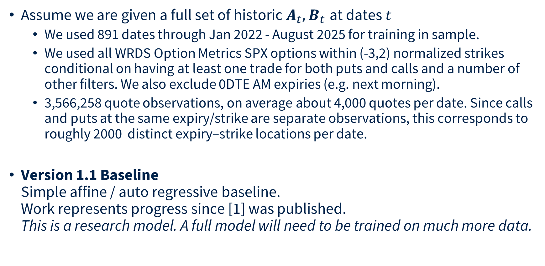
Linear Auto Regressive DYSANOS
Assume we are given a full set of historic $A_{t},B_{t}$ at dates $t$
  We used 891 dates through Jan 2022 - August 2025 for training in sample.
  We used all WRDS Option Metrics SPX options within (-3,2) normalized strikes conditional on having at least one trade for both puts and calls and a number of other filters. We also exclude 0DTE AM expiries (e.g. next morning).
  3,566,258 quote observations, on average about 4,000 quotes per date. Since calls and puts at the same expiry/strike are separate observations, this corresponds to roughly 2000 distinct expiry–strike locations per date.
Version 1.1 Baseline
Simple affine / auto regressive baseline.
Work represents progress since [1] was published.
This is a research model. A full model will need to be trained on much more data.
__
[1] DYSANOS Generative Dynamic Smooth Arbitrage-free Non-parametric Option Surfaces, Hans Buehler et al. 2026 https://arxiv.org/abs/2608.12587

Slide 26
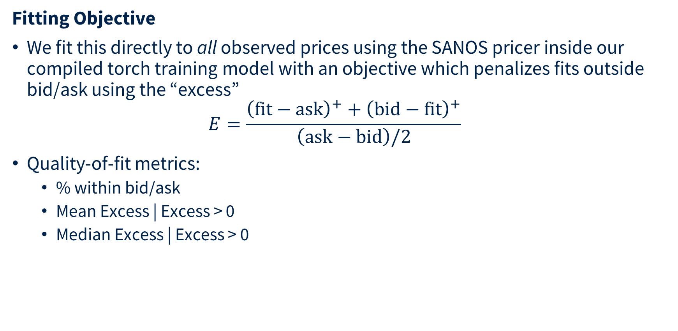
Linear Auto Regressive DYSANOS
Fitting Objective
We fit this directly to all observed prices using the SANOS pricer inside our compiled torch training model with an objective which penalizes fits outside bid/ask using the “excess”
$E=\frac{{\left(\text{fit}−\text{ask}\right)}^{+}+{\left(\text{bid}−\text{fit}\right)}^{+}}{\left(\text{ask}−\text{bid}\right)/2}$
Quality-of-fit metrics:
  % within bid/ask
  Mean Excess | Excess > 0
  Median Excess | Excess > 0

Slide 27
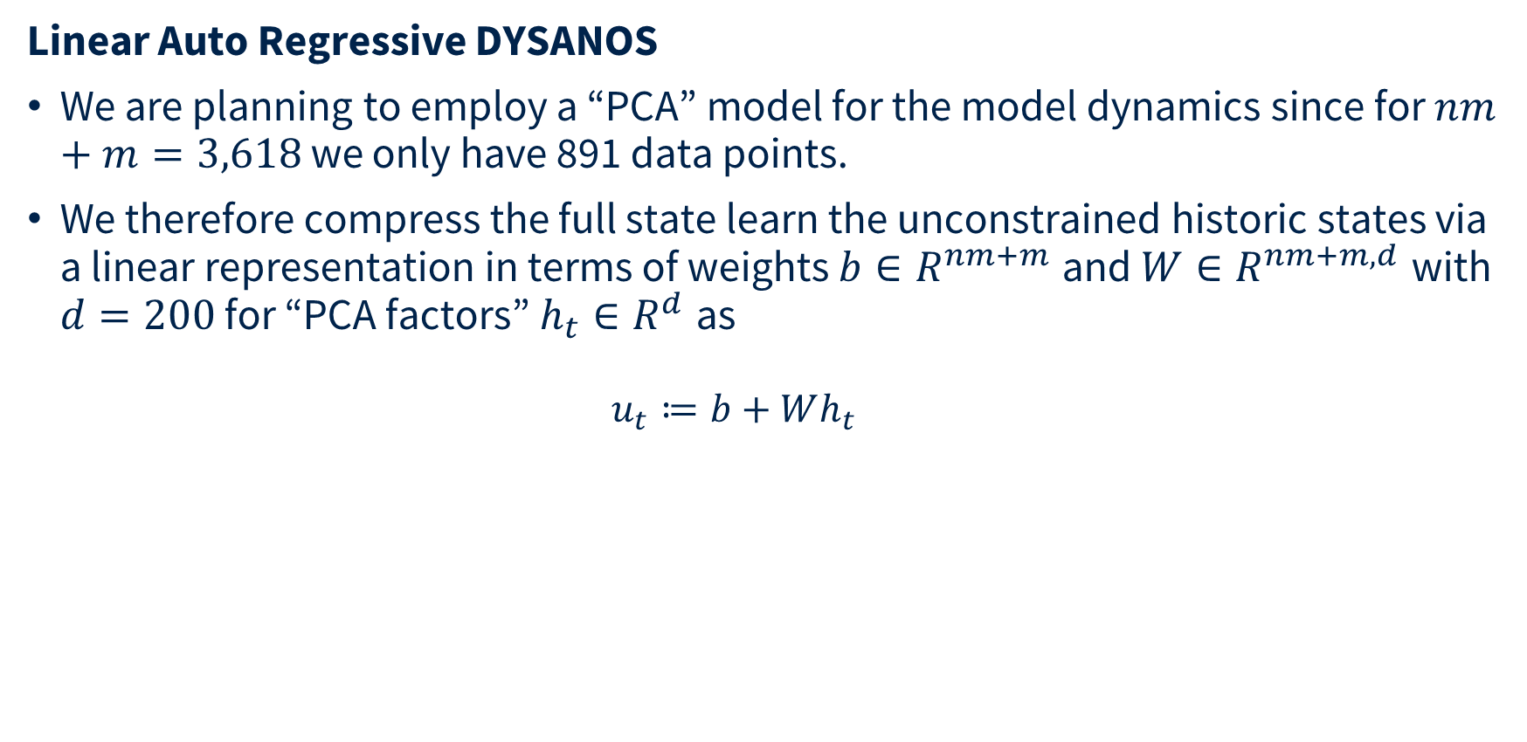
Linear Auto Regressive DYSANOS
Linear Auto Regressive DYSANOS
We are planning to employ a “PCA” model for the model dynamics since for $nm+m=3,620$ we only have 891 data points.
We therefore compress the full state learn the unconstrained historic states via a linear representation in terms of weights $b∈R^{nm+m}$ and $W∈R^{nm+m,d}$ with $d=200$ for “PCA factors” $h_{t}∈R^{d}$ as
  $$u_{t}≔b+Wh_{t}$$

Slide 28

Linear Auto Regressive DYSANOS
Example fit
“Affine” reduction does not harm total fit
Model | Quotes | % Inside | Mean excess | Cond. mean | Cond. median
Full | 3,566,258 | 82.3% | 0.31 | 1.76 | 0.69
Affine-200 | 3,566,258 | 80.9% | 0.32 | 1.69 | 0.68
891 dates, Jan 2022 – Aug 2025; next day AM contracts excluded; all nominal market expiries 1–69D. Excess is measured in half-spreads.

Slide 29
Linear Auto Regressive DYSANOS
Front expiry fit
 | 1D | 2D | 3D | 4D | 5D
Full | 94.56% | 95.21% | 95.57% | 95.77% | 68.43%
Affine-200 | 88.59% | 91.98% | 93.68% | 94.13% | 67.58%

Slide 30
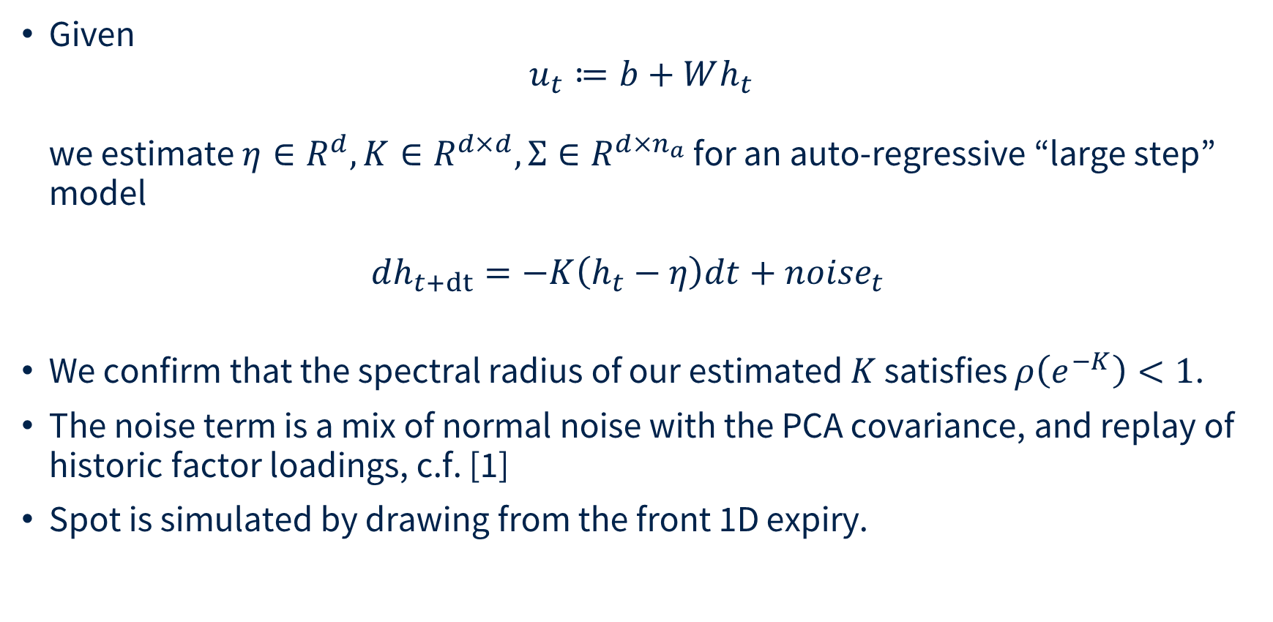
Linear Auto Regressive DYSANOS
Given
$u_{t}≔b+Wh_{t}$
we estimate $η∈R^{d}, K∈R^{d×d},Σ∈R^{d×n_{a}}$ for an auto-regressive “large step” model
$dh_{t+dt}=−K\left(h_{t}−η\right)dt+{noise}_{t}$
We confirm that the spectral radius of our estimated $K$ satisfies $ρ\left(e^{−K}\right)<1$.
The fitted five-session transition uses alternative innovation modes: Gaussian with the fitted covariance, or complete historical three-week block replay; the two are not mixed, c.f. [1].
Spot is simulated by drawing from the front 1D expiry.
__
[1] DYSANOS Generative Dynamic Smooth Arbitrage-free Non-parametric Option Surfaces, Hans Buehler et al. 2026 https://arxiv.org/abs/2608.12587

Slide 31
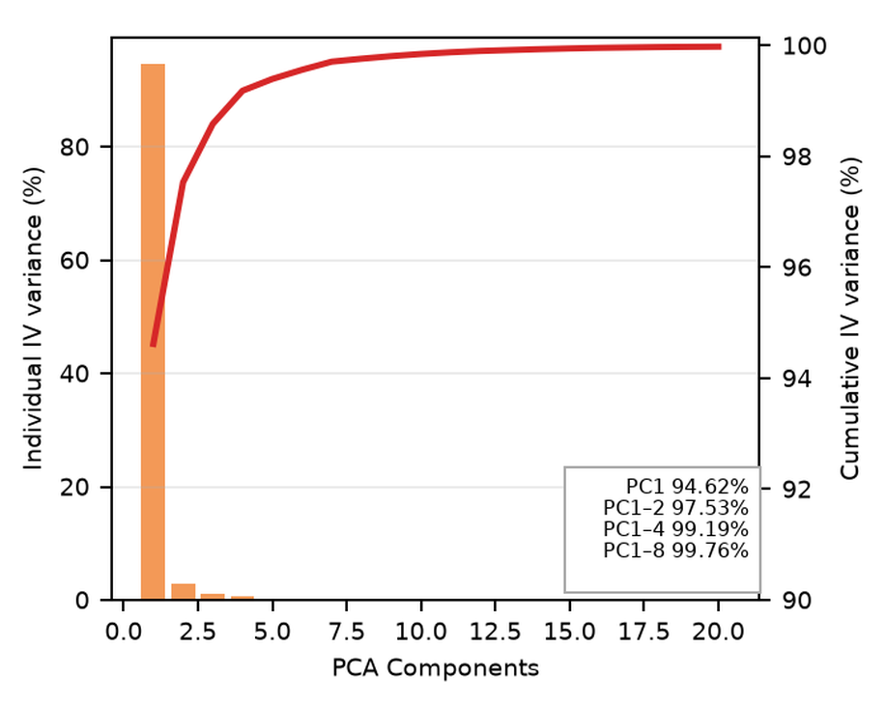
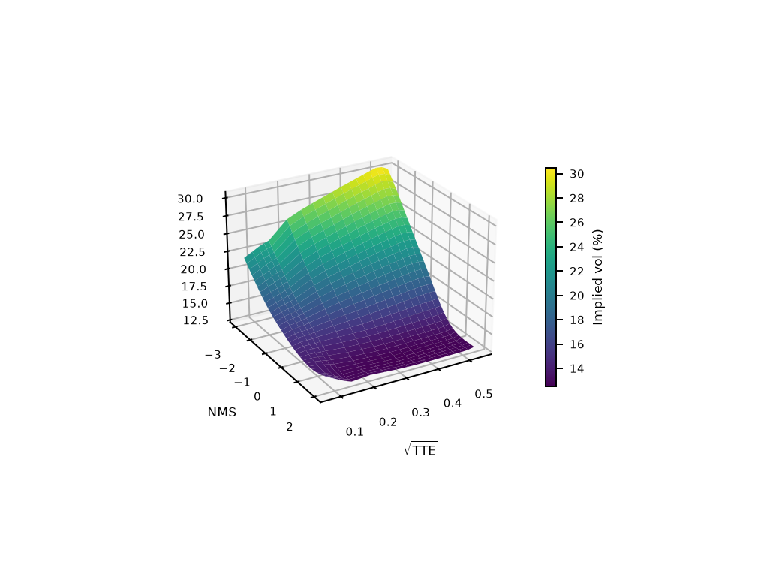
Linear Auto Regressive DYSANOS
Explained Variance
Base volatility surface
These are PCA directions in decoded implied-volatility space under the fitted invariant state covariance—not the 200 affine state coordinates themselves.

Slide 32
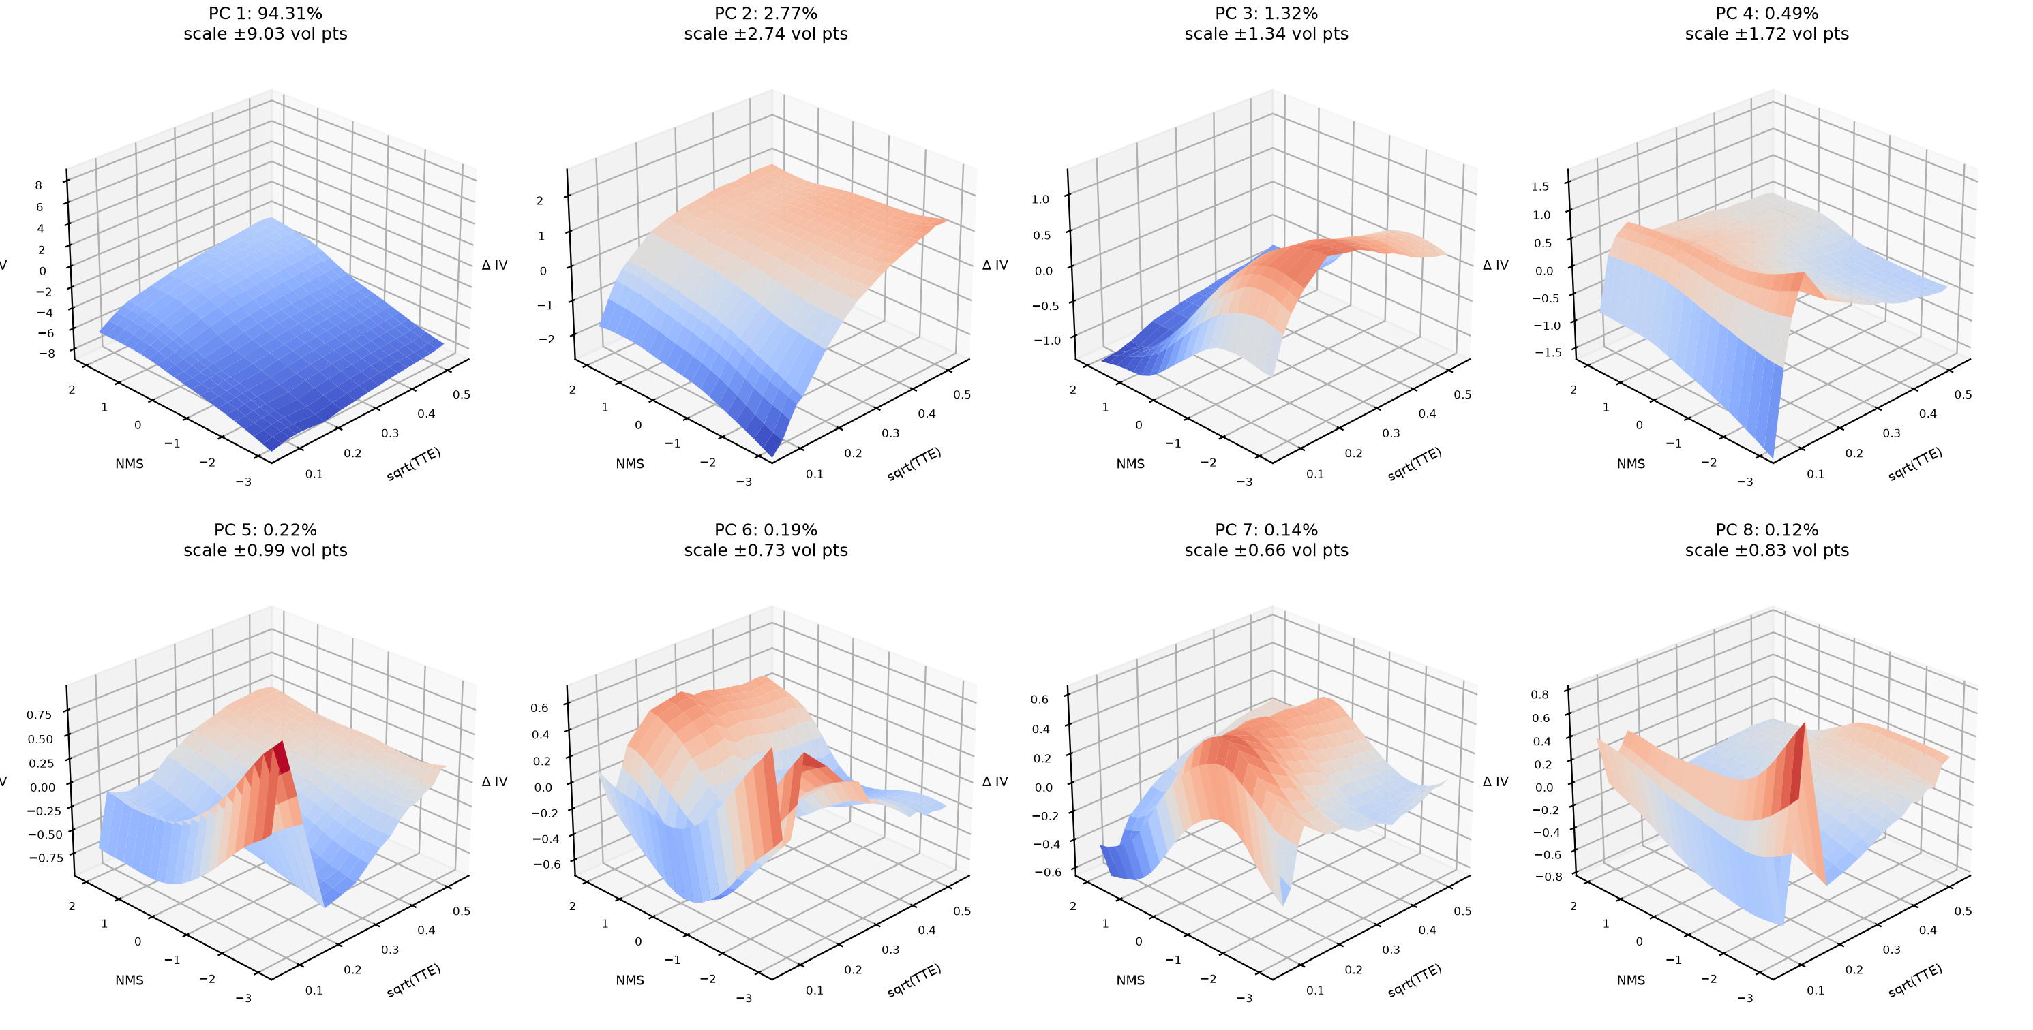
Linear Auto Regressive DYSANOS
These act via SANOS – that means each shock produces arbitrage-free surfaces
Axes: √TTE, normalized moneyness (NMS), and implied-volatility change in vol points. Signs of PCA directions are arbitrary.

Slide 33
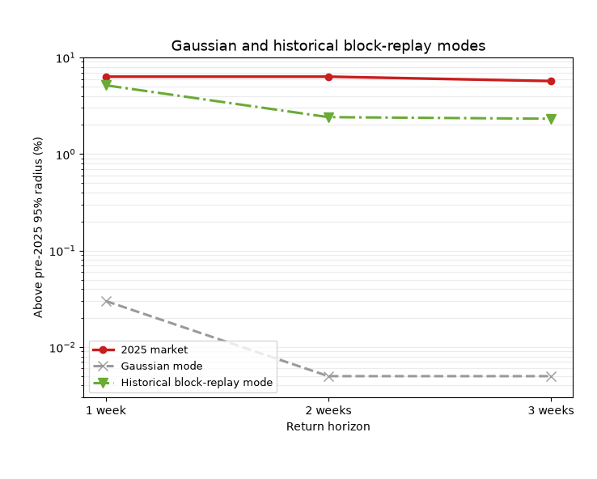
Linear Auto Regressive DYSANOS
The fitted five-session AR(1) is stable, but Gaussian innovations are too thin-tailed
Gaussian / replay
Both modes use the same fitted five-session transition.
Replay preserves complete stored three-week residual sequences; Gaussian uses the fitted covariance.
Student-t and Tail Diffusion alternatives with better tail behaviour are described in the paper.

Slide 34
Linear Auto Regressive DYSANOS
Summary
  Simple “PCA” model for implied volatility
  Statically arbitrage-free in any simulated state
Practical
  All scenarios and PCA factors generated by this model arbitrage-free.
  Can simulate very long histories of option markets

Slide 35
Dynamic Arbitrage

Slide 36
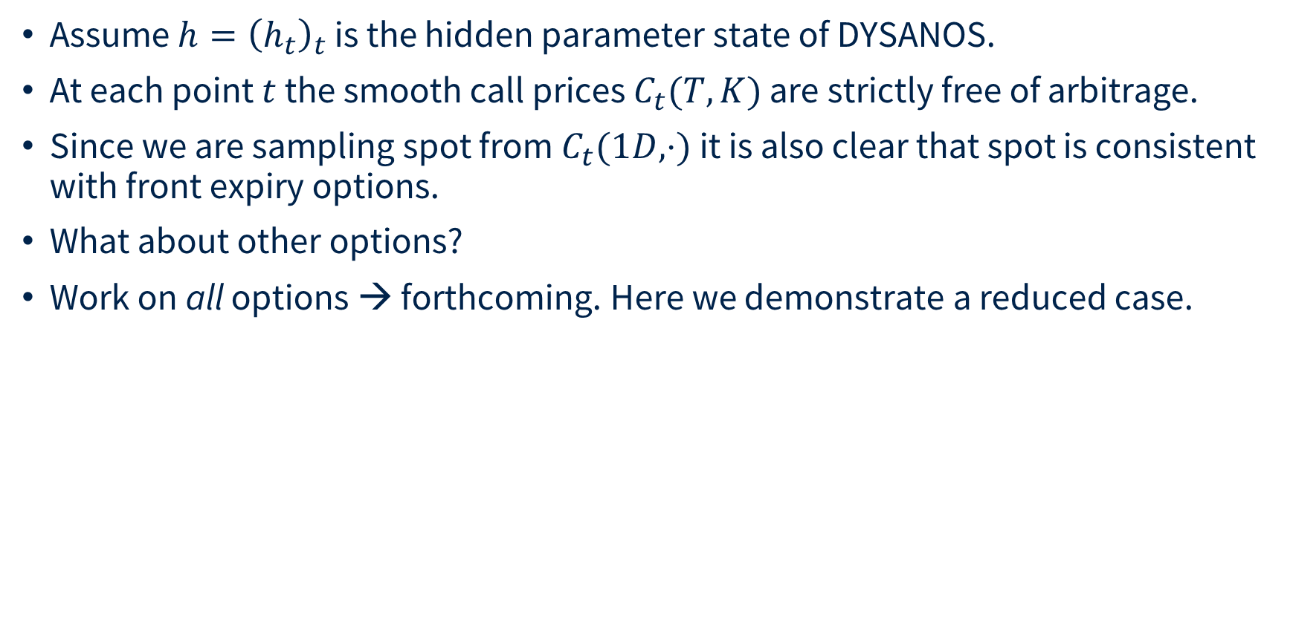
Risk-Neutral DYSANOS
Assume $h={\left(h_{t}\right)}_{t}$ is the hidden parameter state of DYSANOS.
At each point $t$ the smooth call prices $C_{t}(T,K)$ are strictly free of arbitrage.
Since we are sampling spot from $C_{t}(1D,⋅)$ it is also clear that spot is consistent with front expiry options.
What about other options?
Work on all options → forthcoming. Here we demonstrate a reduced case.

Slide 37
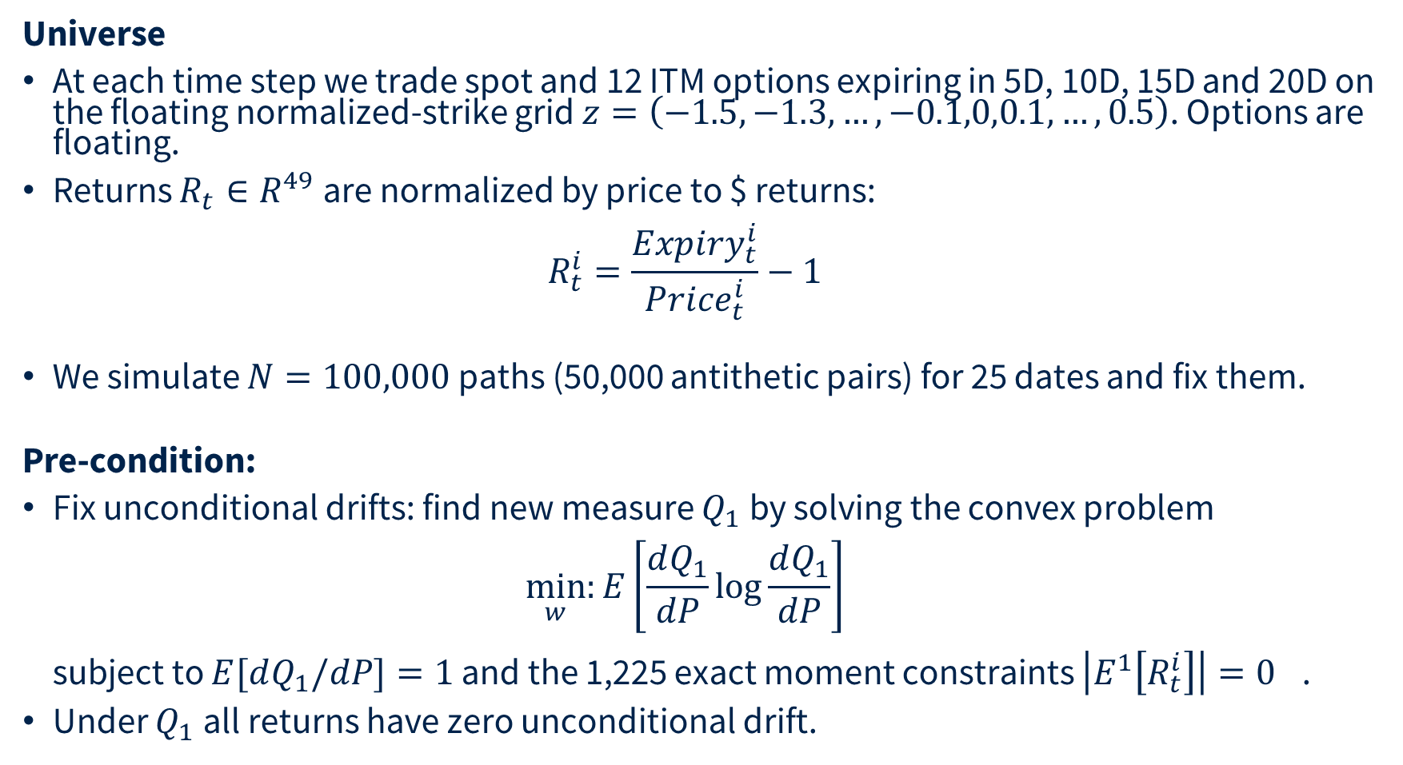
Risk-Neutral DYSANOS
Universe
At each time step we trade spot and 12 ITM options expiring in 5D, 10D, 15D and 20D on the floating normalized-strike grid $z=\left(−1.5,−1.3,…,−0.1,0,0.1,…,0.5\right)$. Options are floating.
Returns $R_{t}∈R^{49}$are normalized by price to $ returns:
$R_{t}^{i}=\frac{Expiry_{t}^{i}}{Price_{t}^{i}}−1$
We simulate $N=100,000$ paths (50,000 antithetic pairs) for 25 dates and fix them.
Pre-condition:
Fix unconditional drifts: find new measure $Q_{1}$ by solving the convex problem
$\min_{w}{:E\left[\frac{dQ_{1}}{dP}\log{\frac{dQ_{1}}{dP}}\right]}$
subject to $E[dQ_{1}/dP]=1$ and the 1,225 exact moment constraints $\left|E^{1}\left[R_{t}^{i}\right]\right|=0^{}$.
Under $Q_{1}$all returns have zero unconditional drift.

Slide 38
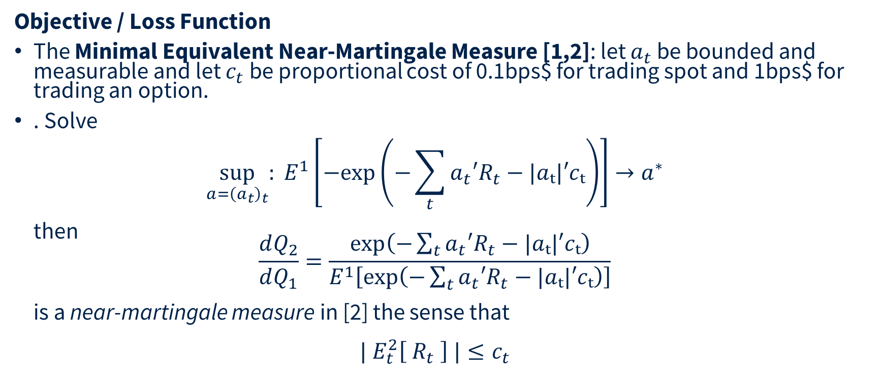
Risk-Neutral DYSANOS
Objective / Loss Function
The Minimal Equivalent Near-Martingale Measure [1,2]: let $a_{t}$ be bounded and measurable and let $c_{t}$ be proportional cost of 0.1bps$ for trading spot and 1bps$ for trading an option.
. Solve
$\sup_{{a=\left(a_{t}\right)}_{t}}{:} E^{1}\left[−exp⁡\left(−\sum_{t}{a_{t}′R_{t}−|aₜ|′cₜ}\right)\right]→a^{∗}$
then
$\frac{dQ_{2}}{dQ_{1}}=\frac{exp⁡\left(−\sum_{t}{a_{t}′R_{t}−|aₜ|′cₜ}\right)}{E^{1}\left[exp⁡\left(−\sum_{t}{a_{t}′R_{t}−|aₜ|′cₜ}\right)\right]}$
is a near-martingale measure in [2] the sense that
$| E_{t}^{2}\left[ R_{t} \right] |≤c_{t}$
__
[1] Marco Frittelli. “The minimal entropy martingale measure and the valuation problem in incomplete markets”. In: Mathematical finance 10.1 (2000), pp. 39–52.
[2] Deep hedging: learning to remove the drift, Buehler et al, 2022 https://www.risk.net/cutting-edge/banking/7932226/deep-hedging-learning-to-remove-the-drift and https://arxiv.org/abs/2111.07844

Slide 39
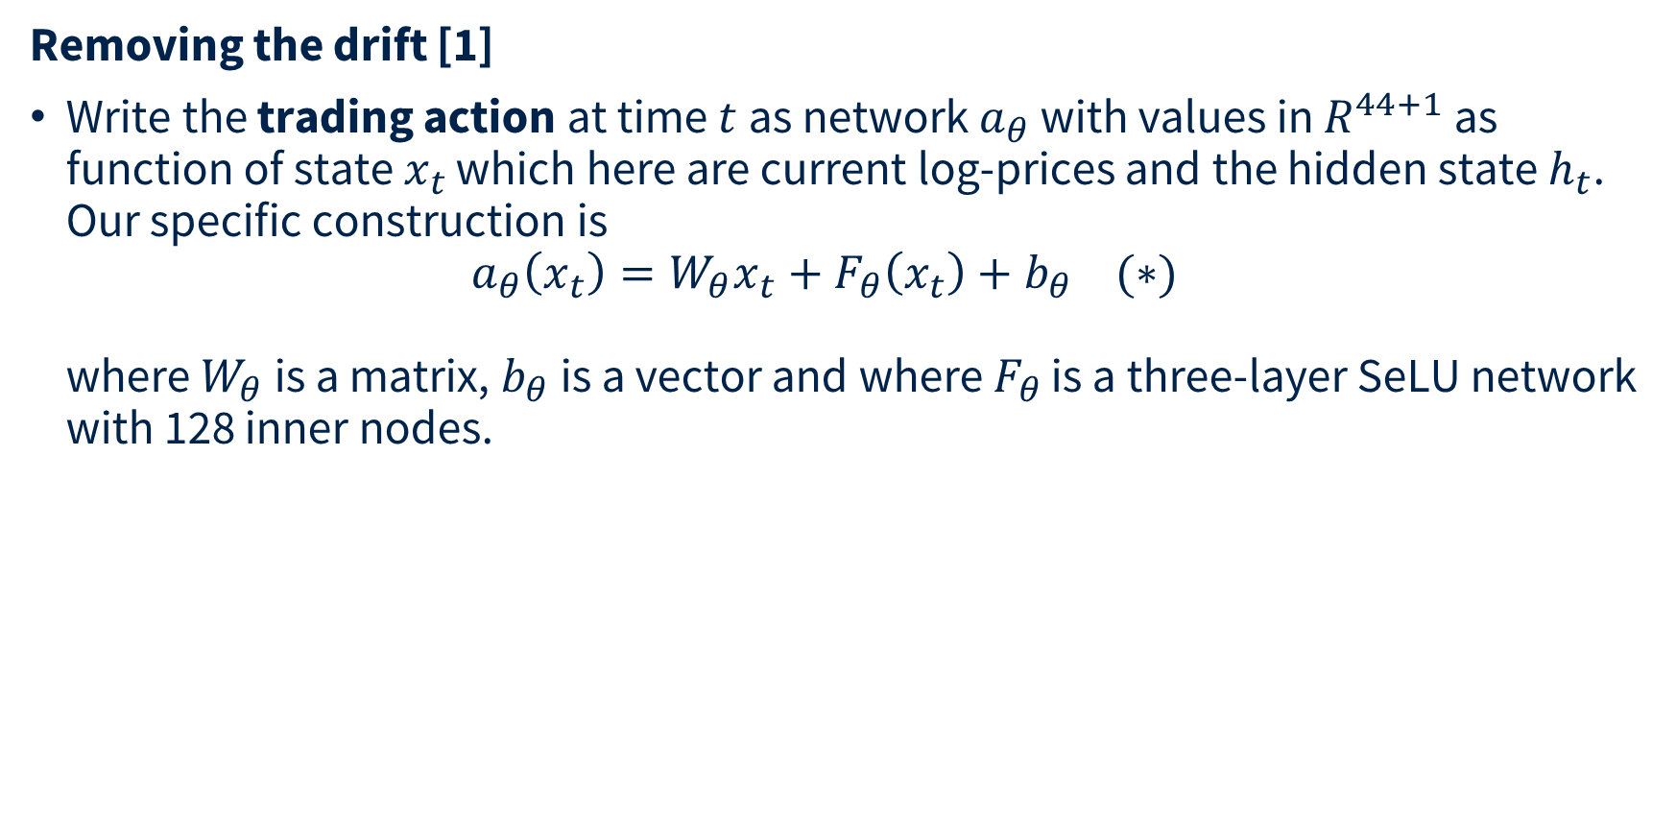
Risk-Neutral DYSANOS
Removing the drift [1]
Write the trading action at time $t$as network $a_{θ}$ with values in $R^{49}$as function of state $x_{t}$ built from time, current log-prices and the 200-dimensional hidden state $h_{t}$.
Schematically, the construction is
$a_{θ}\left(x_{t}\right)=W_{θ}x_{t}+F_{θ}\left(x_{t}\right)+b_{θ} (∗)$
For each expiry, $W_{θ}$ is an expiry-specific affine skip, $b_{θ}$ is its bias, and $F_{θ}$ is a shared two-hidden-layer width-128 SiLU network. The four expiry-specific spot outputs are summed, giving 49 actions and 56,709 parameters.

Slide 40
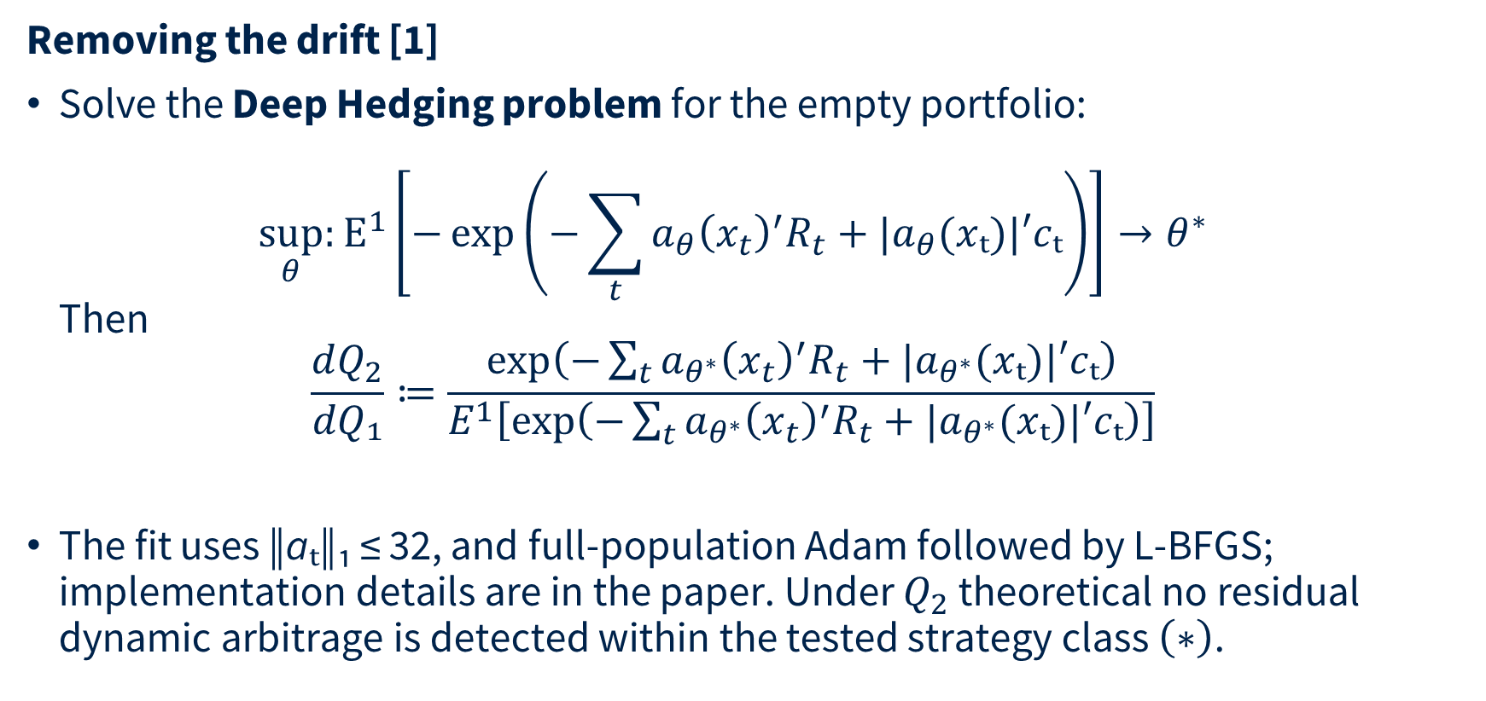
Risk-Neutral DYSANOS
Removing the drift [1]
Solve the Deep Hedging problem for the empty portfolio:
$\sup_{θ}:E^{1}\left[−\exp\left(−\sum_{t}{a_{θ}{\left(x_{t}\right)}^{′}R_{t}+|a_{θ}(xₜ)|′cₜ}\right)\right]→θ^{∗}$
Then
$\frac{dQ_{2}}{dQ₁}≔\frac{\exp\left(−\sum_{t}{a_{θ^{∗}}{\left(x_{t}\right)}^{′}R_{t}+|a_{θ^{∗}}(xₜ)|′cₜ}\right)}{E^{1}\left[\exp\left(−\sum_{t}{a_{θ^{∗}}{\left(x_{t}\right)}^{′}R_{t}+|a_{θ^{∗}}(xₜ)|′cₜ}\right)\right]}$
The fit uses ‖aₜ‖₁ ≤ 32, and full-population Adam followed by L-BFGS; implementation details are in the paper. Under $Q_{2}$ theoretical no residual dynamic arbitrage is detected within the tested strategy class $\left(∗\right)$.
__
[1] Deep hedging: learning to remove the drift, Buehler et al, 2022 https://www.risk.net/cutting-edge/banking/7932226/deep-hedging-learning-to-remove-the-drift and https://arxiv.org/abs/2111.07844

Slide 41
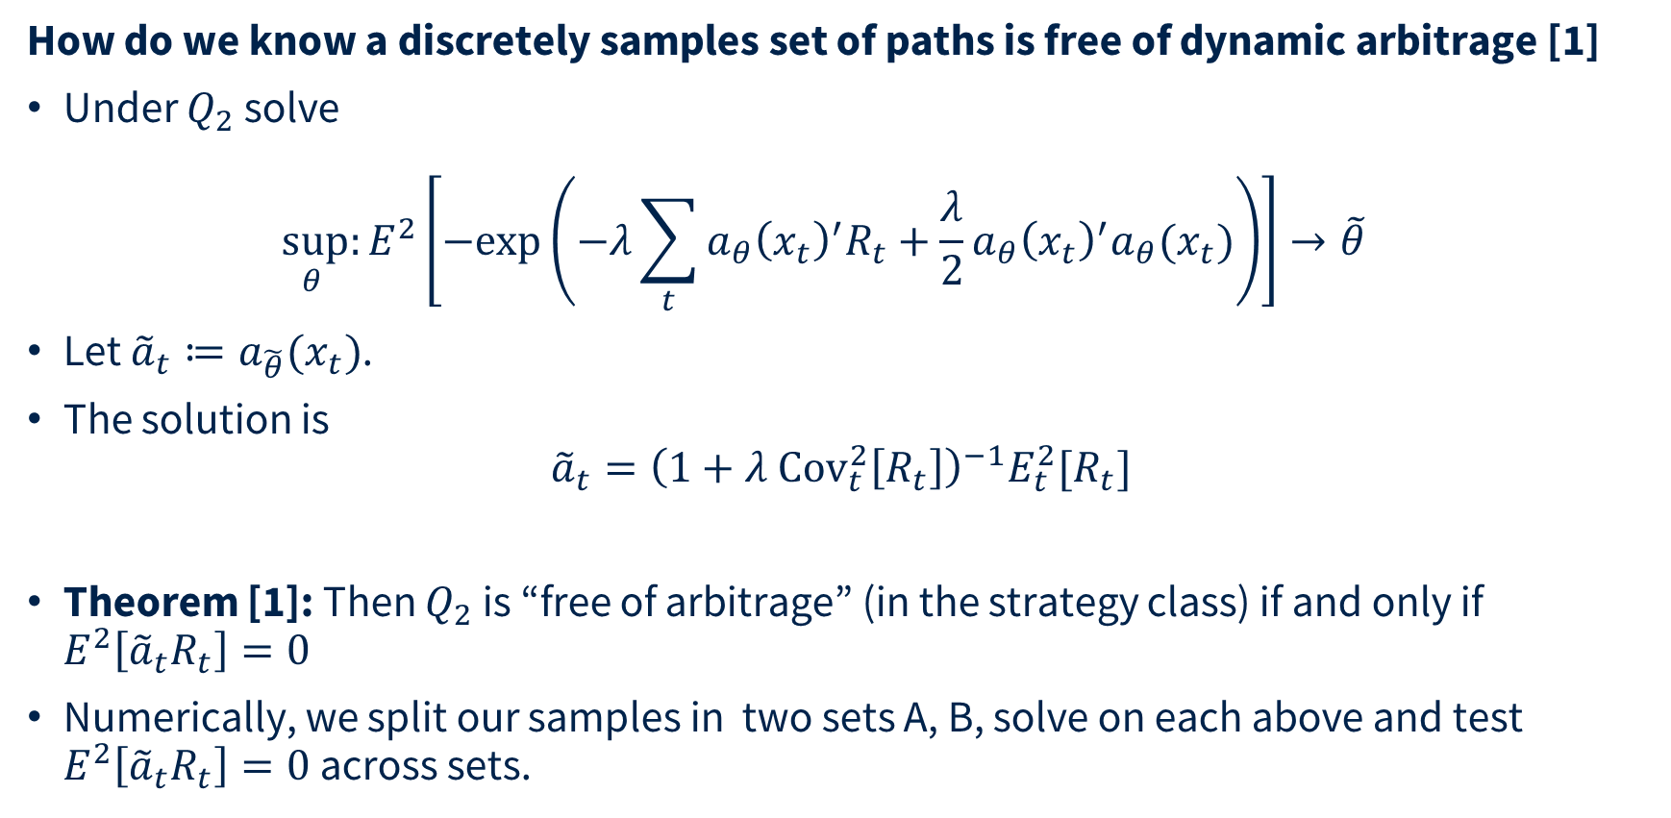
Risk-Neutral DYSANOS
How do we know a discretely samples set of paths is free of dynamic arbitrage [1]
Under $Q_{2}$ solve
$\sup_{θ }:E^{2}\left[−exp\left(−λ\sum_{t}{a_{θ}{\left(x_{t}\right)}^{′}R_{t}}+\frac{λ}{2}a_{θ}{\left(x_{t}\right)}^{′}a_{θ}(x_{t})\right)\right]→\tilde{θ}$
Let ${\tilde{a}}_{t}≔a_{\tilde{θ}}(x_{t})$.
The solution is
${\tilde{a}}_{t}={\left(1+λ {\text{Cov}}_{t}^{2}\left[R_{t}\right]\right)}^{−1}E_{t}^{2}[R_{t}]$
Theorem [1]: Then $Q_{2}$ is “free of arbitrage” (in the strategy class) if and only if $E^{2}\left[{\tilde{a}}_{t}R_{t}\right]=0$
Numerically, we split our samples in two sets A, B, solve on each above and test $E^{2}\left[{\tilde{a}}_{t}R_{t}\right]=0$ across sets.
__
[1] Dysanos, Buehler et al, 2026, https://arxiv.org/pdf/2608.12587

Slide 42
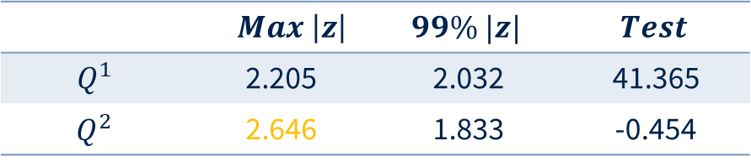
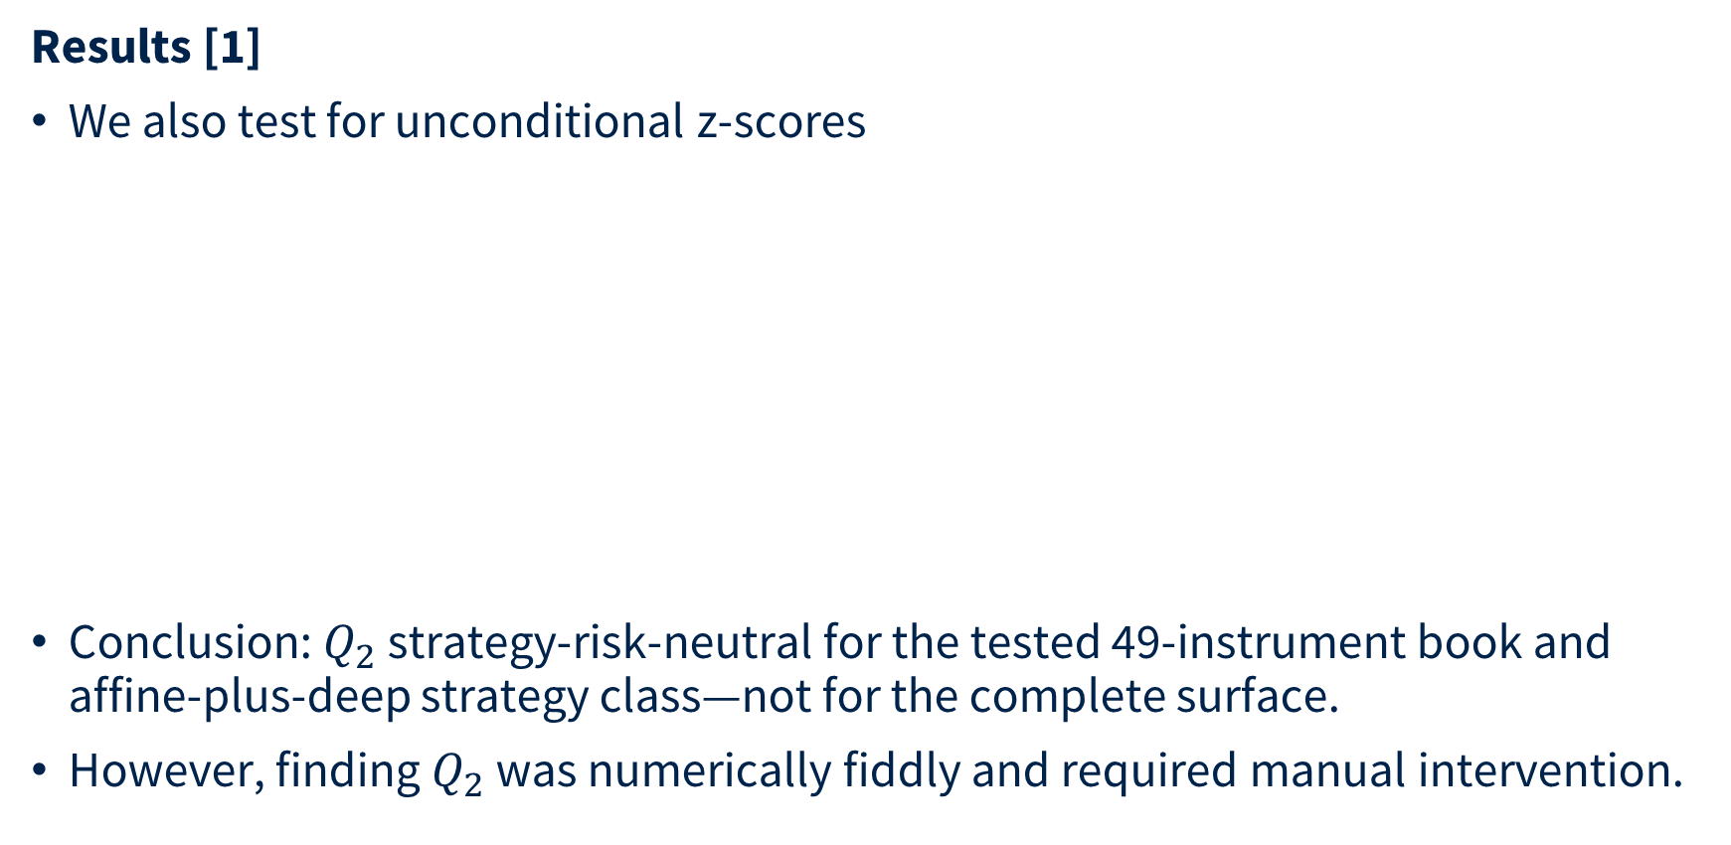
Risk-Neutral DYSANOS
Results [1]
We also test for unconditional z-scores
Conclusion: $Q_{2}$ strategy-risk-neutral for the tested 49-instrument book and affine-plus-deep strategy class—not for the complete surface.
However, finding $Q_{2}$ was numerically fiddly and required manual intervention.
 | $$Max \left|z\right|$$ | $$99\% |z|$$ | $$T_{act}$$
$$Q^{1}$$ | 2.205 | 2.032 | 41.365
$$Q^{2}$$ | 2.646 | 1.833 | -0.454
Two-sided normal cut-offs: 95% = 1.960; 99% = 2.576
Q₂: p_act = 0.650; a large two-sided p-value means the audit does not reject zero conditional drift.
__
[1] DYSANOS Generative Dynamic Smooth Arbitrage-free Non-parametric Option Surfaces, Hans Buehler et al. 2026 https://arxiv.org/abs/2608.12587

Slide 43
Risk-Neutral DYSANOS V1.0
Summary
  Find near-martingale via MEMM method.
  Provides absence of arbitrage to a subset of options.
  Current “model free” method relies, effectively, on having many more paths than tradable instruments.
Next Steps
  Achieve risk-neutrality for the full surface

Slide 44
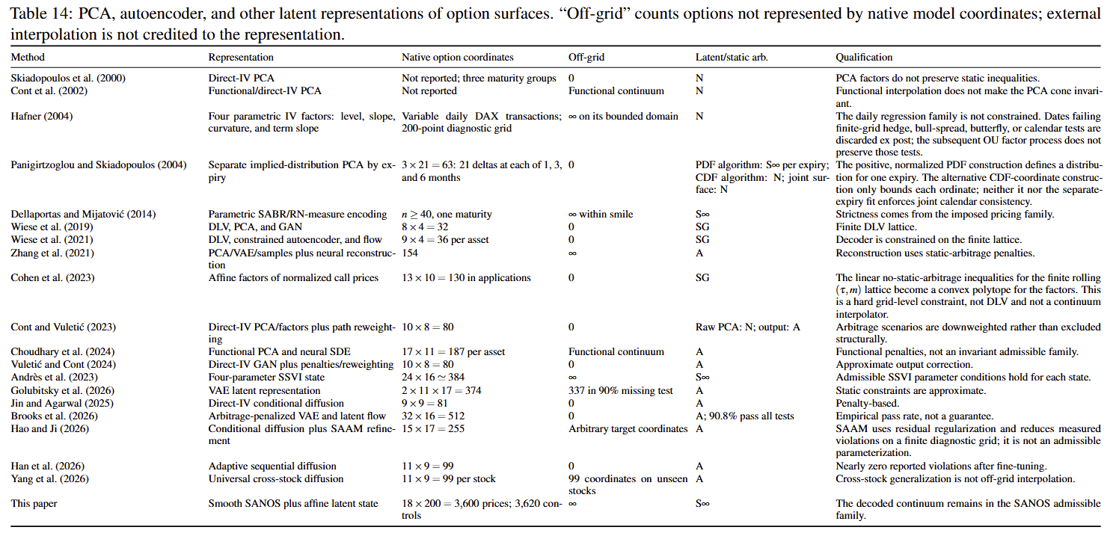
Implied Vol Dynamics Overview

Slide 45
Please ask questions
hans.buehler@maths.ox.ac.uk

