Slide 1
Learning to Trade
SANOS → DYSANOS → GROMM
Hans Buehler, Blanka Horvath, Magnus Wiese
University of Oxford, Institute for Mathematics
hans.buehler@maths.ox.ac.uk
DataSigII Seminar
London, October 28th, 2026

Slide 2
Problem Statement
Historic Quantitative Finance Model Development
  Find “solvable model” which can price all European options.
  Calibrate to market.
  Local vol / particles most practical approach
  Dynamics are an afterthought.
  No consideration for transaction cost or market frictions
Not what we learned
  Black/Scholes insight “The price of a derivative is the cost of its replication”.
  That is not what we are using. The market is not equivalent to local vol.
  We lost track of the original premise of quant finance.

Slide 3
Problem Statement
We want to “learn to trade” a’la Deep Hedging or other methods
  Need a model to simulate the market
  Benchmark hedging methods → open-quant.ai
History
  In rates: HJM, BGM models
  An Equity Market Model or “Stochastic Implied Volatility” was an unsolved problem.
  Schoenbucher 1999: term structure for a fixed strike
  Buehler 2005: consistent variance curves e.g. variance swaps
  Wissel-Schweizer 2007: seminal but unpublished work on a fixed set of options of the entire surface
Carmona-Nadtochiy 2017: continuous strikes and expires, but uses independent increments

Slide 4
Problem Statement
Requirements
  Risk neutral ← need absence of static arbitrage
  Smooth option price function for all strikes and expiries (not just a discrete set)
Code Book
  Implied volatility: most natural representation, but cannot enforce no static arb
  Tangent levy: mathematically accessible, but does not match market dynamics
  Local volatility: easy to enforce no static arb but Dupire local vol requires PDEs
Plan
  Use “discrete” local vol from Buehler-Ryskin 2015 as backbone; add SANOS smoothing to obtain smooth surfaces
  Wissel-Schweizer 2007 showed there is a model which has a risk-neutral measure. Rewrite in nicer coordinates based on Carmona-Nadtochiy 2017

Slide 5

Option Markets

Slide 6
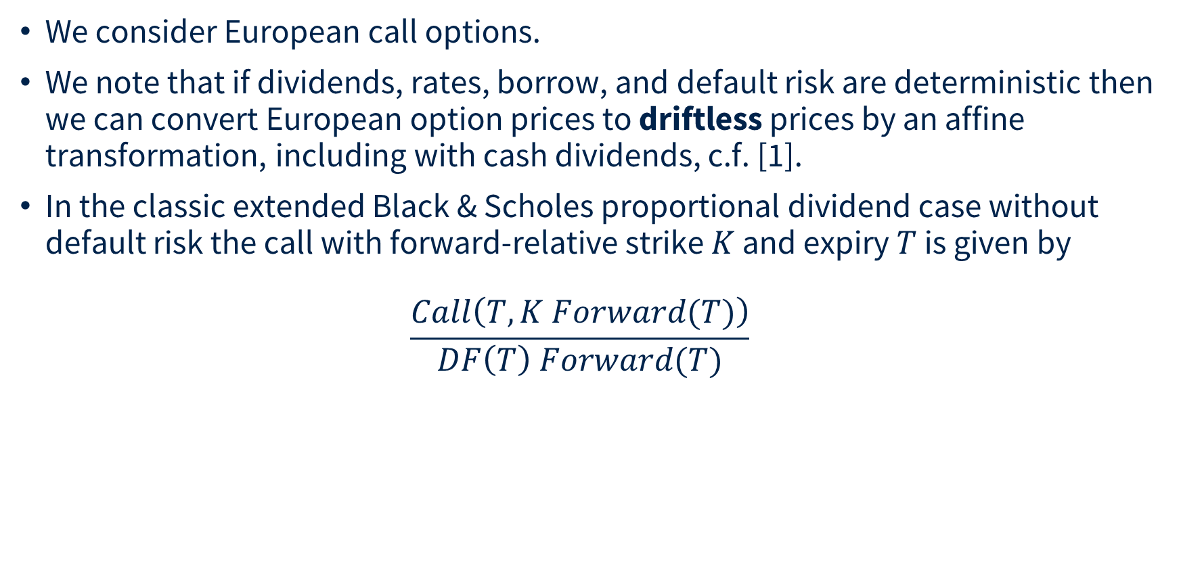
Option Markets
We consider European call options.
We note that if dividends, rates, borrow, and default risk are deterministic then we can convert European option prices to driftless prices by an affine transformation, including with cash dividends, c.f. [1].
In the classic extended Black & Scholes proportional dividend case without default risk the call with forward-relative strike $K$ and expiry $T$ is given by
$\frac{Call\left(T,K Forward(T)\right)}{DF\left(T\right) Forward(T)}$
__
[1] Volatility and Dividends - Volatility Modelling with Cash Dividends and Simple Credit Risk, Buehler 2008, https://papers.ssrn.com/sol3/papers.cfm?abstract_id=1141877

Slide 7
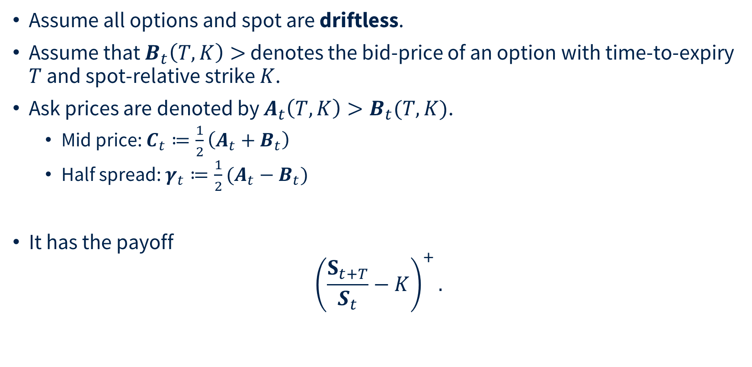
Option Markets
Assume all options and spot are driftless.
Assume that $B_{t}\left(T,K\right)>$ denotes the bid-price of an option with time-to-expiry $T$ and spot-relative strike $K$.
Ask prices are denoted by $A_{t}\left(T,K\right)>B_{t}(T,K)$.
  Mid price: $C_{t}≔\frac{1}{2}\left(A_{t}+B_{t}\right)$
  Half spread: $γ_{t}≔\frac{1}{2}(A_{t}−B_{t})$
It has the payoff
${\left(\frac{S_{t+T}}{S_{t}}−K\right)}^{+}.$

Slide 8
SANOS
Smooth Arbitrage-free Non-parametric Option Surfaces
Joint work with Blanka Horvath, Anastasis Kratsios, Yannick Limmer, Raeid Saqur

Slide 9
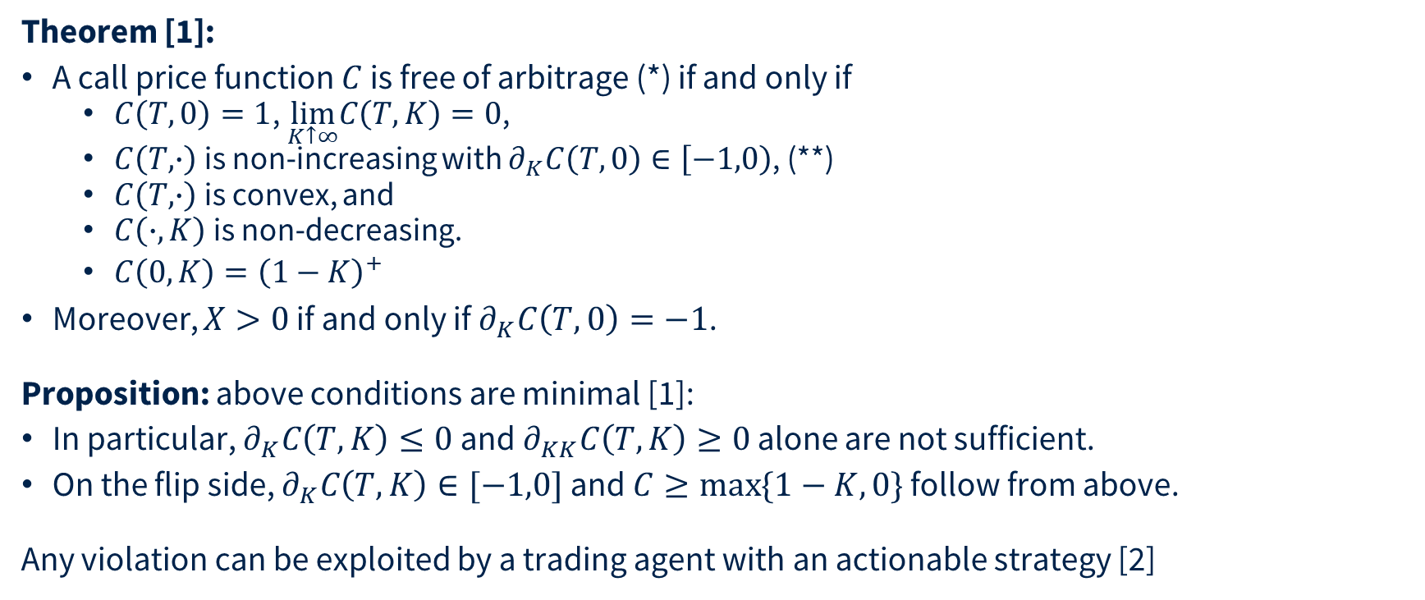
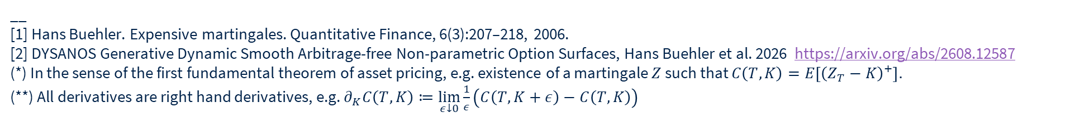
SANOS
Theorem [1]:
A call price function $C$ is free of arbitrage (*) if and only if
  $C\left(T,0\right)=1$, $\lim_{K↑∞}C\left(T,K\right)=0$,
  $C\left(T,∙\right)$ is non-increasing with $∂_{K}C\left(T,0\right)∈\left[−1,0\right)$, (**)
  $C\left(T,∙\right)$ is convex, and
  $C\left(∙,K\right)$ is non-decreasing.
  $C\left(0,K\right)={\left(1−K\right)}^{+}$
Moreover, $X>0$ if and only if$∂_{K}C\left(T,0\right)=−1$.
Proposition: above conditions are minimal [1]:
In particular, $∂_{K}C\left(T,K\right)≤0$ and $∂_{KK}C\left(T,K\right)≥0$ alone are not sufficient.
On the flip side, $∂_{K}C\left(T,K\right)∈[−1,0]$ and $C≥\max{\{1−K,0\}}$ follow from above.
Any violation can be exploited by a trading agent with an actionable strategy [2]
__
[1] Hans Buehler. Expensive martingales. Quantitative Finance, 6(3):207–218, 2006.
[2] DYSANOS Generative Dynamic Smooth Arbitrage-free Non-parametric Option Surfaces, Hans Buehler et al. 2026 https://arxiv.org/abs/2608.12587
(*) In the sense of the first fundamental theorem of asset pricing, e.g. existence of a martingale $Z$such that $C\left(T,K\right)=E\left[{\left(Z_{T}−K\right)}^{+}\right].$
(**) All derivatives are right hand derivatives, e.g. $∂_{K}C\left(T,K\right)≔\lim_{ε↓0}\frac{1}{ε}\left(C\left(T,K+ε\right)−C\left(T,K\right)\right)$

Slide 10
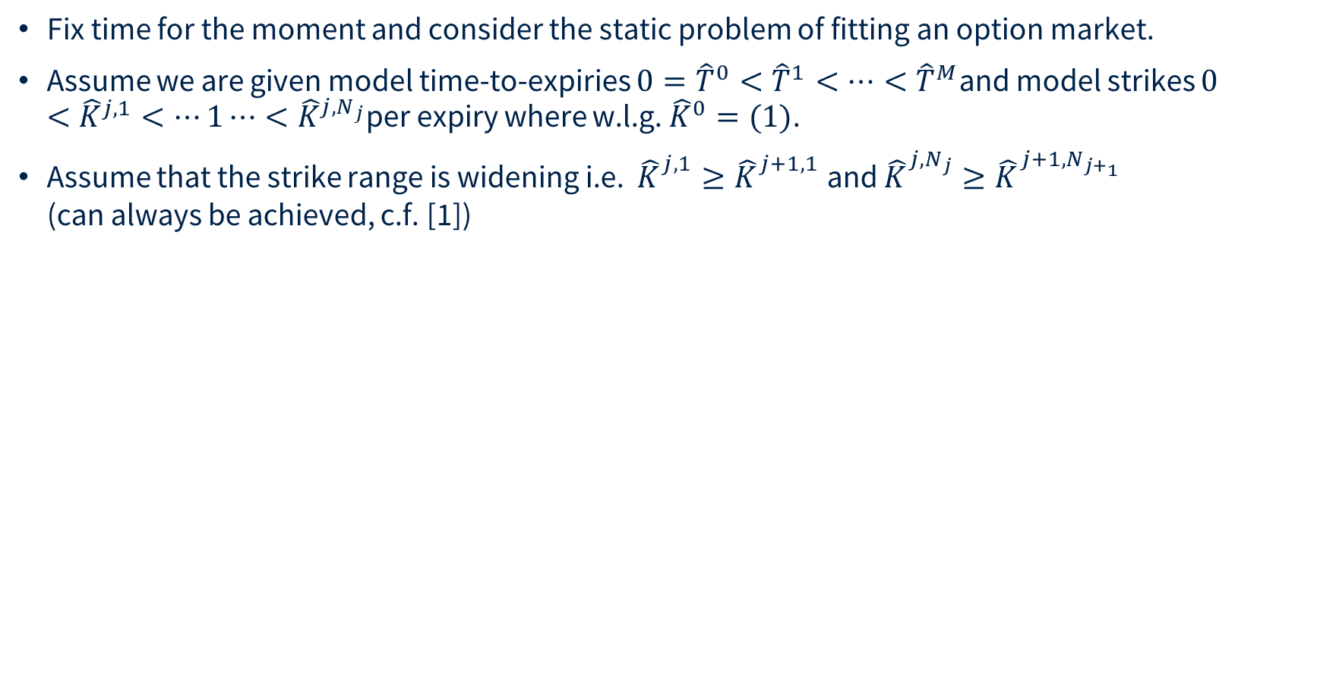
SANOS
Fix time for the moment and consider the static problem of fitting an option market.
Assume we are given model time-to-expiries $0={\hat{T}}^{0}<{\hat{T}}^{1}<⋯<{\hat{T}}^{M}$and model strikes $0<{\hat{K}}^{j,1}<⋯1⋯<{\hat{K}}^{j,N_{j}}$per expiry where w.l.g. ${\hat{K}}^{0}=(1)$.
Assume that the strike range is widening i.e. ${\hat{K}}_{}^{j,1}≥{\hat{K}}_{}^{j+1,1}$ and ${\hat{K}}_{}^{j,N_{j}}≥{\hat{K}}_{}^{{j+1,N}_{j+_{1}}}$
(can always be achieved, c.f. [1])
__
[1] SANOS, Buehler et al, 2026 https://arxiv.org/pdf/2601.11209

Slide 11
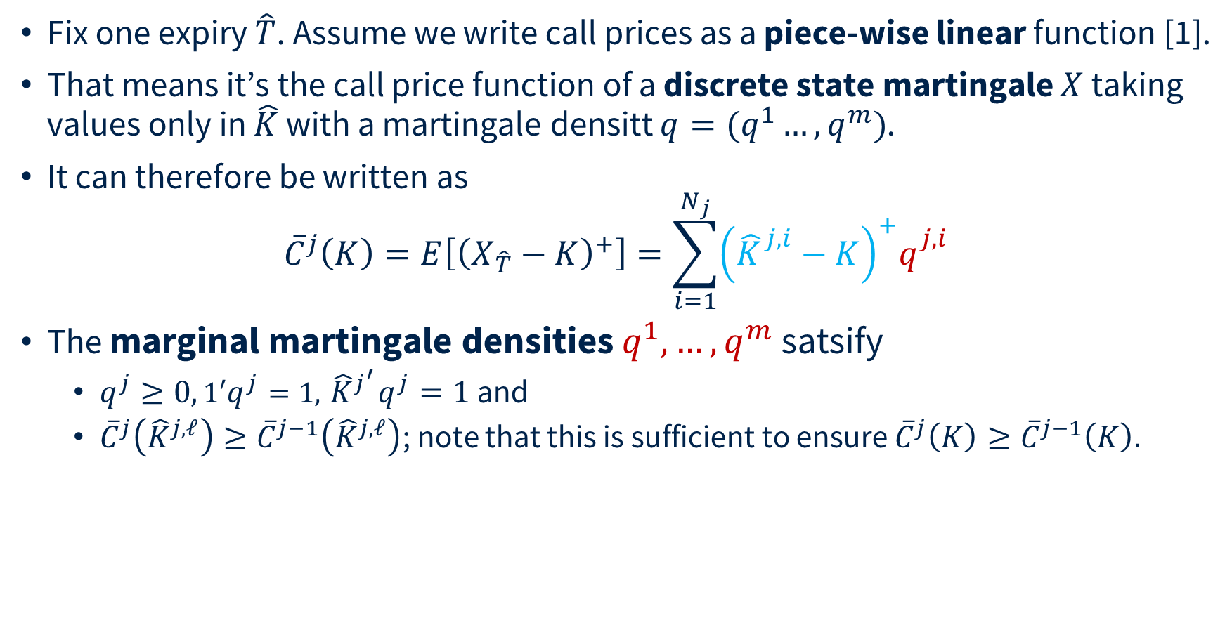
SANOS
Fix one expiry $\hat{T}$. Assume we write call prices as a piece-wise linear function [1].
That means it’s the call price function of a discrete state martingale $X$ taking values only in $\hat{K}$ with a martingale densitt $q=(q^{1}…, q^{m})$.
It can therefore be written as
${\overline{C}}^{j}\left(K\right)=E\left[{\left(X_{\hat{T}}−K\right)}^{+}\right]=\sum_{i=1}^{N_{j}}{{\left({\hat{K}}_{}^{j,i}−K\right)}^{+}q_{}^{j,i}}$
The marginal martingale densities $q^{1},…,q^{m}$ satsify
  $q^{j}≥0, 1′q^{j}=1,{ {\hat{K}}^{j}}^{′}q^{j}=1$ and
  ${\overline{C}}^{j}\left({\hat{K}}^{j,ℓ}\right)≥{\overline{C}}^{j−1}\left({\hat{K}}^{j,ℓ}\right)$; note that this is sufficient to ensure ${\overline{C}}^{j}\left(K\right)≥{\overline{C}}^{j−1}\left(K\right).$
__
[1]Discrete local volatility for large time steps (extended version), Hans Buehler and Evgeny Ryskin, 2015. https://papers.ssrn.com/abstract=2642630

Slide 12
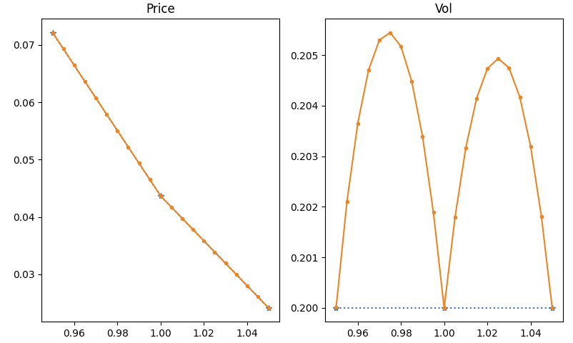
SANOS
Linear interpolation is “too expensive”: example 20% BS prices interpolated linearly.

Slide 13
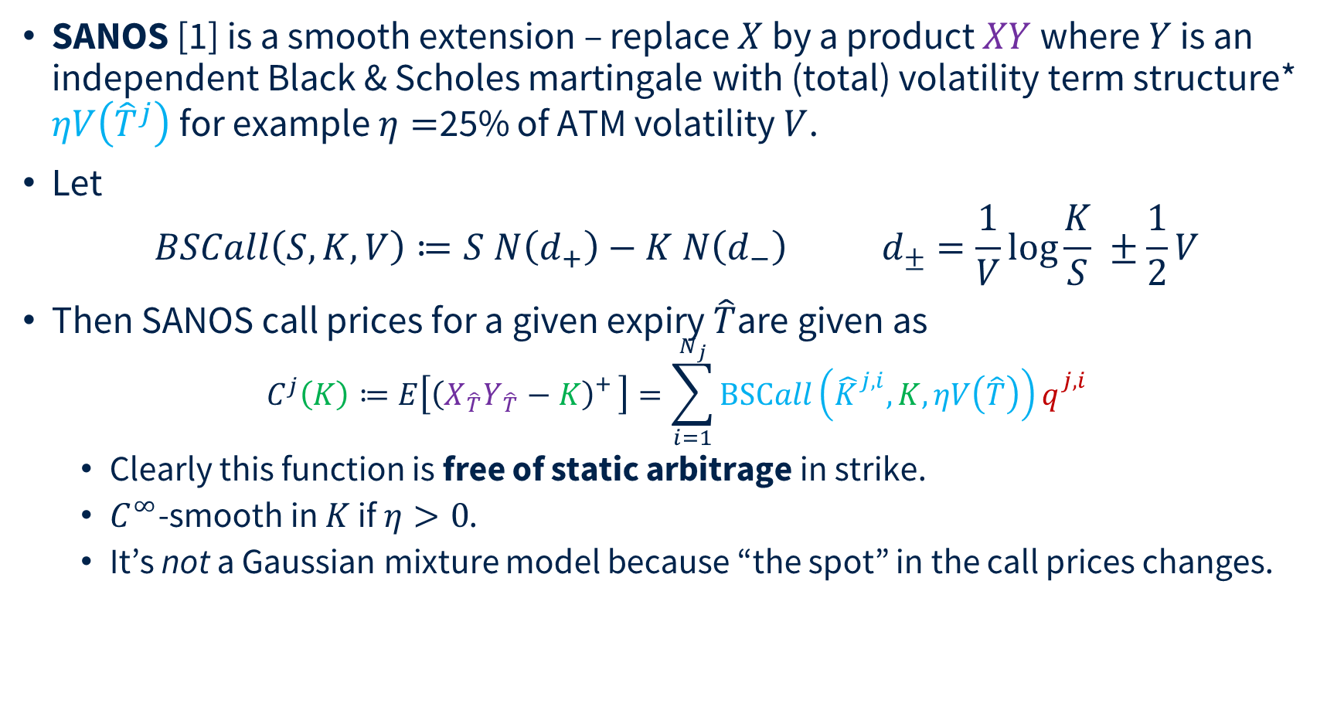
SANOS
SANOS [1] is a smooth extension – replace $X$ by a product $XY$ where $Y$ is an independent Black & Scholes martingale with (total) volatility term structure* $ηV\left({\hat{T}}^{j}\right)$ for example $η=$25% of ATM volatility $V$.
Let
$BSCall\left(S,K,V\right)≔S N\left(d_{+}\right)−K N\left(d_{−}\right) d_{±}=\frac{1}{V}log{\frac{K}{S} }±\frac{1}{2}V$
Then SANOS call prices for a given expiry $\hat{T}$are given as
$C^{j}\left(K\right)≔E\left[{\left(X_{\hat{T}}Y_{\hat{T}}−K\right)}_{}^{+}\right]=\sum_{i=1}^{N_{j}}{BSCall\left({\hat{K}}_{}^{j,i},K,ηV\left(\hat{T}\right)\right)q_{}^{j,i}}$
  Clearly this function is free of static arbitrage in strike.
  $C^{∞}$-smooth in $K$ if $η>0$.
  It’s not a Gaussian mixture model because “the spot” in the call prices changes.
__
[1] SANOS, Buehler et al, 2026 https://arxiv.org/pdf/2601.11209
* Using volatility instead of variance avoids taking square roots (and therefore derivatives thereof) of a variable which can become zero in torch.

Slide 14
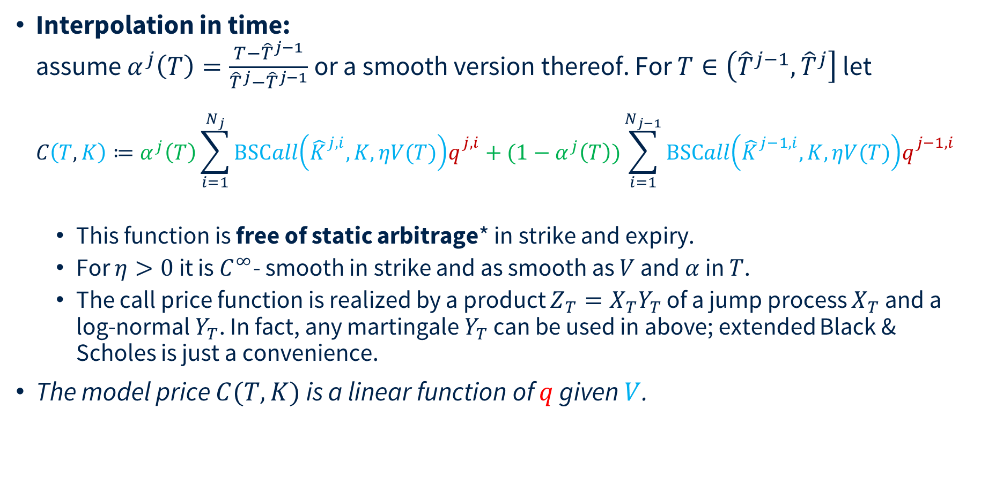
SANOS
Interpolation in time:
assume $α^{j}\left(T\right)=\frac{T−{\hat{T}}^{j−1}}{{\hat{T}}^{j}−{\hat{T}}^{j−1}}$ or a smooth version thereof. For $T∈\left({\hat{T}}^{j−1},{\hat{T}}^{j}\right]$ let
$C\left(T,K\right)≔α^{j}\left(T\right)\sum_{i=1}^{N_{j}}{BSCall\left({\hat{K}}_{}^{j,i},K,ηV(T)\right)q_{}^{j,i}}+(1−α^{j}\left(T\right))\sum_{i=1}^{N_{j−1}}{BSCall\left({\hat{K}}_{}^{j−1,i},K,ηV(T)\right)q_{}^{j−1,i}}$
  This function is free of static arbitrage* in strike and expiry.
  For $η>0$ it is $C^{∞}$- smooth in strike and as smooth as $V$ and $α$ in $T$.
  The call price function is realized by a product ${Z_{T}=X}_{T}Y_{T}$ of a jump process $X_{T}$ and a log-normal $Y_{T}$. In fact, any martingale $Y_{T}$ can be used in above; extended Black & Scholes is just a convenience.
The model price $C(T,K)$ is a linear function of $q$ given $V$.
__
[1] SANOS, Buehler et al, 2026 https://arxiv.org/pdf/2601.11209
* i.e. first fundamental theorem of asset pricing: existence of an integrable positive martingale $Z_{T}$such that $C\left(T,K\right)=E\left[{\left(Z_{T}−K\right)}^{+}\right].$

Slide 15

Fitting to the Market
For the $ℓ$^{th} market option the price $C^{ℓ}≔C(T^{ℓ},K^{ℓ})$ is a linear function of $q$.
Then [1] we may find an arbitrage-free smooth interpolation of discrete call prices $C_{j}^{i}$ jointly across all strikes and expiries by solving a linear problem
$\min_{q}{:}\sum_{ℓ }{\frac{1}{γ_{ℓ}^{i}}\left\{{\left(C_{}^{ℓ}−A_{}^{ℓ}\right)}^{+}+{\left(B_{}^{ℓ}−C_{}^{ℓ}\right)}^{+}+ε \left|C_{}^{ℓ}−M_{}^{ℓ}\right|\right\}}$
with linear constraints:
  $q_{j}≥0$, $1^{′}q^{j}=1$,${{\hat{K}}^{j}}^{′}q^{j}=1$
  ${q^{j}′\left({\hat{K}}^{j}−{\hat{K}}_{}^{j,i}\right)}^{+}≥{q^{j−1}}^{′}{\left({\hat{K}}^{j−1}−{\hat{K}}_{}^{j,i}\right)}^{+}$for all $i,j$.
Straightforward global fit with linear programming.
__
[1] SANOS, Buehler et al, 2026 https://arxiv.org/pdf/2601.11209

Slide 16
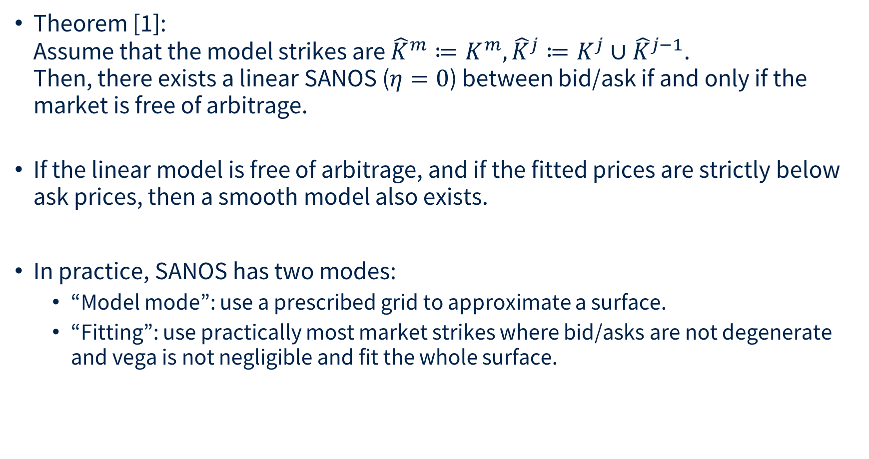
Fitting to the Market
Theorem [1]:
Assume that the model strikes are ${\hat{K}}^{m}≔K^{m},{\hat{K}}^{j}≔K^{j}∪{\hat{K}}^{j−1}$.
Then, there exists a linear SANOS ($η=0$) between bid/ask if and only if the market is free of arbitrage.
If the linear model is free of arbitrage, and if the fitted prices are strictly below ask prices, then a smooth model also exists.
In practice, SANOS has two modes:
  “Model mode”: use a prescribed grid to approximate a surface.
  “Fitting”: use practically most market strikes where bid/asks are not degenerate and vega is not negligible and fit the whole surface.
__
[1] SANOS, Buehler et al, 2026 https://arxiv.org/pdf/2601.11209

Slide 17
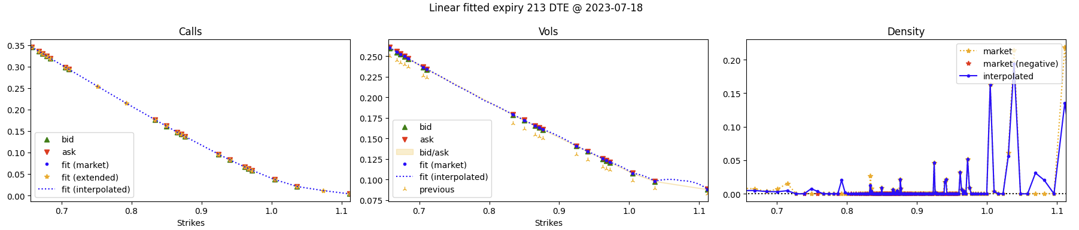
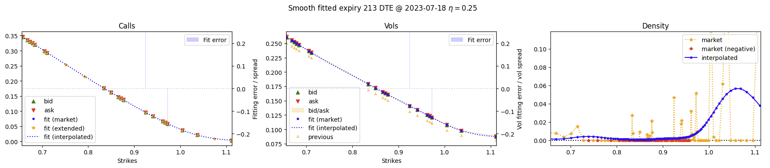
Fitting to the Market
Linear interpolation effect

Slide 18


Fitting to the Market
Fitted 1,000 options within 2 ATM implied volatility standard deviations which had a Vega/sqrtT of at least 0.1% on 2025-05-06 across all 48 expiries from 1 to 657 business days.
Options were chosen by closeness to ATM. The model fitted 91.4% of all options within bid/ask. Of those options not fitted the median error is just 21% of half spread.
The fit took sub-seconds on a desktop PC.

Slide 19
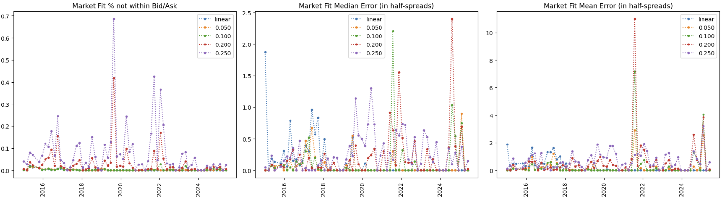
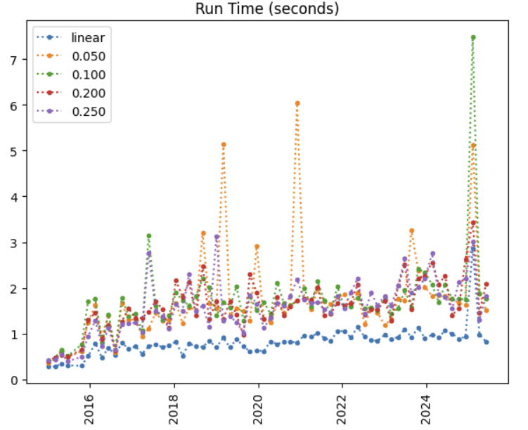
Fitting to the Market
Fitted 1,000 options within 2 ATM implied volatility standard deviations which had a Vega/sqrtT of at least 0.1% across expiries

Slide 20
SANOS
Summary
  First published strictly static arb free smooth option surface parametrization
  Very fast linear programming fit to “all” observed European options within bid/ask; typically 1-3 seconds for 1,000 options. Longer for an entire unfiltered surface.
  Guaranteed linear fit if and only if the market is arbitrage-free within bid/ask
Practical
  Fast pre-processor for local volatility (in fact, it is a type of local volatility → later)
  Can ensure vega scenarios/greeks lead to arbitrage-free results

Slide 21
DYSANOS
Generative Smooth Arbitrage-free Non-parametric Option Surfaces [1]
Joint work with Blanka Horvath, Anastasis Kratsios, Magnus Wiese
__
[1] DYSANOS Generative Dynamic Smooth Arbitrage-free Non-parametric Option Surfaces, Hans Buehler et al, 2026 https://arxiv.org/abs/2608.12587

Slide 22
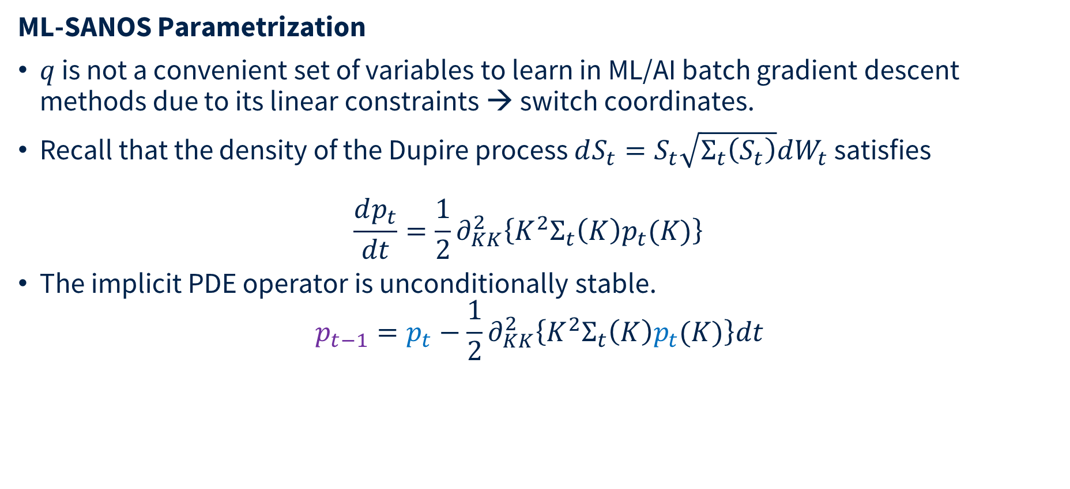
DYSANOS
ML-SANOS Parametrization
$q$ is not a convenient set of variables to learn in ML/AI batch gradient descent methods due to its linear constraints → switch coordinates.
Recall that the density of the Dupire process $dS_{t}=S_{t}\sqrt{Σ_{t}\left(S_{t}\right)}dW_{t}$ satisfies
$\frac{dp_{t}}{dt}=\frac{1}{2}∂_{KK}^{2}\left\{K^{2}Σ_{t}\left(K\right)p_{t}(K)\right\}$
The implicit PDE operator is unconditionally stable.
$p_{t−1}=p_{t}−\frac{1}{2}∂_{KK}^{2}\left\{K^{2}Σ_{t}\left(K\right)p_{t}(K)\right\}dt$
__
[1] Discrete local volatility for large time steps (extended version), Hans Buehler and Evgeny Ryskin, 2015 https://papers.ssrn.com/abstract=2642630
[2] Finite Difference Based Calibration and Simulation, Andreasen et al, 2010 https://papers.ssrn.com/sol3/papers.cfm?abstract_id=1697545

Slide 23
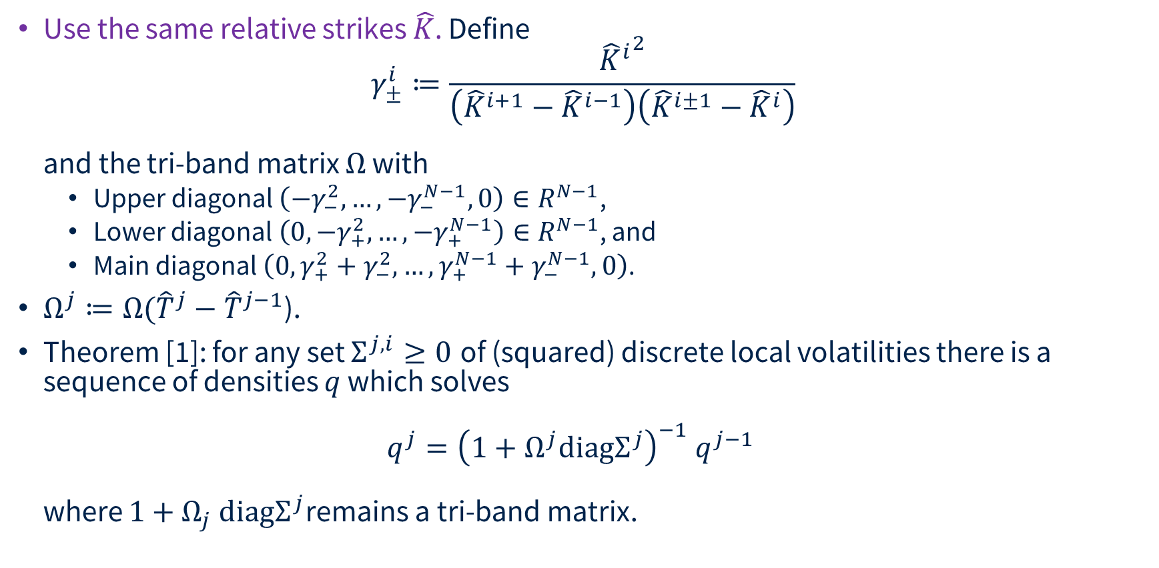
DYSANOS
Use the same relative strikes $\hat{K}$. Define
$γ_{±}^{i}≔\frac{{{\hat{K}}^{i}}^{2}}{\left({\hat{K}}^{i+1}−{\hat{K}}^{i−1}\right)\left({\hat{K}}^{i±1}−{\hat{K}}^{i}\right)}$
and the tri-band matrix $Ω$ with
  Upper diagonal $\left(−γ_{−}^{2},…,−γ_{−}^{N−1},0\right)∈R^{N−1}$,
  Lower diagonal $\left({0,−γ}_{+}^{2},…,{−γ}_{+}^{N−1}\right)∈R^{N−1}$, and
  Main diagonal $\left({0,γ}_{+}^{2}+γ_{−}^{2},…,γ_{+}^{N−1}+γ_{−}^{N−1},0\right)$.
${Ω^{j}≔Ω(\hat{T}}^{j}−{\hat{T}}^{j−1}$).
Theorem [1]: for any set $Σ^{j,i}≥0$ of (squared) discrete local volatilities there is a sequence of densities $q$ which solves
$q^{j}={\left(1+Ω^{j}\text{diag}Σ^{j}\right)}^{−1} q^{j−1}$
where $1+Ω_{j} \text{diag}Σ^{j}$remains a tri-band matrix.
__
[1] Discrete local volatility for large time steps (extended version), Hans Buehler and Evgeny Ryskin, 2015, https://papers.ssrn.com/abstract=2642630

Slide 24
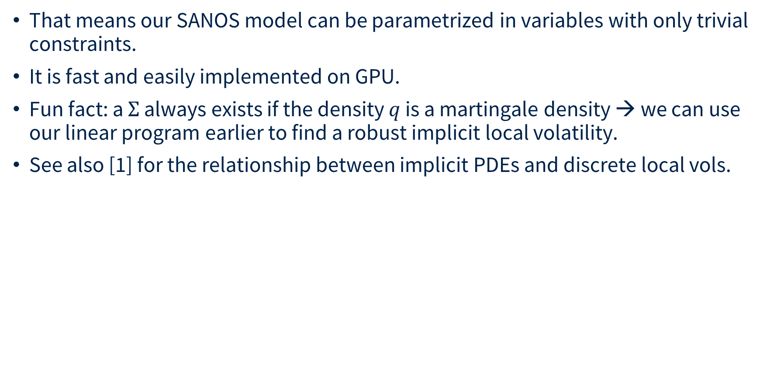
DYSANOS
That means our SANOS model can be parametrized in variables with only trivial constraints.
It is fast and easily implemented on GPU.
Fun fact: a $Σ$ always exists if the density $q$ is a martingale density → we can use our linear program earlier to find a robust implicit local volatility.
See also [1] for the relationship between implicit PDEs and discrete local vols.
__
[1] Finite Difference Based Calibration and Simulation, Andreasen et al, 2010 https://papers.ssrn.com/sol3/papers.cfm?abstract_id=1697545

Slide 25
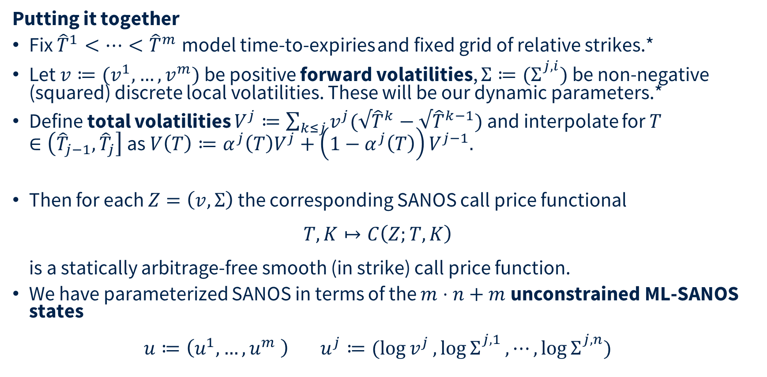
DYSANOS
Putting it together
Fix ${\hat{T}}^{1}<⋯<{\hat{T}}^{m}$model time-to-expiries and fixed grid of relative strikes.*
Let $v≔(v^{1},…,v^{m})$ be positive forward volatilities, ${Σ≔(Σ}_{}^{j,i})$ be non-negative (squared) discrete local volatilities. These will be our dynamic parameters.*
Define total volatilities $V^{j}≔\sum_{k≤j}{v^{j}(√{\hat{T}}^{k}−√{\hat{T}}^{k−1})}$ and interpolate for $T∈\left({\hat{T}}_{j−1},{\hat{T}}_{j}\right]$ as $V\left(T\right)≔α^{j}\left(T\right)V^{j}+\left(1−α^{j}\left(T\right)\right)V^{j−1}.$
Then for each $Z=\left(v,Σ\right)$ the corresponding SANOS call price functional
$T,K↦C\left(Z;T,K\right)$
is a statically arbitrage-free smooth (in strike) call price function.
We have parameterized SANOS in terms of the $m⋅n+m$unconstrained ML-SANOS states
$u≔\left(u^{1},…,u^{m} \right) u^{j}≔(\log{v^{j}},\log{Σ_{}^{j,1}},⋯,\log{Σ_{}^{j,n}})$
__
(*) DTEs used: $1,2,3,4,5,10,15,…,70$; strikes used where z-strikes @ 10% vol for first and last expiry merged, each 100 strikes.

Slide 26
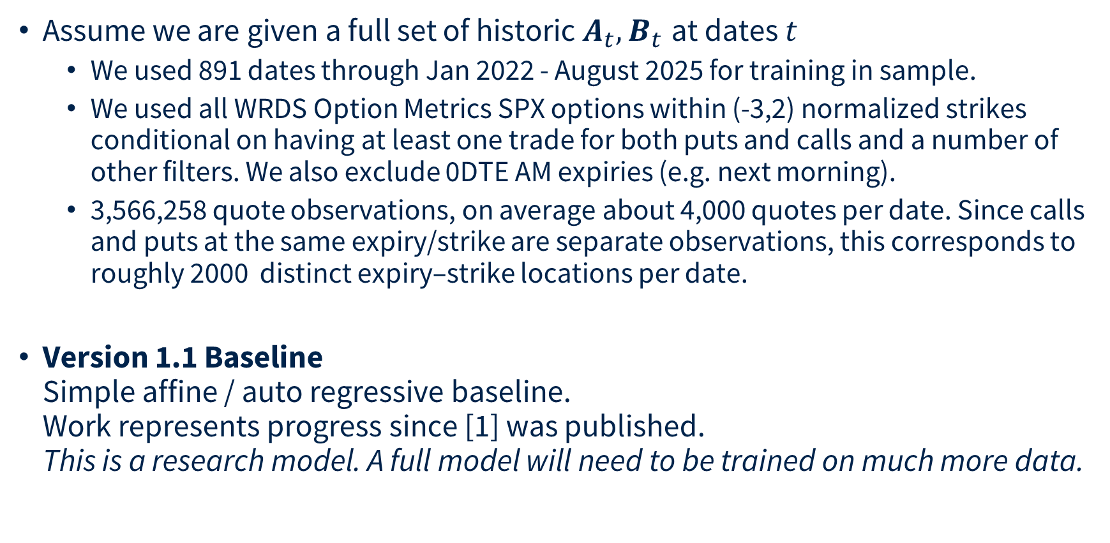
Linear Auto Regressive DYSANOS
Assume we are given a full set of historic $A_{t},B_{t}$ at dates $t$
  We used 891 dates through Jan 2022 - August 2025 for training in sample.
  We used all WRDS Option Metrics SPX options within (-3,2) normalized strikes conditional on having at least one trade for both puts and calls and a number of other filters. We also exclude 0DTE AM expiries (e.g. next morning).
  3,566,258 quote observations, on average about 4,000 quotes per date. Since calls and puts at the same expiry/strike are separate observations, this corresponds to roughly 2000 distinct expiry–strike locations per date.
Version 1.1 Baseline
Simple affine / auto regressive baseline.
Work represents progress since [1] was published.
This is a research model. A full model will need to be trained on much more data.
__
[1] DYSANOS Generative Dynamic Smooth Arbitrage-free Non-parametric Option Surfaces, Hans Buehler et al. 2026 https://arxiv.org/abs/2608.12587

Slide 27
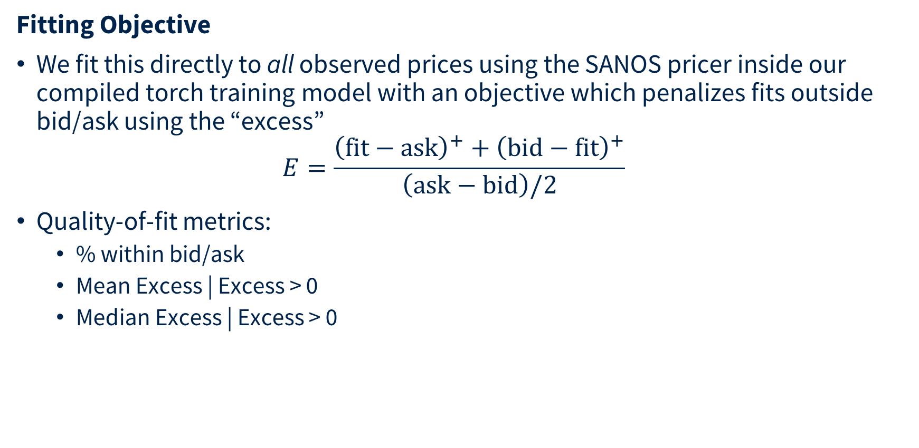
Linear Auto Regressive DYSANOS
Fitting Objective
We fit this directly to all observed prices using the SANOS pricer inside our compiled torch training model with an objective which penalizes fits outside bid/ask using the “excess”
$E=\frac{{\left(\text{fit}−\text{ask}\right)}^{+}+{\left(\text{bid}−\text{fit}\right)}^{+}}{\left(\text{ask}−\text{bid}\right)/2}$
Quality-of-fit metrics:
  % within bid/ask
  Mean Excess | Excess > 0
  Median Excess | Excess > 0

Slide 28
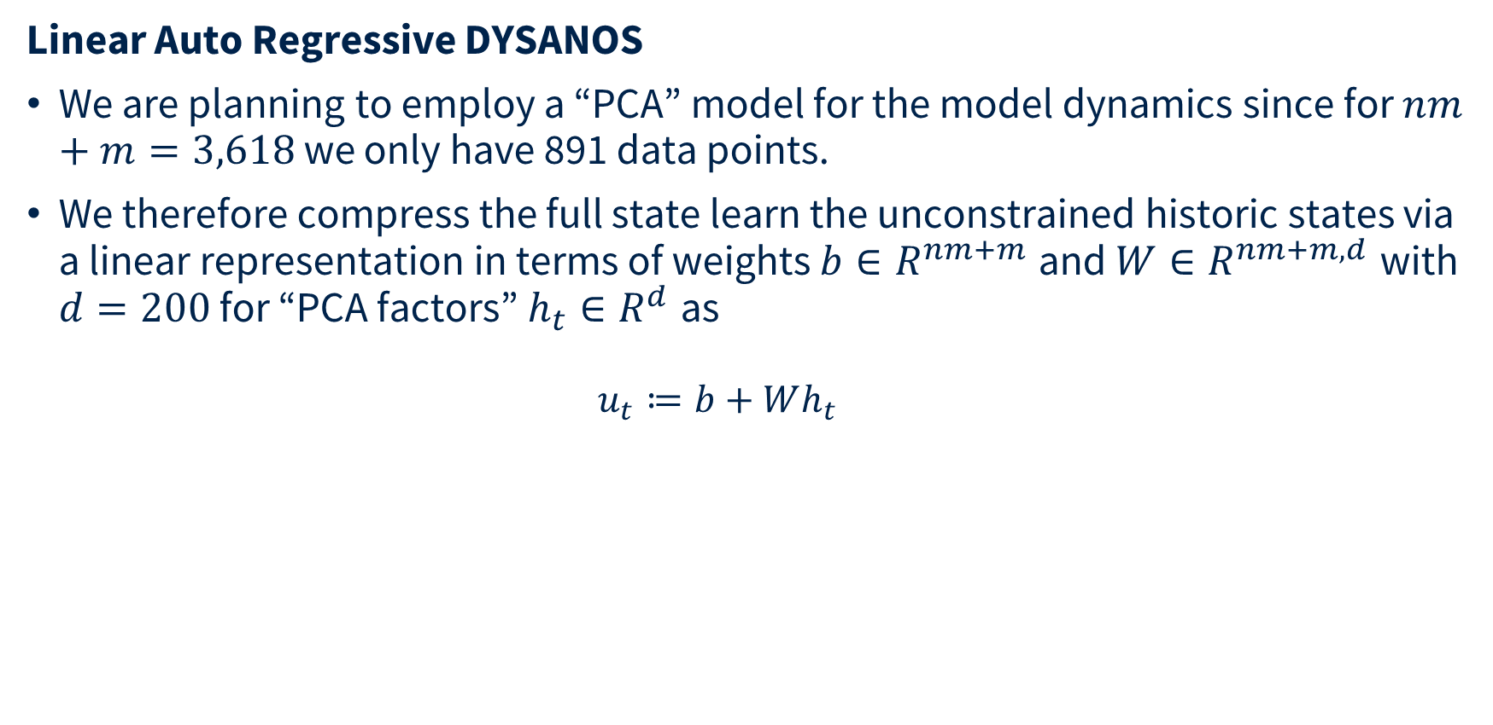
Linear Auto Regressive DYSANOS
Linear Auto Regressive DYSANOS
We are planning to employ a “PCA” model for the model dynamics since for $nm+m=3,620$ we only have 891 data points.
We therefore compress the full state learn the unconstrained historic states via a linear representation in terms of weights $b∈R^{nm+m}$ and $W∈R^{nm+m,d}$ with $d=200$ for “PCA factors” $h_{t}∈R^{d}$ as
  $$u_{t}≔b+Wh_{t}$$

Slide 29

Linear Auto Regressive DYSANOS
Example fit
“Affine” reduction does not harm total fit
Model | Quotes | % Inside | Mean excess | Cond. mean | Cond. median
Full | 3,566,258 | 82.3% | 0.31 | 1.76 | 0.69
Affine-200 | 3,566,258 | 80.9% | 0.32 | 1.69 | 0.68
891 dates, Jan 2022 – Aug 2025; next day AM contracts excluded; all nominal market expiries 1–69D. Excess is measured in half-spreads.

Slide 30
Linear Auto Regressive DYSANOS
Front expiry fit
 | 1D | 2D | 3D | 4D | 5D
Full | 94.56% | 95.21% | 95.57% | 95.77% | 68.43%
Affine-200 | 88.59% | 91.98% | 93.68% | 94.13% | 67.58%

Slide 31
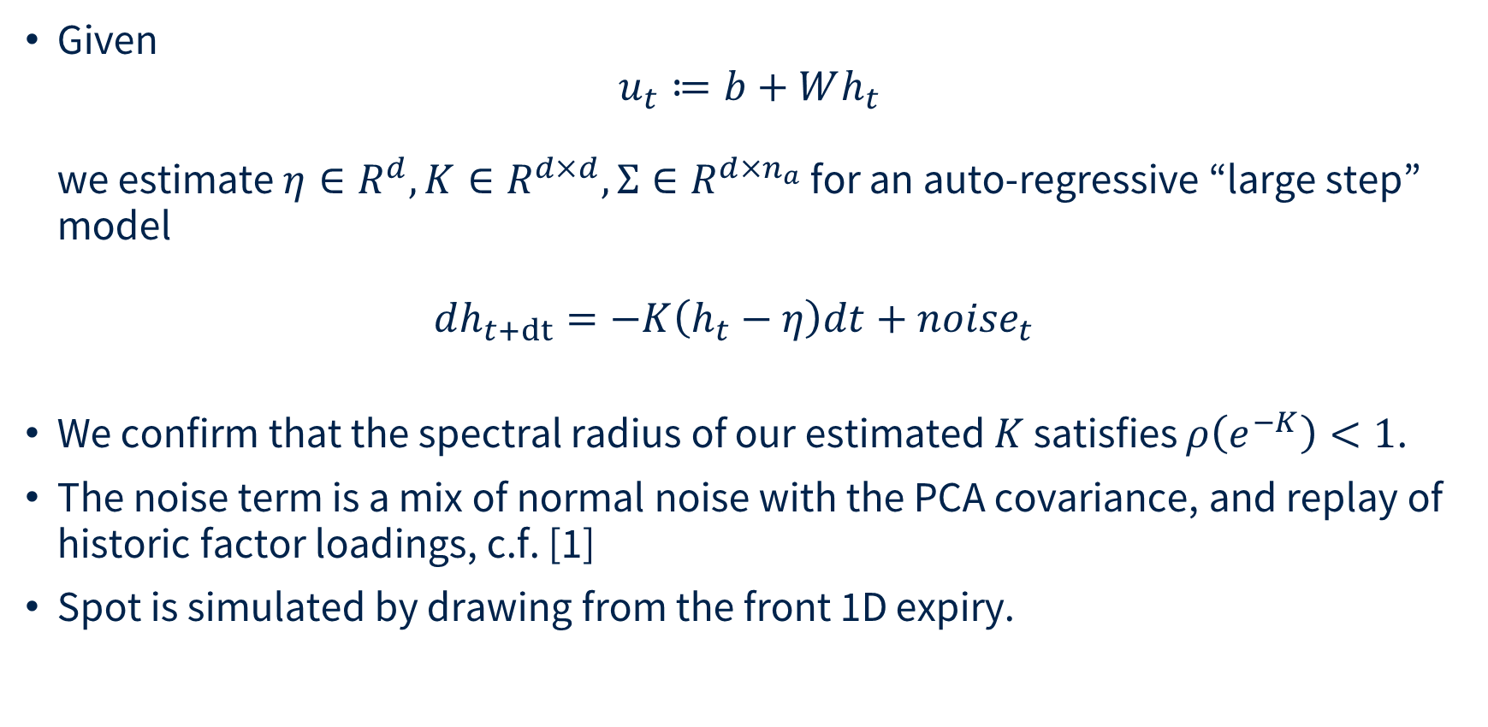
Linear Auto Regressive DYSANOS
Given
$u_{t}≔b+Wh_{t}$
we estimate $η∈R^{d}, K∈R^{d×d},Σ∈R^{d×n_{a}}$ for an auto-regressive “large step” model
$dh_{t+dt}=−K\left(h_{t}−η\right)dt+{noise}_{t}$
We confirm that the spectral radius of our estimated $K$ satisfies $ρ\left(e^{−K}\right)<1$.
The fitted five-session transition uses alternative innovation modes: Gaussian with the fitted covariance, or complete historical three-week block replay; the two are not mixed, c.f. [1].
Spot is simulated by drawing from the front 1D expiry.
__
[1] DYSANOS Generative Dynamic Smooth Arbitrage-free Non-parametric Option Surfaces, Hans Buehler et al. 2026 https://arxiv.org/abs/2608.12587

Slide 32
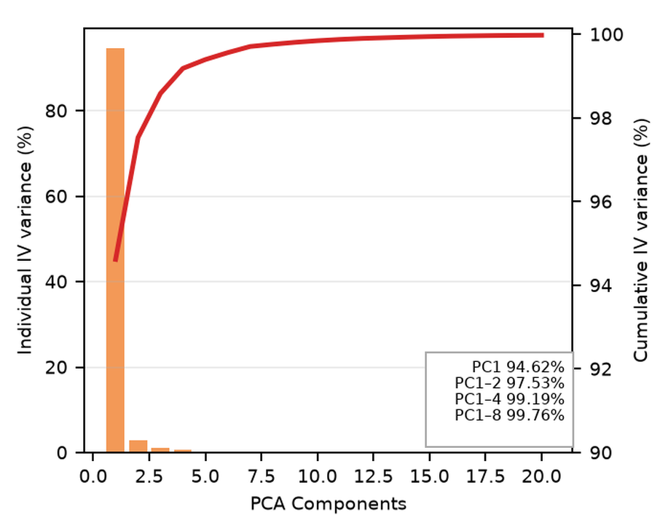
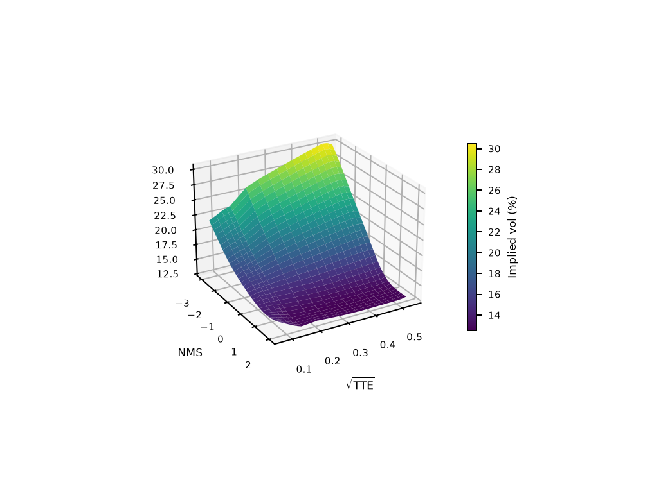
Linear Auto Regressive DYSANOS
Explained Variance
Base volatility surface
These are PCA directions in decoded implied-volatility space under the fitted invariant state covariance—not the 200 affine state coordinates themselves.

Slide 33
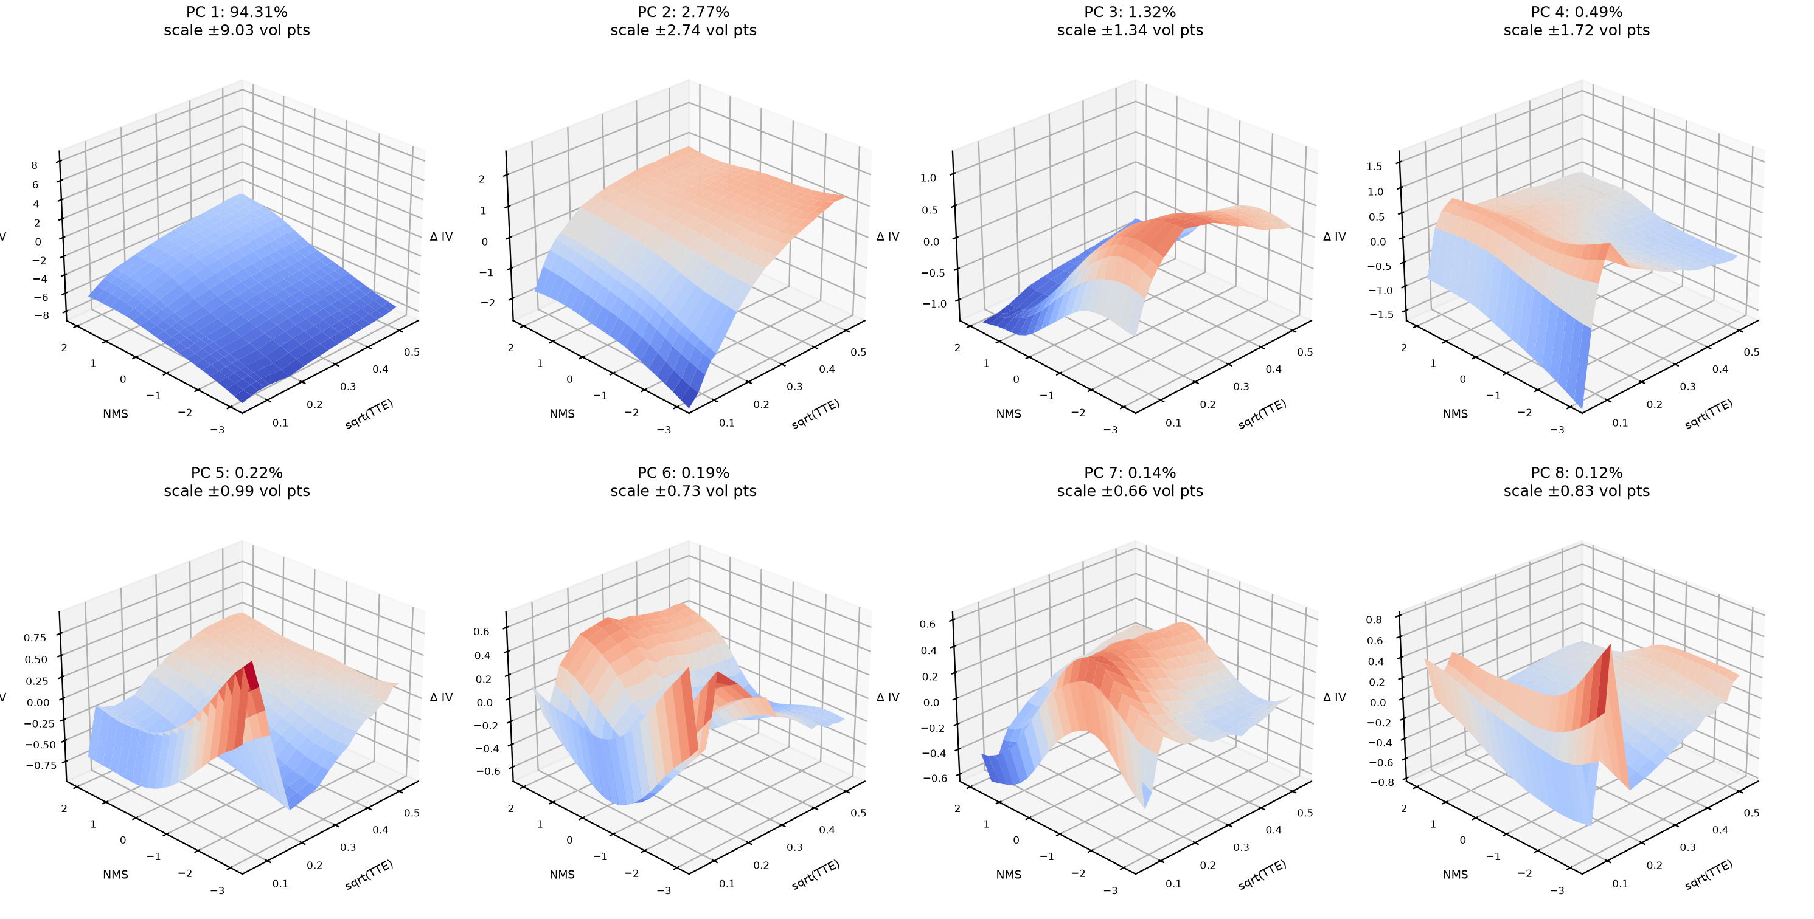
Linear Auto Regressive DYSANOS
These act via SANOS – that means each shock produces arbitrage-free surfaces
Axes: √TTE, normalized moneyness (NMS), and implied-volatility change in vol points. Signs of PCA directions are arbitrary.

Slide 34
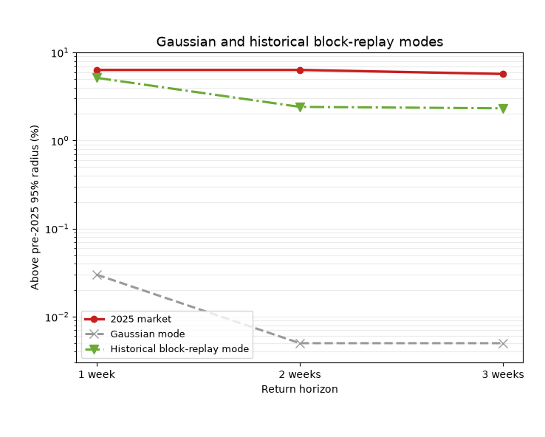
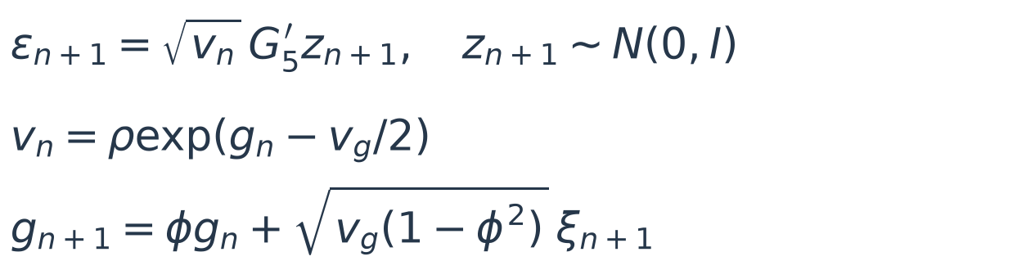
Linear Auto Regressive DYSANOS
A stable AR(1) does not guarantee realistic innovation tails
Tail Diffusion
• Retains the five-session AR mean and loading.
• Random variance gives heavier tails.
• OU log variance clusters shock sizes.
• New shocks, not historical replay.
One-week tail exceedance: 3.75%
Gaussian: 0.03%; 2025 market: 6.33%
Tail event: above the pre-2025 empirical 95% innovation-radius threshold. See paper for fit details.
Notes:
Tail Diffusion follows the fitted five-session AR(1) mean and retains its Gaussian loading G_5. A scalar lognormal variance factor multiplies the Gaussian innovation. The log variance has an exact OU transition, with independent standard-normal xi and z. Stationarity implies g ~ N(0,v_g) and E[v]=rho. The fitted pre-2025 parameters are rho=0.878, phi=0.139, v_g=0.0649 (703 one-week innovations). This is the paper's original Tail Diffusion, not the newer daily [-4,3] neural calibration. Its one-/two-/three-week tail probabilities are 3.75%, 0.78%, 0.66%; see dy22 appendix Tail dynamics. The existing Gaussian / historical block-replay chart is retained unchanged. Innovation-radius tail matching is distinct from matching the level distribution of a VIX-type index.

Slide 35
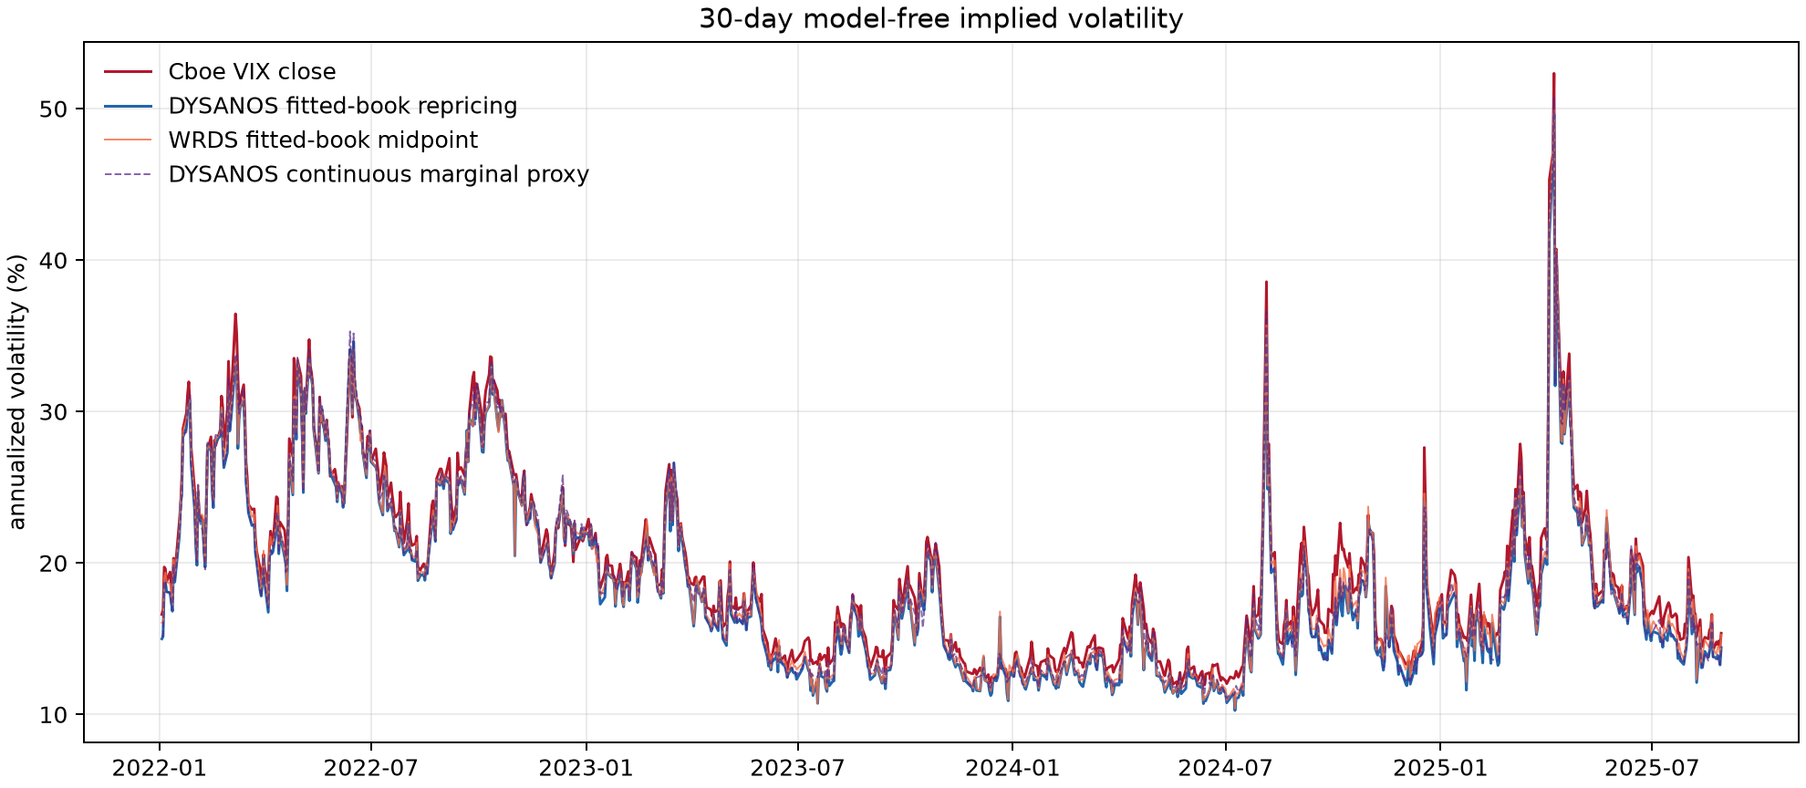
DYSANOS: VIX reconstruction
Same filtered WRDS option book • 891 daily closes, 2022–2025
Static repricing diagnostic—not a simulation or dynamic no-arbitrage test.
Notes:
Source: dy22 Figure 3, fig:dysanos-vix, generated/dysanos_vix_comparison.png. 891 daily closes: 2022-01-03 through 2025-08-29. The Cboe-style discrete strike sum is applied to two PM-listed expiries bracketing 30 calendar days and interpolated in total variance. DYSANOS fitted-book prices and filtered WRDS midpoints use exactly the same filtered strikes. Official Cboe VIX is red; DYSANOS fitted-book repricing blue; WRDS fitted-book midpoint orange; the continuous 30-day marginal proxy is purple dashed. Against official VIX, DYSANOS bias=-1.03 volatility points and RMSE=1.30, versus -0.70 and 1.05 for the filtered WRDS market book. The continuous marginal proxy is not the listed-expiry Cboe calculation. This diagnostic concerns static surface reconstruction, not simulated dynamics.

Slide 36
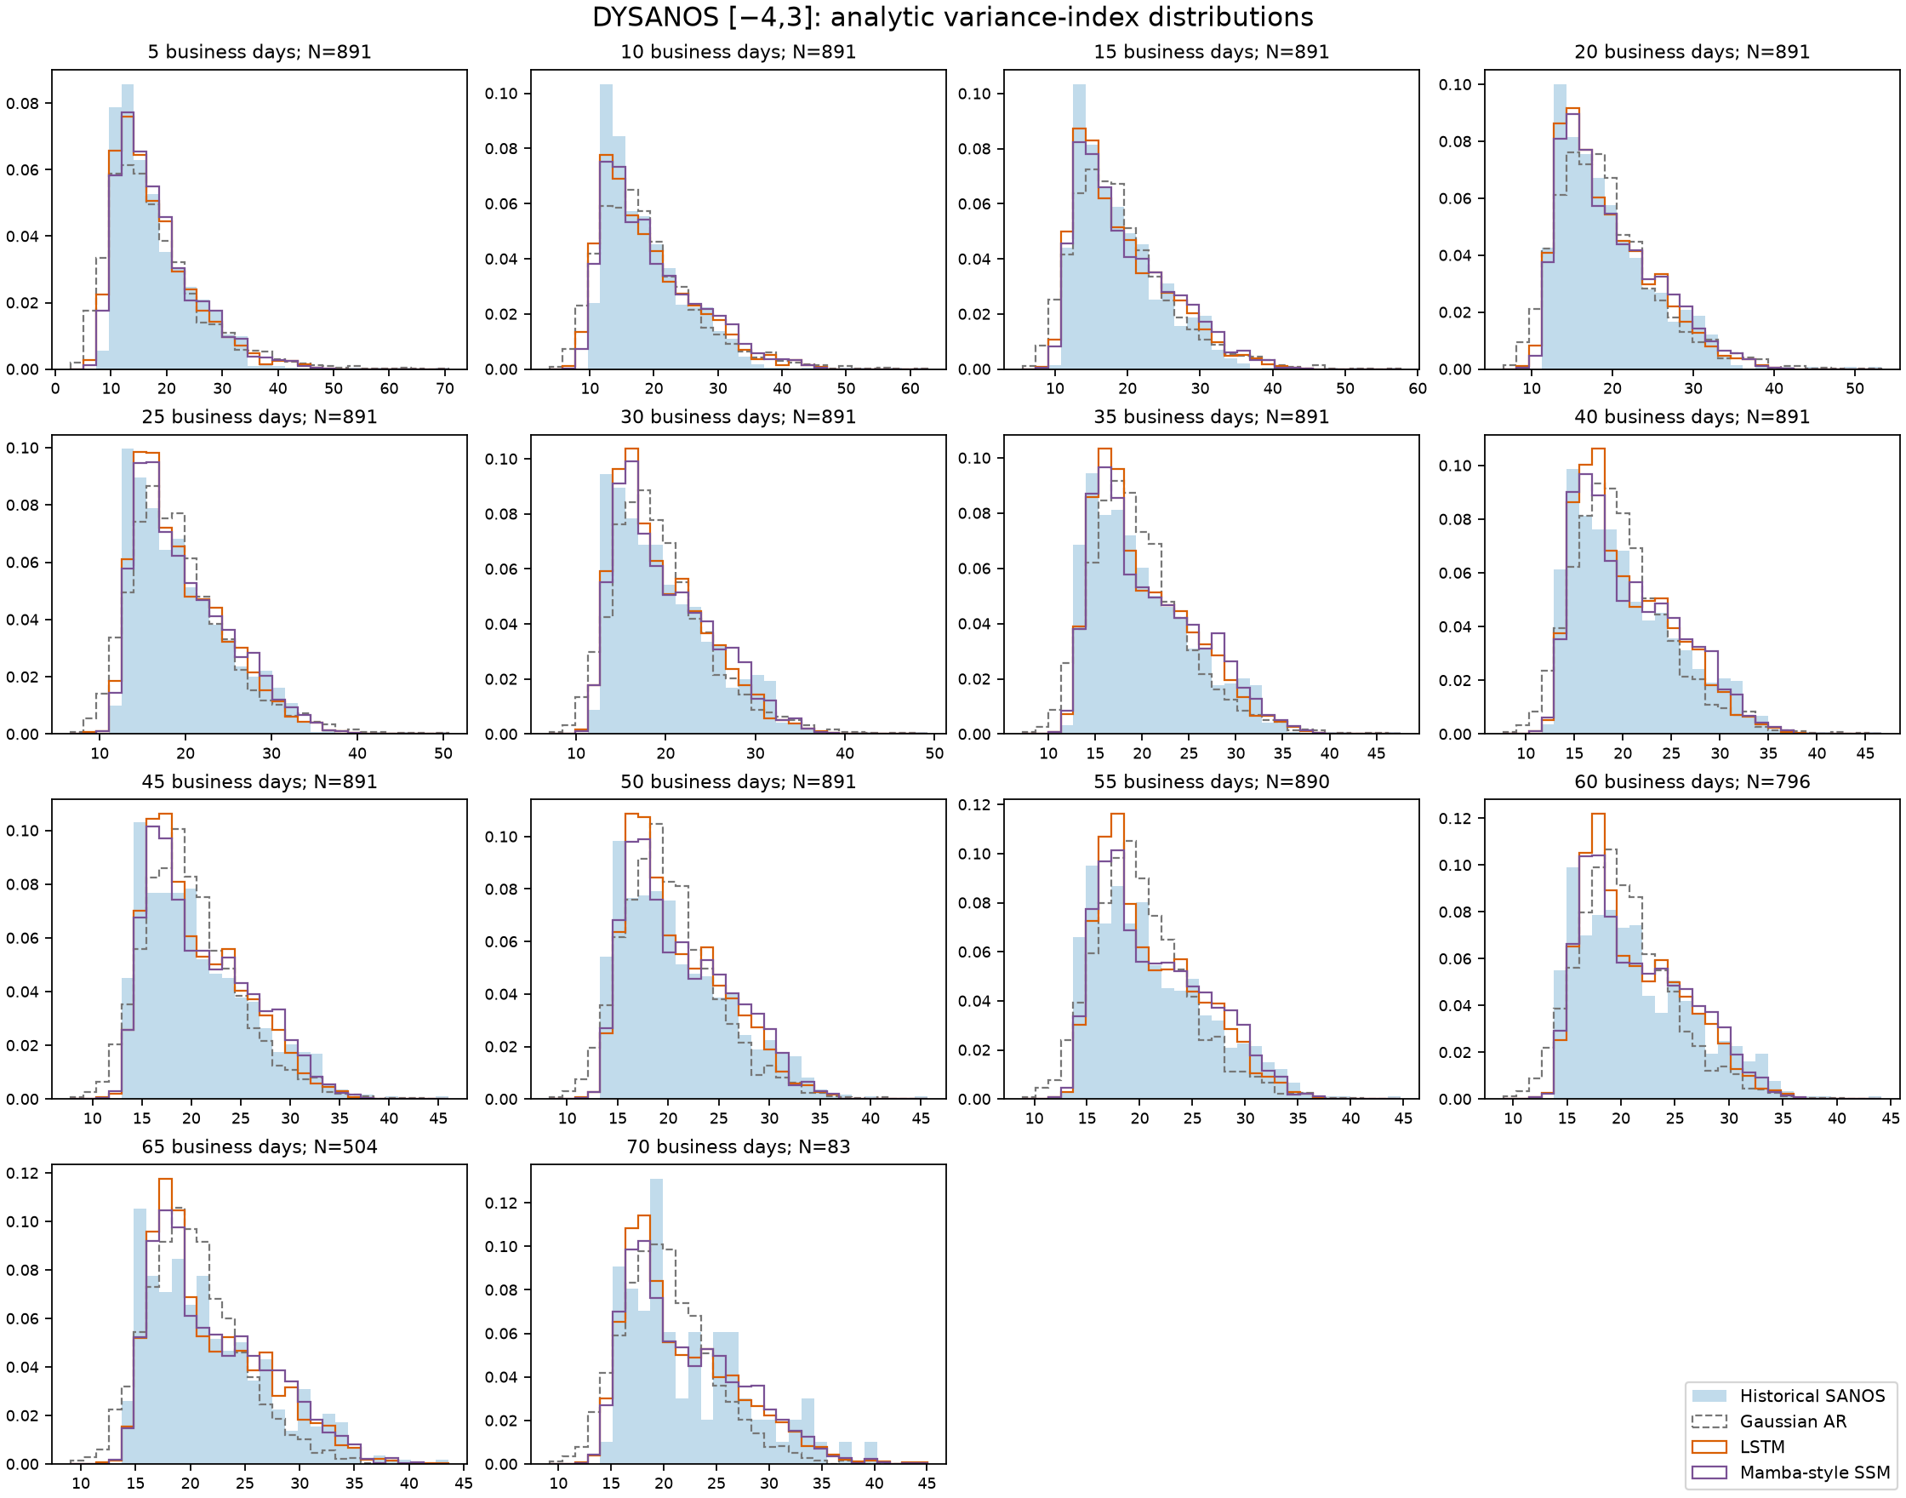
DYSANOS: volatility-index distributions
Log-quantile error ↓
Model
Error
Change
Gaussian AR
0.0681
baseline
LSTM
0.0123
−82%
Mamba-style SSM
0.0135
−80%
• Targets: historic SANOS, 5–70D.
• Fit: Aug. 29, 2025; NMS [−4,3].
• Decoder and AR coefficients frozen.
• Learn innovation drift and scales.
• 2,048 fresh post-burn-in samples.
In-sample; not observed Cboe VIX.
70D target: only 83 historical dates.
Notes:
Source: dy22 Figure 4, fig:variance-index-distribution-calibration. Analytic continuous-strike log-contract variance-index volatility, business-time annualized; not discrete Cboe VIX. Blue is historical fitted SANOS surfaces, not observed VIX futures/options. Historical target dates: 2022-01-03 to 2025-08-29, without expiry extrapolation. Counts: 891 at 5–50D, 890 at 55D, 796 at 60D, 504 at 65D, 83 at 70D. The daily Gaussian AR affine-200 baseline uses NMS [-4,3] and 252 dates ending 2025-08-29. Both overlays keep decoder and AR coefficients fixed and retain all 200 Gaussian innovation directions. 14 price-sensitive directions receive learned means/scales; a background scale is also learned. LSTM: hidden width 32, 7,258 parameters. Compact input-selective diagonal state-space model: 2,522 parameters, Mamba-style, NOT Mamba-3. Each trained for 200 epochs against 14 log-quantile curves (probabilities 0.005–0.995), with smaller daily-change-variance and cross-tenor-correlation penalties. Final neural evaluation: 2,048 fresh independent paths with 256 daily burn-in steps; Gaussian baseline uses exact invariant-state samples. Scores: Gaussian 0.06810771180199712, LSTM 0.012279390197179815, SSM 0.013467052897656092. Relative reductions are 81.97% and 80.23%. Fresh simulation does not make this out-of-sample historical validation: the historical distribution was the calibration target. No proof of dynamic no-arbitrage, recurrence benefit or significant superiority of LSTM over SSM. Remaining tail mismatch is visible. Run: experiments/dysanos/v11/vix-sequence-20261027-v1/pilot; provenance is in quantdata/dysanos/tex/generated/dysanos_variance_index_histograms_provenance.json.

Slide 37
Linear Auto Regressive DYSANOS
Summary
  First smooth option surface simulator – that means we can apply fully consistent shocks to the option surface.
  Simple “PCA” model for implied volatility
  Statically arbitrage-free in any simulated state
Practical
  All scenarios and PCA factors generated by this model arbitrage-free.
  Can simulate very long histories of option markets
What next
  Expand statistical fit e.g. vol-spot correlation term structure.
  High frequency fitting

Slide 38
GROMM
Generative Risk-neutral Option Market Models [1]
Joint work with Blanka Horvath, Magnus Wiese
__
[1] GROMM: Generative Risk-neutral Option Market Models, Wiese, Buehler, Horvath 2026, https://arxiv.org/abs/2610.16732

Slide 39
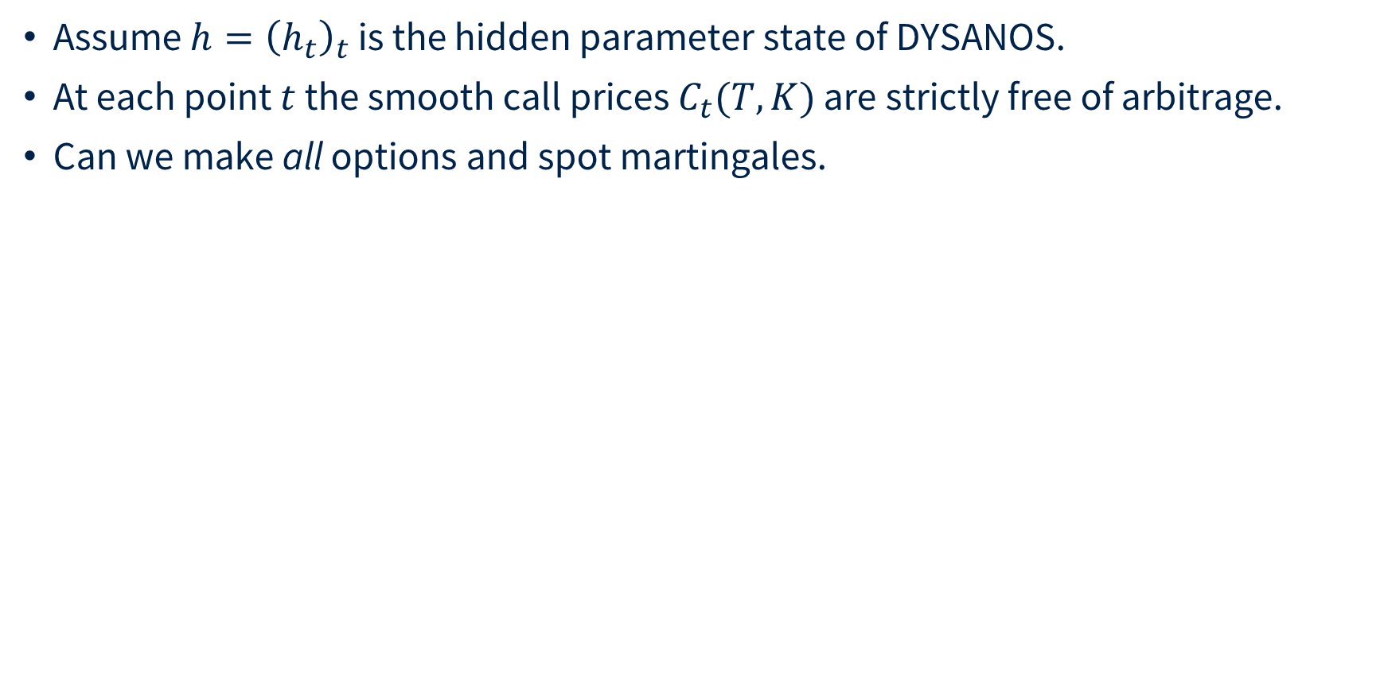
GROMM
Assume $h={\left(h_{t}\right)}_{t}$ is the hidden parameter state of DYSANOS.
At each point $t$ the smooth call prices $C_{t}(T,K)$ are strictly free of arbitrage.
Can we make all options and spot martingales.

Slide 40
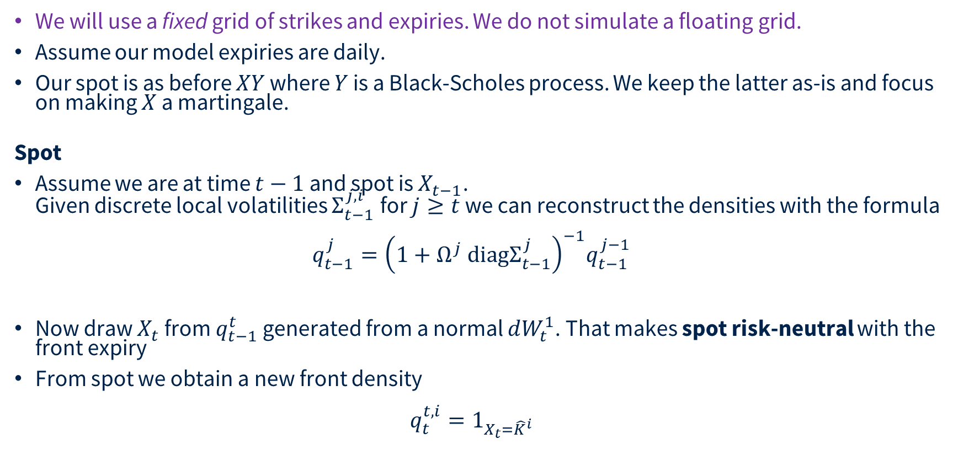
GROMM
We will use a fixed grid of strikes and expiries. We do not simulate a floating grid.
Assume our model expiries are daily.
Our spot is as before $XY$ where $Y$ is a Black-Scholes process. We keep the latter as-is and focus on making $X$ a martingale.
Spot
Assume we are at time $t−1$ and spot is $X_{t−1}$.
Given discrete local volatilities $Σ_{t−1}^{j,i}$ for $j≥t$ we can reconstruct the densities with the formula
Now draw $X_{t}$ from $q_{t−1}^{t}$ generated from a normal $dW_{t}^{1}$. That makes spot risk-neutral with the front expiry
From spot we obtain a new front density
$q_{t}^{t,i}=1_{X_{t}={\hat{K}}^{i}}$

Slide 41
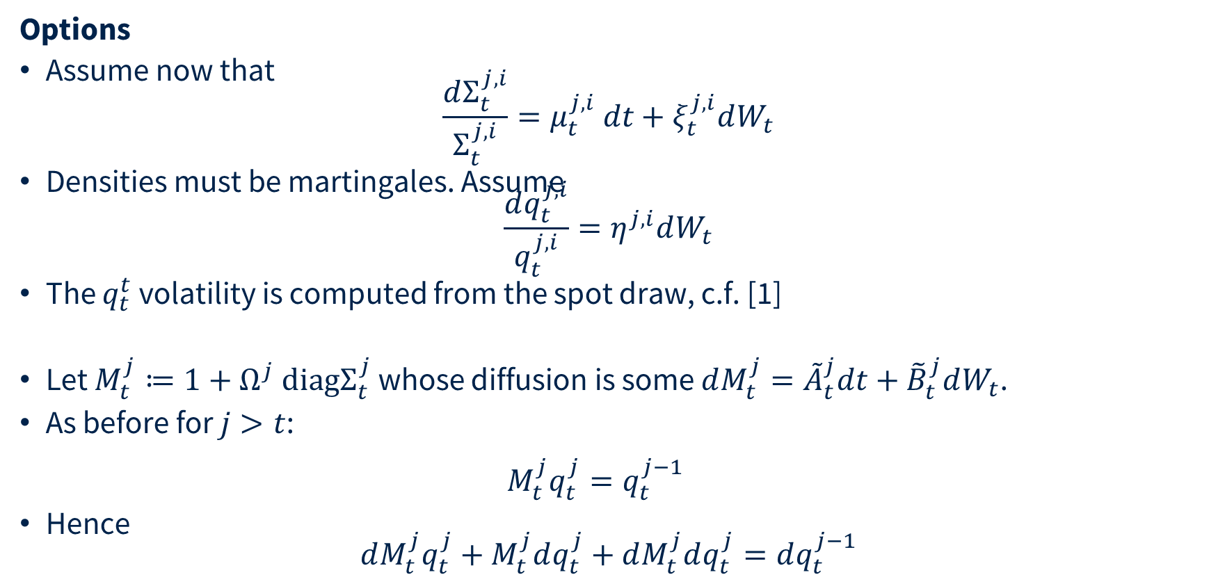
GROMM
Options
Assume now that
$\frac{dΣ_{t}^{j,i}}{Σ_{t}^{j,i}}=μ_{t}^{j,i} dt+ξ_{t}^{j,i}dW_{t}$
Densities must be martingales. Assume
$\frac{dq_{t}^{j,i}}{q_{t}^{j,i}}=η^{j,i}dW_{t}$
The $q_{t}^{t}$ volatility is computed from the spot draw, c.f. [1]
Let $M_{t}^{j}≔1+Ω^{j} \text{diag}Σ_{t}^{j}$ whose diffusion is some $dM_{t}^{j}={\tilde{A}}_{t}^{j}dt+{\tilde{B}}_{t}^{j}dW_{t}$.
As before for $j>t$:
$M_{t}^{j}q_{t}^{j}=q_{t}^{j−1}$
Hence
$dM_{t}^{j}q_{t}^{j}+M_{t}^{j}dq_{t}^{j}+dM_{t}^{j}dq_{t}^{j}=dq_{t}^{j−1}$
__
[1] GROMM: Generative Risk-neutral Option Market Models, Wiese, Buehler, Horvath 2026, https://arxiv.org/abs/2610.16732

Slide 42
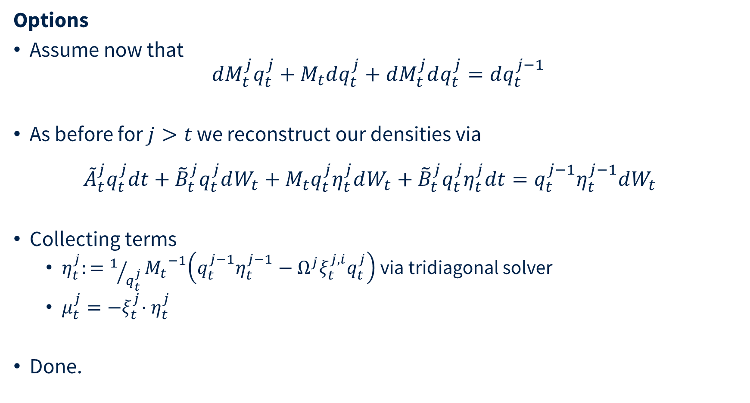
GROMM
Options
Assume now that
$dM_{t}^{j}q_{t}^{j}+M_{t}dq_{t}^{j}+dM_{t}^{j}dq_{t}^{j}=dq_{t}^{j−1}$
As before for $j>t$ we reconstruct our densities via
${\tilde{A}}_{t}^{j}q_{t}^{j}dt+{\tilde{B}}_{t}^{j}q_{t}^{j}dW_{t}+{M_{t}q}_{t}^{j}η_{t}^{j}dW_{t}+{\tilde{B}}_{t}^{j}q_{t}^{j}η_{t}^{j}dt=q_{t}^{j−1}η_{t}^{j−1}dW_{t}$
Collecting terms
  $η_{t}^{j}:=1/{q_{t}^{j}}{M_{t}}^{−1}\left(q_{t}^{j−1}η_{t}^{j−1}−Ω^{j}ξ_{t}^{j,i}q_{t}^{j}\right)$ via tridiagonal solver
  $μ_{t}^{j}{=−ξ}_{t}^{j}⋅η_{t}^{j}$
Done.

Slide 43
GROMM
Estimation
Estimate vol-of-DLVs and P-drift which is consistent with the vol-of-DLVs
We get a P and Q measure …
However, P is restricted. For example backbone volatility cannot move.

Slide 44
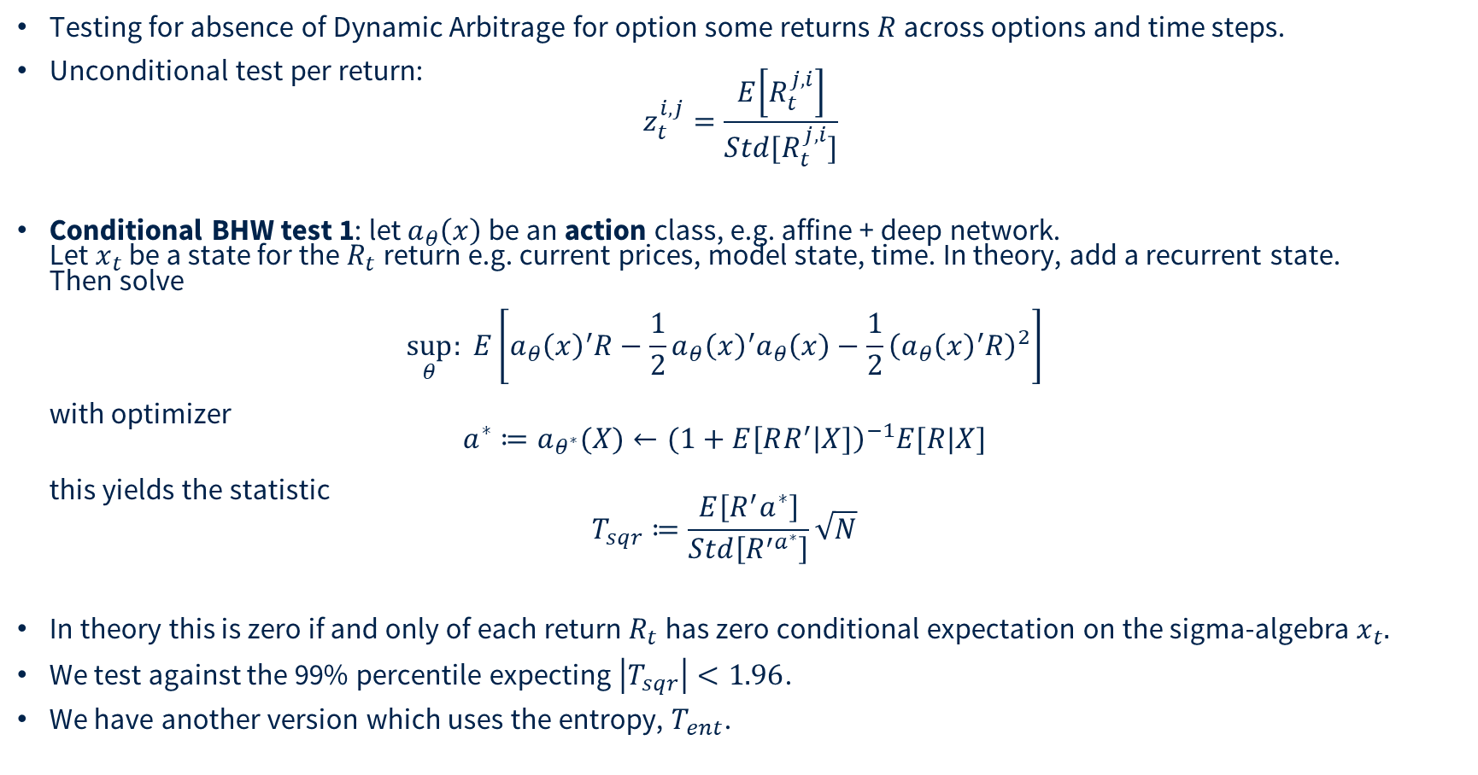
GROMM
Testing for absence of Dynamic Arbitrage for option some returns $R$ across options and time steps.
Unconditional test per return:
$z_{t}^{i,j}=\frac{E\left[R_{t}^{j,i}\right]}{Std[R_{t}^{j,i}]}$
Conditional BHW test 1: let $a_{θ}\left(x\right)$ be an action class, e.g. affine + deep network.
Let $x_{t}$ be a state for the $R_{t}$return e.g. current prices, model state, time. In theory, add a recurrent state.
Then solve
$\sup_{θ}: E\left[a_{θ}{\left(x\right)}^{′}R−\frac{1}{2}a_{θ}{\left(x\right)}^{′}a_{θ}\left(x\right)−\frac{1}{2}{\left(a_{θ}{\left(x\right)}^{′}R\right)}^{2}\right]$
with optimizer
$a^{∗}≔a_{θ^{∗}}(X)←(1+E{\left[RR^{′} | X]\right)}^{−1}E[R|X]$
this yields the statistic
$T_{sqr}≔\frac{E\left[{R^{′}a}^{∗}\right]}{Std\left[R^{′a^{∗}}\right]}\sqrt{N}$
In theory this is zero if and only of each return $R_{t}$ has zero conditional expectation on the sigma-algebra $x_{t}.$
We test against the 99% percentile expecting $\left|T_{sqr}\right|<1.96$.
We have another version which uses the entropy, $T_{ent}$.

Slide 45
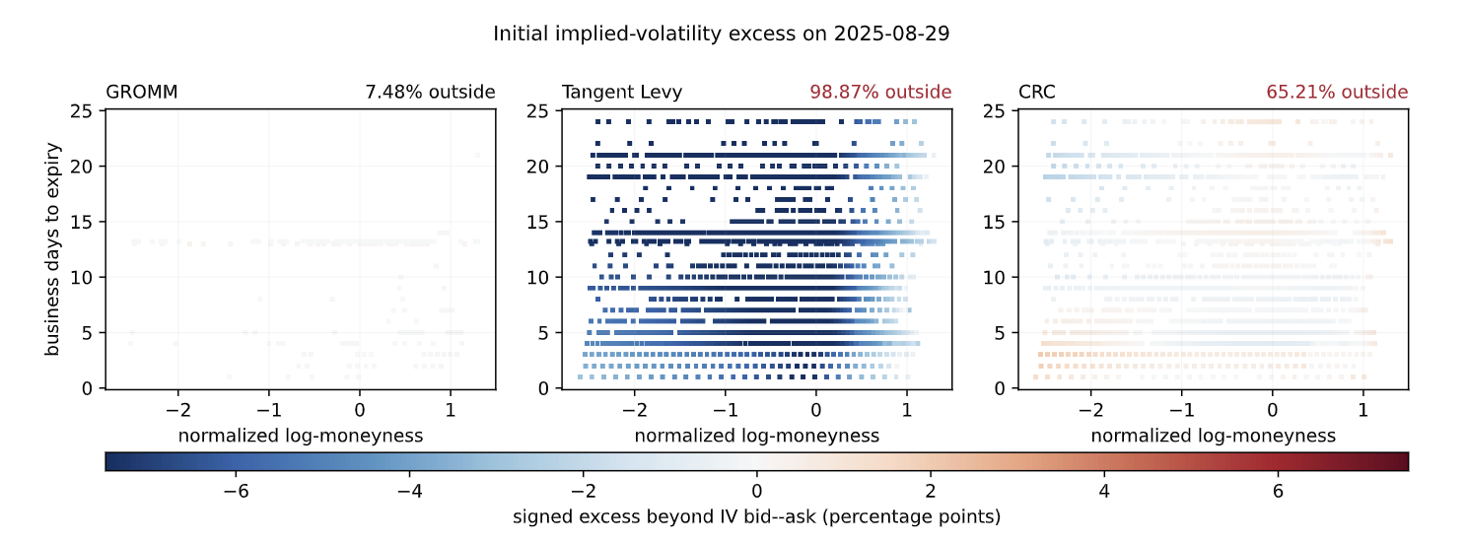
GROMM
We compare with Tangent Levy [1] and CRC [2]
__
[1] René Carmona, Yi Ma, and Sergey Nadtochiy. Simulation of implied volatility surfaces via tangentLévy models. SIAM J. Financial Math., 8(1):171–213, 2017. doi: 10.1137/15M1015510
[2] Matteo Gambara and Josef Teichmann. Consistent recalibration models and deep calibration.https://arxiv.org/abs/2006.09455, 2021. arXiv:2006.09455, version 3; first posted 2020.

Slide 46
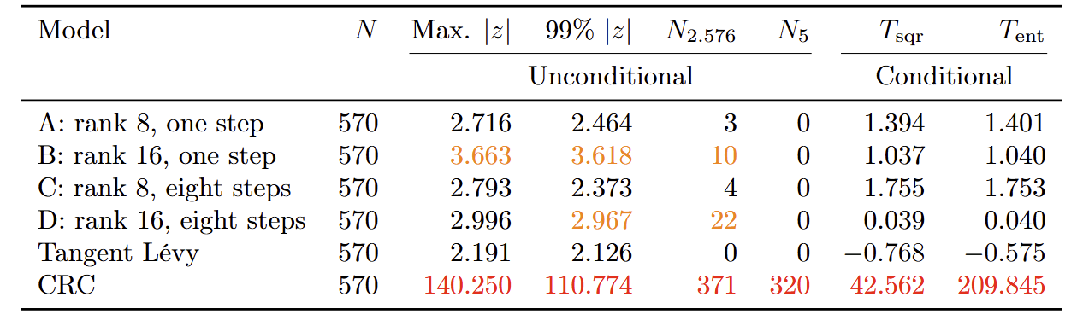
GROMM
We compare with Tangent Levy [1] and CRC [2]
  Tangent Levy is risk-neutral but cannot fit the observed market
  CRC is not risk-neutral in our implementation
  GROMM just works
__
[1] René Carmona, Yi Ma, and Sergey Nadtochiy. Simulation of implied volatility surfaces via tangentLévy models. SIAM J. Financial Math., 8(1):171–213, 2017. doi: 10.1137/15M1015510
[2] Matteo Gambara and Josef Teichmann. Consistent recalibration models and deep calibration.https://arxiv.org/abs/2006.09455, 2021. arXiv:2006.09455, version 3; first posted 2020.

Slide 47
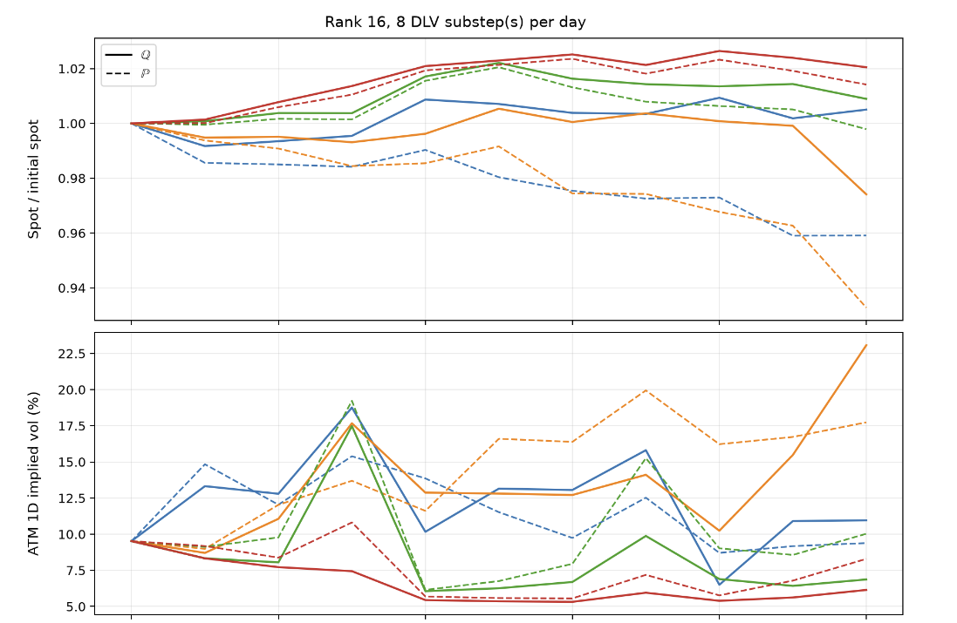
GROMM

Slide 48
Risk-Neutral DYSANOS V1.0
Summary
  First of its kind; functional version of Wissel-Schweizer [1]
  Entire new source of research
Next Steps
  Generalization, training
  Benchmark for hedging

Slide 49
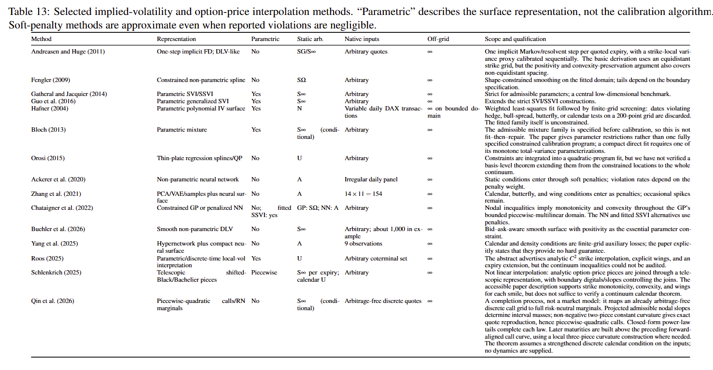
Implied Vol Fitting Literature

Slide 50
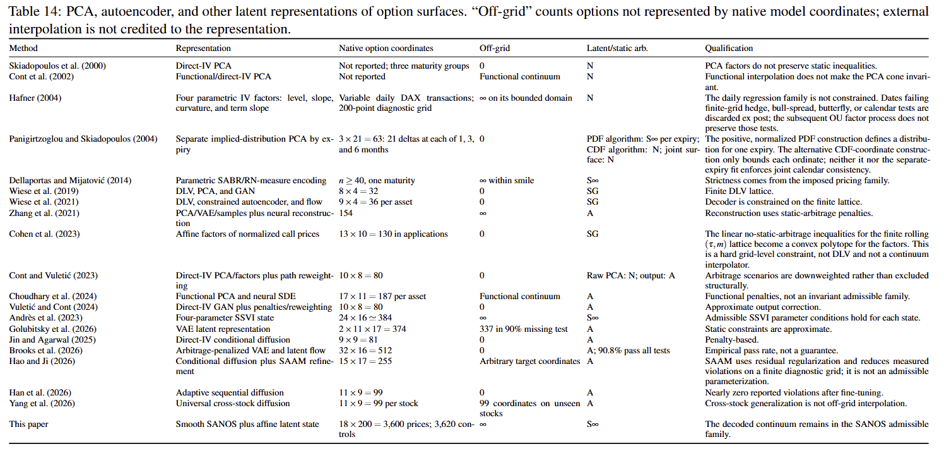
Implied Vol Dynamics Literature

Slide 51
Please ask questions
hans.buehler@maths.ox.ac.uk

