Slide 1

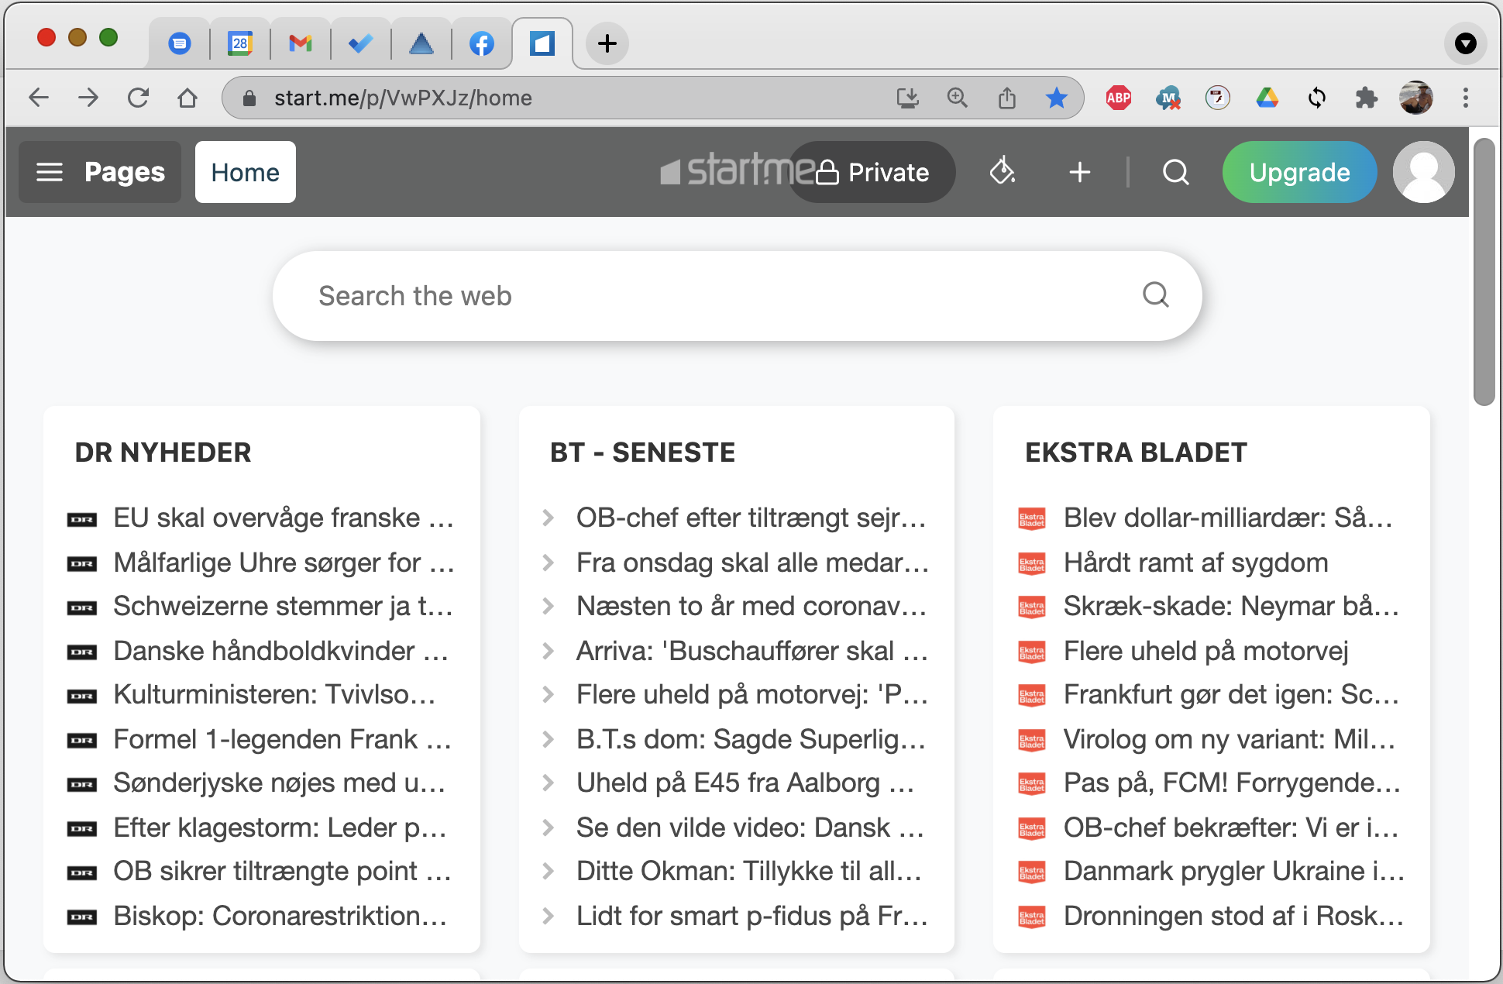

DatabaseJS
Javascript
Vue ,React, Angular …
Microservice with Enterprise features
Serve static content (files)
Expose database as rest service
Participate in service-oriented flows
Up/Download application related files
Reduce or even replace middletier code
Files
Rest-services
Java, C#, javascript …
SQL
PL/SQL, Transact-SQL …
database

Slide 2
Key Features
Multiplexer:
Very low footprint
Scale to thousands of users
Threadpools:
Resource control
Graceful degradation
Authentication:
Tokens
Database
Single Sign On
Database State:
None
Transaction
Dedicated (KeepAlive)
Database features:
Security
Cursors *
Savepoints
Transactions **
Leverage full feature set
Miscellaneous:
SQLRepository
Hot deployment
Cache/Compression
Virtual endpoint support
No Hassle:
Download
Configure
Pack / Distribute
* Improved performance for tableviews
** No need for “compensating transactions”

Slide 3
Architecture
Cluster
Microservice
http
Hot
standby
http
rest
Hot
standby
Shared Memory
IIIIIIIIIIIIIIIIIIIII
FileLock
rest
rest
rest
rest

