Slide 1



Predicting Customer Churn in Telecom
A Machine Learning Approach
By Hans Darmawan - JCDS2602

Slide 2
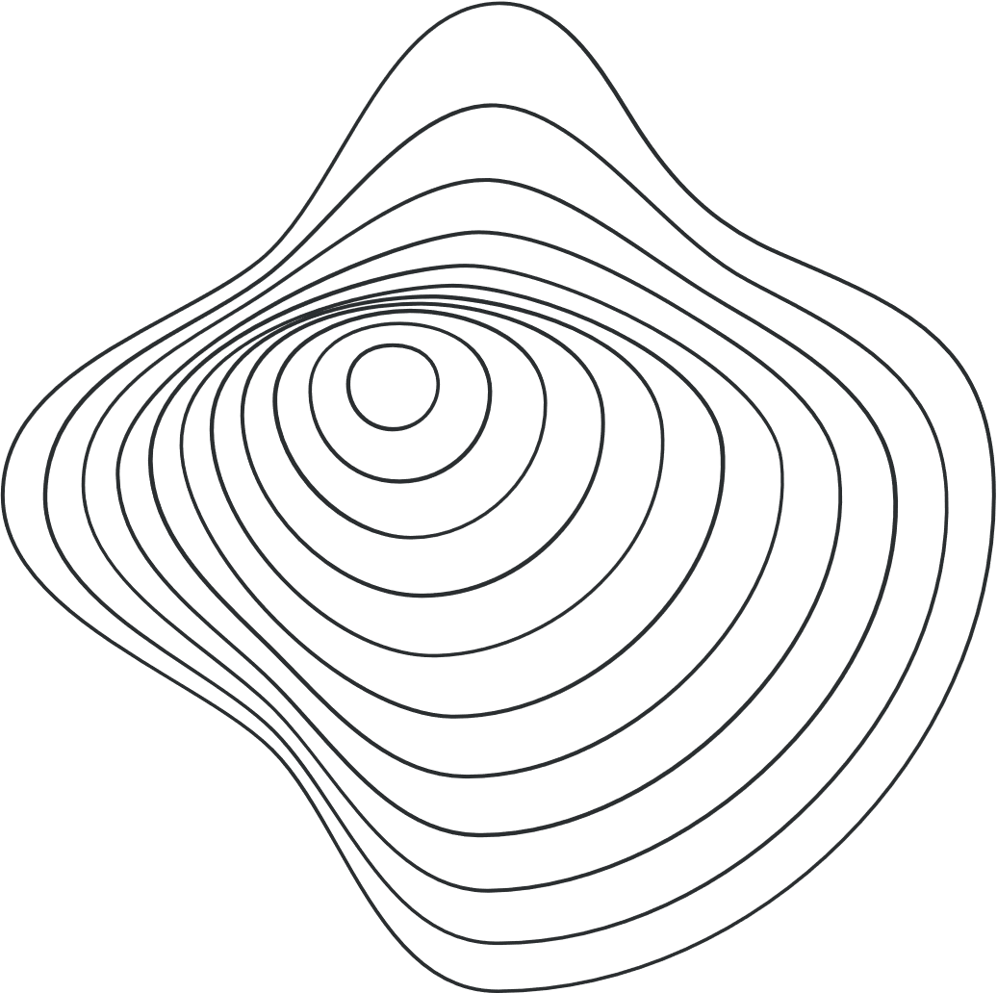
Overview
CRISP-DM Approach
Business Understanding
Data Understanding
Data Preparation
Modeling
Evaluation
Deployment
Conclusion and Recommendations

Slide 3
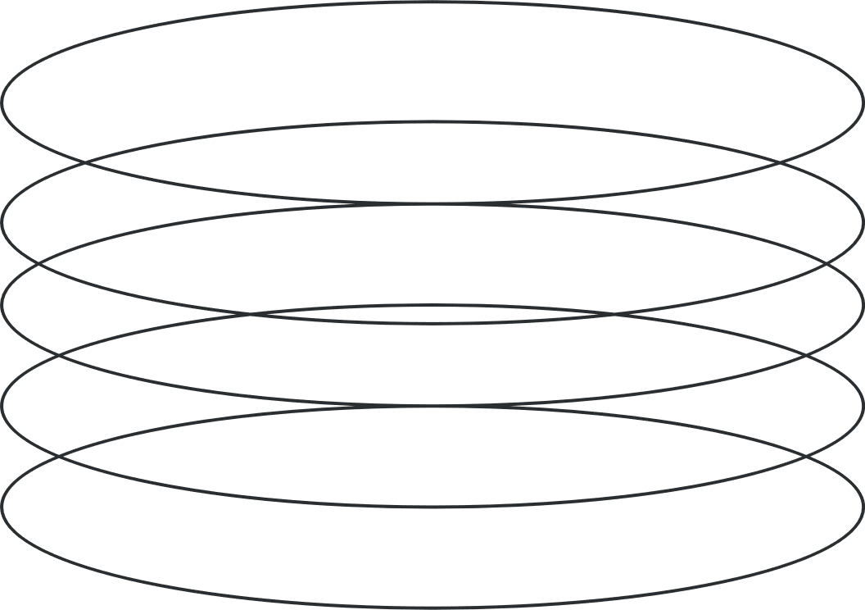
1. Business Understanding
Background
Gap Analysis
Problem Statement
Goals
Analytic Approach
Metric Evaluation
Success Criteria

Slide 4

Business Understanding
Customer Churn Definition
Customer churn in telecom refers to the rate at which customers stop using services, significantly impacting revenue and profitability.
Causes of Churn
Factors contributing to customer churn include dissatisfaction with service quality, pricing, customer support, and competitive offers.
Importance of Retention
Retaining existing customers is more cost-effective than acquiring new ones, making churn management crucial for financial health and growth.
Background

Slide 5
Business Understanding
Lack of Predictive Model
The company currently lacks a predictive model to identify at-risk customers, hindering effective retention strategies.
Data Quality and Engagement Issues
There are significant gaps in data quality and stakeholder engagement that impact informed decision-making.
Need for Continuous Improvement
Establishing a process for continuous improvement is essential to adapt to changing customer behaviors and integrate predictive insights into operations.
Gap Analysis

Slide 6
Business Understanding
Which customers are likely to churn?
Identifying At-Risk Customers: The primary question is to determine which customers are likely to churn.
What factors influence customer churn the most?
Influential Factors: Understanding the key factors that influence customer churn is crucial for developing effective strategies.
How can the company reduce churn and improve customer retention?
Strategies for Retention: Finding ways to reduce churn and improve customer retention is a central concern for the company.
Problem Statement

Slide 7
Business Understanding
Develop Predictive Model
Create a model to classify customers as likely to churn or not, using historical data and machine learning techniques.
Identify Key Features
Analyze which factors most significantly impact customer churn to inform retention strategies.
Actionable Insights
Provide insights that enable the company to implement targeted strategies to reduce churn, such as personalized plans and improved customer support.
Goals

Slide 8
Business Understanding
Rule Based
Widely used by companies.
Machine Learning Based
To overcome rule-based limitations: uncovering hidden patterns in customer behavior.
Approaches

Slide 9
Business Understanding
Customer Acquisition Cost (CAC)
CAC measures the total cost of acquiring a new customer, essential for evaluating marketing efficiency and profitability.
Customer Retention Cost (CRC)
CRC reflects the costs associated with retaining customers, including salaries and loyalty programs.
Recall as Evaluation Metric
Recall is critical for assessing the effectiveness of churn prediction models, focusing on capturing at-risk customers for targeted retention efforts.
Metric Evaluation

Slide 10
Business Understanding
High Recall Performance
Achieve a recall rate of 80% or higher for effective churn prediction.
Reliable Prediction Model
Develop a dependable model that accurately predicts customer churn.
Reduce Customer Acquisition Cost and Retention Cost.
Achieve a total annual cost reduction rate of 20% or higher.
Interpretable Insights
Provide insights that are interpretable and actionable for informed business decisions, ultimately reducing acquisition and retention costs.
Success Criteria

Slide 11
2. Data Understanding
Dataset Information
Missing Values Checking
Duplicated Values Checking
Exploratory Data Analysis (EDA)

Slide 12
Data Understanding
Dataset Information
Column Name | Importance | Impact to Business
Dependents | Moderate | Understanding customer demographics can aid in targeted marketing strategies.
Tenure | High | Longer tenure often indicates customer loyalty, impacting retention strategies.
OnlineSecurity | High | Customers with online security are likely to feel safer, reducing churn.
OnlineBackup | Moderate | Offering online backup can enhance customer satisfaction and retention.
InternetService | High | Understanding service subscriptions helps in optimizing service offerings.
DeviceProtection | Moderate | Device protection can be a key selling point for tech-savvy customers.
TechSupport | High | Good tech support can significantly reduce churn and improve customer satisfaction.
Contract | High | Contract types influence customer retention and revenue predictability.
PaperlessBilling | Moderate | Encouraging paperless billing can reduce costs and appeal to environmentally conscious customers.
MonthlyCharges | High | Understanding pricing impacts customer acquisition and retention strategies.
Churn | Critical | Churn rate is a key performance indicator for business health and customer satisfaction. This column will be used as target.

Slide 13
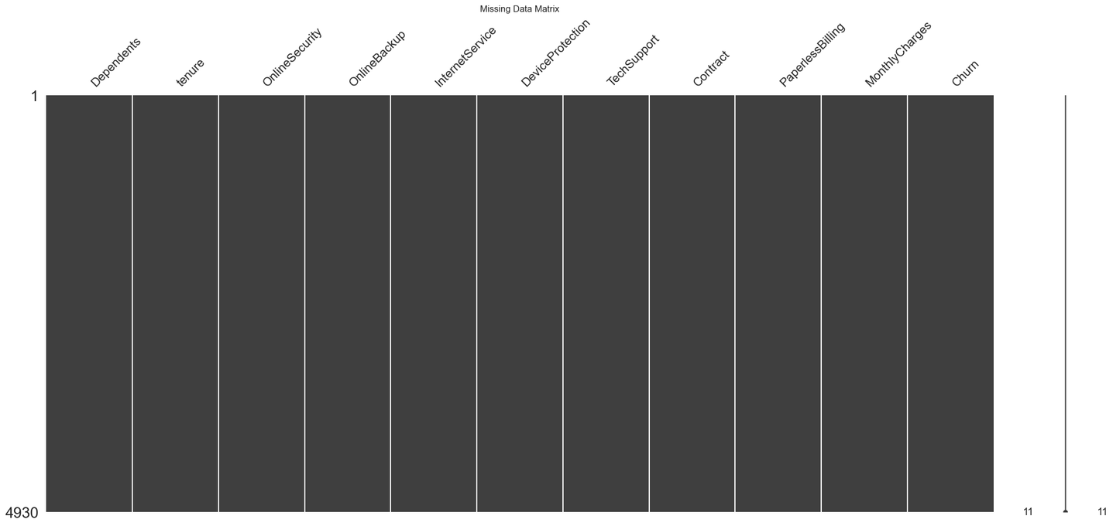
Data Understanding
 | Missing Values Checking
 | No missing values. No need to use imputer in pre-processing.

Slide 14
Data Understanding
Validity of Duplicates
Duplicated rows may represent legitimate repeated observations or transactions, crucial for accurate analysis, particularly in datasets involving transactional data or repeated measurements.
Impact on Data Integrity
Removing duplicates without understanding their context can distort data distributions and compromise data integrity, potentially leading to misleading results and affecting the validity of analyses.
Analytical Significance
Duplicates can provide meaningful information in certain analytical methods and visualizations, highlighting the importance of assessing their origin and significance before deciding to remove them.
Duplicated Values Checking
Number of duplicated rows: 77
Action: Retain Duplicates

Slide 15
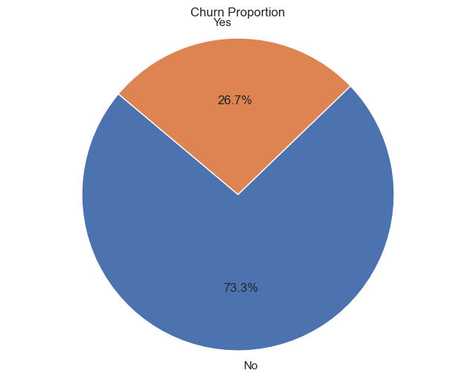
Data Understanding
 | EDA - Churn Proportion
 | Churn: 26.7 % Not Churn: 73.3% Imbalanced Dataset Need to oversampling dataset

Slide 16
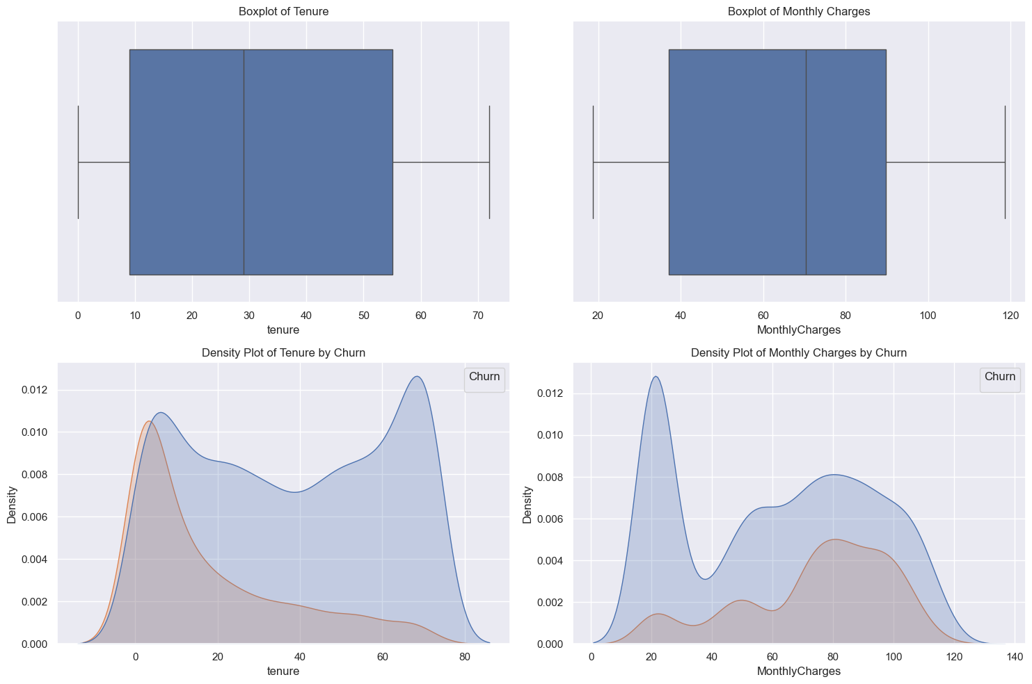
Data Understanding - EDA - Numerical Features Analysis
No negative values Not normally distributed Action: Benchmark MinMax and Robust Scaler in Preprocessor
count | mean | std | min | 25% | 50% | 75% | max
tenure | 4930.0 | 32.401217 | 24.501193 | 0.0 | 9.00 | 29.00 | 55.00 | 72.00
MonthlyCharges | 4930.0 | 64.883032 | 29.923960 | 18.8 | 37.05 | 70.35 | 89.85 | 118.65

Slide 17
Data Understanding
 | unique | top
Dependents | 2 | No
OnlineSecurity | 3 | No
OnlineBackup | 3 | No
InternetService | 3 | Fiber optic
DeviceProtection | 3 | No
TechSupport | 3 | No
Contract | 3 | Month-to-month
PaperlessBilling | 2 | Yes
Churn | 2 | No
 | EDA - Categorical Feature Analysis
 | All categorical columns are nominal, except Contract columns (ordinal). Actions: To use ordinal encoder for Contract columns and one hot encoder for the rest while pre-processing.

Slide 18
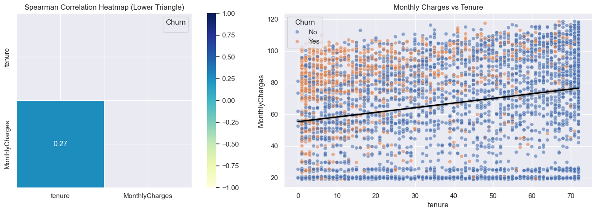
Data Understanding
Correlation Analysis
Low monotonic relationship Directly proportional

Slide 19
3. Data Preparation
Feature Engineering
Binning
Target Labeling
Define X and y
Train-Test Split
Data Transformation Setup

Slide 20
Data Preparation
Feature Engineering
Total Charges = tenure x Monthly Charges
Binning
Equal frequencies based on quarter quantile on tenure, monthly charges, and total charges.
Target Labeling
Churn ⟶ 1, Not Churn ⟶ 0
Define Features and Target
Features (X): All columns except Churn Target (y): Churn

Slide 21
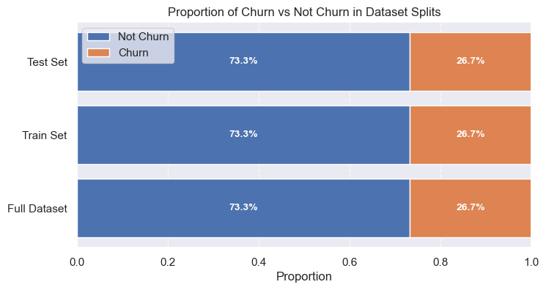
Data Preparation
 | Train-Test Split
 | Train Size: 80 % Test Size: 20 % Stratify on target

Slide 22
Data Preparation
Data Transformation Setup
Step 1
Step 2
Step 3
Step 4
Step 5
Identify Columns
Define Ordinal Categories
Binary Mapping Function
Numeric Transformer Pipeline
Preprocessor Creation
Extract categorical columns (excluding Churn and Contract), numeric columns, and binary columns (with exactly 2 unique values) to categorize the data appropriately for preprocessing.
Create a preprocessor that combines transformations for numeric, binary, ordinal, and categorical features, allowing for a streamlined and efficient data preparation process.
Specify the ordinal categories for the Contract column to ensure that the model understands the inherent order in these categories during training.
Create a function to map binary values ('No' to 0 and 'Yes' to 1) to convert categorical binary features into a numerical format suitable for machine learning algorithms.
Define a pipeline for scaling numeric features using a specified scaler (e.g., RobustScaler or MinMaxScaler) to standardize the range of numeric data and improve model performance.

Slide 23
4. Modeling
Model Initialization and Benchmarking
Hyperparameter Tuning
Learning Curve
Threshold Tuning

Slide 24
Modeling
Model Benchmark Initialization
Step 1
Step 2
Step 3
Step 4
Step 5
Define Base Models and Stacking Classifier
Compile Models Dictionary
Set Up Cross-Validation and Scoring
Evaluate Models with Different Scalers
Identify and Display Best Model and Scaler
Create a list of base models (e.g., Logistic Regression, Random Forest, XGBoost) and define a stacking classifier using these models with Logistic Regression as the meta-model.
Construct a comprehensive dictionary of various machine learning models, including traditional classifiers and the stacking classifier.
Establish a Stratified K-Fold cross-validation strategy and define scoring metrics (e.g., recall) for evaluating model performance.
Iterate over different scalers and models, creating pipelines that include preprocessing and model training, and collect performance scores through cross-validation.
Determine the best-performing model and scaler from the results, create a final pipeline using these selections, and display the optimized pipeline configuration.

Slide 25
Modeling
Best Model Benchmark Initialization
Metric: Recall
Model: AdaBoost
Scaler: Robust
Mean Score: 0.54
Std Dev: 0.04

Slide 26
Modeling
AdaBoost Algorithm
AdaBoost, short for Adaptive Boosting, is an ensemble learning algorithm designed to enhance the performance of weak classifiers by combining them into a stronger model. It works by sequentially training a series of classifiers, each focusing on the misclassified samples from the previous ones, thereby improving the model's ability to handle difficult cases. The final prediction is made by aggregating the weighted outputs of all the classifiers, making AdaBoost effective for various classification tasks while also providing insights into feature importance.
Step 1
Step 2
Step 3
Step 4
Step 5
Initialize Weights
Train Base Classifier
Update Weights
Combine Classifiers
Make Predictions and Evaluate
Assign equal weights to all training samples to ensure each sample contributes equally to the learning process.
Train a simple base classifier (e.g., a shallow decision tree) on the weighted training data and evaluate its performance to identify misclassified samples.
Adjust the weights of the training samples by increasing the weights of misclassified samples and decreasing the weights of correctly classified ones, emphasizing difficult cases for the next classifier.
Train multiple base classifiers iteratively, combining their predictions by weighting them according to their accuracy to create a strong ensemble model.
Use the combined model to make predictions on new data, and assess its performance using various metrics, while also providing insights into feature importance.

Slide 27
AdaBoost
estimator | To specify the type of base classifier used in the AdaBoost ensemble. The default classifier estimator in AdaBoost is a decision tree classifier with a maximum depth of 1
n_estimators | Controls the number of weak classifiers to be combined in the ensemble. More classifiers potentially improving performance but also increasing the risk of overfitting.
learning_rate | Adjusts the contribution of each weak classifier to the final model. A larger learning rate can speed up learning but may lead to overfitting.
algorithm | specifies the algorithm used for combining the weak classifiers
Parameters

Slide 28
Modeling
Searching The Best Model
Step 1
Step 2
Step 3
Step 4
Step 5
Identify Categorical Features for SMOTENC
Define Base Pipeline Steps
Set Parameter Distributions
Configure RandomizedSearchCV
Fit Model and Output Results
Extract the indices of categorical features from the training dataset to prepare for the application of SMOTENC.
Create a base pipeline that includes preprocessing (with the best scaler), a placeholder for a resampler, and a classifier (AdaBoostClassifier).
Define a parameter distribution for the randomized search, including choices for resampling techniques, hyperparameters for AdaBoost, and options for the base classifier.
Set up a RandomizedSearchCV instance to perform hyperparameter tuning, using recall as the scoring metric and stratified cross-validation.
Fit the RandomizedSearchCV on the training data to find the best hyperparameters, and display the best pipeline with the tuned parameters.

Slide 29
Modeling
Best AdaBoost Model After Hyperparameter Tuning
Fitting 5 folds for each of 50 candidates, totalling 250 fits
Best Hyperparameters:
'resampler': RandomOverSampler(random_state=42),
'classifier__n_estimators': 250,
'classifier__learning_rate': 0.01,
'classifier__estimator': DecisionTreeClassifier(max_depth=1),
'classifier__algorithm': 'SAMME
Recall Score: 0.92 ⟶ Increases around 70% From Base Model

Slide 30
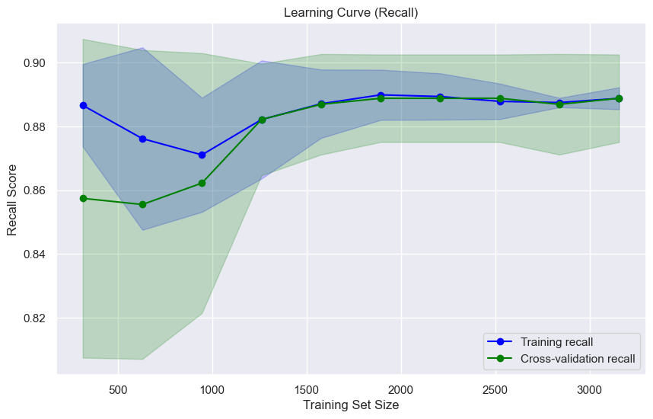
Modeling
 | Recall Learning Curve
 | Training Recall Stability: The training recall scores remained consistently high (around 0.88 to 0.89) across varying training sizes, with low variability indicated by a narrow standard deviation. Cross-Validation Improvement: Initially lower cross-validation recall scores improved and converged towards the training recall as training size increased, showing reduced variability with more data, indicating a well-fitted model. Model Performance and Capacity: The model demonstrated good performance by minimizing false negatives, and recall scores stabilized at larger training sizes, suggesting that the model's capacity was reached with the current features and algorithm, with no significant improvements from additional data.

Slide 31
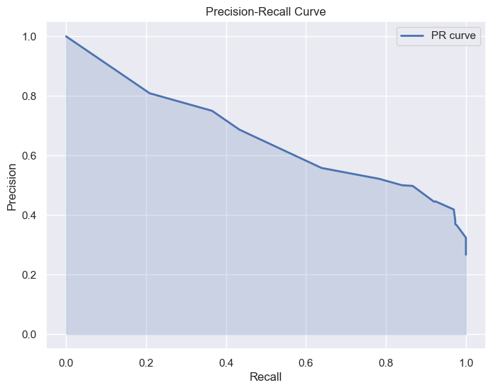
Modeling
 | Threshold Tuning
 | Best threshold by Recall score: 0.1192 Recall score at this threshold: 1.0000 Decision: “No Go”; Too good to be true

Slide 32
5. Evaluation
Feature Importance Using LIME Analysis
Rule Based vs Machine Learning Based

Slide 33
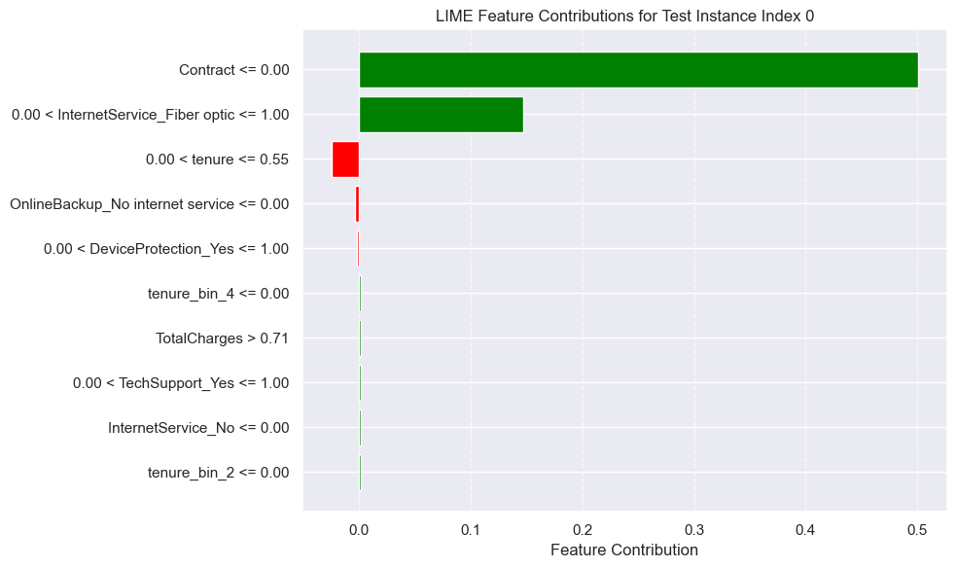
Evaluation
 | Feature Importances - LIME
 | Key Positive Contributors: Contract: Most significant positive impact, crucial for favorable predictions. InternetService_Fiber optic: Also positively influences the prediction. Key Negative Contributor: Tenure (0.00 < tenure <= 0.55): Has a negative contribution, suggesting that this range decreases the likelihood of the predicted outcome.
Notes:
Positive Contributions:
Good Stuff: These are features that help make a prediction more likely. For example, if having a certain type of contract makes it more likely that a customer will stay, that's a good sign!
Helpful for Decisions: Knowing what helps can guide businesses on what to promote or focus on.
Negative Contributions:
Bad Stuff: These features lower the chances of a good outcome. For instance, if having a short customer history is bad for keeping customers, that's a warning sign.
Spotting Problems: Understanding what hurts predictions can help businesses fix issues, like improving customer service to keep people longer.

Slide 34
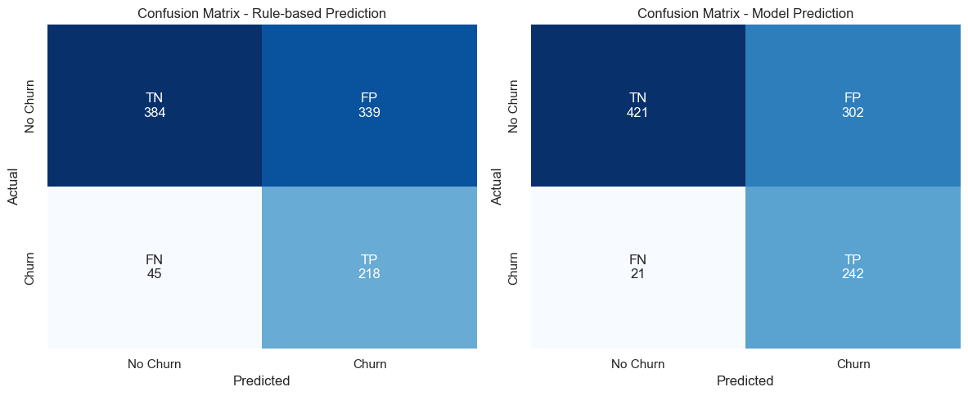
Evaluation
Recall Score Rule: 0.8289
Recall Score ML: 0.9202
Differences: 9.13%
Rule-Based Scenario:
Loss from FN: $9,000
Cost from FP: $16,950
Total Monthly Loss: $25,950
Total Annual Loss: $311,400
Machine Learning Scenario:
Loss from FN: $4,200
Cost from FP: $15,100
Total Monthly Loss: $19,300
Total Annual Loss: $231,600
Differences: $79,800
Percentages savings: 25.63%
Rule Based vs Machine Learning Based
With Machine Learning Model, recall score increases 9.13 % compared to the rule based. The company also can saves 25.63% based on Machine Learning Model instead of rule based.

Slide 35
6. Deployment
Joblib Deployment
Model Limitations

Slide 36
Deployment
Joblib Deployment File
models\best_tuned_pipeline.joblib
Limitations 1 - Data Dependence and Bias
The model's accuracy is heavily reliant on the quality and representativeness of the training data, which may contain biases that affect predictions and limit its generalizability.
Limitations 2 - Pattern Recognition and Adaptability
The model's ability to identify complex patterns or rare events is constrained by the selected features. Additionally, it may not adapt well to changes in customer behavior or external factors unless regularly updated.
Limitations 3 - Overfitting and Interpretability
There is a risk of overfitting or underfitting if the model is not properly tuned. Furthermore, the model may have limited interpretability, and the evaluation metrics used might not capture all aspects of its performance effectively.

Slide 37
7. Conclusion and Recommendations
Conclusion
Business Recommendations
Model Recommendations

Slide 38
Conclusion and Recommendations
Conclusions
- Contract has the strongest positive contribution to churn prediction — customers with certain contract types are more likely to churn.
- InternetService_Fiber optic also positively contribute to churn risk.
- Tenure has a negative contribution — shorter tenure customers are more likely to churn.
- The Machine Learning Scenario significantly increases recall score around 9% and reduces False Negatives and False Positives losses, saving nearly $80,000 annually, a quarter of the total losses under the Rule-Based system.

Slide 39
Conclusion and Recommendations
Business Recommendations
Contract Optimization: Promote contract types that enhance customer retention and satisfaction, offering incentives to encourage selection. Internet Service Offerings: Invest in expanding fiber optic infrastructure and promote its benefits to attract more customers. Customer Retention Strategies: Develop targeted strategies for customers with short tenures, including personalized outreach and loyalty programs. Feature Awareness Campaigns: Educate customers on the advantages of additional features like online backups and device protection. | Customer Feedback Loop: Implement feedback mechanisms to refine service offerings and address customer pain points. Analyze Customer Segments: Conduct analysis to understand diverse customer needs, enabling tailored marketing and services. Retention Metrics Monitoring: Regularly track key metrics related to contracts and service usage to identify trends and adjust strategies.

Slide 40
Conclusion and Recommendations
Model Recommendations
Balance Precision and Recall: Instead of focusing solely on maximizing recall, the company can tune the model to achieve a better balance between precision and recall. This can be done by adjusting the classification threshold or using evaluation metrics like the F1-score that consider both precision and recall. Regular Model Retraining: Customer behavior and market conditions change over time. Regularly retraining the model with new data ensures that it adapts to recent trends and maintains accuracy.

Slide 41
“It is the greatest truth of our age: Information is not knowledge.”
― Caleb Carr
Thank You :D

