Slide 1
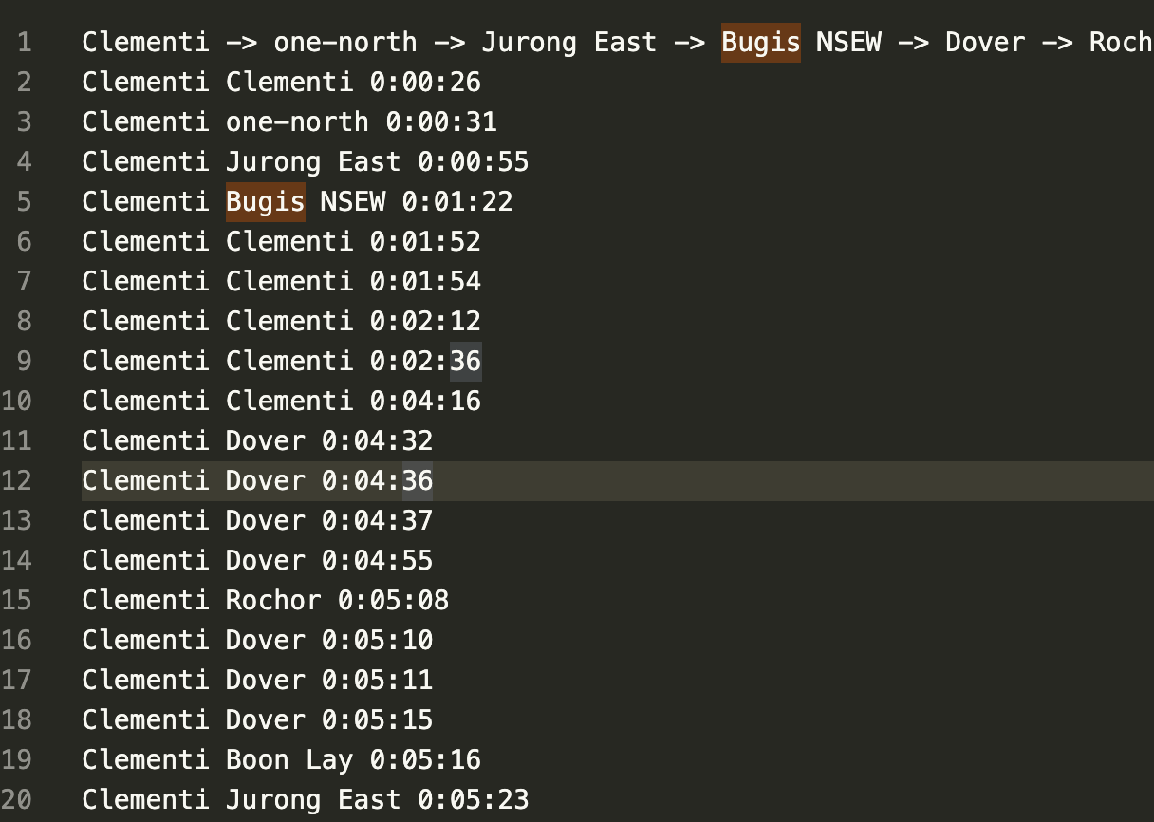
Given the origin, destination and the time in time out, we can get the difference between the time in and time out and used that as the duration for the trip between stations.
We then take a starting point for example Clementi and its destination and sort them by the traveling duration. This give us the result as follows:
Clementi -> one-north -> Jurong East -> Bugis NSEW -> Dover -> Rochor -> Boon Lay -> Buona Vista NSEW -> Buona Vista CCL -> Commonwealth -> Chinese Garden -> Bukit Batok -> Lakeside -> Queenstown -> Bukit Gombak -> Holland Village -> Kent Ridge -> Redhill -> Tiong Bahru -> Choa Chu Kang -> Farrer Road -> Haw Par Villa -> Pioneer -> Outram Park NSEW -> Botanic Gardens CCL -> Joo Koon -> Yew Tee -> Botanic Gardens DTL -> Tanjong Pagar -> Outram Park NEL -> Pasir Panjang -> Kranji -> Caldecott -> Raffles Place -> Labrador Park -> Chinatown NEL -> Marymount -> Teck Whye -> City Hall -> Newton DTL -> Clarke Quay -> Chinatown DTL -> Marina Bay -> HarbourFront NEL -> Marsiling -> HarbourFront CCL -> Telok Blangah -> Bishan CCL -> Somerset -> Telok Ayer -> Dhoby Ghaut NSEW -> Woodlands -> Downtown -> Lavender -> Serangoon CCL -> Braddell -> Little India NEL -> Dhoby Ghaut NEL -> Lorong Chuan -> Kallang -> Orchard -> Farrer Park -> Bukit Panjang BPLRT -> Bugis DTL -> Bras Basah -> Little India DTL -> Cashew -> Admiralty -> Ang Mo Kio -> Aljunied -> Tai Seng -> Sembawang -> Novena -> Nicoll Highway -> Promenade -> Paya Lebar NSEW -> Bayfront CCL -> Toa Payoh -> Yio Chu Kang -> Boon Keng -> Newton NSEW -> Serangoon NEL -> Eunos -> Yishun -> Marina South Pier -> MacPherson CCL -> Kembangan -> Paya Lebar CCL -> Fajar -> Hougang -> Bedok -> Dakota -> Stadium -> Potong Pasir -> Bayfront DTL -> Tanah Merah -> Kovan -> Khatib -> Expo NSEW -> Mountbatten -> Simei -> Tampines NSEW -> Punggol -> Pasir Ris -> Changi Airport -> Meridian -> Fernvale -> Compassvale
Problem came out when there are data consists of multiple origin to destination trips made and using my naïve method to take the shortest time and ignore the rest will cause this issue: Bugis NSEW seems to be an anomaly data.
Solution: we can use the median result and use it as the duration for that particular origin to destination duration

Slide 2
At this point of time, I noticed that is troublesome to code this out in python loops and should be using a library (pandas) instead to process this set data.
New Strategy: We can convert the duration from hh:mm:ss to just seconds by using the formula on excel “=RC[-1]*86400” for example. This give us 0:12:24 to 744 seconds instead. Hence, we add that to a new column.
Next, we can group the origin and destination as 1 group then sort the median of the duration to get the “flat” network.

Slide 3
Clementi 206.0
Dover 403.5
Jurong East 453.0
Buona Vista NSEW 498.0
Chinese Garden 584.0
Commonwealth 649.0
Buona Vista CCL 664.5
Lakeside 716.0
Queenstown 808.0
Bukit Batok 869.5
Holland Village 877.0
one-north 879.0
Bukit Gombak 890.0
Haw Par Villa 907.0
Boon Lay 915.0
Redhill 931.5
Pioneer 1062.0
Tiong Bahru 1065.5
Kent Ridge 1125.0
Choa Chu Kang 1157.0
Botanic Gardens DTL 1192.0
Outram Park NSEW 1200.0
Joo Koon 1213.0
Botanic Gardens CCL 1225.0
Farrer Road 1254.0
Outram Park NEL 1315.0
Pasir Panjang 1320.0
Yew Tee 1325.0
Tanjong Pagar 1355.0
Caldecott 1404.5
Labrador Park 1412.5
Raffles Place 1479.0
Marymount 1488.0
Kranji 1513.0
Chinatown DTL 1591.0
Clarke Quay 1596.0
Chinatown NEL 1598.0
City Hall 1617.0
Teck Whye 1635.0
Marsiling 1635.5
Marina Bay 1679.5
Telok Blangah 1718.0
Bugis NSEW 1774.0
HarbourFront CCL 1780.5
Telok Ayer 1787.5
Bishan CCL 1811.5
HarbourFront NEL 1853.0
Bukit Panjang BPLRT 1883.0
Bugis DTL 1883.0
Lavender 1888.0
Newton DTL 1889.0
Lorong Chuan 1894.5
Little India DTL 1899.0
Cashew 1902.0
Dhoby Ghaut NSEW 1920.0
Rochor 1921.0
Woodlands 1940.0
Somerset 1943.0
Little India NEL 1973.0
Dhoby Ghaut NEL 1994.0
Kallang 2021.0
Serangoon CCL 2023.5
Downtown 2026.0
Admiralty 2057.0
Farrer Park 2084.0
Orchard 2092.0
Aljunied 2129.0
Bras Basah 2178.5
Boon Keng 2253.0
Marina South Pier 2264.0
Paya Lebar NSEW 2264.5
Bayfront CCL 2267.0
Newton NSEW 2270.5
Tai Seng 2277.5
At this point, the problem arrives where bi-direction network have an issue.
For example the results suggests the network in the flow from Clementi -> -> -> to the front and not the in reverse <- <- <- direction.
This results in Clementi>Dover>Jurong East.
Toa Payoh 2278.0
Novena 2323.0
Nicoll Highway 2334.0
Promenade 2351.0
Eunos 2360.0
Sembawang 2360.5
Yio Chu Kang 2380.0
Fajar 2431.0
Braddell 2446.5
Yishun 2457.0
Paya Lebar CCL 2499.0
Kembangan 2551.5
Dakota 2597.0
MacPherson CCL 2606.0
Potong Pasir 2654.0
Serangoon NEL 2704.0
Hougang 2725.0
Bayfront DTL 2747.0
Bedok 2767.0
Stadium 2850.0
Kovan 2858.5
Tanah Merah 2964.0
Ang Mo Kio 2979.0
Mountbatten 3024.0
Khatib 3032.0
Simei 3150.0
Tampines NSEW 3208.5
Punggol 3256.5
Expo NSEW 3348.0
Meridian 3570.0
Changi Airport 3747.0
Pasir Ris 3857.0
Fernvale 4270.0
Compassvale 4551.0

Slide 4
We can solve this bidirection issue, if we validate the duration. For example:
Clementi -> Dover takes 403 seconds, then Clementi -> Jurong East 435 Seconds implying a network such as Clementi -> Dover -> Jurong East
If we validate that Jurong East -> Dover is longer than Clementi -> Dover, we can be sure that Jurong East is the other direction Jurong East <- Clementi -> Dover

