Slide 1
HELS
Event Manager Systems
Lisa Gonsalves
Sanika Patankar
Eshank Bele
Hansel D’silva

Slide 2
Contents
Introduction
Abstract
Summary
Features & Functions
Technologies used in this project
Home page
Login\Sign in Section
Conclusion

Slide 3
Introduction
In real scenarios, various events are taking place simultaneously inside an organization and everything got messed up if venue is not available at desired time, also all hard work will become unproductive and leaves bad reputation of organization.
So, we work with an event management system that is management website where all venues which are available at current time will be apportioned to user.

Slide 4
Abstract
Our project is an online event management system or rather a portal in the form of a website, a mortal that will help in the functionality of an event organizer as well as participants and stakeholders of the event.
HELS is an event management web application where creation and development of small and/or large-scale personal or corporate events such as festivals, conferences, volunteering events for NGOs, concerts, or conventions are advertised.

Slide 5
Summary
This web application will have 3 modules:
Admin
Organizers
Customers
The Admin module will be in charge of verifying organizers with ID proof and having access to anything on the website related to events, organizers, and customers , as well as making any modifications to the events if necessary.
The Organizer module contains a registration and login system for the organizers.The organizers can add events, edit information regarding the event, add venue of the event ,update organizer info, specify type of event, give details about booking, etc. They can set a price for the event as well.
The customer module will also have a registration and login system for the customers. They should be able to see the events put up by the organizers. They can select an event and pay for it(if it is a paid event). They should also be able to see the availability for each course.

Slide 6
Features & Functions
HELS allows you :
Minimize administration efforts
Eliminate missed communications
Digitize how your events are run
Comply with COVID-19 safety guidelines
Save time planning future events
Access detailed reports & analytics
Features of HELS :
Customized processes & scheduling
Effortless event updates & tracking
Resources & documentation
Mobile on-the-go access
Data security & management
Custom reporting & dashboards

Slide 7
Technologies used in this project
HTML and CSS : HTML and CSS are used to create the website which is used to structure the website.
PHP : It is used to link the database to the website.

Slide 8
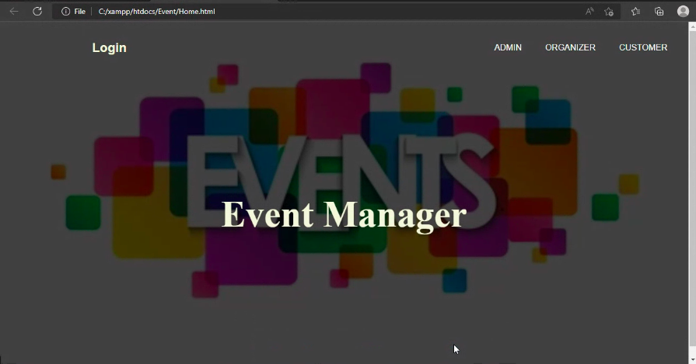
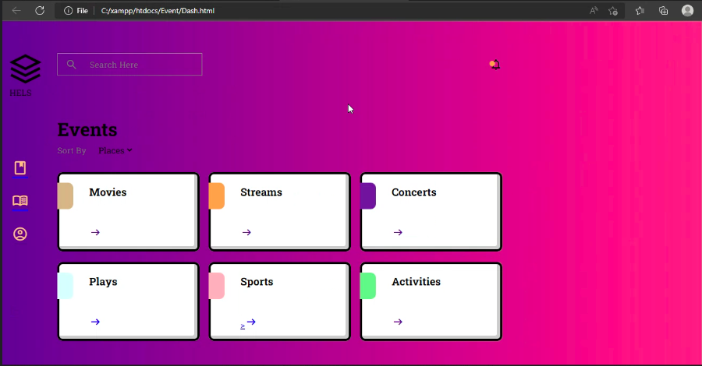
Home page

Slide 9
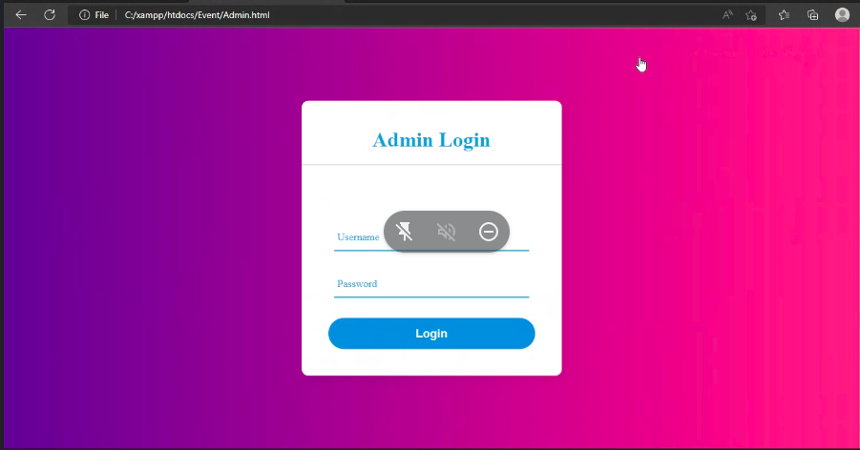
Login/Sign in Section
For Admin

Slide 10
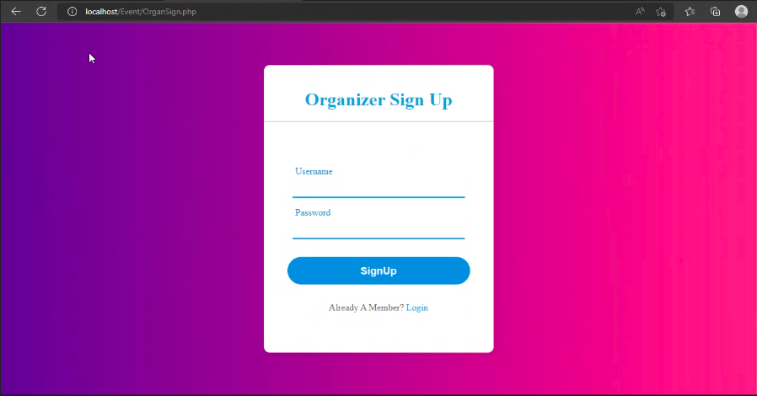
For Organizers

Slide 11
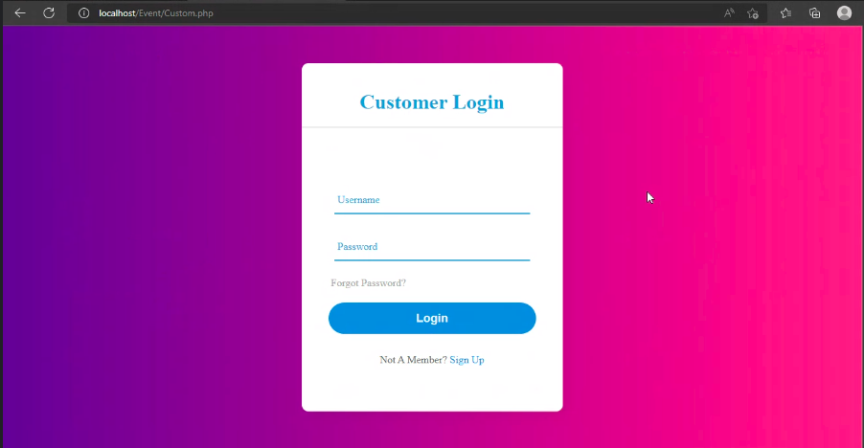

For Customer

Slide 12
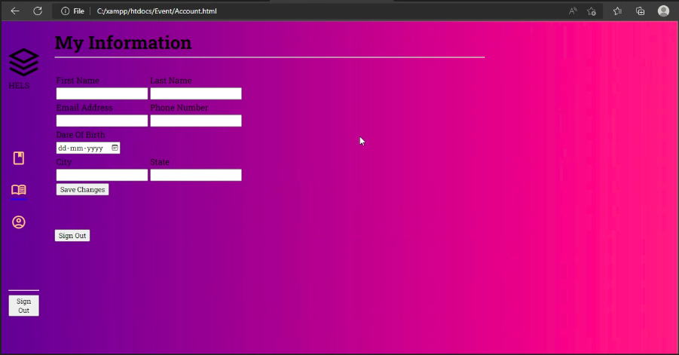
Information about the customer

Slide 13
Conclusion
This online event management system could be implemented at several places requiring to manage different events.
This system is able to manage online events irrespective of their scale.
There are several events management systems in the market and are doing good job but this project provides several other features that some event management system lacks.
This event management system is quick and handy.
During the research it was observed that events are major part of a human being and several events take place on daily basis.
Lots of paperwork is involved and hence lots of time and money is also wasted managing those events.
There is a need for managing events digitally to reduce time and effort hence this leads us to this project and make this project more relevant in current time.
Small scale events happening in a locality are usually given less preference than events occurring on a large scale hence small-scale events maybe highly benefited by this project.

Slide 14
THANK YOU

