Slide 1
BUBBLE WARRIOR ADVENTURES
HANSEL DE LA CRUZ
KYLE JOLICOEUR
JENNIFER GREEN

Slide 2
INTRODUCTION
BUBBLE WARRIOR ADVENTURES IS A TOP-DOWN 2D ADVENTURE GAME IN THE STYLE OF LEGEND OF ZELDA OR POKEMON GAMES
PLAYER SHOULD BE ABLE TO TALK WITH NPCS, BROWSE AN INVENTORY AND EQUIPMENT SYSTEM, TRAVEL FROM ZONE TO ZONE, AND BATTLE NPC ENEMIES ON THE MAIN SCREEN
ENTIRE GAME SHOULD LAST FROM 5-10 HOURS IF FOLLOWING THE PLOT

Slide 3
COMPLETED SYSTEMS
GAME ENGINE IS BUILT, STATE CAN BE SAVED BETWEEN SESSIONS
SEVEN WORKING MAPS
COLLISION IS WORKING
ATTACK ANIMATIONS BUILT AND INTEGRATED
ENEMIES ADDED WITH SOME BASIC AI
INVENTORY SCREEN BUILT
SCRIPT OUTLINE COMPLETED, SOME NPCS WRITTEN

Slide 4
GAME ENGINE
State management system created from scratch
States are stored in an internal std::stack container
Transitions can occur by calling push(), change() or pop() methods in StateHandler
Push pauses the previous state and pushes a new one on top.
Change removes the previous state calling its destructor and pushed a new one on top
Pop calls the destructor of the current state and resumes the previous state, if any

Slide 5
MAP RENDERING
Maps are created using an open source tool called Tiled
This tool can then export maps as .tmx files which can be run through an XML parser
For this we used pugixml, an open source library, to parse the .tmx file and pull out the individual layers of the map to be drawn in the game.
Each layer then stores its own objects and tiles that the game engine can read and render accordingly

Slide 6
COLLISION DETECTION
Collision detection was created using a bounding box collision algorithm
Every object in the game has a bounding box rectangle that is used in the algorithm
If any two objects intersect then their respective collision handlers are called.
For example if the player and a potion collide, the player is aware it collided with a potion and increases its HP, the potion is aware it collided as well and can signal the MapHandler to be removed.

Slide 7
TO BE COMPLETED
ADD NPC CHARACTERS AND INTEGRATE SPEECH/SCRIPTED RESPONSES
ADD ATTACK ABILITIES TO NPC ENEMIES (DONE)
ADD INVENTORY ITEMS AND BUILD “BUBBLE” SYSTEM FOR EQUIPMENT
BUILD 2-3 MORE MAPS, (DONE) INCLUDING OVERLAND MAP
FINALIZE BEGINNING PORTION OF SCRIPT (DONE)

Slide 8
LATEST UPDATES
TWO NEW MAPS ADDED
ALL MAPS UPDATED WITH THREE NEW OBJECT LAYERS
RE-WROTE HOW WE HANDLED OBJECT COLLISION AND STATE MANAGEMENT
NPC AND ENEMY LOCATIONS ADDED TO ALL MAPS
WORK STARTED ON ENEMY ANIMATIONS
MAP RENDERING IMPROVED
CHARACTER ANIMATIONS IMPROVED
ITEMS ADDED TO MAPS

Slide 9
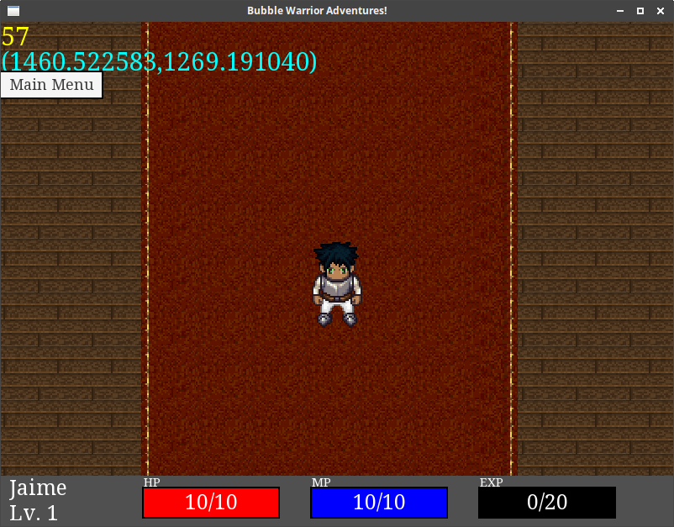
SCREENSHOTS
Ingame

Slide 10
