Slide 1



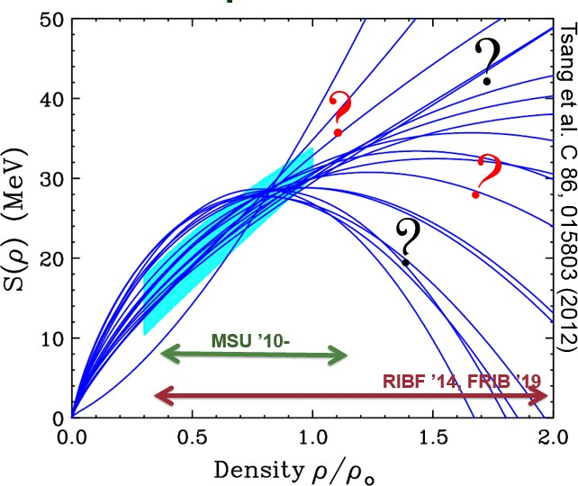
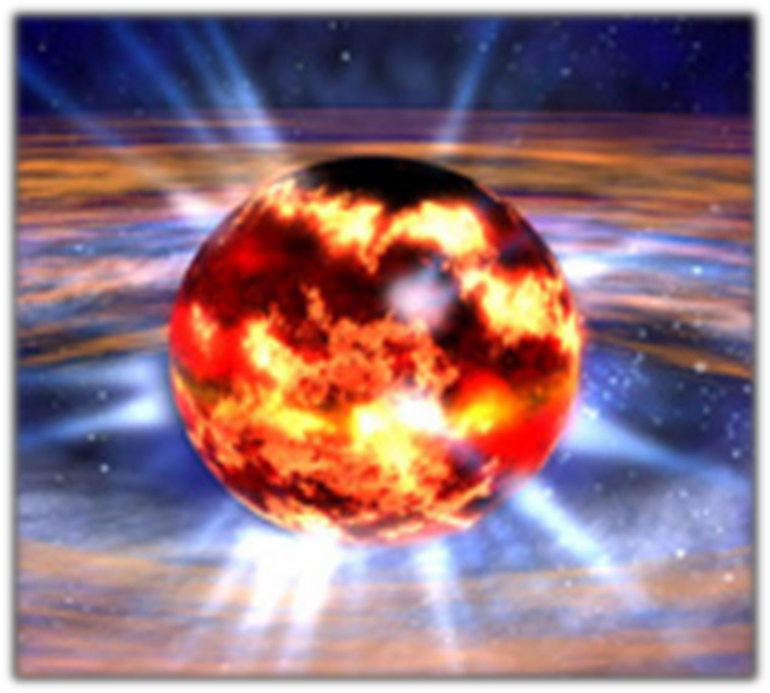
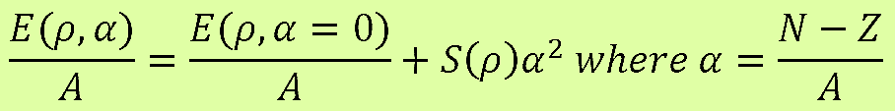
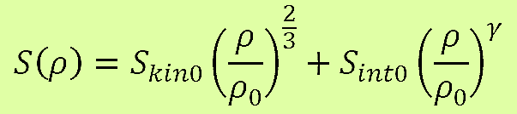
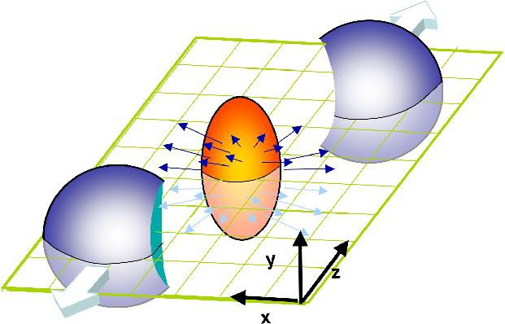



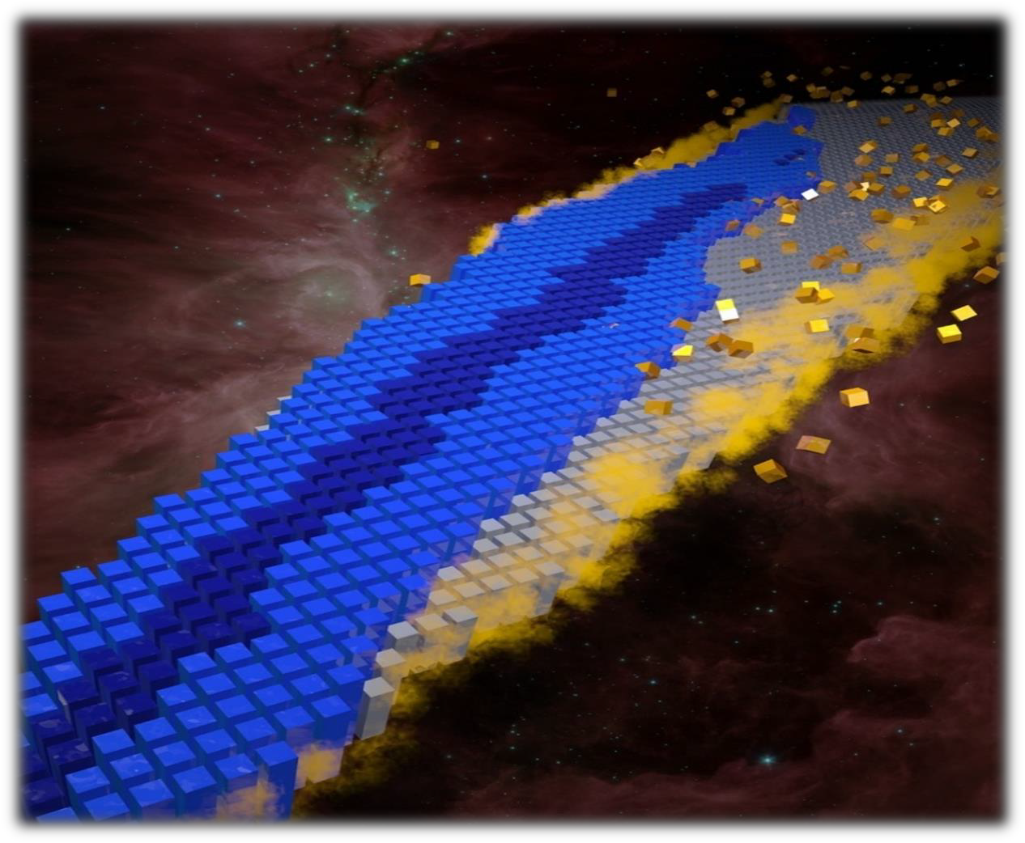
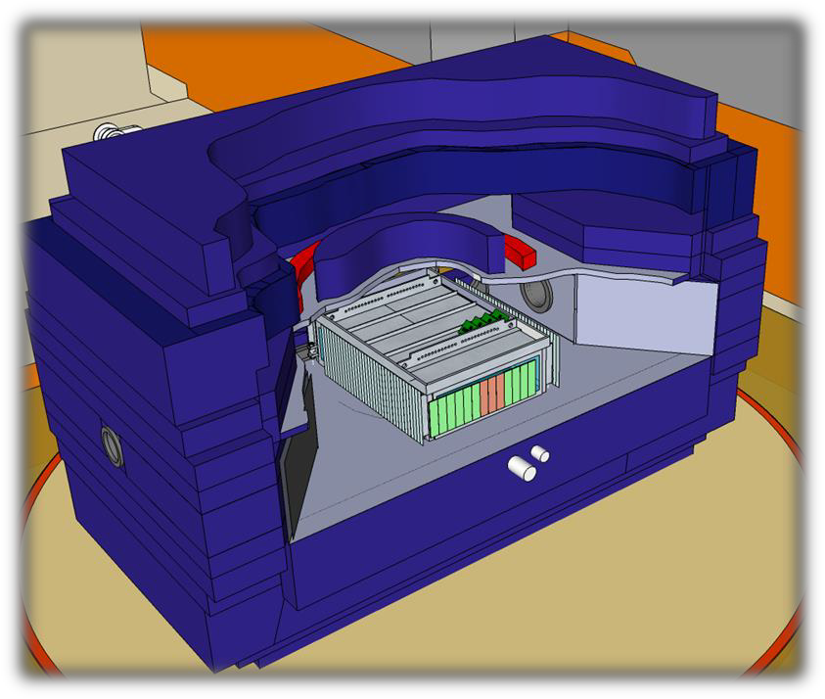

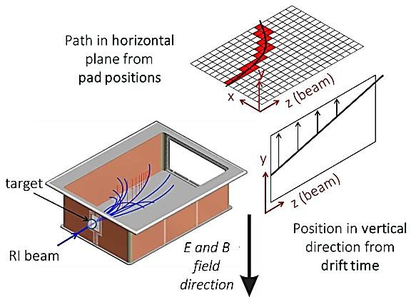

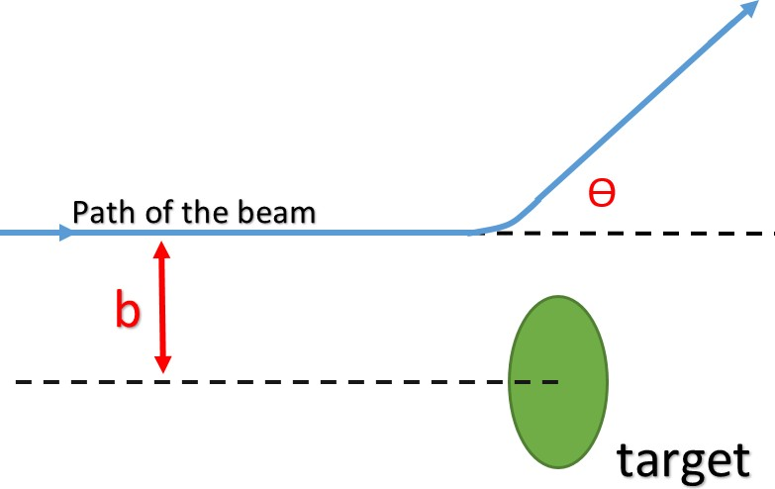
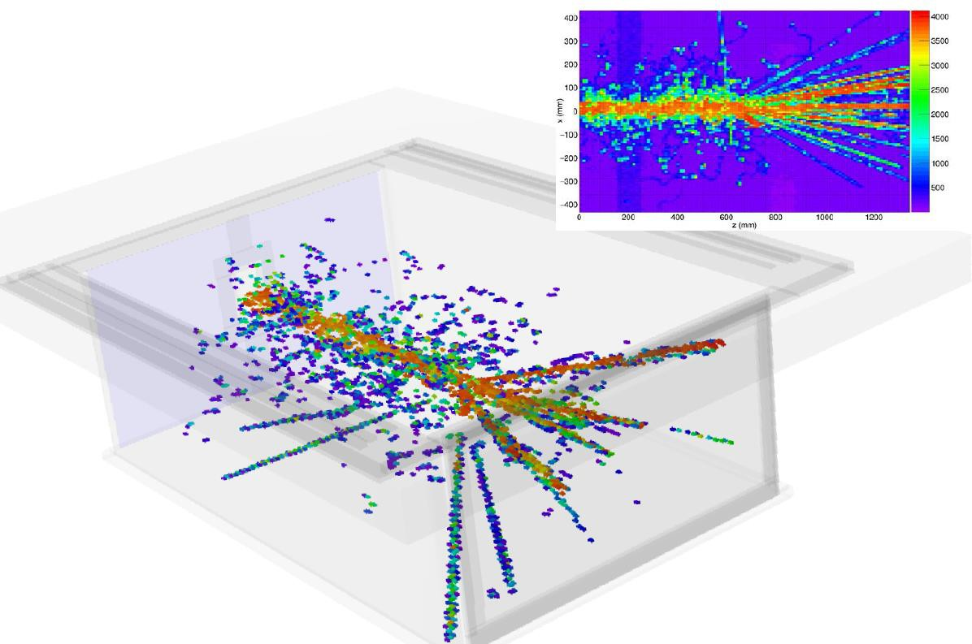

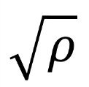


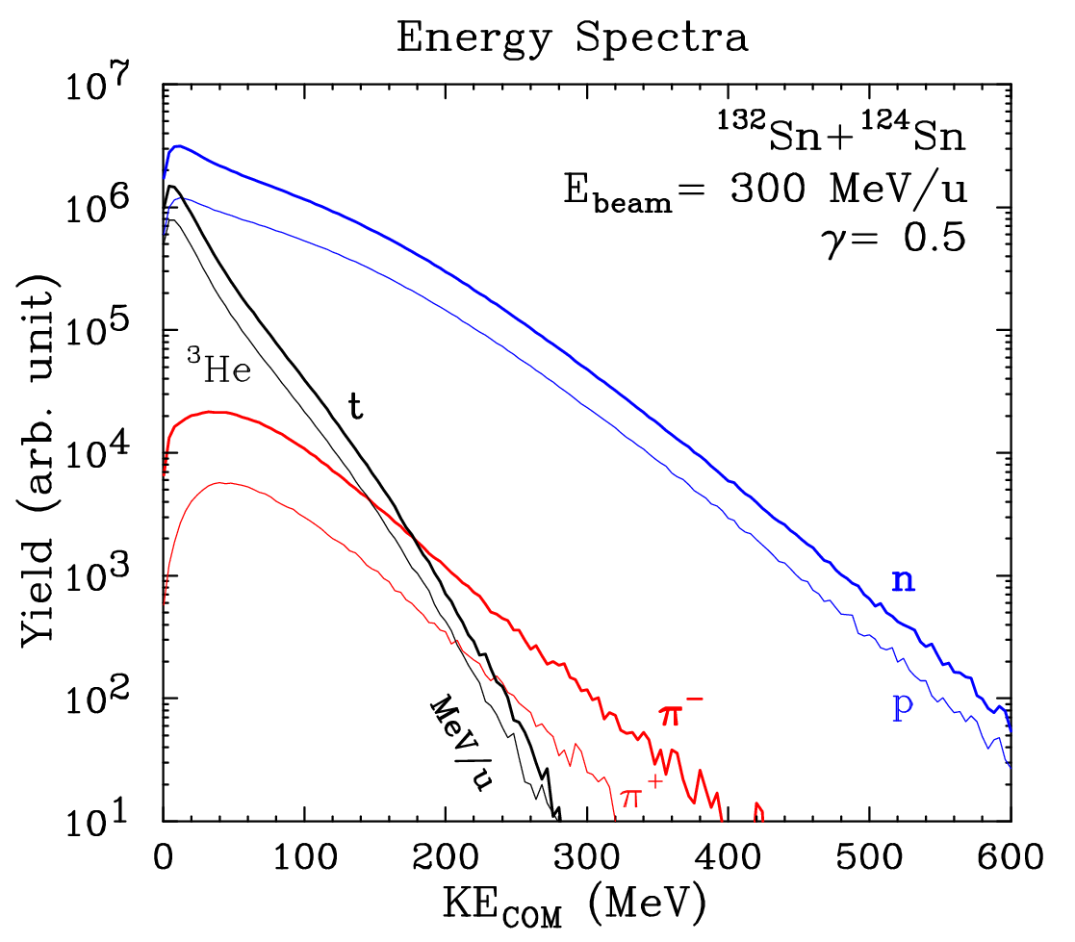
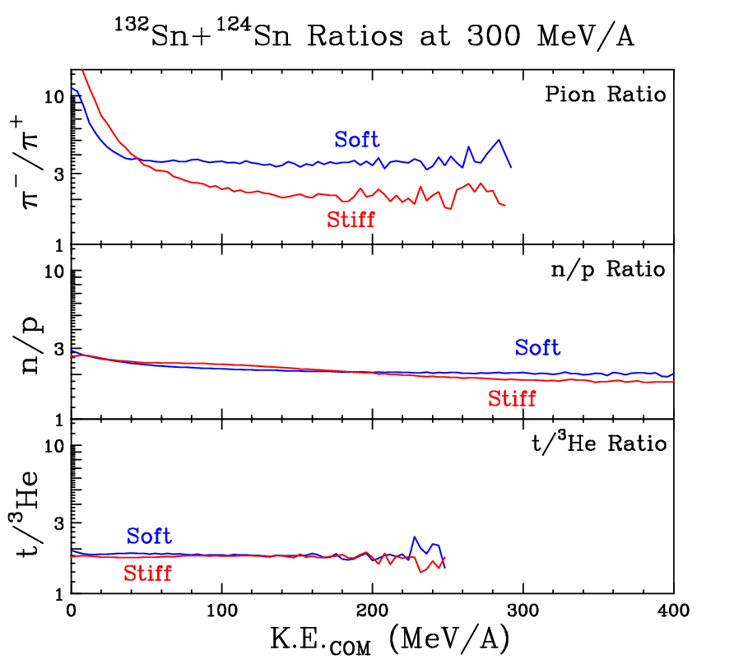
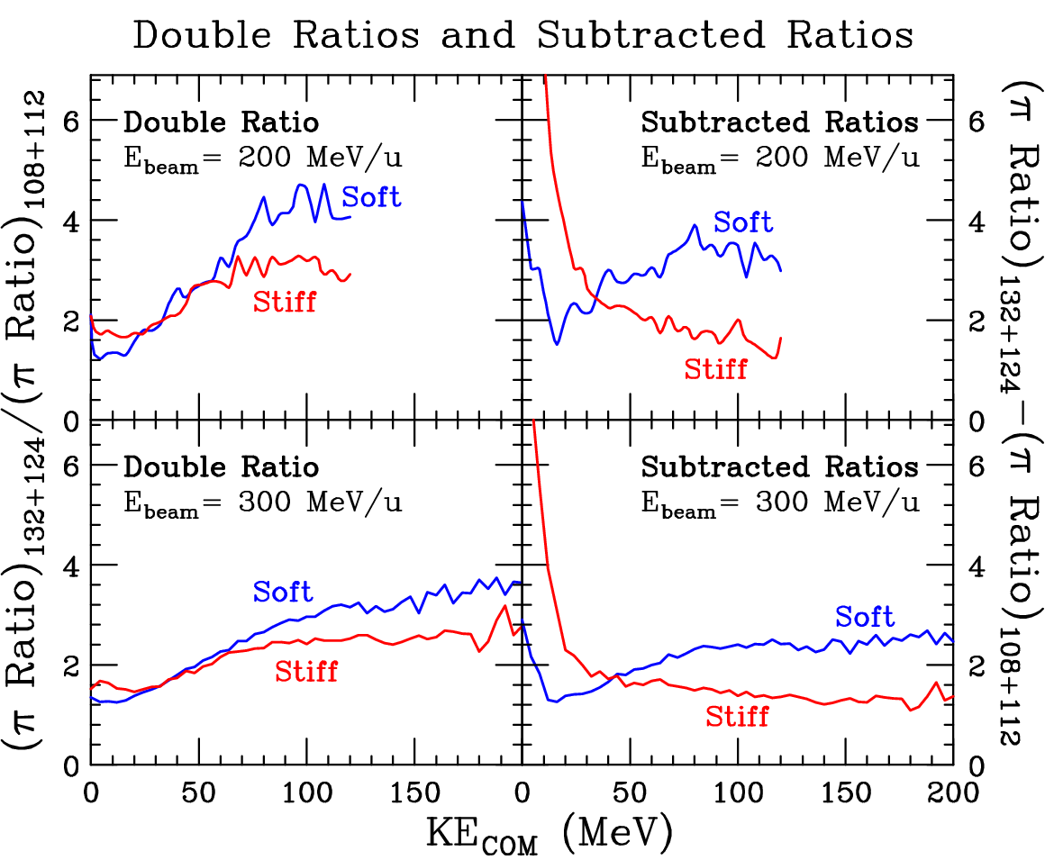






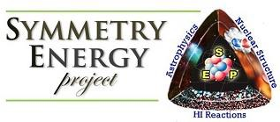
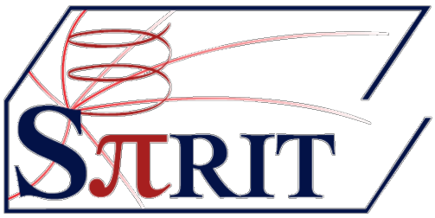
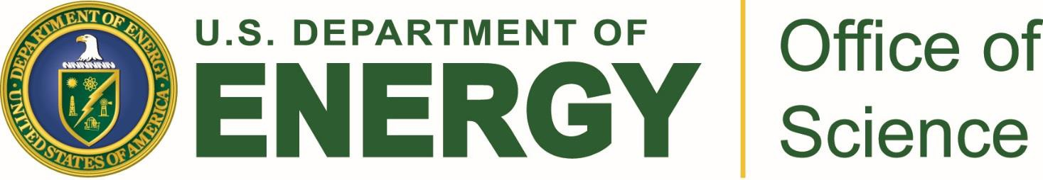

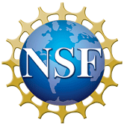
Search for Nuclear Symmetry-Energy Observables in Heavy Ion Collisions to Understand the Properties of Neutron Stars
Hananiel Setiawan
Advisor: Dr. M.B. Tsang, National Superconducting Cyclotron Laboratory and Michigan State University
MOTIVATION
Neutron stars are very dense astronomical objects
HEAVY ION COLLISIONS & pBUU TRANSPORT MODEL
EXPERIMENTAL PLANS
We need 300 MeV/u with reasonable-intensity ¹³²Sn & ¹⁰⁸Sn secondary beams, available at RIBF (RIKEN), Japan & FRIB (2020)
We need a time-projection chamber (TPC) inside a strong magnet to detect pions and other particles.
In 2010, MSU received a $1.2 million grant from DOE to construct SπRIT (SAMURAI Pion-Reconstruction and Ion-Tracker)
The Nuclear Equation of State (EOS)
stiffer
Why does a neutron star not collapse under its own weight? Pressure from symmetry-energy counters the gravity.
softer
Symmetry-energy is not well understood, especially at high density.
Completed in 2013 & shipped to RIKEN in 2014
Two experiments have been approved: ¹³²Sn + ¹²⁴Sn
and ¹⁰⁸Sn + ¹¹²Sn (2016).
Neutron Star
Source: nasa.gov
We can use Heavy Ion Collisions at high energy to produce high-density region to study symmetry energy.
n
π+
π-
Data from these experiments will be compared to the simulations to extract the value of gamma (γ)
The nuclear symmetry-energy,
a part of the Nuclear Equation of State (EOS), is the price paid for having unequal numbers of neutrons and
protons
Our goal is to find the best & most sensitive observable constructed from particles produced during the collisions.
p
³He
(below) Interpretation of possible particle tracks inside TPC
Heavy Ion Collision simulations were done using pBUU (Boltzmann-Uehling- Uhlenbeck) transport model [1]:
triton
(above) Figure A
A schematic view of a heavy ion collision and particles produced
U. W. Heinz, J. Phys. A42 214003 (2008)
The Nuclear Landscape
Image by Oak Ridge NL
¹³²Sn + ¹²⁴Sn and ¹⁰⁸Sn + ¹¹²Sn
Beam energy: 200 & 300 MeV/u
2 E_{sym} parametrizations:
(above) SπRIT TPC inside the Samurai magnet chamber in RIKEN
Soft (γ=0.5, E_{sym} )
Stiff (γ=1.75, E_{sym} ∝ )
References
[1] J. Hong and P. Danielewicz, Phys. Rev. C 90, 024605 (2014)
Symmetry energy influences wide range of objects from mass-radius relationship of neutron stars to halo nuclei and neutron skins.
∝
(above) Figure B
Simple illustration of impact parameter – b.
Image by Hananiel Setiawan
(left) An actual event
from the commissioning testing run (Oct 2015)
R. Shane, et al., Nucl. Instrum. Meth. A 784,
513-517 (2015).
RESULTS
SUMMARY | NEXT STEP
Simulations show that pion ratio is the most sensitive observable, compared to n/p and triton/³He.
Experiments of (Sn+Sn) collisions will be carried out in RIKEN, Japan in 2016.
We plan to do more simulations with asymmetric system of ⁴⁸Ca+¹²⁴Sn and ⁴⁰Ca+¹¹²Sn for planning future experiments.
Figure 1 Relative yield for neutron, proton, triton, ³He, and pions.
Figure 2 Comparison of pion ratio (π-/π+), n/p ratio, and t/³He ratio.
Figure 3 Enhanced pion ratios of ¹³²Sn
+ ¹²⁴Sn &
108_{Sn +} 112_{Sn}
using double & subtracted ratios methods.
ACKNOWLEDGEMENTS:
US Department of Energy Grant No. DE-SC0004835
MSU NSCL/FRIB, HiRA/SEP group, and the SPiRIT Colaboration
J. Estee, J. Barney, Z. Chajecki, P. Danielewicz, J. Hong , W.G. Lynch, R. Shane, S. Tangwancharoen, M.B. Tsang, R. Showalter, S. Sweany, J. Winkelbauer, J. Manfredi, P. Morfouace
This material is based upon work supported by the National Science Foundation (NSF) and the Department of Energy, Office of Science (DOE). Any opinions, findings, and conclusions or recommendations expressed in this material are those of the author(s) and do not necessarily reflect the views of the NSF, DOE, or MSU

