Slide 1
How to create a Hadoop Project with Maven

Slide 2
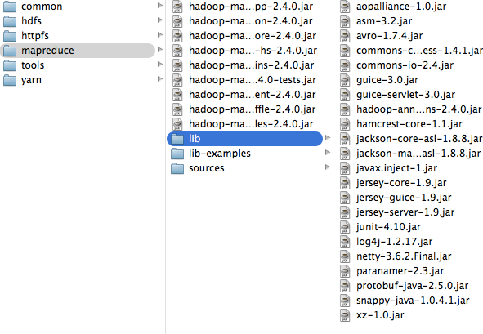

Problem?
Has anyone downloaded Hadoop 2.4.0?
How many libraries it has?

Slide 3
We solve it with Maven
Simple: a dependency manager
Manages the whole project

Slide 4
First: configure Maven in our machine (~/.m2/settings.xml): Cloudera repo
<?xml version="1.0" encoding="UTF-8"?>
<settings>
<profiles>
<profile>
<id>standard-extra-repos</id>
<activation>
<activeByDefault>true</activeByDefault>
</activation>
<repositories>
<repository>
<!-- Central Repository -->
<id>central</id>
<url>http://repo1.maven.org/maven2/</url>
<releases>
<enabled>true</enabled>
</releases>
<snapshots>
<enabled>true</enabled>
</snapshots>
</repository>
<repository>
<!-- Cloudera Repository -->
<id>cloudera</id>
<url>https://repository.cloudera.com/artifactory/cloudera-repos</url>
<releases>
<enabled>true</enabled>
</releases>
<snapshots>
<enabled>true</enabled>
</snapshots>
</repository>
</repositories>
</profile>
</profiles>
</settings>

Slide 5
Configure Maven Poject
$ mvn archetype:generate -DarchetypeGroupId=org.apache.maven.archetypes -DgroupId=cl.puc.iic3413.hadoop -DartifactId=word count
That command creates the project structure…
And we add the dependencies needed:
<dependencies>
<dependency>
<groupId>junit</groupId>
<artifactId>junit</artifactId>
<version>3.8.1</version>
<scope>test</scope>
</dependency>
<dependency>
<groupId>org.apache.hadoop</groupId>
<artifactId>hadoop-client</artifactId>
<version>2.4.0</version>
</dependency>
</dependencies>

Slide 6
The POM file needs some plugins to build the jar file
<build>
<plugins>
<plugin>
<groupId>org.apache.maven.plugins</groupId>
<artifactId>maven-jar-plugin</artifactId>
<configuration>
<archive>
<manifest>
<addClasspath>true</addClasspath>
<mainClass>cl.puc.iic3413.hadoop.WordCount</mainClass>
</manifest>
</archive>
</configuration>
</plugin>
<plugin>
<groupId>org.apache.maven.plugins</groupId>
<artifactId>maven-compiler-plugin</artifactId>
<configuration>
<source>1.6</source>
<target>1.6</target>
</configuration>
</plugin>
</plugins>
We finally do:
$mvn clean install
That’s it!

Slide 7
Now, how do we run it?
Two options:
Unix script file: look at run.sh
Maven run
$ mvn exec:java -Dexec.mainClass=cl.puc.iic3413.hadoop.WordCount -Dexec.args=“main class arguments"
But we have to modify a little bit the pom.xml
<plugin>
<groupId>org.codehaus.mojo</groupId>
<artifactId>exec-maven-plugin</artifactId>
<version>1.2.1</version>
<executions>
<execution>
<goals>
<goal>java</goal>
</goals>
</execution>
</executions>
<configuration>
<mainClass>cl.puc.iic3413.hadoop.WordCount</mainClass>
</configuration>
</plugin>

