Slide 1

MovieLens
Hans Alberto Franke
6987680

Slide 2
Transparency / Justify
Pop-Up explaining interface
High level explanations: because u watch star wars, what others users like you
Mid level explanations: when user click on popup helper: you receive action because…
On SetupPage: show the user statistics and the recommender movies
Policy Page: how we collect your data

Slide 3
Control
Setup: personal values (my x others, new x rated) and cold Start
Setup: Director and actors
Setup: Control font size (letter)
Main: User can select genres / friends
Main: Incognito
Setup: Multiple Profiles
ALL: Rate Movies

Slide 4
Diversity
Trick or Treat
Random Movie

Slide 5
Recommender
Content Based
Collaborative

Slide 6
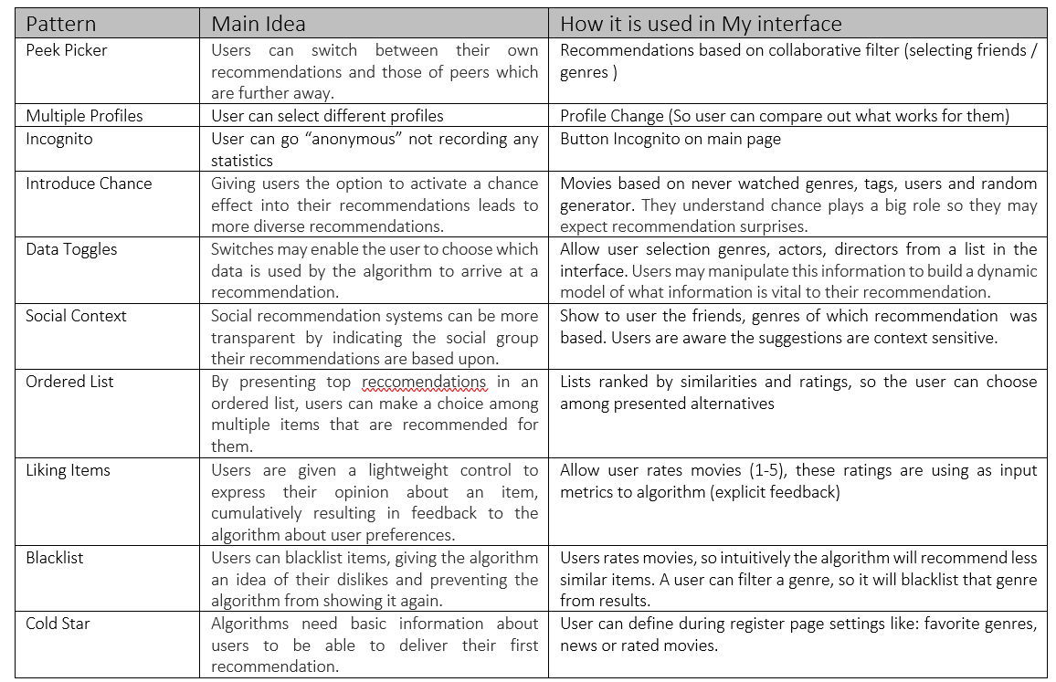
Patterns
List of all patterns used in this work

