Slide 1
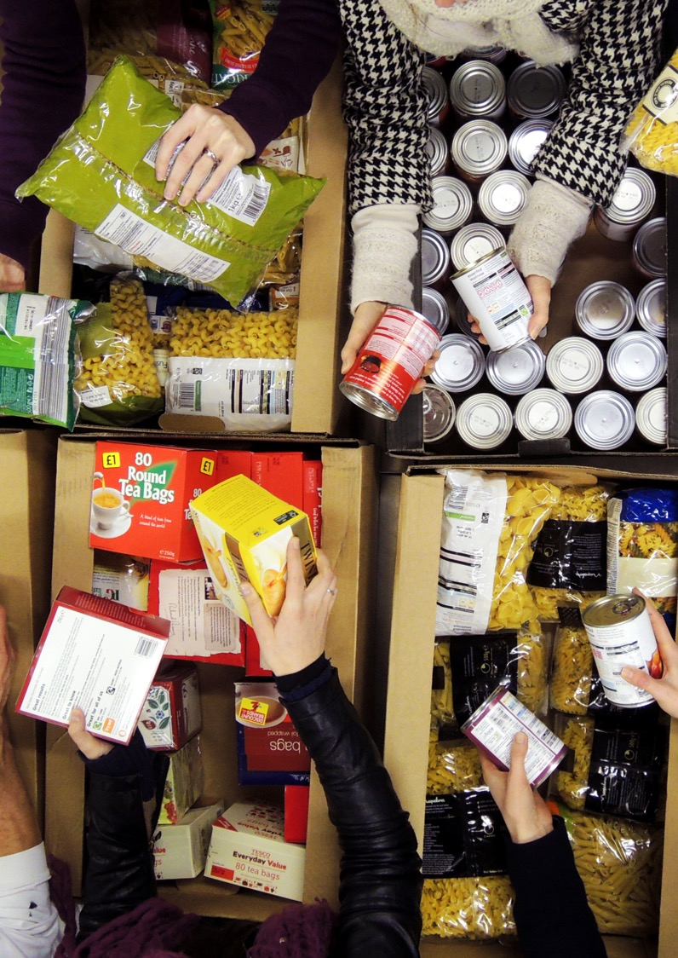
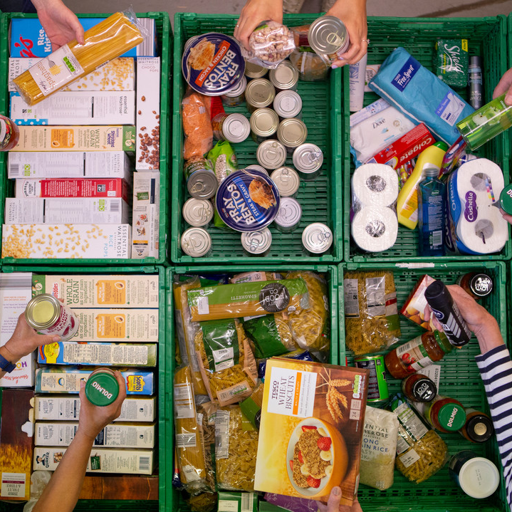
End of year stats 2023/24
Supporting you to share this data with key stakeholders

Slide 2
What’s in this resource
What the figures this year are telling us for the UK
What the figures are telling us for nations and regions
Key policy asks: what we think needs to be done
Template slides to help you communicate the data in your area

Slide 3
What the figures are telling us
Notes:
We will be sharing the End of Year stats with the media on Monday 13 May.
You are very welcome to use the resources and do pre-recorded interviews / interviews for print ahead of this time, but to be clear content can’t be published ahead of the embargo date, which lifts at 00:01am on Wednesday 15 May.
There are lots of training and advice available to please get in touch with your AM or the press team, if you would like more information.
These figures tell a really tough story – a story which all of the food banks in our network are already very familiar with.
They are some of the most powerful tools we have in making our case for change to policy makers and the public. Before we get into the detail of them, I wanted to thank all food banks for how they use the DCS to ensure we can have this information. It such vital data.
Also worth saying that this is amalgamated data for the whole network and shows trends, but can’t tell the story of every individual food bank. Each food bank data looks different, as does each local areas – that’s fine, there’s some advice about how to talk about this.

Slide 4
Busiest ever period
Notes:
Food banks in the Trussell Trust network distributed over 3.1 million food parcels between April 2023 and March 2024.
This is the most parcels that the network has ever distributed at this point in the year and represents a 4% increase from the same period last year (in 2022/23). And is almost double compared to five years ago
Over 1.1 million of these were for children.
This is the first time food banks in the Trussell Trust network have distributed over 3 million parcels in total.
We are highlighting in our messaging about the statistics that the levels of need seen this year are part of a longer-term trend which pre-dates the cost-of-living crisis, and even the COVID-19 pandemic. We are also recognising that with the removal of the cost of living payments people claiming Universal Credit will actually be worse off this year, despite the recent benefit uprating.

Slide 5
Majority of support provided by food banks for families with children
Overall two thirds (65%) of the support provided by food banks in the previous year was for families with children.
Since 2018/19 the number of parcels for families with three or more children has more than doubled (106% increase) compared to an 86% increase for families living without any children.

Slide 6
Worrying emerging trend of pensioners turning to food banks
In the last year just 3% of parcels were provided to people aged 65+ despite them accounting for 19% of the UK population.
However, poverty rates amongst pensioners have started to grow in recent years, and there is a concerning emerging trend of pension age households needing to turn to food banks.
Notes:
Between 2018/19 and 2023/24 food bank support for these households has more than quadrupled – (an increase of 345%), compared to an 81% rise amongst households without someone of pension age.
This mismatched increase in food parcel provision continued from 2022/23 to 2023/24 (27% vs 1%).

Slide 7
Cost of living payments correlate with a reduction in need
Three significant Cost of Living Payments in the last year all had a significant but short term impact of the need for food banks.
Spring payment saw a 16% decrease compared to the previous weeks but in the weeks following distribution parcels distributed increased by 11%.
Autumn payment saw a 14% decrease compared to the previous weeks but in the weeks following distribution parcels distributed increased by 31% as food banks went into winter.
Winter payment saw a 24% decrease compared to the previous weeks but in the weeks following distribution parcels distributed increased by 15%.
Notes:
The fact that these periods of respite from the Cost-of-Living payments were short-lived shows that one-off payments are unable to make a lasting difference when people’s regular income (from social security and from work) is just too low to enable people to afford the essentials.

Slide 8
food banks see increasing need & deepening hardship
“It feels like since COVID we haven't stopped. It’s been like go, go go, go, go, go, go, go, go . And it's been getting busier and busier with the cost of living crisis increasing, increasing people's need.”
Project Manager, Swales Foodbank in the Trussell Trust network
Notes:
We are also highlighting in our research outputs:
that food banks are not just facing a change to operations – such as having to purchase more food and/or find additional warehouse space to store food or other items.
That they are also supporting more people, and that the people they are supporting are facing deepening hardship and distress – with food banks expressing deep concern over the depth of hardship experienced by people they have been supporting, particularly over the winter months.

Slide 9
Our Nations and regions

Slide 10
Change for Nations and regions
Notes:
Looking across Scotland, Wales and Northern Ireland.
Northern Ireland has seen the biggest increase from last year (11%), with Wales seeing a very slight increase (1%). Scotland is relatively the same as the previous year with a very slight decrease.
All are significantly above levels seen in just five years ago in 218/19

Slide 11
Change for English regions
Notes:
London has seen the biggest percentage increase since last year – with a 17% increase in the number of parcels distributed. Yorkshire has also seen a significant increase at 15%.
Some areas such as the East Midlands and the North East have seen decreases since the previous years. But as you can see in the graph all areas remain concerningly higher than just five years ago in 2018/19.

Slide 12
Key policy asks

Slide 13
A future without the need for food banks
Our manifesto for the 2024 general election:
Sets out the actions we urge all political parties to support, and our priorities for the next UK Government
Has been developed using our research, data and insight from food banks and lived experience partners
Will help us raise the profile of food bank need and the changes we want to see during the election campaign
Will help us influence political parties and candidates to make pledges in support of our vision

Slide 14
A future without the need for food banks
As we approach the next UK general election, we urgently need to hear how parties will build a future where no one needs a food bank to survive. Urgent reform of our social security system, which currently isn’t even providing enough support for people to afford the essentials, is critical. Introducing an ‘Essentials Guarantee’ into Universal Credit would ensure that everyone has a protected minimum amount of support to afford the essentials.

Slide 15

What are the building blocks to ending the need for food banks?
A supportive social security system:
Introduce an Essentials Guarantee
Make debt deductions from social security payments more affordable

Slide 16

What are the building blocks to ending the need for food banks?
Everyone can get the right support at the right time, especially when times are tough:
A long-term strategy and funding for local crisis support
Ensure people on low incomes can access the advice they need on money matters

Slide 17

What are the building blocks to ending the need for food banks?
People are supported in a way that reflects the reality of their lives, especially if they’re facing higher costs and barriers as parents, carers or disabled people:
Swift and accurate decisions about disability social security support
An overhauled employment support offer
Scrap the two-child limit

Slide 18

What are the building blocks to ending the need for food banks?
Everyone has the security we all need to access opportunities and have hope for the future:
New workers’ rights legislation
Invest in building 90,000 new social homes every year in England
Empower communities with places, spaces, and public transport services which build connection

Slide 19
Scotland
The election of a new First Minister of Scotland is an important opportunity. Once elected, they should convene the promised summit with the anti-poverty sector and people with lived experience of poverty. The Scottish Government should also:
Increase the level of the Scottish Child Payment from £26.70 to at least £40 a week
Boost investment into the Scottish Welfare Fund
Mitigate the two-child cap to provide vital support to families with three or more children who are much more likely to need to use a food bank
Reverse cuts to the housing budget and build more homes for social rent
Pause recovery of debt to public bodies in Scotland

Slide 20
Northern Ireland
The Northern Ireland Executive must choose to prioritise support for people facing financial hardship. We urgently need the Northern Ireland Executive to:
Deliver a budgeted anti-poverty strategy with clear interventions that will end the rising need for emergency food in Northern Ireland.
Prioritise policies that will protect people from poverty and destitution, including the full implementation of recommendations from the reviews of welfare mitigations and discretionary support.
Ensure that free school meal payments during holiday periods are restored ahead of the summer.
Call on the UK Government to implement an Essentials Guarantee, to protect people in receipt of Universal Credit from going without essentials.

Slide 21
Wales
The new First Minister of Wales has the opportunity to turn the tide of hardship facing communities and work to end the need for food banks in Wales. The Welsh Government should:
Deliver a plan to reduce and prevent the need for food banks in Wales
Implement the Welsh Benefits Charter to streamline and simplify Welsh benefits
Set clear targets and accountability measures to reduce child poverty following the publication of the Child Poverty Strategy for Wales
Ensure crisis support meets individuals’ needs with increased funding for the Discretionary Assistance Fund
Call on the UK Government to introduce an ‘Essentials Guarantee’

Slide 22
TEMPLATE SLIDES TO HELP YOU COMMUNICATE THE DATA IN YOUR AREA

Slide 23
ADD THE NAME OF THE LOCAL AREA YOU SUPPORT HERE
Notes:
There are a few options depending on how you want to present your data please delete the slides that are not relevant to you.

Slide 24
What our data tells us in [insert area]
From April to September 2023 we have given out XXX many emergency parcels to people in [insert area]
XXX of these were provided for children.
This represents a XX% increase from last year and a XX% increase from pre-pandemic levels.
It’s not right that people in our community are needing a charity’s help to put food on the table. Everyone in [insert area] should be able to afford the essentials.​
But the rise in the cost of living is pushing more and more families through the doors of food banks.

Slide 25
what our data tells us in [insert area]
Notes:
You can edit this chart by clicking on it and in the chart design tab clicking on edit data.
From April to September 2023 we have given out XXX many emergency parcels to people in [insert area]
XXX of these were provided for children.
This represents a XX% increase from last year and a XX% increase from pre-pandemic levels.
It’s not right that people in our community are needing a charity’s help to put food on the table. Everyone in [insert area] should be able to afford the essentials.​
But the rise in the cost of living is pushing more and more families through the doors of food banks.

Slide 26
Messaging if you aren’t seeing increases since last year
Any number of parcels distributed is too many
Food banks in the Trussell Trust network represent just part of the picture of emergency food aid in your area
For more advice, see our End of Year Stats FAQs

Slide 27
thank you

