Slide 1
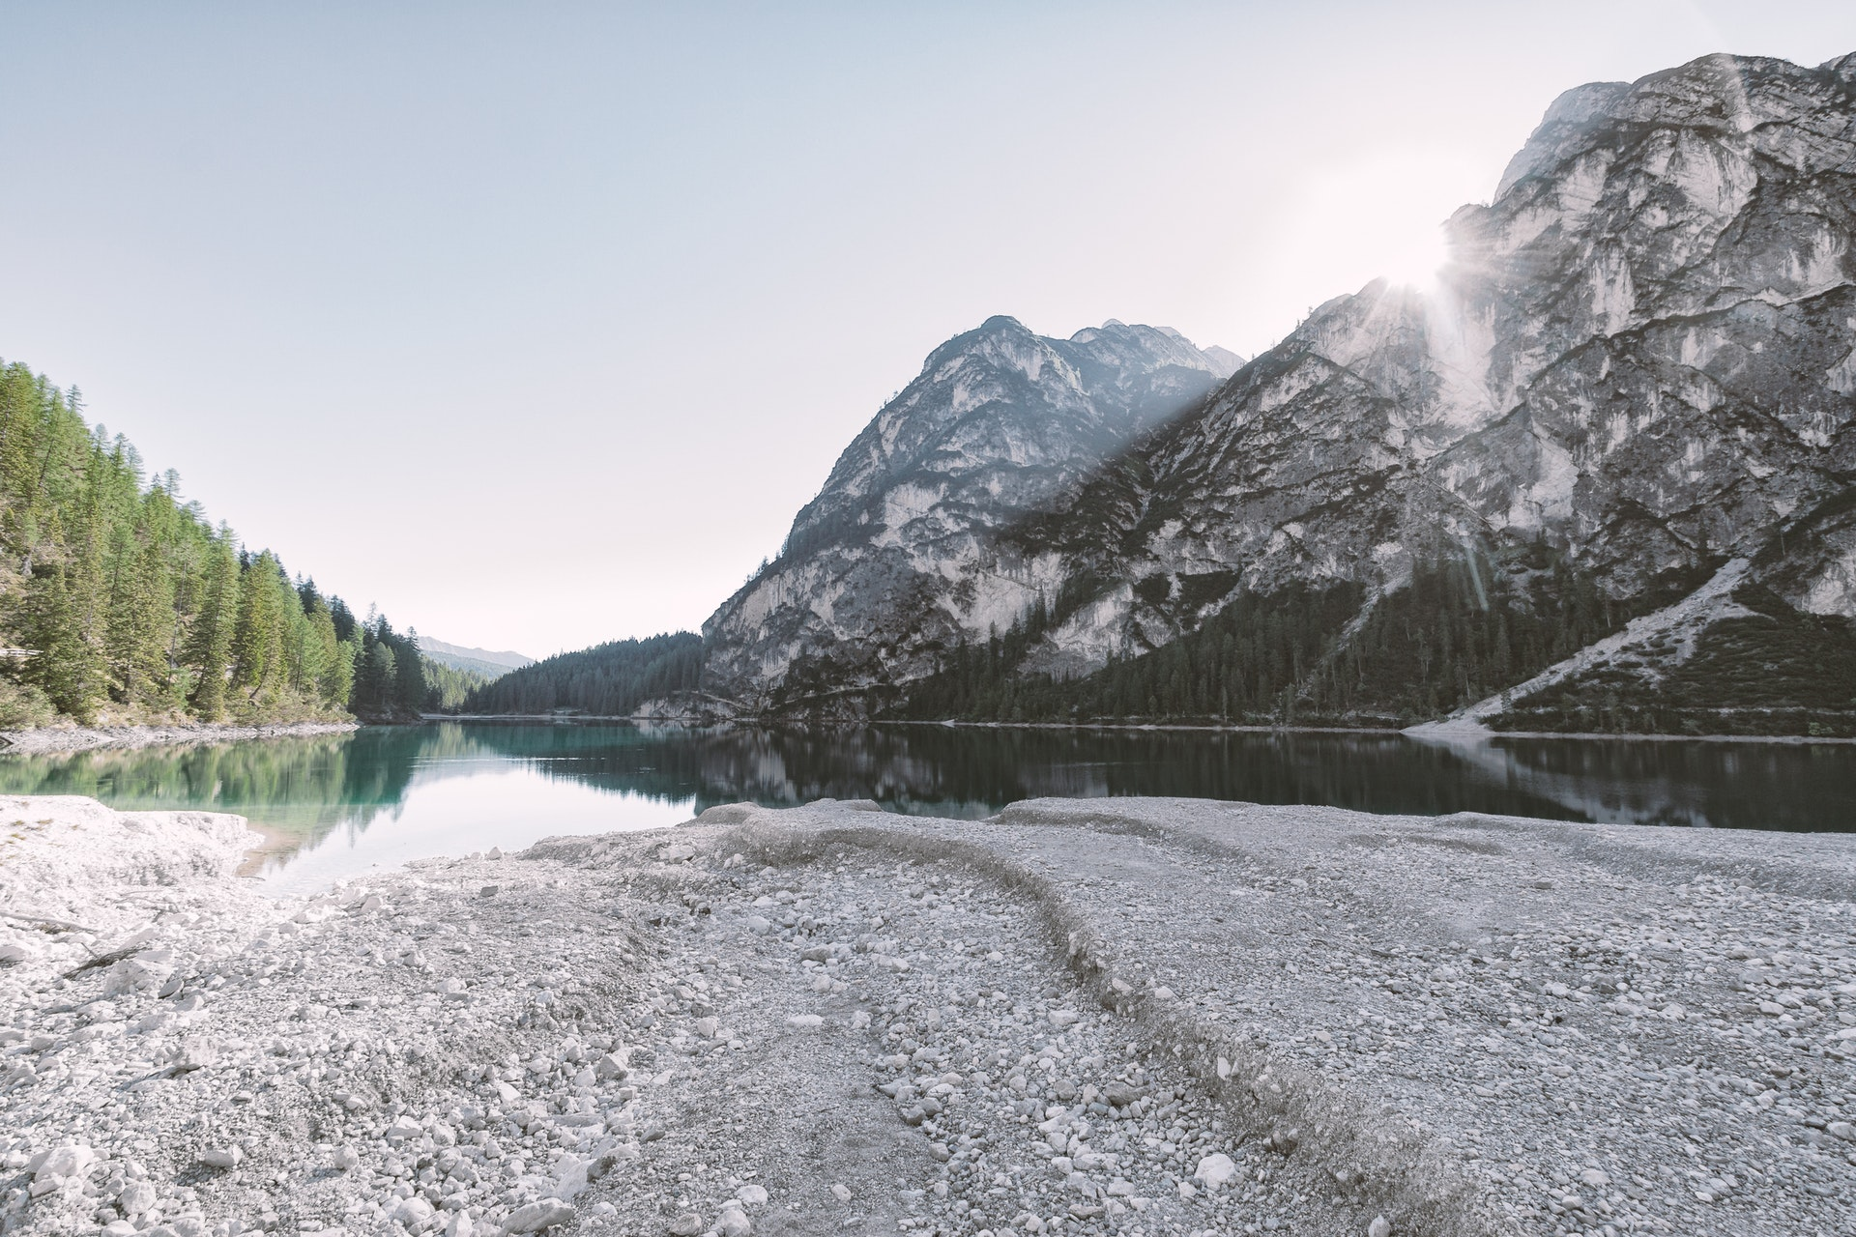
3
Personalized Recommendation

Slide 2
Country/Region Selection
Sample queries to assist country/region selection
Return the number of student with GPA less than 3.3 been accepted to graduate programs in different regions in descent order
……

Slide 3
University Selection
Sample queries to assist university selection
List the average GPA, GRE, TOFEL scores for appliers in CUHKSZ who are accepted by MIT in 2022.
Search for DS programs in United States universities whose tuition fee is less than 50000.
……

Slide 4
Program Selection
Sample queries to assist program selection
List the numbers of students from CUHKSZ been accepted by different programs offered by MIT in descent order
……

Slide 5
General Positioning
Part of a Sample Decision Tree:
GPA>=3.5?
Y
N
GRE>325&TOEFL>105?
GPA>=3.0?
Y
N
Y
N
US TOP 30
Further Classification
US TOP 20
US TOP 50

Slide 6
2
Problem

Slide 7
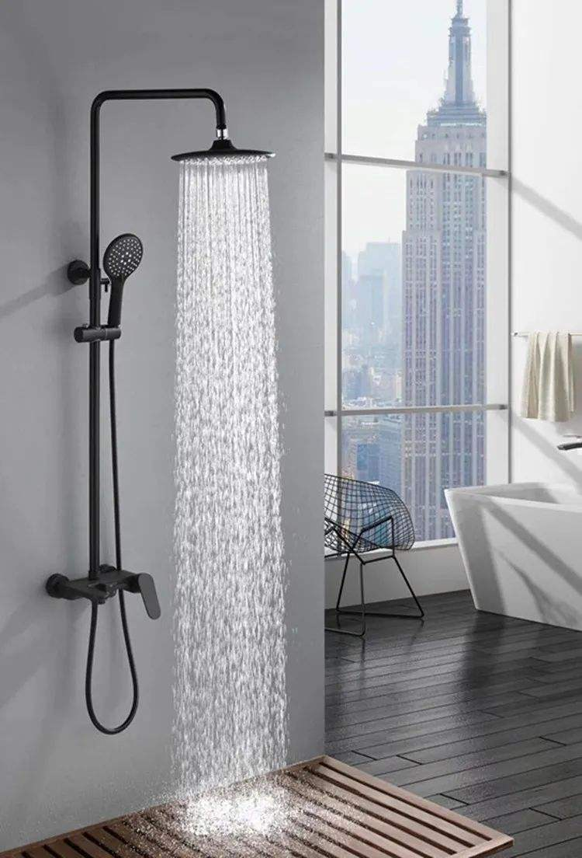
A scene of daily life: taking a shower
Wasting water when waiting for hot water

Slide 8
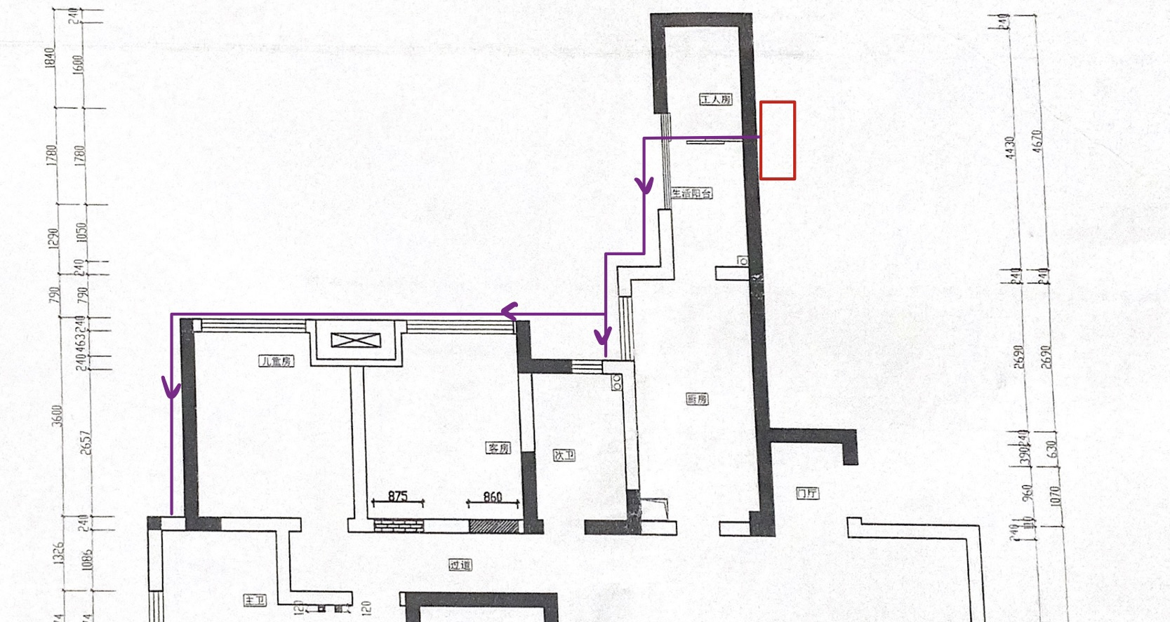
Water heater
Living balcony
Washroom 1
Washroom 2

Slide 9
A scene of daily life: taking a shower
Wasting water when waiting for hot water
Solution:
Use a washbasin to collect?

Slide 10
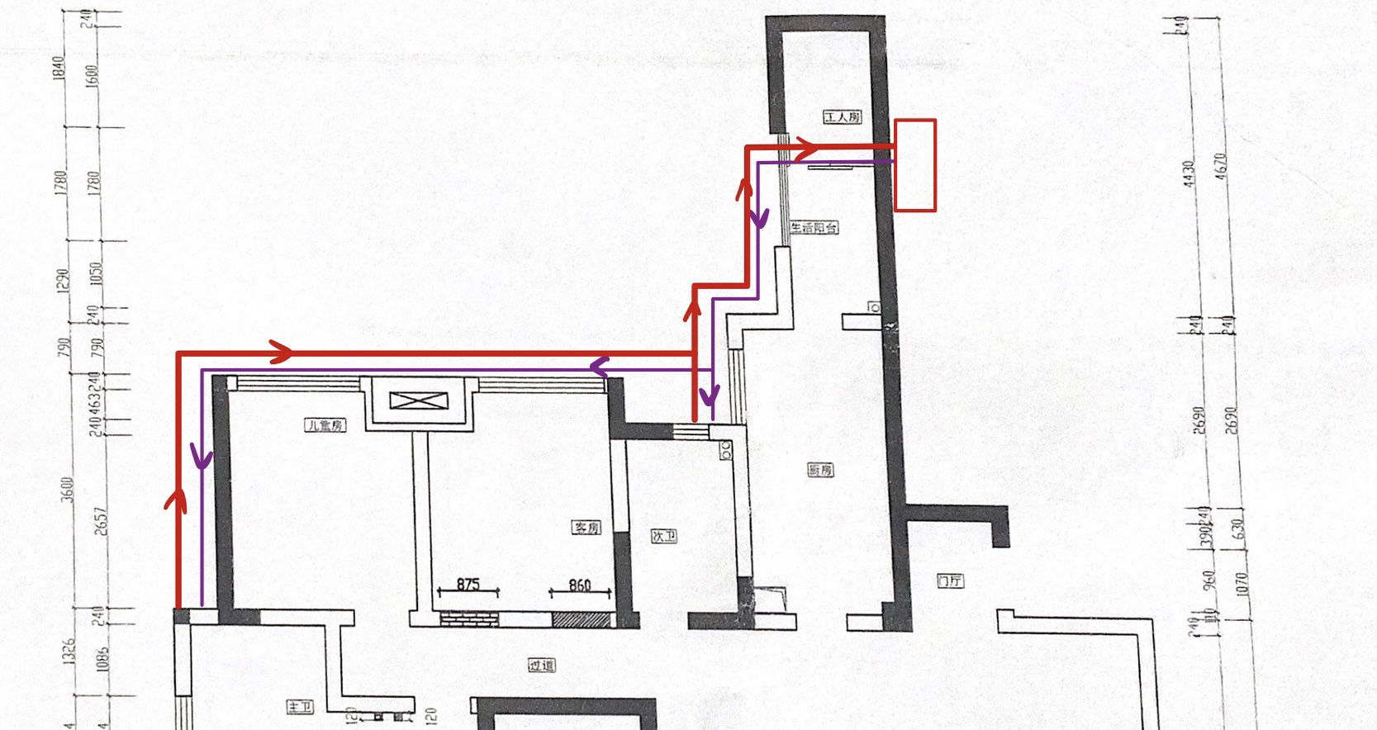
Water heater
Water heater
Living balcony
Living balcony
Washroom 1
Washroom 1
Washroom 2
Washroom 2

Slide 11
Water-recycling tube
1
Recycle the cold water to the water heater
2
Release the water when it is comfortable enough

Slide 12
Implementation
A water recycling tube
A temperature detector and a valve
An intelligent control system
Save water conveniently
Keep away from cold water and get comfortable water immediately
Small cost and a big difference

Slide 13
4
Conclusion

Slide 14
Conclusion
Water-recycling tube
Contribute to the water conservation at a low cost
Save water and improve people’s life

Slide 15
Reference
Chen, X., Li, F., Li, X., Hu, Y., & Hu, P. (2020). Evaluating and mapping water supply and demand for sustainable urban ecosystem management in Shenzhen, China. Journal of Cleaner Production, 251, 119754.

Slide 16
Q & A

Slide 17
Water saving measures in Shenzhen
Water saving in school:

Slide 18
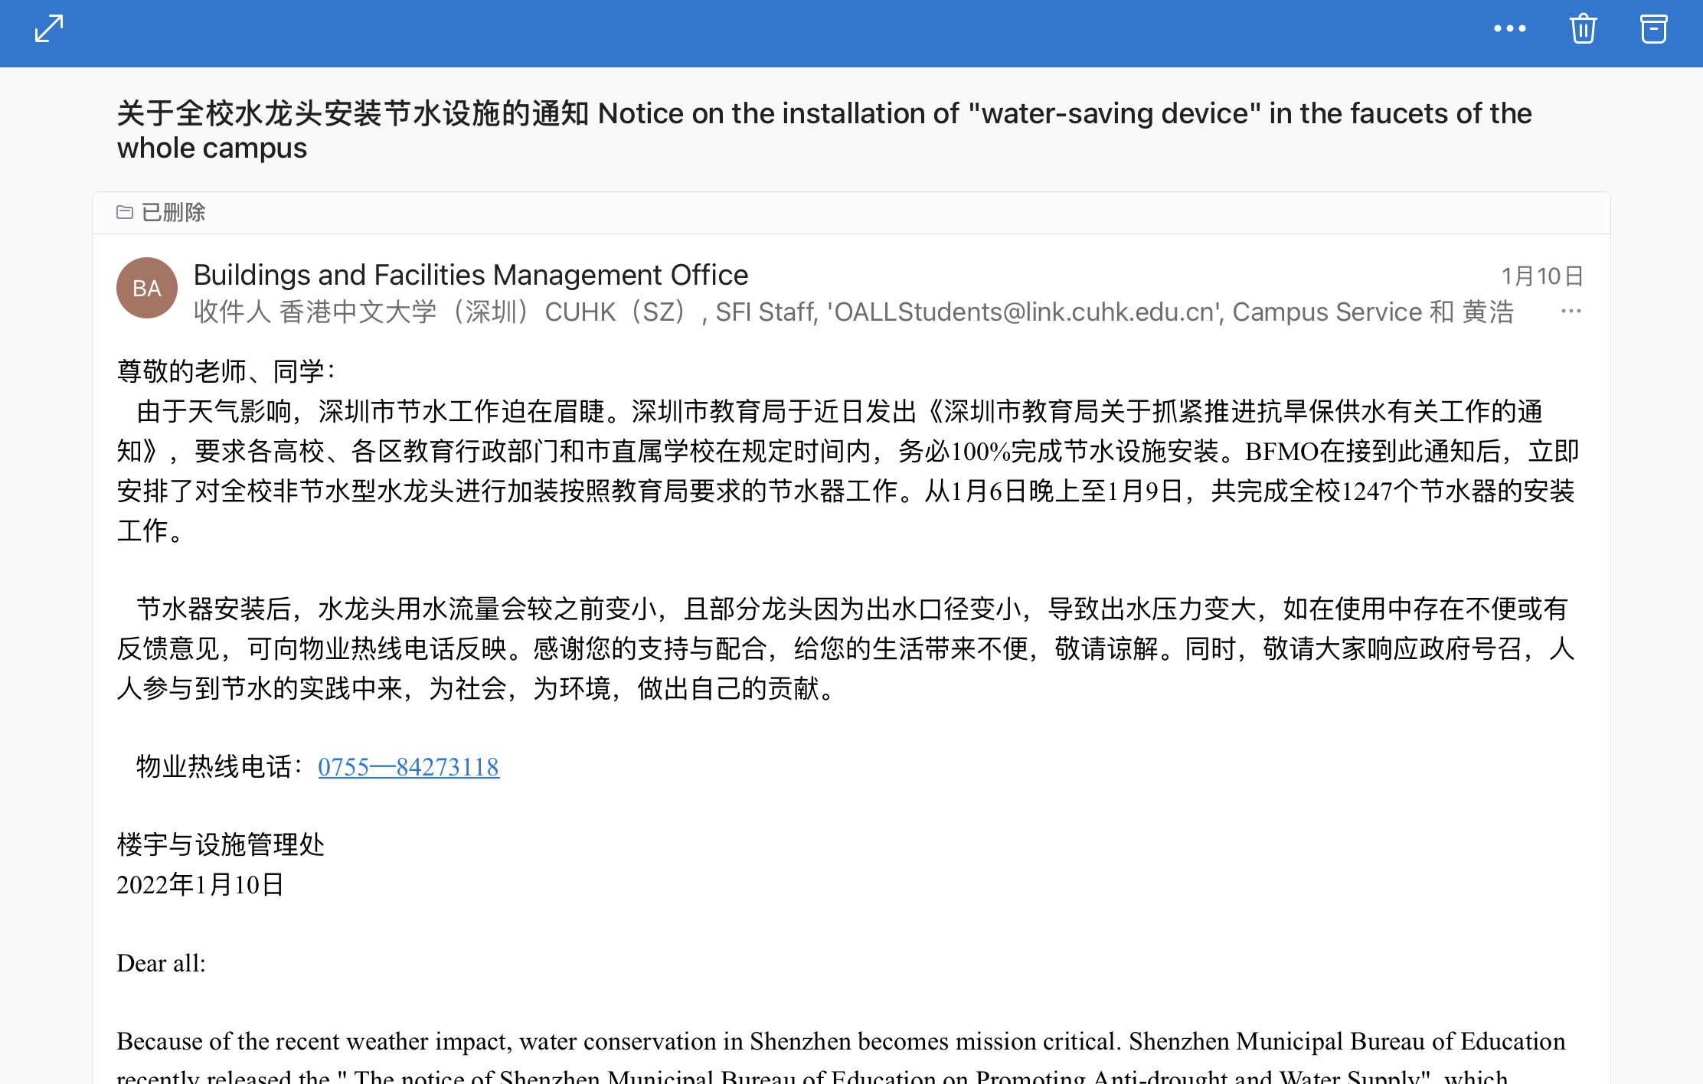

Slide 19
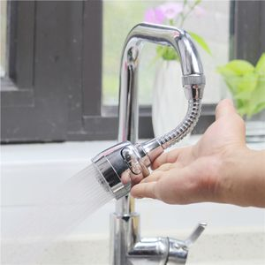
Water saving measures in Shenzhen
Water saving in school:
"water-saving device" in the faucets

