Slide 1

✨
CSC3170 Group 5

Slide 2


Contents
1
2
3
4
Introduction
Database Strengths
Personalized
Recommendation
Successful Cases

Slide 3
1
Introduction

Slide 4

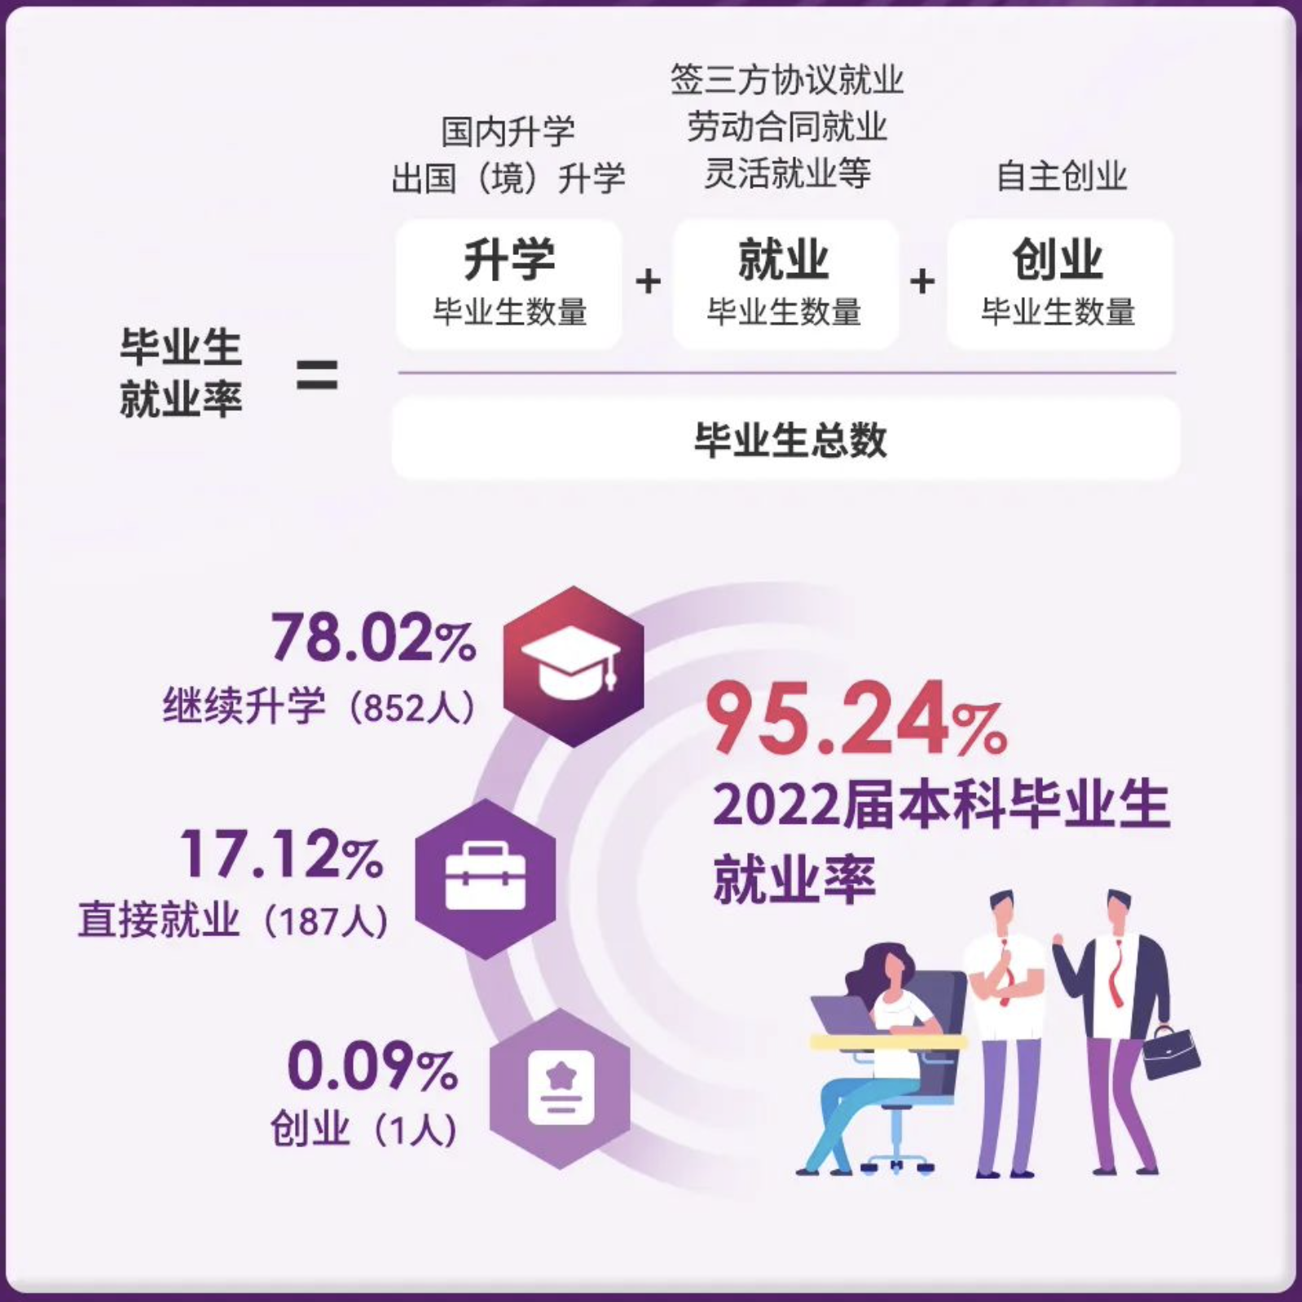
Background
More undergraduate students study abroad
No convenient tool

Slide 5
Mission
Our mission: ensure no obstacles in graduate application!
Our task: information, resources, and support
Your task: pursue graduate study globally

Slide 6
Service scope
Services provided
Application database
Personalized recommendation and support

Slide 7
2
Strengths
Why choose database？

Slide 8

Strengths
1. Store large amounts of information
University
Region, Location, QS……
Major
Rank, scale……
Program
GPA, Recommendation Requirement, Tuition……

Slide 9

Strengths
2. Easy for analysis：
Application Requirement
GPA.
Language standard examination scores.
…….

Slide 10

Strengths
2. Easy for analysis:
Tuition
Possible expenditures.
The scholarships of the programs.
……

Slide 11

Strengths
2. Easy for analysis：
Job prospects
Employment situation of the applied universities, majors, and programs
……

Slide 12
3
Personalized Recommendation

Slide 13
Country/Region Selection
Sample queries to assist country/region selection
Return the number of student with GPA less than 3.3 been accepted to graduate programs in different regions in descent order
……

Slide 14
University Selection
Sample queries to assist university selection
List the average GPA, GRE, TOFEL scores for appliers in CUHKSZ who are accepted by MIT in 2022.
Search for DS programs in United States universities whose tuition fee is less than 50000.
……

Slide 15
Program Selection
Sample queries to assist program selection
List the numbers of students from CUHKSZ been accepted by different programs offered by MIT in descent order
……

Slide 16
University Selection
Sample queries to assist university selection
Integrate and analyze large amount of data stored in our database system
Get graphic recommendation based on decision tree
Providing general positioning of university selection for students

Slide 17
General Positioning
Part of a Sample Decision Tree:
GPA>=3.5?
Y
N
TOEFL>105?
GPA>=3.0?
Y
N
Y
N
US TOP 30
Further Classification
US TOP 20
US TOP 50

Slide 18
4
Successful Cases of
Application

Slide 19

Successful Cases of Application
The case of student who successfully get the offer of MIT

Slide 20

Successful Cases of Application
Querying cases of students who applied for and were accepted into computer science programs

Slide 21
Successful Cases of Application
Querying cases of students with a GPA greater than 3.5 and a GRE score greater than 320

Slide 22
Q & A

