Slide 1
Low-Overhead Memory Leak Detection Using Adaptive Statistical Profiling
ZHANG Hansheng
1 Nov 2013

Slide 2
About the Paper
In Proceedings of the 11th International Conference on Architectural Support for Programming Languages and Operating Systems (ASPLOS 2004)
Trishul M. Chilimbi, Microsoft Research, One Microsoft Way, Redmond, WA
Matthias Hauswirth, University of Colorado at Boulder , Boulder, CO

Slide 3
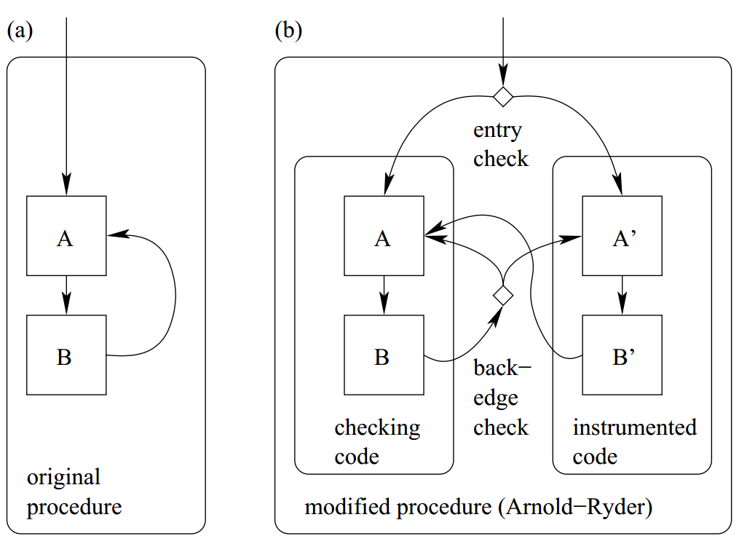

Arnold-Ryder framework
startup:nCheck = nCheck0
If nCheck > 0
run checking code
decrease nCheck
else
run instrumented code
nCheck = nCheck0
$$sampling rate=\frac{1}{nCheck0+1 }$$
Notes:
Instead of full tracing
Run checking code ncheck0 times and instrumented code once

Slide 4
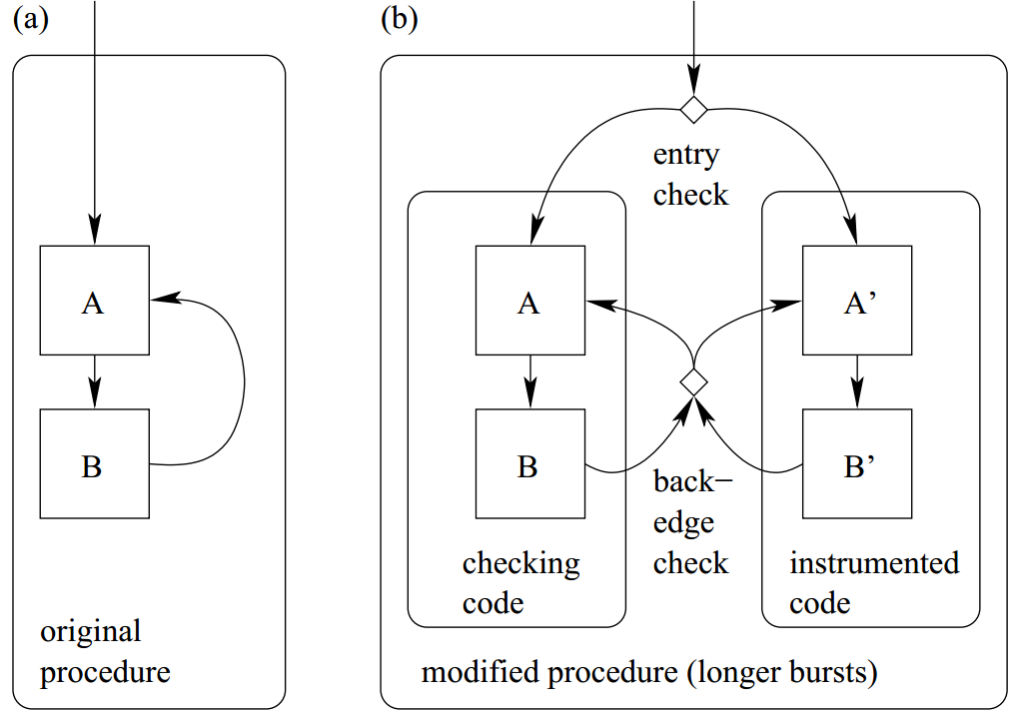
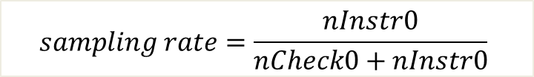
Bursty Tracing
startup:
nCheck = nCheck0
nInstr = 0
If nCheck > 0
run checking code
decrease nCheck
if nCheck=0
nInstr=nInstr0
if nInstr>0
run instrumented code
decreate nInstr
if nInstr=0
nCheck=nCheck0
$$sampling rate=\frac{nInstr0}{nCheck0+nInstr0}$$
Notes:
Run instrumented code nInstr0 times instead of once

Slide 5
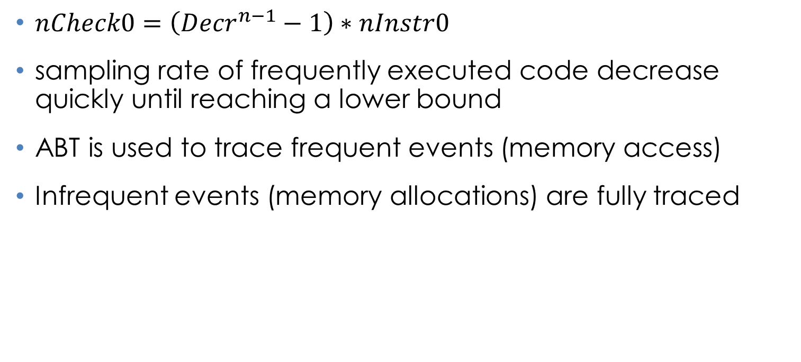
Adaptive Bursty Tracing (ABT)
$nCheck0=\left({Decr}^{n−1}−1\right)∗nInstr0$
sampling rate of frequently executed code decrease quickly until reaching a lower bound
ABT is used to trace frequent events (memory access)
Infrequent events (memory allocations) are fully traced

Slide 6
Heap Model
Requirements
AllocateObject(ip, startAddress, size)
FreeObject(ip, startAddress)
FindObject(ip, addresss)
GetObjectIterator
Implementations
Hash table (address->objectInfo)
Hash table (startAddress->objectInfo)
Hash table (address->offsetToStartAddress)
Address tree
Notes:
Ip, instruction pointer

Slide 7
Heap Model
Address: 0101
0
1
0
1
0
1
0
1
0
1
0
1
0
1
0
1
0
1
0
1
0
1
0
1
0
1
0
1
0
1
0000
0100
0101
1000
1100
Slides showing heap model are copied from: http://research.microsoft.com/en-us/um/people/trishulc/swatpresentation3.ppt

Slide 8
Heap Model
0
1
0
1
0
1
0
1
0
1
0
1
0
1
0
1
0
1
0
1
0
1
0
1
0
1
0
1
0
1
0101
8 byte
0000
0100
1000
1100

Slide 9
Heap Model
0
1
0
1
0
1
0
1
0
1
0
1
0
1
0
1
0
1
0
1
0
1
0
1
0
1
0
1
0
1
0000
0100
1000
1100

Slide 10
Heap Model
0
1
0
1
0
1
0
1
0
1
0
1
0
1
0
1
0
1
0
1
0
1
0000
0100
1000
1100

Slide 11
Heap Model
0
1
0
1
0
1
0
1
0
1
0
1
0
1
0
1
0
1
0
1
0
1
0000
0100
1000
1100

Slide 12
Heap Model
0
1
0
1
0
1
0
1
0
1
0
1
0
1
0000
0100
1000
1100

Slide 13
Heap Model
0
1
0
1
0
1
0
1
0
1
0
1
0
1
Start address: 0101
Size: 8
Access count: 19
Last access time: 19’000’000
Alloc site: EIP 0x400019
Last access site: EIP 0x400190

Slide 14
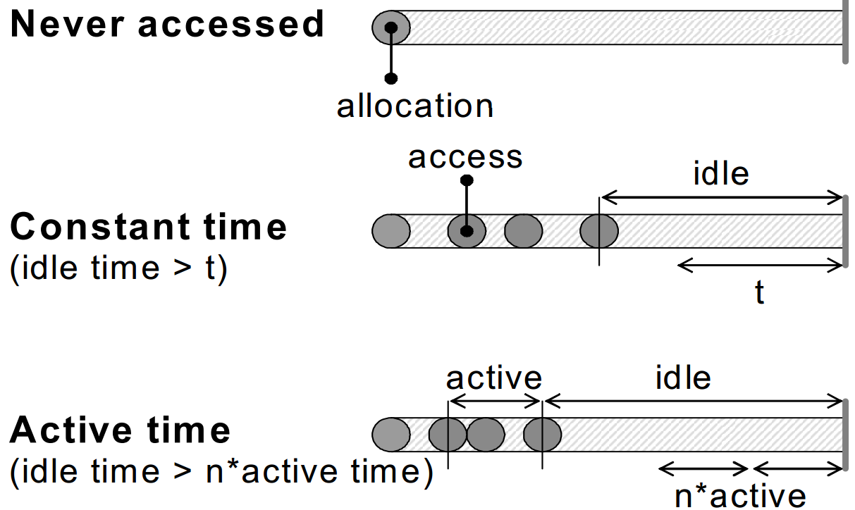
Leak Reporting
Notes:
‘time’ is actually ‘number of accesses’

Slide 15
Experiments
Benchmarks
SPECInt2000
Largest data
Case study
Large Interactive Web Application
3rd Party PC Game (Strategy)
Multimedia Application
First Party PC Game (Simulation)

Slide 16
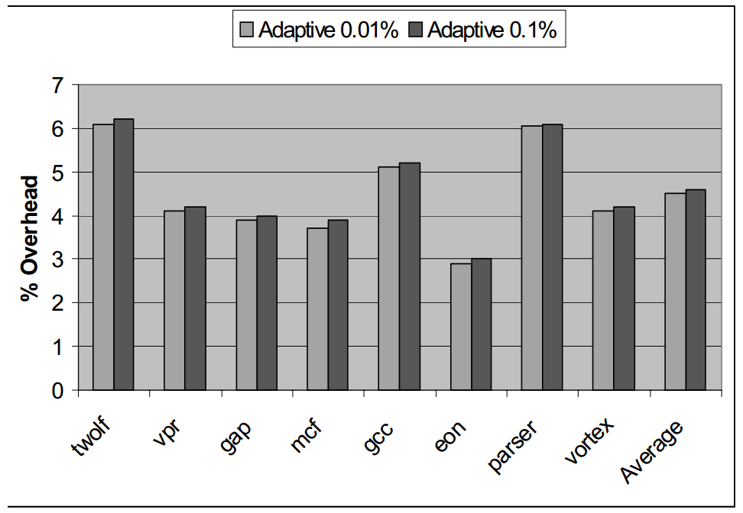
Runtime Overhead
Notes:
Produce one leak report at the end

Slide 17
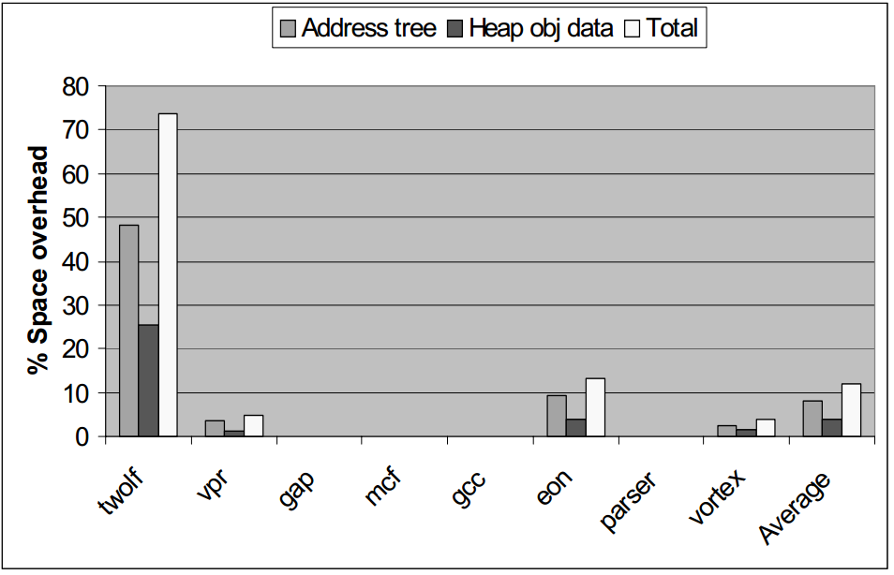
Space Overhead
Notes:
Take heap snapshots, count average [maximum?]

Slide 18
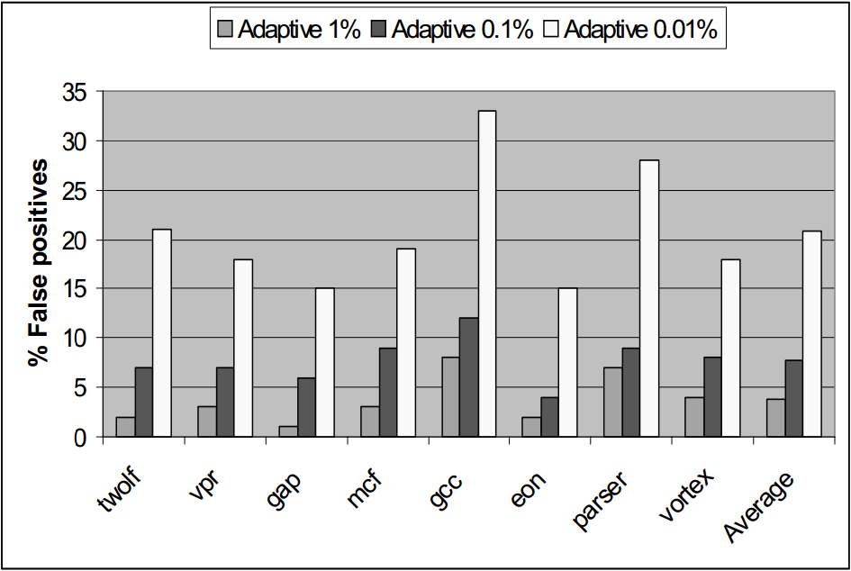
Impact of Adaptive Profiling on Leak Detection

Slide 19
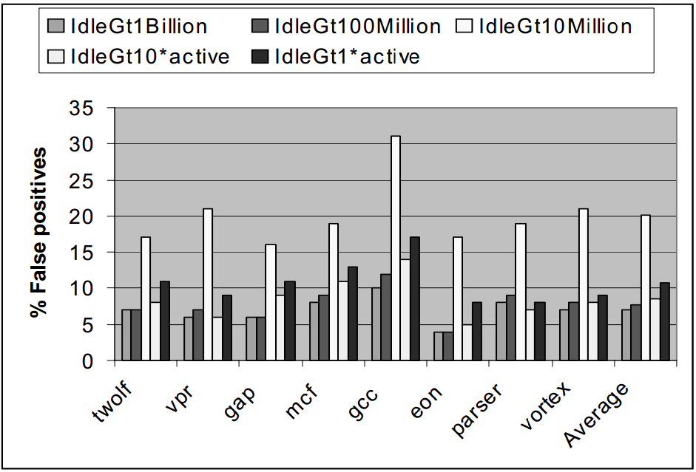
Staleness Prediction Evaluation

Slide 20
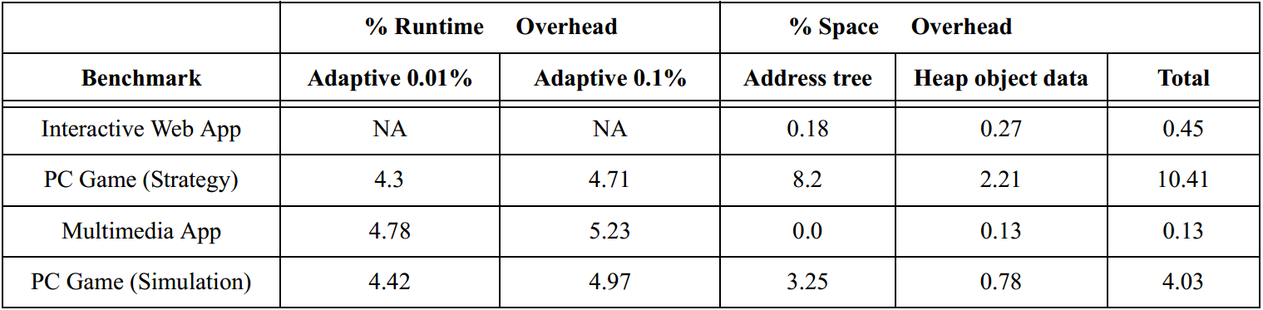
Case Studies

