Slide 1
Automatic Software Repair Using GenProg
张汉生
ZHANG Hansheng
2013/12/3
Notes:
使用GenProg自动修Bug 遗传算法

Slide 2
GenProg: A Generic Method for Automatic Software Repair
Claire Le Goues, ThanhVu Nguyen, Stephanie Forrest and Westley Weimer
IEEE Transactions on Software Engineering , 2012
A Systematic Study of Automated Program Repair: Fixing 55 out of 105 Bugs for $8 Each
Claire Le Goues, Michael Dewey-Vogt, Stephanie Forrest and Westley Weimer
International Conference on Software Engineering, 2012
Notes:
两篇论文，一个团队
第一篇是TSE的，在它之间已经有三四篇，这篇是对GenProg一个总结性的
第二篇是ICSE的，主要是看GenProg对现实中的bug能修多少，以及计算一下自动修复bug一个需要多少钱

Slide 3
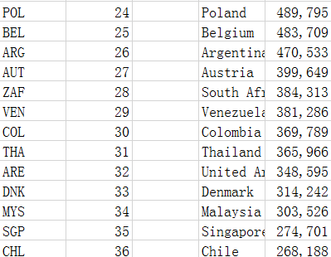
Problem: Buggy Software
Research by University of Cambridge, January 2013
49.9% programming time spent debugging
$312 billion per year
http://www.roguewave.com/DesktopModules/Bring2mind/DMX/Download.aspx?entryid=1606&command=core_download&PortalId=0&TabId=607
Global GDP Ranking 2012 from World Bank
http://data.worldbank.org/data-catalog/GDP-ranking-table
million
Notes:
程序员花很多时间在修bug，大家深有体会
每年花费，312 billion，相当于丹麦2012年的GDP
美国的是15684.800，中国的是八千多

Slide 4
Solution: Pay Strangers
Bug Bounties
Expensive: “The bounty for valid critical client security bugs will be $3000 (US) cash reward and a Mozilla T-shirt”, http://www.mozilla.org/security/bug-bounty.html
May take much time
Could be difficult to validate
Notes:
超级大的系统，代码结构也不是很好
很贵，mozilla security的bug bounty，3000刀
发布很久才能有bug
难以验证

Slide 5
Solution: Automate
GenProg
Input:
buggy program(.c source code)
A test suite contains:
Positive tests descripting required function of the program
One negative test addressing the bug
Output:
A patch passes all tests
Insights: Repaired program is a variant of the buggy one that:
fixing the bug -> pass the negative test
maintaining the functional requirements -> pass all positive test
Use genetic programming to find such a patch
Notes:
C源文件作为输入
多个positive的测试 一个negative的case，跑不过的test
变种
遗传算法

Slide 6
Outline
Motivating Example
Technical Approach
Repair Results
Examples
Monetary Cost of Automated Program Repair

Slide 7
Outline
Motivating Example
Technical Approach
Repair Results
An Example
Monetary Cost of Automated Program Repair

Slide 8
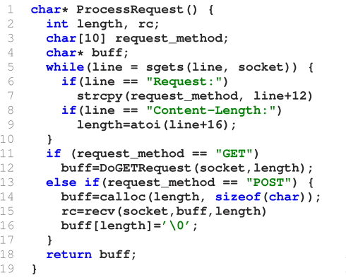
Buggy webserver code
Failed Test:
request_method = “POST”
length < 0
Failed to return expected html
Notes:
Nullhttpd v0.5.0

Slide 9
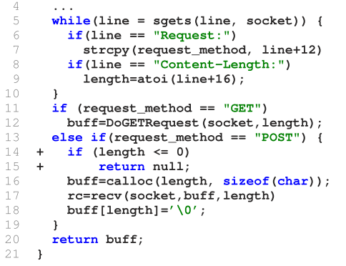
Patched webserver
Another function does the bounds check
Eventually GenProg tries inserting the check from cgi_main into ProcessRequest
A program with this check passes all tests
Notes:
理想中的情况

Slide 10
Outline
Motivating Example
Technical Approach
Repair Results
An Example
Monetary Cost of Automated Program Repair

Slide 11





GenProg: Quick Look
DISCARD
INPUT
ACCEPT
EVALUATE FITNESS
OUTPUT
MUTATE
Notes:
输入：c文件，测试，有一个没有通过
变异（交叉），fitness基于通过测试的个数
直到有一个修复能够通过所有测试

Slide 12
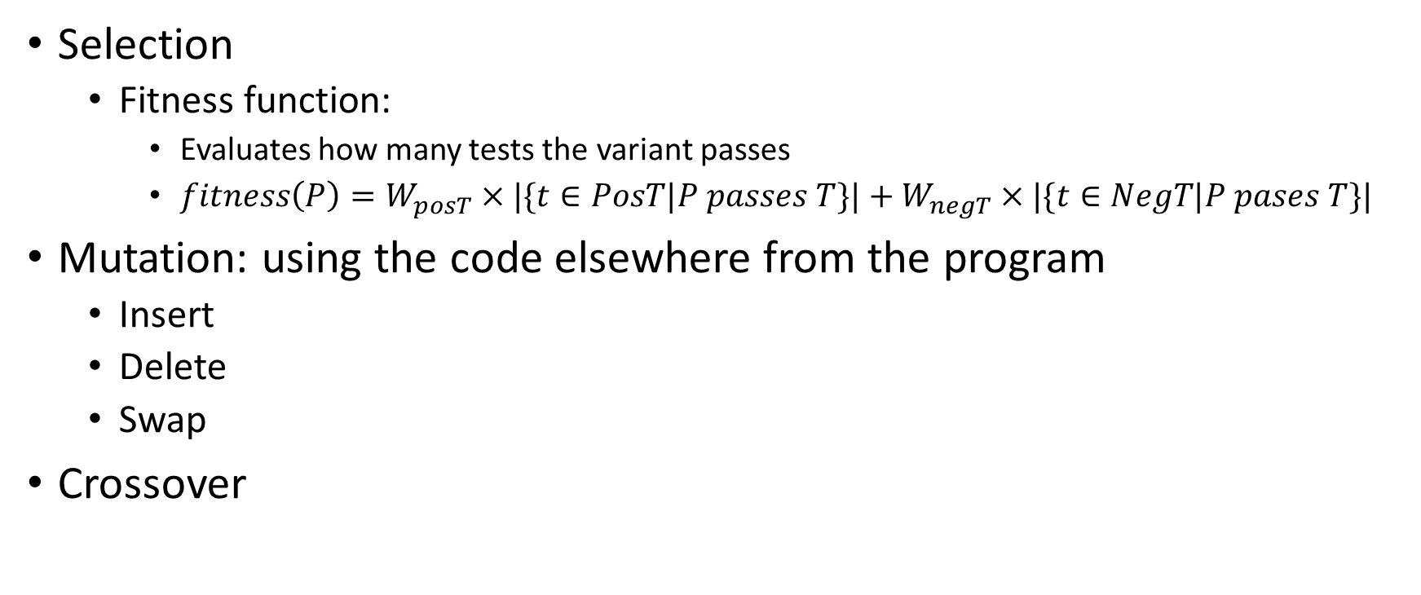
Selection and Genetic Operators
Selection
Fitness function:
Evaluates how many tests the variant passes
$fitness\left(P\right)=W_{posT}×|\{t∈PosT|P passes T\}|+W_{negT}×|\{t∈NegT|P pases T\}|$
Mutation: using the code elsewhere from the program
Insert
Delete
Swap
Crossover

Slide 13
Outline
Motivating Example
Technical Approach
Repair Results
An Example
Monetary Cost of Automated Program Repair

Slide 14
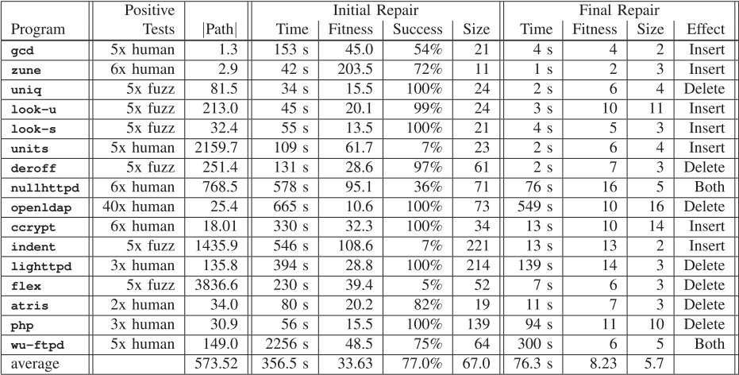
Results
100 trials for each repair
Initial Repair is minimized to final repair

Slide 15
Outline
Motivating Example
Technical Approach
Repair Results
An Example
Monetary Cost of Automated Program Repair

Slide 16
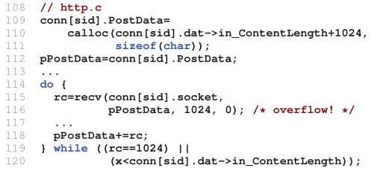

Nullhttpd: Remote Heap Buffer Overflow
Expected Repaired (in the next release by human developers): inserts local bounds check in the left function
GenProg: use right function to process post-data in high-level function
Notes:
上面的哪行，如果contentlength为负数，有可能往任意缓冲区里面写东西

Slide 17
Outline
Motivating Example
Technical Approach
Repair Results
An Example
Monetary Cost of Automated Program Repair

Slide 18

Bug Bounties: Tarsnap.com
200 candidate patches
Harmless or minor: 125
True positive: 75
Total cost: $1,265
$\frac{\$1265}{75} ≈\$17$
Notes:
125个无关紧要
真正的重要的bug有75个

Slide 19
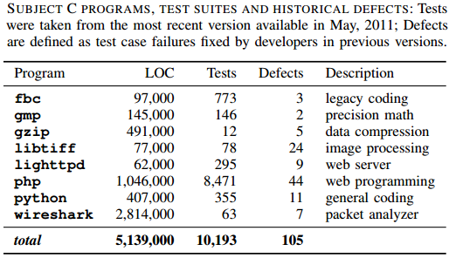
Experiment Setup
Amazon’s EC2 cloud computing infrastructure
10 trials for each repair
32-bit Fedora 13 Linux

Slide 20
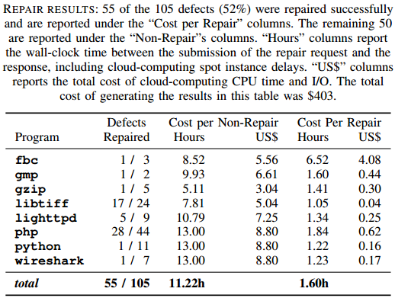
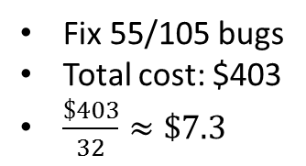
Results
Fix 55/105 bugs
Total cost: $403
$\frac{\$403}{32}≈\$7.3$

Slide 21
_{Thank You}

