Slide 1
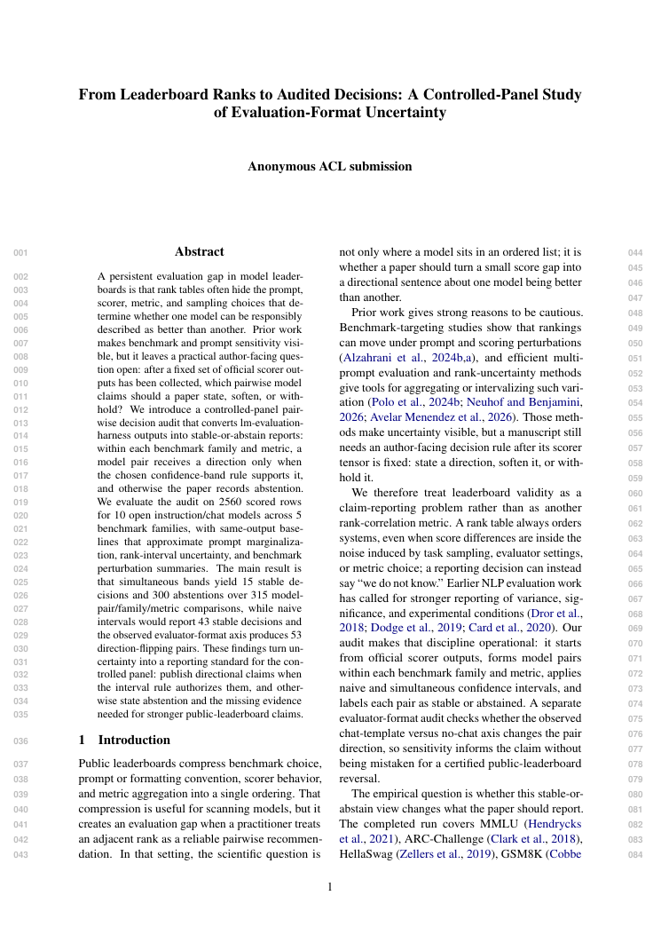
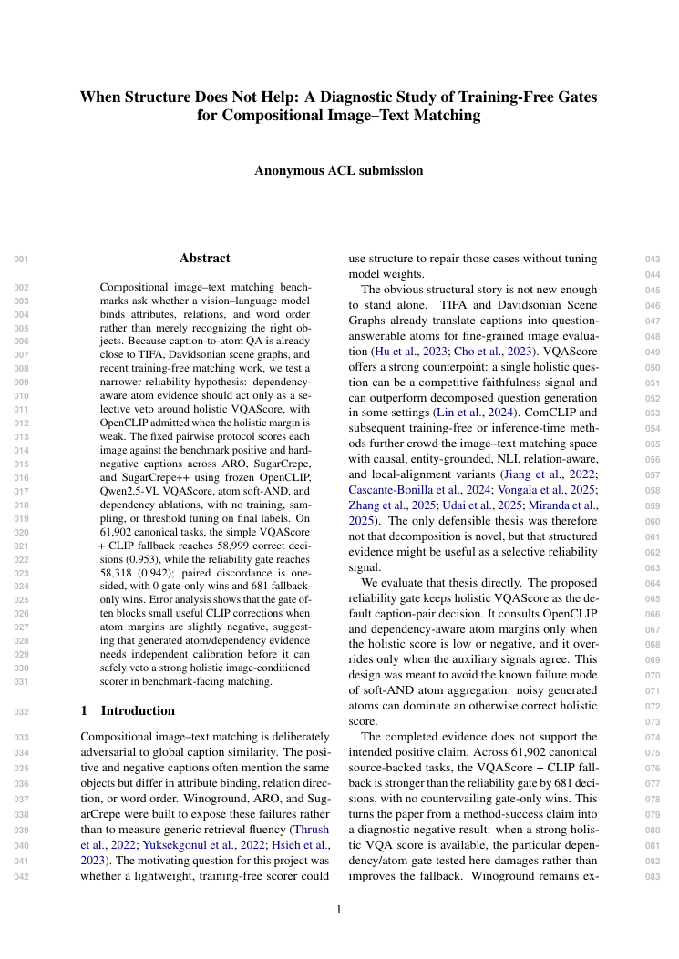
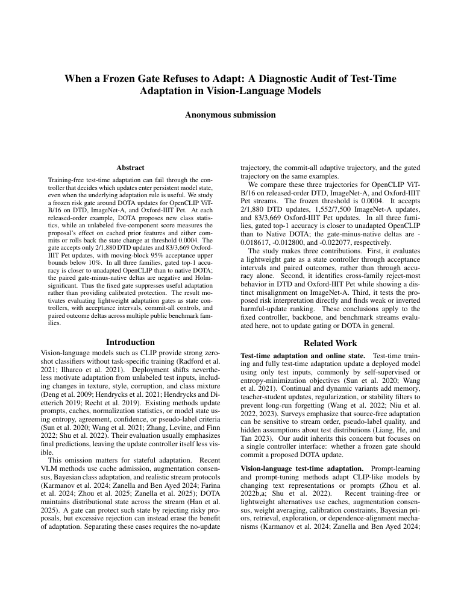
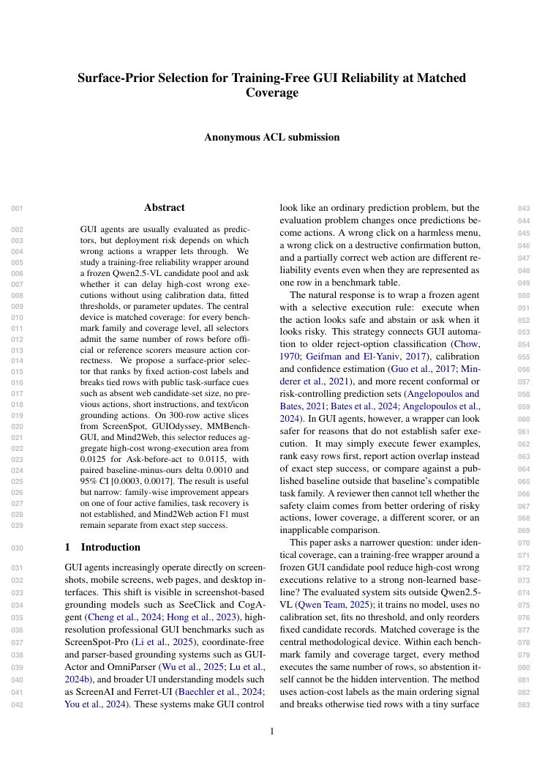
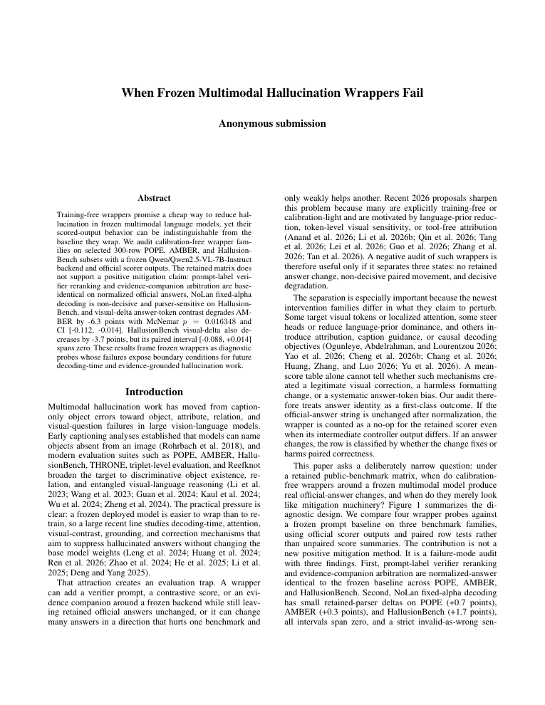
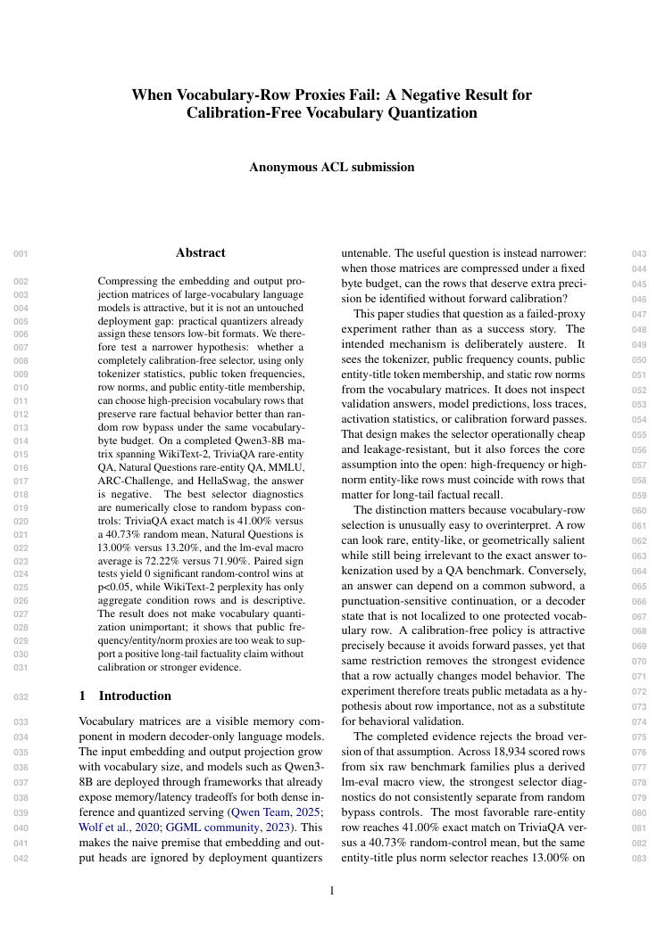
Six completed manuscripts - real PDF first pages
Scientific result on each card - Argus production process below
Evaluation reliability
Vision-language matching
Test-time adaptation
Multimodal agents
Multimodal hallucination
Model quantization
Audited leaderboard decisions
Compositional matching gate
Frozen adaptation gate
GUI reliability at matched coverage
Frozen hallucination wrappers
Vocabulary-row quantization proxies
15 stable - 300 abstained
0.953 fallback > 0.942 gate
2 / 1,880 DTD updates
0.0125 -> 0.0115 risk area
15 cells - 4,500 rows
0 significant wins vs random
ARGUS
6/6
640
576
286
89
16
production process
papers completed
campaign-hours
Engineer rounds
Reviewer revisions
session rolls
Stage rollbacks

