Slide 1



America’s next power cycle
COAL VS. CLEAN ENERGY • 3–5-YEAR INVESTMENT OUTLOOK
The Future of U.S. Energy Investing captures growth.
OUR POSITIONING
OVERWEIGHT
NEUTRAL
UNDERWEIGHT
Renewable developers
Natural gas
U.S. thermal coal
Notes:
Team thesis. Industry recommendations remain conditional on execution, valuation and financing.

Slide 2
The U.S. transition remains incomplete
Clean-generation growth covered 80% of U.S. demand growth in 2025
Clean-generation growth as % of demand growth
Clean Power Covered More Demand Growth ---- but the U.S. Fell Behind in 2025
80%
U.S. clean-growth coverage
Clean and fossil generation both grew in 2025.
110%
91-country sample
2025 clean-growth coverage
30 pp
2025 coverage gap
Clean growth lagged the sample, leaving room for more U.S. deployment.
INVESTMENT IMPLICATION
Separate the opportunity in new clean supply from the continuing role of existing generation.
Source: SIG × BDAA Ember electricity dataset, 2020–2025; 2025 coverage is 91 countries.
Notes:
Team figure rebuilt as a native chart from the original labels. The 2023 U.S. ratio and the axis wording still require reconciliation with the source calculation.

Slide 3
Solar and wind drove global electricity growth
2025 generation changes show where incremental supply came from
Change in global electricity generation, 2025 vs. 2024 (TWh) • 2024 baseline: 30,930 TWh
841
TWh solar + wind growth
Solar and wind added 841 TWh.
Global demand increase: 849 TWh
+35
+11
−38
+205
849
TWh demand growth
Against 849 TWh of demand growth.
849
+636
99%
Ratio of the two increases
Solar and wind nearly matched demand growth.
Solar
Wind
Nuclear
Other low-carbon
Fossil
Demand growth
INVESTMENT IMPLICATION
Clean supply growth creates an opportunity to investigate developer economics.
Source: Ember Global Electricity by Country, 2025; global comparison as presented in team analysis. Global figure, not U.S. data.
Notes:
SIGxBDAA.pdf p. 2. Global figure, not U.S. data. Waterfall rebuilt from the original labels (636 + 205 + 35 + 11 − 38 = 849).

Slide 4
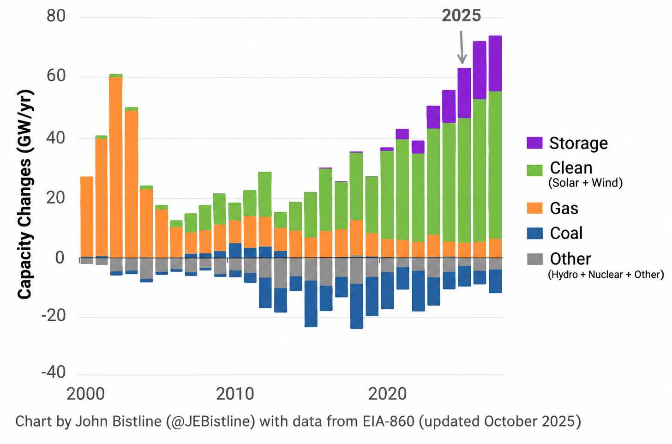



Renewables and storage lead new U.S. capacity
Annual additions and retirements show a changing construction mix
U.S. installed power capacity: annual additions and retirements (GW/yr)
Solar + wind
New capacity leaders 43.4GW + 11.8GW
Storage
Fast-growing additions 24.3 GW
Coal
Net retirements -6.4GW
Capacity is not the same as generation.
New construction favors clean power and storage.
INVESTMENT IMPLICATION
New construction and the existing generation fleet create different investment exposures.
Source: EIA Form 860; chart credited to John Bistline (@JEBistline), updated Oct 2025.
Notes:
Original team figure, EIA-860 (credited to John Bistline). The mis-titled embedded headline ('demand growth') was cropped; the capacity data and credit line are unchanged. New construction favors clean power and storage, but capacity is not the same as generation.

Slide 5
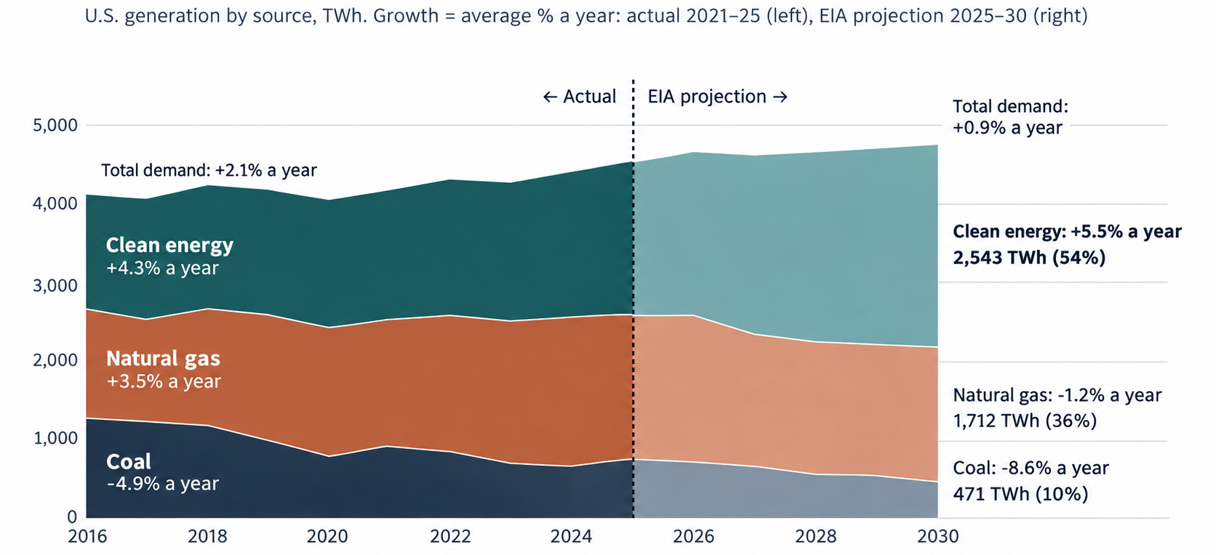
Clean power expands while gas retains a major role
The cited EIA scenario changes the mix without eliminating natural gas
Through 2030, EIA projects clean energy, +600 TWh, gas -99, coal -264
+600
TWh clean generation
by 2030
−264
TWh coal generation
by 2030
36%
Natural gas share
in 2030
2030 generation mix
Clean power grows in the EIA scenario while gas remains a major electricity source.
INVESTMENT IMPLICATION
The scenario supports clean growth alongside continued natural-gas generation.
Source: EIA Electric Power Monthly Table 1.1 and Annual Energy Outlook 2026 Table 8 (Counterfactual Baseline); team chart.
Notes:
EIA AEO 2026 Counterfactual Baseline scenario. Policy assumptions materially affect the result. 2030 mix: clean 2,543 TWh (54%), gas 1,712 TWh (36%), coal 471 TWh (10%). Original team figure retained; embedded title and source footer cropped because they are restated on the slide.

Slide 6
Coal’s rebounds interrupt a long-term decline
U.S. coal generation remains below earlier levels despite periodic recoveries
Coal’s generation rebound interrupts a long-term decline
U.S. coal generation, TWh per year
−41%
2016 to 2025
1,239 → 735 TWh
+16%
2021 rebound
+125 TWh vs. 2020
+13%
2025 rebound
+83 TWh vs. 2024
−8.7%
2026 Jan–Aug YoY
Preliminary
INVESTMENT IMPLICATION
A rebound alone does not establish a reversal of coal’s longer-term outlook.
Source: Actual: EIA Electric Power Monthly, Table 1.1. Projection: EIA AEO 2026, Table 8, Counterfactual Baseline. 2026 Jan–Aug from Table 1.1 (preliminary).
Notes:
Team figure rebuilt as a native chart from the original labels. Grey bars are the cited EIA Counterfactual Baseline projection. 2021: 773 + 125 = 898 TWh. 2025: 652 + 83 = 735 TWh.

Slide 7
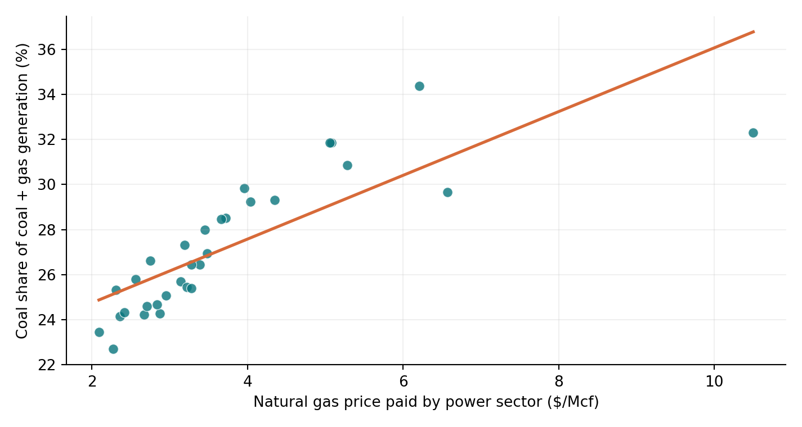
Natural gas prices help explain coal’s temporary rebounds
Historical fuel-switching signal + forward-looking EIA outlook
Coal share of coal + gas generation vs. power-sector gas price, monthly
+3.5%
2027 U.S. gas production
EIA forecast
−9.2%
2027 Henry Hub gas price
EIA forecast
r = +0.81
Gas–coal link
31 months, Jan 2024–Jul 2026
Cheaper gas may reduce coal’s dispatch advantage—but renewable growth, demand and retirements also matter.
INVESTMENT IMPLICATION
Lower gas prices could pressure coal utilization → UNDERWEIGHT U.S. THERMAL COAL
Sources: EIA Electric Power Monthly Table 1.1; EIA Natural Gas Electric Power Price; team Pearson calculation. 2027 outlook: EIA Oct. 2026 STEO. Correlation ≠ causation.
Notes:
Team Pearson calculation on 31 monthly observations. Correlation does not establish causation; renewable growth, demand and retirements also affect coal dispatch.

Slide 8


Three ways to invest in the power transition
Company comparison | Illustrative 2030 financial outlook based on 2023–2025 historical trends
INDUSTRY CONTEXT
Demand +2.5–4%/yr
Coal utilization toward 30%
Tax credits for eligible projects
Revenue: 2025 reported vs. 2030 projected ($B)
NEE
NextEra Energy
−1.26% CAGR
Renewable development + utility
2025 REVENUE
$27.41B
FORWARD P/E RATIO
~18.9x
2030E EBITDA
$13.95B
GEV
GE Vernova
+7.02% CAGR
Grid, power equipment + services
2025 REVENUE
$38.07B
FORWARD P/E RATIO
~37x
2030E EBITDA
$4.49B
VST
Vistra
+9.55% CAGR
Power generation + retail
2025 REVENUE
$17.74B
FORWARD P/E RATIO
~13-16x
2030E EBITDA
$8.25B
INVESTMENT TAKEAWAY
GEV and VST show stronger revenue momentum; NEE has the highest modeled EBITDA. Earnings growth is not stock valuation.
Method: Revenue2030 = Revenue2025 × (Revenue2025 / Revenue2023)^(5/2); EBITDA2030 = Revenue2030 × 2025 EBITDA margin.
Sources: NEE, GEV and VST 2025 Form 10-K filings; team calculations. Industry scenarios are context, not projection inputs.
Notes:
Team valuation table. Confirm estimate source and as-of date before submission. Revenue growth is not the same as stock valuation.

Slide 9
Execution and policy could weaken our positioning
Each risk should have an observable condition that changes our view
# | Risk | Evidence | Investment call | What would change our mind?
1 | Clean growth stalls | Clean added only +10 TWh in 2023 | Overweight Clean | Another 2023-type year
2 | Tax credits phase out after 2027 | OBBBA curtails many credits post-2027 | Overweight Clean | Solar plans drop in 2028
3 | Gas stays expensive | Coal rose +16% (2021), +13% (2025) | Underweight Coal | Gas > $3.60, coal rises
4 | Data centers favor gas | Demand growth +0.9% to 2030 | Neutral Gas | Gas share climbs
5 | Policy keeps coal plants open | Retirements < 2.5 GW in 2025 | Underweight Coal | Coal retirements stall
6 | Grid delays slow projects | U.S. clean covers 80% vs 110% global | Overweight Clean | U.S. coverage < 80%
7 | EIA’s projection too optimistic | EPA rules may be repealed | Underweight Coal | Coal declines slower
8 | Already priced in | Clean stocks may reflect growth | Overweight Clean | Valuations remain high
PORTFOLIO RESPONSE
Reassess if projects slip, developer economics weaken or coal demand remains resilient.
Notes:
Original risk table rebuilt as a native table. The tax-credit row is worded as a phase-out because the blanket claim that all clean-energy credits end after 2027 is too broad.

Slide 10



Our allocation favors renewable developers
A 3–5-year view with explicit conditions for maintaining conviction
OVERWEIGHT
NEUTRAL
UNDERWEIGHT
Renewable developers
Natural gas
U.S. thermal coal
Prefer viable project returns, contracted revenues and manageable financing
Retains a major supply role while clean generation expands
Periodic rebounds coexist with longer-term decline and retirement exposure
Project delivery
Returns on new investment
Coal utilization
Valuation
REVIEW TRIGGERS
Notes:
Team investment recommendation. Electricity-generation trends alone do not establish excess stock returns.

Slide 11



Sources & methodology: competition datasets
Primary data provided by SIG × BDAA
Ember: Global Electricity by Country (2020–2025)
EIA: U.S. Coal Consumption and Quality (2020–2025)
country_year_electricity_2020_2025.csv
eia_coal_consumption_quality_2020_2025.csv
Generation, demand, clean/fossil mix and country-level comparisons. 2025 coverage: 91 countries, not the full world.
Coal consumption, receipts, stockpiles, delivered prices and coal quality by state/sector.
Team-derived calculations
Data-quality notes
U.S. clean-generation growth ÷ U.S. demand growth; 91-country sample comparison; coal trends and fuel-switching analyses.
93.5%
The 91 countries with 2025 data represented 93.5% of 2024 world demand. Show sample coverage when interpreting global comparisons.

Slide 12
Sources & methodology: external evidence
Independent sources used for charts, forecasts and financial projections
EIA: Electric Power Monthly, Table 1.1
U.S. annual generation, coal rebound/decline and monthly coal-versus-gas electricity generation.
eia.gov/electricity/monthly
1
EIA: Natural Gas & Annual Energy Outlook
Natural gas prices, production and Henry Hub outlook; 2030 power generation scenario.
eia.gov/outlooks/aeo
2
EIA-860 / U.S. capacity additions chart
U.S. capacity additions and retirements; chart credited to John Bistline (@JEBistline), based on EIA-860.
eia.gov/electricity/data/eia860
3
Ember & external commentary
Ember electricity data and commentary; capacity commentary.
x.com/ember_energy/status/2059560268313579840
linkedin.com/posts/rameznaam_almost-all-the-power-being-added-to-the-us…
4
Company financials & team model
NextEra Energy, GE Vernova, Vistra: 2025 Form 10-K filings. Pearson r = +0.81: Jan 2024–Jul 2026, n = 31, team calculation.
sec.gov/edgar/search
5

