Slide 1
America’s next power cycle
Coal vs. clean energy • 3–5-year investment outlook
The Future of U.S. Energy Investing
captures growth.
POSITIONING | Overweight renewable developers. Neutral natural gas. Underweight U.S. thermal coal.
1
U.S. ENERGY INVESTMENT OUTLOOK
Notes:
Team thesis. Industry recommendations remain conditional on execution, valuation and financing.

Slide 2
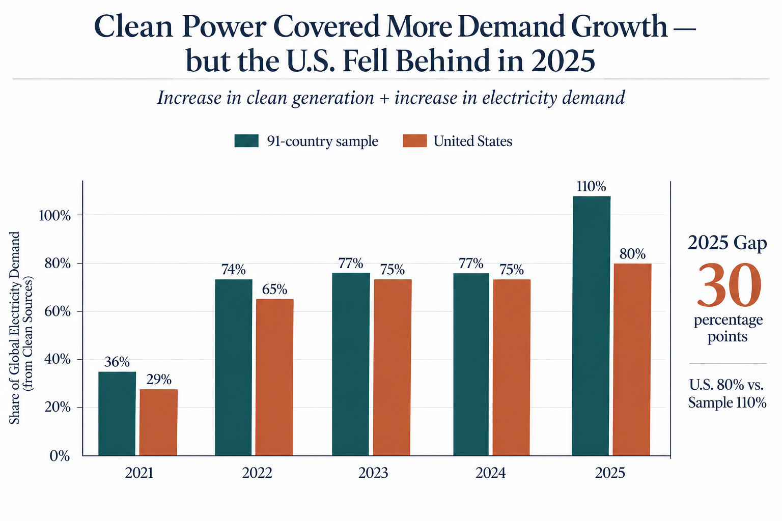
The U.S. transition remains incomplete
Clean-generation growth covered 80% of U.S. demand growth in 2025
U.S. OPPORTUNITY
KEY SIGNALS
80%
Clean and fossil generation both grew in 2025.
U.S. clean-growth coverage
110%
91-country sample
30 pp
2025 coverage gap
Clean growth lagged the sample, leaving room for more U.S. deployment.
Investment implication | Separate the opportunity in new clean supply from the continuing role of existing generation.
Source: SIG × BDAA Ember electricity dataset, 2020–2025; 2025 coverage is 91 countries.
3
U.S. ENERGY INVESTMENT OUTLOOK
Notes:
Original team figure. 2023 U.S. ratio and axis wording require reconciliation with the source calculation. Original figure preserved without any recolouring, replacement data, redrawing or cropping.

Slide 3
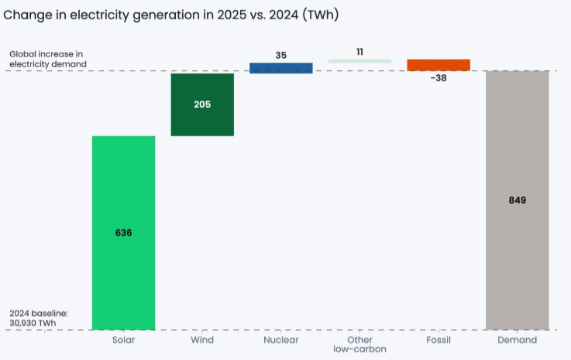
Solar and wind drove global electricity growth
2025 generation changes show where incremental supply came from
GLOBAL CONTEXT
KEY SIGNALS
841
Solar and wind added 841 TWh against 849 TWh of demand growth.
TWh solar + wind growth
849
TWh demand growth
99%
Ratio of the two increases
Solar and wind nearly matched incremental electricity demand in the sampled global totals.
Investment implication | Clean supply growth creates an opportunity to investigate developer economics.
Source: Ember Global Electricity by Country, 2025; global comparison as presented in team analysis.
2
U.S. ENERGY INVESTMENT OUTLOOK
Notes:
SIGxBDAA.pdf p. 2. Global figure, not U.S. data. Original figure preserved without any recolouring, replacement data, redrawing or cropping.

Slide 4
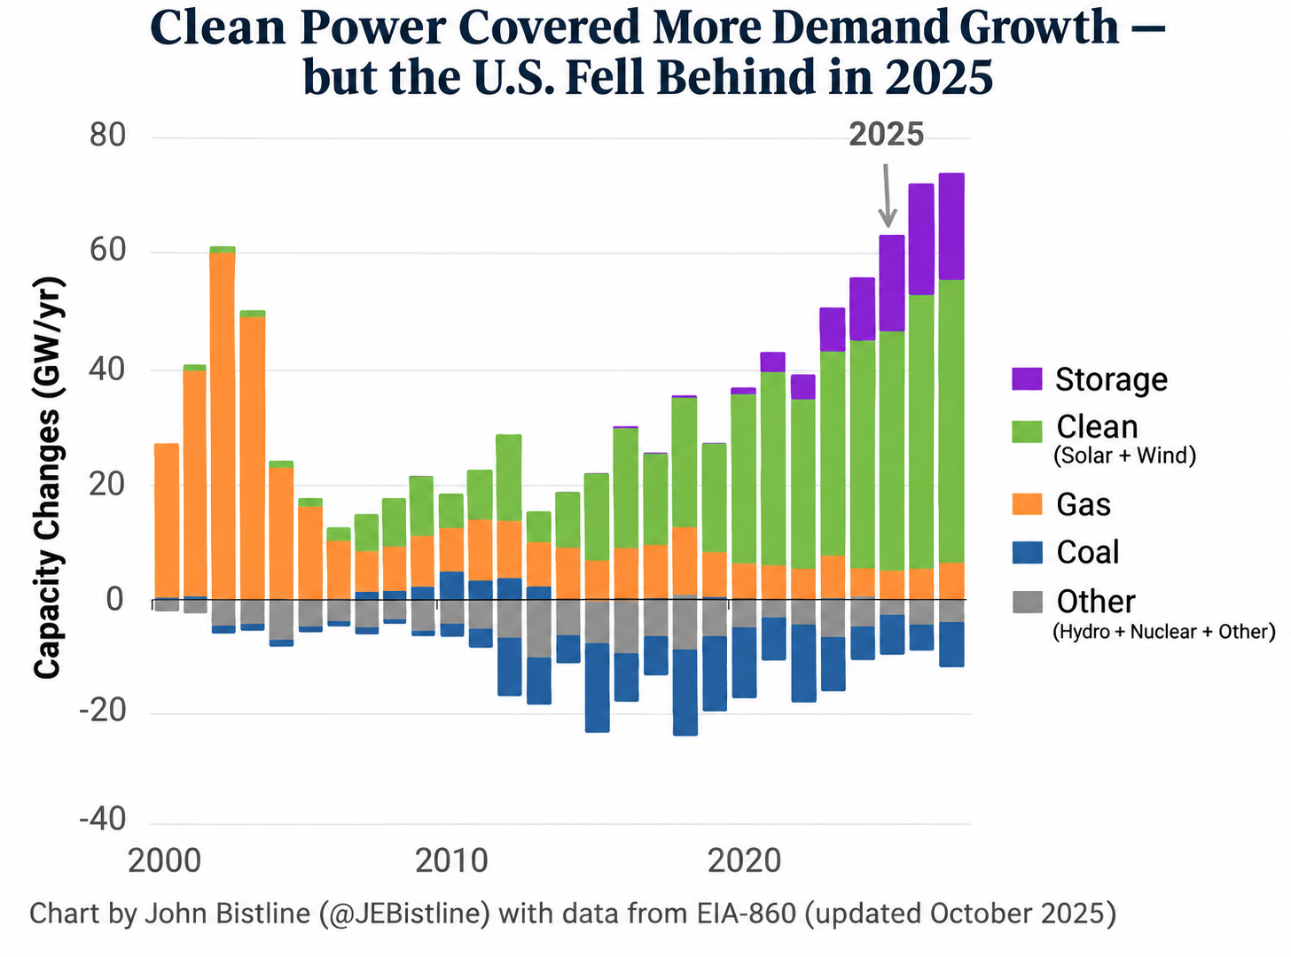
Renewables and storage lead new U.S. capacity
Annual additions and retirements show a changing construction mix
CAPACITY MIX
KEY SIGNALS
Solar + wind
The chart shows installed power capacity, measured in GW.
New capacity leaders
Storage
Fast-growing additions
Coal
Net retirements
New construction favors clean power and storage, but capacity is not the same as generation.
Investment implication | New construction and the existing generation fleet create different investment exposures.
Source: EIA Form 860; chart credited to John Bistline (@JEBistline), updated Oct 2025.
4
U.S. ENERGY INVESTMENT OUTLOOK
Notes:
Original team figure, EIA-860. Embedded demand-growth title does not describe this capacity chart. Original figure preserved without any recolouring, replacement data, redrawing or cropping.

Slide 5
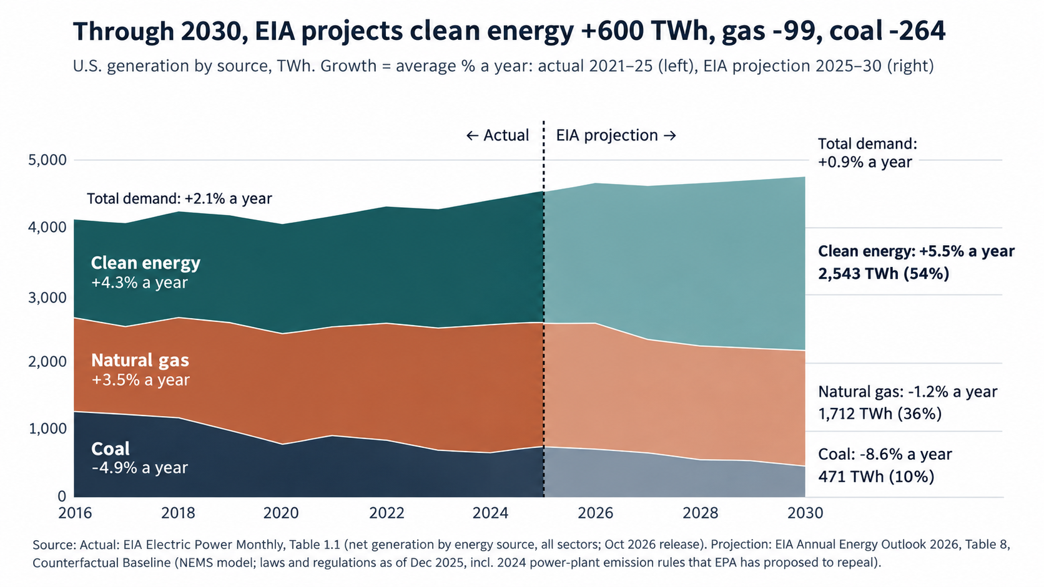
Clean power expands while gas retains a major role
The cited EIA scenario changes the mix without eliminating natural gas
KEY SIGNALS
+600 TWh
Clean generation by 2030
−264 TWh
Coal generation by 2030
36%
Natural gas share in 2030
Clean power grows in the EIA scenario while gas remains a major electricity source.
Investment implication | The scenario supports clean growth alongside continued natural-gas generation.
Source: EIA Electric Power Monthly Table 1.1 and Annual Energy Outlook 2026 Table 8; team chart.
6
U.S. ENERGY INVESTMENT OUTLOOK
Notes:
EIA AEO 2026 Counterfactual Baseline scenario. Policy assumptions materially affect the result. Original figure preserved without any recolouring, replacement data, redrawing or cropping.

Slide 6
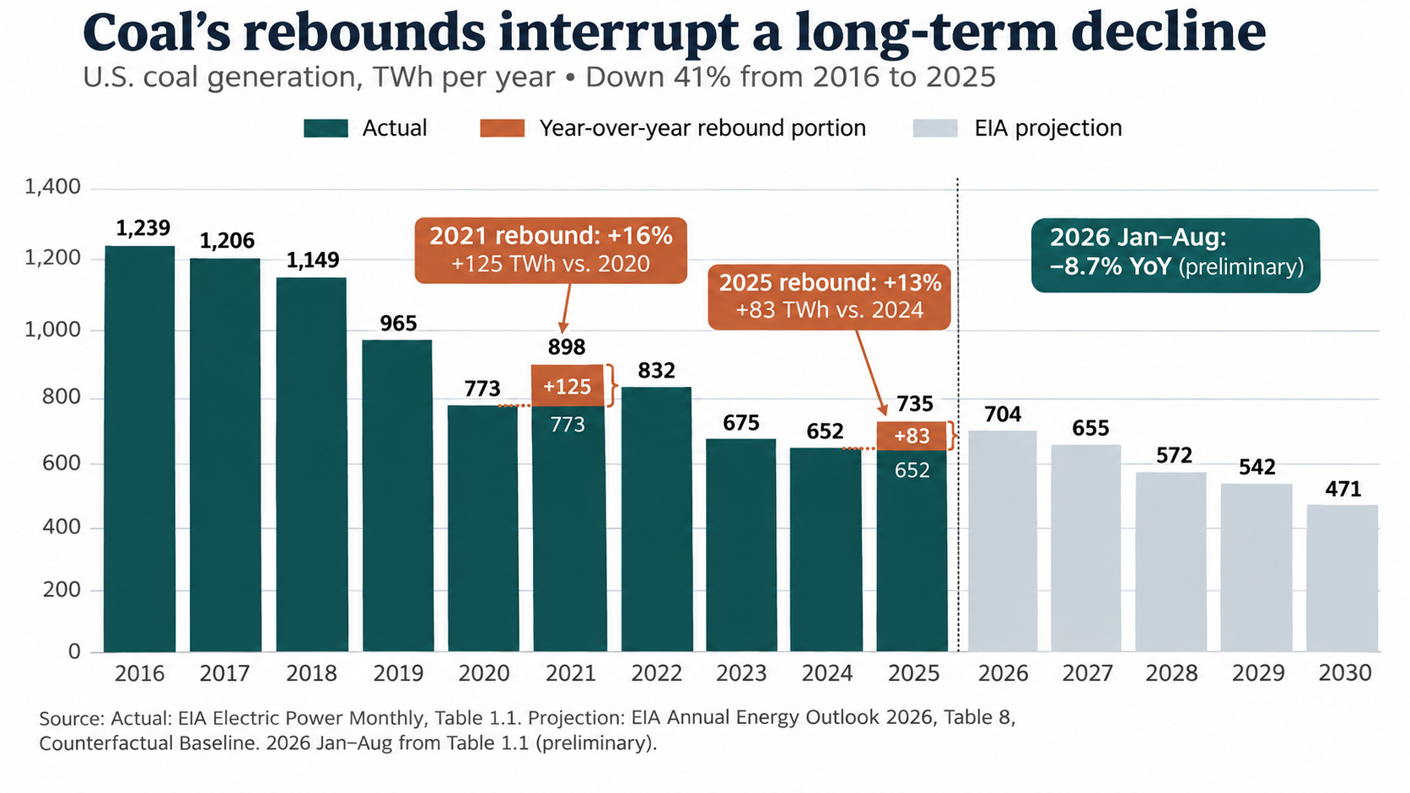
Coal’s rebounds interrupt a long-term decline
U.S. coal generation remains below earlier levels despite periodic recoveries
Investment implication | A rebound alone does not establish a reversal of coal’s longer-term outlook.
5
U.S. ENERGY INVESTMENT OUTLOOK
Notes:
Original team figure. Grey bars are the cited EIA Counterfactual Baseline projection. Original figure preserved without any recolouring, replacement data, redrawing or cropping.

Slide 7
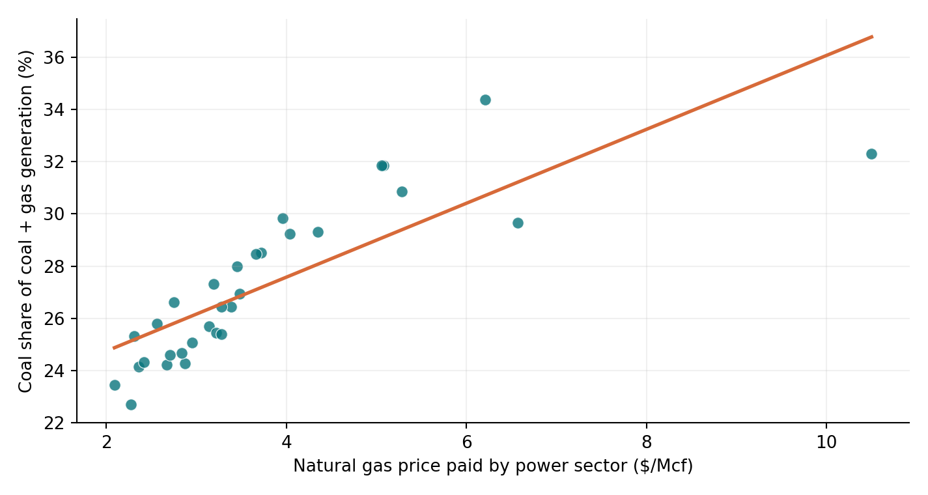
Natural gas prices help explain coal’s temporary rebounds
Historical fuel-switching signal + forward-looking EIA outlook
2027 U.S. GAS PRODUCTION
+3.5% forecast
2027 HENRY HUB GAS PRICE
−9.2% forecast
Cheaper gas may reduce coal’s dispatch advantage—but renewable growth, demand and retirements also matter.
Pearson r = +0.81 | 31 months (Jan 2024–Jul 2026)
INVESTMENT IMPLICATION | Lower gas prices could pressure coal utilization → UNDERWEIGHT U.S. THERMAL COAL
Sources: EIA Electric Power Monthly Table 1.1; EIA Natural Gas Electric Power Price; team Pearson calculation. 2027 outlook: EIA Oct. 2026 STEO. Correlation ≠ causation.

Slide 8
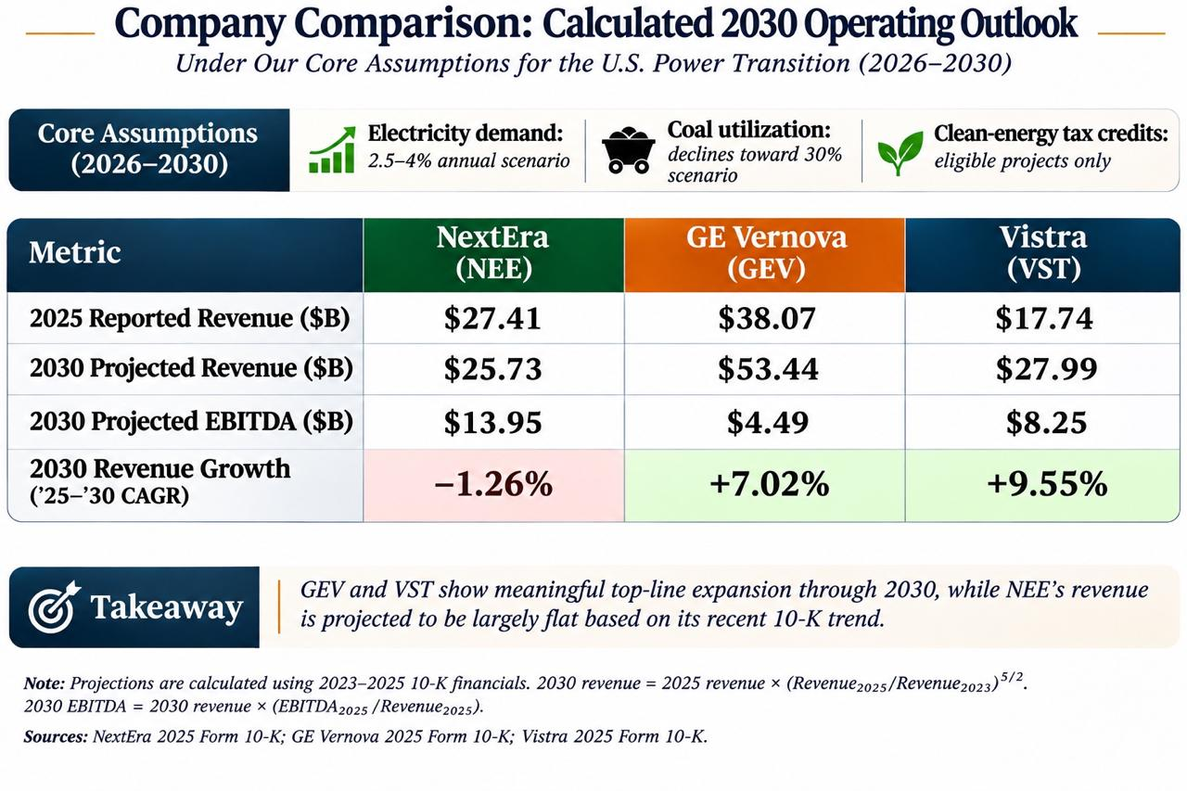
Company comparison | Three ways to invest in the power transition
Illustrative 2030 financial outlook based on 2023–2025 historical trends
INDUSTRY CONTEXT Demand +2.5–4%/yr • Coal utilization toward 30% • Tax credits for eligible projects
NextEra Energy
GE Vernova
Vistra
NEE | Renewable development + utility
GEV | Grid, power equipment + services
VST | Power generation + retail
2030 PROJECTED REVENUE
2030 PROJECTED REVENUE
2030 PROJECTED REVENUE
$25.73B
$53.44B
$27.99B
2025 revenue $27.41B
2025 revenue $38.07B
2025 revenue $17.74B
EBITDA $13.95B
−1.26% CAGR
EBITDA $4.49B
+7.02% CAGR
EBITDA $8.25B
+9.55% CAGR
INVESTMENT
TAKEAWAY
GEV and VST show stronger revenue momentum; NEE has the highest modeled EBITDA. Earnings growth is not stock valuation.
Method: Revenue2030 = Revenue2025 × (Revenue2025 / Revenue2023)^(5/2); EBITDA2030 = Revenue2030 × 2025 EBITDA margin.
Sources: NEE, GEV and VST 2025 Form 10-K filings; team calculations. Industry scenarios are context, not projection inputs.
8
U.S. ENERGY INVESTMENT OUTLOOK
Notes:
Team valuation table. Confirm estimate source and as-of date before submission. Original figure preserved without any recolouring, replacement data, redrawing or cropping.

Slide 9
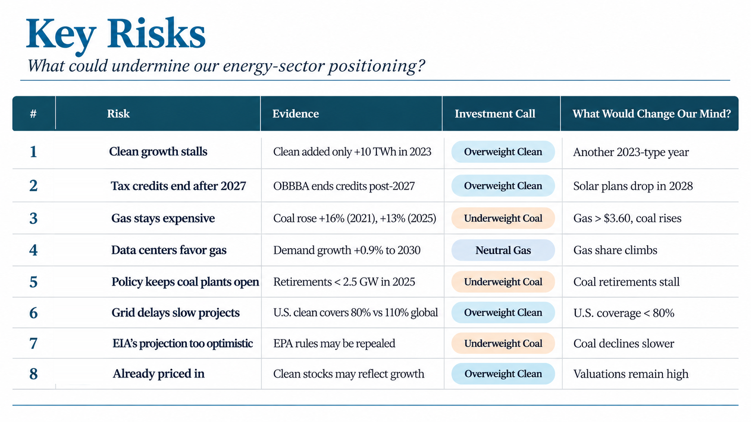
Execution and policy could weaken our positioning
Each risk should have an observable condition that changes our view
Portfolio response | Reassess if projects slip, developer economics weaken or coal demand remains resilient.
9
U.S. ENERGY INVESTMENT OUTLOOK
Notes:
Original risk table. The blanket claim that all clean-energy credits end after 2027 is too broad. Original figure preserved without any recolouring, replacement data, redrawing or cropping.

Slide 10
Our allocation favors renewable developers
A 3–5-year view with explicit conditions for maintaining conviction
Industry | Position | Reason
Renewable developers | OVERWEIGHT | Prefer viable project returns, contracted revenues and manageable financing
Natural gas | NEUTRAL | Retains a major supply role while clean generation expands
U.S. thermal coal | UNDERWEIGHT | Periodic rebounds coexist with longer-term decline and retirement exposure
REVIEW TRIGGERS | Project delivery, returns on new investment, coal utilization and valuation.
10
U.S. ENERGY INVESTMENT OUTLOOK
Notes:
Team investment recommendation. Electricity-generation trends alone do not establish excess stock returns.

Slide 11
Sources & methodology — competition datasets
Primary data provided by SIG × BDAA
Ember — Global Electricity by Country (2020–2025)
country_year_electricity_2020_2025.csv · generation, demand, clean/fossil mix and country-level comparisons. 2025 coverage: 91 countries, not the full world.
EIA — U.S. Coal Consumption and Quality (2020–2025)
eia_coal_consumption_quality_2020_2025.csv · coal consumption, receipts, stockpiles, delivered prices and coal quality by state/sector.
Team-derived calculations
U.S. clean-generation growth ÷ U.S. demand growth; 91-country sample comparison; coal trends and fuel-switching analyses.
Data-quality notes
The 91 countries with 2025 data represented 93.5% of 2024 world demand. Sample coverage should be shown when interpreting global comparisons.
11
U.S. ENERGY INVESTMENT OUTLOOK

Slide 12
Sources & methodology — external evidence
Independent sources used for charts, forecasts and financial projections
EIA — Electric Power Monthly, Table 1.1
U.S. annual generation, coal rebound/decline and monthly coal-versus-gas electricity generation. https://www.eia.gov/electricity/monthly/
EIA — Natural Gas & Annual Energy Outlook
Natural gas prices, production and Henry Hub outlook; 2030 power generation scenario. https://www.eia.gov/outlooks/aeo/
EIA-860 / U.S. capacity additions chart
U.S. capacity additions and retirements; chart credited to John Bistline (@JEBistline), based on EIA-860. https://www.eia.gov/electricity/data/eia860/
Ember & external commentary
Ember electricity data and commentary: https://x.com/ember_energy/status/2059560268313579840 ; capacity commentary: https://www.linkedin.com/posts/rameznaam_almost-all-the-power-being-added-to-the-us-share-7394808099259244544-HtXN/
Company financials & team model
NextEra Energy, GE Vernova, Vistra — 2025 Form 10-K filings (SEC EDGAR: https://www.sec.gov/edgar/search/). Pearson r=+0.81: Jan 2024–Jul 2026, n=31, team calculation.
12
U.S. ENERGY INVESTMENT OUTLOOK

