Slide 1

Global Water Consumption
2320030331 Hansi Challagulla
2320030184 Nallaparaju Nikhil Varma
2320030006 Ramayanam Naga Abhijith
2320030029 Bandarupalli Bhavika Sree

Slide 2
Abstract
Water resources are critical to economic development, environmental sustainability, and human well-being, yet increasing demand and uneven distribution have intensified global water stress. This project focuses on analyzing and comparing water consumption patterns across different countries using a structured, data-driven approach. Unlike traditional solutions that rely on locally stored data and provide static reports, this project utilizes a centralized cloud-based system to store and manage global water consumption data. The aim is to understand how water usage varies geographically and sector-wise, and to highlight trends related to consumption levels, per capita usage, and water scarcity.
By organizing global water consumption data into a centralized database and visualizing it through interactive dashboards, the project enables efficient comparison of water usage across multiple countries over a span of years. It provides insights into overall water consumption, sector-wise distribution (agricultural, industrial, and household), temporal trends, and scarcity levels among countries. This approach enhances data accessibility, scalability, and supports meaningful comparisons that are not easily achievable through existing local analysis tools.
The project is designed to serve as a decision-support and awareness tool for students, researchers, and policymakers by transforming raw numerical data into intuitive visual representations. Ultimately, the work demonstrates how centralized cloud-based data management and business intelligence tools can be used to perform large-scale comparative analysis and address real-world sustainability challenges related to global water consumption.

Slide 3
Existing solutions and problems
Most existing water consumption analysis systems rely on local data storage such as Excel or standalone databases.
Traditional solutions provide static reports with limited real-time analysis and comparison capabilities.
Many platforms lack interactive dashboards for country-wise and sector-wise data visualization.
Existing tools often do not support cloud-based data integration, making scalability and remote access difficult.
Data is usually analyzed in isolation, without enabling dynamic filtering or comparative insights.

Slide 4
Proposed Solution
Implements a cloud-based database for centralized and scalable data storage.
Enables interactive dashboards for real-time country-wise and sector-wise analysis.
Supports dynamic filtering and comparison using slicers for better insights.
Provides visual representation of trends through charts and graphs.
Integrates data storage and visualization for efficient decision-making.

Slide 5
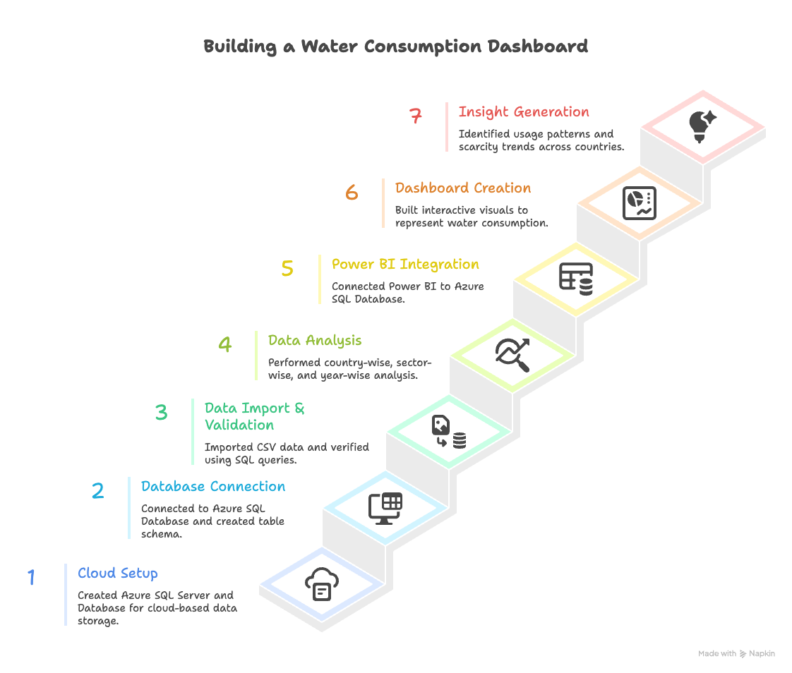
Project Workflow

Slide 6
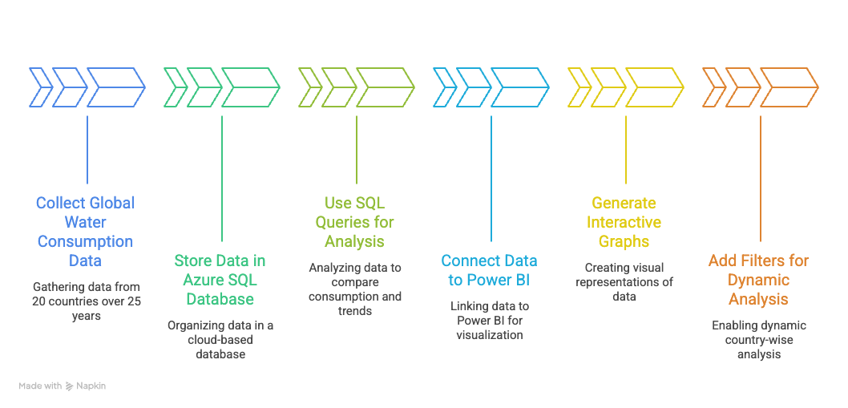
Methodology

Slide 7
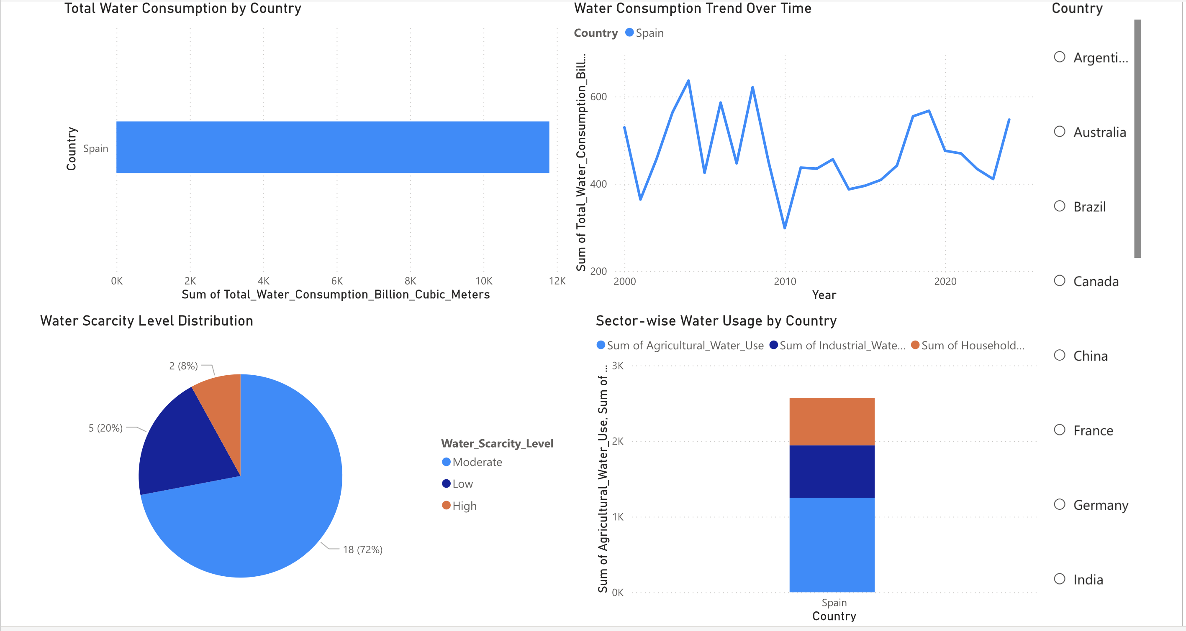
Expected Output

