Slide 1

Tourist Demand Prediction
2320030328 Deepika Ketavarapu
2320030331 Hansi Challagulla
2320030332 Vivek Uppalapati
2320030377 Akshara Budha

Slide 2
Introduction & Motivation
Problem Statement
Tourism demand fluctuates due to seasonal changes, trends, and external factors, making it difficult to accurately predict visitor arrivals. Poor demand forecasting leads to overcrowding, inefficient resource utilization, and reduced service quality, affecting both revenue and tourist experience.
Why This Project is Needed
To analyze historical tourism data.
To identify seasonal trends and visitor patterns.
To improve accuracy of demand prediction

Slide 3
Objectives
Primary Objective
Analyze tourist patterns and forecast future demand.
Specific Objectives
Identify seasonal tourism patterns.
Group tourists based on travel patterns.
Classify tourists and destinations.
Predict future visitor arrivals using regression models.

Slide 4
Literature Survey
Existing Solutions & Identified Gaps
Many studies rely on advanced deep learning models that are complex and computationally expensive.
Most approaches focus primarily on demand forecasting, without analyzing tourist travel patterns in detail.
Existing systems often adopt single-model strategies, lacking integration of clustering, classification, and regression techniques within a unified framework.

Slide 5
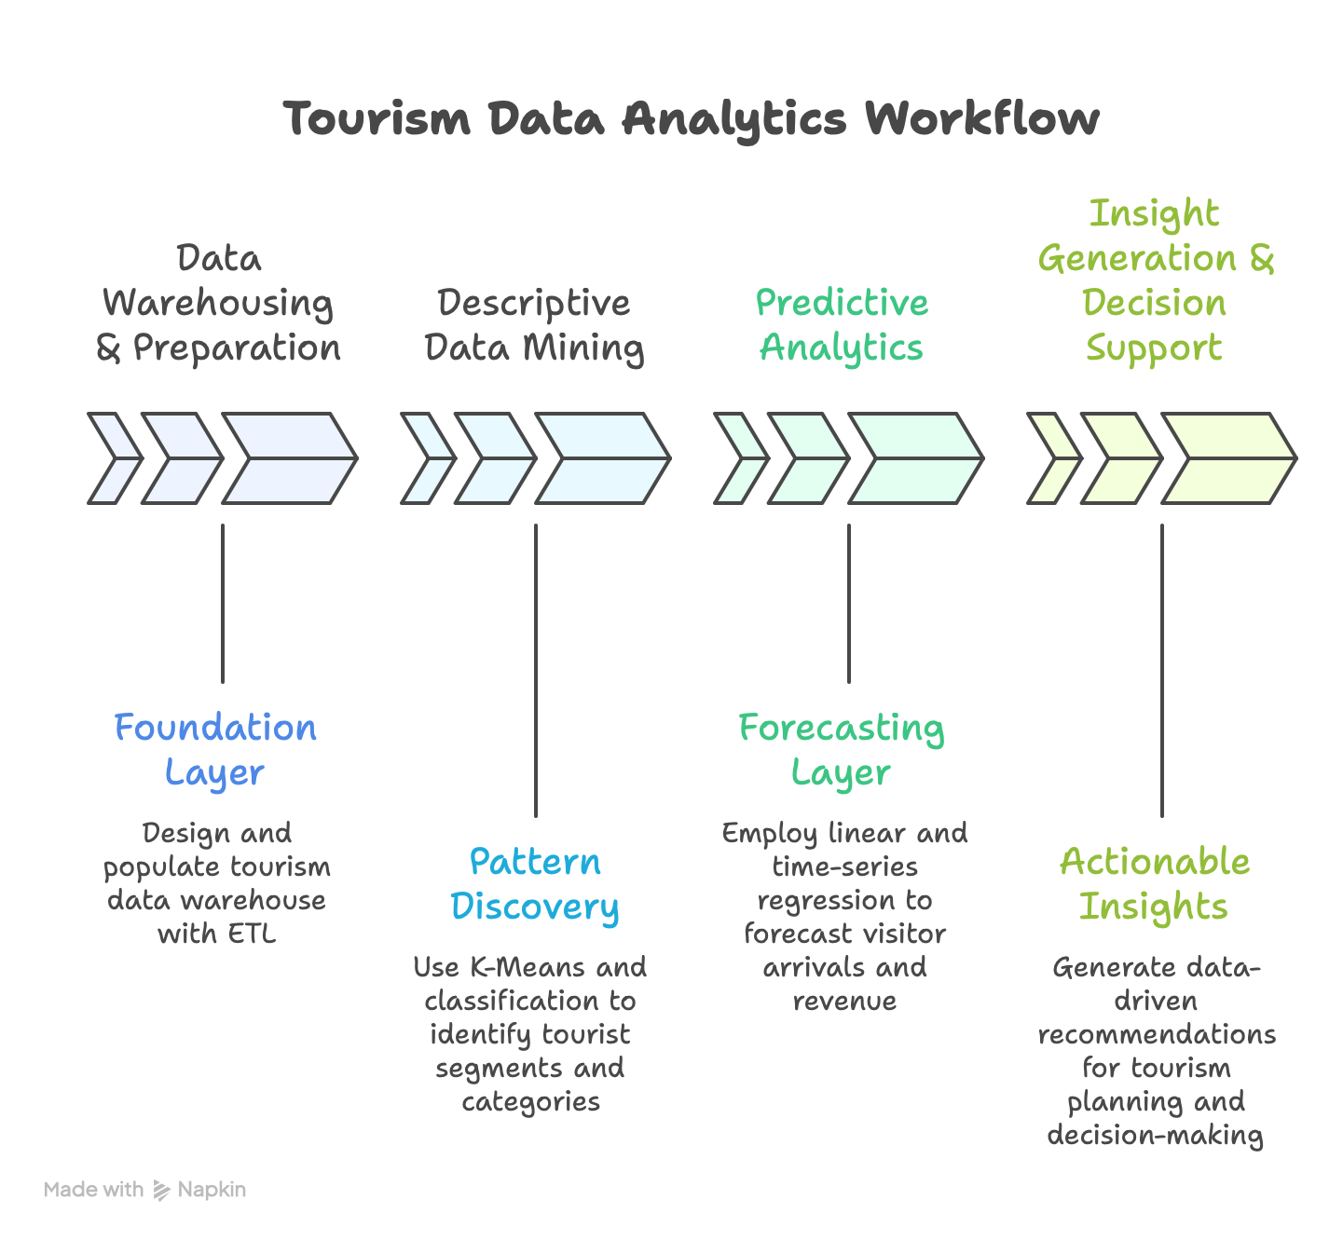
Proposed Methodology

Slide 6
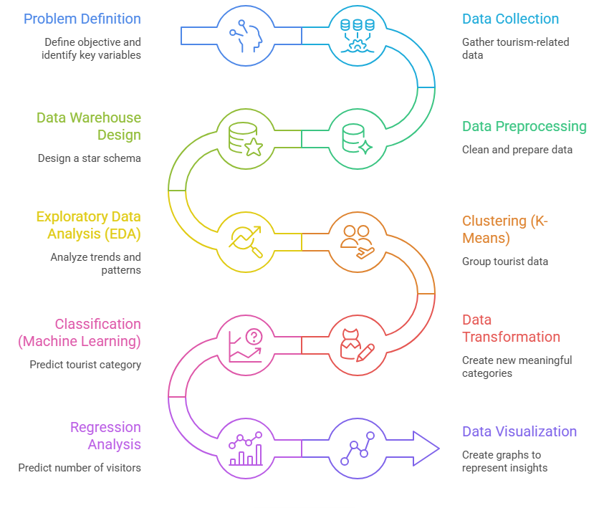
Implementation Steps

Slide 7
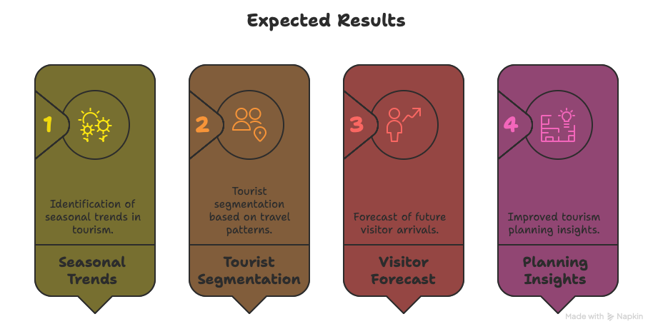
Expected Results & Deliverables

Slide 8
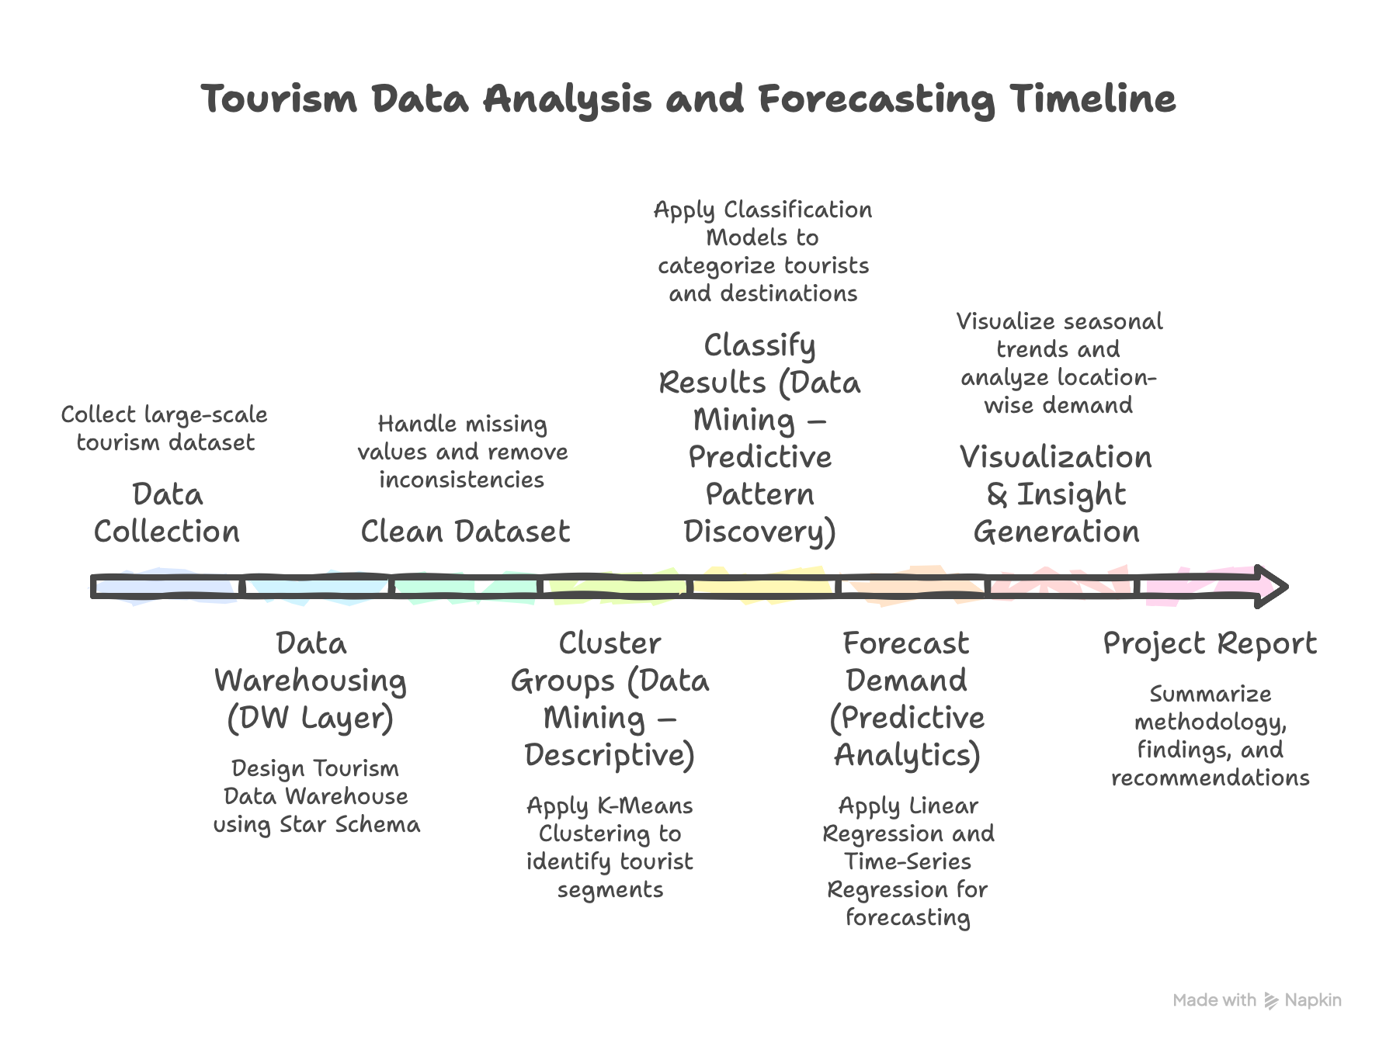
Timeline

Slide 9
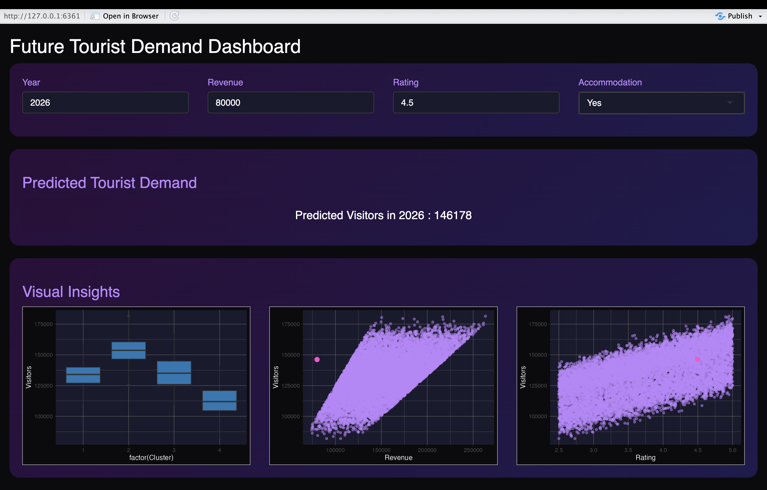
OUTPUT

Slide 10
References
Hou, H. et al. (2026) – Research on interpretable tourism demand forecasting with multi-source data. https://www.mdpi.com/2079-8954/14/2/146
Qin, F. et al. (2025) – Tourism demand forecasting using social media data: a deep learning–based ensemble model. https://www.sciencedirect.com/science/article/abs/pii/S0160738325001641
Yi, S., Chen, X., & Tang, C. (2025) – Time series transformer for tourism demand forecasting (Tsformer). https://www.nature.com/articles/s41598-025-15286-0
Zhang, Y. (2025) – Tourism demand forecasting based on a hybrid BiLSTM-Transformer model. https://www.mdpi.com/2071-1050/17/5/2210
Devi, R. et al. (2024) – Forecasting of Indian tourism industry using time-series modeling and regression analysis. https://www.sciencedirect.com/science/article/pii/S2215016124001766
Sancho Núñez, J. C. et al. (2024) – Machine learning applied to tourism: Systematic review covering forecasting and analytics. https://www.researchgate.net/publication/381993806_Machine_learning_applied_to_tourism_A_systematic_review

