Slide 1
Automated Template System
by Johannes A. Odendaal

Slide 2
Contents
Introduction
System Components
Features
Change Management
Licence and Copyright

Slide 3
Introduction
The Automated Template System enables managing & maintaining documentation standards in a company when using MS Word
Provides flexibility with ease & consistency of use to enhance productivity & efficiency of users when generating different types of documents
Speeds up producing documents with consistent and professional appearance across the company
Dramatically cuts down on editing time for all users

Slide 4
Introduction
Enables efficient professional technical editing with minimal time wasted on formatting and appearance
Integrates easily with engineering & company processes and systems
Overall system offers efficient, effective & consistent maintenance
Default MS Word templates can be used to create standardized MS Word document layouts, or system of registered company document layouts
Quality at the source – empower the users!

Slide 5
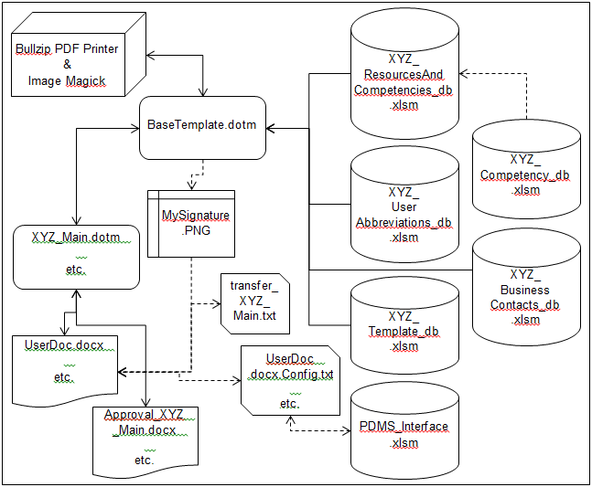
System Components

Slide 6
System Components
MS Word Templates
Minimal default set of MS Word templates (*.dotx, *.dotm) that embodies company look & feel (face value), implement company documentation standard
Automation part consolidated into a totally generic MS Word base template that does not offer any face value
Default MS Word templates reference base template to gain access to automation functionality
Template Database
Contains standardized abbreviations, case definitions for captions or headings, allowed style names, document type definitions, security classifications, etc.
Based on MS Excel
Business Contacts Database
Contains list of business contacts, their designations and business addresses

Slide 7
System Components
User Abbreviations Database
User-defined abbreviation definitions, not overwritten with Automated Template System updates
Based on MS Excel
Product Data Management System (PDMS) Interface
Provides interfacing code to exchange and control documents’ metadata or configuration data between a PDMS and the document itself
Indirect interface to the PDMS, used in an offline mode of operation
Example interfacing code resides in an Excel workbook
Can be used as the official document index or interfacing code integrated with company’s PDMS

Slide 8
System Components
Competency Database
Provides a comprehensive tool to manage resource competencies within a company (required in formal industry sectors)
Influences who may prepare, review and approve formal documents
No direct interface with the MS Word templates; creates a simplified database for use with the MS Word templates
Based on MS Excel
Resources and Competencies Database
Provides list of approved resources, their competency levels & competency functions for specific project phases within specific competency areas
Based on MS Excel

Slide 9
System Components
3rd Party Applications
Image Magick (http://www.imagemagick.org)
Open source, free for use, distributed under Apache 2.0 licence
Used for creation of composite electronic signature image
Bullzip PDF Printer (http://www.bullzip.com)
Free for up to 10 users in a company
Optional installation
Provides ability to programmatically apply copy protection to PDF files
Enhances security of PDF files created by the signature utility
If not installed automatic creation of signed copy-protected PDF documents not available

Slide 10
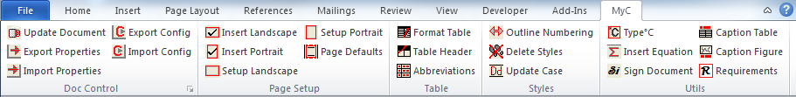
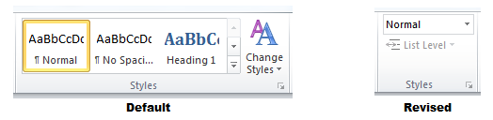
Features
Automated Template System Ribbon
Conveniently integrated with standard MS Word menu & ribbon system
Provides advanced Automated Template System functionalities at click of a button
Revised Styles Group on Home Ribbon
Similar to MS Word 2003’s ‘style-at-a-glance’ informative user interface
List level control active when needed
Hides style options users should not use

Slide 11

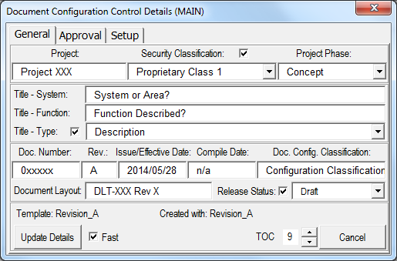
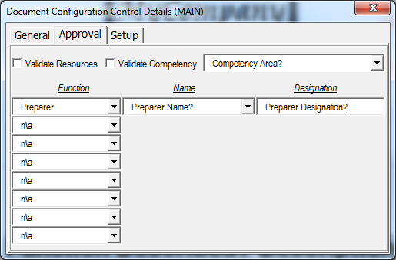
Features
DocControl group: Update Document
Manage document configuration control information embedded as fields in the document
Consistently update the table of contents; list of figures and tables; and all cross references in the document

Slide 12
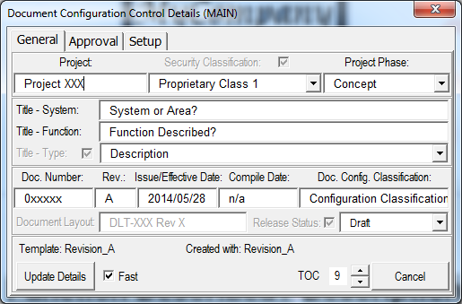
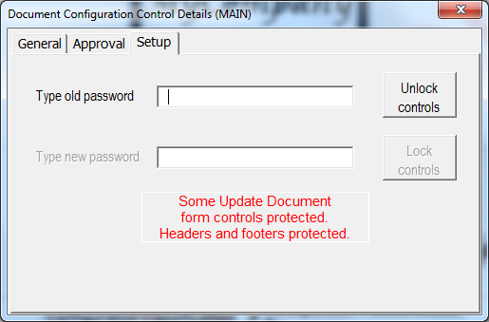
Features
DocControl group: Update Document
Optionally protect certain meta data in Update Document visual control
Optionally protect editing in headers and footers
Optionally lock ‘form type’ document, allow form fields/content controls

Slide 13
Features
DocControl group: Export Properties
Export all custom document properties to a text file for importing into another document based on the same template
Used to transfer meta data to a new document with MS Word template changes
DocControl group: Import Properties
Import all document properties that have been exported with the ‘Export Document Properties’
DocControl group: Export Config
Export all custom document properties to a text file for import into the PDMS workbook or company PDMS system (interfacing code supplied)
DocControl group: Import Config
Import all custom document properties from a text file as exported by the PDMS workbook or company PDMS system (interfacing code supplied)
Use Update Document utility after import to apply changed metadata

Slide 14

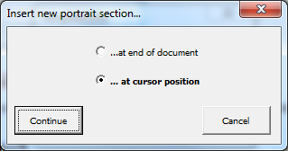
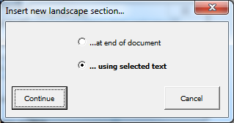
Features
Page Setup group: Insert Landscape, Insert Portrait
Insert landscape/portrait section with all the correct formats, headers, footers and fields
Options: at the cursor position, using selected text, at the end of document
No warping of text in headers & footers!
Page Setup group: Setup Landscape, Setup Portrait
Format current section to the correct landscape/portrait format
No warping of text in headers & footers!

Slide 15
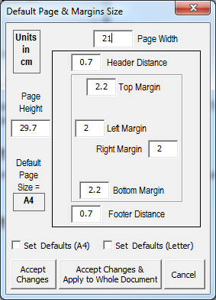
Features
Page Setup group: Page Defaults
Set default page layout parameters for Insert Landscape, Insert Portrait & Setup Landscape, Setup Portrait utilities
Two predefined page sizes – A4 & Letter
Other user defined default page sizes possible
Change default values only or also apply to all sections in document

Slide 16

Features
Table group: Format Table
Format new or existing table
Implement consistent company table standard
Table group: Table Header
Format selected text as table header
Use company table standard
Table group: Abbreviations
Delete current abbreviations table and compile new one with abbreviations found in document
Make use of abbreviations listed in template & user abbreviations databases

Slide 17

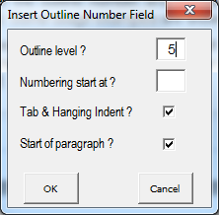

Features
Styles group: Outline Numbering
Easily adds outline numbering to paragraphs, fit in with outline numbered headings

Slide 18
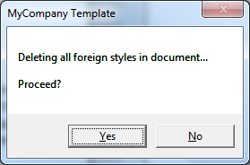
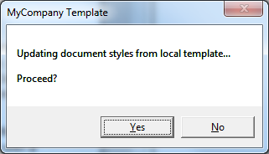
Features
Styles group: Delete Styles
Delete all foreign (not permitted) styles as defined in template database
Update all styles with those in default attached MS Word template

Slide 19
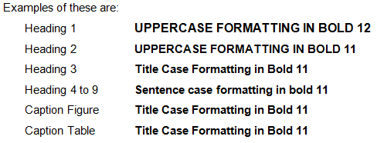
Features
Styles group: Update Case
Apply correct case formatting to all headings and captions as defined in template database
Maintains uppercase for abbreviations
Maintains lowercase for link words

Slide 20

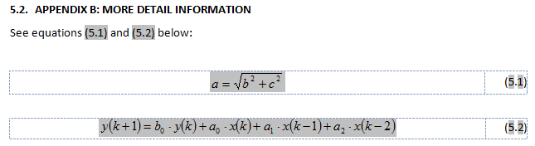
Features
Utils group: Type °C
Type °C at the cursor position
Utils group: Insert Equation
Insert numbered equation in the document
Implement standard MS Word numbering fields for easy cross‑referencing
Use default MS Word equation editor, prevents document corruption caused by many 3rd party utilities with extensive use of equations

Slide 21
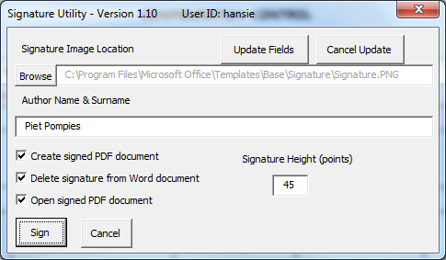
Features
Utils group: Sign Document
Digitally sign document (without locking it), used for letters & memos
Use composite date-time stamped signature, single bitmap for enhanced security
Options: create signed copy-protected PDF, delete signature from MS Word document, open the signed PDF document, signature height

Slide 22
Features
Utils group: Caption Table
Insert table caption at beginning of paragraph above table, change style accordingly
Non‑breaking white space added between ‘Table’ and table number that makes up the caption label
Whole caption label always together on same line when referenced
Caption formatted to always stay with table header and 1st table row on same page
Utils group: Caption Figure
Insert figure caption at beginning of paragraph below inline figure, change the style accordingly
Non‑breaking white space added between ‘Figure’ and figure number that makes up the caption label
Whole caption label always together on same line when referenced
Special formatting applied to inline figure, always stay with caption on same page

Slide 23
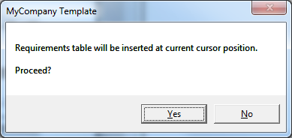
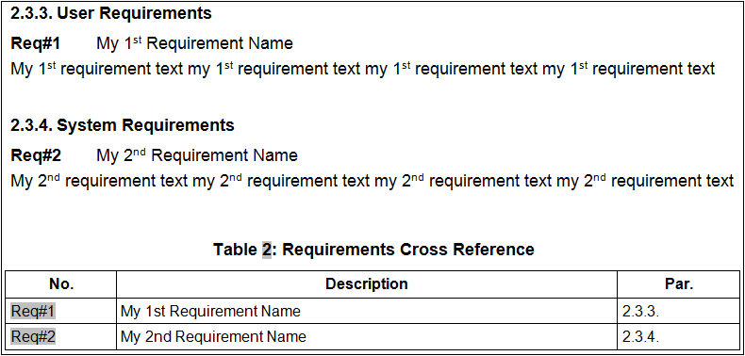
Features
Utils group: Requirements
Compile requirements table at cursor position
Based on use of auto numbering Requirements style in document
Insert cross‑reference table; requirement number, requirement name, heading number

Slide 24
Change Management
Implementing a system like this in an organization can be a daunting task
This should not stop you making the right decision for your organization
Basic change management scheme:
Create a documentation standard for your organization if it does not exist
Identify your organization’s Microsoft Word super user(s)
Implement the documentation standard (face value) into the default templates
Roll-out the Automated Template System to the super user(s)
Train the super user(s)
Self study of the user manual with pre-defined template usage exercises
Physical/remote group contact session to mark exercises & embed training

Slide 25
Change Management
Create ‘most used’ standardized Microsoft Word document layouts based on default templates
Roll-out the Automated Template System to elect target group
Super user(s) train the elect target group
Physical/remote group contact session - Automated Template System presentation & demonstration
Self study of the user manual with pre-defined template usage exercises
Physical/remote group contact session to mark exercises & embed training
Fine tweak the training syllabus
Create company wide Automated Template System roll-out & training plan
Implement the company wide Automated Template System roll-out & training plan
Create compliment of standardized Microsoft Word document layouts based on default templates
Super user(s) remain the 1st contact point for user support
Regular process & documentation quality measurement to enhance overall learning in the organization

Slide 26
Licence and Copyright
Copyright 2001 - 2014 Johannes Odendaal
Copyright limited to all Visual Basic for Applications programming and associated visual controls that define the template system
Licence conditions
Non-exclusive & licensed to a specific entity
Non-expiring licence
Only licensed if lawfully obtained and correctly installed
For exclusive use and direct or indirect business of the licensee
May be used by any of the Licensee’s direct or indirect employees or contractors, unlimited amount of users

Slide 27
Licence and Copyright
May only be used if authorized by the licensee whereby information is captured in documents based on or making use of the Automated Template System
Applicable to any version of the Automated Template System specifically released to the licensee
Does not entitle the Licensee to future upgrades or releases unless otherwise agreed
Does not infringe on the copyright
In automatic effect if the template system is installed

