Slide 1

NeuroFleetX – Backend System Architecture (Bus Fleet Management)

Slide 2
1)NeuroFleetX backend is built using Node.js + Express.js with a modular API design.
2)Architecture follows a microservice-oriented structure integrated with MongoDB.
3)Supports real-time tracking, booking, AI analytics, and CRUD operations.
4)Backend layers include:
  Authentication & User Services
  Bus Management Service
  Route & Stop Management Service
  Ticketing & Seat Management Service
  Live Tracking Service (REST + WebSocket)
  Traffic & AI Analytics Service
  Admin Control Panel APIs
5)Ensures seamless communication with:
  Frontend (React)
  AI Microservice (Python FastAPI)
  MongoDB database

Slide 3


Backend API Architecture
NeuroFleetX backend exposes 10 major API categories, each mapped to specific bus operations:
1. Auth & User Management APIs
API Method Description
/auth/register POST Register new user (Passenger/Admin/Driver)
/auth/login POST Login & get JWT token
/auth/logout POST Invalidate token
/users/{id} GET Get user details
/users/update/{id} PUT Update profile
2. Bus Management APIs
API Method Description
/ buses GET Get list of all buses
/ buses/{busId} GET Get bus details
/ buses/add POST Add a new bus /buses/update/{busId} PUT Update bus info /buses/delete/{busId} DELETE Delete bus

Slide 4

3. Route & Stop Management APIs
API Method Description
/routes GET Get all routes
/routes/{routeId} GET Get route + stop list
/routes/add POST Add new route
/routes/update/{routeId} PUT Update route
/routes/delete/{routeId} DELETE Delete
/routes/{routeId}/stops GET Get stops of a route
/stops/add POST Add stop
4. Live Tracking APIs (WebSocket + REST)
API Method Description
/tracking/{busId} GET Get latest location of bus
/tracking/update POST Update bus location (from GPS device)
/ws/live-tracking → Sends live location to users.
5. Ticket Booking APIs
6. Seat Availability APIs
7. Traffic & AI Analytics APIs
8. Alerts & Emergency APIs
9. Reports APIs
10. Admin APIs

Slide 5
MONGODB SCHEMA (Collections + Fields)
Why MongoDB?
  Handles large, continuous GPS data
  Flexible schema for buses, trips, and sensors
  Perfect for real-time, high-frequency data
  Easier to scale horizontally
1. users Collection
{ "_id": "U123",
"name": "Hansika",
"email": "hansika@mail.com", "password": "hashed", "role": "admin/passenger/driver", "
phone": "987654", "createdAt": "2025-01-01" }
2. buses Collection
{ "_id": "B101", "registrationNo": "MP09 AB 1234", "driverId": "U56", "capacity": 40, "routeId": "R5", "status": "running/maintenance" }
3. routes Collection
{ "_id": "R5", "routeName": "City Circle Express", "stops": ["S1", "S2", "S3", "S4"], "totalDistance": 14.6 }
4. stops Collection
{ "_id": "S1", "name": "Railway Station", "location": { "lat": 22.73, "lng": 75.85 }, "order": 1, "routeId": "R5"
}

Slide 6
5. liveTracking Collection
{ "_id": "T12345", "busId": "B101", "location": { "lat": 22.74, "lng": 75.86 }, "speed": 35, "timestamp": "2025-11-29T12:30:00Z"}
6. tickets Collection
{ "_id": "TK2039", "userId": "U123", "busId": "B101", "seatNo": 12, "fare": 20, "paymentStatus": "Paid", "qrCode": "uniqueToken123", "bookingTime": "2025-10-11" }
7. seatStatus Collection
{ "_id": "SS101", "busId": "B101", "totalSeats": 40, "occupiedSeats": 28, "availableSeats": 12, "updatedAt": "2025-11-29"}
8. trafficData Collection
{ "_id": "TD90", "zone": "MG Road", "congestionIndex": 0.78, "timestamp": "2025-11-29T12:35:00Z"}
9. aiPredictions Collection
{ "_id": "AI334", "busId": "B101", "predictedETA": [ { "stopId": "S1", "eta": "10:05" }, { "stopId": "S2", "eta": "10:15" } ], "demandForecast": 62, "routeRecommendation": "Take Route 2 instead of Route 5" }
10. alerts Collection
{ "_id": "AL505", "busId": "B101", "type": "breakdown/accident/emergency", "description": "Engine overheating", "timestamp": "2025-11-29"}

Slide 7
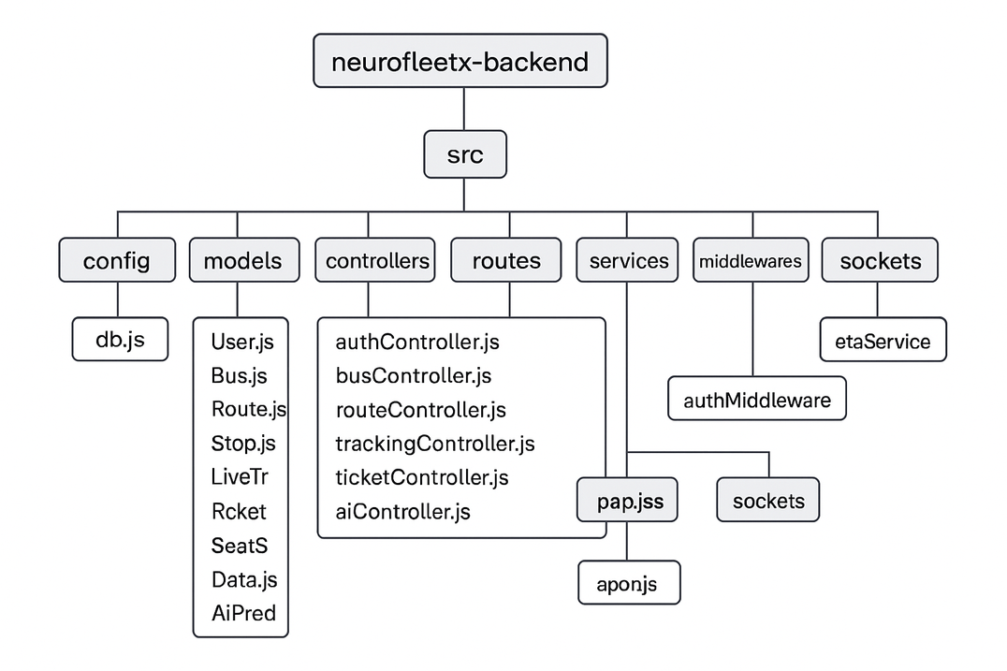
Backend File Structure
  Models represent MongoDB collections exactly from your schema PDFs.
  Controllers map directly to each API group in your backend.pdf.
  Services contain heavy logic (AI calls, dispatching, telemetry).
  Sockets enable live bus tracking (/ws/live-tracking).
  Routes folder exposes all REST APIs cleanly organized.
  Utils contains reusable helpers (Haversine, JWT, validation).

