Slide 1
E-Commerce Sales Analysis
Data Storytelling & Statistical Validation
Name: E. Hansika
Course: Undergraduate

Slide 2
Objective
Analyze e-commerce sales data
Identify trends and top products
Understand customer behavior
Use statistical validation

Slide 3
Dataset Overview
Includes:
• Order ID, Date
• Product & Category
• Price, Quantity
• City, Payment Method

Slide 4
Tools Used
• Python (Pandas, Matplotlib, Seaborn)
• SQL
• Google Colab
• PowerPoint

Slide 5
Analysis Performed
• Exploratory Data Analysis
• Revenue Trends
• Category & Product Analysis
• City & Payment Analysis
• SQL Queries

Slide 6
Key Insights
• Electronics generates highest revenue
• Sales show upward trend
• Top cities: Hyderabad, Delhi
• Laptops are top product
• UPI widely used

Slide 7
Business Conclusion
Electronics dominate revenue
High-value products drive growth
Focus on strong markets for expansion

Slide 8
Hypothesis Testing
H0: No revenue difference
H1: Electronics higher revenue
Method: T-Test

Slide 9
Statistical Result
p-value < 0.05
Reject H0
Electronics significantly higher revenue

Slide 10
Recommendations
• Focus on Electronics
• Promote laptops
• Target top cities
• Encourage digital payments

Slide 11
Final Conclusion
Data-driven insights help businesses improve performance and make better decisions

Slide 12
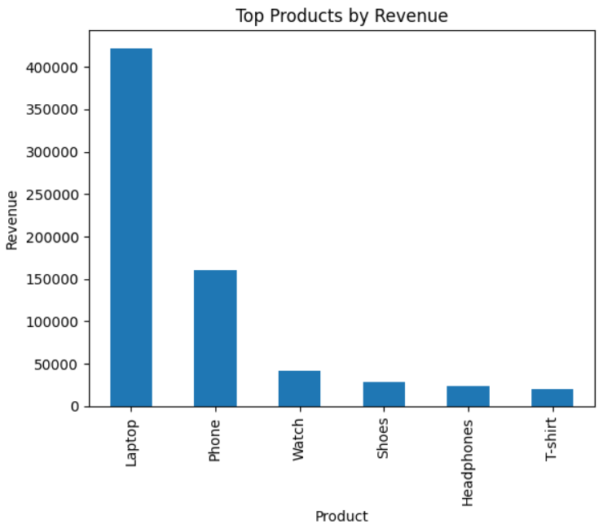

Slide 13
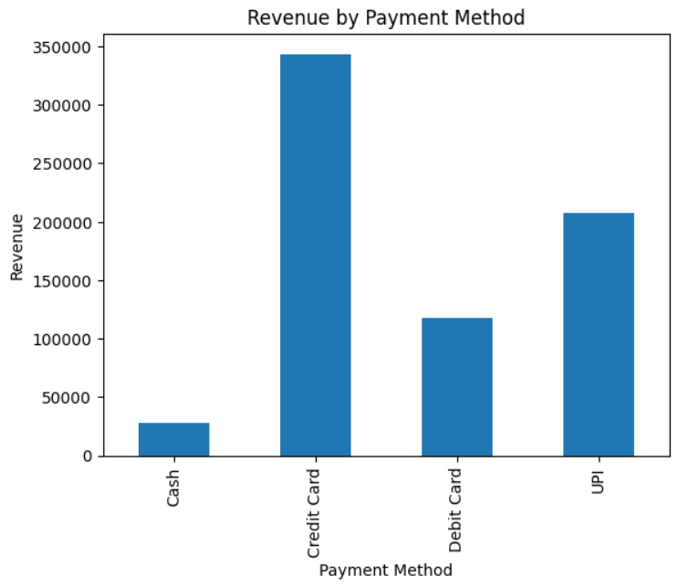

Slide 14
