Slide 1

TRAKORY
A UNIVERSAL TFRACKING SYSTEM
Track Movies · Series · Anime · Books · Games — All in One Place
By: Hansika Gupta | SAP ID: 590023988 | Under the Guidance of: Arti Ma'am

Slide 2
01
Overview
5
3
In today's digital world, users consume content from multiple platforms such as movies, web series, books, anime, and games. However, there is no single platform where users can efficiently track and manage all types of content in one place.
Content Types
Live APIs
TRAKORY is a full-stack Django web application that provides a centralized platform to track, organize, and manage all types of entertainment content with features like real-time API data, status tracking, rating system, mood-based recommendations, and personalized dashboards.
8
∞
Mood Filters
Users Supported

Slide 3
02
Problem Statement
✗
No centralized system to track all content types together
✗
Lack of personalized recommendations based on taste
✗
Difficulty remembering what was watched, read, or played
✗
Existing platforms limited to one category only (IMDb = movies, MAL = anime)
✗
No proper progress tracking for episodes or pages
✗
No cross-category statistics or viewing habits analysis

Slide 4
03
Market Research
🎬
3.2B+
Active streaming subscribers worldwide (2024)
⛩
500M+
MyAnimeList registered users tracking anime
📚
150M+
Goodreads users tracking their reading lists
📺
1.5B+
Hours of video content watched daily on YouTube
→ TRAKORY addresses ALL these user bases in ONE unified platform

Slide 5
04
Our Solution
Universal Platform
Smart Status Tracking
Real-Time API Data
Track Movies, Series, Anime, Books & Games all in one place with unified interface
Watching, Completed, Plan to Watch, On Hold, Dropped — tailored per category
Live posters & info from TMDB, Jikan & OpenLibrary APIs with search functionality
AI Recommendations
Mood-Based Discovery
Statistics Dashboard
Personalized suggestions based on your ratings, genre preferences and watch history
8 moods — Funny, Scary, Romantic, Mind-Bending, Action, Chill, Inspiring, Fantasy
Visual charts for category, genre, ratings, monthly activity and hours watched

Slide 6
05
Key Features
🔐
📋
🎬
🔍
User Auth
Content Tracking
Netflix Browse
Smart Search
Register, Login, Logout with session management
Add, Edit, Delete with status, rating & progress
Real posters from live APIs with hover effects
Search across all categories in real-time
✨
😌
📊
🛡️
AI Recommendations
Mood Pick
Statistics
Admin Panel
Based on your ratings, genre & watch history
8 moods to discover perfect content instantly
Visual charts — genre, rating, monthly activity
Django admin at /admin/ for full control

Slide 7
06
How It Works
01
Register / Login
02
Browse Content
03
Add to Your List
Create account or log in securely with Django authentication
Explore real movies, series, anime and books from live APIs
Click Done, Watching, Fav or Plan on any hovered card
04
Track Progress
05
Get Recommendations
06
View Dashboard
Update episodes watched, pages read and overall status
System analyses your ratings and suggests similar content
See all stats, charts and your complete content journey

Slide 8
07
User Journey Map
🌐
✍️
🎬
➕
✨
📊
→
→
→
→
→
1
2
3
4
5
6
Discover
Register
Browse
Add & Track
Get Recs
Analyse
User hears about TRAKORY from a friend or search
Creates account with username, email & password
Explores Netflix-style browse page with live posters
Marks content as Watching, Done, Fav or Plan
Receives AI recommendations based on ratings
Views personal stats, charts & viewing habits

Slide 9
08
App Screenshots
Dashboard
Browse Page
Mood Pick
Statistics
My List
Stats Overview
Netflix-style UI
8 Mood Options
6 Visual Charts
Search & Filter
Category Bars
Real Posters
Instant Results
Hours Watched
Progress Bars
Recent Items
Hover Effects
Add to List
Top Rated Items
Star Ratings
Avg Rating
Live API Data
Filter by Category
Monthly Activity
Status Badges

Slide 10
09
Tech Stack & Architecture
Frontend
HTML5 · CSS3 · Bootstrap · JavaScript
Backend
Python 3.14 · Django 6.0 · Django ORM · CSRF Security
Database
SQLite3 · Django Migrations · Session Management
APIs
TMDB API (Movies/Series) · Jikan API (Anime) · OpenLibrary API (Books)
Architecture: MVT Pattern | Browser → urls.py → views.py → models.py → SQLite → Templates → Browser

Slide 11
10
System Architecture
🌐 Browser (User)
HTTP Request
Django Backend
urls.py
views.py
models.py
forms.py
templates/
🗄️ SQLite Database
🌐 External APIs
HTML Response
TMDB
Jikan
OpenLibrary

Slide 12
11
API Integration
TMDB API
Jikan API
OpenLibrary
The Movie Database
MyAnimeList Unofficial
Internet Archive
Free with key
100% Free — No key
100% Free — No key
Provides:
Provides:
Provides:
→ Movie posters & titles
→ Anime titles & posters
→ Book titles & covers
→ Series info & ratings
→ Episode count & ratings
→ Author information
→ Trending & popular lists
→ Top & popular anime
→ Publication year
→ Search by title
→ Search by title
→ Subject categories
→ Discover by genre & mood
→ Airing & upcoming anime
→ Search by title or genre
Used in: Movies, Series, Browse, Recommendations, Mood Pick
Used in: Anime Browse, Recommendations, Mood Pick
Used in: Books Browse, Recommendations

Slide 13
12
Database Schema
USER (Django Built-in)
CONTENTITEM
id (PK)
id (PK)
username
1 → Many
user_id (FK → User)
email
title
category (movie/series/anime/book/game)
password (hashed)
status (Watching/Completed/etc)
date_joined
rating (1-5)
progress (episodes/pages)
total
genre

Slide 14
13
Security Features
🛡️
CSRF Protection
🔐
Password Hashing
🔑
Session Management
Every form has a unique CSRF token generated by Django that prevents cross-site request forgery attacks from malicious websites.
User passwords are never stored in plain text. Django uses PBKDF2 algorithm with SHA256 to securely hash all passwords.
Django creates encrypted session cookies after login. Sessions expire automatically and are stored server-side, not in the browser.
👤
User Data Isolation
🚫
Login Required
✅
Input Validation
Every database query filters by request.user ensuring complete data privacy. Users can never access or modify other users' content.
All pages except login and register use @login_required decorator. Unauthenticated users are automatically redirected to login.
Django forms validate all user input server-side. ModelForms enforce data types, max lengths and required fields automatically.

Slide 15
14
Real World Impact
⏱️
📈
🎯
Saves Time
Boosts Productivity
Better Decisions
No more switching between IMDb, MAL, Goodreads — everything in one dashboard
Track progress on books and courses, never lose your place again
Ratings and stats help users discover what genres they truly enjoy most
👩‍🎓
🌍
🔒
Students & Binge Watchers
Universally Accessible
Private & Secure
Perfect for college students managing entertainment alongside studies
Web-based application works on any device with a modern browser
Each user's data is fully isolated with Django's session-based auth

Slide 16
15
Before vs After TRAKORY
❌ Without TRAKORY
✅ With TRAKORY
✗ Using 5 different apps for different content types
✓ One unified platform for all content types
VS
✗ Forgetting episode numbers mid-series
✓ Progress tracking with episode and page counts
✗ No idea what to watch next after finishing a show
✓ AI recommendations based on personal ratings
✗ Manually noting down ratings in a notebook or notes app
✓ Star rating system with genre-based statistics
✗ No analysis of personal viewing habits or preferences
✓ Visual charts showing viewing habits and patterns
✗ Spending 30 mins deciding what to watch every night
✓ Mood-based discovery picks content in seconds

Slide 17
16
Future Scope
→ Mobile App (React Native)
→ ML-based AI Recommendations
Phase 1
→ Push Notifications for new seasons
Phase 2
→ Social sharing — share your list
→ Dark / Light mode toggle
→ Import from IMDb / MAL / Goodreads
→ Cloud Sync across devices
→ Production hosting on AWS
Phase 3
→ Export list as PDF / Excel
Phase 4
→ PostgreSQL for scalability
→ Collaborative watchlists with friends
→ 100,000+ concurrent users support

Slide 18
17
Learnings & Challenges
🎓 What I Learned
⚔️ Challenges Faced
⚡ Full-stack web development with Django & Python
🔒 SSL certificate errors with Python 3.14 on Mac
🗃️ Database design, ORM queries and migrations
🗄️ Django 6.0 migration issues with new project setup
🔌 Integrating third-party REST APIs in Django
🌐 TMDB API rate limiting and SSL compatibility
🔐 User authentication, sessions and security
📱 Making responsive UI work across all screen sizes
🎨 Responsive UI design with HTML, CSS, JavaScript
⚙️ Dynamic status options changing per content category
🚀 Building production-ready applications from scratch
🎯 Building recommendation engine without ML libraries

Slide 19
18
Conclusion
TRAKORY is a complete, production-ready full-stack web application that successfully solves the real-world problem of scattered content tracking. By combining a Netflix-style browse interface, real-time API integration, AI-powered recommendations, mood-based discovery, and detailed statistics — all under one login — TRAKORY delivers a unified and personalized entertainment management experience.
Built With
Django · Python · SQLite · HTML · CSS · JS
APIs Used
TMDB · Jikan · OpenLibrary
Key Skills
Full Stack · REST APIs · Auth · ORM · UI/UX
GitHub
github.com/hansikag22-del/TRAKORY-

Slide 20
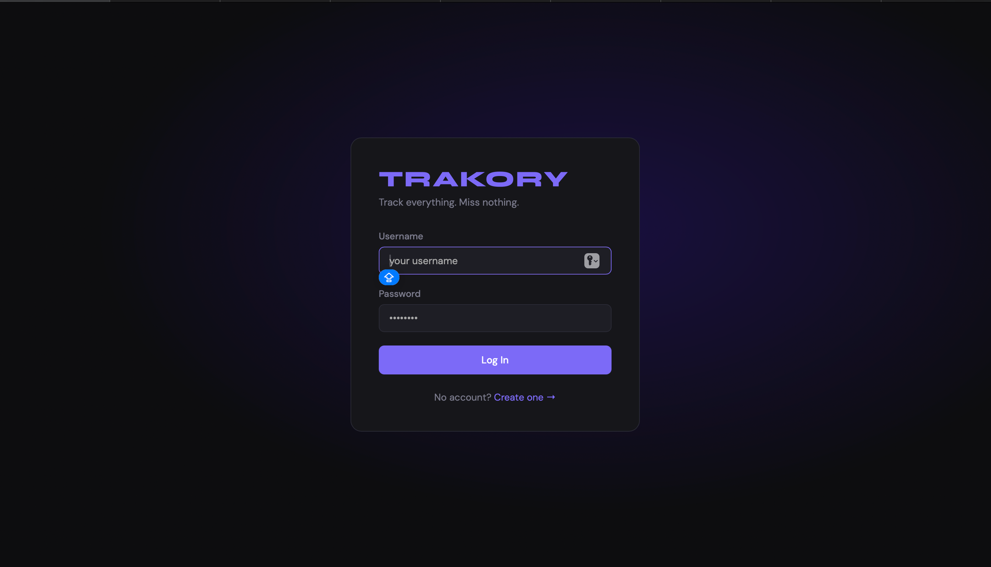

Slide 21
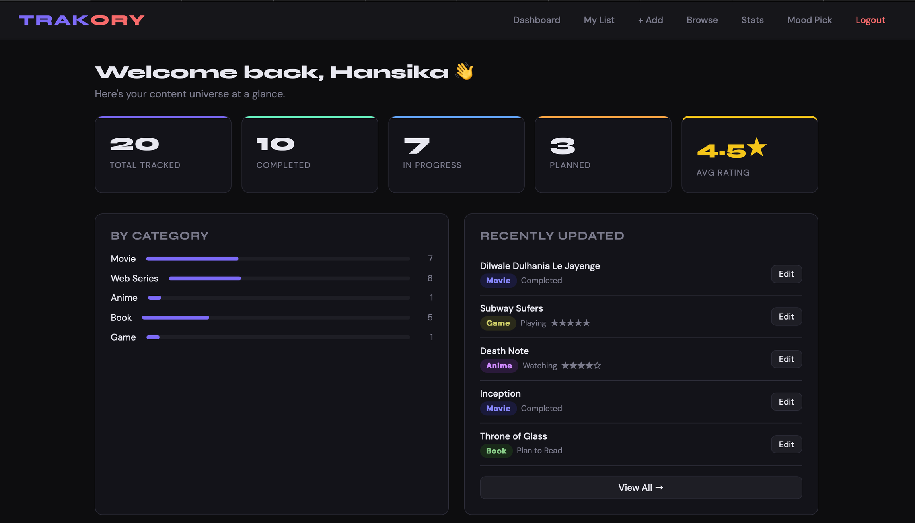

Slide 22
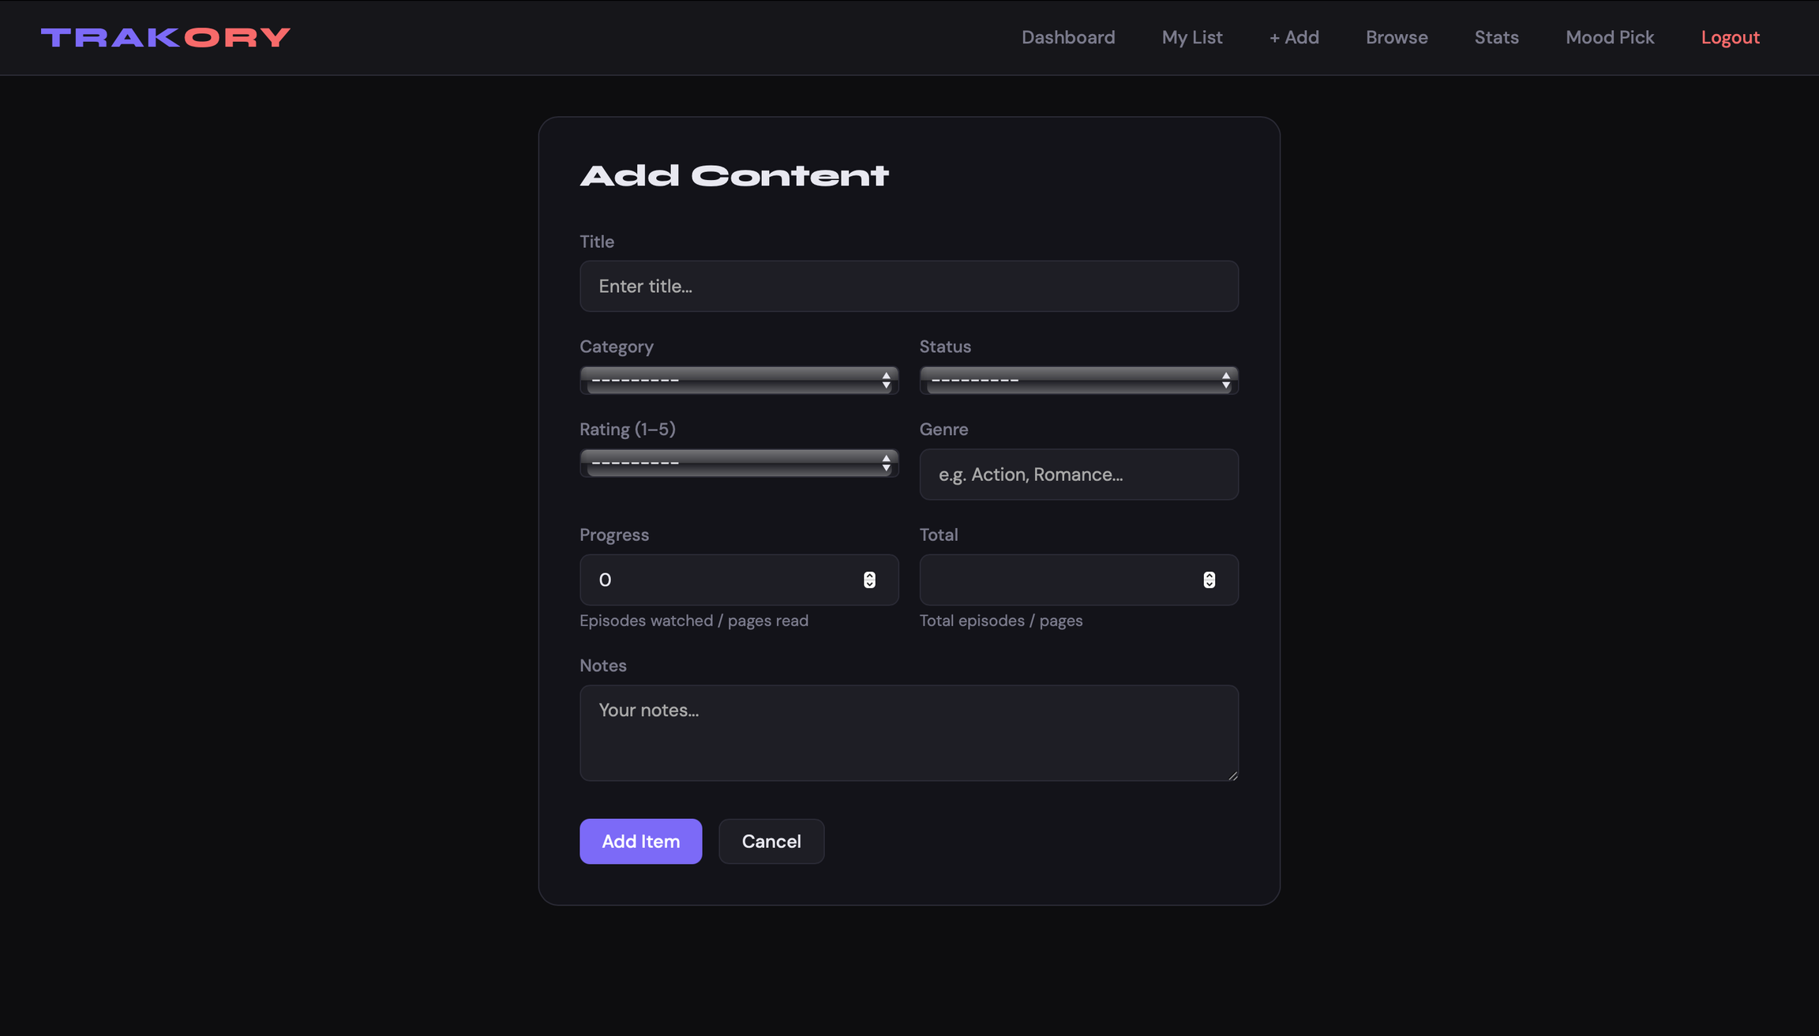

Slide 23
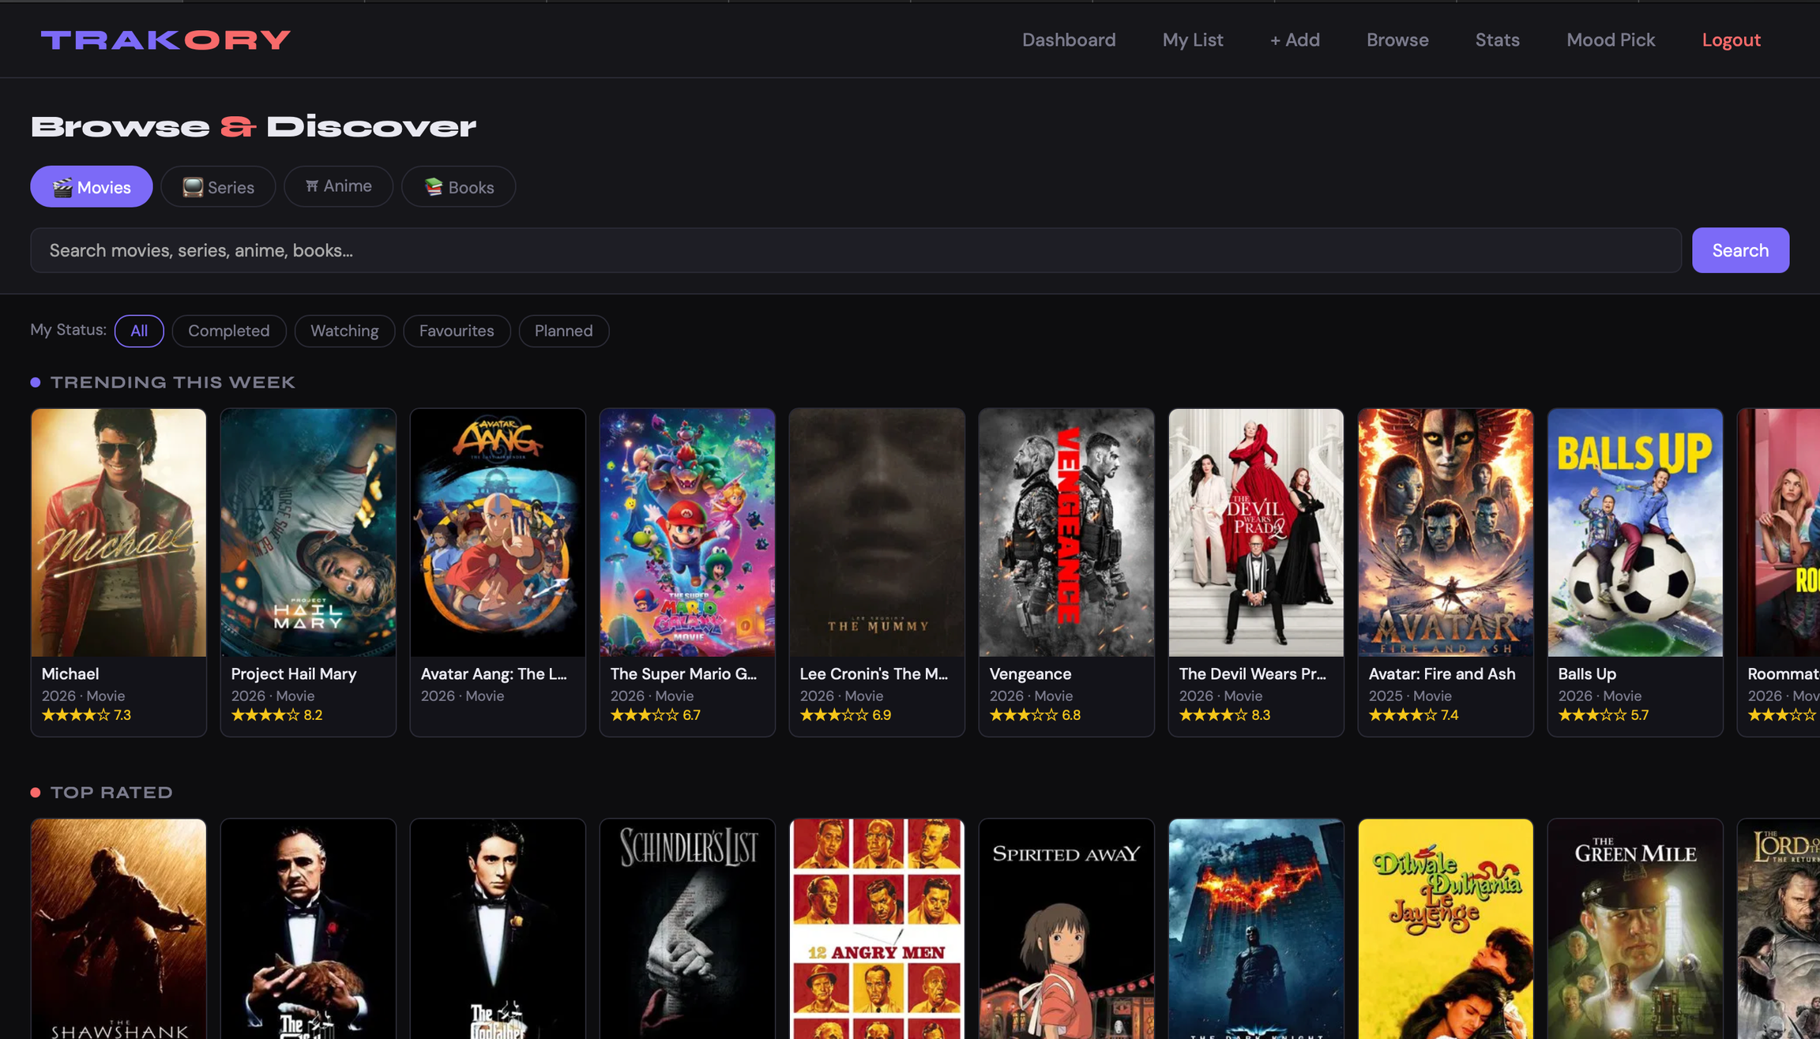

Slide 24
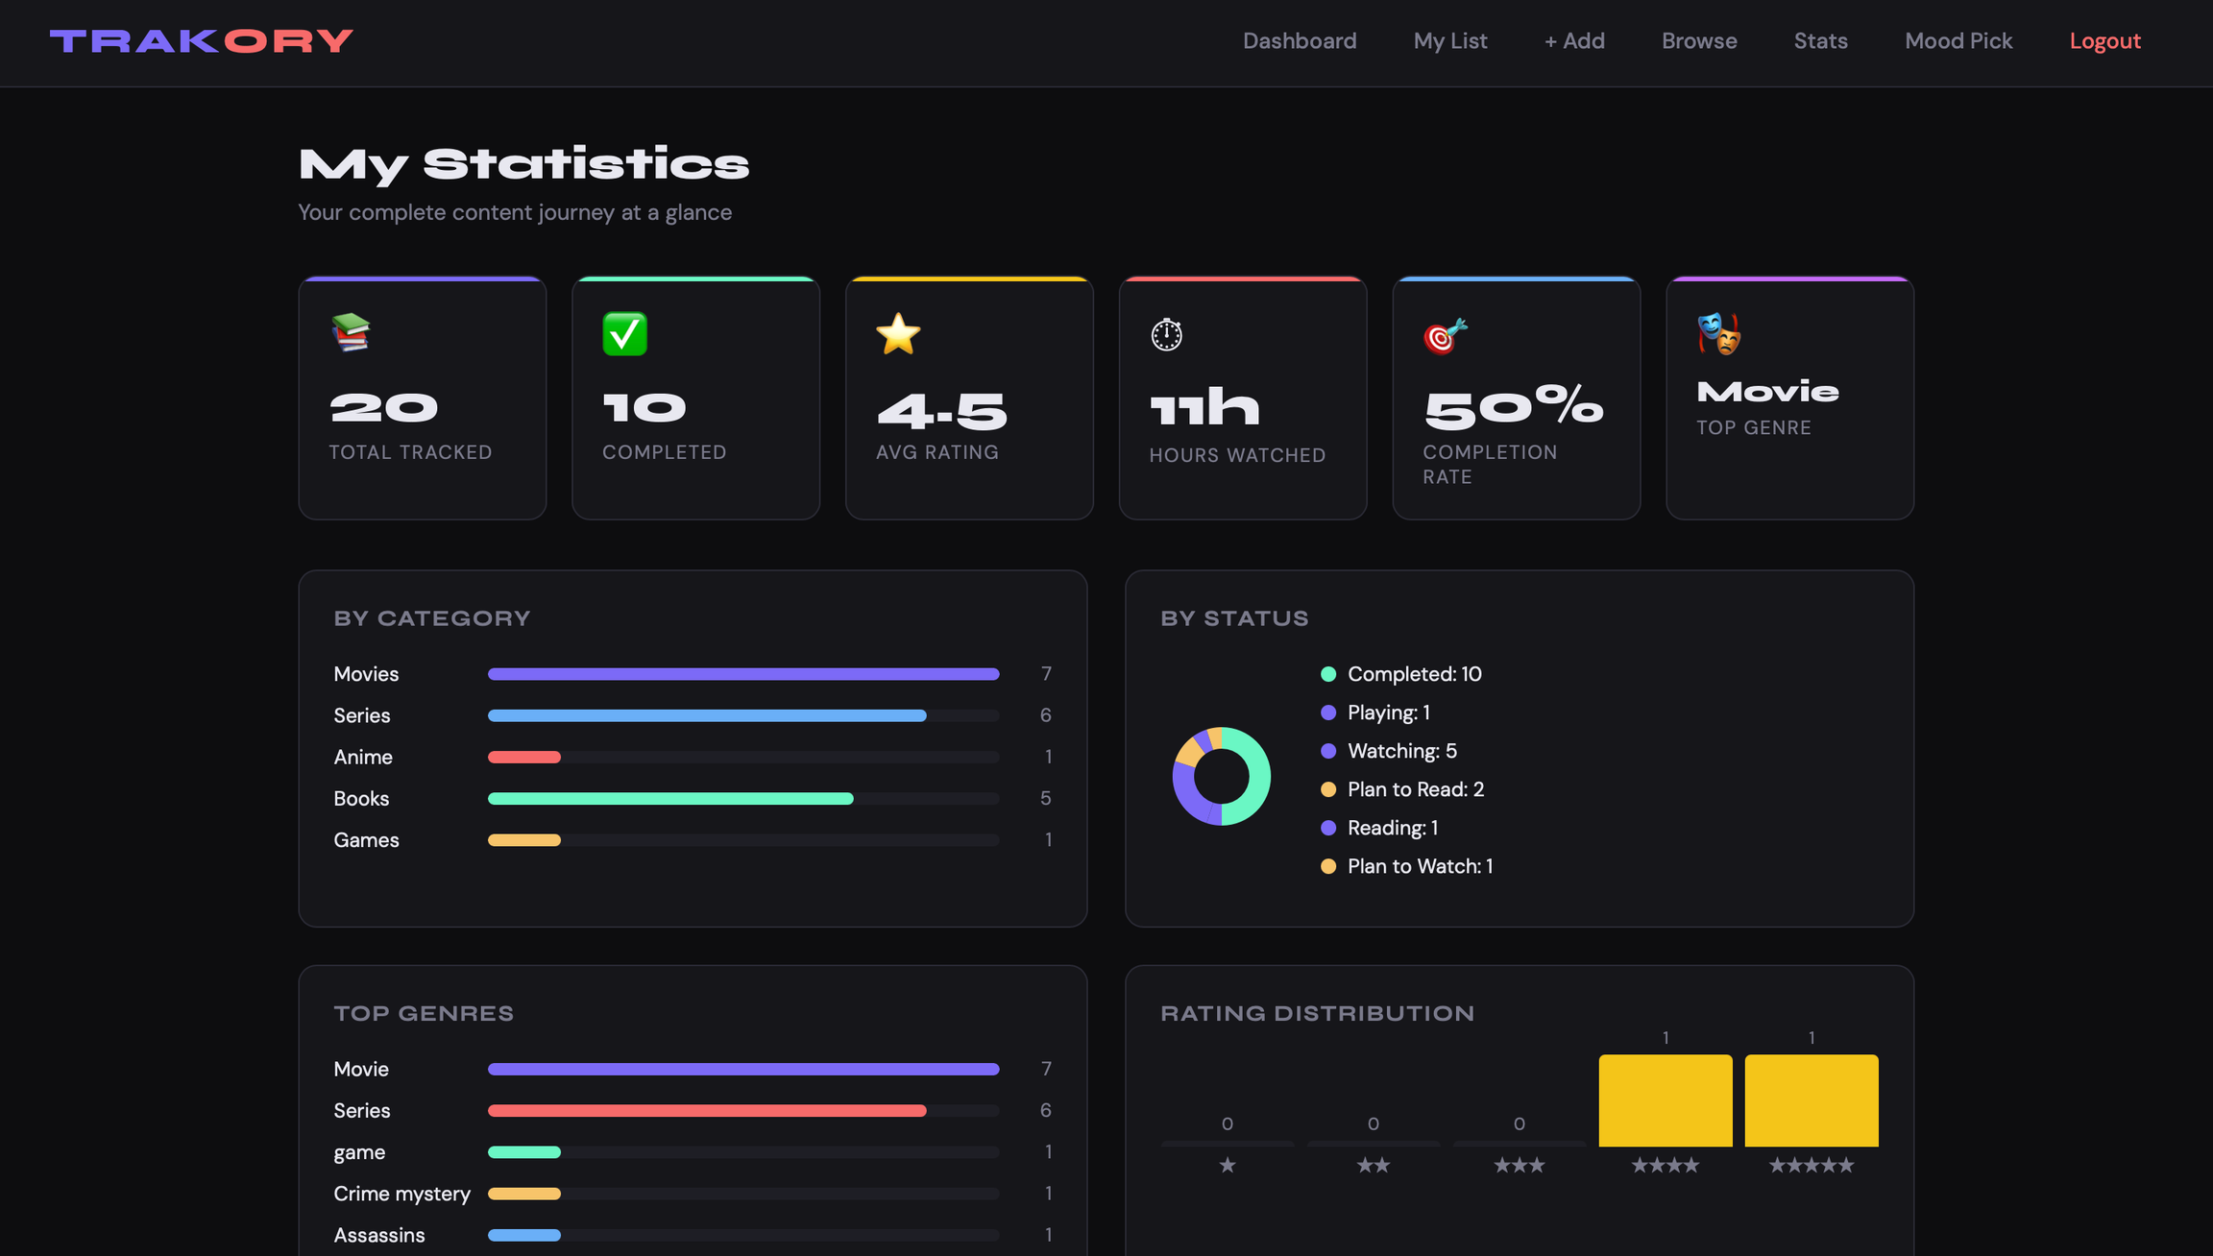

Slide 25
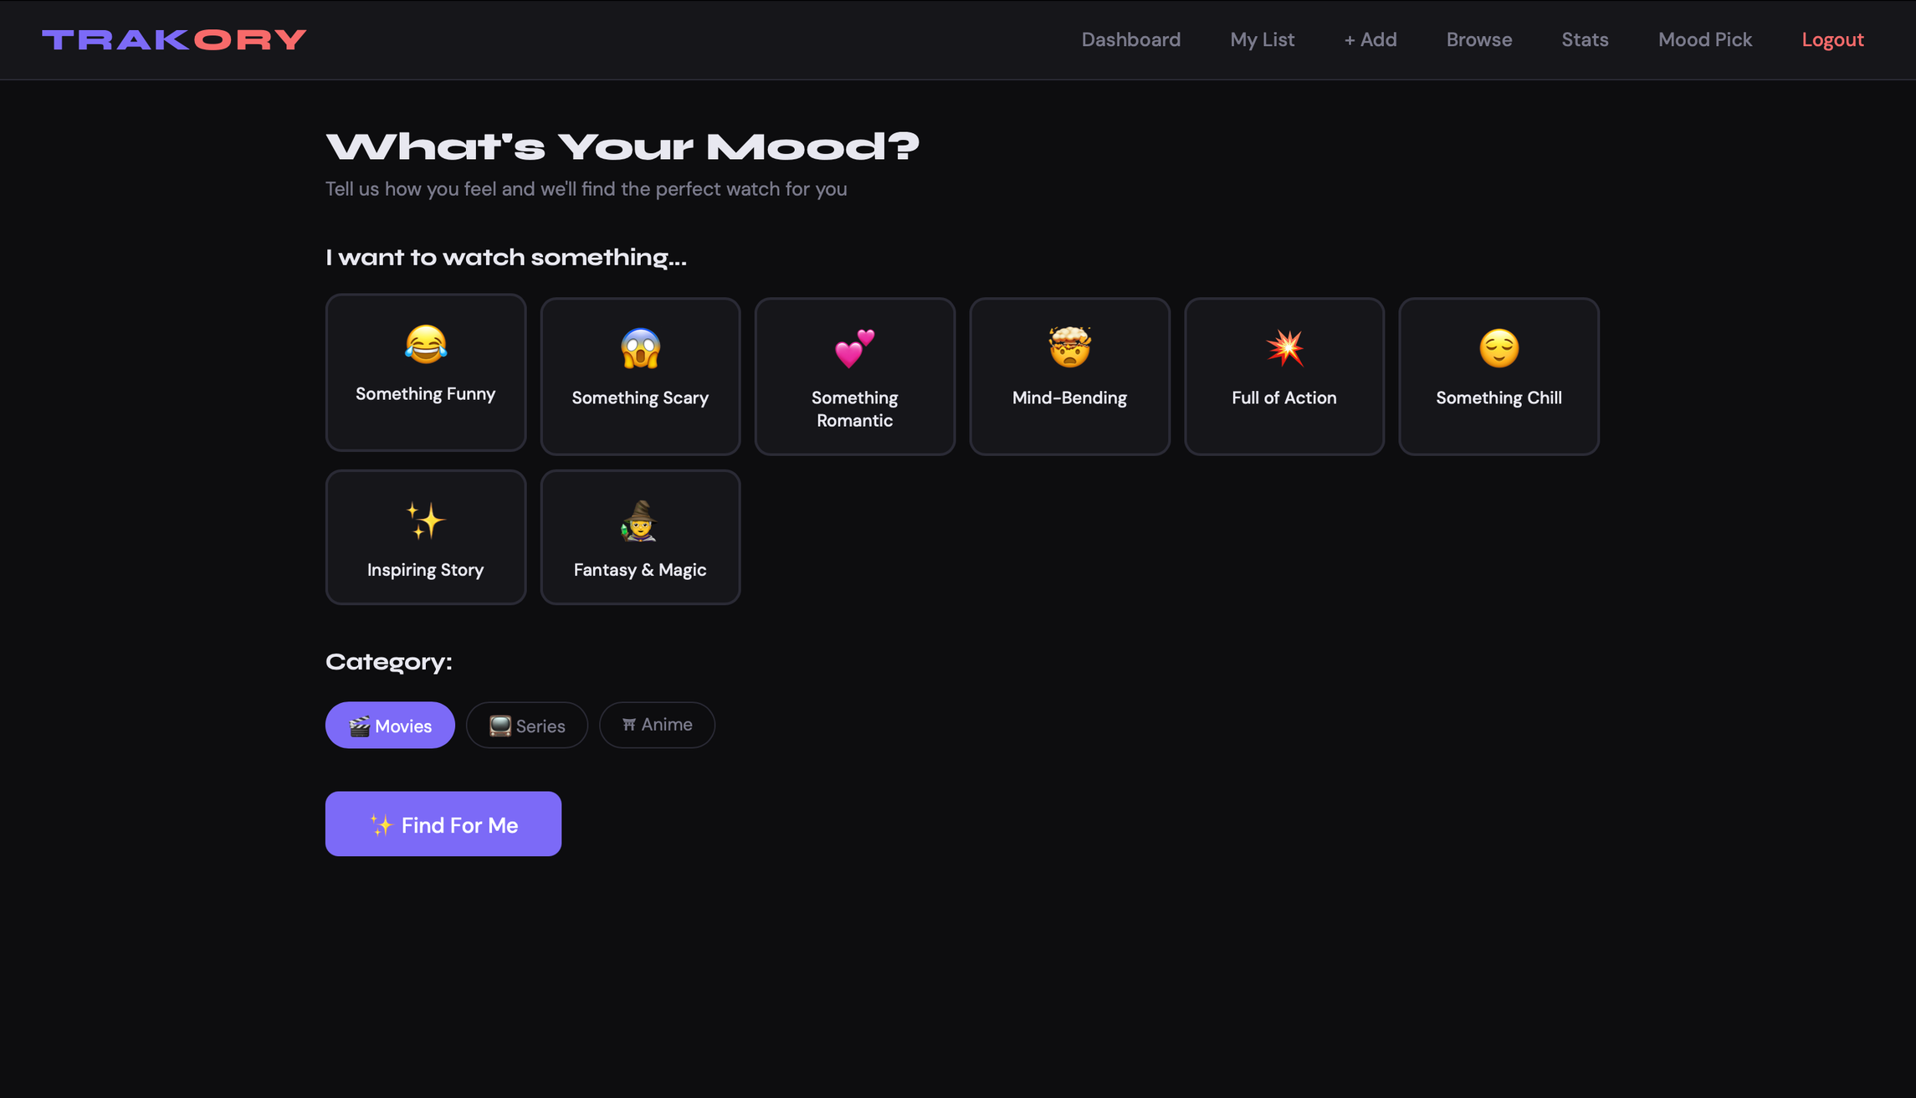

Slide 26
THANK YOU
TRAKORY — A Universal Tracking System
Hansika Gupta
SAP ID: 590023988
Under the Guidance of Arti Ma'am
github.com/hansikag22-del/TRAKORY-
Questions & Discussion Welcome

