Slide 1

Statistical Analysis of Campus Recruitments

Slide 2
Under the guidance of :
Project Team:
Shraddha Bhagwat
Roopa M.S.
Krutika Gawale
Krishna Agarwal
Oshin Bhatt
Gayatri Shinde
Mr. Rahul Kulkarni

Slide 3

Project Objectives
Statistical Analysis of Campus Recruitment
Analysis of number of students selected from different colleges by different companies

Slide 4
Project Flow
EXTRACT
Dataset
Reports Based on Dataset
Heterogeneous Sources i.e. operational data (Excel files)
TRANSFORM
Data warehouse
PowerBI
LOAD
(SSIS)

Slide 5
Source Data
Company source data
Date
College Name
Company Name
Head office location
Country
Package
Students Selected
Students Participated
Criteria
College source data
Date
College Name
Location
Survey Name
Number of Indian Students
Number of Foreign Students
Fees
Rank

Slide 6
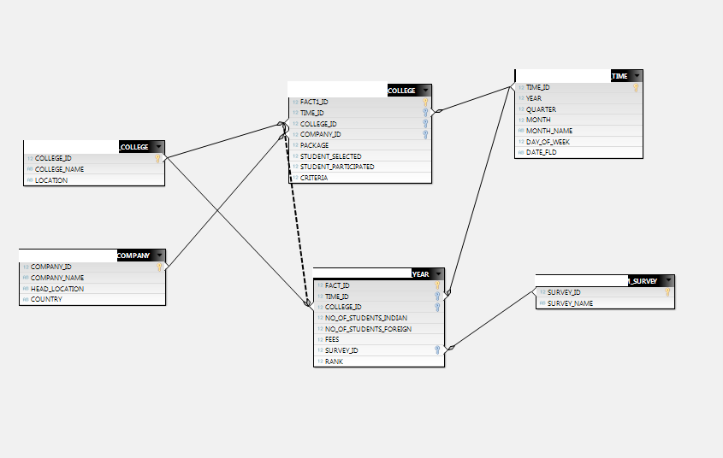
Data Warehouse Fact Constellation Schema

Slide 7
Staging Tables
Source
(Company)
Data conversion
(Source)
Sort
Data cleansing
(Ltrim,Rtrim)
Conditional split
(Data validation)
Staging Area 1
Source
(College)
Data conversion
(Source)
Sort
Data cleansing
(Ltrim,Rtrim)
Conditional split
(Data validation)
Staging Area 2

Slide 8
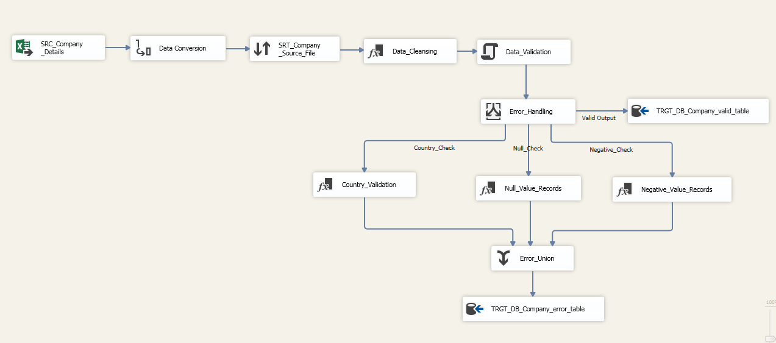
Company Staging Table

Slide 9
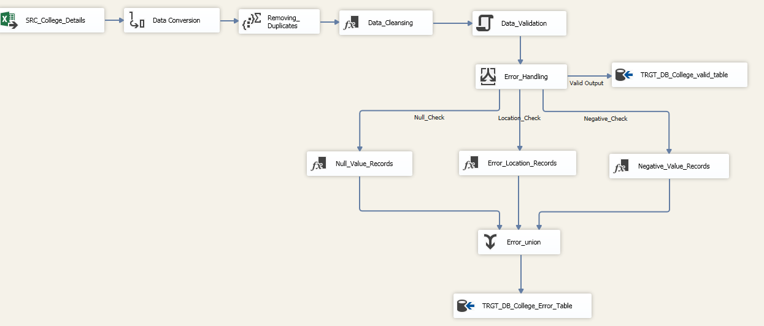
College Staging Table

Slide 10
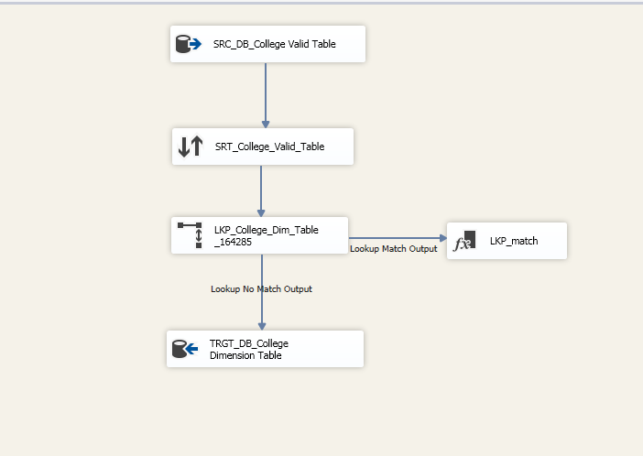
College Dimension Table

Slide 11
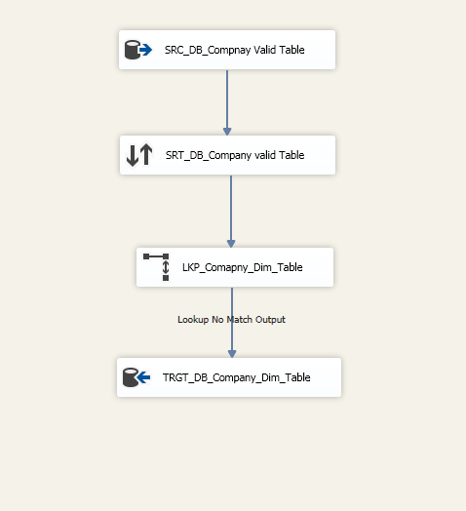
Company Dimension Table

Slide 12
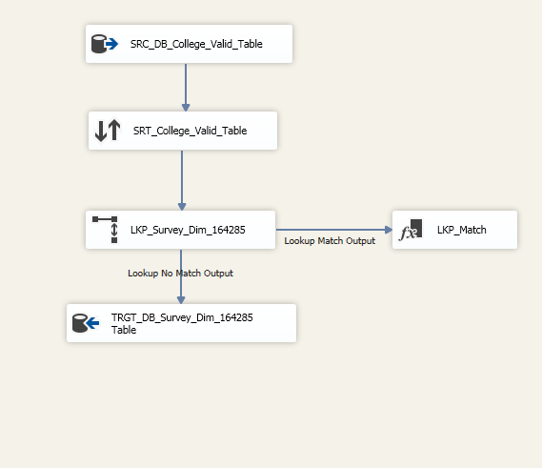
Survey Dimension Table

Slide 13
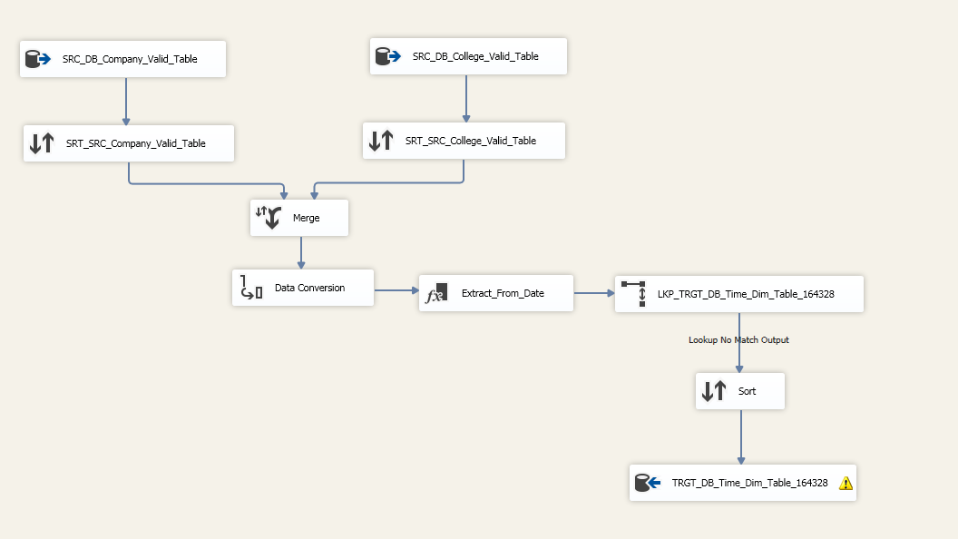
Time Dimension Table

Slide 14
Populating Fact Tables
College Dimension
(Lookup)
Source
(Staging Area)
College Fact
Survey Fact
Company Dimension (Lookup)
Survey Dimension (Lookup)
Time
Dimension (Lookup)

Slide 15
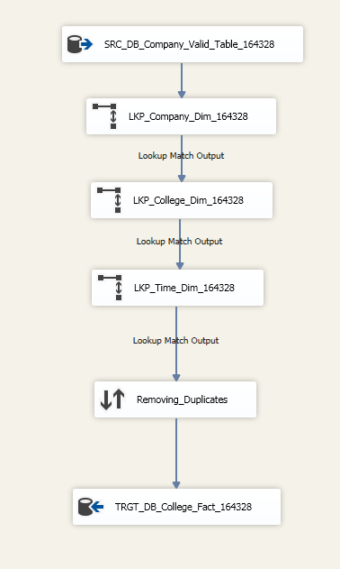
College Fact Table

Slide 16
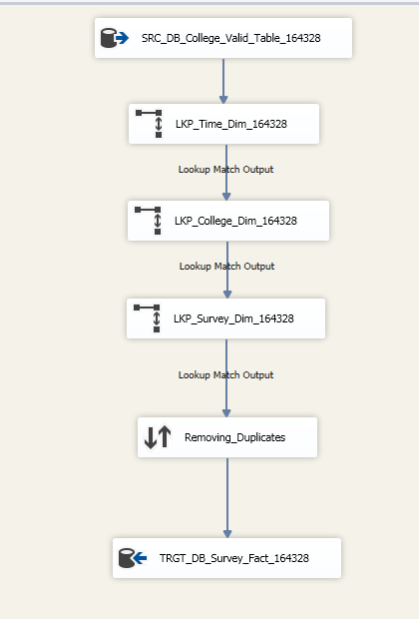
Survey Fact Table

Slide 17
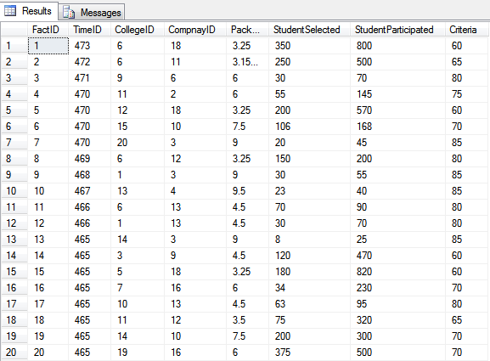
College Fact Table Data

Slide 18
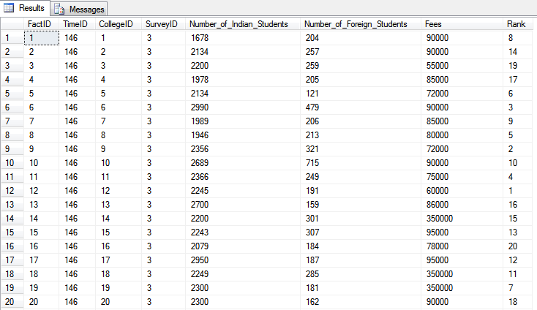
Survey Fact Table Data

Slide 19
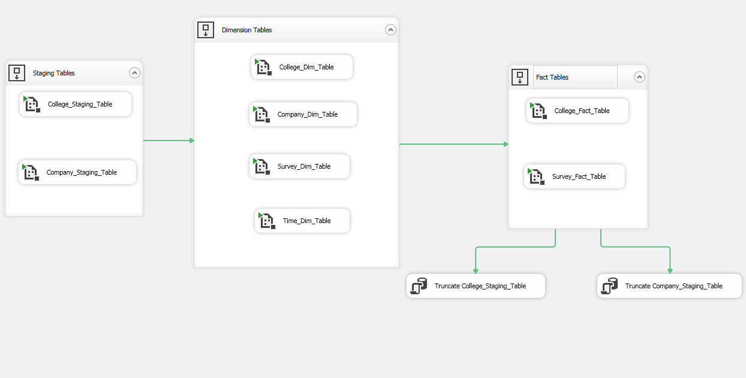
Automation

Slide 20
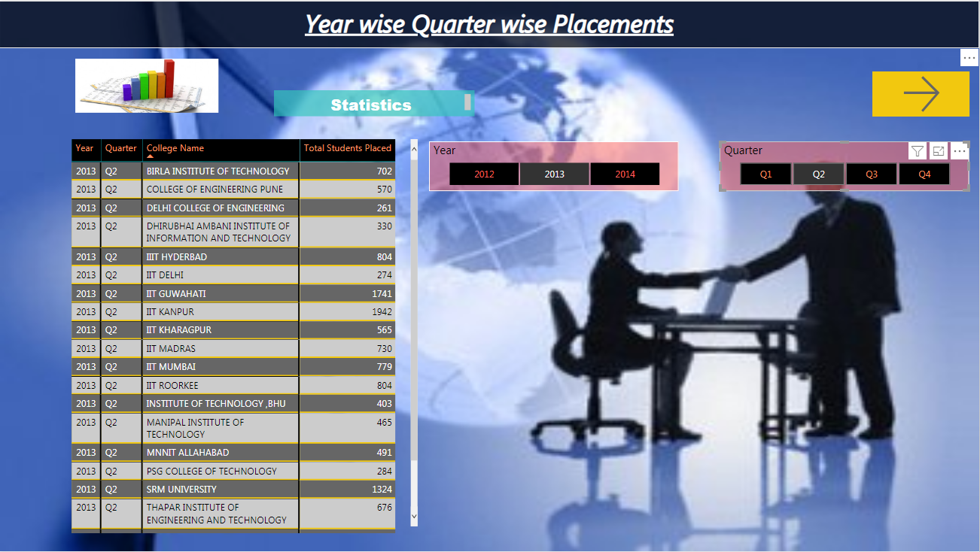
Statistical Analysis of Campus Recruitment

Slide 21
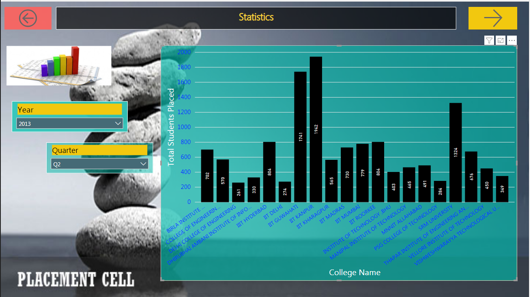

Slide 22
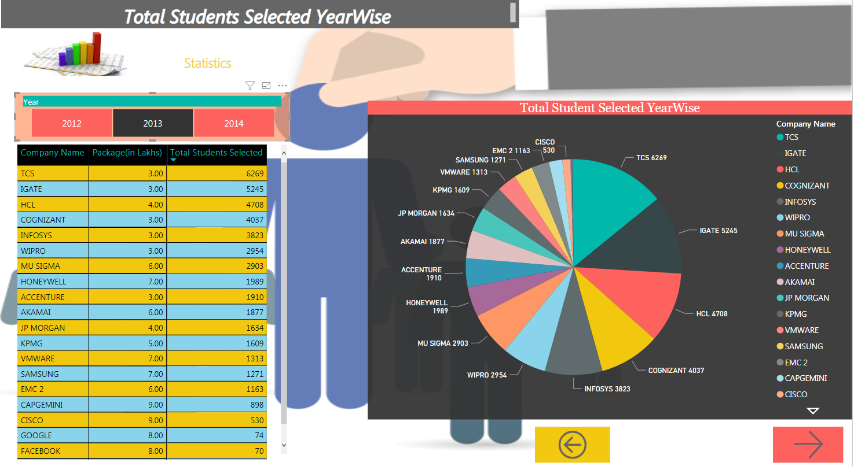

Slide 23
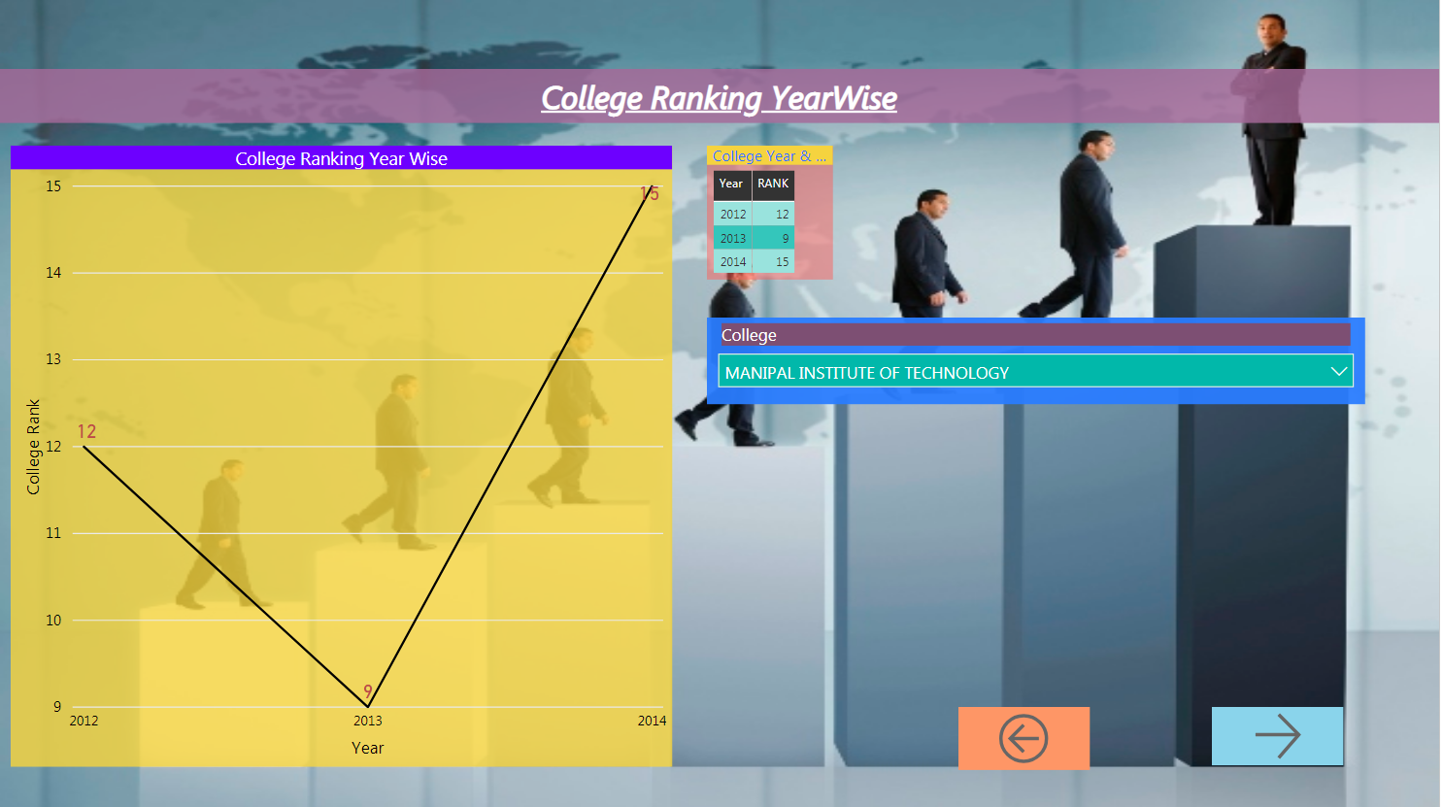

Slide 24
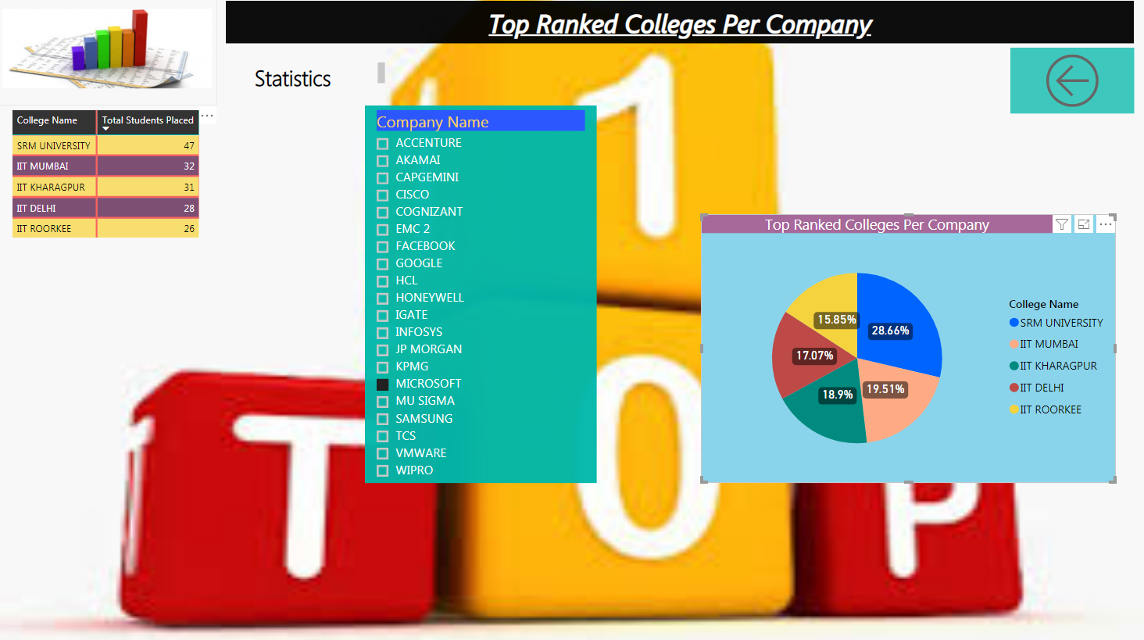

Slide 25

Any Queries?

Slide 26


